Slide 1
3.6 Organisms respond to changes in their internal and external environments

Slide 2
Specification
A stimulus is a change in the internal or external environment.
A receptor detects a stimulus.
A coordinator formulates a suitable response to a stimulus. An effector produces a response.
Receptors are specific to one type of stimulus.
Nerve cells pass electrical impulses along their length. A nerve impulse is specific to a target cell only because it releases a chemical messenger directly onto it, producing a response that is usually rapid, short-lived and localised.
In contrast, mammalian hormones stimulate their target cells via the blood system. They are specific to the tertiary structure of receptors on their target cells and produce responses that are usually slow, long-lasting and widespread.
Plants control their response using hormone-like growth substances.

Slide 3
3.6.1 Stimuli, both internal and external, are detected and lead to a response
Organisms increase their chance of survival by responding to changes in their environment.
In flowering plants, specific growth factors move from growing regions to other tissues, where they regulate growth in response to directional stimuli. The effect of different concentrations of indoleacetic acid (IAA) on cell elongation in the roots and shoots of flowering plants as an explanation of gravitropism and phototropism in flowering plants.
Taxes and kineses as simple responses that can maintain a mobile organism in a favourable environment.
The protective effect of a simple reflex, exemplified by a three neurone simple reflex. Details of spinal cord and dorsal and ventral roots are not required.

Slide 4
Tropisms
A tropism is the growth of a plant in response to a directional stimulus.
The plant grows towards or away from the stimulus.
List some tropisms in plants.
Light - phototropic
Gravity - gravitropic
Water – hydrotropic
https://www.youtube.com/watch?v=pCFstSMvAMI

Slide 5
Plant growth factors
Exert their influence by affecting growth
Some plant growth factors affect the tissues that release them rather than acting on a distant target organ.
Indoleacetic acid (IAA) is a plant growth factor belonging to a group of sunstances called Auxins. IAA controls plant cell elongation.

Slide 6
Plant growth factors
https://www.youtube.com/watch?v=HR9KHW-e0pY

Slide 7
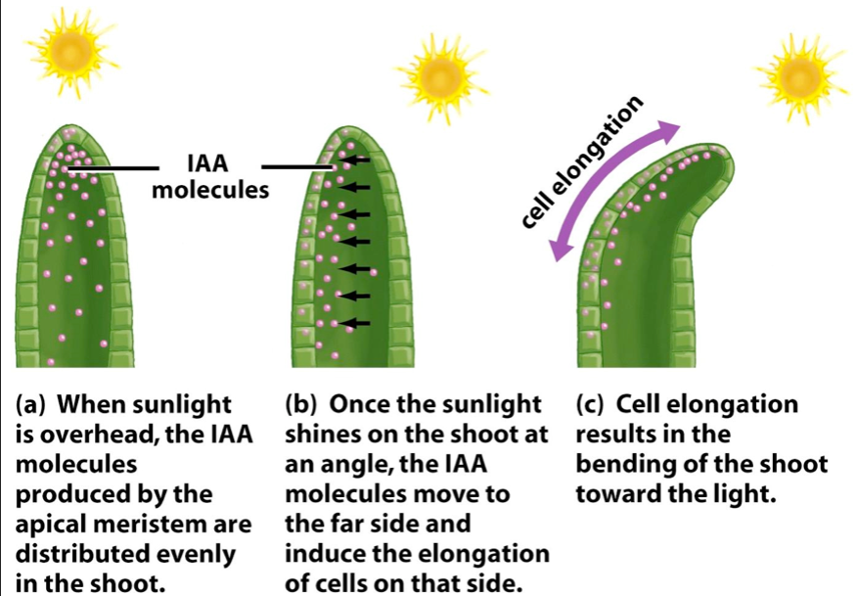
Phototropism in flowering plants
Cells in the tip of the shoot produce IAA, which is then transported down the shoot
The IAA is initially transported evenly throughout all regions as it begins to move down the shoot
Light causes the movement of IAA from the light side to the shaded side of the shoot

Slide 8
Phototropism in flowering plants
A greater concentration of IAA builds up on the shaded side of the shoot than on the light side
As IAA causes elongation of shoot cells and there is a greater concentration of IAA on the shades side of the shoot, the cells on this side elongate more
The shaded side of the shoot elongates faster than the light side, causing the shoot to bend towards the light.

Slide 9
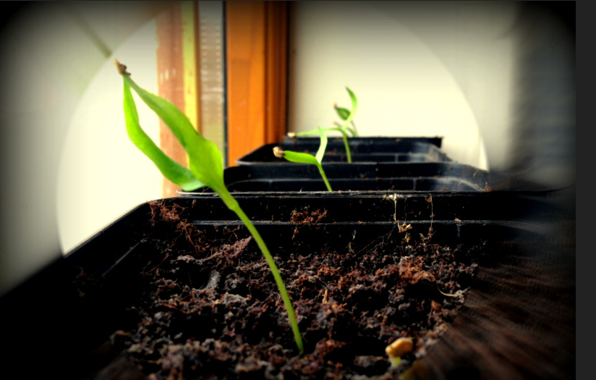

Slide 10
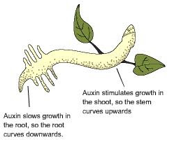
How would IAA affect roots?
High concentrations of IAA inhibits cell elongation in roots.
Therefore cell elongation is greater on the light side than the dark side so roots bend away from light.
Roots are negatively phototropic

Slide 11
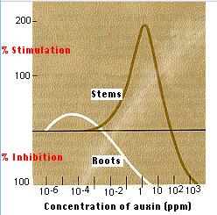

Slide 12
Gravitropism
Gravity leads to a change in the distribution of IAA carrier proteins that export IAA from cells

Slide 13
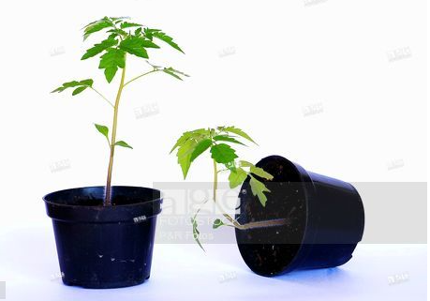
Gravitropism in flowering plants – roots https://www.youtube.com/watch?v=pi3P3uJOsN4
Cells in the tip of the root produce IAA, which is then transported along the root
The IAA is initially transported to all sides of the root
Gravity influences the movement of IAA from the upper to the lower side if the root
A greater concentration of IAA builds up on the lower side of the root than the upper side

Slide 14
Gravitropism in flowering plants - roots
As IAA inhibits the elongation of root cells and there is a greater concentration of IAA on the lower side, these cells elongate less than those on the upper side
This causes the root to bend downwards towards the force of gravity.

Slide 15
Gravitropism in flowering plants - shoots
The greater concentration of IAA on the lower side increases cell elongation so shoots grow upwards away from gravity

Slide 16
Role of IAA in elongation growth
IAA is produces in root and shoot tips. It is then transported in one direction away from the tip. IAA increases a plant cell’s plasticity (ability to stretch) of their cell walls. The response only occurs in young cell walls where cells are able to elongate. As the cells mature they develop greater rigidity so older parts of the root or shoot will not be able to respond.
The way in which IAA increases the plasticity of cells is called the acid growth hypothesis. Hydrogen ions are actively transported from the cytoplasm into the spaces in cell walls causing the cell walls to become more plastic allowing the cell to elongate by expansion.

Slide 17
Explain how the movement of IAA in shoots helps a plant survive.
IAA moves towards the shaded side of the shoot causing the cells here to elongate faster than the cells on the light side and the shoot beds towards the light.
This ensures the shoot and the leaves attached to it are illuminated which increases the rate of photosynthesis which is needed to produce glucose for respiration and ATP for growth. These plants therefore have a better chance of survival.

Slide 18
Suggest two advantages to a plant having roots that respond to gravity by growing in the direction of its force.
Roots grow down into the soil so the plant is anchored
Roots are closer to water which is needed for photosynthesis and turgidity of plant cells

Slide 19
Consider the following facts about IAA:
They are easily made synthetically
They are readily absorbed by plants
They are not easily broken down
They are lethal to some plants in low concentrations
Narrow-leaved plants are less easily killed then broad-leaved plants
Suggest ways in which these facts might be relevant to agricultural practice.
IAA can be used as a herbicide as it is readily absorbed, easily made synthetically and lethal to some plants
Most commercial crops are narrow leaved and weeds are broad leaved so can be applied with little or no harm to crops but will kill the weeds
IAA is not easily broken down so will persist in the soil which is useful to prevent broadleaved plants from growing but could cause problems if IAA accumulates along food chains.

