Slide 1
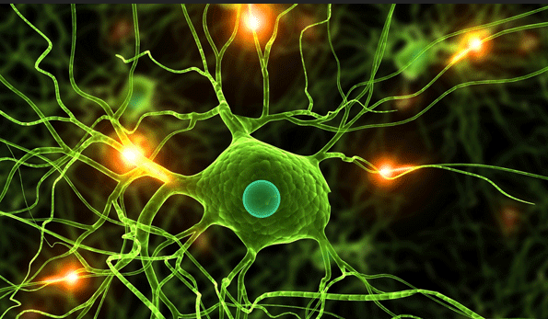
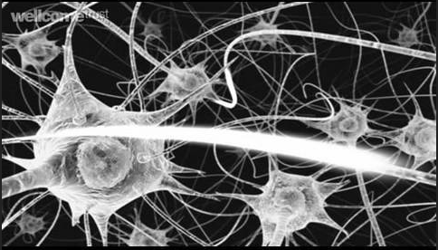
3.6.2 Nervous coordination

Slide 2
3.6.2.2 Synaptic transmission
The detailed structure of a synapse and of a neuromuscular junction.
The sequence of events involved in transmission across a cholinergic synapse in sufficient detail to explain:
unidirectionality
temporal and spatial summation
inhibition by inhibitory synapses.
A comparison of transmission across a cholinergic synapse and across a neuromuscular junction.
Students should be able to use information provided to predict and explain the effects of specific drugs on a synapse. (Recall of the names and mode of action of individual drugs will not be required.)

Slide 3
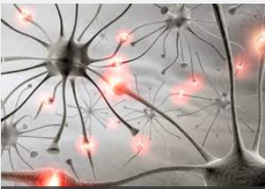
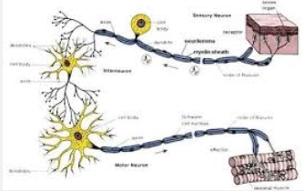
Neurones are not in direct contact with each other but are separated by ting gaps (20um) called synapses.
Synapses convey action potentials between neurones and between neurones and effectors

Slide 4
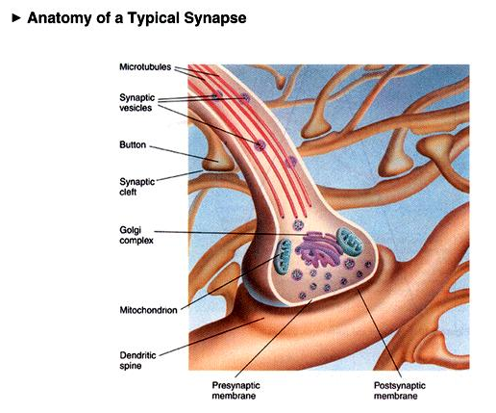
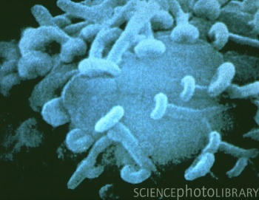
The synapse
Nerve endings
Chemical synapse

Slide 5
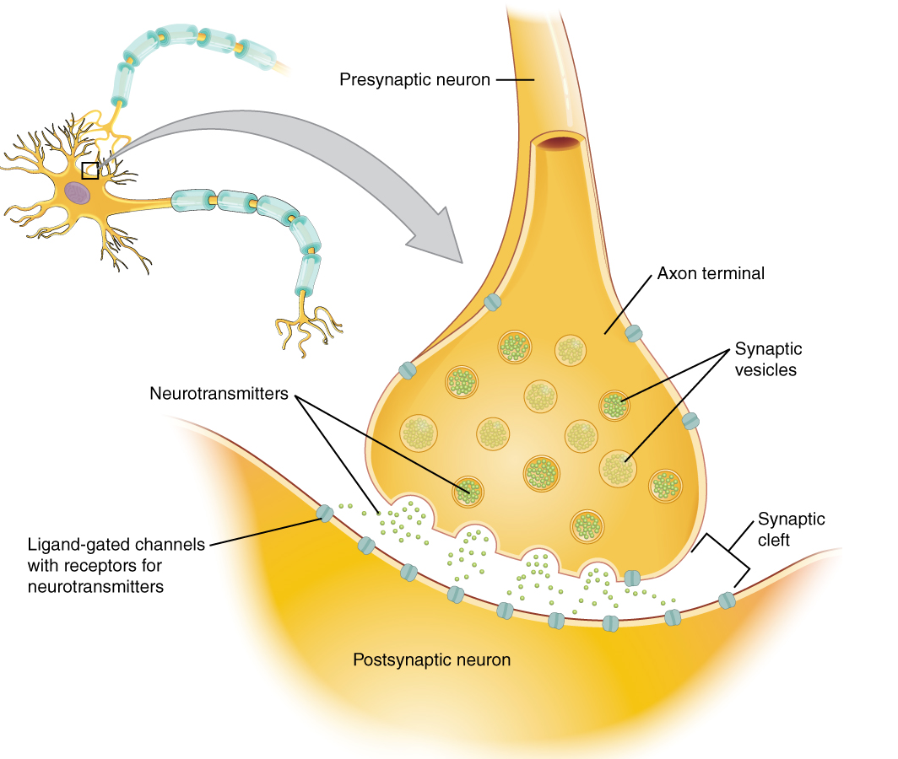

Slide 6
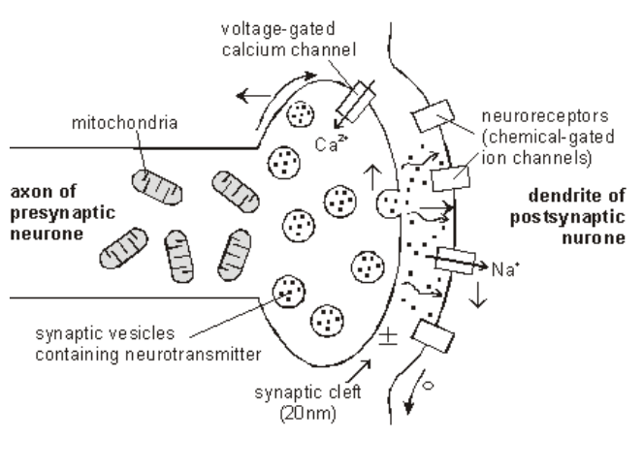
You must be able to draw this.
Use the terms –
Synaptic knob
Synaptic vesicle
Mitochondria
Pre-synaptic membrane
Synaptic cleft
Post-synaptic membrane

Slide 7
Transmission at the synapse
Transmission between synapses is by chemicals called neurotransmitters.
These are made in the Golgi body (synthesis requires energy from respiration).
They are stored in vesicles in the synaptic bulb.

Slide 8
Neurotransmitters
Neurotransmitters fall into several chemical classes based on the molecular structure. The major types of neurotransmitters include acetylcholine, biogenic amines, and amino acids. The neurotransmitters can also be classified based on function (excitatory or inhibitory). Acetylcholine – Released from a cholinergic synapse

Slide 9
http://www.youtube.com/watch?v=rWrnz-CiM7A

Slide 10
What happens at a synapse?
Notes:
Teacher notes
There are several different types of neurotransmitter. Acetylcholine is found at cholinergic synapses, as shown in the animation. The neurotransmitter noradrenaline is present at adrenergic synapses. Some neurotransmitters and their receptors are excitatory, i.e. they create a new action potential in the postsynaptic neurone. Others are inhibitory, i.e. they make it less likely that a new action potential will be created in the postsynaptic neurone.
See the ‘Muscles’ presentation for more information about synapses between motor neurones and a muscle fibre (neuromuscular junction).

Slide 12
neurotransmitter molecules diffuse across the synaptic cleft
neurotransmitter receptors are membrane protein with binding sites with a shape complementary to the neurotransmitter
neurotransmitters broken down by enzymes so the ion channels to close and the receptors are available again and so the resting potential can be re-established
this sequence takes 0.5 msec which results in a synaptic delay in the transmission of impulses.

Slide 13
Flow chart task
Write out all the events that occur at a synapse on separate postits and then lay them out and sort them out into the correct order

Slide 14
Transmission across a synapse

Slide 15
The structure of the synapse

Slide 16
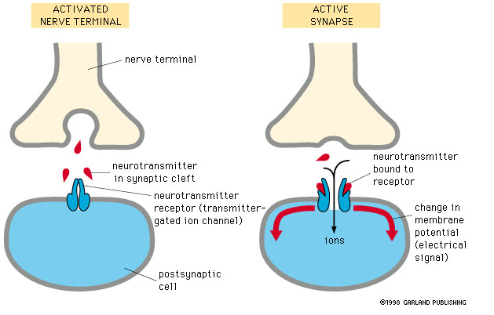
Bozeman
Crash course

Slide 17
Features of synapses.
Unidirectional
Enable impulses to be transmitted from one neurone to another, so enables nerve circuits to function.
Pass impulses IN ONE DIRECTION only.
Act as junctions – since synaptic vesicles are present only in the knob of the presynaptic neurone, impulses can only pass across a synapse in one direction.

Slide 18
Features of synapses.
Summation
Low-frequency action potential often lead to the release of insufficient concentrations of neurotransmitter to trigger an action potential in the post synaptic neurone.
They can, however, do so in a process called summation which entails a rapid build up neurotransmitter in the synapse by one of two methods:

Slide 19
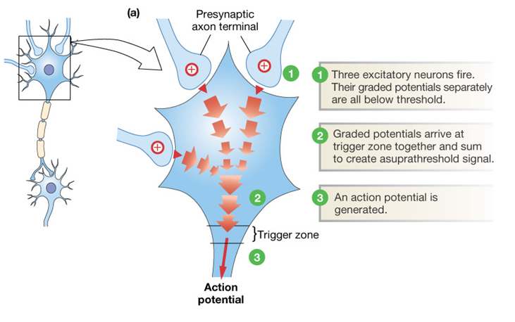
Spatial summation
A number of presynaptic neurones together release enough neurotransmitter to exceed the threshold value of the post synaptic neurone therefore triggering a new action potential

Slide 20
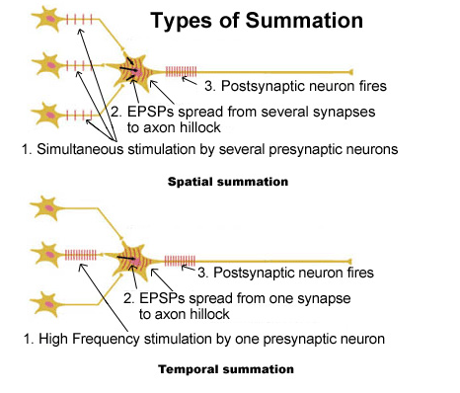
Temporal summation
A single presynaptic neurone releases neurotransmitter many times over a very short period.
If the concentration of neurotransmitter is high enough to reach the threshold value a new action potential is triggered

Slide 21
Some neurotransmitters and their receptors are excitatory, i.e. they create a new action potential in the postsynaptic neurone.
Others are inhibitory, i.e. they make it less likely that a new action potential will be created in the postsynaptic neurone.

Slide 22
Types of synapse - Excitatory synapses
Binding of neurotransmitter to postsynaptic neurone
opens Na+ gated channels
→ Na+ diffuses IN
→depolarisation
→ action potentials
so nerve impulses can continue around the nerve circuit.

Slide 23
Inhibitory synapses
Neurotransmitter released which binds to chloride ion protein channels on post synaptic neurone causing channels to open.
Cl⁻ diffuse IN to postsynaptic neurone by facilitated diffusion
The binding of the neurotransmitter causes opening of potassium gated channels
K+ diffuses OUT → inside of neurone becomes even more negative (from -65mV to -80mv)
The membrane is said to be hyperpolarised meaning needs avery large influx of Na+ to raise to threshold value ie very difficult to depolarise membrane
→ no action potentials
so nerve impulses cannot continue around the nerve circuit.

Slide 24
Functions of synapses
Synapses allow a single impulse from one neurone to initiate a new impulse in a number of different neurones at a synapse. This allows a single stimulus to create a number of simultaneous responses
Synapses allow a number of impulses to be combined at a synapse. This allows nerve impulses from receptors reacting to different stimuli to contribute to a single response

Slide 25
Effects of drugs
A psychoactive drug acts on the CNS where it alters brain function resulting in temporary changes in perception, mood, consciousness and behaviour. These effects are due to their action on synapses.

Slide 26
Excitory Drugs – stimulate nervous system creating more action potentials in post-synaptic membranes
Inhibitory drugs – create fewer action potentials in post-synaptic membranes

Slide 27
animations of how drugs work
effects of drugs on synapses
http://www.pbs.org/wnet/closetohome/science/html/animations.html
http://learn.genetics.utah.edu/content/addiction/mouse/‘mouse party – fun!

Slide 28
Synaptic disrupting type: | Explanation of term: | Specific example of action
Excitory | They stimulate the nervous system by creating more action potentials in postsynaptic neurones. They mimic the neurotransmitter, stimulate the release of more neurotransmitter or inhibit the enzyme which breaks down the neurotransmitter | Caffeine and nicotine increase the metabolic rate in pre-synaptic cells. There is an increase in production of ATP which stimulates neurotransmitter synthesis. they reduce the threshold for excitation of post-synaptic membranes. Amphetamines and Ecstasy Prozac – prevents the elimination of serotonin from synaptic cleft. Serotonin involved in regulation of sleep and certain emotional states.
Inhibitory | They inhibit the nervous system by creating fewer action potentials in postsynaptic neurons. They block receptors on sodium/potassium ion channeks on post synaptic neurone or cause less neurotransmitter to be released. | Alcohol Beta blockers -Lower heart rate and reduce anxiety Valium – enhances binding of GABA to its receptors. GABA is an inhibits formation of action potentials Morphine and codeine – mimic effects of endorphins by binding to endorphin receptors in the brain. Endorphin block the sensation of pain

Slide 29
Effects of drugs on synapses
The effect of a drug on the synapse depends on the type of transmitter
A drug could inhibit the action of an excitory neurotransmitter and so fewer action potentials generated so a particular effect reduced
A drug could inhibit an inhibitory neurotransmitter so more action potentials generated so a particular effect enhanced

Slide 30
Drugs and synapses
Amphetamines (speed, ectasy) – prescribed to treat obesity
Stimulates release of neurotransmitters such as noradrenalin
Caffeine increases the metabolic rate in pre-synaptic cells. There is an increase in production of ATP which stimulates neurotransmitter synthesis.
Caffeine and nicotine – reduce the threshold for excitation of post-synaptic membranes.

Slide 31
Drugs and synapses – Cannabis (marijuana)
Cannabis works on an inhibitory synapse that results in dopamine not working.
The body naturally produces anandamide which binds with cannabinoid receptors and turns of the release of inhibitory neurotransmitter so that dopamine IS release.
Cannabis contains THC which MIMICS anandamide and so THC binds to the cannabinoid receptors and inhibition of dopamine is turned off and dopamine is released which gives a sense of calm and relaxation
The inhibitory synapse is inhibited!!

Slide 32
Tolerance and Dependency
If drugs taken over long period synapses are modified so more drugs needed for same effect – tolerance
Changes to the CNS means individual can no longer manage without drug – dependency
Physical – withdrawal symptoms
Psychological – no withdrawal symptoms but constant craving

Slide 33
Organophosphate and cholinesterase
Organophosphate insecticides inhibit cholinesterase
Acetylcholine remains in the synaptic cleft
Acetylcholine binds over and over again to receptors
The muscles become overstimulated.
(This results in an excitatory effect)
http://Sarin

