Slide 1
3.6.4.2 Control of Blood Glucose Concentration

Slide 2
OBJECTIVES
Describe the role of Glucagon and Insulin in the regulation of blood Glucose
Explain How Glucagon and Insulin regulate blood glucose concentration

Slide 3
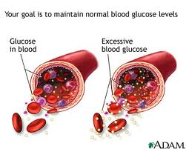
What could alter your blood glucose concentration?
Normal blood glucose level = 90 mg / 100cm3 of blood

Slide 4
What could alter your blood glucose
Sources of blood glucose:
Diet
Stored Glycogen from liver and muscles
Glucose is used up by
Exercise/respiration
Other factors controlling the concentration
Hormones
  Insulin
  Glucagon
  Adrenaline

Slide 5
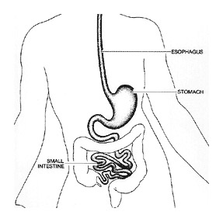
SUMMARY OF CARBOHYDRATE DIGESTION
Carbohydrates are digested into glucose
  Mouth
  Duodenum
  Ileum
Glucose is absorbed in the small intestine:
  Through epithelial cells via
  co-transport into blood vessels

Slide 6
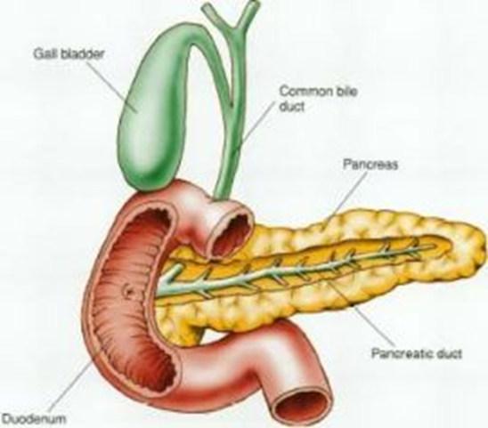
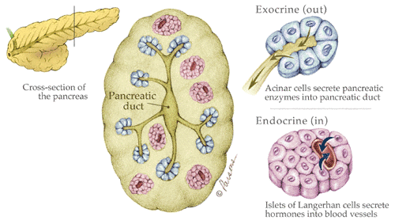
The role of the pancreas in regulating blood glucose:
The pancreas detects the concentration of glucose in the blood
The pancreas produces digestive enzymes (protease, amylase and lipase)
The pancreas produces the hormones insulin and glucagon for regulating blood glucose.

Slide 7
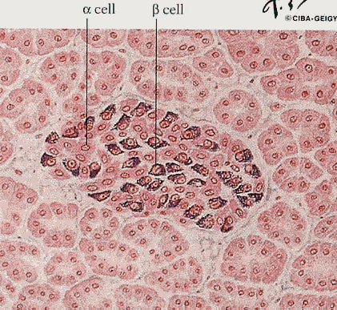
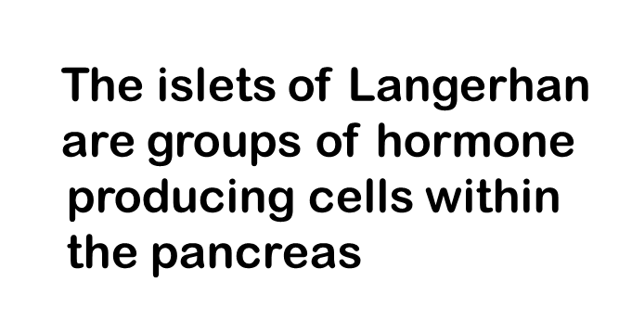
Produced when your glucose has “gone” – i.e. low blood glucose
The α cells are larger and produce glucagon
The β cells are smaller and produce insulin
Produced when you have taken lots of sugar “in” – i.e. high blood glucose level

Slide 8
How can blood glucose affect your health?
High
Low
Lowers water potential in the blood. Water diffuses out of the cells by osmosis into the blood
This leads to thirst and a lot of urine being produced
Very high blood glucose can damage brain cells, causing a coma.
High blood glucose encourages bacterial growth on the skin, leading to infections (e.g. boils, thrush)
Bacterial growth on skin means wounds are slow to heal
High glucose levels in the eye can enter the fluid of the lens and cause cloudiness.
Low blood glucose causes tiredness/fatigue, trembling, sweating and shakiness
More severe cases can cause confusion, blurred vision, headache and a difficulty concentrating
Extreme low blood sugar can result in a loss of consciousness.

Slide 9
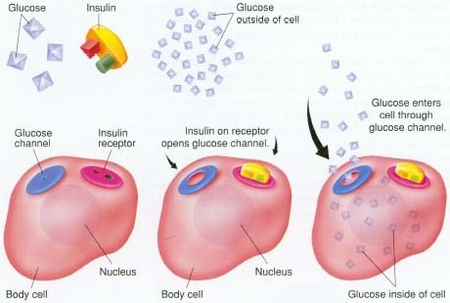
EFFECT OF INSULIN ON UPTAKE OF GLUCOSE

Slide 10
High Blood Glucose
  A high blood glucose concentration creates a low Water potential. The surrounding tissue cells have a higher water potential, so water diffuses out of the cells by osmosis into the blood
  This makes a person feel thirsty and also produce a lot of urine
  High blood glucose can damage brain cells and lead to a coma and possible death
http://www.dnatube.com/video/8349/Animation-in-3D-of-the--Insulin-processes-mechanism

Slide 11
HIGH BLOOD GLUCOSE
High blood glucose detected by Beta cells of pancreas
Pancreas releases insulin into the blood. This helps to lower blood glucose in a number of ways:
1. Insulin binds with cell surface glycoprotein receptors and causes a change in the tertiary structure of glucose transport protein channels so channels open which increases the rate of absorption of glucose into the cells.
2. Insulin activates enzymes in the liver to convert glucose to insoluble glycogen (glycogenesis)
3. Insulin converts glucose to fats
4. Insulin also increases the respiratory rate of cells which therefore burns glucose in oxidation
Glucose level drops in liver and sets up a concentration gradient so glucose diffuses from the blood into the liver
Blood glucose level drops

Slide 12
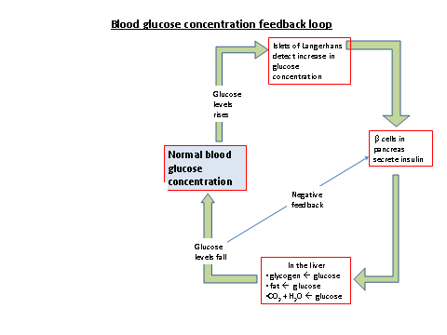

Slide 13
BLOOD GLUCOSE LEVEL LOW
Low blood glucose detected by alpha cells in pancreas
Pancreas releases glucagon
Glucagon binds to liver receptor cells
Glucagon activates enzymes to increase breakdown of stored glycogen in liver and muscles to soluble glucose (. Glycogenolysis)
Glucagon also causes amino acids and glycerol to combine in the liver to form glucose (Gluconeogenesis)
Glucose level in liver rises which sets up a concentration gradient between liver and the blood
Glucose diffuses into the blood
Blood glucose concentration increases

Slide 14
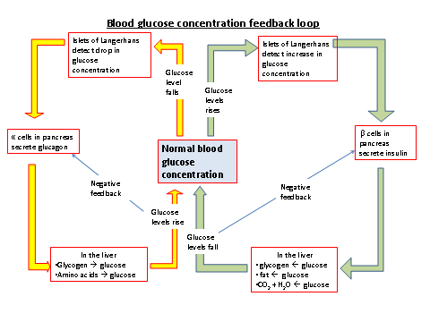

Slide 15
Key Terms
 | Glycogenesis | Glycogenolysis | Gluconeogenesis
When does it happen? | High blood glucose detected by Beta cells of pancreas – insulin is produced | Low blood sugar detected by alpha cells in pancreas – glucagon produced | Low blood sugar detected by alpha cells in pancreas – glucagon produced
What reactions are involved? | Glucose converted to glycogen in the liver | Glucagon causes enzymes in liver and muscles to break down glycogen into glucose | Glucagon causes enzymes to catalyse reaction of amino acids or glycerol to produce glucose
What is the effect on blood glucose concentration? | Blood glucose level drops | Blood glucose level increases | Blood glucose level rises

Slide 16
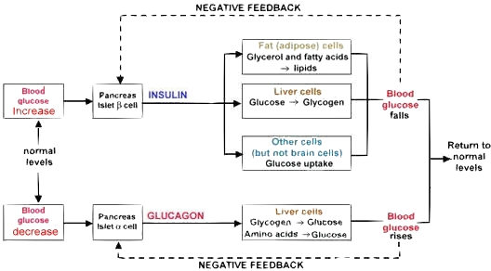
GLUCOSE HOMEOSTASIS – collective memory

Slide 17
GLUCOSE HOMEOSTASIS – collective memory

Slide 18
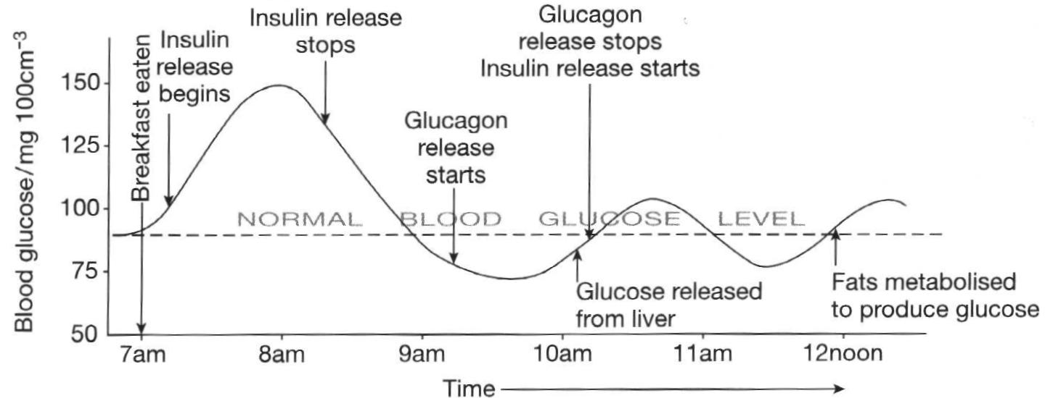
HORMONE CHANGES DURING THE DAY

Slide 19
The Second Messenger model
Insulin binds to cell surface receptors and directly causes the changes in membrane permeability, allowing glucose uptake.
Glucagon does not have a direct effect. When it is detected by membrane receptors, a second messenger molecule is produced.
Other hormones, especially adrenaline, use this model to bring about changes blood glucose
http://highered.mheducation.com/sites/0072507470/student_view0/chapter17/animation__second_messenger__camp.html

Slide 20
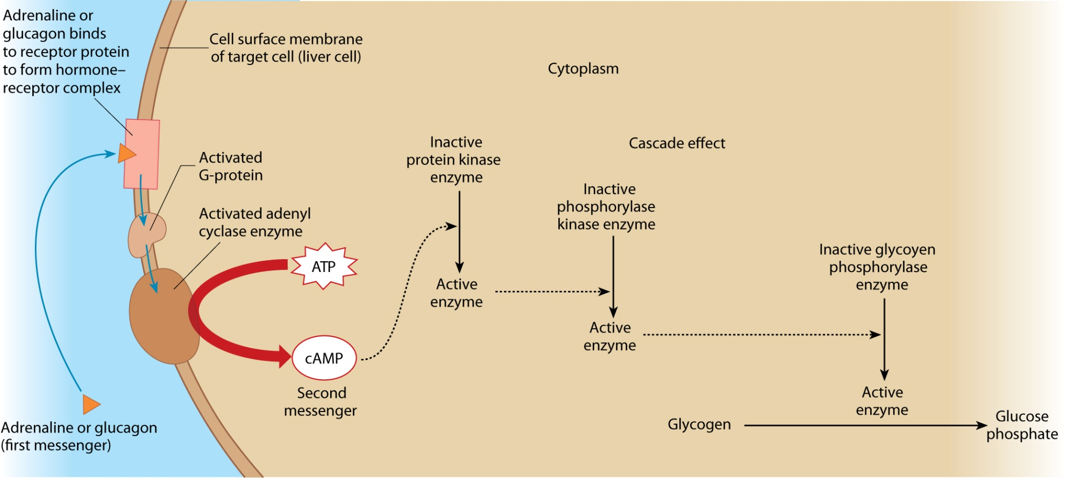
The second messenger model of the action of adrenaline and glucagon on a liver cell

Slide 21
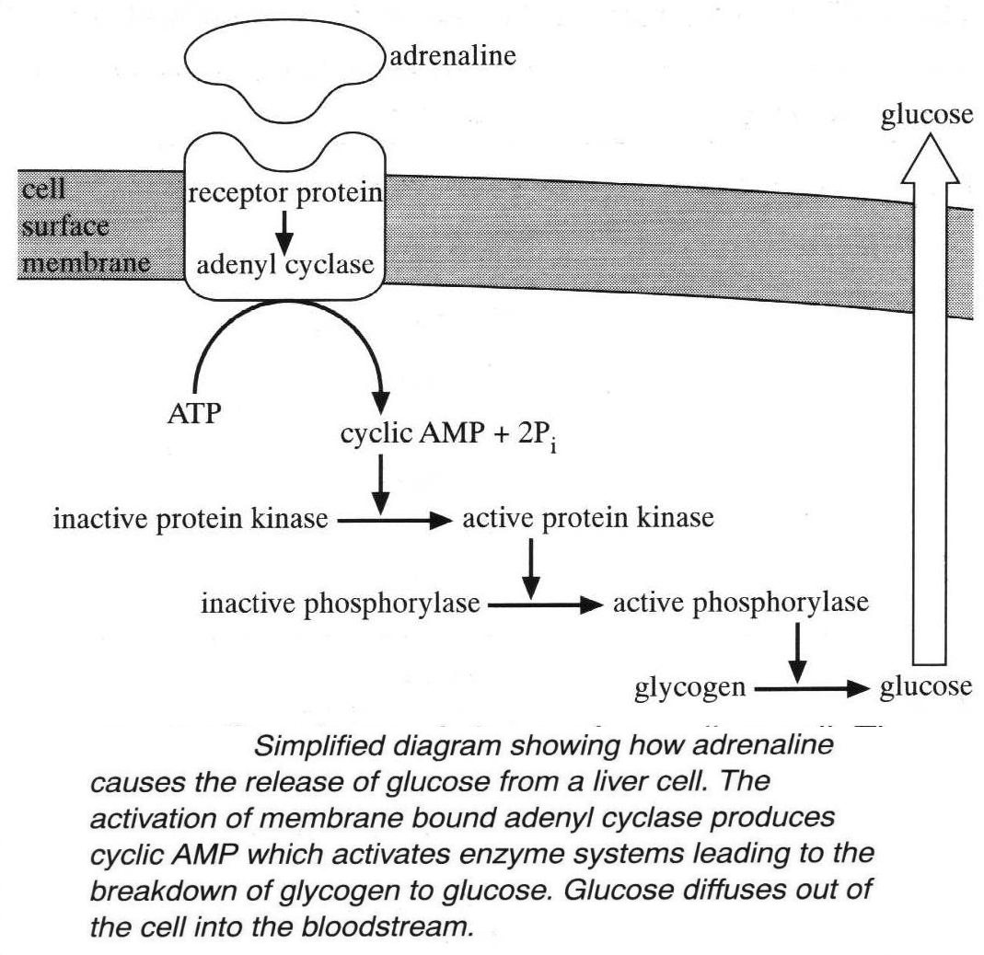
THE SECOND MESSENGER MODEL OF HORMONE ACTION
Adrenaline and glucagon act via a similar mechanism
Adrenaline binds to receptor site and activates an enzyme inside the membrane
The enzyme converts ATP to cyclic AMP which acts as a second messenger that activates other enzymes which convert glycogen to glucose

Slide 22
Effects of Adrenaline
Adrenaline released on excitement or stress
Adrenaline binds to liver receptors and activates the enzyme causing breakdown of glycogen to glucose and also inactivates the enzyme which synthesizes glycogen from glucose
The combined effect raises blood glucose level by glycogenolysis which allows greater respiration and ATP production
Increases Heart rate to speed up blood flow
Constricts arterioles to digestive system
Dilates arterioles to liver and muscles increasing blood flow and supply of glucose and oxygen
Pupils dilate

Slide 23
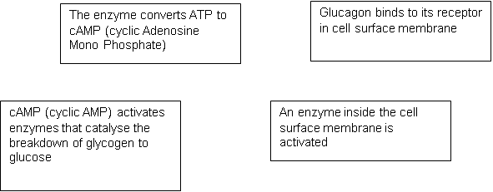
Second messenger summary:
1. Arrange these text boxes to make a flow chart to summarise how glucagon can cause the conversion of glycogen to glucose:
2.
Name the 1st messenger molecule in this system.
What other hormone could also act as the 1st messenger?
3. Name the 2nd messenger in this system.
4. What is the advantage of using a 2nd messenger?
5. What is an advantage of glucagon being broken down within minutes of being secreted?
6. Why is it necessary to prevent blood glucose levels
a) getting too high?
b) Getting too low?

Slide 24
Increased Blood Glucose | Decreased Blood Glucose
Caused by
Responses
Gluconeogenesis:
Synthesis of glucose from fatty acids and glycerol
Glycogenolysis:
Liver glycogen broken down into glucose
Eating/Drinking
Glucose absorbed by ileum
Glycogenesis: Glucose converted into glycogen and stored in liver and muscles
Exercise/lack of glucose in diet
Glucose used in respiration
Glycolysis, Krebs, etc.
Increased uptake of glucose by cells
Glucose converted to lipids in adipose tissue
Increased respiration rate by cells

Slide 25
Increased Blood Glucose | Decreased Blood Glucose
Eating/Drinking Glucose absorbed by ileum | Exercise/lack of glucose in diet Glucose used in respiration Glycolysis, Krebs, etc.
Glycogenesis: Glucose converted into glycogen and stored in liver and muscles Increased uptake of glucose by cells Increased respiration rate by cells Glucose converted to lipids in adipose tissue | Glycogenolysis: Liver glycogen broken down into glucose Gluconeogenesis: Synthesis of glucose from fatty acids and glycerol
Caused by
Responses

Slide 26
Play your cards right
The answer to these questions is either INSULIN & GLUCAGON
Write these words on either side of a mini-whiteboard/piece of paper
All stand to start
If you get an answer wrong sit down but continue playing

Slide 27
This hormone is injected regularly by some diabetics
insulin

Slide 28
This hormone is secreted by alpha cells
glucagon

Slide 29
This hormone increases the permeability of cells to glucose
insulin

Slide 30
This hormone stimulates the formation of glucose from glycogen
glucagon

Slide 31
This hormone stimulates an increase in respiration rate
insulin

Slide 32
This hormone is secreted by beta cells
insulin

Slide 33
This hormone stimulates the conversion of glucose to fatty acids
insulin

Slide 34
This hormone is produced in response to low blood glucose level
glucagon

Slide 35
This hormone stimulates glycogenesis
insulin

Slide 36
This hormone stimulates gluconeogenesis
glucagon

Slide 37
This hormone is secreted in response to high blood glucose level
insulin

Slide 38
This hormone stimulates glycogenolysis
glucagon

Slide 39
This hormone stimulates the conversion of amino acids to glucose
glucagon

Slide 40
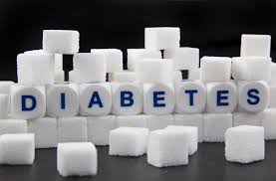

Slide 41
Objectives
Describe the difference between type I and type II diabetes
Explain how these conditions can be controlled

Slide 42
DIABETES MELLITUS
INABILITY TO CONTROL BLOOD GLUCOSE DUE TO REDUCED OR NO INSULIN SECRETION
Type 1 Vs type 2
https://www.youtube.com/watch?v=4r5O3NkSXtY
Sam’s Story
https://www.youtube.com/watch?v=2bhcqzPq15o

Slide 43
EFFECT OF INSULIN ON UPTAKE OF GLUCOSE

Slide 44
Symptoms of Diabetes
Lack of insulin will cause high blood glucose.
The kidney filtrate will also contain high glucose concentration and glucose is excreted in urine
Due to the high level of glucose in the kidney Filtrate, the water potential of the filtrate will be low so water will diffuse out of the blood and will not enter the blood from the filtrate.
High water content of kidney filtrate will result in more urine.
The blood and body will be dehydrated.
Brain cells will detect lower water content and there will be a sensation of thirst.
Glucose will not be entering cells and weight loss will occur also tiredness & blurred vision due to clouding of the lens.
High blood glucose encourages bacteria and skin infections e.g. boils & thrush.

Slide 45
Type 1 Diabetes
Autoimmune disease which destroys Beta insulin producing cells in pancreas
No insulin released so glucose channels remain shut so cells:
  Starved of glucose which leads to fatigue, breakdown of fats and then weight loss
  Kidneys excrete glucose into the filtrate, this lowers water potential so water diffuses out of the blood which produces a large amount of urine and makes patient thirsty and leads to dehydration of tissues
  The high glucose encourages bacterial growth at cuts so wounds are slow to heal
  High blood glucose encourages bacteria and skin infections e.g. boils & thrush.
  Glucose builds up in the liquid of the lens of the eye causing cloudiness and blurred vision

Slide 46
DIABETES 1
Managed by :
  Diet: mainly starches that are digested slowly so prevents sudden rise in blood glucose levels.
Insulin injection at regular times e.g. after breakfast. (may include genetically engineered insulin). Insulin injections not given orally, since insulin is a protein and it would be digested.
Blood glucose needs to be monitored to calculate insulin dose.

Slide 47
Measuring blood glucose levels
https://www.youtube.com/watch?v=QAXOFzr7eRI

Slide 48
Type 2 Diabetes
Insulin is produced but receptor cells are desensitized to insulin
Receptor cells become furred up by fats so insulin cannot bind
If some insulin does bind the channels will not open properly
Glycoprotein receptors are lost so less insulin binds and less glucose can enter
Usually affects older people, 40-55 years and People who are often overweight
Females rather than males
Managed by:
  Control of carbohydrate intake in diet.
  Weight loss
  Drugs to slow the rate of carbohydrate absorption from intestine.
  Add more Insulin

Slide 49

Diabetes
Dietary control of diabetes
Eat foods that are low in sugar
Because you have no insulin to convert high blood sugar into liver glycogen.
e.g. pasta is good because it is only slowly digested into glucose and the body has time to cope even if insulin levels are low
Carry some sugary food around with you
Because if you exercise hard or go for quite a long time without a meal you have no glycogen to convert into blood glucose to keep your blood sugar levels up.

Slide 50
Simulation
Use the Excel model to simulate responses of a diabetic and non-diabetic person
Discuss the following questions:
What health problems are caused by:
High blood glucose
Low blood glucose
Why are diabetic people at risk from both excessively high and low blood sugars during their day?

Slide 51
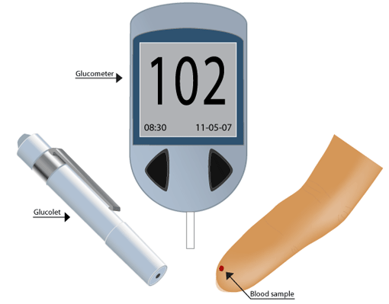
OGTT TEST EQUIPMENT

Slide 52
How Science Works - Oral Glucose Tolerance Test (OGTT)
How would you (safely) test to see if someone was diabetic?

Slide 53
Diagnosis of Diabetes
High glucose content of urine suggests diabetes.
Confirmation achieved as a result of glucose tolerance tests.
Blood sugar measured in a fasting patient.
They are then given a known quantity of glucose.
Blood sugar re-measured 2 hours later.

Slide 54
How Science Works - Oral Glucose Tolerance Test (OGTT)
The patient has to have fasted for the previous 8-14 hours (water is allowed).
Usually the OGTT is scheduled to begin in the morning (0700-0800)
A zero time (baseline) blood sample is drawn.
The patient is then given a glucose solution to drink up to 75 g for an adult (It should be drunk within 5 minutes).
Blood is drawn at regular intervals using a lancet
measurement of glucose is usually made with a portable glucose analyser.
The most important sample is the zero and 2 hour sample

Slide 55
RESULTS ANALYSIS
Fasting Blood Glucose
From 3.6 to 6.0 mM | normal fasting glucose
From 6.1 to 6.9 mM | impaired fasting glucose
7.0 mM and above | probable diabetes
Oral Glucose Tolerance Test (OGTT) Results (2 hours after a 75-gram glucose drink)
Less than 7.8 mM | normal glucose tolerance
From 7.8 to 11.0 mM | impaired glucose tolerance
Over 11.1 mM | probable diabetes

Slide 56
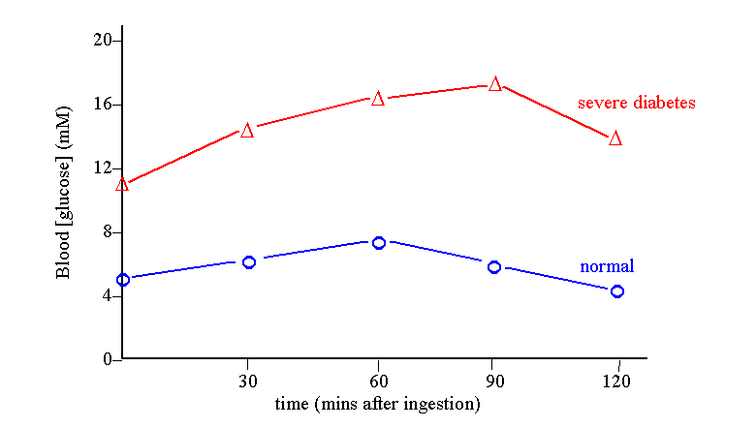
Results of Glucose Tolerance test

Slide 57
Explanation of Results
In a normal patient:
As blood glucose rises above the normal range of 7.7mMol/litre insulin is secreted and blood glucose is reduced, returning to normal after 120 minutes.
In a diabetic patient:
Insulin is not secreted, blood glucose rises as it is absorbed and only slowly falls as glucose is used for respiration.

Slide 58
Required Practical 11

