Slide 1
3.6.4.1 Principles of Homeostasis and Negative Feedback

Slide 2
What is homeostasis?
Homeostasis is the maintenance of a constant internal environment within a living organism despite fluctuations in its external and internal environment (BFY 310)

Slide 3
What is meant by the internal environment? – whiteboard suggestions

Slide 4
Factors that must be controlled
Water potential
Concentration of solutes in the blood and tissue fluid eg amino acids and glucose
Temperature
pH
Concentration of oxygen
Concentration of carbon dioxide
Blood pressure

Slide 5
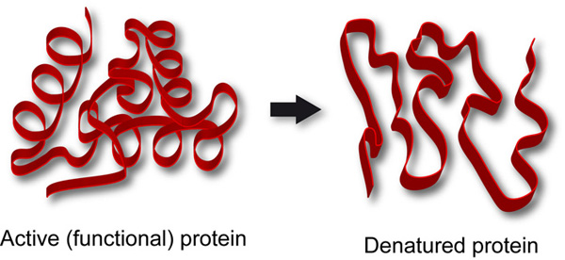
Why is homeostasis important?
Enzymes are sensitive.
Homeostasis will keep the fluctuations of temperature, pH and concentrations minimal so that enzymes can continue to function at their optimum rate.

Slide 6
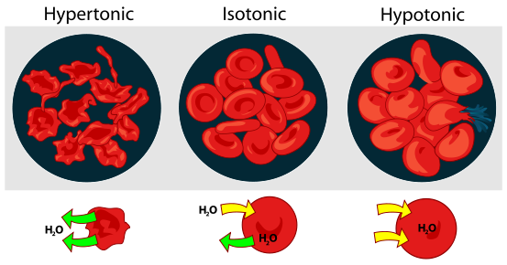
Why is homeostasis important?
Tissue fluid surrounds all cells, cells respond to changes in the composition of the fluid

Slide 7
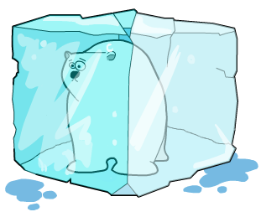

Why is homeostasis important?
Independence from external conditions – Animals with a constant internal environment can maintain a constant level of activity regardless of their environment.
Organisms increase their survival chances by modifying their internal environment in response to external changes

Slide 8
Examples of Homeostasis
Glucoregulation = keeping blood sugar levels constant
Thermoregulation = keeping body temperature constant at …?...°c
Osmoregulation = keeping water and ion levels constant

Slide 9
Co-ordination of control
Homeostatic control requires a number of features:
The optimum point. This is monitored by:
A receptor which detects any deviation from the optimum point and sends a signal to:
A co-ordinator which sends information in the form of chemical hormones or nerve impulses from the receptor to an:
Effector which is either a muscle or gland which causes changes to return the system to the optimum point. This return to normality creates a:
Negative Feedback mechanism

Slide 10
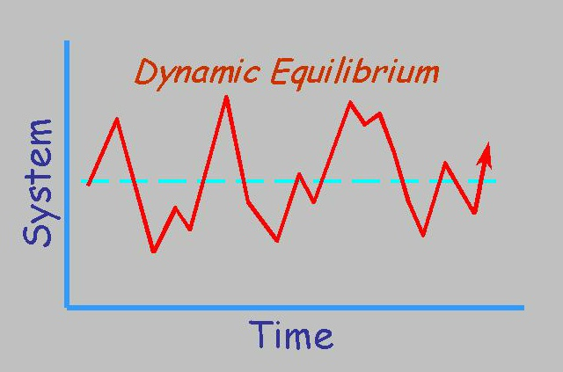
What is dynamic equilibrium?
Dynamic equilibrium refers to a condition in which the parts of a system are in continuous motion, but they move in opposing directions at equal rates so that the system as a whole does not change.

Slide 11
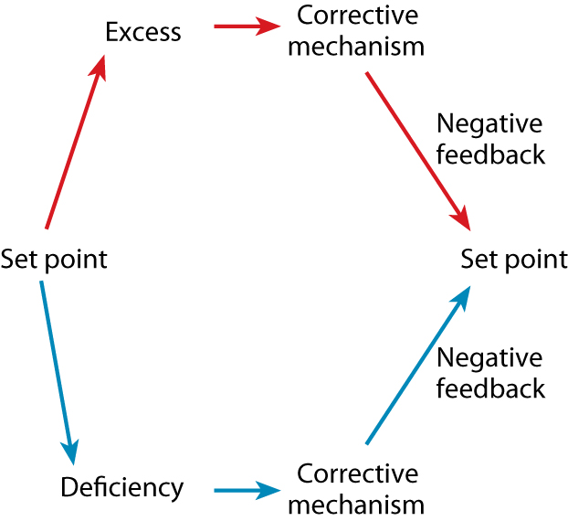
A generalized diagram showing how negative feedback keeps a system in a stable condition. A change from the usual level of a factor (the set point for that factor) triggers a corrective mechanism which restores the factor to its usual level.

Slide 12
Bozeman feedback loops
http://www.youtube.com/watch?v=q_e6tNCW-uk&feature=relmfu

Slide 13
Negative feedback
Negative Feedback is the mechanism by which the internal environment of a body is maintained at a constant level (the norm).
Homeostasis and negative feedback - Bozeman biology body temp

Slide 14
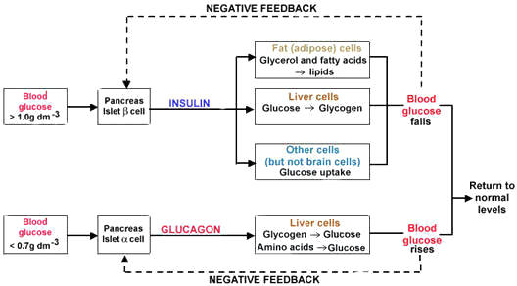
What is the change, the detector/receptor, the mechanism and the response?

Slide 15
Negative Feedback
Describe the parts of the negative feedback loop responsible for maintaining a steady body temperature.
Section | Set Point / Optimum Level | Input | Receptor | Controller | Effector | Output | Feedback Loop
Description/definition | The normal /optimum level | A detectable change | Measures the level of change | Receives and controls info from receptor | Carries out the change needed to restore to norm | System is returned to normal / optimum level | Informs the receptor about the changes made by the effector
Example | Body temp 37 C | Body temp rises to 39c | Temp receptors in Brain detect increase | Hypothalamus sends nerve impulses to arteriole muscle | Vasodilation | Body temp falls | Informs the thermoreceptors in the hypothalamus

Slide 16
Negative Feedback
A series of changes that result in a substance being restored its normal / optimum level.
Section | Set Point / Optimum Level | Input | Receptor | Controller | Effector | Output | Feedback Loop
Description | The normal /optimum level | A detectable change | Measures the level of change | Receives and controls info from receptor | Carries out the change needed to restore to norm | System is returned to normal / optimum level | Informs the receptor about the changes made by the effector
Example | Body temp 37 C | Body temp rises to 39c | Temp receptors in Brain detect increase | Hypothalamus sends nerve impulses to arteriole muscle | Vasodilation | Body temp falls | Informs the thermoreceptors in the hypothalamus

Slide 17
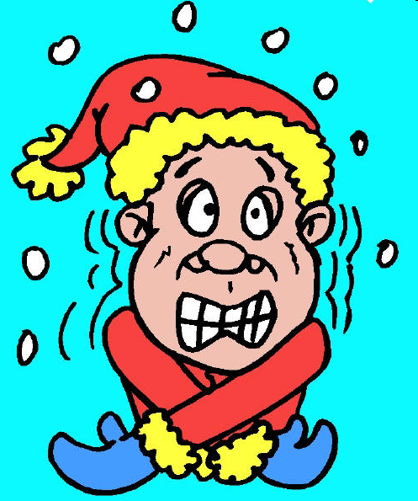
Positive feedback
Not common
Increases original change detected by receptors
Usually harmful
E.g. body temp falls, enzymes become less active, less heat released, temp continues to fall!

Slide 18
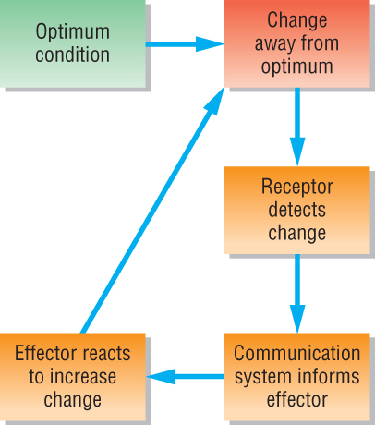
Week 1
Positive feedback
Positive feedback
© Pearson Education Ltd 2009
This document may have been altered from the original

Slide 19
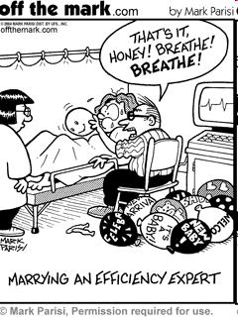
Uses of positive feedback
Labour!!
Cervix opens
Oxytocin released
Oxytocin increases contractions
Cervix stretches more

Slide 20
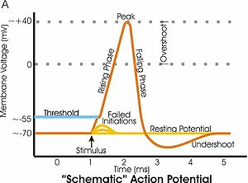
Positive feedback
Other examples?

