Slide 1
Make your life easy
Using Word to manage your sources

Slide 2
Click on References in the ribbon and then find Manage Sources

Slide 3
Click on it and the following box appears

Slide 4
Click on New

Slide 5
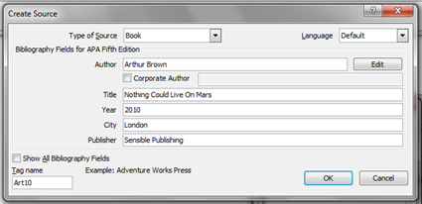
Choose your source type and fill in the details

Slide 6
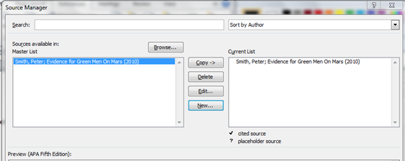
It will then appear on your master list and on the list for the current document
Close

Slide 7
If you click on Insert Citation, then the list for the current document appears and you can select the source you are referencing the quote from.

Slide 8
If you want to add anything to the citation e.g. a page number, use Edit Citation – click on the citation and then choose edit

Slide 9
You can create a Bibliography too! Click on Bibliography

Slide 10
Choose Bibliography and it is created in an established format for you!

Slide 11
You can also insert footnotes, Click on Insert Footnote followed by Insert Citation and a footnote will appear at the bottom of the page.
Footnotes are all automatically renumbered if you move the text around.

