Slide 1
GOOD RESEARCH TECHNIQUES FOR YOUR EPQ
VERY EXCITING MINI LECTURE SERIES !!!
2. FOOTNOTES

Slide 2
What are footnotes, endnotes, references ?
Footnotes are a way of documenting the specific books, articles or sources you’ve used to write your project
They show the reader exactly where you’ve got your information from in your research.
You will be required to use footnotes when you write dissertations at university or MA or even PhD theses.

Slide 3
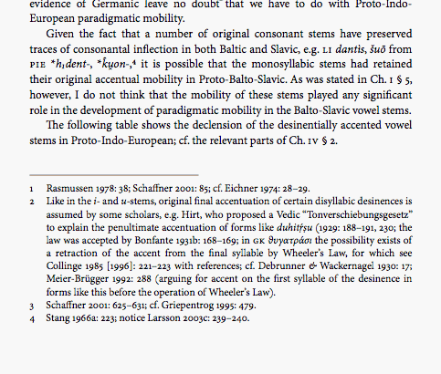
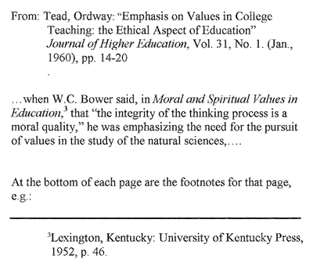
For instance:
Examples

Slide 4
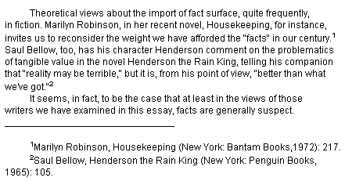
Footnotes should be used…
When you quote from or refer to a point of view in source
To acknowledge sources that you have ‘borrowed’ from to obtain the factual details in an account or piece of description
To acknowledge sources which have provided you with images or statistical information
When you want to add a comment which doesn’t quite fit into the flow of the main text but which will be helpful to the reader

Slide 5
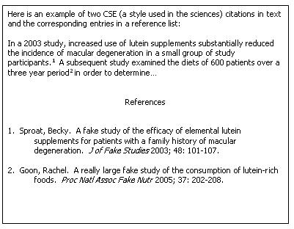
Footnotes cont
Footnotes are indicated by a number in the text of your project
The details of the source relating to that number are shown at the bottom of the page or section or at the end of the study (endnotes)
Footnotes are numbered consecutively

Slide 6
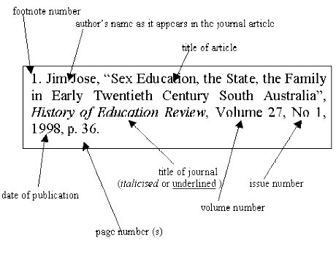
For your purposes the footnote need only include the author, title, and the date of publication
At university you might be required to include a greater level of detail as shown below
If you have consecutive footnotes referring to the same author you don’t have to write the whole reference out again you can just ‘ibid’ followed by the author’s surname
2.Ibid Jose
The convention ‘op cit’ is used for referring to a source in a footnote previously referred to
3. op cit Marmaduke
Not very interesting bit..alas..
Footnotes cont

Slide 7
Using Microsoft Word to Create Footnotes
Go to References
And then click Insert Footnote
At the bottom of the page you will then be presented with the following:
¹
You then add the reference at the bottom of the page as shown:
¹ Peter Murray ‘The Architecture of the Italian Renaissance’ 1969

