Slide 1
Unit 20:
Single camera techniques
Learning Aim A:
Understand Single Camera Productions
Learning Aim B:
Explore Single Camera Techniques
Learning Aim C:
Produce a Single Camera Production

Slide 2
Single Camera Production Options
TV Drama Opening

Slide 3
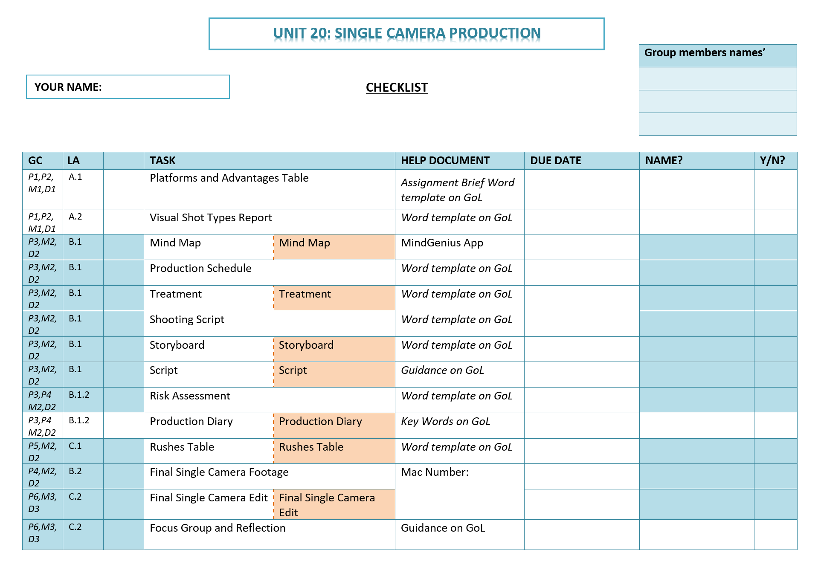

Slide 4
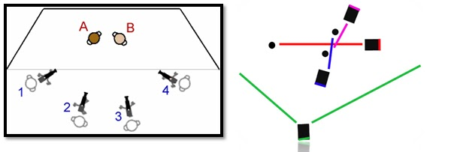
Defining a single camera production
A single-camera production uses just one camera. Each of the various shots and camera angles are taken with the same camera which is moved and reset to get each shot or new angle. The actors and actions are repeated the same each time to maintain continuity.

Slide 5
Defining a single camera production
A single-camera production uses just one camera. Each of the various shots and camera angles are taken with the same camera which is moved and reset to get each shot or new angle. The actors and actions are repeated the same each time to maintain continuity.

Slide 6
Defining a single camera production
A single-camera production uses just one camera. Each of the various shots and camera angles are taken with the same camera which is moved and reset to get each shot or new angle. The actors and actions are repeated the same each time to maintain continuity.

Slide 7
Defining a single camera production
A single-camera production uses just one camera. Each of the various shots and camera angles are taken with the same camera which is moved and reset to get each shot or new angle. The actors and actions are repeated the same each time to maintain continuity.

Slide 8
The wide shot shows the full scene or area of action. This shot is useful to show viewers the overall geography of the scene and for bridging jumps in continuity during editing.
Show major changes in the scene's basic elements. In film production many directors start out by shooting a scene, beginning to end, from the MASTER SHOT perspective.

Slide 9
However you do it, the series of setups associated with a scene is commonly referred to as COVERAGE. A handy tip to save yourself in the edit is to ensure you shot a series of CUTAWAYS.
Master Shot
Cutaway

Slide 10
Once this shot is filmed, the director repositions the camera for the medium shots and close-ups of the various actors. For these the actors once again repeat all their dialogue.
To accommodate the new camera distances and angles these setups often require changes in lights, microphone positions, and sometimes even make-up. Obviously, all this has to involve changes that will (that should) go unnoticed when all of the takes are cut together.
In Psycho (1960), Alfred Hitchcock repositioned his single camera 78 times to achieve a fast-paced montage in the infamous shower scene.

Slide 11
Grading Criteria
PASS 1 | MERIT 1 | DISTINCTION 1
Explain the purposes of different types of single camera production | Analyse the use of single camera techniques within different types of single camera production. | Evaluate detailed examples of the uses of different single camera techniques and their effectiveness in different types of single camera production.
PASS 2
Explain the use of single camera techniques.
Assignment Sheet

Slide 12
Learning Aim A: Platforms and Advantages
Type of SCP | Platforms | Advantages | Disadvantages | Examples & Techniques used
TV Drama / comedy / soap
Documentary
Adverts
Corporate / promotional video
Narrative-based music video

Slide 13
UNIT 20 LA A TASK: PLATFORMS AND ADVANTAGES
Type of SCP | Platforms | Advantages | Disadvantages | Examples & Techniques used
Corporate / promotional video | Trade-shows Conferences Internet; corporate websites / social media channels Waiting rooms and lobbies You-tube | Relatively cheap; only requires one camera operator Generally formulaic and easy to access Working with non-professional actors A small single camera set-up may be less intimidating. | More time consuming to re-shoot for different angels. Small crew allows plenty of flexibility regarding ‘coverage’ More control over lighting and blocking the scene | Frontier Corporate Video 2014 Lots of static talking head shots of a diverse range of people. Direct address to camera emphasises sincerity of company and employees. Interviews with staff provide corporate agenda; community /team/ importance of team / comfort etc. Simplicity of techniques allow audience to focus on content rather than style. Time-lapse shots used to condense time frame. Moving camera – smooth tracking shots to product – designed to be aesthetically pleasing and slick. Corporate branding included throughout, including inter-title cards (corporate font and logo). Motivational non-diegetic music provides a sound-bed

Slide 14
PLATFORMS AND ADVANTAGES: Analysis
Type of SCP | Platforms | Advantages | Disadvantages | Examples & Techniques used
TV Drama / comedy / soap | Channel 4 Channel 4OD App Amazon Prime Youtube |  |  | Spaced, Season 2 Ep 5

Slide 15
PLATFORMS AND ADVANTAGES: Class Analysis
Type of SCP | Platforms | Advantages | Disadvantages | Examples & Techniques used
TV Drama / comedy / soap | Channel 4 Channel 4OD App Amazon Prime Youtube | Small lounge, on location meant single camera set up was appropriate with space for actors to move | Moving the camera for different action shots, can be difficult to accurately recreate intricate shots and maintain continuity | Spaced, Season 2 Ep 5 The shot-reverse-shots used throughout the ‘action’ sequence have been filmed using a single camera set up and conform to the continuity editing rules to ensure an understanding of the ‘fight’ from each characters perspective.

Slide 16
PLATFORMS AND ADVANTAGES: Tips
Type of SCP | Platforms | Advantages | Disadvantages | Examples & Techniques used
Do your research to ensure it is a single camera production | Think nationally in the UK and internationally how and where to people view this show? TV Online Apps? | What are the advantages of this scene/episode being filmed as a single camera production? Be specific, reference a character, an action, the set etc… | What are the disadvantages of this scene/episode being filmed as a single camera production? Be specific, reference a character, an action, the set etc… | Name the show and put a link to your chosen clip here Analyse: Cinematography Mise-en-scene Lighting Sound Editing Link them where possible to the fact that it is a single camera production. For example master shots, continuity editing etc…

Slide 17
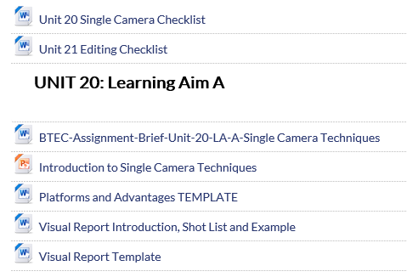
UNIT 20 LA A TASK: PLATFORMS AND ADVANTAGES
Download ‘Platforms and advantages TEMPLATE’
Research and crack on!

Slide 18
List of Single Camera Productions
Spaced
The Office
Curb Your Enthusiasm
Scrubs
Peep Show
My Name is Earl
The Inbetweeners
Sex and the City
Phoenix Nights
The Royle Family
Cowboy Builders
Dinner Date
The One Show (documentaries)
Escape to the Country

Slide 19
Type of SCP TV Drama / comedy / soap | Platforms | Advantages | Disadvantages | Examples & Techniques used
 | Channel 4 All 4 App Amazon Prime YouTube | Less equipment required and working in a small space such as a London flat is more practical It cheaper to just have one camera as the budget doesn’t have to be spent on extra cameras and camera operators and with a low budget new Channel 4 production on untested talent it makes sense. It is done in few takes allowing the actors to move around for their take of the fight scene. It won’t need many people on set to film due to only being one camera. There will only be a few people behind the scenes which is appropriate for on location shooting in a small space. | Less creative freedom over the different shots as there's only one angle shot of the take. The advantage of taking more takes is that if someone looks wrong in one shot, they can switch to the other one without losing continuity. It takes up a lot of time filming, and multiple takes are required for the scene to cut together. This scene would need close ups on each character on multiple takes, along with the pan and master shots. Editing can be more time consuming as there are more shots that have to be cut together and with this fight scene it is important to ensure the continuity editing rules are followed. | Spaced, Season 2 Ep 5 Close-ups as each character is ‘shot’ creates an intimate atmosphere Pan around the room to view the chaos of the battle, which would needed to have been shot separately to the close up. Dutch angle, depicting action and disorientation Handheld camera movements create an intimate environment reflecting their friendships Master shots were used to reflect the relationship between characters. Cutaway shot of ‘Jess’ in the frame by herself demarcating her from the battle There weren't any gun props as it was all in their minds. This adds to the humour of the scene when somebody walks in and catches them being extremely childish. Setting is a living room it makes it more natural and everyday small setting, ideally suited to a single camera production The acting is very melodramatic which also adds to the humour of the scene Warm lighting almost creates a home like atmosphere to the scene like they are everyday people Diegetic sound was used by the characters, for example, the noises of gunfire from their mouths to indicate that they have a weapon The fast pace editing, builds to the intensity of the scene, helps continuity flow and works with in the genre they are recreating Works within the 180-degree rule to help narrate the scene and allow the audience to visually connect with what is happening.

Slide 20
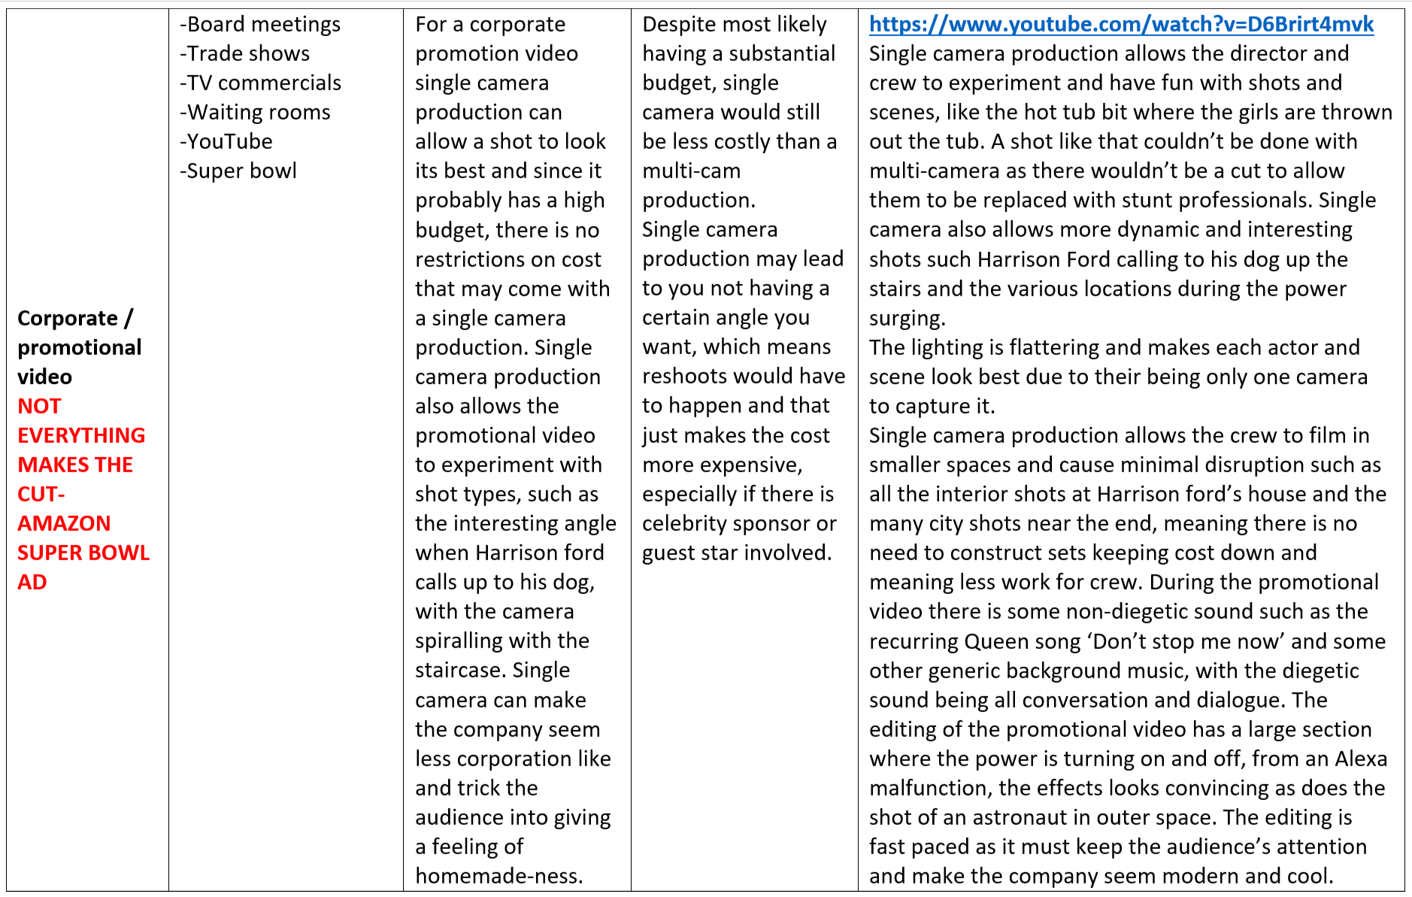

Slide 21
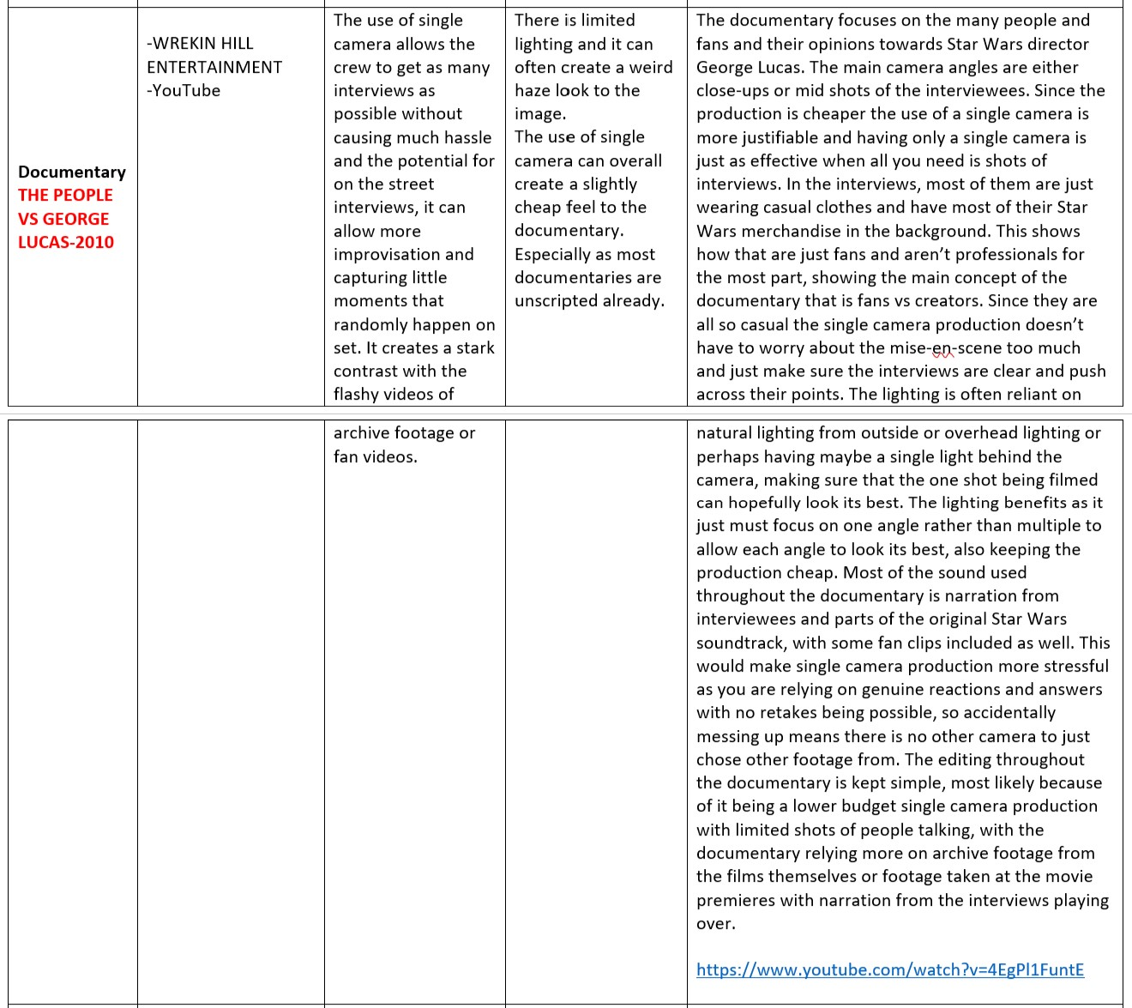

Slide 22
Unit 20: Learning Aim A Platforms and Advantages
Due Friday 24th Feb

Slide 23
Task |  | Deadline
Unit 20 | Platforms and Advantages | Friday 24th February
Unit 10 | Film Fiction Learning Aim B & C Final Submission | Friday 10th February
Unit 20 | Visual Shot Types Report | Friday 24th February

Slide 24
PLATFORMS AND ADVANTAGES: Tips
Type of SCP | Platforms | Advantages | Disadvantages | Examples & Techniques used
Do your research to ensure it is a single camera production | Think nationally in the UK and internationally how and where to people view this show? TV Online Apps? | What are the advantages of this scene/episode being filmed as a single camera production? Be specific, reference a character, an action, the set etc… | What are the disadvantages of this scene/episode being filmed as a single camera production? Be specific, reference a character, an action, the set etc… | Name the show and put a link to your chosen clip here Analyse: Cinematography Mise-en-scene Lighting Sound Editing Link them where possible to the fact that it is a single camera production. For example master shots, continuity editing etc…

Slide 25
PLATFORMS AND ADVANTAGES: Tips
Type of SCP | Platforms | Advantages | Disadvantages | Examples & Techniques used
Do your research to ensure it is a single camera production | Think nationally in the UK and internationally how and where to people view this show? TV Online Apps? | What are the advantages of this scene/episode being filmed as a single camera production? Be specific, reference a character, an action, the set etc… | What are the disadvantages of this scene/episode being filmed as a single camera production? Be specific, reference a character, an action, the set etc… | Name the show and put a link to your chosen clip here Analyse: Cinematography Mise-en-scene Lighting Sound Editing Link them where possible to the fact that it is a single camera production. For example master shots, continuity editing etc…

Slide 28
LA A: Platforms and Advantages
Due Friday 31st January
7 college days remaining
½ way through allotted time
5 platforms to complete

Slide 29
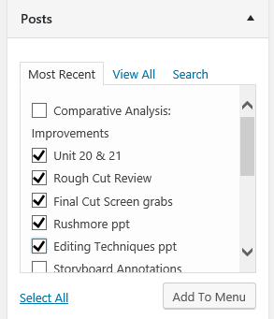
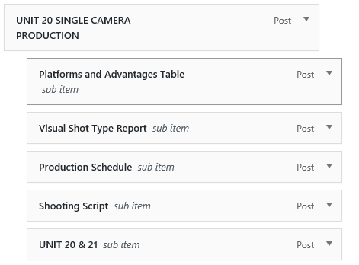
To use Edublogs menus correctly…
1. Create a UNIT 20 and a UNIT 21 post (they’ll be empty apart from the post name), ensure you ‘publish’ your post
2. Go back to ‘Dashboard’ select ‘Appearance’ and ‘Menus’ then look at the ‘Posts’ section and select the post/s you want to be included in your menu.
3. Then select ‘Add to Menu’
4. In the ‘Menu Structure’ Section on the right the posts you have selected will appear
5. Drag and drop to put your menu in the right order.
Make a note of the hierarchy of the menu, so work belonging to the corresponding unit needs to be dragged and dropped below and to the right.
6. Then select ‘Save Menu’

Slide 30
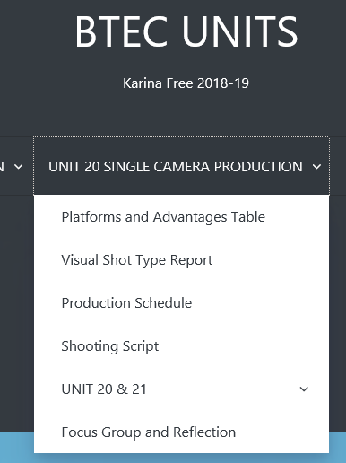
edublogs
Remember your edublogs menu

Slide 31
UNIT 20: SINGLE CAMERA PRODUCTION

Slide 32
Task |  | Deadline
Unit 20 | Platforms and Advantages | Friday 24th February
Unit 10 | Film Fiction Learning Aim B & C Final Submission | Friday 10th February
Unit 20 | Visual Shot Types Report | Friday 24th February
Half Term
Unit 21 | LA A Editing 2 Tasks: Editing Techniques ppt Rushmore Review | Friday 3rd March
Unit 20/21 | Planning paperwork | Friday 10th March

Slide 33
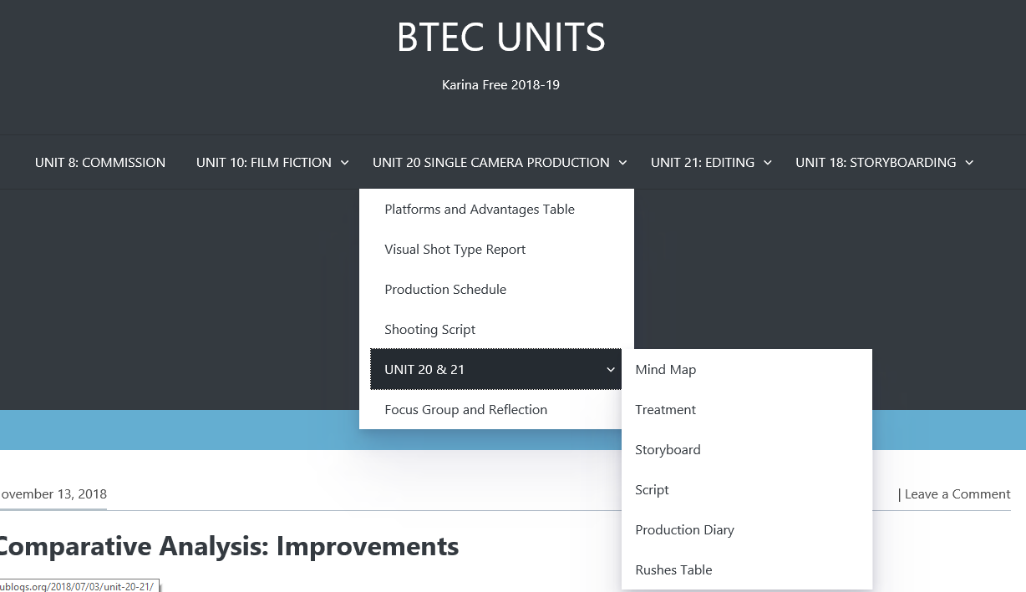

Slide 34
Grading Criteria
PASS 1 | MERIT 1 | DISTINCTION 1
Explain the purposes of different types of single camera production | Analyse the use of single camera techniques within different types of single camera production. | Evaluate detailed examples of the uses of different single camera techniques and their effectiveness in different types of single camera production.
PASS 2
Explain the use of single camera techniques.
Assignment Sheet

Slide 35
Task |  | Deadline
Unit 20 | Platforms and Advantages | Friday 24th February
Unit 10 | Film Fiction Learning Aim B & C Final Submission | Friday 10th February
Unit 20 | Visual Shot Types Report | Friday 24th February
Half Term
Unit 21 | LA A Editing 2 Tasks: Editing Techniques ppt Rushmore Review | Friday 3rd March
Unit 20/21 | Planning paperwork | Friday 10th March

Slide 36
Grading Criteria
PASS 1 | MERIT 1 | DISTINCTION 1
Explain the purposes of different types of single camera production | Analyse the use of single camera techniques within different types of single camera production. | Evaluate detailed examples of the uses of different single camera techniques and their effectiveness in different types of single camera production.
PASS 2
Explain the use of single camera techniques.
Assignment Sheet

Slide 37
Visual Shot Type Report Scenario:
You have been commissioned by Studio7 to produce a pilot for a new police drama
In teams of 4, you must take still images demonstrating single camera techniques. You’ll need to consider cinematography and you may wish to prepare props to help you.
Individually you will analyse the shots and techniques used.

Slide 38
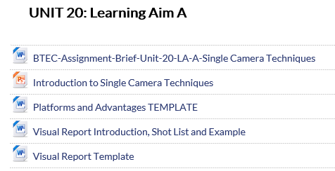
UNIT 20 LA A TASK: Visual Shot Type Report
Download ‘Visual Shot Type Report’
Groups, 4s are ideal
Plan your story carefully to fulfil the brief
Plan your shots and mise-en-scene
Grab a camera
Take pictures, as per the list
There’s 19 in total
Import
Individually define and analyse techniques in relation to Single Camera Production

Slide 39
Still images required |  | Pass | Merit | Distinction
Shot type | Establishing Shot | Y | Y | Y
Shot type | Master Shot | Y | Y | Y
Shot type | Cutaway | Y | Y | Y
Framing | Mid shot | Y | Y | Y
Framing | Extreme Close up | Y | Y | Y
Framing | Point of view (POV) | Y | Y | Y
Angles | High Angle | Y | Y | Y
Angles | Low Angle | Y | Y | Y
Movement | Focus Pulling | Y | Y | Y
Movement | Zooming | Y | Y | Y
Continuity | Consistent scene set up | Y | Y | Y
Continuity | Tripod use | Y | Y | Y
Framing | Medium Close up |  | Y | Y
Framing | Wide Shot |  | Y | Y
Framing | Over-the-shoulder angles |  | Y | Y
Framing | Rule of thirds |  | Y | Y
Angles | Ariel |  | Y | Y
Framing | Shot-reverse-shot and 180-degree rule |  |  | Y
Angles | Canted Angle |  |  | Y
You grade isn’t just dependent on what shots you do
You also need to consider:
Accuracy of the shots
Your definitions
Your detail of analysis
  Explain (P)
  Analyse (M)
  Evaluate (D)

Slide 40
Visual Shot Type Report Scenario:
You have been commissioned by Studio7 to produce a pilot for a new police drama
In teams of 4, decide upon:
Plot
Cinematography
Mise-en-scene
Individually you will analyse the shots and techniques used.

Slide 41
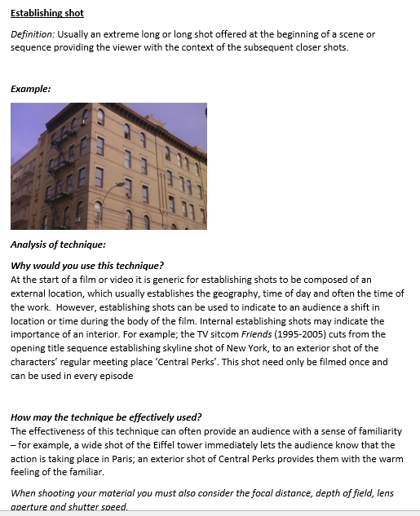
How to write your Visual Shot Type Report
Establishing shot
Definition:
Example:
Why would you use this technique?
Purpose
Analysis
How may the technique be effectively used?
Single camera context and example relating to your new
police drama

Slide 42
How to write your Visual Shot Type Report
Establishing shot
Definition:
Example:
Why would you use this technique?
Purpose
Analysis
How may the technique be effectively used?
Single camera context and example relating to your new
police drama

Slide 43
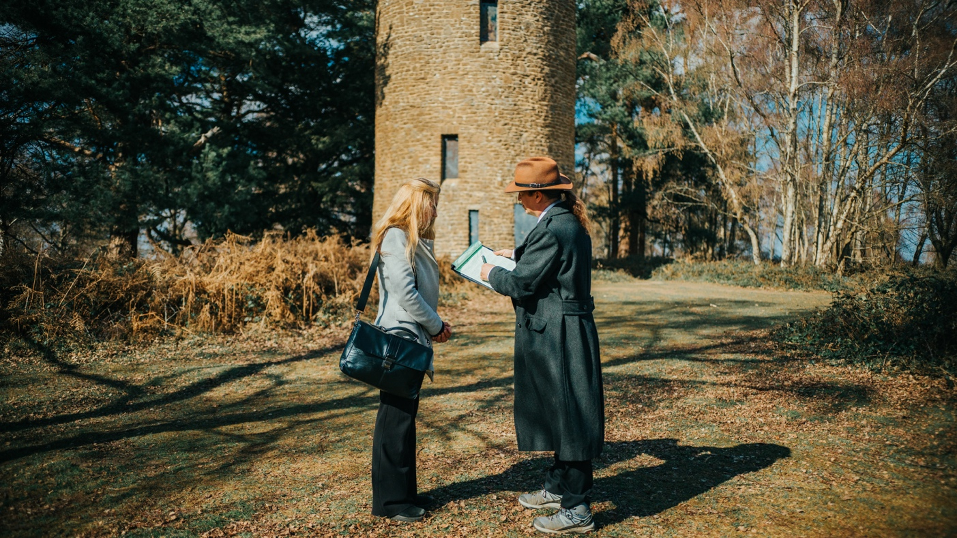
Master shot
Definition:
The master shot used to show all the relevant scenery and characters in one camera perspective they're usually a longer shot as well and it's a continuous filming of the scene as it takes place.
Example:
Why would you use this technique?
You would use the technique when you want to record a whole scene from start to finish from one cameras perspective and this angle can capture all the necessary action taking place that needs to be shown while keeping all the actors in the frame so the camera stays in a single position which really ensures the full attention will be on the action and movement from the actors. Finally, a master shot works great for editors as it serves as a backup shot in case the other footage from other angles had issues or didn't work well, and this is when the master shot can really help editors in post-production.
How may the technique be effectively used?
A master shot technique can be effectively used in post when cutting between multiple angles as you can have other shots shown throughout the scene to add a variety of perspectives to keep the viewers engaged, in this case the detective is interviewing the witness about what she remembers from the fight she saw. This scene would be cut together using shot-reverse shots.
Purpose
Analysis
Single camera context and example relating to your new police drama story

Slide 44

Over-the-shoulder angles
Definition:
Over the shoulder angles are achieved by filmmakers having the camera positioned just over the actor’s shoulder. It is a way to capture the perspective of the subject whose shoulder the camera is placed behind and often be used to add a dynamic perspective into the show.
Example:
Why would you use this technique?
You could use over the shoulder angles in your scene when you are capturing a perspective from one of the actors within a scene. This technique can be used to help them tell a story in their scenes and control the how much they see the actors faces and can display a dynamic relationship between two characters in the show.
How may the technique be effectively used?
An effective use for over the shoulder angles is to show a new point of view to the audience. This is achieved by using a perspective to show where the actors are in relation to one another and allow the viewers to have a variety of perspectives and keep the viewers engaged. In this scene the Over-the-shoulder angles are used as the detective shows the witness a transcript of a previous interview.
Purpose
Analysis
Single camera context and example relating to your new police drama story

Slide 45
UNIT 20 LA A TASK: Visual Shot Type Report:
24th February
Download ‘Visual Shot Type Report’
Groups, 4s are ideal
Plan your story carefully to fulfil the brief
Plan your shots and mise-en-scene
Grab a camera
Take pictures, as per the list
There’s 19 in total
Import
Individually define and analyse techniques in relation to Single Camera Production

Slide 46
UNIT LA A
Platforms and Advantages
TV
Documentary
Advert
Corporate/Promotional
Music Video
VSTR
12 to Pass
17 to Merit
19 to Distinction
DUE

Slide 47
To use Edublogs menus correctly…
1. Create a UNIT 20 and a UNIT 21 post (they’ll be empty apart from the post name), ensure you ‘publish’ your post
2. Go back to ‘Dashboard’ select ‘Appearance’ and ‘Menus’ then look at the ‘Posts’ section and select the post/s you want to be included in your menu.
3. Then select ‘Add to Menu’
4. In the ‘Menu Structure’ Section on the right the posts you have selected will appear
5. Drag and drop to put your menu in the right order.
Make a note of the hierarchy of the menu, so work belonging to the corresponding unit needs to be dragged and dropped below and to the right.
6. Then select ‘Save Menu’

