Slide 1
LGBT+ Training
TS 5: Adapting teaching to the needs of specific pupils
Notes:
https://www.youtube.com/watch?v=j6Ca_vlx-Ao

Slide 2
LGBT+ - What does is stand for?
LGBT+ stands for:
Lesbian
Gay
Bi(sexual)
Trans(gender)
+ - Anyone who identifies outside of the LGBT acronym e.g. agender, asexual, intersex

Slide 3
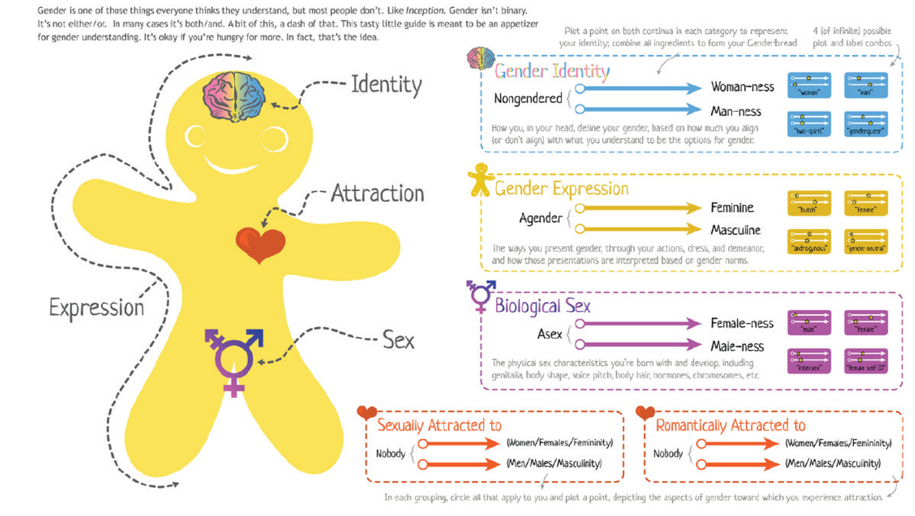
The Genderbread Person

Slide 4
Understanding Gender Identity
Man
Woman
Cisgender: An individual whose gender identity matches their sex assigned at birth.
Transgender: An individual whose gender identity differs from their sex assigned at birth:-
–FtM: Males who were assigned female at birth
–MtF: Females who were assigned male at birth
–Genderqueer: A person who does not identify as either of the gender binaries (male or female) any or all of the time.
Non-Binary:
Agender: An individual who neither identifies as male nor female.
Bi/Tri/Pangender: An individual who considers themself to have two or more genders
Genderfluid: An individual who moves between genders or with a fluctuating gender identity.
Two-Spirit: A term traditionally used by Native American people to recognize individuals who possess qualities or fulfil roles of different genders.

Slide 5
Understanding Gender Expression
Feminine
Masculine
Androgynous: An appearance and/or identification that is neither male nor female, presenting a gender that is either mixed or neutral.

Slide 6
Understanding Biological Sex
Male
Female
Intersex: A term used to describe a person whose sex chromosomes, genitalia and/or secondary sex characteristics are determined to be neither exclusively male nor female.

Slide 7
Understanding Sexual Orientation
Heterosexual: An individual who experiences sexual attraction to a person of the opposite gender.
Homosexual: An individual who experiences sexual attraction to a person of the same gender.
Bisexual: An individual who experiences sexual attraction to people of two genders.
Polysexual: An individual who experiences sexual attraction to people of many genders.
Pansexual: An individual who experiences sexual attraction to people of any gender.
Asexual: An individual who does not experience sexual attraction to people of any gender.
Skoliosexual: An individual who experiences sexual attraction to people of non-binary gender.
Androsexual: An individual who experiences sexual attraction to masculinity.
Gynosexual: An individual who experiences sexual attraction to femininity.
Demisexual: An individual who experiences sexual attraction only once a strong emotional connection is formed.

Slide 8
Understanding Romantic Attraction
Heteroromantic: An individual who experiences romantic attraction to a person of the opposite gender.
Homoromantic: An individual who experiences romantic attraction to a person of the same gender.
Biromantic: An individual who experiences romantic attraction to people of two genders.
Polyromantic: An individual who experiences romantic attraction to people of many genders.
Panromantic: An individual who experiences romantic attraction to people of any gender.
Aromantic: An individual who does not experience romantic attraction to people of any gender.
Skolioromantic: An individual who experiences romantic attraction to people of non-binary gender.
Androromantic: An individual who experiences romantic attraction to masculinity.
Gynoromantic: An individual who experiences romantic attraction to femininity.
Demiromantic: An individual who experiences romantic attraction only once a strong emotional connection is formed.

Slide 9
Class Exercise!
In order for you to fully understand the five different components of yourself, label your Genderbread Person outline:
gender identity
gender expression
biological sex
sexual orientation
romantic attraction

Slide 10
Further Learning Opportunities
Specialised CPD sessions on:
Knowledge of LGBT+ Issues
Role as a Personal Tutor to LGBT+ Students
Inclusion of LGBT+ issues in subject curricula through:
Schemes of Work
Case Studies
Lesson Exemplars
Celebrating awareness days e.g. Transgender Day of Remembrance
Celebrating LGBT+ History Month every February in a cross-curricular capacity

