Slide 1
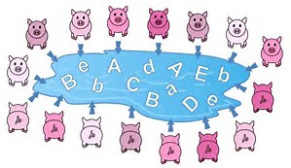
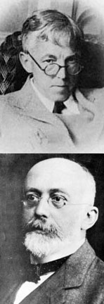
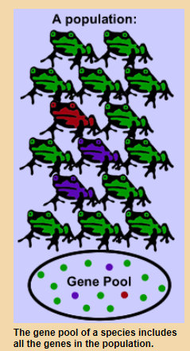
3.7.2 Population genetics
LO: to consider alleles and genes in an entire population

Slide 2
Specification 3.7.2 Population and Hardy-Weinberg
Species exist as one or more populations.
A population as a group of organisms of the same species occupying a particular space at a particular time that can potentially interbreed.
The concepts of gene pool and allele frequency.
The Hardy–Weinberg principle provides a mathematical model, which predicts that allele frequencies will not change from generation to generation. The conditions under which the principle applies.
The frequency of alleles, genotypes and phenotypes in a population can be calculated using the Hardy–Weinberg equation:
p² +2pq + q² =1
where p is the frequency of one (usually the dominant) allele and q is the frequency of the other (usually recessive) allele of the gene.

Slide 3
Population genetics
Objectives:
To define the terms gene pool and allelic frequency.
To define and explain the Hardy-Weinberg principle.
To use the Hardy-Weinberg principle to calculate allele genotype and phenotype frequencies.
https://www.bing.com/videos/search?q=hardy+weinberg+bozeman&&view=detail&mid=1F5EE82F997E1BC5C8061F5EE82F997E1BC5C806&FORM=VRDGAR
Bozeman video on Hardy-Weinberg
https://www.bing.com/videos/search?q=hardy+weinberg+bozeman&&view=detail&mid=0D38334EF2796356D9690D38334EF2796356D969&FORM=VRDGAR
Bozeman video on solving Hardy-Weinberg problems
http://www.youtube.com/watch?v=WhFKPaRnTdQ Crash Course Biology
http://www.phschool.com/science/biology_place/labbench/lab8/quiz.html
Notes:
Practical/Demo ideas
Pluck– tie in gas exchange with this unit. Also slices of arteries and veins can be taken off the heart of the pluck to be used in the following lessons practical on elasticity of veins and arteries. (Not sure how much of the arteries and veins will be left on the hearts that the students are dissecting)
Looking at prepared slides of arteries, veins and capillaries under the microscope

Slide 4
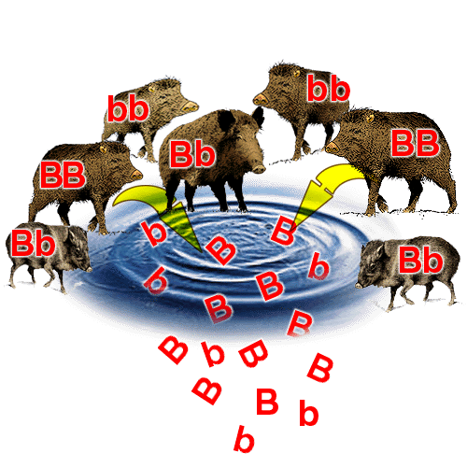
What is a gene pool?
What is a gene pool?
All of the alleles of all of the genes of all of the individuals in a population at a given time.
The gene pool’s composition changes from one generation to the next as the relative proportions of alleles vary.
Allele frequency is the number of times an allele occurs within the gene pool
If there is a consistent change in allele frequency (the proportion of organisms in the population carrying a particular allele) then a population is evolving.
Notes:
Teacher notes
Those individuals who are unable to reproduce do not contribute to the gene pool.

Slide 5
Introducing the Hardy-Weinberg principle
The Hardy-Weinberg principle is a mathematical model used to calculate the allele frequencies of traits with dominant and recessive alleles.
The model assumes that the population:
No mutations
No flow of alleles into or out of the population (emigration or immigration)
No selection – alleles are equally likely to be passed onto the next generation
Large population
Mating within the population is randon
If these assumptions are met then the allele frequencies of the population will remain stable over time.

Slide 6
H-W equation 1: allele frequency
Consider a two allele gene – dominant allele A, recessive allele a
Frequency of allele A = p
Frequency of allele a = q
p + q = 1.0

Slide 7
Example
a species of plant has either red or white flowers. Allele R (red) is dominant to allele r (white). If the frequency of R is 0.4 in a population, what is the frequency of r?

Slide 8
Step by step
p + q = 1
R + r = 1
0.4 + r = 1
r = 1 – 0.4
r = 0.6

Slide 9
Your turn:
ADA is a genetic metabolic disorder caused by a recessive allele (a). The recessive allele frequency in a population is 0.16. What is the frequency of dominant allele A?
p + q = 1
A + a = 1
A + 0.16 = 1
A = 1 – 0.16
A = 0.84
Have a go at the stretch

Slide 10
The Hardy-Weinberg principle

Slide 11
Calculating allele frequencies

Slide 12
H-W equation 2: genotype frequency
3 possible genotypes: homozygous rec/homozygous dominant/ heterozygous
AA Aa aA aa
All the possible combinations of alleles A and a must add up to the entire population so:
AA + Aa + aA + aa = 1.0
As a frequency;
p² + 2pq + q² = 1.0
We can now rearrange this equation to work out the frequency of any allele in the population

Slide 13
There are two alleles for flower colour (R and r), so there are three possible genotypes: RR, Rr and rr. If the frequency of RR is 0.56 in a population, what is the frequency of r?
You know that RR is homozygous dominant genotype so RR = R² R² = 0.56 R = √0.56 R = 0.75
You know that the allele frequency for R = p p + q = 1 R + r = 1 0.75 + r = 1 r = 1 – 0.75 r = 0.25
p2 + 2pq + q2 = 1.0
So R² = p²

Slide 14
Application. What you can do?
Predict genotype frequency.
Predict percentage of a population that has a certain genotype
Show if any external factors are affecting allele frequency

Slide 15
Equations
p2 + 2pq + q2 = 1
Use when given information about phenotypes/genotypes
p + q = 1
Use when give information about allele frequency
Badger worksheets – worked examples

Slide 16
MWB - Question 1
If 98 out of 200 individuals in a population express the recessive phenotype, what percent of the population would you predict would be heterozygotes?

Slide 17
Answer 1
98/200 = (q2)
0.49 = q2
0.7 = q
p + q = 1
p = 1 – 0.7
p = 0.3
2pq = 2(0.3)(0.7) = 0.42 = 42% heterozygotes

Slide 18
Question 2
2. Your original population of 200 was hit by a tidal wave and 100 organisms were wiped out, leaving 36 homozygous recessive out of the 100 survivors. If we assume that all individuals were equally likely to be wiped out, how did the tidal wave affect the predicted frequencies of the alleles in the population?

Slide 19
Answer 2
36/100 = q2
0.6 = q
p + q = 1
p = 0.4
Heterozygous = 2 (0.4)(0.6) = 0.48 = 48%
Homozygous dominant = (0.4)(0.4) = 0.16 = 16%

Slide 20
Question 3
Lets say that brown fur coloring is dominant to grey fur coloring in mice. If you have 168 brown mice in a population of 200 mice........
What is the predicted frequency of
Homozygous dominants
Heterozygotes
Homozygous recessives

Slide 21
Answer 3
200 mice in total
168 = brown = p2 + 2pq
32/200 = grey fur = q2
0.16 = q2
0.4 = q
p = 0.6 (p + q = 1)
p2 = 0.36 = 36%
2pq = 0.48 = 48%
q2 = 0.16 = 16%

Slide 22
Question 4
If 81% of a population is homozygous recessive for a given trait. Calculate
Frequency of homozygous dominant
Frequency of heterozygotes
Frequency of dominant and recssive alleles

Slide 23
Answer 4
q2 = 0.81
q = 0.9
p = 0.1
p2 = 0.01
2pq = 0.18

Slide 24
Question 5
If 51% of the population carries at least one copy of the recessive allele
what is the predicted frequency of the population expressing the dominant phenotype

Slide 25
Answer 5
51% = 2pq + q2
49% = 0.49 = p2
0.7 = p
0.3 = q
p2 + 2pq =
0.49 + 0.42 = 0.91 have dominant phenotype

Slide 26
Question 6
Albinism is a rare genetically inherited trait that is only expressed in the phenotype of homozygous recessive individuals (aa). The most characteristic symptom is a marked deficiency in the skin and hair pigment melanin. This condition can occur among any human group as well as among other animal species. The average human frequency of albinism in North America is only about 1 in 20,000.
calculate the frequency of the dominant allele in North America
the frequency of people expressing the normal phenotype in

Slide 27
Answer 7
q2 = 1/20,000
q = 0.0071
p = 0.9929
dominant phenotype =
p2 + 2pq = 0.9859 + 0.01409
=0.999999

Slide 28
Question 8
1 in 1700 US Caucasian new borns have cystic fibrosis.
calculate the frequency of the recessive cystic fibrosis allele and the dominant allele in the population
calculate the frequency of non cystic fibrosis sufferers in the population

Slide 29
Answer 8
q2 = 1/1700
q = 0.0243
p = 0.9757
p2 + 2pq
(0.9757)(0.9757) + 2(0.9757)(0.0243)
0.9567

Slide 30
Question 9
If 9% of an African population is born with a severe form of sickle-cell anemia (ss), what percentage of the population will be more resistant to malaria because they are heterozygous(Ss) for the sickle-cell gene?

Slide 31
Answer 9
q2 = 9%
q2 = 0.09
q = 0.3
p = 0.7
2pq = 2(0.3)(0.7) = 0.42 = 42%

Slide 32
Question 10
The allele y occurs with a frequency of 0.8 in a population of clams. Give the frequency of
genotypes YY, Yy, and yy. Show your work!

Slide 33
Answer 10
The allele y (recessive) has a frequency q = 0.8.
p + q = 1, then p = 1 – 0.8 = 0.2
genotype:
YY genotype frequency = p2 = 0.04
Yy genotype frequency = 2pq = 0.32
yy genotype frequency = q2 = 0.64.

Slide 34
Answers booklet questions
1. Sea otters were close to extinction at the start of the 20th century. Following a ban on hunting sea otters, the sizes of their populations began to increase. Scientists studied the frequencies of two alleles of a gene in one population of sea otters. The dominant allele, T, codes for an enzyme. The other allele, t, is recessive and does not produce a functional enzyme.
In a population of sea otters, the allele frequency for the recessive allele, t, was found to be 0.2.
(i) Use the Hardy-Weinberg equation to calculate the percentage of homozygous recessive sea otters in this population. Show your working.
Mark scheme
(a) (i) Two marks for correct answer of 4;;
One mark for calculation involving 0.2 × 0.2 or 0.04;

Slide 35
2. The shells of this snail may be unbanded or banded. The absence or presence of bands is controlled by a single gene with two alleles. The allele for unbanded, B, is dominant to the allele for banded, b.
A population of snails contained 51% unbanded snails. Use the Hardy-Weinberg equation to calculate the percentage of this population that you would expect to be heterozygous for this gene. Show your working. (3)
Mark scheme:
1. Correct answer of 42% = 3 marks
Answer of 0.42 = 2 marks
Award one mark maximum for answer of
49.9 / 49.98 / 50% or 0.49 / 0.5
2. q² = 0.49 / 49% OR q = 0.7 / 70%
Award one mark maximum for answer of 40.8 / 41% or 0.41
3. Shows understanding that 2pq = heterozygotes / carriers / shows answer is derived from 2pq;
Accept: b² = 0.49 / 49% or b = 0.7 / 70% for mark point 2

