Slide 1
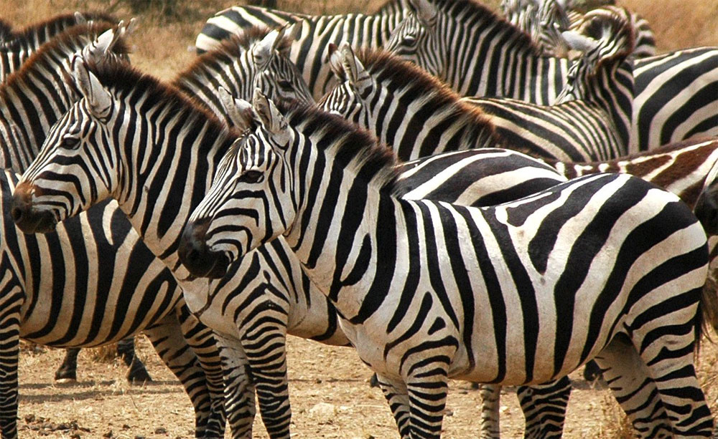
Variation and Natural Selection
LO: to consider alleles and genes in an entire population

Slide 2
Think – pair - share
1. What does the Hardy-Weinberg principle predict about the frequency of the t allele after another 10 generations?
2. Why could an allele frequency change?
3. What is variation?
4. What is natural selection?

Slide 3
Answers self-assess
1. It will be the same (HWP predicts that allele frequency will not change from one generation to the next)
2. The allele codes for a characteristic that affects the chance of an organisms surviving.
3. The difference between organisms of the same species. (a species)
4. mutation; have an advantage; more likely to survive, reproduce; and pass on successful alleles.

Slide 4
Variation and Natural Selection
Objectives:
To describe the factors that affect variation due to genetic factors and due to environmental influences
To explain the role of variation in natural selection
To explain the role of overproduction of offspring in natural selection
Notes:
Practical/Demo ideas
Pluck– tie in gas exchange with this unit. Also slices of arteries and veins can be taken off the heart of the pluck to be used in the following lessons practical on elasticity of veins and arteries. (Not sure how much of the arteries and veins will be left on the hearts that the students are dissecting)
Looking at prepared slides of arteries, veins and capillaries under the microscope

Slide 5


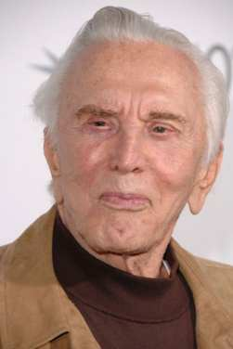
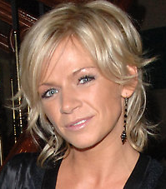

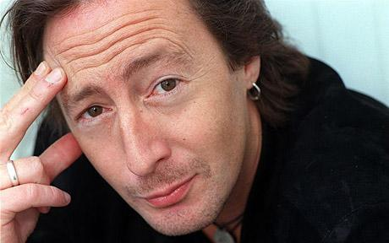
Parents
A
B
C
Progeny (children)
2
3
1

Slide 6
Parents
A
B
C
Johnny Ball
Progeny (children)
2
3
1
Zoe Ball

Slide 7
Parents
A
B
C
John Lennon
Progeny (children)
2
3
1
Julian Lennon

Slide 8
Parents
A
B
C
Kirk Douglas
Progeny (children)
2
3
1
Michael Douglas

Slide 9
What is variation?
Variation is the term used to describe the differences that exist between living organisms.
All living organisms show considerable variation.
Variation is a combination of genetic and environmental factors, it can often be difficult to distinguish between these two effects:
Genetic variation = heritable variation
Environmental variation = non heritable variation

Slide 10
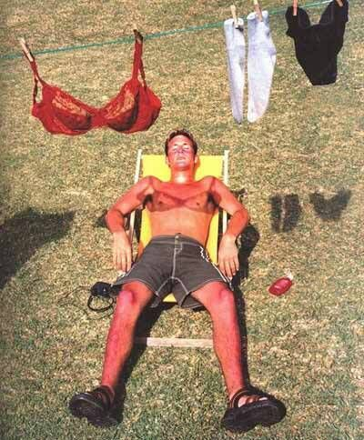
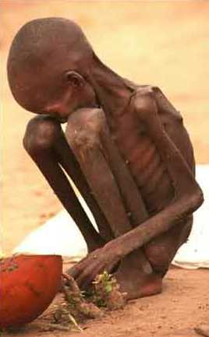
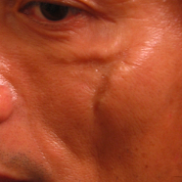
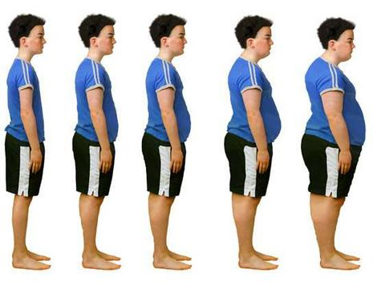
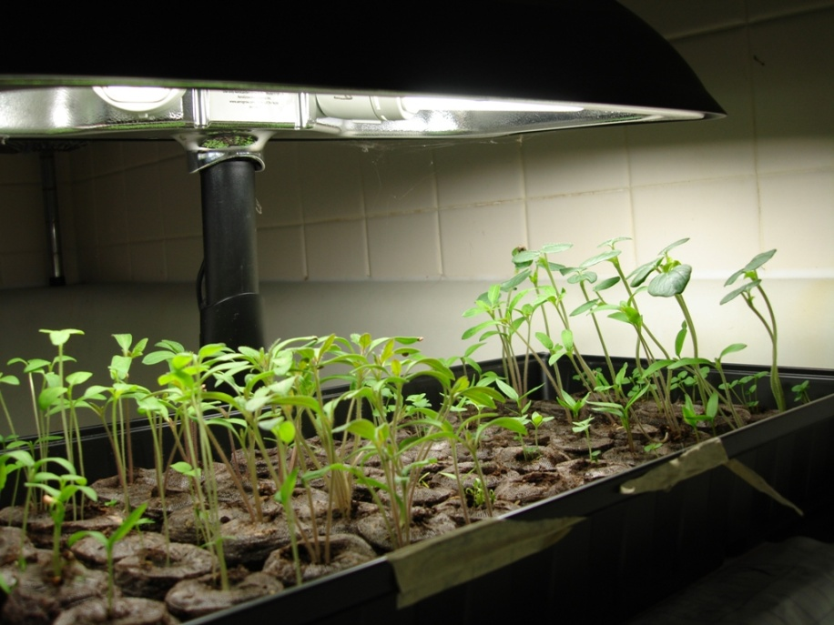
What causes variation?

Slide 11
Variation due to genetic factors
Within a population, all members have the same genes. Genetic differences occur as members of the population have different alleles of these genes.
Fill the table in your booklet
            Mutations
            Meiosis
            Random fertilisation of gametes
Mutation creates new alleles while meiosis and random fusion of gametes re-shuffle alleles

Slide 12
Quick check – any questions?
Random fertilisation of gametes | Sexual reproduction results in new combinations of gametes. Which gametes fuse together adds infinite variety to offspring parents can produce
Mutations | These sudden changes to genes and chromosomes may or may not be passed on to the next generation. This is the main cause of variation
Meiosis | Special form of nuclear division produced new combinations of alleles before they are passed into the gametes.

Slide 13
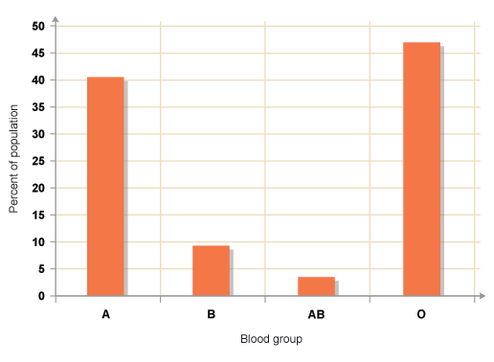
Variation due to genetic factors
When variation is a result of genetic factors, discontinuous variation is often seen.
Characteristics fit into distinct groups
There are no intermediates
Usually controlled by one gene with two or more alleles.
Environmental factors have little influence.

Slide 14
Twin studies
If organisms of identical genotype are subject to different environmental influences, they show considerable variety.
Identical twins separated at birth can be studied to see the effect of the environment in which they have been raised.
Nature or nurture?

Slide 15
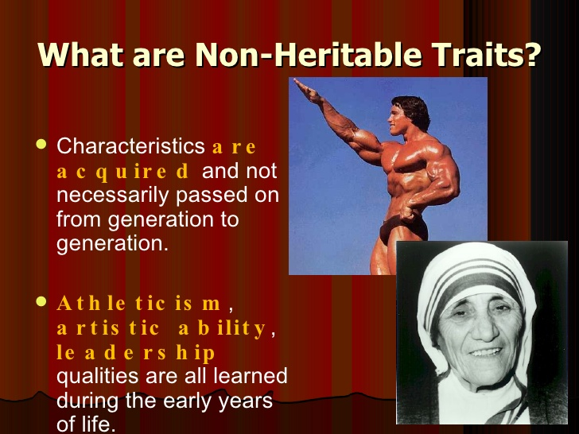
Environmental variation
Affects the way the organism’s genes are expressed. Genes set the limits but the environment determines where an organism lies in those limits
Environmental issues include?
Climate
pH
Food availability

Slide 16
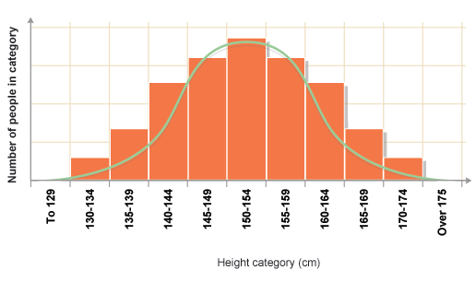
Variation due to environmental influences
Range of phenotypes seen.
Controlled by many genes (polygenic).
Influenced by environmental factors (An individual inherits the alleles for tallness but whether or not maximum height reached will depend on nutrition during growth period).
Follows a ‘normal’ distribution - a gradation from one extreme to another.

Slide 17
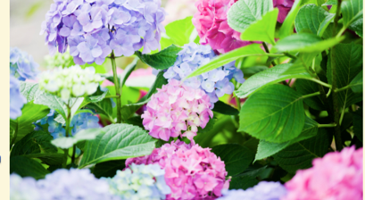
Environment and plants
Higher pH soil (6.0-6.2) = Pink hydrangeas.
Low pH soil (5.2-5.5) = Blue flowers.

Slide 18
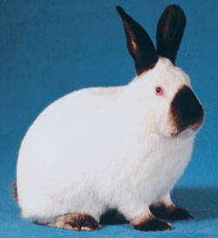
Environmental variation
Fur colour in the Himalayan rabbit is affected by temperature
  Most of the fur is white except ears, feet and tail
  Black colour only develops in temperatures below 25˚C
  If patch of white fur shaved and cold pad applied the hair will grow back black

Slide 19
Evolutionary significance of variation
Variations due to the effect of the environment have little evolutionary significance as they are not passed from one generation to the next.
Much more important to evolution is inherited variation that results from genetic changes.
Although these processes may establish a new combination of alleles in one generation it is mutations that generate long-lasting variation of a novel kind.
However the occurrence of a useful mutation is a very rare event.

Slide 20
Natural selection
Every organism is subject to a process of selection based on its suitability for survival under the conditions that exist at the time. The environmental factors that limit the population of a species are called selection pressures.
Include predation, disease and competition.
These selection pressures determine the frequency of all the alleles within the gene pool.

Slide 21
Evolution by Natural selection
Depends upon:
Organisms produce more offspring than can be supported by available supply of food, light, space etc
There is genetic variability within population of all species
A variety of phenotypes that selection operates against.

Slide 22
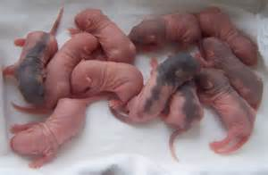
Role of over-production of offspring
Theoretically organisms can increase numbers exponentially.
High reproductive rates ensure species are sufficiently large to survive to breed
High reproductive rate usually in high death rate species
Lower reproductive rates coincide with higher degree of parental care to maintain numbers in populations

Slide 23
Why is overproduction helpful?
Where there are too many/too little offspring for resources there is intraspecific/interspecific competition.
The more/less offspring, the greater/less competition, the fewer/more offspring die.
But the deaths are/are not random.
The individuals more/less suited to the environment survive, are more/less likely to breed and so pass on more/less favourable allele combinations to the previous/next generation.
The next generation will therefore have the same/a different allele frequency from the previous.
The population will have a better/worse combination of alleles for the conditions, this is natural selection.

Slide 24
Selection pressures
These are environmental forces that alter the frequency of alleles in a population.
They increase the chances of some alleles being passed on to the next generation and decrease the chances of others being inherited.
The effect of selection pressures on the frequency of alleles in a population is called natural selection which drives evolution.
https://www.hhmi.org/biointeractive/natural-selection-lactose-tolerance demonstrates how supply of food can affect natural selection and hence evolution (I minute)

Slide 25
Selection Pressures
Selective Agents:
Predation
Competition
Disease
Supply of food
Nesting sites
Human influence

Slide 26
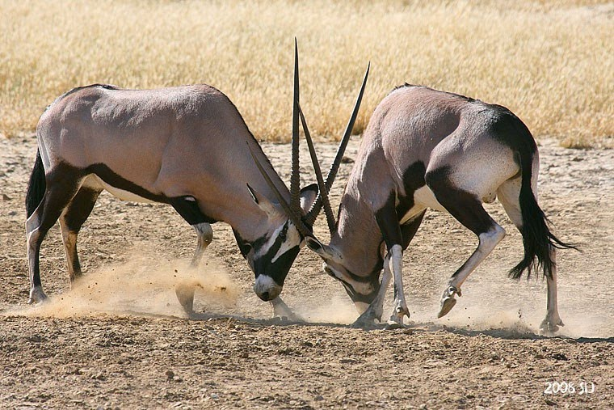
Competition
Intraspecific competition is where members of the same species vie for the same resource in an ecosystem (e.g. food, light, nutrients, space, mates).
https://www.youtube.com/watch?v=EDDBBRRq67M Dawson’s bees show competition for mates

Slide 27
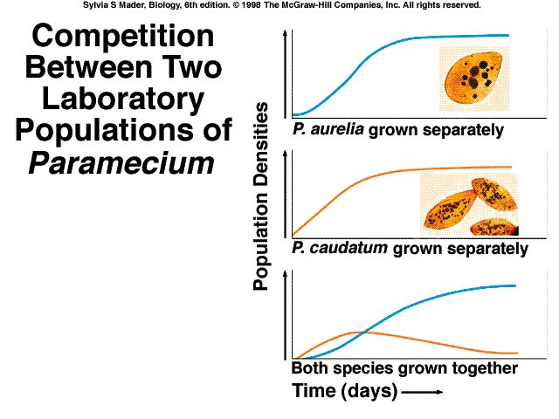
Interspecific competition
Interspecific competition is where individuals of different species vie for the same resource in an ecosystem.
Where food, space, NOT mates, are limited
Predator – prey relationships
http://www.bbc.co.uk/nature/adaptations/Antipredator_adaptation#p00c6ht4
Aerial attack from the life of birds shows different species competing for food/protecting their young. Can impact on the survival of the species.

Slide 28
Rock Pocket Mice
The effect of selection pressures (volcanic larval flow changes the desert landscape) on coat colour of pocket mice living in Mexico.
Google: Natural Selection and the rock pocket mouse – you tube, watch the video and answer the questions in the question booklet.
https://www.youtube.com/watch?v=sjeSEngKGrg

Slide 29
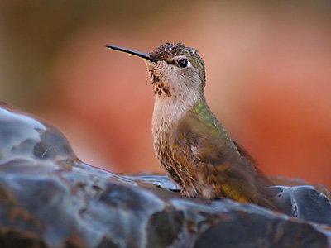
Darwin’s theory of Natural Selection
Observations
In any population there is variation. Genetic variation
Individuals within a population have the potential to produce large numbers of offspring yet the number of adults tends to stay the same from one generation to the next. Overproduction of offspring
From these observations, two deductions were made:
Struggle for existence with the fittest surviving (Competition causing a high mortality rate)
Individuals that survive and reproduce pass on favourable characteristics (A selective advantage)
Natural selection drives the development of new species
https://www.youtube.com/watch?v=uz7U4k522Pglopment of new species

Slide 30
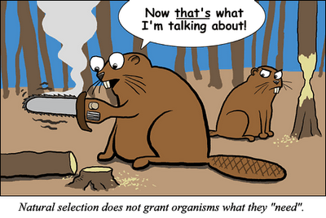

Slide 31
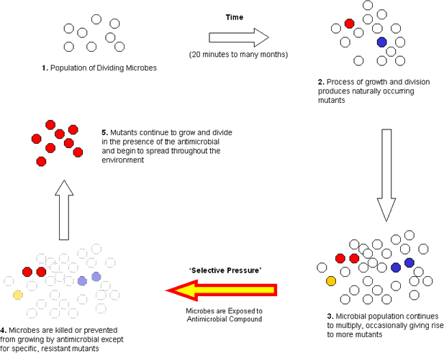
Human influence: Antibiotic selection pressure/selective agent
http://evolution.berkeley.edu/evolibrary/news/100901_bedbugs and pesticides (11 mins)

Slide 32
Breeding Bunnies Activity

