Slide 1
Specification 3.7.3 Selection and Speciatoin
The effects of stabilising, directional and disruptive selection.
Evolution as a change in the allele frequencies in a population.
Reproductive separation of two populations can result in the accumulation of difference in their gene pools. New species arise when these genetic differences lead to an inability of members of the populations to interbreed and produce fertile offspring. In this way, new species arise from existing species.
Allopatric and sympatric speciation. The importance of genetic drift in causing changes in allele frequency in small populations.
Students should be able to:
• explain why individuals within a population of a species may show a wide range of variation in phenotype
• explain why genetic drift is important only in small populations
• explain how natural selection and isolation may result in change in the allele and phenotype frequency and lead to the formation of a new species
• explain how evolutionary change over a long period of time has resulted in a great diversity of species.

Slide 2
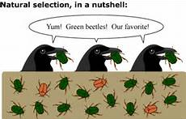
Selection and Evolution
LO: to appreciate what happens when HWP does not apply

Slide 3
Effects of different forms of selection
Objectives:
To describe stabilising, directional and disruptive selection.
To explain the effects of each of these forms of selection on evolution.
Starter
What happens in natural selection?
(5 marks)
Notes:
Practical/Demo ideas
Pluck– tie in gas exchange with this unit. Also slices of arteries and veins can be taken off the heart of the pluck to be used in the following lessons practical on elasticity of veins and arteries. (Not sure how much of the arteries and veins will be left on the hearts that the students are dissecting)
Looking at prepared slides of arteries, veins and capillaries under the microscope

Slide 4
So what is selection?
Process by which organisms that are better adapted to their environment survive and breed (whilst other don’t!)
When certain individuals are reproductively more successful and they pass on their alleles
This means that not all alleles are as likely to be passed on to next generation

Slide 5
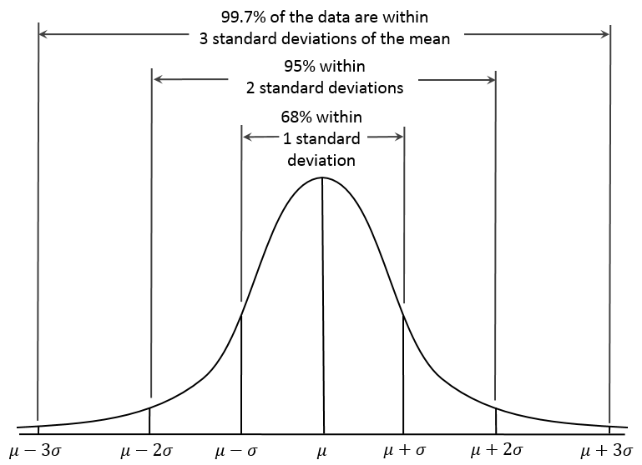
Recap – Variation: normal distribution
Number of individuals
Think, pair, share
What does this show?
A trait on a continuum eg height

Slide 6
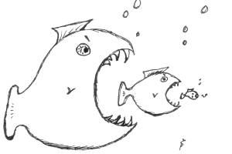
Extend understanding - What we need to look at?
What happens to the curve if natural selection occurs.

Slide 7
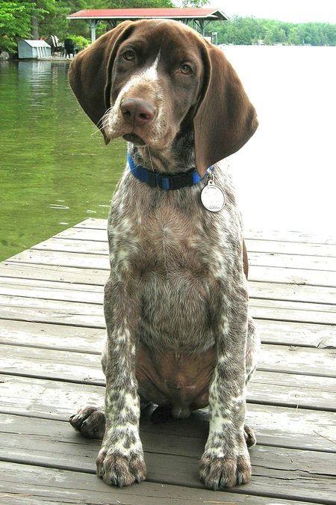
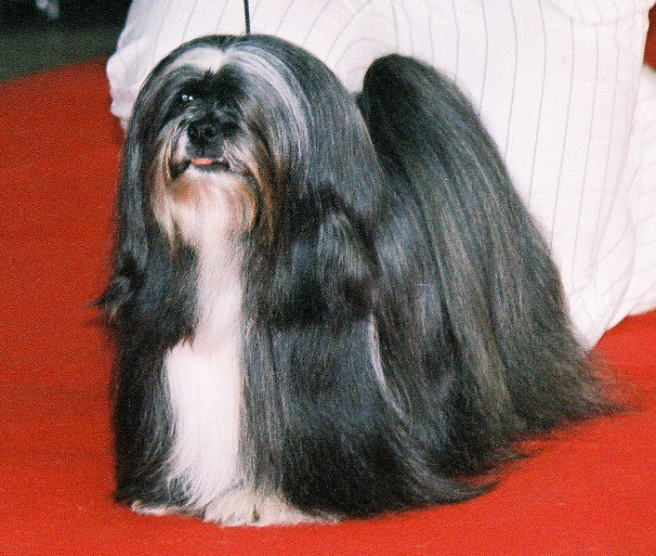
Check - Stabilising selection
When environmental conditions remain stable, this favours average individuals closest to the mean and preserves a characteristic of a population. This eliminates extreme phenotypes
Normal distribution curve becomes higher and has a narrower spread –
Who wins?!?

Slide 8
Check - Directional selection
Environmental change that favours individuals that vary in one direction from the mean. (an extreme phenotype, eliminating opposite extreme)
Effect – normal distribution curve stays same height but moves either left or right
Who wins?!?

Slide 9
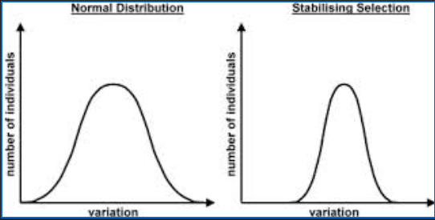
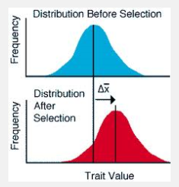
Types of Natural Selection
Stabilising Selection
Stable environment so extreme phenotypes eliminated
Directional Selection
Environment changes so extreme phenotype favoured
Caribou question in booklet

Slide 10
Disruptive Selection
This is opposite to stabilising selection
It favours extreme phenotypes at the expense of intermediates
Least common but most important for evolution
Occurs when env factor takes two or more distinct forms

Slide 11
Example 1 - temperature
If there was a wide range of temperatures throughout the year – continuous variation in fur length (graph A)
If summer temperatures is static (15oC) and winter (5oC) individuals with 2 distinct fur lengths predominate either active in the summer or winter. (graph B)
After many generations 2 distinct sub-populations are formed (graph C)

Slide 12
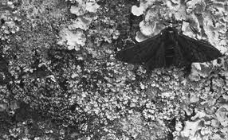
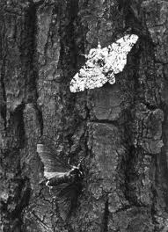
Industrial melanism in the peppered moth
Dark form due to a single gene mutation resulting in the production of more melanin
The moth flies at night and rests on the bark of trees during the day.
Before the industrial revolution there were many light and very few dark moths.
1950s onwards dark moths became prevalent in areas with heavy pollution.
Why?
Peppered moth simulation

Slide 13
Example 2 – Coho salmon
Large and small males both an advantage to pass on alleles to next generation
Small – sneak up on females in spawning ground
Large – fierce competitors

Slide 14
What type of natural selection took place in the populations of both species after they had colonised island 3? Explain your answer.

