Slide 1
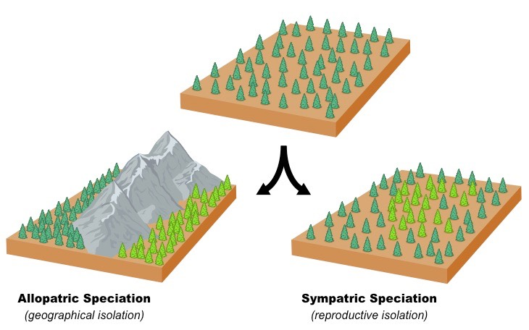
Isolation and Speciation
LO: to appreciate how new species arise

Slide 2
Speciation
Objectives:
To explain how selection affects allelic frequencies
To explain how populations become geographically isolated
To describe allopatric and sympatric speciation
Starter:
Watch the video (5 minutes) and fill in the booklet page on the 5 factors that change allele frequency.
https://www.youtube.com/watch?v=5NdMnlt2keE
Notes:
Practical/Demo ideas
Pluck– tie in gas exchange with this unit. Also slices of arteries and veins can be taken off the heart of the pluck to be used in the following lessons practical on elasticity of veins and arteries. (Not sure how much of the arteries and veins will be left on the hearts that the students are dissecting)
Looking at prepared slides of arteries, veins and capillaries under the microscope

Slide 3
The thing about populations…
All organisms produce more offspring than can be supported by the resources. But because of competition, most populations remain a relatively constant size.
This means that the alleles frequencies within the populations must change. (according to changing environments)

Slide 4
What does advantageous mean?
That an alleles has an advantage at any one time – according to its environmental conditions – this can change…

Slide 5
Allele frequency
Allelic frequency is affected by selection.
Selection is caused by environmental change and so…
Environmental change affects the probability of an allele being passed on and therefore the number of times it occurs in a gene pool

Slide 6
Speciation
Speciation is the evolutionary process leading to the formation of a new species.
Populations first need to be reproductively separated from each other so that gene pools can diverge and breeding sub units form (demes)
The isolated populations develop different characteristics & eventually will no longer be able to breed with each other and not reproductively isolated from each other

Slide 7
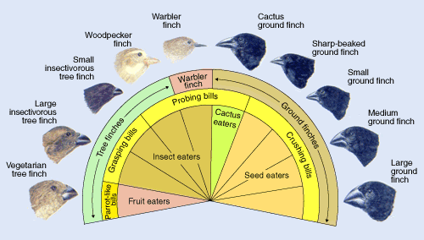
Adaptive radiation
When populations becoming adapted to their local environments due to the selection pressures on the different phenotypes created by different combinations of the same alleles.
Adaptive Radiation in Darwin’s finches
All from a common ancestor - http://www.bbc.co.uk/learningzone/clips/darwins-finches/13929.html

Slide 8
Genetic drift
Genetic drift – variation in the relative frequency of different genotypes
Seen in a small population when random factors impact the frequency of alleles (gene pool) in subsequent generations.
https://www.youtube.com/watch?v=VTC3SpXWd-E

Slide 9
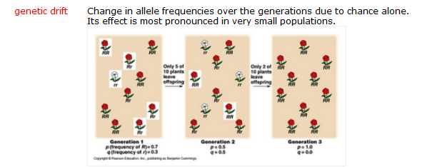
Genetic drift and how it may lead to speciation
http://www.bozemanscience.com/003-genetic-drift/
Good intro

Slide 10
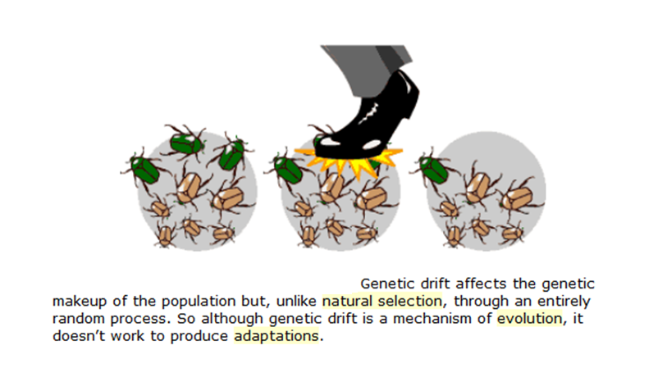

Slide 11
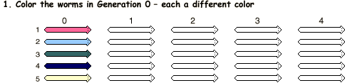
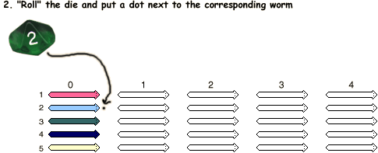

Slide 12
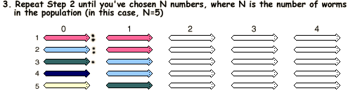
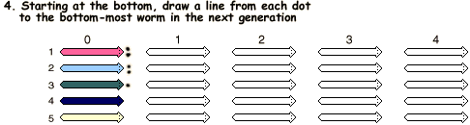

Slide 13
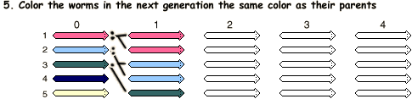

Slide 14
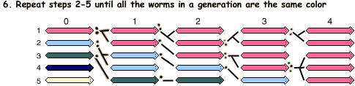
Then answer the questions in your booklet

Slide 15
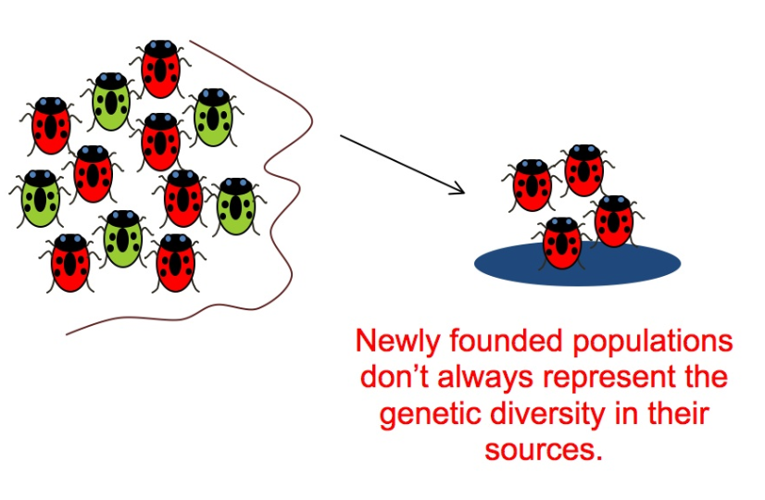
The founder effect (Extension not on specification) http://www.youtube.com/watch?v=Q6JEA2olNts
An important example of genetic drift is when a few individuals become isolated from the rest of the species and start a new population, for example, when a few individuals colonise an isolated island or some new habitat.

Slide 16
Founder effect and genetic drift
Founder members of the new population are a small sample of the population from which they originated. By chance they may have a very different gene frequency.
While the founder population remains small it may undergo genetic drift and become even more different from the large parental population. This process is called the founder effect. The effect undoubtedly contributed to the evolutionary divergence of Darwin’s finches after strays from the South American mainland reached the remote Galapagos Islands.

Slide 17
Founder effect and genetic drift
Disasters such as earthquakes, floods, and fires may reduce the size of a population drastically. The result is that the genetic makeup of the surviving population is unlikely to be representative of the makeup of the original population.
By chance certain alleles will be over represented among survivors, other alleles will be underrepresented, and some alleles will be eliminated completely.
Because alleles for at least some loci are likely to be lost from the gene pool, the overall genetic variability in the population is usually reduced.

Slide 18
How does a new species arise?
Evolution is the mechanism by which speciation occurs and involves changes to the genotype & phenotype.
These changes enable the organism to better exploit the environment.
The concept of evolution is that species existing today have arisen from pre-existing ones
The tree of life showing evolution and common ancestry.

Slide 19
Stages in Speciation
There are 6 stages
Stage 1
A large interbreeding population of one species exists- sharing the same gene pool.

Slide 20
Stages in Speciation
Stage 2
A barrier (isolating mechanism) separates the population into 2 seperate breeding groups.

Slide 21
Stages in Speciation
Stage 3
Random mutations in each sub-population give rise to new variation within each group (but not shared by both groups)

Slide 22
Stages in Speciation
Stage 4
Different selection pressures act on each sub-population depending on local conditions like:
  Climate
  Predators
  Disease.
  Natural selection affects each sub-group in a different way, by favouring the alleles that allow the individuals to better exploit their environment.

Slide 23
Stages in Speciation
Stage 5
Over a very very long time……
Stages 3 & 4 cause the two gene pools to become so altered that the groups become genetically distinct & reproductively isolated.

Slide 24
Stages in Speciation
Stage 6
If the original barrier is removed, the two sub-populations are no longer able to interbreed (since their chromosomes are no longer able to form homologous pairs).
There are now 2 separate distinct species.
Speciation has occurred.

Slide 25
Speciation
Different isolating mechanisms lead to 2 types of speciation;
Allopatric speciation.
2. Sympatric speciation
Watch Crash course Speciation and Bozeman Speciation for consolidation
http://www.youtube.com/watch?v=2oKlKmrbLoU
https://www.youtube.com/watch?v=rlfNvoyijmo

Slide 26
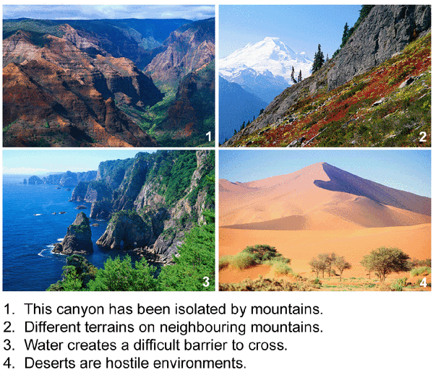
Allopatric Speciation
This canyon is isolated by mountains
Different terrains on neighbouring mountains
Water creates a difficult barrier to cross
Deserts are hostile environments
Geographical barrier leads to allopatric speciation

Slide 27

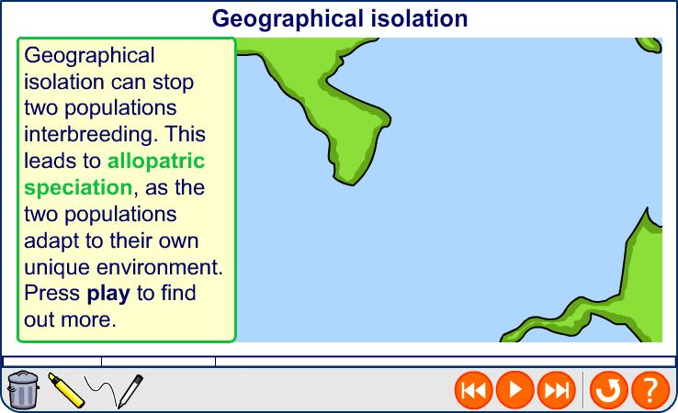

Allopatric speciation

Slide 28
Geographical Isolation

Slide 29
Geographical barrier

Slide 32
Sympatric Speciation
Other isolating mechanisms result within a population in the same area that leads them to become reproductively separated which over time leads to speciation.
Grebe courtship (David Attenborough)

Slide 33
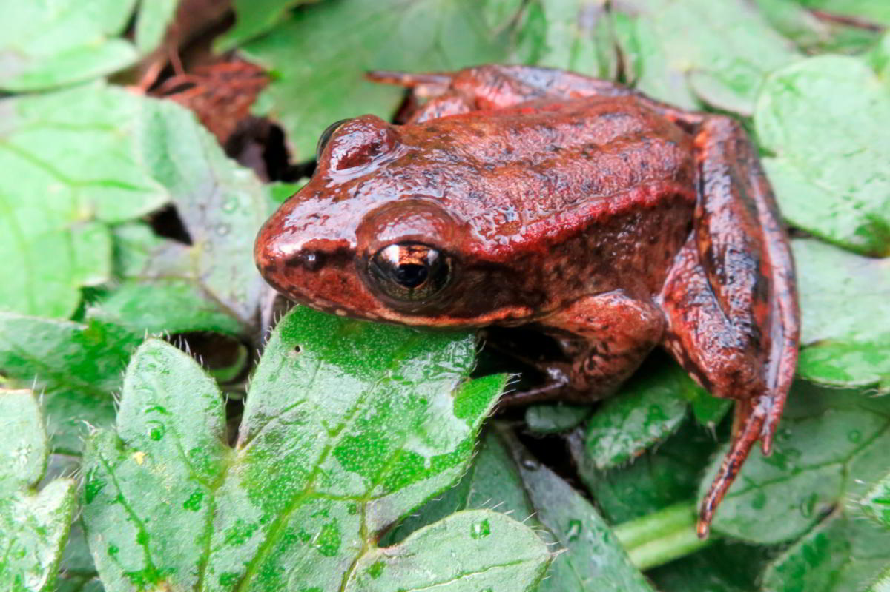
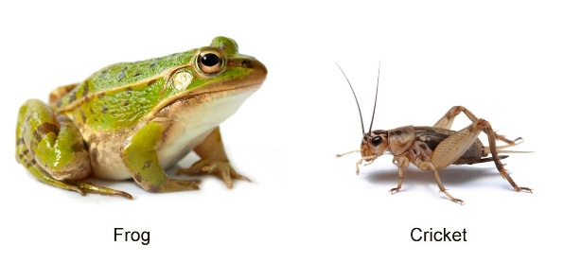
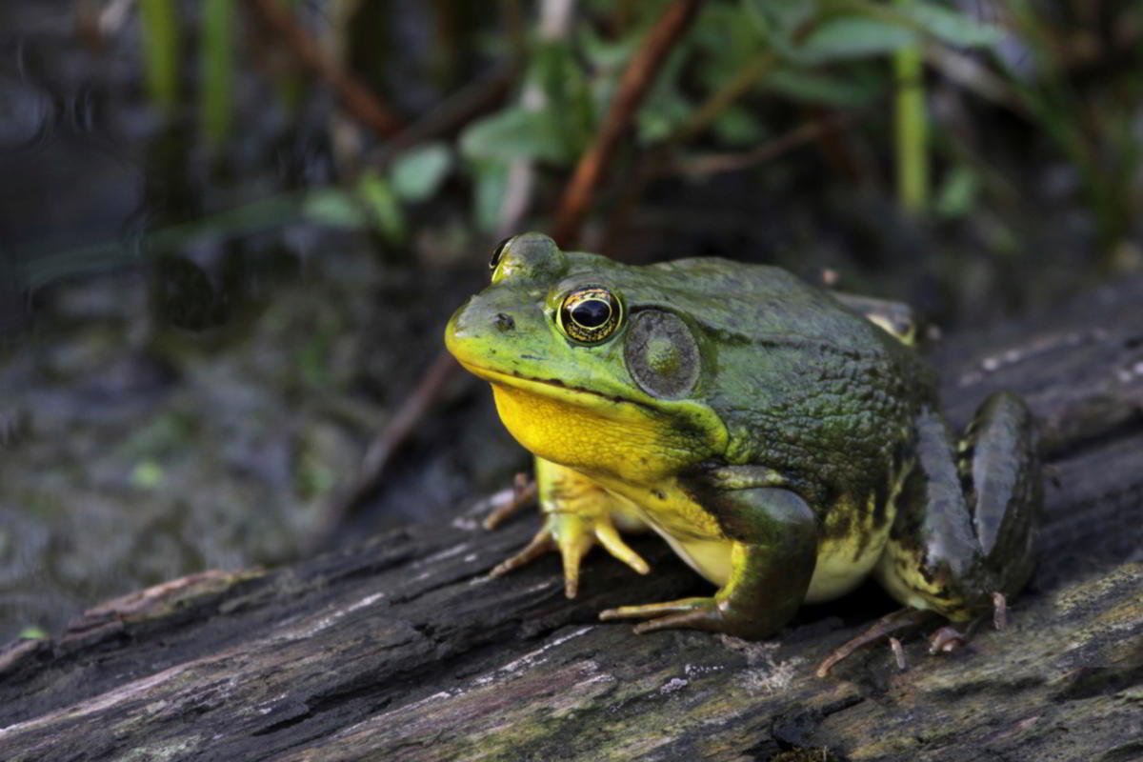
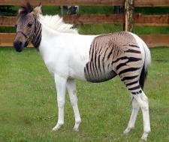
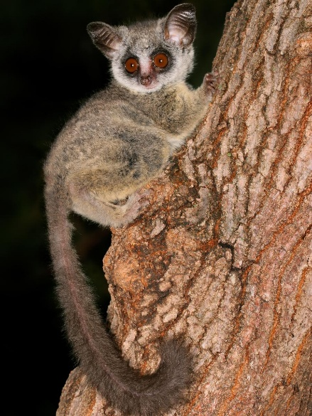
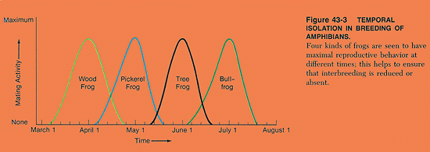
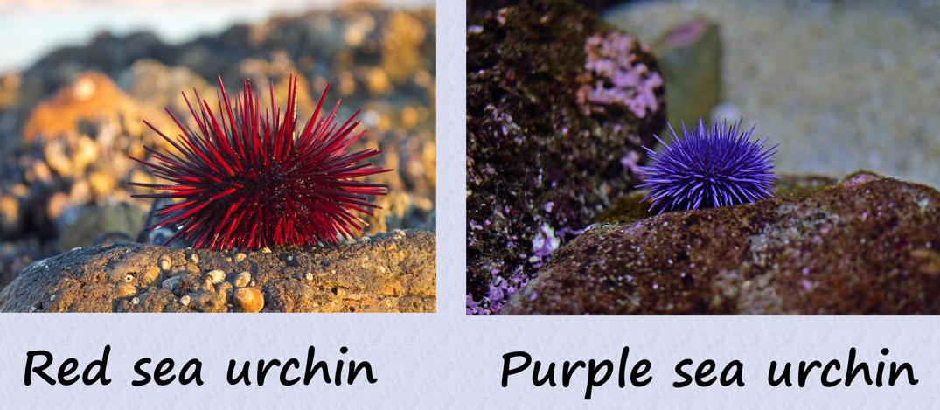
American bullfrog breeds in permanent ponds Red legged frog breeds in streams
Sympatric
isolating
mechanisms
Ecological
Behavioural
Fogs and crickets have distinct vocalisations
Mechanical
Horse 2n=64 and a donkey 2n=62 produces a hydrid with 63 chromosomes = vsn’t form viable gametes
Hybrid
sterility
Temporal
Gametic
Gametes of these 2 urchin species are genetically incompatible
20 species of bushbaby – each with distinctly shaped genetalia
Fill in the table with the isolating mechanism that best fits the description

Slide 34
Reproductive isolation
Type of barrier | How it leads to isolation
Ecological | Populations inhabit different habitats within the same area and so individuals rarely meet. Includes differences in abiotic factors such as temperature, humidity,pH, salinity, altitude
Temporal | Breeding seasons of each population do not coincide and so they no not interbreed
Behavioural | Differences in courtship behaviour (such as markings on the opposite sex, mating calls, actions by a mate) cause individuals to not respond. Mutations may cause the variations that prevent mating.
Mechanical | Anatomical differences may prevent reproduction occurring
Gametic | Gametes may be prevented from meeting due to genetic or biochemical incompatibility. Some pollen grains fail to germinate or grow when they land on a stigma of different genetic make-up. Some sperm are destroyed by chemicals in the female reproductive tract
Hybrid sterility | Hybrids formed from the fusion of gametes from different species are often sterile because they cannot produce viable gametes

Slide 35

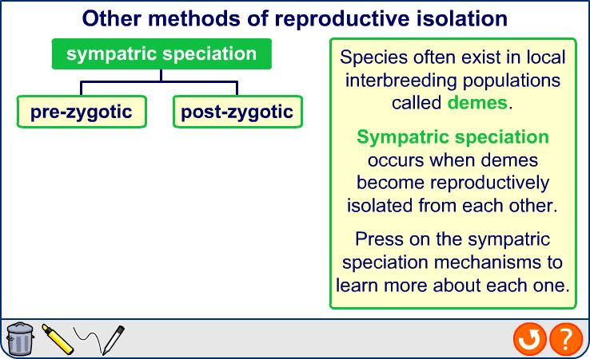
Sympatric speciation
Notes:
Teacher notes
See the Boardworks AS Biology ‘Classification’ presentation for more information about how to define a species.
A liger is specifically a cross between a male lion and female tiger; a cross between a female lion and a male tiger is called a tigon. More information on ligers is available at http://www.liger.org/
Photo credit: Tom Nord
Patrick, a male liger

Slide 36
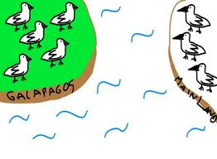
Isolation and speciation - animation
Bozeman reproductive isolation and speciation

Slide 37
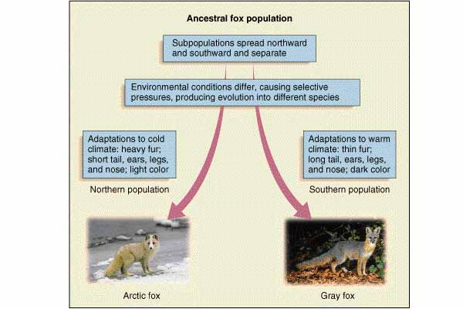

Slide 38
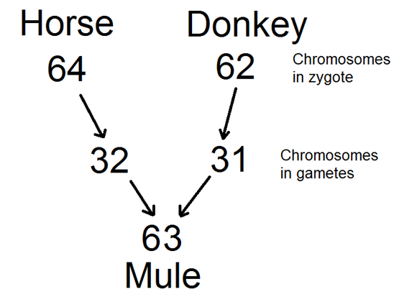
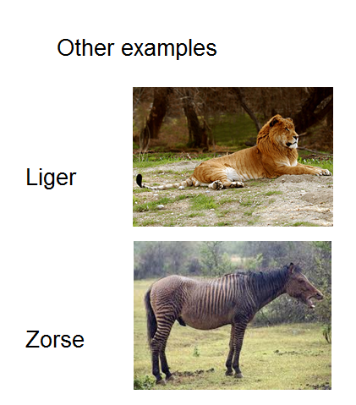
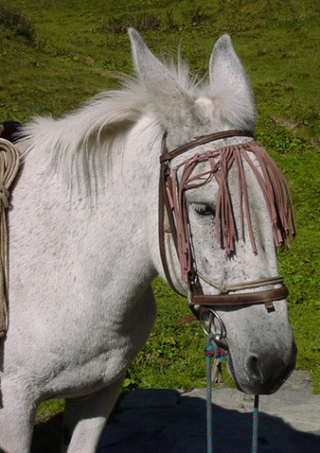
Hybrid Sterility

Slide 39
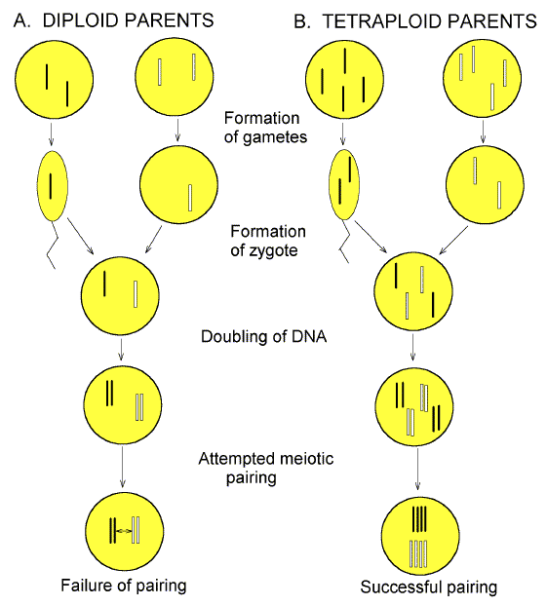
Explanation of hybrid sterility – failure to undergo synapsis and form bivalents
When two species try to breed, there will be two sets of different homologous chromosomes.
When the gamete nuclei fuse the homologues will not have partners and so pairing at prophase 1 will not take place.

