Slide 1
3.3.3 Digestion

Slide 2
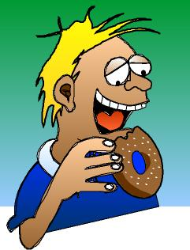
Human Nutrition
Gut specialised for:
Ingestion – solid food taken in through mouth
Digestion – mechanical & chemical breakdown of large insoluble to small soluble molecules
Absorption – soluble molecules taken into bloodstream
Egestion – elimination of undigested material from the body
Text

Slide 3
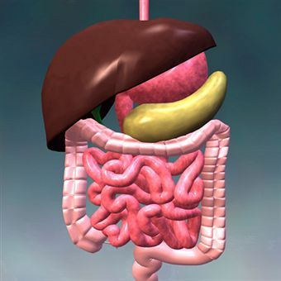
Human Gut
A tube around 9-10 metres long
Begins in the mouth and ends in the anus with associated organs and glands
Site of ingestion, digestion and absorption
3

Slide 4
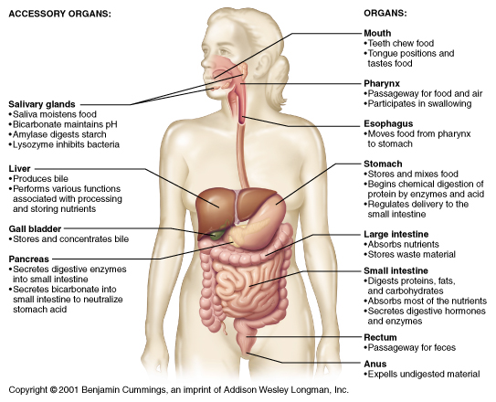
Overview of Digestive System Functions
Figure 14.1
Slide 14.1
Copyright © 2001 Benjamin Cummings, an imprint of Addison Wesley Longman, Inc.

Slide 5
The major organs
Mouth
Oesophagus
Stomach
Small intestine (Duodenum and ileum)
Pancreas
Liver

Slide 6
Digestion
Digestion takes place in two stages:-
1. Physical breakdown
2. Chemical digestion

Slide 7
Physical Digestion
The physical breaking up of large pieces of food into smaller pieces
Starts in the mouth with the slicing and chewing action of the teeth
Increases the surface area for enzyme action (chemical digestion)
Continues in the stomach by the churning action caused by the contraction of muscles in the stomach wall
This increases the surface area for enzymes to act (chemical digestion)
7

Slide 8
Chemical Digestion
The chemical breakdown of food molecules into smaller, soluble molecules by enzymes
Occurs in a number of stages
All digestive enzymes are hydrolases -they break chemical bonds by the addition of water
8

Slide 9
Three Main groups of Enzymes
Carbohydrases (including amylase and maltase and lactase and sucrase) which hydrolyse carbohydrates (starch) eventually to monosaccharides
Proteases (peptidases) which are subdivided into Endopeptidases (Pepsin and Trypsin) and Exopeptidases (dipeptidase). They hydrolyse proteins eventually to amino acids
Lipases which hydrolyse lipids to fatty acids and glycerol

Slide 10
Digestion of carbohydrates
• amylase in saliva from salivary glands in mouth
• amylase in pancreatic juice acts in the duodenum
• maltase secreted by cells at the tips of the villi in the ileum complete digestion
• sucrase hydrolyses sucrose into glucose and fructose
• lactase hydrolyses lactose into glucose and galactose

Slide 11
Digestion of proteins
Proteins are hydrolysed to amino acids, which can be absorbed in the ileum of the small intestine.
Different types of proteases are involved in the hydrolysis of proteins, including endopeptidases, exopeptidases and membrane-bound dipeptidases.
Proteins are hydrolysed in the stomach. Since proteins form the major organic component of cells, early digestion of proteins ensures other organic molecules are accessible to digestive enzymes in the small intestine.
Protein digestion begins with endopeptidases. The action of endopeptidases increases the number of ‘ends’ that can be hydrolysed by exopeptidases. This speeds the rate of protein digestion.
Absorption of amino acids involves co-transport with sodium ions.

Slide 12
Digestion of proteins
Proteins are large complex molecules that are hydrolysed by a group of enzymes called peptidases.
Endopeptidases hydrolyse peptide bonds along the length of the protein to provide more ‘free ends’ for exopeptidases to act on (Trypsin and Pepsin).
Exopeptidases hydrolyse the peptide bonds on the terminal amino acids (secreted from pancreas)
Dipeptidase will finally hydrolyse the bond between the two amino acids of a dipeptides into amino acids. They are membrane bound and found on cell surface membrane of epithelial cells lining the ileum

Slide 13
Protein digestion
Like all digestion, this involves hydrolysis
Three types of enzyme involved
Endopeptidases: hydrolyse peptide bonds between specific amino acids in the middle of a polypeptide
Exopeptidases: hydrolyse peptide bonds between specific amino acids at the ends of a polypeptide
Dipeptidases: hydrolyse the peptide bond in a dipeptide
Version 1.0

Slide 14
Exopeptidases and endopeptidases
Exopeptidase breaks bonds at ends of polypeptide to produce dipeptides or individual amino acids
Endopeptidase breaks bonds in middle of polypeptide to produce shorter polypeptides

Slide 15
Pause for thought
The first stage of protein digestion occurs in the stomach.
An endopeptidase (pepsin) is the only protein-digesting enzyme in the stomach.
Only later, in the small intestine, is the food mixed with exopeptidases.
Suggest the advantage of this sequence.

Slide 16
Dipeptidases
Dipeptidases are located in the surface membranes of cells lining the small intestine
They hydrolyse dipeptides into amino acids
As a result, the final products of protein digestion are amino acids, which are absorbed by cells lining the ileum of the small intestine

Slide 17
Summary of protein digestion

Slide 18
Digestion of lipids
•Bile (not an enzyme) emulsifies large fat droplets to small droplets called micelles
•To increase surface area for pancreatic lipase action
Secreted into small intestine
Lipase is found in the pancreas juices (pancreatic Lipase)
•The lipid is hydrolysed into 3 fatty acids and glycerol or two fatty acids and a monoglyceride.

Slide 19
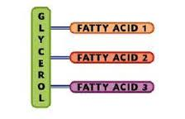
Monoglyceride and Triglyceride
Triglyceride

Slide 20
Absorption occurs in the ileum

Slide 21
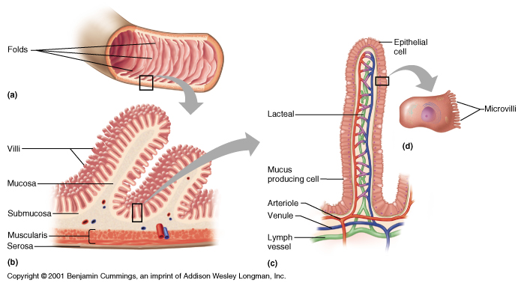
Small Intestine - Ileum
Enzymes (maltase, lipase and peptidases) are secreted by cells at the tips of villi to complete digestion
Copyright © 2001 Benjamin Cummings, an imprint of Addison Wesley Longman, Inc.
Figure 14.9
Slide 14.10A

Slide 22
Adaptations for absorption
Villi increase surface area for diffusion
Thin walled reducing the diffusion path
Muscle contraction maintains a diffusion gradient
Blood vessels carry away absorbed material maintaining a diffusion gradient
Epithelial cells lining the villi possess microvilli increases surface area for absorption

Slide 23
Amino acid and glucose absorption
Uptake from the ileum is by facilitated diffusion through specific carrier molecules in the surface membranes of epithelial cells
With each amino acid/ glucose, one Na⁺ ion is also taken up, an example of co-transport
A diffusion gradient for Na⁺ is maintained by their active transport through the base of the epithelial cells
Amino acids pass through the base of the epithelial cells by facilitated diffusion

Slide 24
Absorption of Amino acids and Glucose-Co -Transport
Sodium ions transported out of epithelial cell via the sodium potassium pump (requires ATP)
Maintains low concentration of sodium ions inside the epithelial cell compared to the lumen
Sodium ions diffuse down a concentration gradient from the lumen into the epithelial cell by facilitated diffusion grabbing a glucose/amino acid molecule with it (against a concentration gradient)-Co Transport
Glucose/amino acids pass into the blood via facilitated diffusion.

Slide 25
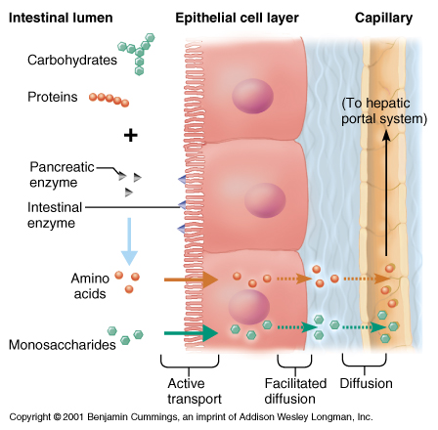
Absorption of Proteins and Carbohydrates
Hepatic portal vein carries glucose to
to liver.
Glucose is absorbed from the blood by cells for respiration and any excess is converted to fat for storage
Figure 14.13
Slide 14.14A

Slide 26
Absorption of trigycerides
Triglycerides once digested to monoglycerides and fatty acids by pancreatic lipase remain in association with the bile salts. The structures formed are called micelles
Once the micelle comes into contact with the epithelial cell lining the ileum they break down and release the non-polar monoglycerides and fatty acids which diffuse across the cell-surface membrane into the epithelial cells.
They are then transported to the endoplasmic reticulum where they are recombined to form triglycerides. In the endoplasmic reticulum and Golgi apparatus the triglycerides associate with cholesterol and lipoproteins which become surrounded by a protein coat to form structures called chylomicrons.
The chylomicrons are water soluble lipoproteins and are too big to pass into blood capillaries but can enter the large pores of the lacteals. Thus the chylomicrons move out of epithelial cell by exocytosis and enter the lymphatic capillaries called lacteals.
They are then transported in the lymphatic vessels which eventually empty through the thoracic duct and into circulatory system.

Slide 27
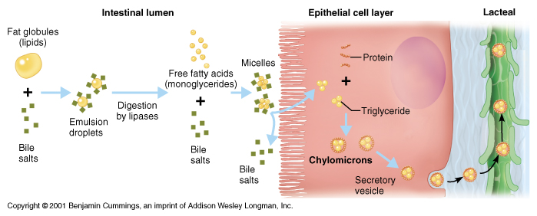
Absorption of Fats
from lacteal through lymphatic system to the blood stream
Figure 14.14
Slide 14.14B

Slide 28
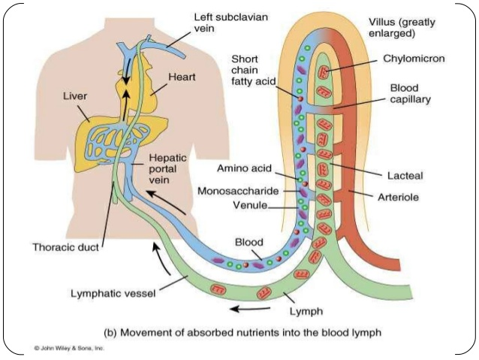
Transport of lipids into the lymphatic system
lymphatic system (in green). Lipids are transported into the lacteals found at the centre of the villi in the ileum. They enter the blood stream via the thoracic duct

Slide 29
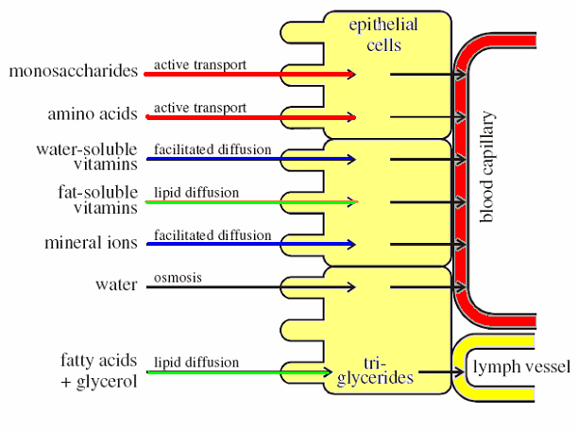
Overview of absorption in the ileum
diffusion and
diffusion and
most water is reabsorbed together with soluble nutrients

