Slide 1
Gas Exchange
Definition: the process by which oxygen reaches cells and carbon dioxide is removed from cells (not respiration)
For respiration in animals
For respiration and photosynthesis in plants
By diffusion
Or ROD = SAD
-------
TOES

Slide 2
Size
As organisms get bigger, their volume and surface area get bigger, but not by the same amount
As organisms get bigger their SA : Volume ratio gets smaller

Slide 3
Why do large, multicellular organisms need specialised gas exchange surfaces?
Surface area to volume ratio too small
Larger organisms have higher metabolic requirements (require more energy and hence more oxygen)
Simple diffusion is simply not fast enough to meet the needs of each and every cell from the outside through to the inside (diffusion path too long)

Slide 4
Features of all Gas exchange surfaces
Large SA to volume ratio
Thin to allow short diffusion path
Permeable to gases
Moist (because membranes that are permeable to water are permeable to gases – waterproof surfaces are not permeable to gases)
Also across all membranes there must be a concentration gradient of gases so that diffusion can take place (not a feature of the surface itself)

Slide 5
Moisture
Aquatic organisms obtain their oxygen from that dissolved in water, not from water molecules (some produced by aquatic plants and some from the external atmosphere). Note Moving water is better oxygenated, warmer water contains less dissolved oxygen.
Terrestrial organisms have to balance their needs for rapid gas exchange with the prevention of water loss. All gas exchange surfaces are moist.
Moisture suggests permeability to gases however gases diffuse faster in air (1000x)

Slide 6
Features of Larger, multicellular organisms
Ventilation system to bring respiratory medium in contact with respiratory surface
Internal transport system to maintain conc. grad
Respiratory pigment to transport gases efficiently

Slide 7
Ventilation systems
Gases move from a high pressure to a low pressure
Ventilation describes how the gas exchange medium is brought into contact with the gas exchange surface
Ventilation systems are designed to increase the volume and decrease the pressure allowing the gas exchange medium to move in
Or to decrease the volume and increase the pressure allowing the gas exchange medium to flow out.

Slide 8
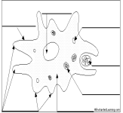
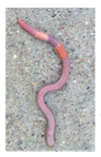
Organism | Gas Exchange Surface | Diffusion Pathway | Concentration gradient | Special Features
 | Permeable Cell surface membrane | Short and cell size does not exceed 100 micro meters | Oxygen diffuses down a conc. grad as oxygen is used up in aerobic respiration. Opp with carbon dioxide | None - SA: Vol Ratio high, simple diffusion adequate.
 | Permeable skin surface | Short distance through skin to blood system | Primitive circulatory system to maintain conc. grad for diffusion | Elongated body to improve SA:Vol ratio for diffusion. Mucus secreted Sedentary life style means requirements for oxygen are modest. Haemoglobin

Slide 9
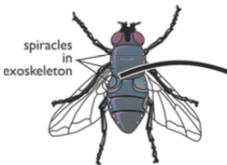
Organism | Gas Exchange Surface | Diffusion Pathway | How is Concentration gradient maintained? | Special Features
Insects | Fluid filled tracheoles that penetrate deep into the tissues. Walls are freely permeable to gases | Short -oxygen diffuses directly to cells (insect small), thin tracheole walls. When active the water at the end of the tracheoles moves into the muscle cells reducing the diffusion pathway and increasing SA. | Use of oxygen by cells keeps conc. Low in cells. Larger insects Ventilation: using rhythmical body movements that result from contraction and relaxation of muscles in thorax and abdomen. | Highly branched internal system of tubes (tracheae) – large SA Rings of Chitin to keep larger tubes open No transport system, No Hb Spiracles in hard, impermeable exoskeleton allow gases to enter and leave and can be open/closed. Hairs.

Slide 10
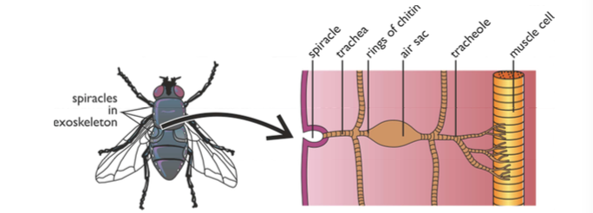
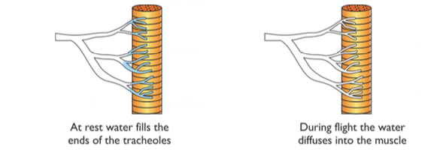
Can you draw?

Slide 11
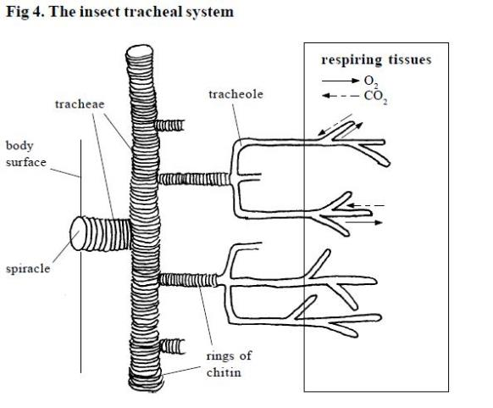
The tracheoles extend throughout all of the body tissues. Atmospheric air is brought directly to respiring tissues as there is a short diffusion pathway from a tracheole to any body cell.
When cells are respiring the oxygen is used up and so its concentration towards the end of the tracheoles falls.
This creates a diffusion gradient.

Slide 12
Carbon dioxide is produced through respiration and this creates a diffusion gradient in the opposite direction.
As diffusion in air is more rapid than in water, gases are exchanged quickly by this method.

Slide 13
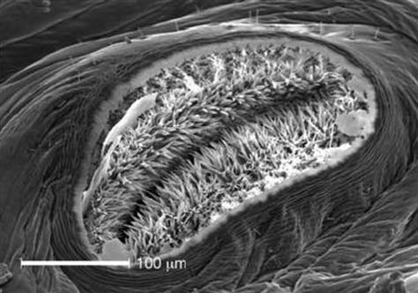
The spiracles can be closed by valves and may be surrounded by tiny hairs
These help keep humidity around the opening to ensure there is a lower concentration gradient of water vapour, and so less is lost from the insect by evaporation

Slide 14
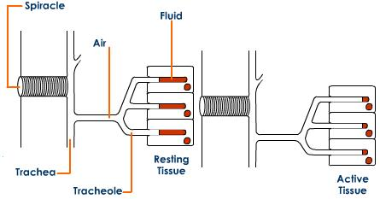
mechanism of gas exchange
As anaerobic respiration in the muscle cell occurs, lactate accumulates and forces the fluid in the tracheoles to enter the tissue.
The exit of fluid creates a lower volume of water in the tubes and so more oxygen is drawn into them.

Slide 15
mechanism of gas exchange
Final diffusion pathway takes place in gas rather than liquid and so faster.
Rate of gas exchange faster
However spiracles open for longer and so greater levels of evaporation

Slide 16
Ventilation
Small insects rely on diffusion through the tracheal system to get gases in and out of the tissues
Insects can also pump muscles throughout their bodies to force air down the tracheal tubes, thus speeding up the delivery of oxygen.
This is especially important during flight

Slide 17
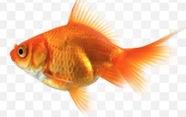
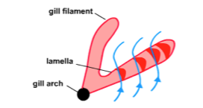
Organism | Gas Exchange Surface | Diffusion Pathway | How is Concentration gradient maintained? | Special Features
 | Permeable Gill Plates (or lamellae) | Reduced by thin capillary wall and squamous epithelia cells in gill plates | Extensive network of capillaries on gill plates with haemoglobin Ventilation: Mouth opens, Operculum closes, Floor buccal cavity lowers because muscles contract, Volume increases, Pressure decreases below outside water pressure, water moves in. | Aquatic environment less oxygen, more dense Huge surface area for diffusion of gases provided by 4 pairs of gills, each having thousands filaments. Further enlarged by filaments having lamellae (gill plates) Unidirectional flow of water Countercurrent mechanism in bony fish to maintain the concentration gradient over the entire gill plate so that blood becomes more saturated with oxygen. Parallel flow in cartilagenous fish.
Gill plate
(lamella)

Slide 18
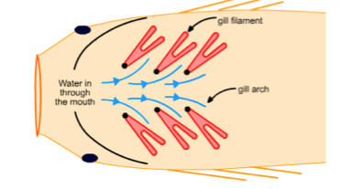
Unidirectional Flow

Slide 19
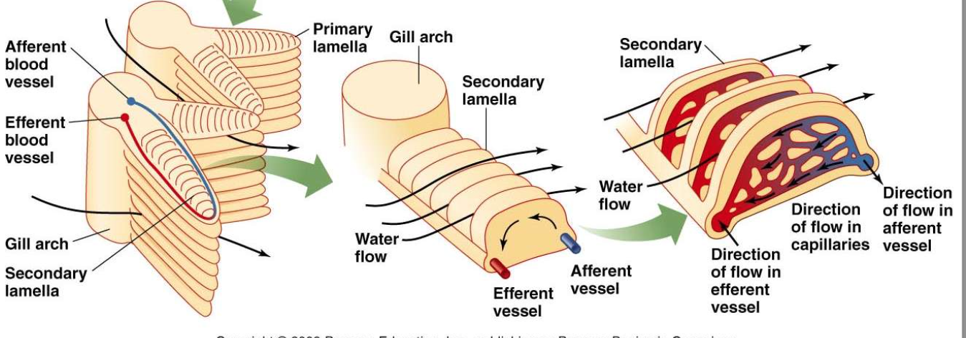
Be prepared to draw direction of blood and water flow

Slide 20
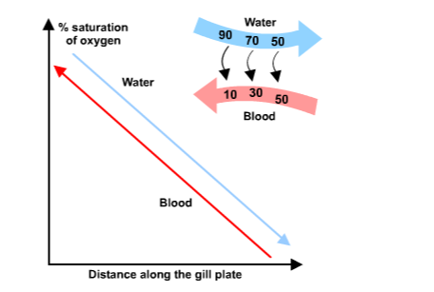
Counter current flow

Slide 21
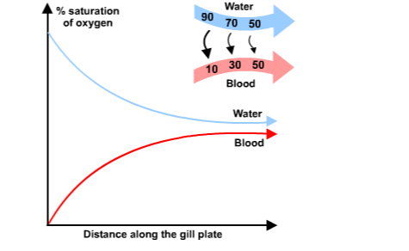
Parallel Flow

Slide 22
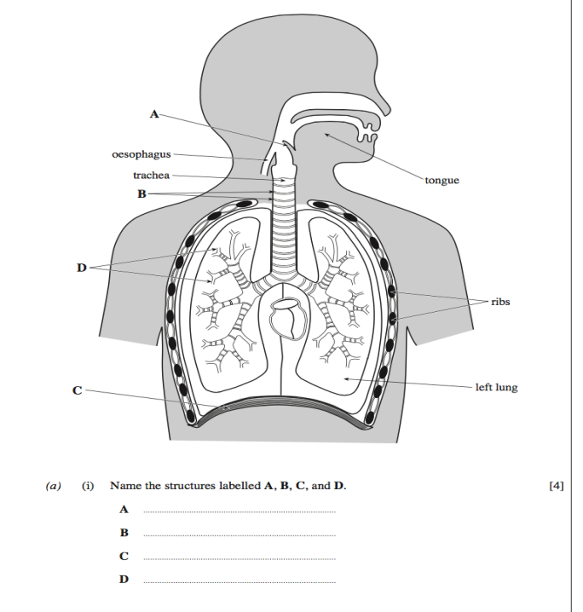

Slide 24
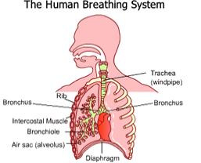
Organism | Gas Exchange Surface | Diffusion Pathway | How is Concentration gradient maintained? | Special Features
Lungs in thorax Epiglottis Trachea Bronchi Bronchioles Alveoli Pleural membranes Ribs Intercostal muscles Diaphragm (10 labels) | Walls of alveoli. | Squamous epithelia and thin walled capillaries give short diffusion path – just 2 thin cells | Transport system with haemoglobin Ventilation: Inspiration: External Intercostal muscles contract pulling ribcage up/outwards; diaphragm contracts/flattens; thorax volume increases, pressure decreases, air moves into lungs. Expiration: Intercostal muscles relax, internal intercostal muscles contract, ribcage moves down/inwards; diaphragm relaxes into dome shape; thorax volume decreases, pressure increases, air pushed out. | Internal Lungs Rings of cartilage keep airways open. Presence of many alveoli provide huge SA for gas exchange. Extensive network of capillaries on alveoli. Diaphragm muscle improves process of ventilation Air passage lined with goblet cells to secrete mucus and epithelia cells have cilia Tidal breathing less efficient Pleural fluid between pleural membranes acts as lubricant to prevent friction. Surfactant prevents surface tension.

Slide 25
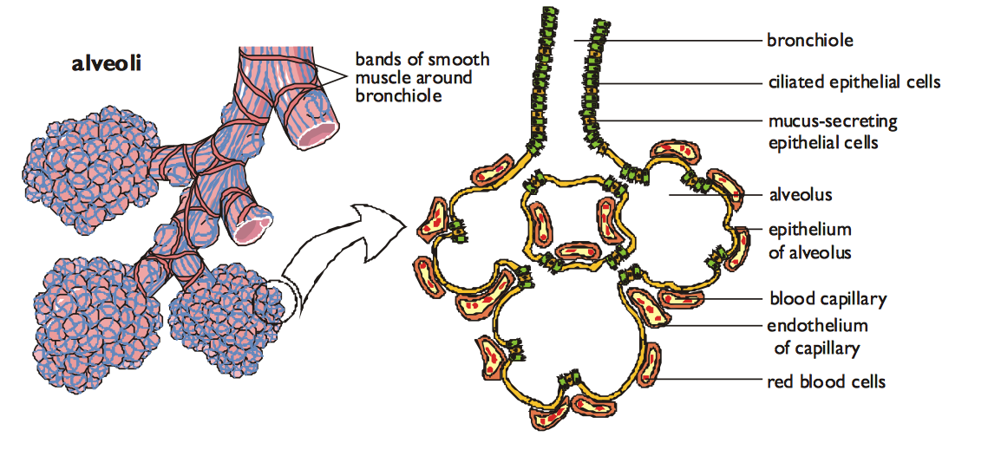

Slide 26
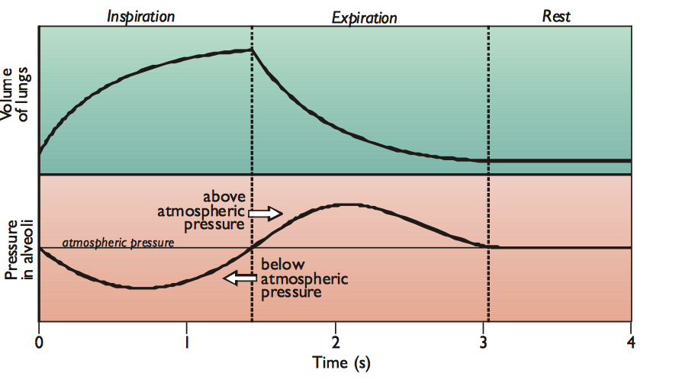
Air flows from high pressure to low pressure

Slide 27
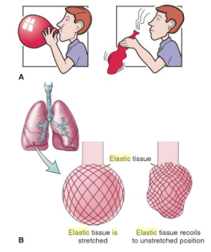
Elastic tissue
Recoil of elastic tissue plays a major part in expiration (rather like the air being released from a balloon)
Only under more strenuous conditions do the various muscles play a part.

Slide 28
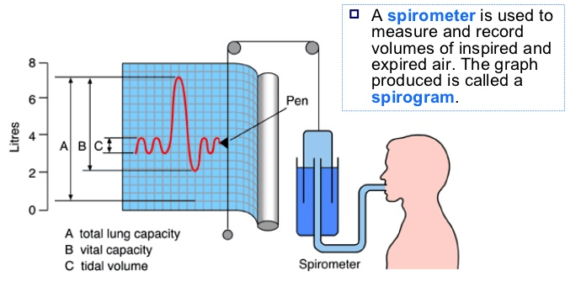
What is a spirometer?

Slide 29
Summary of Volume Changes in the Lungs (see next slide for definitions)

Slide 30
Summary of Volume changes in the Lung
Tidal volume: The volume of air breathed in and out without conscious effort (usually, 0.4 – 0.5 dm3 for adults)
Ventilation rate: The number of breaths per minute (healthy person at rest around 15 breaths)
Inspiratory reserve volume: The additional volume of air that can be inhaled with max effort after a normal inspiration. Expiratory reserve volume: the additional volume of air that can be forcibly exhaled after a normal exhalation.
Vital Capacity: The total volume of air that can be exhaled after a max inhalation = TV+IRV+ERV
Residual Volume: The volume of air remaining in the lungs after max exhalation (the lungs can never be completely emptied)
Total Lung Capacity: VC + RV

Slide 31
Pulmonary ventilation
Pulmonary ventilation = tidal volume x breathing rate
(dm³min⁻¹) (dm³) (min⁻¹)

Slide 32
Risk factors for lung disease
Smoking
Air pollution
Genetic make up
Infections
Occupation

Slide 33
Interpreting lung disease data
Cause: one variable causes a change in a second variable
Correlation: occurs when a change in one or two variables is reflected by a change in the other variable. There is a relationship between the two variables.
Correlation may not indicate causation.

Slide 34
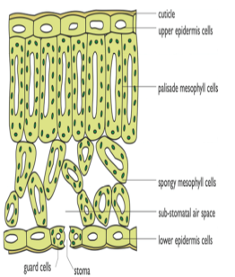
Organism | Gas Exchange Surface | Diffusion Pathway | How is Concentration gradient maintained? | Special Features
Cuticle Epidermis Palisade mesophyll Spongy mesophyll Vascular bundle Air space Stomata Guard cells (8 Labels) | Combined damp surfaces of all Spongy mesophyll cells which are Permeable to gases | Thin to give short diffusion distance into leaf. | Diffusion through stomata, no ventilation mechanism Gases can diffuse 10,000x more quickly in air As gases diffuse from spongy mesophyll to other cells, the conc. grad. Is maintained | Thin, flat leaf with large surface area Irregular shaped, loosely packed Spongy mesophyll with unusually large intercellular spaces allows circulation of gases Stomatal pores, mainly on lower epidermis, allow gas exchange Guard cells border stomata and change shape to open and close pores. Water proof cuticle to prevent water loss which cannot act as a gas exchange surface. Respiration night and day/photosynthesis day only

Slide 35
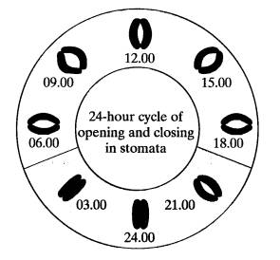
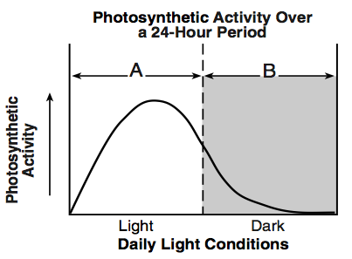

Slide 36
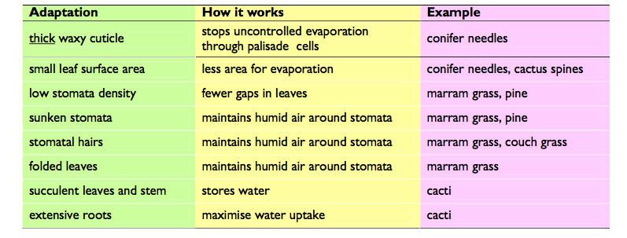
Xerophytes

Slide 37
Adaptions of the leaf for photosynthesis
Transparent cuticle and epidermis so mesophyll reached by light
Orientation to sun to expose max area to light
Surface area large for light trapping
Palisade cells elongated and densely packed, filled with chloroplasts
Air spaces in spongy mesophyll allow easy diffusion of gases
Chloroplasts can move
Thin to allow light to penetrate to cells

