Slide 1

Immune Response
Non specific response
Specific response
Immunity - vaccines and antibodies

Slide 2
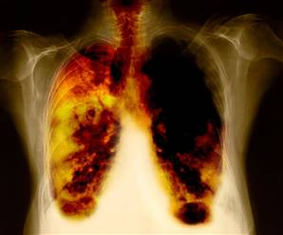
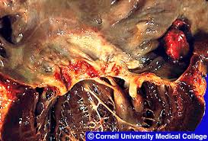
What is disease?
Disease is a malfunction of the body or mind which has an adverse effect on good health. It has mental, physical and social aspects.
There are 3 types of diseases:
Infectious disease - one that you can catch and caused by pathogens
Lifestyle disease - one that you can not catch and caused by environmental
factors such as smoking or diet
Genetic disease - inherited conditions

Slide 3
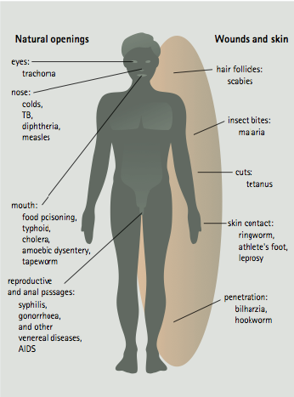
For an organism to be considered a pathogen it must:
Gain entry to the host
Colonise the tissues of the host
Resist the defences of the host
Cause damage to the host tissues or produce toxins (exotoxins)

Slide 4
How does the body prevent their entry?
How do they get into the body?
Through the gas-exchange system (e.g. pathogens that cause flu, TB and bronchitis)
Through the digestive system (e.g. pathogens that cause cholera, typhoid and dysentery)
Skin
Mucus and cilia hairs
Enzymes to break them down
Stomach acid
Tears

Slide 5
Non-specific Defence
There are 2 main types:
Physical barriers
Phagocytosis
The mechanisms are the same whatever the pathogen involved.

Slide 6
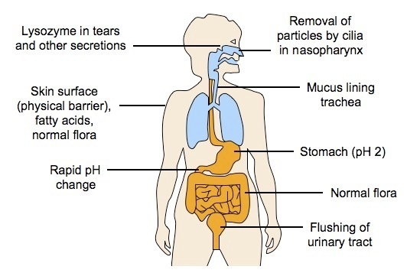
First line of defence
Notes:
6
6

Slide 7
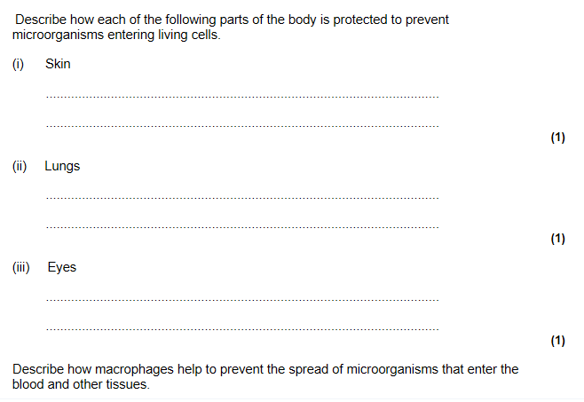
Most students able to gain recall marks
Dead cells / keratin as barrier
Skin acidity kills microbes
Skin flora kill/complete with microbe
mucus traps microorganisms
Tears contain lysozyme / contain enzymes which kill microbes
(accept bactericide)
Few able to explain the role of lymphocytes
Move to site of infection; Phagocytosis / engulf bacteria; Stimulate (T)- lymphocytes /B cells/ T cells
Notes:
7

Slide 8
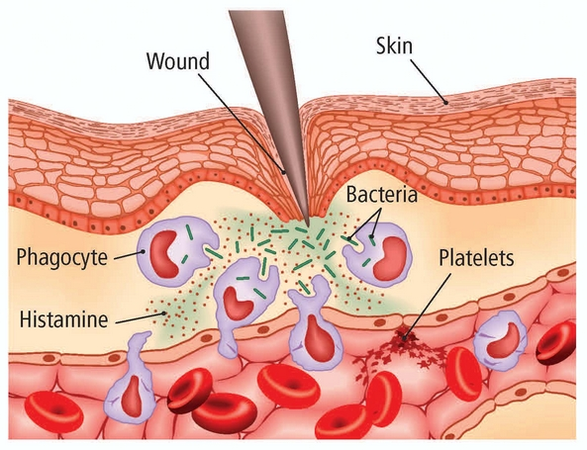

Slide 9
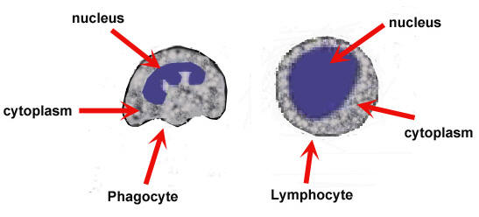
White blood cells: a defensive role
Engulf pathogens by phagocytosis:
Increase in number in response to
bacterial or viral infections. Clonal expansion
Involved in a non-specific immune
response
Involved in a specific immune response

Slide 10
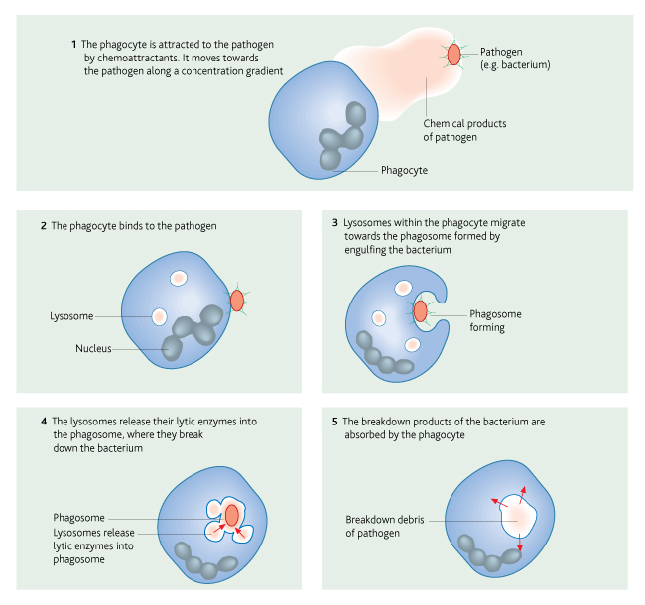

Slide 11
Phagocytosis – key points
The phagocyte detects chemicals produced by the pathogen (or abnormal cells) and moves towards it.
The phagocyte has several receptors on its surface so binds to the pathogen.
The pathogen is engulfed and a phagosome formed.
Lysosome (contains lysozymes) fuse with the phagosome and release their enzymes.
The pathogen is broken down and the products absorbed or released from the cell by exocytosis
Notes:
11

Slide 12
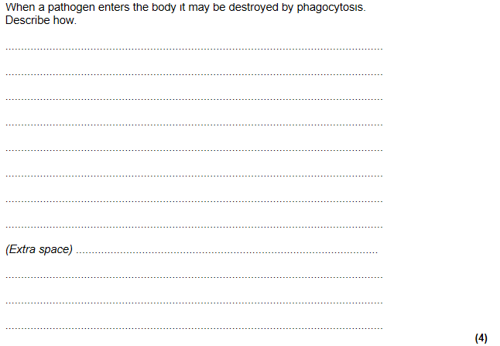
Phagocyte attracted by a substance / recognises (foreign) antigen:
(Pathogen) engulfed/ ingested
Enclosed in vacuole /vesicle/ phagosome
(Vacuole) fuses / joins with lysosome
Lysosomes contains enzymes
Pathogen digested / molecules hydrolysed
Many students gained all four marks. The main reason for failing to gain marks was for not specifying the idea of fusion of the lysosome with the phagocytic vesicle. Some students, however, failed to read the question properly and wrote in more general terms about B cells and T cells or lymphocytes, ignoring phagocytes.
01869 336410
Notes:
12

Slide 13
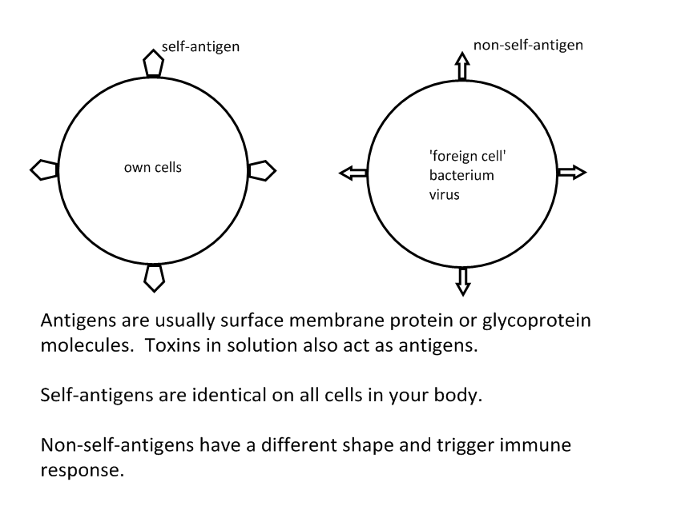
Cells have ‘markers’ on their surface called antigens:
Our own cells have ‘self-antigens’.
Foreign antigens are ‘non-self antigens’

Slide 14
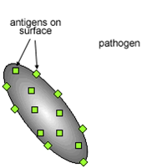
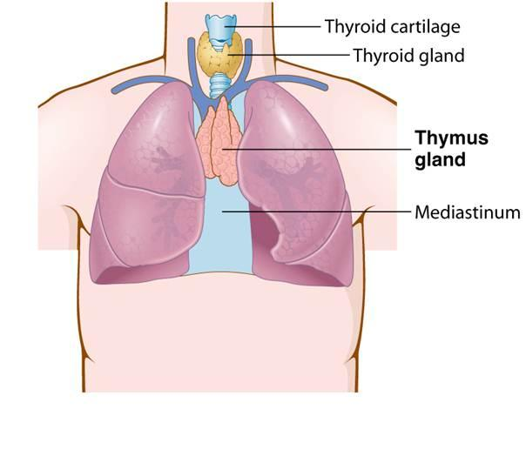
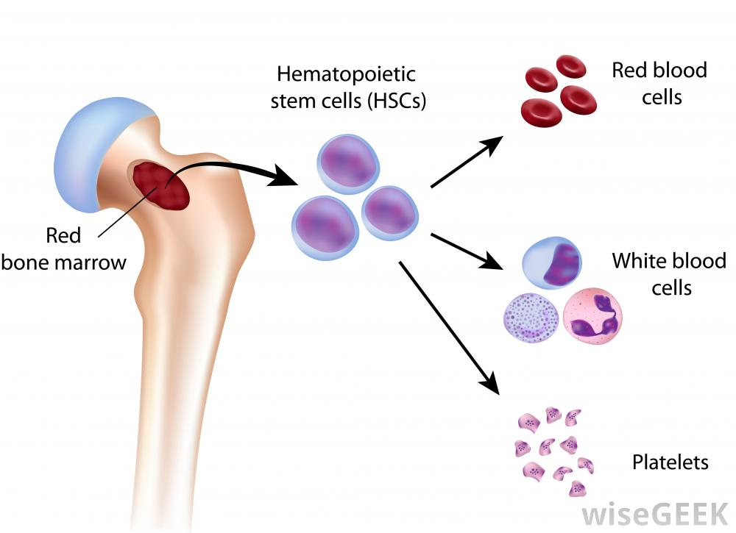
A specific immune response:
Immune response depends on presence
of ‘antigens’ on surface of pathogen
Types of immune response:
Cellular response – mediated by T-lymphocytes
(mature in the Thymus gland)
Involves cell which attack ‘foreign’ organisms directly
Humoral response – mediated by B-lymphocytes
(mature in the Bone marrow)
Involves only chemicals (antibodies) no cells directly involved

Slide 15
Cell mediated immunity:
Antigen presentation on macrophage or infected cell
Receptors on certain helper T - cells fit exactly to presented antigen
Activation of other T cells (cloning)
Then… differentiation:
Kills infected cells
Memory cells
Stimulates B cells
to divide
Stimulates phagocytes
engulf pathogens

Slide 16
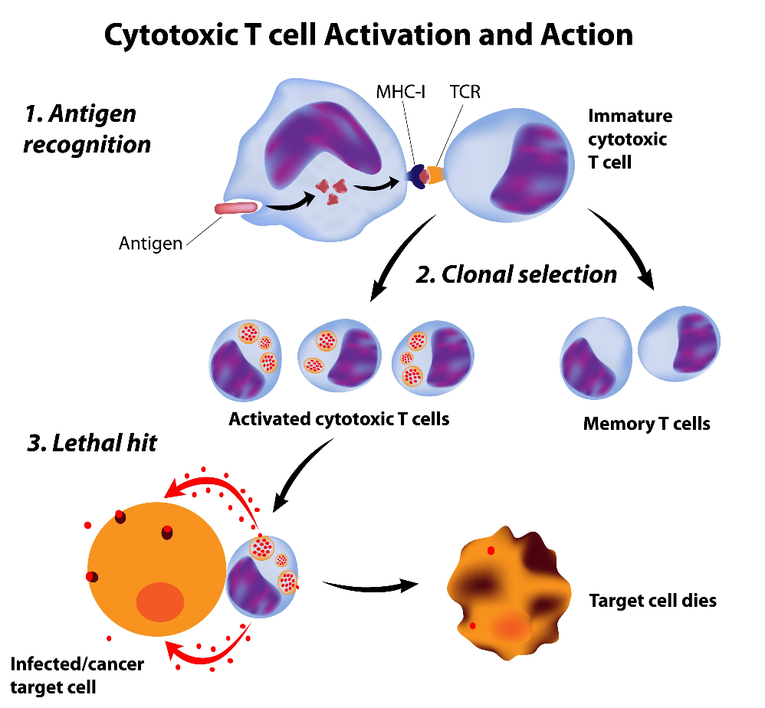
How cytotoxic cells kill infected cells
Perforin makes holes in cell surface membrane

Slide 17
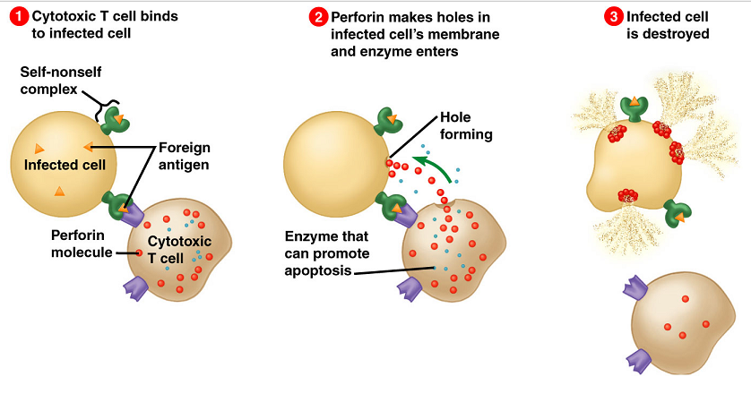

Slide 18
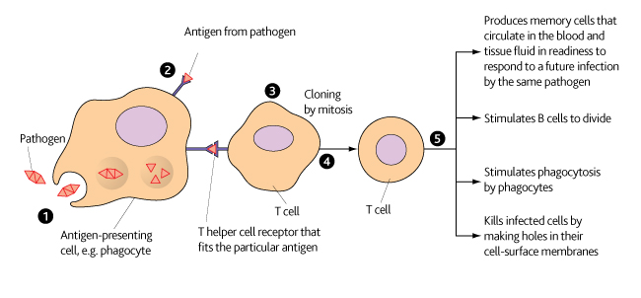

Slide 19
Humoral Response
Antigen binds to a B cell with complimentary membrane bound antibodies
Antigen is presented on the membrane
Helper T cell binds to presented antigen and activates the B cell
The B cell divides to produce many clones
The clones differentiate
Plasma cells
Memory cells
Antibodies are produced

Slide 20
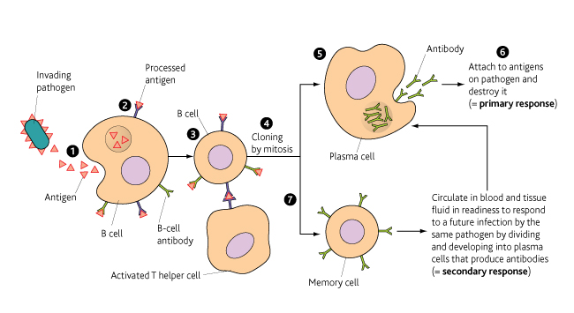

Slide 21
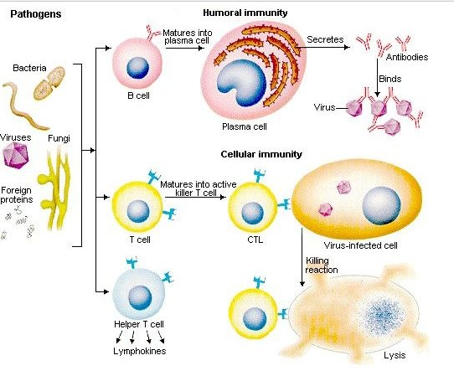
Summary of specific response

Slide 22
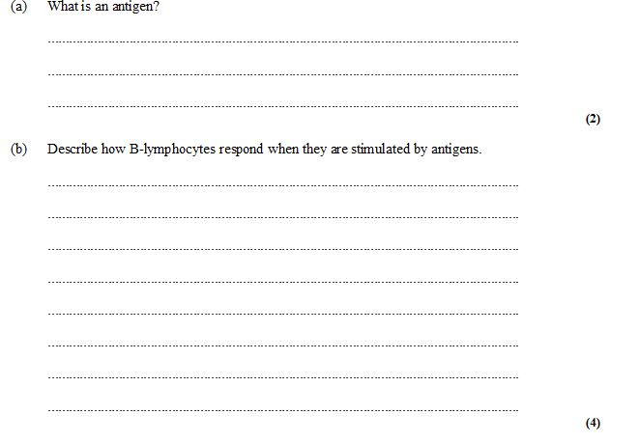

Exam question
molecule / part of molecule / protein / glycoprotein / named molecule;
that stimulates an immune response / eq;
divide by mitosis / form clones;
produce plasma cells; (plasma cells)
make antibodies;
(plasma cells) produce memory cells;

Slide 23
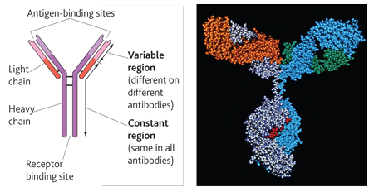
B lymphocytes – release antibodies

Slide 24
Antibodies *
B cells ( B lymphocytes) divide producing
clones of plasma cells that secrete antibodies
Variable region has specific shape due to the
sequence of amino acids of the primary protein
structure
Specific shape is complementary to the shape of
the antigen
Forms an antigen-antibody complex
Clumping (agglutination) of the invading pathogens by antibodies means that they cannot move round the body so easily, spreading the disease, cannot enter cells so easily but can be engulfed by phagocytes more easily

Slide 25
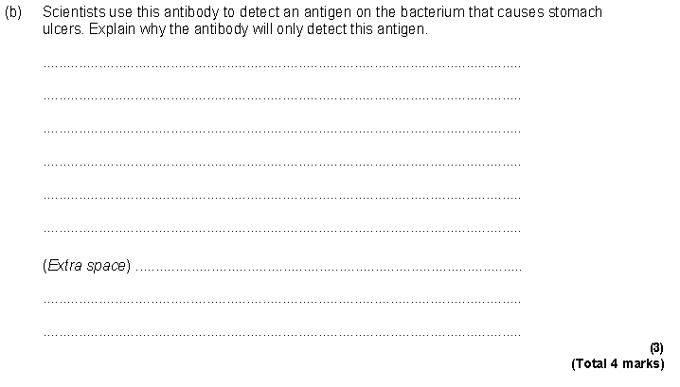
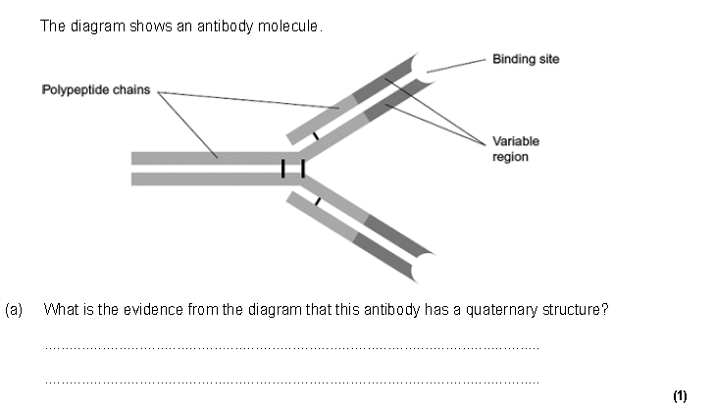
Exam Question
Has more than one / four polypeptide chains / made up of polypeptide chains;
Antibody / variable region has specific amino acid
sequence / primary structure;
2. The shape / tertiary structure of the binding site;
Do not accept active site for this point.
3. Complementary to / fits / binds with these antigens;
Accept active site for this point.
4. Forms complex between antigen and antibody;
01869 336410

Slide 26
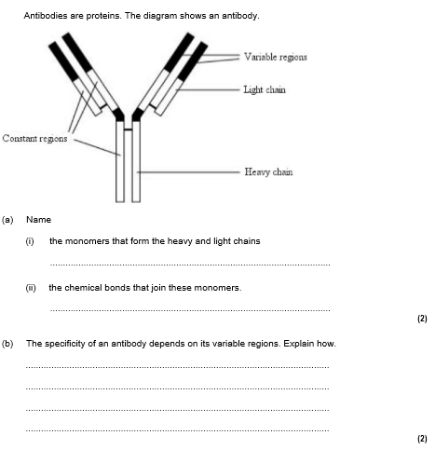
Exam Question
Amino acids;
Peptide
Contains specific sequence of amino acids;
Complimentary shape enables attachment to antigen.
01869 336410

Slide 27
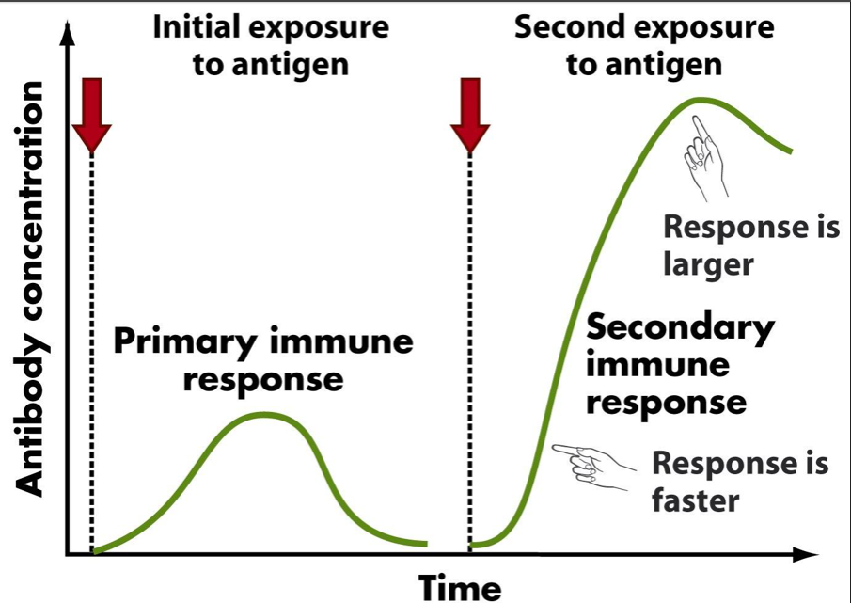
Primary Response:
As a result of initial bacterial infection, specific antibodies made by plasma cells and some B-memory cells left in the blood.
Over time the antibody concentration falls, but the B-memory cells remain.
Secondary Response:
If another infection by the same pathogen occurs,
the B-memory cells present produce a faster and more intense response.
The pathogen is destroyed before any symptoms of the infection occur.

Slide 28
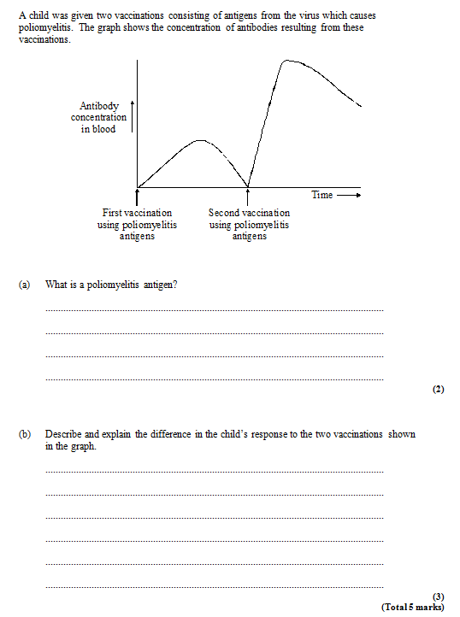
Exam question
1. Protein / glycoprotein / molecule on surface of virus;
2. Stimulates immune response / antibody production;
1. Greater / more rapid production of antibodies following second vaccination;
2. First encounter takes time for B cells to become activated / clonal selection process / time delay before antibodies can be produced;
3. Memory cells present as result of first vaccination;

Slide 29
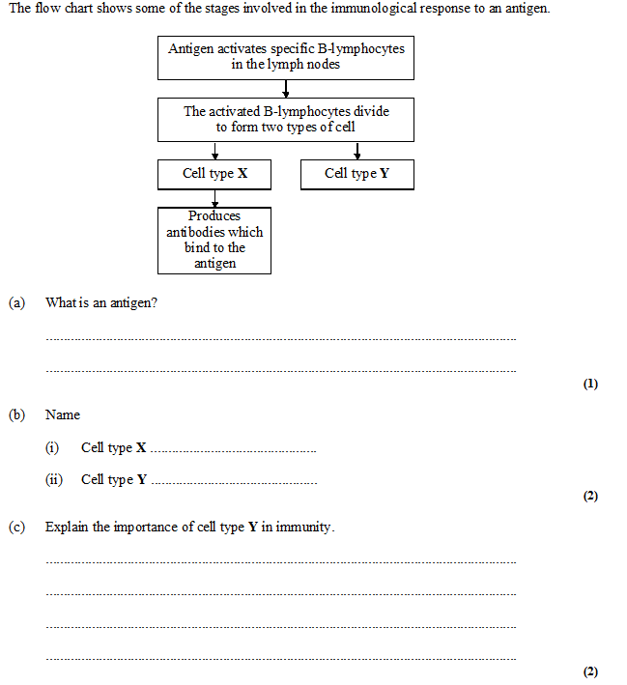
Exam question
A molecule which stimulates an immune response / antibody production / surface protein / glycoprotein / non-self protein; 1
Plasma cells 1
Memory (B) cells;1
Carried (an immunological) memory of the specific antigen;
Produces large amounts of plasma cells quickly if the
same antigen is encountered a second time;
Rapid production of antibodies;
Not just ‘bigger immune response’ 2 max

Slide 30
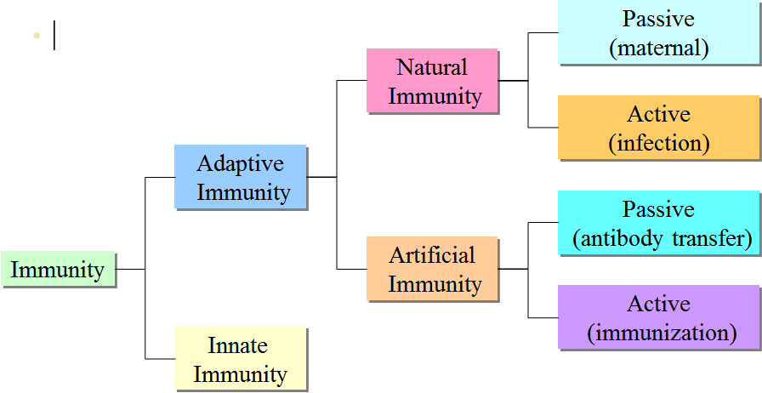
Immunity
What is immunity?
When a body has to produce antibodies to an antigen.
Difference between Active and Passive immunity?
Active – when you actually make the antibodies yourself, produce memory cells
Passive – when you acquire the antibodies from another source.

Slide 31
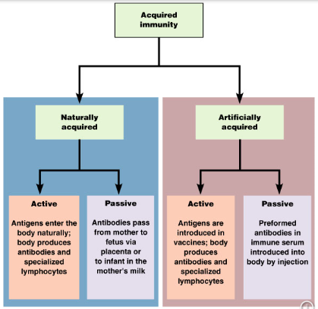

Slide 32
Natural immunity
Artificial immunity
Antibodies passed from mother
to foetus.
Passive
Have antibodies but haven’t made them.
Antibodies produced by another
organism are injected into a
person.
Antibodies passed from mother
to baby in breast milk.
Active
Antibodies produced by plasma
cells as a result of infection.
Memory cells also made...
Antibodies made by plasma cells
as a result of antigens being
introduced into the body by a
Vaccination...
Memory cells also made
Have antibodies that were made in the body.

Slide 33
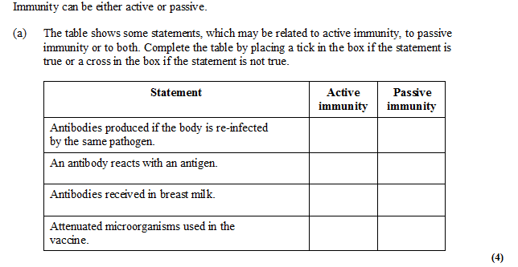
Exam Question
√
√
√
√
√

Slide 34
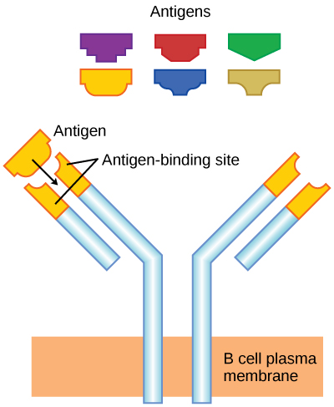
Antigenic variability
The genes coding for antigens have a fast rate of mutation
This means the antigens of particular pathogens are
frequently changing
This means our immune system has trouble keeping up
Each time a new strain invades our body we have to go through
the primary response as we will not have the memory cells for the
antigen of the new strain
This explains why we suffer from colds & flu regularly

Slide 35
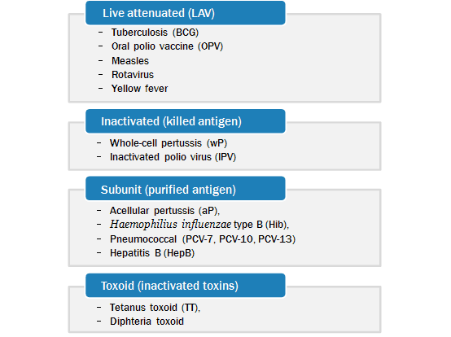
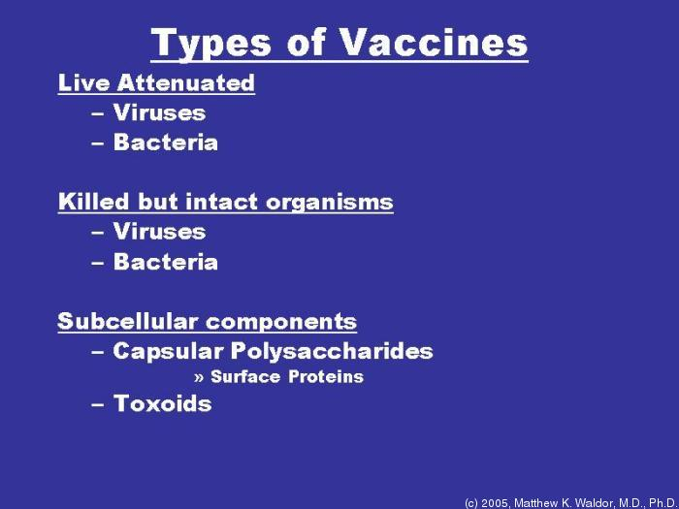
Different types of Vaccination
Types of vaccination
(all involve receiving a dose of the antigen – to stimulate the
production of antibodies

Slide 36
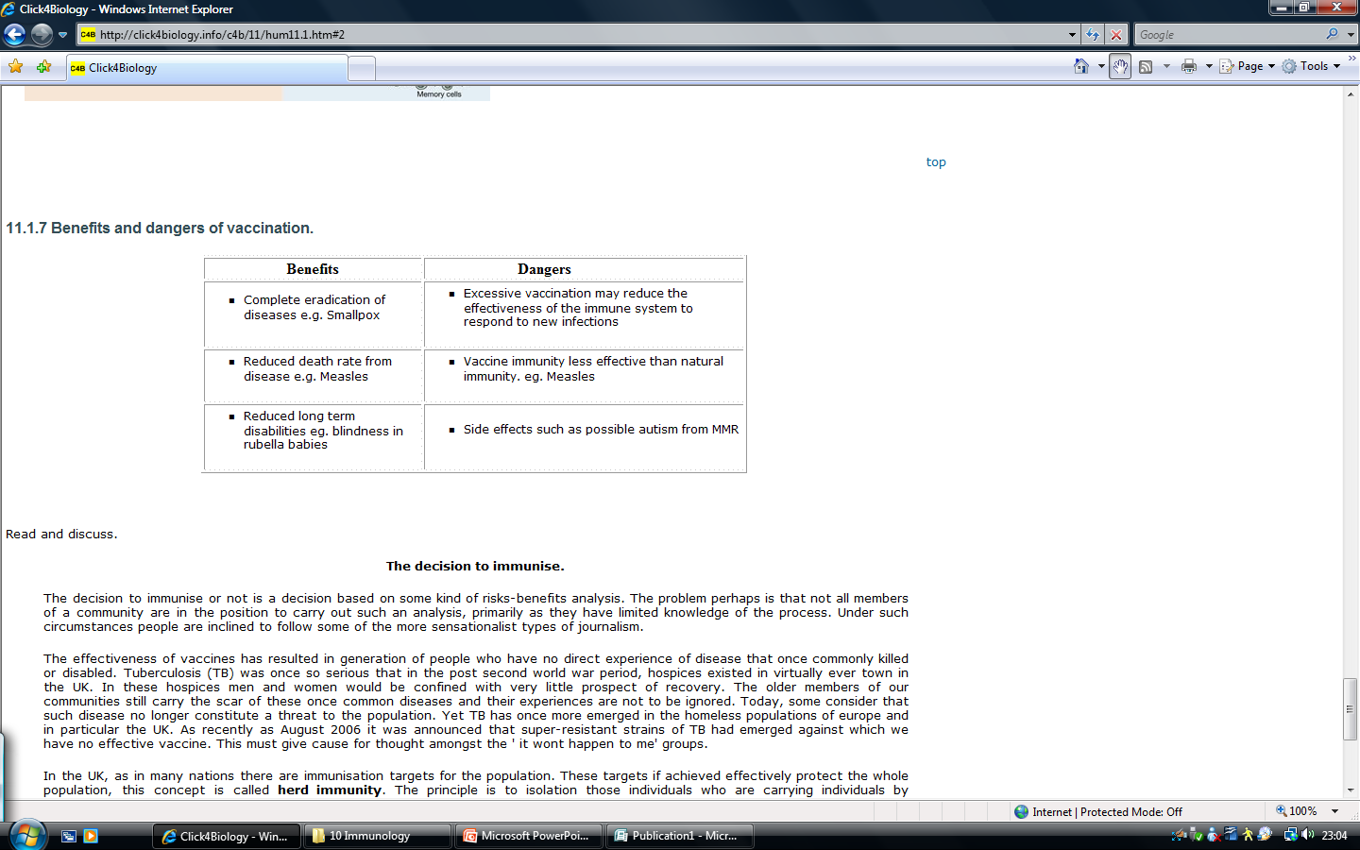
Stimulate active immunity against a particular disease.
memory cells are ready to secrete antibodies
Vaccinations therefore protect individuals from diseases
This reduces the occurrence of the disease
If a large percentage of the population are vaccinated then those not
vaccinated are also less likely to catch the disease as there are fewer
people to catch it from
This is called HERD immunity

Slide 37
Past Paper Question
Q Vaccines protect people against disease. Explain how. 5marks
1. Vaccines contain antigens / antigens are injected;
Ignore references to T or B cells.
2. Dead pathogens / weakened pathogens;
Accept bacteria / viruses etc but not disease
3. Memory cells made;
4. On second exposure memory cells produce antibodies /
become active /recognise pathogens;
Idea of memory cells responding.
5. Rapidly produce antibodies / produces more antibodies;
Production of antibodies must be qualified for mark.
Underlined ideas essential.
6. Antibodies destroy pathogens;
Accept bacteria/viruses etc but not disease
7. Herd effect / fewer people to pass on disease; 5marks

Slide 38
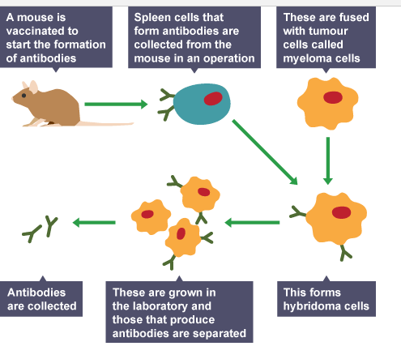
Monoclonal antibodies

Slide 39
What are Monoclonal Antibodies Used for?
Medical Uses
To target specific cells and substances.
e.g. Antibodies specific to cancer cell antigens.
  They attach to receptors on cancer cells
  They block chemical signals that stimulate uncontrolled growth.
To Diagnose disease
  e.g. flu, hepatitis and chlamydia.
  To diagnose certain cancers e.g. prostate cancer
Pregnancy testing

Slide 40
How monoclonal antibodies work
Used on their own to activate the immune system
Attached to a drug
Attached to an enzyme that will illicit a colour change
Attached directly to a coloured particle

Slide 41
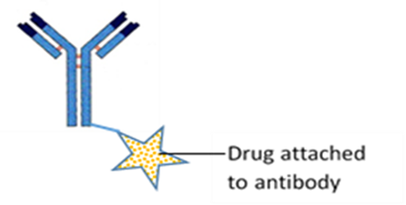
Direct and indirect Monoclonal antibody therapy
Direct Antibody therapy
  Antibody is used on its own to stimulate the immune system
  E.g. Herceptin-monoclonal antibody used to treat breast cancer
  Advantage is non toxic
Indirect Antibody therapy
  A cytotoxic or radioactive drug is attached to the monoclonal antibody
  When the cancer attaches it kills the cell
  Known as magic bullets
  Advantage smaller doses, reduces side effects and is cheaper

Slide 42
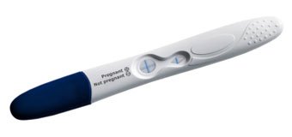
How monoclonal antibodies used in pregnancy testing
Pregnancy tests rely on monoclonal antibodies which bind to a hormone human chorionic gonadotropin (HCG)
HCG is made in the early stages of pregnancy.
Tiny amounts of the hormone are passed out of the body in the urine.
This is what is picked up by the monoclonal antibodies in the pregnancy test.

Slide 43
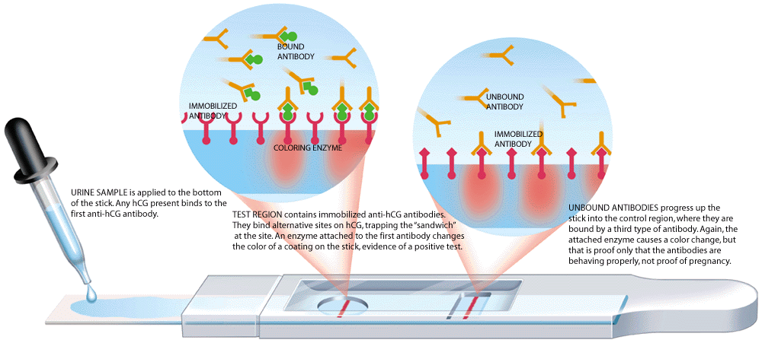
Prevents false negative results

Slide 44
Positive result seen in window
1st Anti HCG monoclonal antibody
HCG Hormone
Antibody binds to first anti HCG antibody. Proves test is working
Enzyme causing colour change or directly attached to blue latex
2nd Anti HCG monoclonal antibody-bound to strip

Slide 45
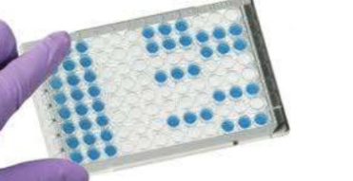
Enzyme–Linked Immunosorbant Assay (ELISA)
Two types of ELISA
  Direct ELISA
  Indirect ELISA

Slide 46
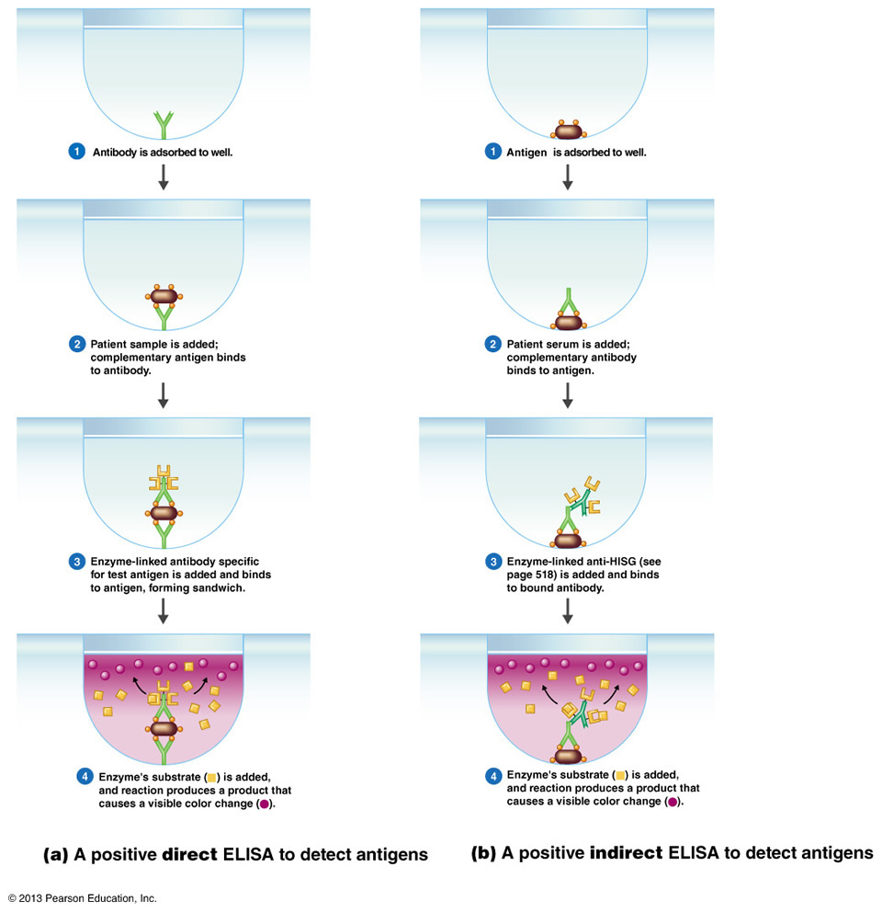

Slide 47
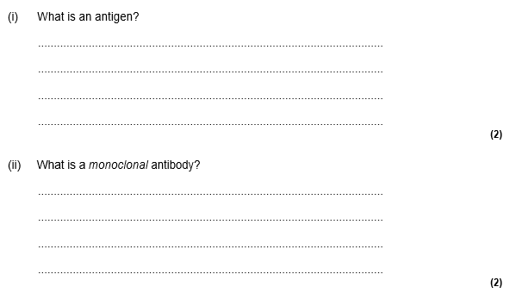
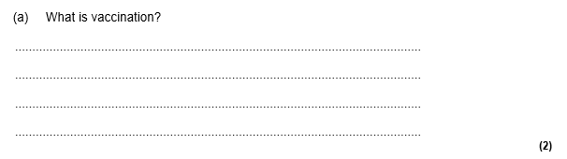
Recall Exam Questiona
Injection of antigens/toxoids;
(Antigen from) attenuated microorganism/non-virulent
microorganisms/dead microorganisms/isolated from microorganism;
Stimulates the formation of memory cells.
protein / glycoprotein / glycolipid / polysaccharide / molecule;
on surface / membrane (of cell);
causes immune response / description / triggers antibody production; .
reference to hybrid cell from tumour / cancer and B-lymphocyte/hybridoma;
antibodies all the same / from one type of plasma cell;
specific to / complementary to / fits only one antigen;

Slide 48
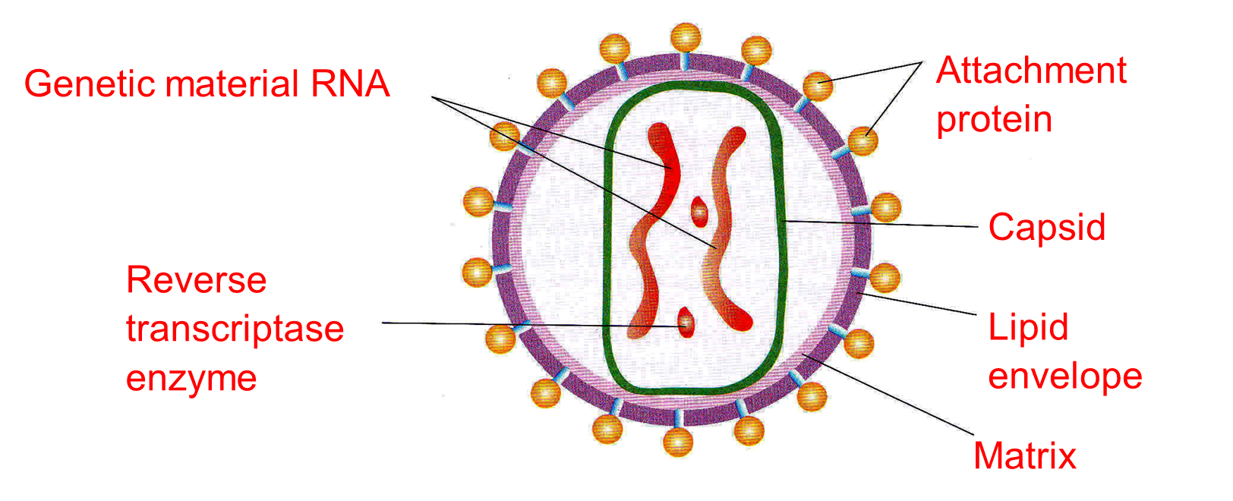
HIV Structure - Human Immunodeficiency Virus

Slide 49
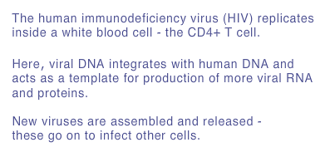
HIV Human Immunodeficiency Virus

Slide 50
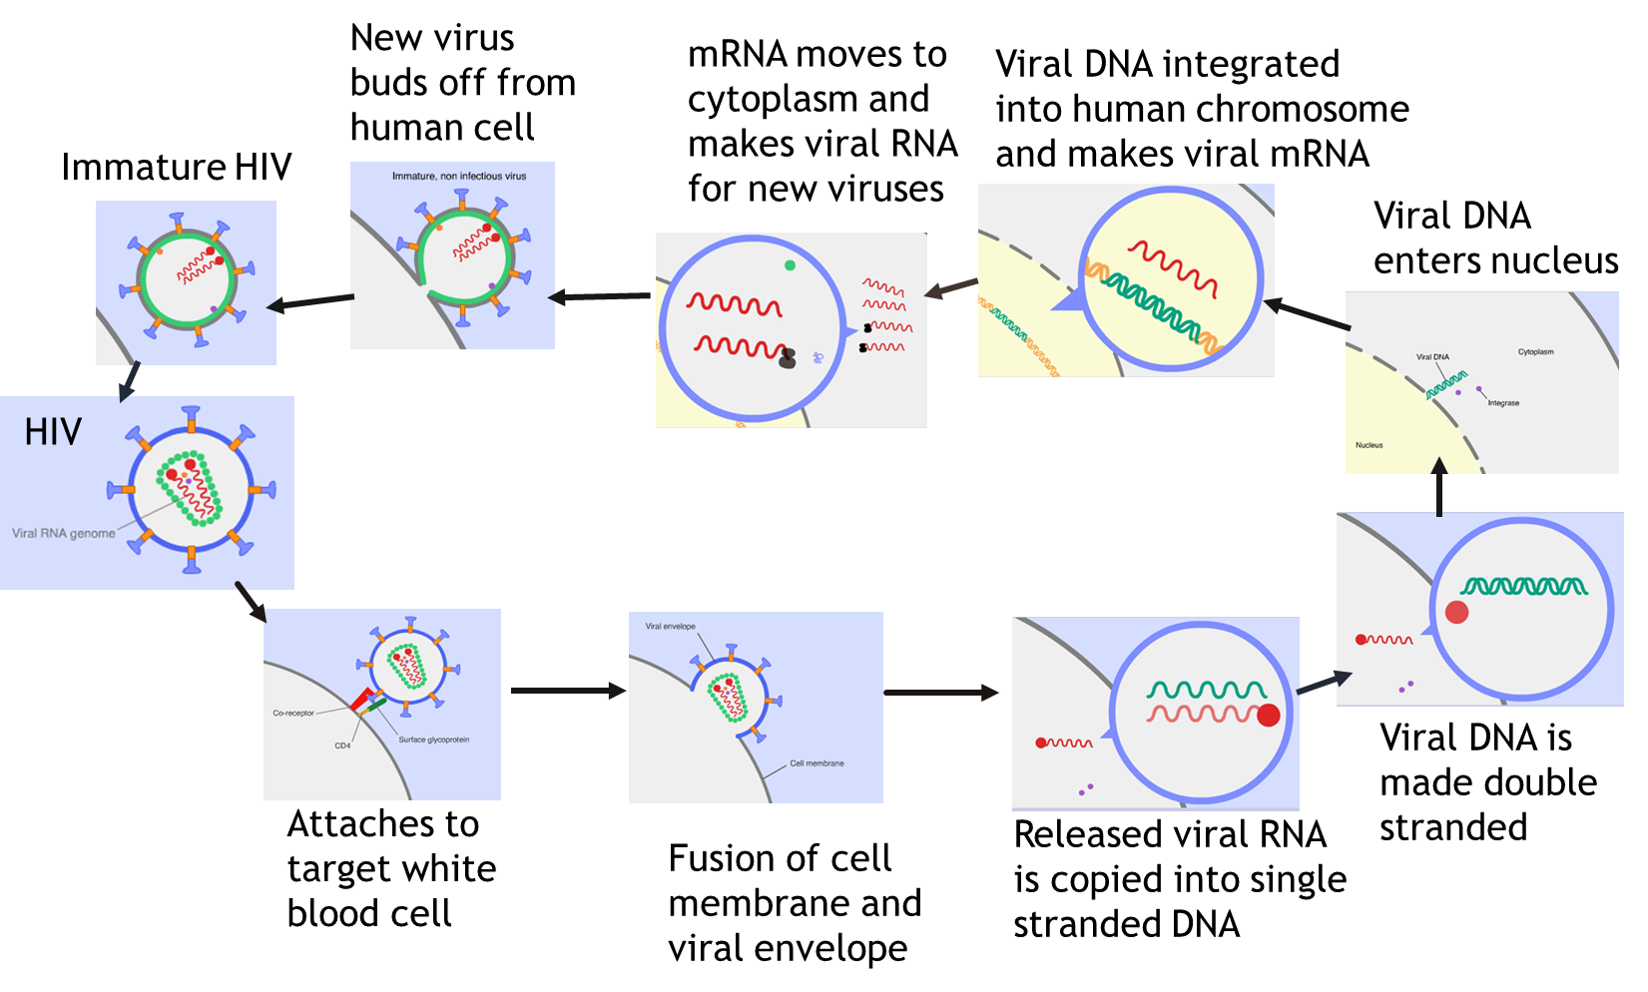
HIV Life Cycle
Using viral Enzyme reverse transcriptase

Slide 51
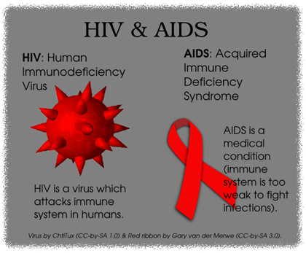
HIV and AIDS
AIDS: Acquired immune deficiency syndrome
The Human Immunodeficiency virus (HIV) causes the symptoms AIDS
HIV does not directly kill a person
It kills or interferes with the normal functioning of helper T-cells.
So the body cannot produce adequate numbers of B-cells to produce antibodies or Cytotoxic T-cells to kill infected cells.
So the body’s immune response is reduced and it is more susceptible to infections and cancer.
These secondary infections ultimately cause death.

