Slide 1
Transport
Phloem
Xylem
Haemoglobin

Slide 2
Overview
During photosynthesis, organic compounds are synthesised in a plant’s leaves
  The leaves act as a source
Most of these organic compounds are moved to parts of the plant that are actively growing, to storage organs or to seeds
  These regions act as sinks
Transport is from source to sink
Transport occurs in the phloem tissue
Version 1.0

Slide 3
Key concepts
Solutes are dissolved substances.
Like xylem, the phloem is arranged as cells in a tube arrangement.
Sieve tube elements and companion cells.
Translocation is the movement of solutes.
The source is where the sugars come from, and the sink is where they go to.
Sugar is made in the leaves, so they are the source, and transported to the roots, so they are the sink.
In early spring, the leaves need energy to grow, so they sugars are transported from the roots (now the source) to the leaves (now the sink)

Slide 4
Enzymes maintain concentration gradients between sources and sinks.
Eg – in potatoes, sucrose is converted into starch in the sink area.
This means there is also a lower concentration of sucrose at the sink end than in the phloem.
Thus ensuring a constant supply of new sucrose reaches the sink from the phloem.
Links here to starch being insoluble so does not affect the water potential so a cell. – Good storage molecule.
Enzymes!!!!!!

Slide 5
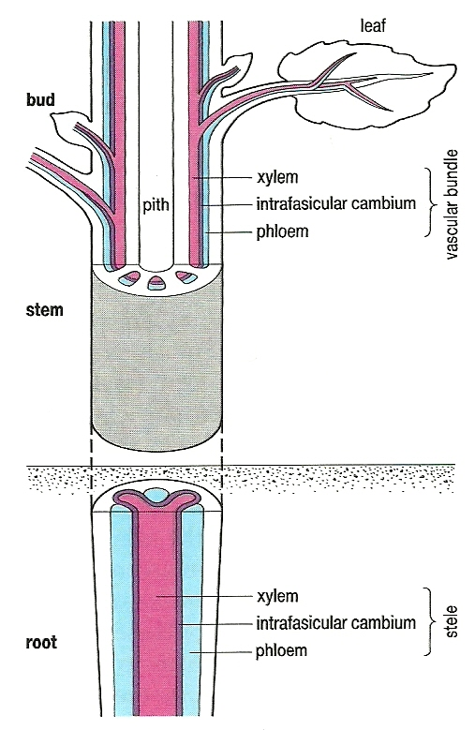
Location of phloem
Note the close association between phloem and xylem in all parts of plant

Slide 6
Evidence that transport of organic compounds occurs in the phloem
¹⁴C used to label organic compounds – subsequent autoradiography shows labelled compounds are in the phloem
The bark of a tree contains the active phloem – remove a ring of bark and downward movement of organic compounds stops where bark removed
Sap-sucking insect – piercing mouthpart found to be in phloem and sap removed via piercing mouthpart found to contain organic compounds
Version 1.0

Slide 7
Structure of phloem
Two types of cell
Sieve tube elements
  Stacked one on top of another
  No nucleus, thin layer of cytoplasm around large central ‘vacuole’, few organelles, P-protein in cytoplasm
  Large pores in end walls (sieve plates) with cytoplasm passing from element to element
  Smaller pores in side walls with strands of cytoplasm (plasmodesmata) running through to adjacent:
Companion cells
  Smaller cells with nucleus, cytoplasm and organelles
  Each controls activity of adjacent sieve tube element

Slide 8
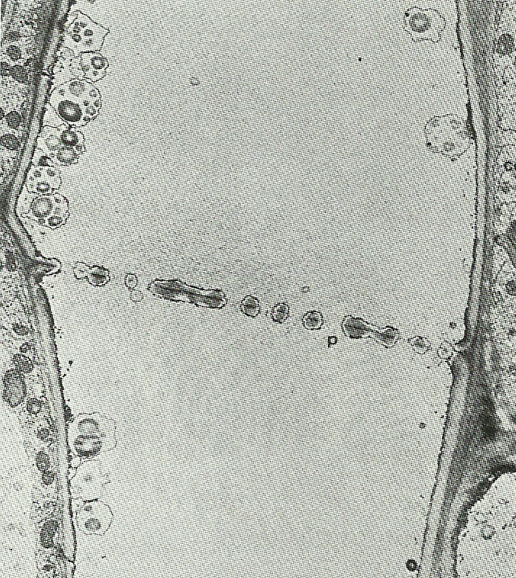
Two sieve tube elements
This slide was taken using an optical microscope
It shows a sieve plate between two adjacent sieve tube elements
Notice:
  the pores (p) in the sieve plate
  very little cytoplasm in the sieve tube elements

Slide 9
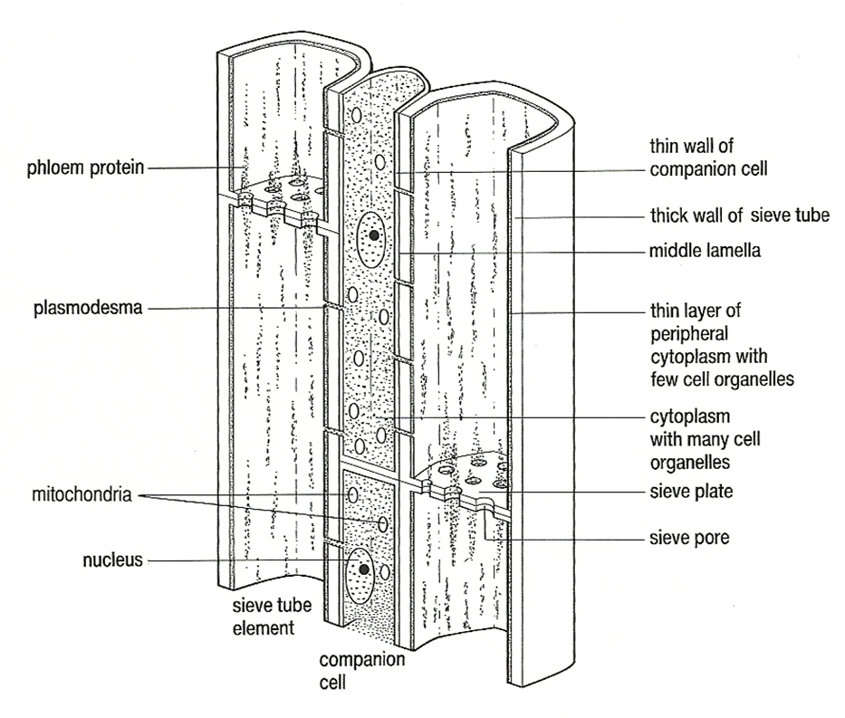
Sieve tube elements and a companion cell

Slide 10
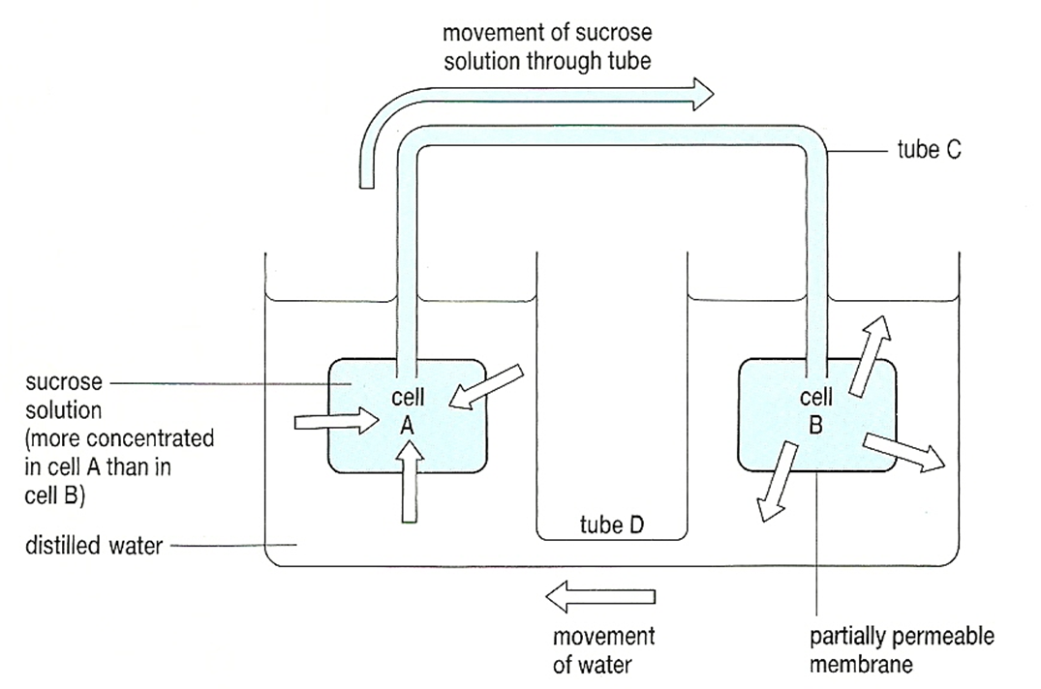
A model of mass flow

Slide 11
Transport in the phloem (1)
Loading from source
In the leaves, solutes are passed from photosynthesising cells into the companion cells of the phloem
The companion cells then load the solutes into the sieve tube elements via plasmodesmata
ATP hydrolysis is involved in this transfer

Slide 12
Mass flow hypothesis.
How is sucrose loaded into the phloem at the source?
Hydrogen ion (H+) are actively transported from the companion cells into the surrounding tissues
the H+ will then diffuse back into the companion cells as it does, it brings in Sucrose with it via a co-transporter protein
sucrose builds up in the companion cell, then diffuses into the sieve tube via the plasmodesmata

Slide 13
Transport in the phloem (2)
Pressure flow from source to sink
Entry of solutes into sieve tube elements lowers their water potential (makes the water potential more negative)
As a result, water enters the sieve tube elements from the surrounding xylem vessels
This increases the hydrostatic pressure within the sieve tube elements, pushing their contents through the pores in the sieve plates (up or down the plant)

Slide 14
Transport in phloem (3)
Unloading to a sink
As solutes are pushed down a pressure gradient, they are surrounded by cells with a lower solute concentration
Solutes leave the phloem into these cells, lowering their water potential
Water leaves the phloem by osmosis, returned to the surrounding xylem and is re-circulated
Cells in the sink use, or store, the solutes

Slide 15
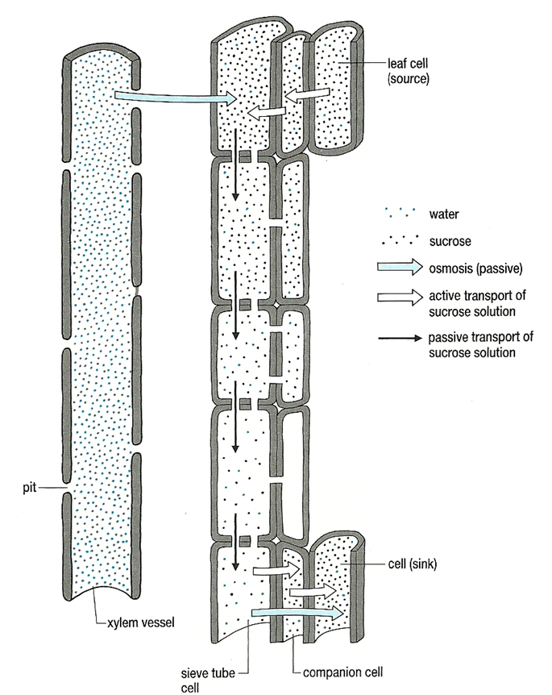
Mass flow hypothesis

Slide 16
Contents of phloem / mg cm⁻³
Non-reducing sugars / ∼ 80–120
  Very little reducing sugar transported
Amino acids / ∼ 5
Proteins / ∼ 2
Organic acids / ∼ 3
Inorganic ions / 5

Slide 17
Evaluating evidence: For mass flow
Uses phloem:
Radioactively labelled carbon on CO₂ used in photosynthesis will be found in the phloem (in the sucrose)
Ringing of a tree, removing the phloem, leads to a build up of sugar above the ring
Aphid feeding on plants will have their mouth-parts connected to the phloem

Slide 18
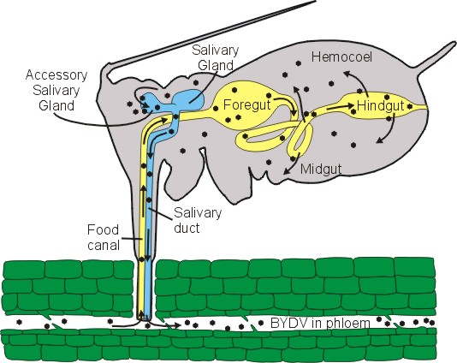
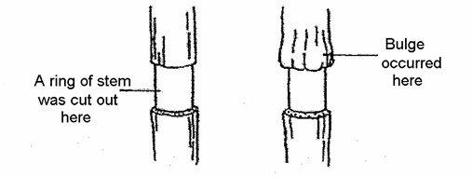

Slide 19
Uses ATP
Companion cells have many mitochondria
Metabolic poisons that inhibit respiration will stop translocation
Rate of flow of sugars in phloem is very fast
Uses H+
pH of companion cells higher than surrounding cells (loses H+, less acidic)

Slide 20
Against mass flow
solutes in phloem move at different rates
role of sieve plate unclear

Slide 21
Radioactive tracers.
Using radioactive carbon dioxide: because the carbon will be incorporated into organic substances.
The movement of these organic substances can then be tracked using autoradiography.
Plant is killed, the sample is then placed on a photographic film – the film will turn black wherever radioactive substance is found.
So autoradiography on plants that have been killed at different times show an overall movement from source to sink. Eg products of photosynthesis move from leaves towards the roots.

Slide 23
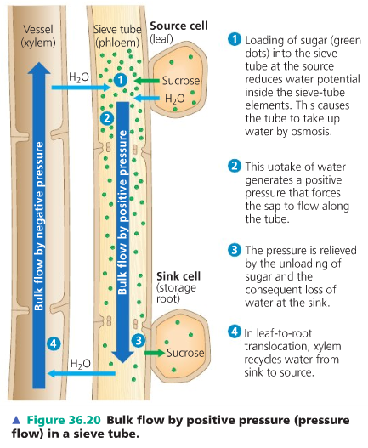
Answers

Slide 24
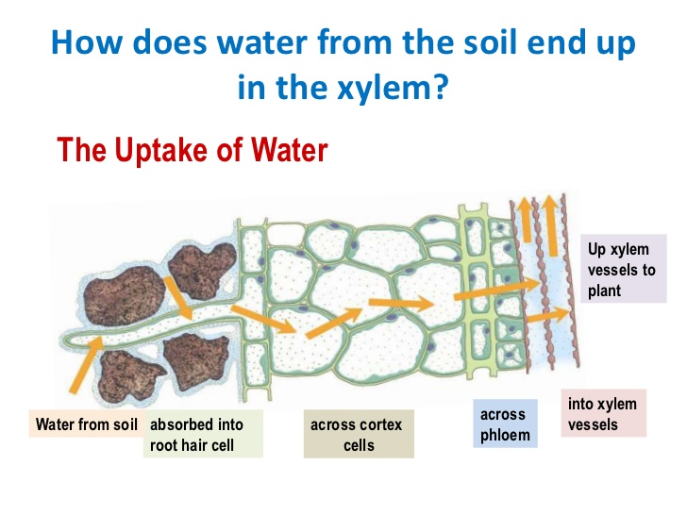
Adaptations of root hair cells
Symplast /Apoplast routes

Slide 25
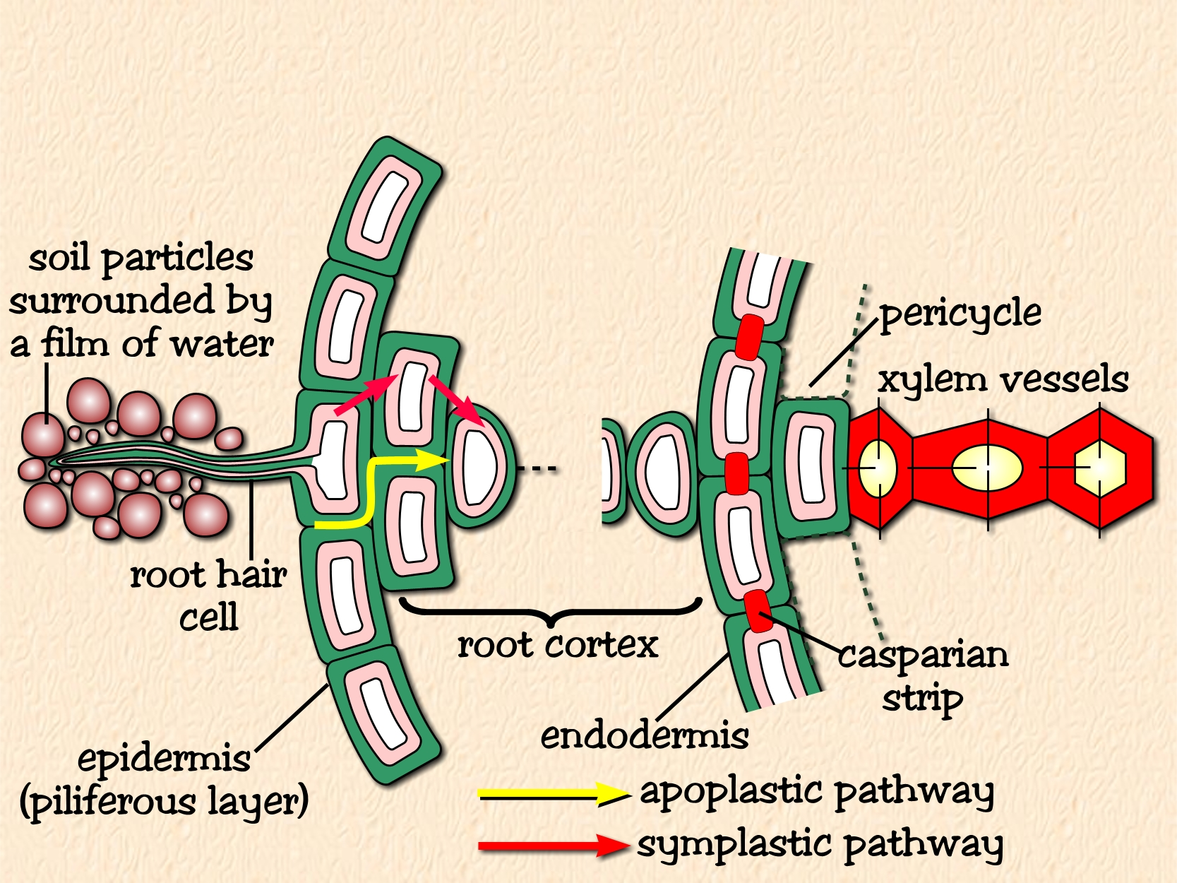

Water Transport Across The Root
Mineral ions are actively transported into the
root hair cells lowering the Water potential so it is lower than that in the soil.
Water therefore enters root hair cells from the soil solution by osmosis
(i.e. along a water potential gradient)

Slide 26
Root pressure.
Ions are actively transported from the endodermis to the xylem.
This lowers the water potential of the xylem.
Water moves from the roots into xylem by osmosis!!!!!.

Slide 27
How does water move up the xylem (in the stem)?
Cohesion and tension help to transport water from the roots to leaves against gravity:
Water evaporates from the leaves at the “top” of the xylem through transpiration stream
This creates tension (suction) which pulls more water into the leaf (think of a straw)
Water molecules are cohesive (stick together H-bonding), adhesion water molecules are attracted to the walls of the xylem.
So a column of water moves upwards through the xylem

Slide 30
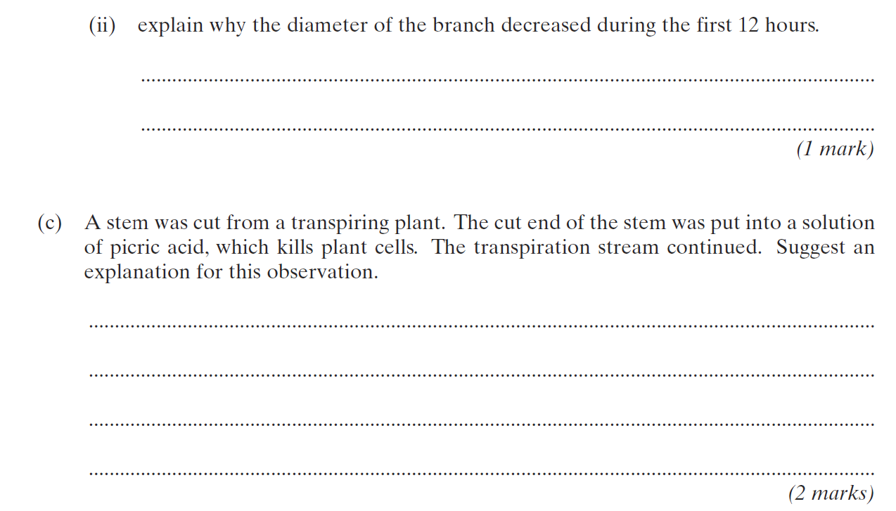

Slide 31
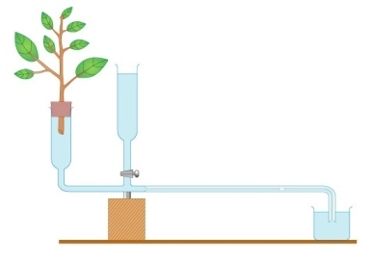
Measuring rate of transpiration?
Use a potometer
Measures rate of water uptake by a plant
Presume, rate of water uptake = rate of transpiration
Healthy leaf and shoot of plant is used

Slide 32
Other questions
Why add stem under water?
What is the purpose of the reservoir?
How can we compare different plants.
Light intensity why have a beaker of water in front of the lamp?
Why does the bung need to be air tight.
What measurements do we need to take to calculate the rate of transpiration?
The final rate will be an overestimate of transpiration. Why?

