Slide 1
How can I revise effectively?

Slide 2
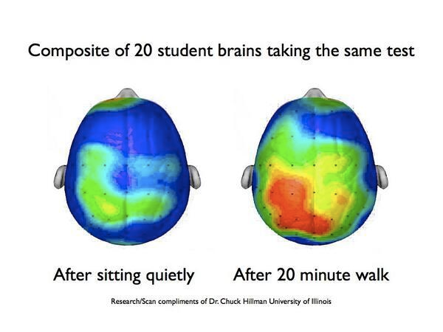
Your brain - 2% total body weight
- and yet it receives 20% of body’s blood supply

Slide 3
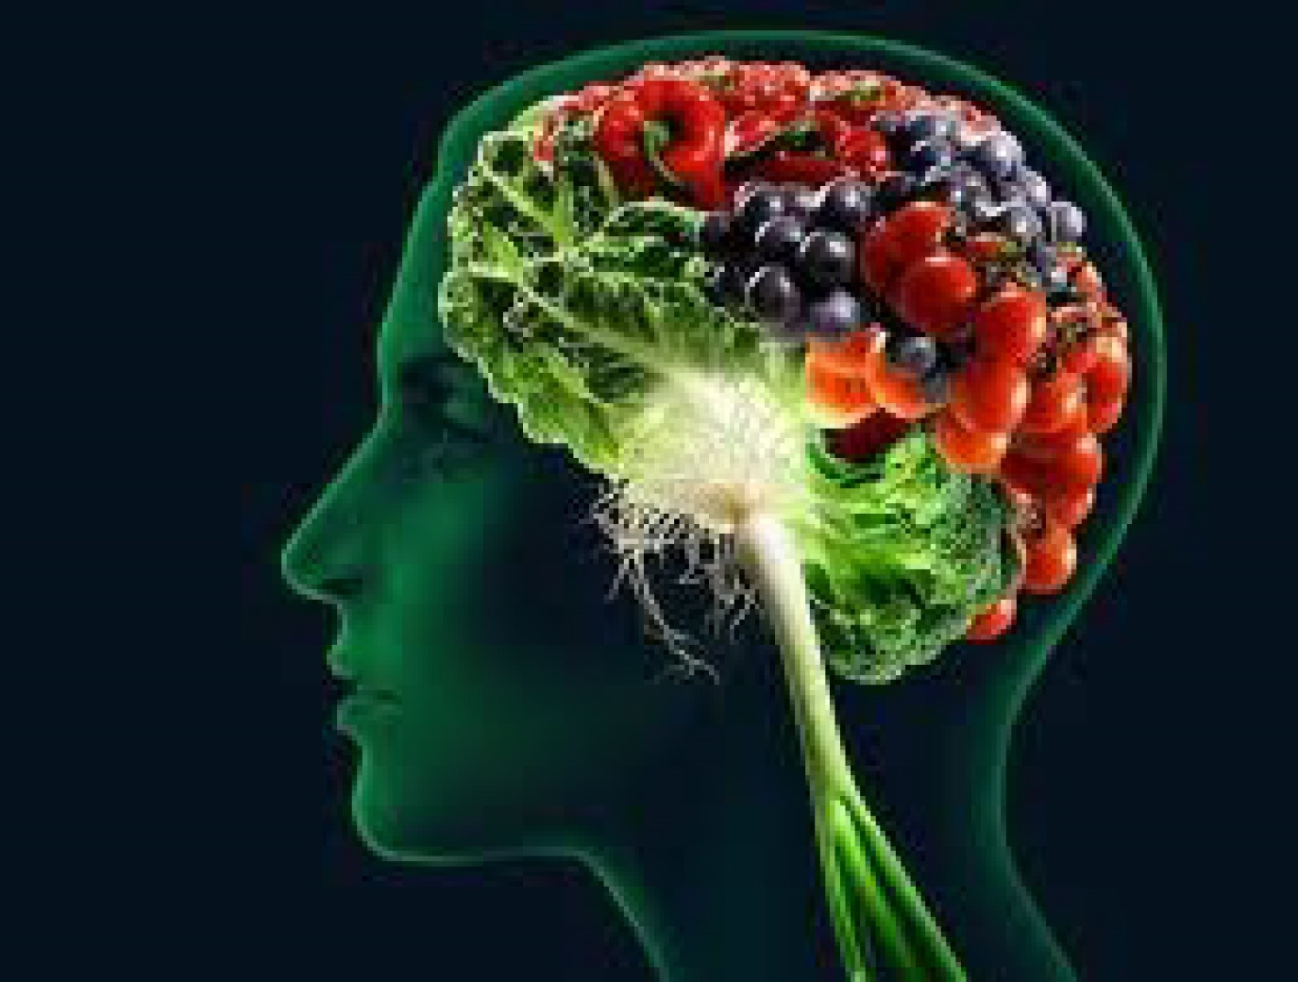

Slide 4
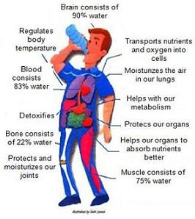
Drink 6-8 glasses a day
Fill a bottle in the morning and keep it with you
Cut down on: caffeinated drinks
fizzy drinks
energy drinks

Slide 5
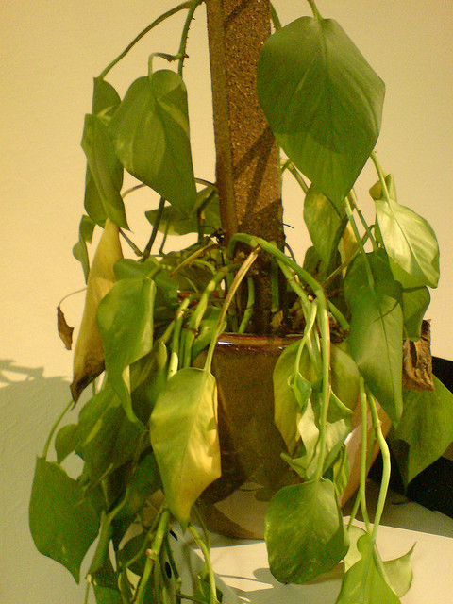
Signs of dehydration
Tiredness
Sluggish thinking
Concentration issues
Short term memory loss
Head ache
Moody
Craving caffeine and sugar

Slide 6
Sleep
Consolidates memory!
Aides memory process
Reduces stress hormones

Slide 9
So how can this workshop move beyond 20 percent student retention?
Your focus
Use the Memory maps - write on them, make them yours
Talk to each other during the breaks
Walk in your breaks/snacks/water
PEQs

Slide 10
Active Revision starts with active consolidation
Reading through your notes to check understanding and using multiple sources of information/1-1s/study buddy to find answers to things that you don’t fully understand.

Slide 11
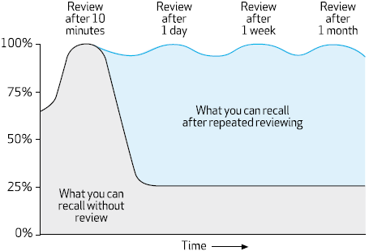
Active Revision
Summarise the information: memory cards, memory maps
Revisit on a daily basis.

Slide 12
Active Revision
Practise papers (timed)
Practise topics (evaluate your weaknesses)
Practise timed essays
Practise with a study buddy

Slide 13
Examiner’s feedback
Do not write outside the prescribed box, use additional pages in booklet and identify clearly which part of the question you are continuing.
Quality of written communication (“good English and orderly presentation”)
Handwriting
Spelling

Slide 14
Advice from Revision Guide
“Candidates tend to penalise themselves unnecessarily when they misread questions, either because they read them too quickly or too superficially. It is essential that candidates appreciate the precise meaning of each word in the question if they are to be successful in producing concise, relevant and unambiguous responses. The mark value at the end of the question provides a useful guide as to the amount of information required in the answer”

Slide 15
Examination technique
Start with a question that you feel confident with
Do not spend too long on any one Q, come back to it at the end.
Read the information at the beginning of every question for clues/signposts. Can you visualise/draw the information to help you gain understanding?
a), b) and c) are all related to the opening statement. i), ii), iii) are closely related to a) or b) or c)
Read the question twice (once, backwards), check command words such as describe, explain
Avoid the use of “it” in your exam answers – what is it? Treat the examiner as if they are a small child.

Slide 16
Examination technique
Consider using bullet points for clarity (one bullet point/mark)
Use AS knowledge (not GCSE), raise your level to that of an AS student, using specific AS vocabulary.
Think laterally, make links between unit 1 and unit 2, relate your knowledge to the specification.
Read your answer back to yourself, does it make sense, is your language precise? do you need to expand on your answer?
Use labels, draw diagrams to clarify your answers
Annotate Graphs/tables/figures to work out what the data is telling you – don’t be afraid to write on the exam paper. Quote data in your answers.

Slide 17
Proteins and Enzymes

Slide 18
Amino acids are the basic monomer units which combine to make up a polymer called a polypeptide. Polypeptides can be combined to form proteins.
Hydrogen atom
H
Amino group
O
H
Carboxylic acid group
N
C
C
H
OH
R
R group
There are 20 naturally occurring amino acids found in proteins. These are the same in all living organisms. Evidence for evolution

Slide 19
DIPEPTIDE
R
R
H
O
H
O
N
C
C
N
C
C
H
OH
H
OH
H
H
Peptide bond
CONDENSATION
R
O
H
R
H
O
N
C
C
N
C
C
H
OH
H
H
H₂O

Slide 20
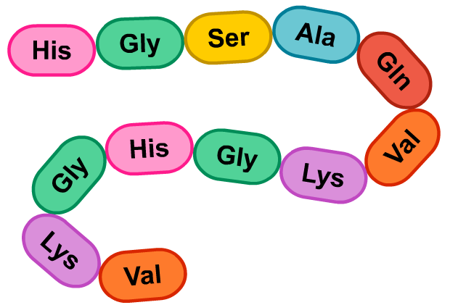
Sequence of amino acids in primary structure is determined by DNA.
Primary structure determines ultimate shape and function of protein. A protein’s shape is very specific to its function.
Type, Number, Sequence
Primary structure

Slide 21
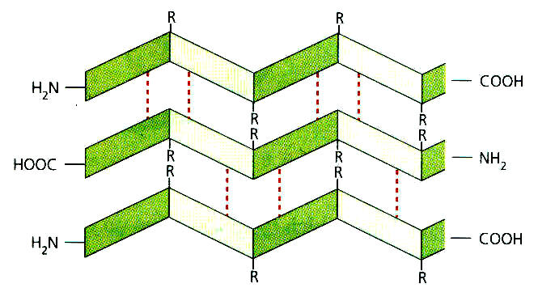
Secondary Structure
H Bonds between the –C=O (negative charge) and –NH(positive charge) either side of peptide bonds
R
R
R
R
R
R
R
R
R
R
R
R
R
R
α-helix

Slide 22
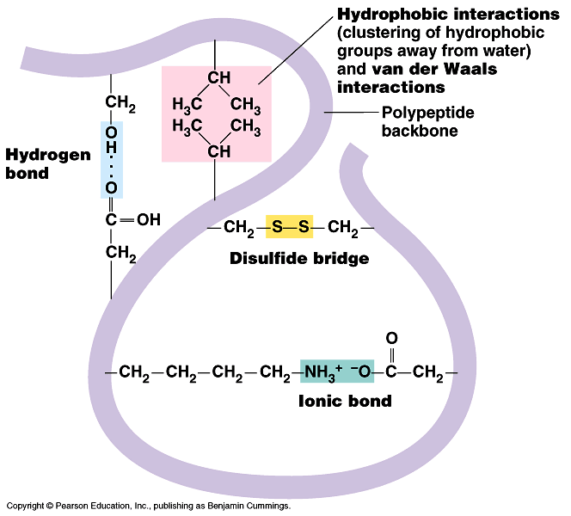
Tertiary structure
amino group: called
N terminus
carboxyl group: called
C terminus
Note: carboxyl terminus (C terminus) and
amino terminus (N terminus) at either ends of protein

Slide 23
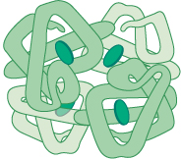
Quaternary Structure
A number of different individual polypeptide chains. There may also be non-protein (prosthetic groups). This 3D shape determined by primary sequence.

Slide 24
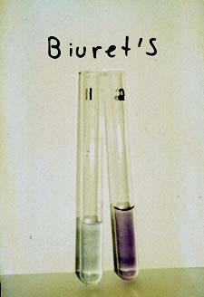

Slide 25
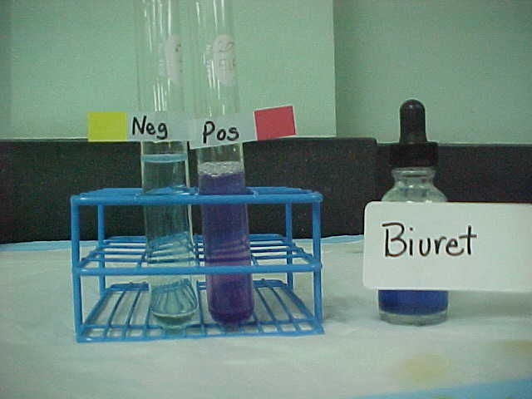
Biuret test for Proteins
Place a sample of the solution to be tested in a test tube and add an equal volume of Biuret reagent (copper (II) sulfate solution and sodium hydroxide)
A purple/lilac colour shows protein is present
If the solution stays blue then the result is negative (no protein present).

Slide 26
Fibrous | Globular
Structural (keratin,collagen) | Metabolic (haemoglobin, insulin,enzymes,hormones, transport proteins)
Unbranched primary structure; tightly wound secondary structure; tertiary structure is twisted helix quaternary structure 3 polypeptides wound together | secondary and tertiary structures with a specific 3d spherical shape
Structure maintained by H bonding | H bonding, ionic bonds and disulphide bridges and hydrophobic bonds
Parallel polypeptide chains cross linked to form long fibres, which provide strength | Surface of the molecule has depressions in it into which other molecules can fit
Stable | Relatively unstable, 3d structure can be affected by temp and pH
Usually insoluble in water (external R groups are non polar) | Usually soluble in water (external R groups are polar)

Slide 27
Functions of Proteins
Function | Examples
Catalysis | Hydrolytic enzymes in lysosomes Amylases, endo and exo peptidases, lipases to hydrolyse starch, protein and lipids in gut
Transport | Haemoglobin to transport oxygen and carbon dioxide Myoglobin to carry oxygen in muscle Intrinsic proteins in membrane – channels and pumps (facilitated diffusion and active transport)
Structural/support | Collagen fibres in connective tissue (cartilage and tendons) Keratin fibres in hair, nails and claws

Slide 28
Functions of Proteins
Function | Examples
Defence | Antibodies mark foreign proteins for elimination
Hormones | Insulin to regulate blood sugar
Motion | Actin and myosin for the contraction of muscle fibres
Exchange of materials between blood and cells | Large plasma proteins reduce the water potential in the blood
Can you think of any more?

Slide 29
Enzymes
All enzymes are tertiary globular proteins where the protein chain is folded back on itself into a spherical or globular shape.
Each enzyme has its own sequence of amino acids and is held in its tertiary form by hydrogen bonds, disulphide bridges and ionic bonds. This complex three-dimensional shape gives the enzyme many of its properties.
Enzymes are proteins made inside living cells but may act inside the cell (intracellular) or outside (extracellular) such as the digestive enzymes of the alimentary canal.

Slide 30
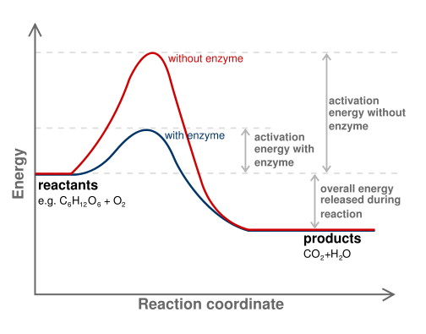
Energy of Reactions
Before a chemical reaction can proceed it must initially be activated. ie its energy must be increased.
This energy required is called ACTIVATION ENERGY
The energy required to break existing bonds so that new ones can be formed (this is the energy needed to start the reaction)
Enzymes lower the activation energy by putting stress on the bonds within a molecule, or by holding molecules closer together. This increases the chances of a reaction, and so lowers the energy required to begin it

Slide 33
Lock and Key Model
EXPLANATION
Rigid model
Enzyme is ‘lock’
Substrate is ‘key’
Enzyme substrate complex forms and lowers Ea
Enzyme can be used again
Note: substrate shape is COMPLEMENTARY to the active site shape.
S
P
P
S
E
E
E
Enzyme (a protein) has a TERTIARY structure that gives it an ACTIVE SITE with a SPECIFIC shape
Substrate fits the active site and forms ENZYME SUBSTRATE COMPLEX
Reaction takes place and products are released
Induced Fit Model
EXPLANATION
Enzyme MOULDS itself around the substrate
Ea is lowered
Enzyme can be used again
MORE WIDELY ACCEPTED VIEW
Is a DYNAMIC MODEL
S
P
P
S
E
E
E
The active site of the enzyme is FLEXIBLE and takes on the shape of the substrate

Slide 36
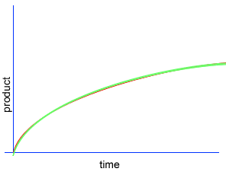
Enzymes and Rate of reaction
We can measure the rate of reaction
by measuring the appearance of product,
or the disappearance of reactants over time.
A chemical reaction proceeds when molecules with sufficient kinetic energy, successfully
collide, and react.
Initially, product is formed at a high rate as there are plenty of substrate molecules to fit the active sites forming an enzyme substrate complex.
As substrate molecules become scarce, the rate of product formation slows down and eventually levels out when all of the substrate has been converted to product

Slide 37
Measuring rate of change (express per unit time)

Slide 38
Enzyme graphs – you have to know these!
Describe-describe the shape of the graph
Explain- tell me what is happening biologically to explain the shape of the graph
Factors effecting enzyme action
Temperature
pH
Concentration substrate
Concentration of enzyme
Controlled experiment
Boiled enzyme, cooled and then repeat experiment –all other conditions remain the same

Slide 39
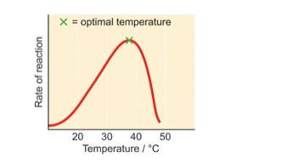
Temperature
There is a certain temperature at which an enzyme's
catalytic activity is at its greatest (see graph).
This optimal temperature is usually around human body temperature (37.5C) for the enzymes in human cells.
As the temperature rises, reacting molecules have more and more kinetic energy. This increases the chances of a successful collision and more enzyme substrate complexes so the rate increases.
Above this temperature the enzyme structure begins to break down (denature) since at higher temperatures the hydrogen, disulphide and ionic bonds that hold the tertiary structure in shape are broken as the enzyme molecules gain even more kinetic energy. This results in a change of shape of the active site- firstly rate slows as substrate less easily fits into active site (45C) until 60C when enzyme no longer bind to the substrate (denatured)

Slide 40
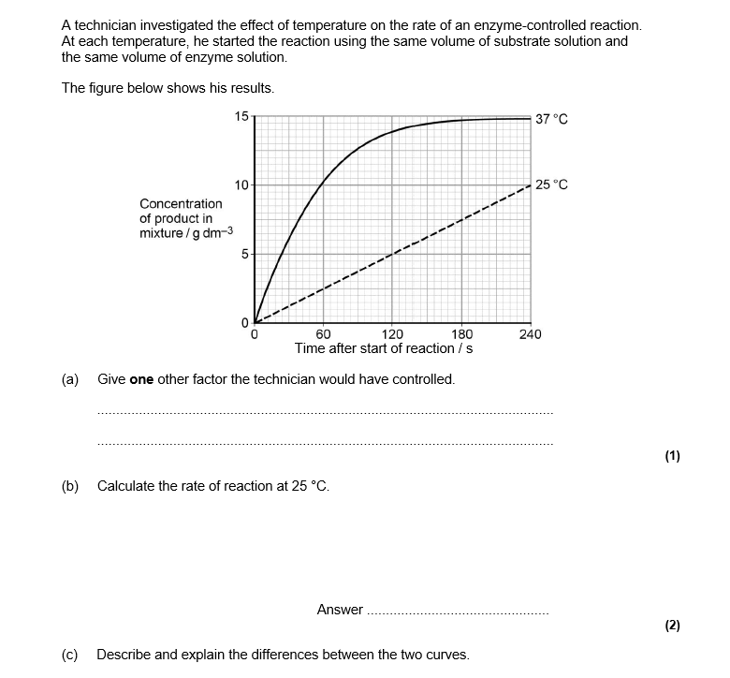

Slide 41
Mark scheme

Slide 42
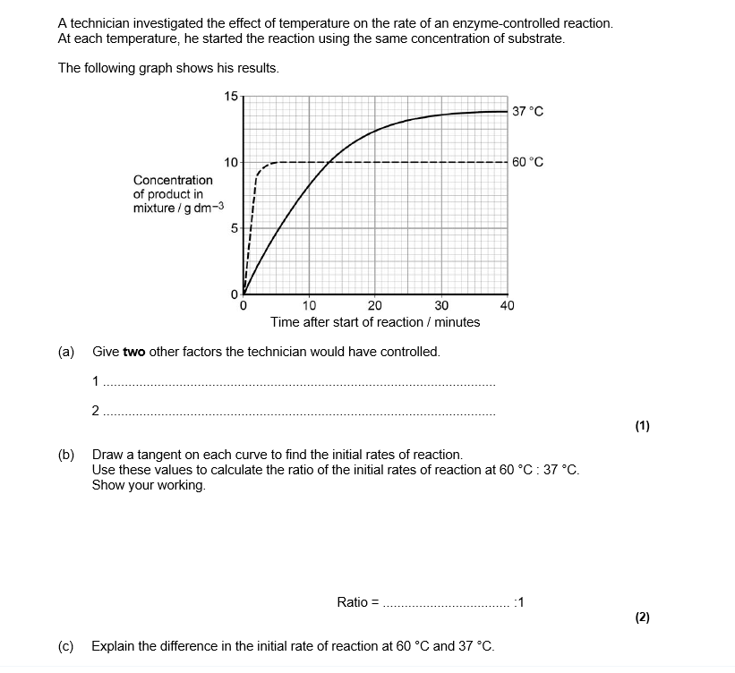

Slide 44
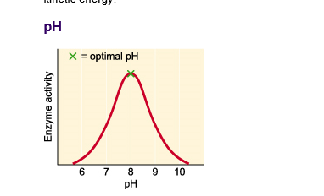
pH
PH of a solution measure of H+ ion concentration
A change in pH:-
alters charges on amino acids that make up the active site of the enzyme. Substrate can no longer attach to active site-No ENZYME SUBSTRATE COMPLEXES FORM.
Large pH changes cause bonds maintaining tertiary structure to be broken
Hydrogen and ionic bonds are bond affected by pH

Slide 47
Effect of Enzyme Concentration
Diagram to Show the Effect of Enzyme Concentration on an Enzyme Controlled Reaction
The rate of an enzyme catalysed reaction will vary with changes in enzyme concentration. Increasing the enzyme concentration will increase the rate of reaction
Normally there is excess substrate so the rate continues to rise as enzyme concentration is increased
Substrate is limiting, rate levels off.
B
y
Enzyme is limiting
Reaction rate
A
Enzyme concentration
x

Slide 48
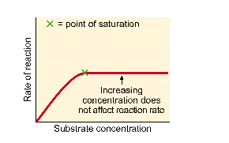
Effect substrate concentration
Excess substrate
All active sites are full
The enzyme/substrate complex has to dissociate before the active sites are free to accommodate more substrate.
Limiting factor enzyme
Low substrate concentration
Not all active sites occupied
Limited number of substrate molecules the enzyme can collide with
Enzymes not at full capacity
Limiting factor substrate
Vmax rate of reaction at it’s maximum. All enzyme’s active sites are full (saturated)

Slide 51
Key words
active site
Complementary to
Enzyme substrate complexes

Slide 52
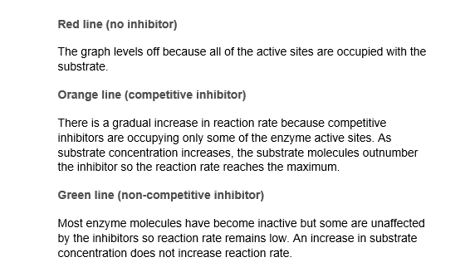
graphs

Slide 55
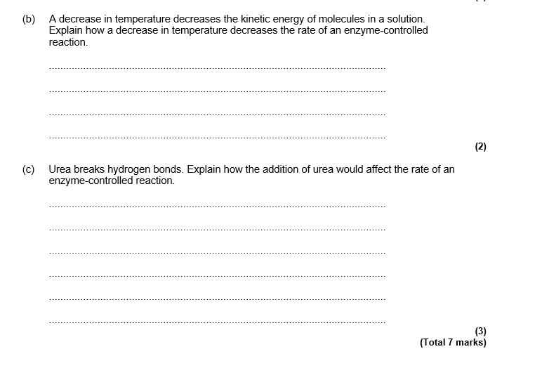

Slide 57
Control of metabolic pathways
The activity of the enzymes is controlled by the end product molecules binding to a specific allosteric site on the enzyme, distinct from the active site. This is a sophisticated way of controlling the rate.
End product inhibition usually takes place as part of a metabolic pathway.

Slide 58
increased kinetic energy increases collisions
Enzyme is denaturing
Enzyme is denaturing
enzyme DENATURES due to vibration
All active sites of enzymes are occupied
ENZYME IS LIMITING
rate of reaction
Optimum pH
rate of reaction
Optimum temperature
pH
Some enzyme molecules have active sites available SUBSTRATE IS LIMITING
temperature
2 Effect of pH
rate of reaction
1 Effect of Temperature
Factors Affecting Enzyme Action Overview
substrate conc^{n}
3 Effect of Substrate Concentration
reaction with no inhibitor
reaction with no inhibitor
With excess substrate rate continues to increase. ENZYME IS LIMITING
rate of reaction
rate of reaction
If SUBSTRATE is LIMITING rate levels off.
substrate conc^{n}
substrate conc^{n}
rate of reaction
More substrate means more will bind to the enzymes active site in preference to the inhibitor. At high substrate concentrations the COMPETITIVE INHIBITOR has little effect
NON - COMPETITIVE INHIBITOR affects the same number of enzyme molecules. Increasing the substrate concentration does not reduce the effect of the inhibitor
Enzyme conc^{n}
4 Effect of Enzyme Concentration
5 Effect of Competitive Inhibitor
6 Effect of Non Competitive Inhibitor

Slide 59
Inorganic ions
Inorganic ions occur in solution in the cytoplasm and body fluids of organisms, some in high concentrations and others in very low concentrations.
Each type of ion has a specific role, depending on its properties.
Students should be able to recognise the role of ions in the following topics:
hydrogen ions and pH;
iron ions as a component of haemoglobin;
sodium ions in the co-transport of glucose and amino acids;
and phosphate ions as components of DNA and of ATP.

