Slide 1
Meiosis

Slide 2
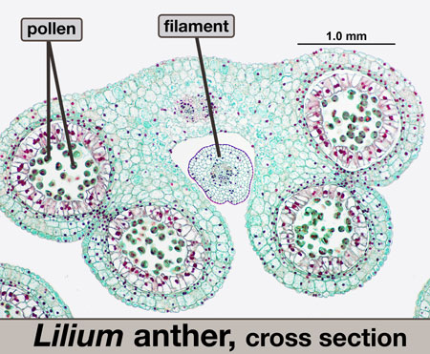
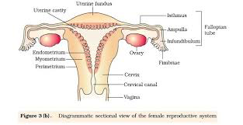
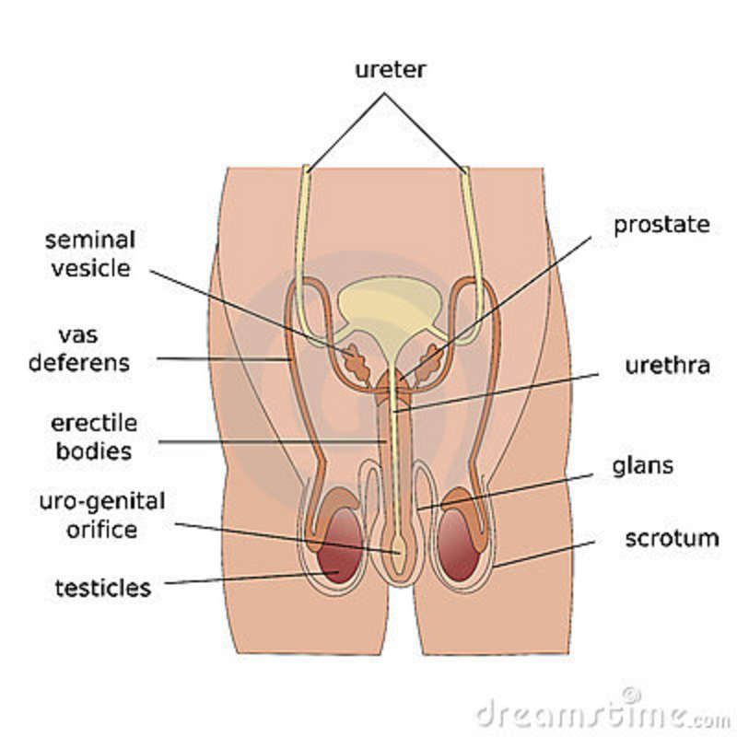
Where does meiosis take place?
In the reproductive organs of both plants and animals
To make haploid gametes

Slide 3
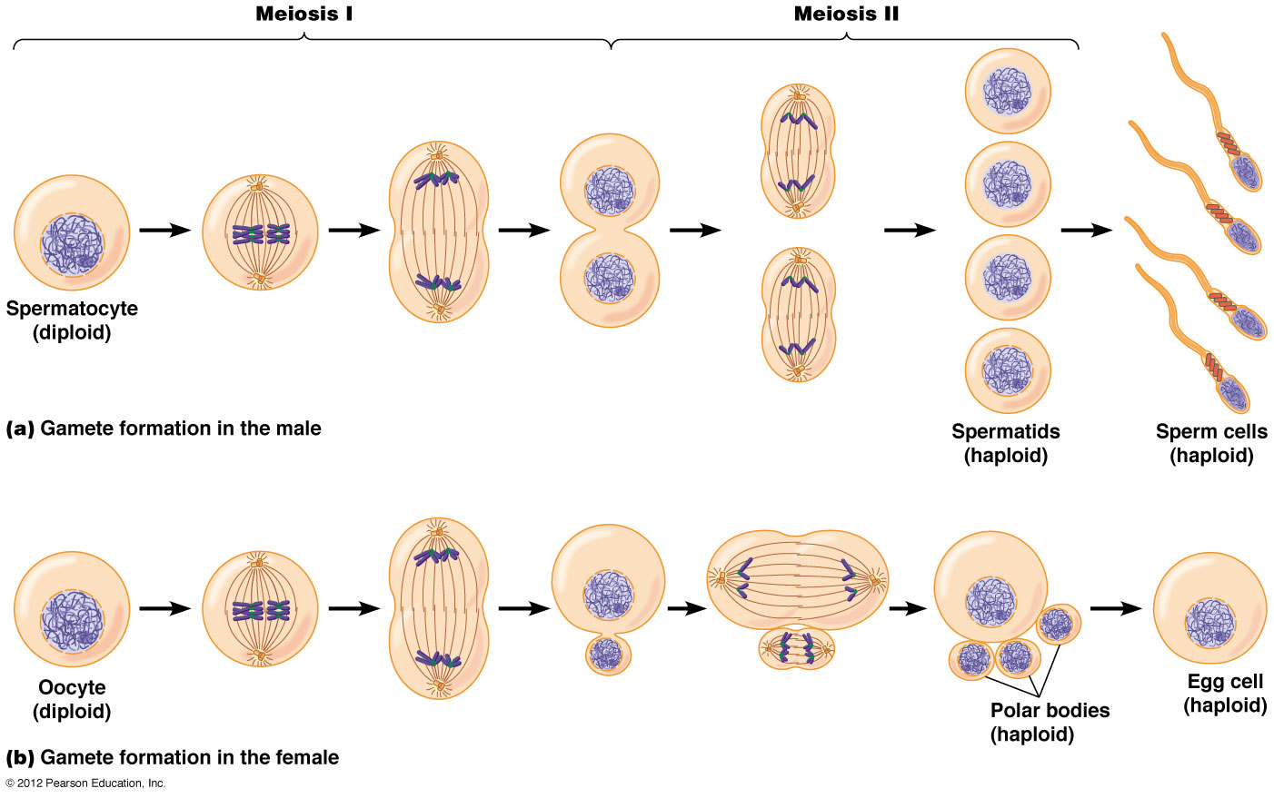
What are the gametes called?

Slide 4
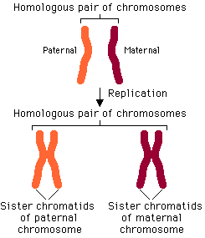
What are homologous chromosomes?
Pairs of chromosomes carrying alleles of same gene loci and therefore determine the same features.
One of the pair is derived from the female parent (maternal chromosome), one is derived from the male parent (paternal chromosome)

Slide 5
The significance of meiosis
It is a reduction division so that gametes are haploid and at fertilisation the diploid number of chromosomes of the species is restored
Genetic variation is produced by meiosis as during prophase 1 crossing over during chiasmata formation takes place. This means new combinations of genes takes place and linked genes may be separated.
Homologous pairs of chromosomes arrange themselves on the equator of the cell in metaphase 1 and separate at anaphase 1 independently of each other. This is called the independent assortment of homologous chromosomes
Each gamete is haploid and so needs another gamete to form a diploid zygote and so new combinations of genetic material are formed.

Slide 6
In meiosis each chromosome lines up alongside its homologous partner.
Chromatids of each pair become twisted around each other. Portions of the chromatid break off.
When these homologous pairs arrange themselves on the equator they do so at random. Which one of the pair that goes into the daughter cell depends on this lining up. This is called independent segregation

Slide 7
Key events in meiosis
You must be able to identify stages of meiosis from photomicrograph or diagram.
Is there one region of stained material, then it is the first division of meiosis – look for where the staining is, diffuse, centrally placed or making V shapes?
Are there two regions of stained material in one cell, then this is a stage of meiosis 2.
You MUST always have a number following the stage eg prophase 1 or anaphase 2
You must also be able to distinguish between haploid and diploid cells – look for matching pairs of chromosomes and you have a diploid cell, the diploid number of chromosomes is the total number of all the chromosomes in the nucleus. If you only see unmatching chromosomes then you have a haploid nucleus.

Slide 8
Causes of variation

Slide 9
Mutations
A change in the quantity or structure of DNA
Two types:
Gene (point ) mutation – a change in one or more nucleotides bases or a change in the sequence of bases, caused by errors in DNA replication.
Chromosome mutation – a change in the number or structure of chromosomes, caused by errors in cell division.

Slide 10
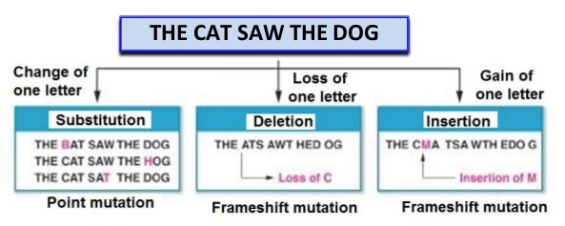
Gene Mutations
Base substitutions (point mutations)
Base deletions or insertions (frameshift mutations)

Slide 11
Sickle Cell Anaemia – a genetic disease caused by a base substitution

Slide 12
Effects on blood flow. The sickle shaped cells cannot carry as much oxygen and get caught in the capillaries cutting off the blood supply to the organs

Slide 13
An advantage in certain parts of the world?
An increased resistance to malaria because misshapen deflated red blood cells are poor hosts to plasmodium that causes the disease.

Slide 14
Substitution Effect on the Protein
The significance of the difference depends on the role of the amino acid that’s changed. If it is important in forming bonds that determine the tertiary structure of the final protein, then the replacement amino acid may not form the same bonds. The protein may then be a different shape and therefore not function properly. For example, if the protein is an enzyme then its active site may no longer fit the substrate.
If the new triplet still codes for the same amino acid then the mutation will have no effect. This is one of the advantages of the degenerate code.

Slide 15
Frame shift effect on the protein
So called because they shift the way that the sequence is read.
Caused by insertions or deletions of bases.
Since mRNA is translated 3 nucleotides at a time insertions or deletions that do not involve multiples of three change how all of the mRNA nucleotides down stream of the mutation are translated.
Almost always result in a non functional protein.

Slide 16
Mutagenic Agents
Can increase the rate of gene mutation.

Slide 17
Chromosome mutations
Two types:
Changes in whole sets of chromosomes (polyploidy), where organisms have 3 or more sets rather than the usual two. Usually found in plants.

Slide 18
Chromosome mutations
Changes in the number of individual chromosomes
Resulting from homologous pairs of chromosomes or sister chromatids failing to separate during mitosis or meiosis. Known as non disjunction.

