Slide 1
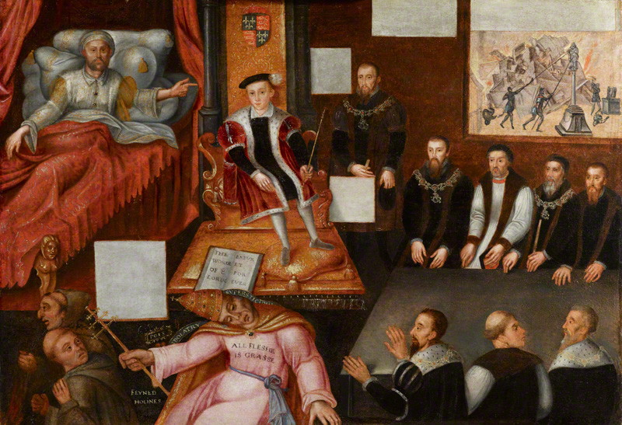
EDWARD VI 1547-53

Slide 2
3 THEMES
Monarchy: how seriously was the monarchy undermined by having an underage king & by Northumberland’s attempt with Edward’s support to stop Mary becoming Queen in 1553?
Rebellions: why was there so much unrest in 1549 (especially the Western & Norfolk Rebellions) & how seriously did they threaten the government?
Religion: how successful was the attempt by Edward, Somerset & Northumberland to make England Protestant for the first time?

Slide 3
SOURCE EVALUATION
1. Set of rebel demands which mentions only religious grievances at a time of social & economic unrest.
2. Letter from the Venetian ambassador to the Venetian Senate about rebellions in Cornwall & Norfolk.
3. Letter from Sir William Paget to Somerset in 1549 criticising his anti-enclosure policy & claiming it caused the rebellions by encouraging the peasants to take the law into their own hands.
4. Account by a Catholic gentleman about whether Edward VI or Northumberland was responsible for trying to exclude Mary from the succession in 1553.
5. Letter from the Privy Council, at a time when it was dominated by Northumberland, to Mary warning her that she was not the rightful heir.
6. Letter from the French ambassador to his master Henry II regarding a conversation he had with Northumberland about French intervention to stop Mary becoming Queen in 1553.

Slide 4
EVIDENCE THAT THE ROYAL MINORITY WAS A SERIOUS PROBLEM
Royal minorities had caused problems before: there had been civil wars in the reigns of both Henry III, who became King at the age of 9 in 1216, & Edward V, who became King at 12 in 1483. E V had lost the throne to his uncle Richard III after only 3 months & was almost certainly murdered by him.
As a child king, E obviously did not have the authority his father had had, nor could he intimidate people as H had done through the Treason Act & over 300 executions for opposing the Reformation.
This problem was compounded by Somerset’s decision to repeal H’s Treason Act & the heresy laws, which caused an upsurge of religious unrest.
As Lord Protector Somerset did not have the same authority an adult king would have had, partly as his title went against H’s wishes (expressed in his will) for a balanced Regency Council.
The outbreak of serious rebellions in the South West & Norfolk in 1549 which resulted in the fall of Somerset showed how govt. authority had been undermined.

Slide 5
EVIDENCE THAT IT WAS NOT
Henry III (1216-72), Richard II (1377-99) & Henry VI (1422-61) had all succeeded to the throne as minors but retained their throne into adulthood.
E was not sickly until his final illness in 1553 so the general assumption was that he would live to become an adult king & have an heir as Henry III & Henry VI had done.
Henry VII & VIII had established a strong Tudor dynasty by 1547 & no one challenged E’s right to the throne, including the rebels of 1549.
As E’s uncle & following his victory over the Scots at Solway Moss it was logical that Somerset should be L Protector. In a country used to monarchy, it made sense to have a Protector rather than rule by a Regency Council which might have difficulty reaching agreement.
The crisis of 1549, including the rebellions & the fall of Somerset, were caused more by Somerset’s incompetence & underlying religious & economic problems rather than by the royal minority as such.
Following the crisis of 1549, Northumberland restored stability 1550-3 & there was no further unrest until it became clear that E was dying.

Slide 6
EVIDENCE THAT THE SUCCESSION CRISIS OF 1553 SERIOUSLY THREATENED THE STABILITY OF THE MONARCHY
It could be argued that Northumberland (below right) acted as an “overmighty subject”, putting his own ambition & interests above the security of the Crown. He married Lady Jane Grey to his son Lord Guildford Dudley & then persuaded the dying 15 year old King to alter his “Device for the Succession” in Jane’s favour.
Jane’s claim as the granddaughter of H’s sister Mary was clearly inferior to that of H VIII’s eldest daughter Mary; she knew this & did not want to be queen but was manipulated by Nthumb.
Legally the Succession Act of 1544 clearly overruled the “Device” of a 15 year old king which was never approved by Parliament. It also superseded the acts of 1534 & 1537 (quoted by the Privy Council in a letter to Mary just after E’s death) which had excluded Mary from the succession.
In June 1553, knowing E was dying, Nthumb. forced the Privy Council & other notable people to sign articles supporting Jane. When E died on 6 July Nthumb. kept his death secret for 2 days & forced leading London citizens to sign E’s “Device”.
Conversely, it can be argued that it was Edward himself who threatened the security of his own dynasty by trying to interfere with the succession for religious reasons; he was quoted as saying, “if our sister Mary were to be queen, it would all be over for the religion we have established”.
Similarly Archbishop Cranmer showed disloyalty to the dynasty he was appointed to serve for religious reasons & b/c he knew Mary would burn him as a heretic. His later claim that “I never liked” E’s will & “if by any means possible it had been in my power to have prevented the making of that Will, I would have done it” was an obvious lie.
There was a real threat that the succession dispute in 1553 could have provoked not just a civil war but also a foreign invasion: Nthumb. discussed with the French ambassador the possibility of French military aid against the half-Spanish Mary, while Mary herself requested help from her nephew Charles V.

Slide 7
EVIDENCE THAT IT DID NOT
If Nthumb. was the main author of the attempt to interfere with the succession he was remarkably & uncharacteristically incompetent in how he set about it: he did not have an army available to support Jane (in fact he had disbanded his army in 1552), he failed to prevent Mary escaping to East Anglia & he also neglected to organise a propaganda campaign against her.
The nobility & gentry had a vested interest in supporting the principle of legitimate inheritance, on which their right to their own property depended; it was therefore never likely that they would support Jane against Mary.
Mary acted quickly & decisively to secure her rightful position by escaping to East Anglia, proclaiming herself Queen, sending letters to the Privy Council & important towns asserting her claim & quickly raising a large army.
As soon as Nthumb. left London to confront Mary, the Privy Council went over to her & many of his soldiers deserted despite being offered higher pay, showing how strong loyalty to the rightful heir was. In fact so many of his army deserted that Nthumb. had to give up & declare Mary Queen himself instead of fighting her.
The religious divisions in England mattered less than her legitimacy: she was greeted with enthusiasm in London despite the presence of many Protestants there. Some historians have argued that Mary herself underestimated the extent to which her success was due to her legitimacy rather than her religion.

Slide 8
EVIDENCE THAT THE WESTERN REBELLION WAS CAUSED BY RELIGION
William Body was murdered at Helston when he tried to enforce the destruction of images in local churches.
Traditionally known locally as the “Prayer Book Rebellion”, it started with demonstrations agt. the Book of Common Prayer in Bodmin (Cornwall) & Sampford Courtenay (Devon, where the priest was forced to read Mass instead). Most Cornish peasants at this time still spoke Cornish & the rebels said that they did not understand English.
The rebellion seems to have started by priests like Robert Welch who then persuaded Humphrey Arundell, a local gentleman with military experience, to lead them.
When the rebellion was crushed the priests involved were publicly hanged in their “popish” mass vestments.
The rebels’ initial demands have been lost but the 2nd set were predominantly religious.

Slide 9
RELIGIOUS UNREST IN NORFOLK & ELSEWHERE
Unlike the rebels in Devon & Cornwall, the Norfolk rebels seem to have been Prot. & anticlerical: they used the Book of Common Prayer in their camp at Mousehold Heath & made no demands for the restoration of Catholicism.
They demanded that the clergy preach the Word of God, teach poor children & be accountable to local peasants rather than the lord of the manor. They also demanded a reduction of tithes.
There is clear evidence of religious unrest, often led by priests, in Yorkshire (the Seamer rising), Oxfordshire, Hampshire & Northamptonshire.

Slide 10
EVIDENCE THAT THE WESTERN REBELLION HAD SOCIAL & ECONOMIC CAUSES
Evidence of social & economic grievances in the initial rebel demands, in particular for the cancellation of the tax on sheep & cloth which hit Devon particularly hard because of the importance of sheep farming there.
Although Humphrey Arundell provided some gentry leadership, there is also much evidence that this was a rebellion of peasants against gentry: the Cornish rebels attacked & robbed the gentry at St Michael’s Mount & the Devon rebels at killed William Hellyons, a gentleman who tried to stop them & force them to go home.
The city authorities in Exeter denied access to the rebels & recruited guards from the wealthier elements of the population to hold the city; they feared that the poor within the city might support the rebels & bribed them with cheap food & poor relief to prevent them from doing so.
Even the commander of the royal army which defeated the rebels criticised the local gentry for making the peasants pay extortionate rents, abandoning the traditional concept of “good lordship”.

Slide 11
EVIDENCE THAT THE NORFOLK REBELLION HAD SOCIAL & ECONOMIC CAUSES
The unrest started in Attleborough & Wymondham as riots against enclosures, directed especially against a local lawyer, John Flowerdew. These riots started when the news reached Attleborough that Hales’ anti-enclosure commission would soon be coming to Norfolk, encouraging the peasants to take the law into their own hands.
There was peasant anger that gentry were grazing large flocks of sheep on common land, exhausting the land or even forcing the peasants off it.
As in Devon & Cornwall there were complaints about excessive rent rises.
Serfdom was still practised on some of the Duke of Norfolk’s estates.
The rebels demanded commissions elected by peasants to take control of local government from gentry JPs.
The depression in the cloth trade hit Norfolk, especially Norwich, more seriously than virtually anywhere else in England.

Slide 12
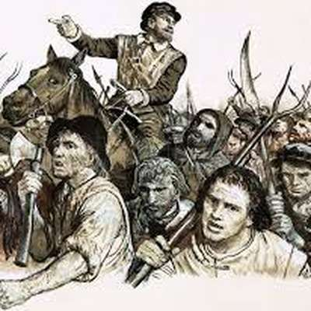
EVIDENCE OF SOCIAL & ECONOMIC UNREST GENERALLY
There is clear evidence of unrest against enclosures in Lincolnshire, Hertfordshire, Cambridgeshire, Suffolk, Kent & even Surrey, where local peasants threw down enclosures at Witley before marching on Godalming!
John Guy has described the rebellions & unrest in 1549 as the nearest England has come to class warfare.

Slide 13
POLITICAL CAUSES
The downfall of the Courtenay family in 1538 created a power vacuum in Devon & Cornwall; with no dominant local noble, the gentry were leaderless.
As in Devon & Cornwall, the political disgrace of the Duke of Norfolk in 1546 (not reversed until Mary’s reign) created a local power vacuum which left the local gentry leaderless.
The King was only 11 & as Lord Protector Somerset did not have the same authority as a king.
In most counties local nobles, e.g. Arundel in Sussex, prevented unrest from escalating.

Slide 14
EVIDENCE THAT THE WESTERN REBELLION POSED A SERIOUS THREAT
All attempts by local gentry to disperse the rebels failed; on 20 July Cornish rebels joined Devon rebels at Crediton, taking the govt. by surprise
The royal army was slow to reach Devon b/c it had to put down unrest in Oxfordshire & Buckinghamshire first
Somerset had to offer them a pardon but they still refused to disperse (they were not fooled like the Pilgrims of Grace). Troops had to be diverted from Scotland & mercenaries employed to put rebellion down.
It took at least 3 battles to defeat the rebellion; Lord Grey, who had fought in Scotland, said the battle at Clyst Heath was the most ferocious he had ever taken part in.
There were more executions than in Norfolk b/c the govt. saw the rebellion as a serious threat to its religious policy, hence the hanging of rebellious priests in their mass vestments.

Slide 15
EVIDENCE THAT THE NORFOLK REBELLION POSED A SERIOUS THREAT
Strong leadership, not just from Kett but also other important men like Thomas Aldryche & the Mayor of Norwich, Thomas Cod
Norwich (then England’s 2nd city) captured
The rebels had an army of 16,000 men; the Marquis of Northampton was too intimidated to fight them.
Somerset had to offer them a pardon but they still refused to disperse (they were not fooled like the Pilgrims of Grace).
Troops had to be diverted from Scotland & mercenaries employed to put rebellion down.

Slide 16
EVIDENCE THAT THE UNREST SERIOUSLY UNDERMINED GOVERNMENT STABILITY
The King was a minor & as Lord Protector Somerset did not have the same authority an adult king would have had.
With wars against France & Scotland, there was a danger of a foreign invasion to coincide with the rebellions.
There was unrest in at least 26 counties in 1549, reflecting widespread religious & economic grievances.
The nobility were sufficiently concerned to support the overthrow of Somerset in October 1549, blaming him for provoking rebellions through his anti-enclosure policy & failing to suppress them.
Even after Somerset’s fall, there was further unrest in the South West, Nottinghamshire & Kent in 1550.

Slide 17
EVIDENCE THAT THE UNREST WAS NOT SERIOUS
The King’s position was not threatened, in fact the Norfolk rebels called themselves “the King’s Commissioners”.
There was virtually no gentry leadership (unlike the Pil. of Grace).
The western rebels failed to take Exeter (whereas the Norfolk rebels did take Norwich).
They made no attempt to march on London to gain more support despite widespread unrest elsewhere.
Once the govt. had enough troops available, the rebels were no match for them.
Kett made the mistake of moving from his well fortified camp at Mousehold Heath to Dussindale, where his unwise decision to take on Warwick’s army led to defeat.
The fact that only 50 Norfolk rebels were executed (fewer than in Devon & Cornwall) suggests they weren’t seen as a serious threat.
In most counties the unrest was contained, either by negotiation, as in Sussex where the Earl of Arundel persuaded the rebels to disperse by granting many of their demands, or by force, as in Northamptonshire where local gentry used their retainers to put down the unrest. The Earl of Shrewsbury contained the unrest in Shropshire, Derbyshire & Nottinghamshire.

Slide 18
EVIDENCE THAT ENGLAND WAS A PROTESTANT COUNTRY BY 1553
Eng. became officially Prot. for the first time; as David Loades has put it, “it was highly artificial & imposed by authority; nevertheless it was successfully imposed”. This was due to the influence of politicians like Somerset & Northumberland, bishops like Cranmer & Hooper & foreign reformers like Martin Bucer. According to Ronald Hutton, “The machinery of coercion and supervision deployed by the government was so effective that for most parishes passive resistance was simply not an option”.
According to Ronald Hutton, the evidence of surviving churchwardens’ accounts suggest that the 1552 Book of Common Prayer was implemented within the timeframe set by Parl., including the replacement of stone altars (symbolising the real presence in communion) with wooden communion tables. Even the Cath. historian Eamonn Duffy says of the common people, “used to obedience, many of them accepted the changes, however unwelcome, as unavoidable”.
Evidence from wills suggests that Prot. belief was stronger in London, the South East & East Anglia than in the North & West.
It was most popular with people who were young, educated or involved in trade with the Netherlands or Germany.
In some parts of the Thames Valley surviving traces of Lollardy ( a pre-Reformation heretical group who circulated extracts from the Bible in English) made some people more receptive to Protestantism.

Slide 19
EVIDENCE AGAINST
The religious changes since 1529 seem to have left many clergy & laity confused, apathetic & indifferent, inclined neither to welcome the changes nor oppose them. Most of the clergy continued to serve under Henry VIII, Edward VI & Mary despite all the changes.
Edward was only King for 6 years & England officially Prot. for 4 (1549-53) before Mary restored Catholicism. The 1552 Act of Uniformity only lasted a year & E died before the 42 Articles could be imposed. There wasn’t enough time to make England truly Prot.
Duffy has claimed that many parishes kept or hid as many images & as much church plate (silver cups for communion wine etc) as they could rather than destroying them. According to Hutton, “Catholic practices retained their vitality in the parishes until the moment they were proscribed … accounts suggest that Tudor parishioners were reluctant to implement any religious changes”.
The fact that Hooper felt the need to urge his clergy to preach against salvation by good works, prayers for the dead, transubstantiation & the worship of saints & images suggests that such Cath. beliefs were still popular.
The Prot. Martin Bucer admitted, “the bishops have not yet agreed on Christian doctrine, let alone the rules of the Church, and very few parishes have qualified clergymen. Sometimes the clergy read the service rapidly, so that the ordinary people have no more understanding of it than if it were in Latin rather than English”
In 1550 Parliament complained that alongside the Book of Common Prayer “are still practised corrupt, untrue and superstitious ceremonies, which allow some to attack the order and meaning of the Prayer Book and encourage great diversity of opinion”. In 1552 Parl. made church attendance compulsory b/c “a great number of people in this realm wilfully and damnably refuse to come to their parish churches”.
Sir William Paget warned Somerset that “the use of the old religion is forbidden by a law, but the use of the new is not yet printed in the stomachs of 11 out of 12 parts of the realm”.
Cath. belief was especially strong among older, less educated people in the North & West; but even in Kent only 8% of wills in E’s reign were explicitly Prot.
Only 20% of the clergy married & there seems to have been hostility from many of the common people to married clergy & (even more so) their wives.

Slide 20
KEY POINTS
The contrast between Somerset & the much more competent Northumberland shows that the royal minority did not necessarily guarantee instability.
The succession crisis of 1553 was less serious than it seemed b/c loyalty to Mary as the rightful heir was so strong.
The Western Rebellion was caused by social & economic factors to a much greater extent than the surviving set of rebel demands suggests, while the Norfolk Rebellion was overwhelmingly economic rather than religious in character. It therefore seems clear that economic rather than religious factors were the main cause of rebellions & unrest in 1549.
Protestantism was successfully imposed from 1549 onwards but most people did not really accept it in their hearts & 4 years (until Edward died in 1553) was nowhere near enough to stop Mary restoring Catholicism.

Slide 21
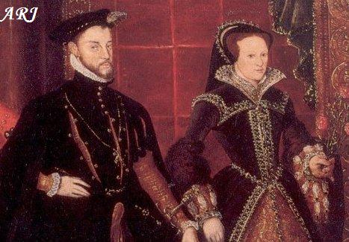
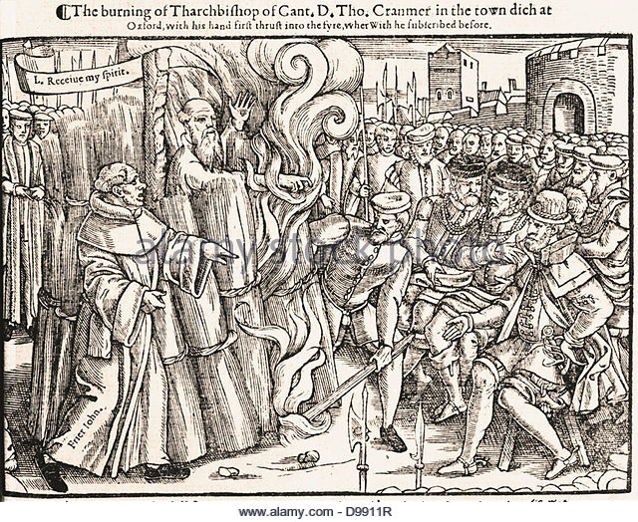
MARY I 1553-8

Slide 22
3 THEMES
Monarchy: how much of a problem was it to have a female ruler in a male dominated society?
Rebellions: how serious a threat did the Wyatt Rebellion pose?
Religion: how strongly Catholic did England become as a result of Mary’s Counter-Reformation?

Slide 23
SOURCE EVALUATION
A published account written by a Catholic priest in Yorkshire claiming that the restoration of Catholicism under Mary was enthusiastically welcomed by the common people.
Extracts from the churchwardens’ accounts in a parish in Berkshire recording the restoration of the Catholic altar, images etc in the local church.
Letter to Charles V from his ambassadors in England warning him that the restoration of Catholicism in England might be jeopardised unless the gentry were reassured that they would be allowed to keep monastic & chantry lands.

Slide 24
EVIDENCE THAT A FEMALE RULER WAS A THREAT TO POLITICAL STABILITY
The last female monarch, Matilda, had provoked a civil war in the mid 12th century.
It was assumed that a female ruler would be too weak to control the nobility & would certainly not be able to lead an army into battle.
Mary’s marriage was only a problem b/c she was female: no one was worried about H VIII marrying foreign princesses like Catherine of Aragon b/c it was assumed that H, b/c he was a man, would be in charge, whereas when Mary married Philip it was feared that he would dominate her b/c in the 16th century a wife was expected to be subordinate to her husband.
B/c she was female, Mary could not win whomever she married: her marriage to Philip led to fears that Spain would dominate England, but if she had married an English noble like Edward Courtenay, the other nobles would be jealous & resentful.
Her marriage to Philip was a disaster, provoking the Wyatt Rebellion & the French war which led to the loss of Calais.

Slide 25
EVIDENCE THAT THE WYATT REBELLION 1554 POSED A SERIOUS THREAT
If all 4 of the rebellions against the Spanish marriage had taken place or if Wyatt had not delayed his march on London by besieging Cooling Castle (he did in any case reach the city gates in London) the Wyatt rebellion could have succeeded, either in forcing her to change her choice of husband or perhaps even replacing her with Elizabeth.
The fact that the London militia defected to Wyatt, shouting “we are all Englishmen!” showed how unpopular the Spanish marriage was.
Mary was only saved by the loyalty of a few nobles (like the Duke of Norfolk, by then in his 80s) & their retainers. Penry Williams has claimed, “a crucial episode in Tudor history was thus determined with most of the political nation standing aside”.
The fact that there were very few executions (except Northumberland) after the Grey conspiracy & fewer than 100 after Wyatt (compared with 178 following the Pilgrimage of Grace, which never got near London) suggests that Mary’s govt. did not feel strong enough to be as brutal as Henry VIII had been.

Slide 26
EVIDENCE OF POLITICAL STABILITY
The fact that M was clearly the rightful heir mattered more than her gender.
Mary acted promptly & decisively both against Jane in 1553 (when she fled to Norfolk & rallied support there) & against Wyatt in 1554 (when she wisely ignored the advice of her councillors & stayed in London to rally support there), showing that her gender mattered less than her determination & political skill.
M had good advisers, e.g. Winchester on finance & Pole on church reform. She was able to govern effectively despite her gender, as shown by the improvements in the Navy & the land defence system (Militia & Arms Acts) resulting from the French war.
Memories of the Wars of the Roses in the previous century & the hatred towards the gentry shown by the 1549 rebels (in both the South West & Norfolk) made the gentry reluctant to support any rebellion for fear that it would lead to a breakdown of law & order, threatening both their property & their social status.
Despite the factional rivalry between Paget & Gardiner over the Spanish marriage, M’s Privy Council generally governed effectively, especially in terms of increasing royal revenue, & there were no further rebellions after Wyatt despite the bad harvests & trade depression.

Slide 27
RELIGIOUS SUCCESSES
In bringing back the Mass & Catholic doctrines like transubstantiation & clerical celibacy, Mary was returning to her father’s policy; in the history of religious policy 1529-58, it was the shortlived enforcement of Protestantism under E VI (from the first Act of Uniformity in 1549 until his death in 1553) which seems out of place. M therefore had a strong base on which to build.
Robert Parkyn, a Cath. priest in Yorkshire, wrote, “from August 1553 in many places in Yorkshire, priests were very glad to say mass in Latin ... The English service was voluntarily laid aside”.
It is not true that M relied solely on persecution to restore Catholicism. Cardinal Pole, her Archbishop of Canterbury, had constructive plans for reform, such as a crackdown on clerical abuses like pluralism & non-residence, a Cath. translation of the New Testament, a Cath. Book of Homilies (short sermons) & a seminary (priests’ training college) in each diocese (the area controlled by a bishop). There is no reason to doubt that these policies would have been successful if they had been given more time.
In any case the burnings may not have been as unpopular as is often assumed. The local authorities in London ordered the burnings to be held in the mornings to reduce the crowds, but this may have been due to to a fear of the general disorder which often attends such large gatherings (e.g. pickpocketing) rather than fear of demonstrations in support of the victims.
Parliament readily agreed to the restoration of the Mass in 1553 & the restoration of the heresy laws in 1554 was only delayed b/c MPs feared that the monastic lands many of them had purchased would have to be given back. Once that issue was resolved, the heresy laws were passed & the burnings could begin.
Churchwardens’ accounts in different parts of the country (e.g. Stanford-in-the-Vale in Berkshire & Morebath in Devon) suggest that parishes were quick to restore altars, images, mass vestments etc despite the considerable cost of doing so.
On balance the evidence suggests that M’s policies were succeeding & ultimately failed, not b/c her policies were unpopular or poorly thought out but b/c she died too early & failed to leave a Cath. heir, enabling Elizabeth to restore Prot. The length of time it took Elizabeth to make England truly Prot. (the whole 45-year reign as far as Lancashire was concerned, according to Christopher Haigh) emphasises how much M achieved in such a short time.

Slide 28
RELIGIOUS FAILURES
Like the Prot. religious changes in E’s reign, M’s policies (especially Pole’s plans for long term reform) did not have enough time to make an impact before they were reversed.
The determining factor in the English Reformation was obedience (based on a combination of loyalty & fear) to the monarch. M’s success in claiming the throne owed more to the fact that she was the legitimate heir than to her religion. England avoided the religious conflict which broke out in France or Germany b/c most people put obedience to the monarch first. This meant that most people complied with the restoration of Cath. under M but did not resist the enforcement of Prot. under Elizabeth. M therefore failed to make England strongly enough Cath. by 1558 to prevent Elizabeth restoring Prot.
Just as Prot. sources admitted the lack of progress of Prot. in E’s reign, Cath. sources in M’s show the survival of Prot. in London & the South East. A royal messenger reported the hanging of a cat dressed as a Cath. priest in London, while even Charles V’s ambassador admitted, “the people of London are murmuring about the cruel enforcement of the recent Acts of Parliament against heresy … The haste with which the bishops have proceeded in this matter may well cause a revolt”. A Cath. priest in Essex reported to his bishop that Prots. “not only absent themselves from church services, but daily they lure away many others who had outwardly conformed”.
M could restore the Mass, clerical celibacy, the papal supremacy etc but not the monasteries or chantries b/c the gentry who had bought their lands were determined to hold onto them.

Slide 29
KEY POINTS
Mary’s decision to marry Philip was a disaster, leading to the Wyatt Rebellion & the loss of Calais without producing the heir she so desperately wanted.
This showed the problems of having a female ruler (her marrying the Spanish king caused a rebellion while Henry VIII marrying a Spanish princess did not).
Nevertheless Mary’s success in crushing the rebellion, the effectiveness of her Privy Council & the absence of further rebellions after Wyatt show that having a female ruler did not guarantee instability.
The Wyatt Rebellion was caused mainly by the Spanish marriage rather than religion.
There was little opposition to Mary restoring Catholicism (except the gentry’s concern about monastic lands) but Elizabeth had 9 times as long to make England Protestant as Mary had to make England Catholic.

