Slide 1
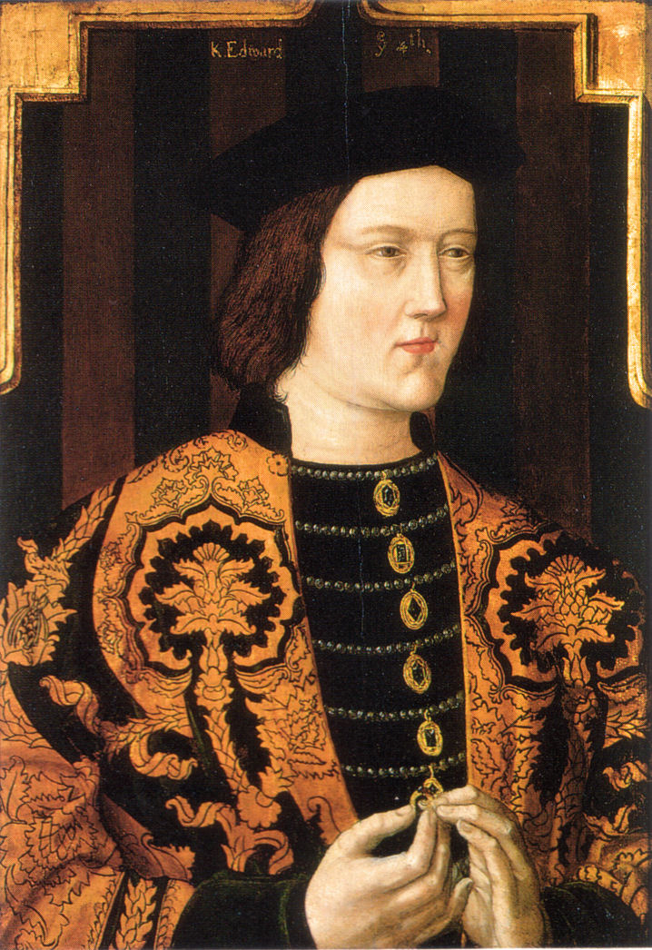
Edward IV
What characteristics did Edward have which were promising for a Medieval king?

Slide 2
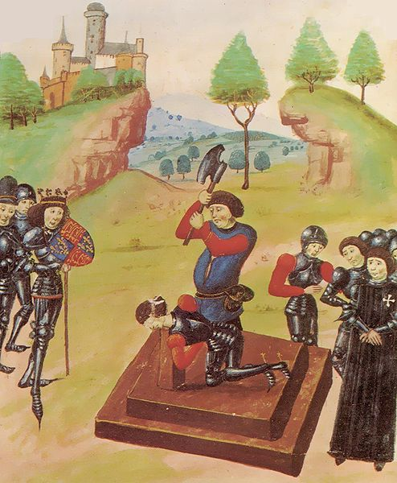
1st Steps Securing the Kingdon
Henry, Margaret and Prince Edward of Lancaster were still a threat and had taken shelter in Scotland. Their main support in England came from Sir Ralph Percy in the North.
Edward fought two battles in 1464 to try to gain control of the whole Kingdom; Hedgeley Moor where Percy was killed, and Hexham where Somerset was captured and executed. Margaret and Edward fled to France and Henry VI was captured and put in the tower the following year (1465).

Slide 3
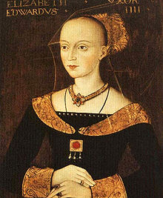
Marriage to Elizabeth Woodville in 1464
Edward married for love but why was this marriage an unwise move by Edward?

Slide 4
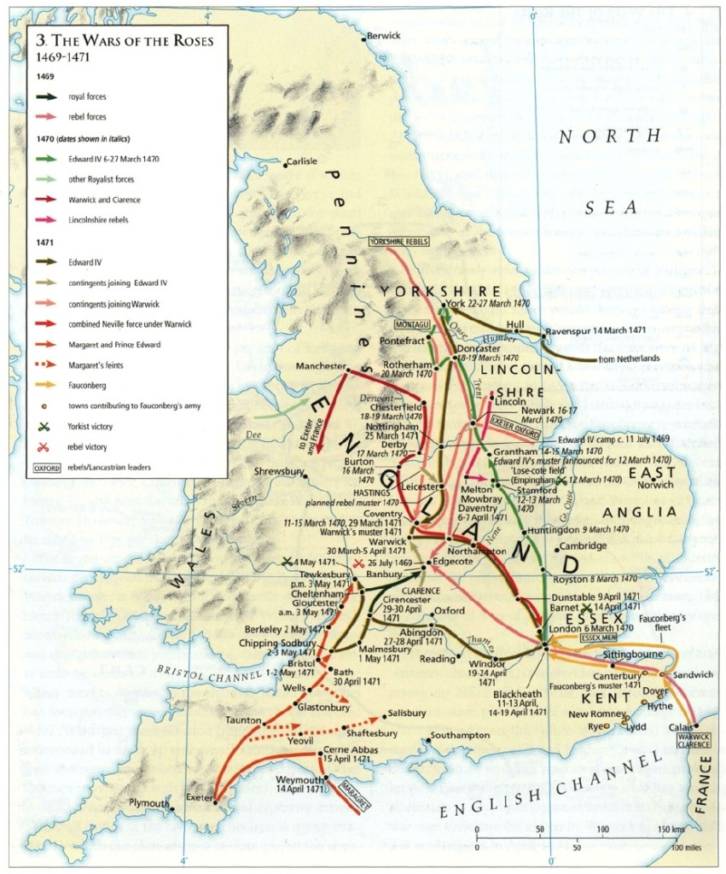
The Readeption of Henry VI
Human Timeline Exercise to Recap.

Slide 5
Causes of the Readeption
Edwards Marriage to Elizabeth Woodville alienated Warwick- Why?
Warwick was over mighty and unreasonable? – Give evidence
Foreign Involvement? Louis XI of France helped put Warwick and Margaret together. Why did he do this?

Slide 6
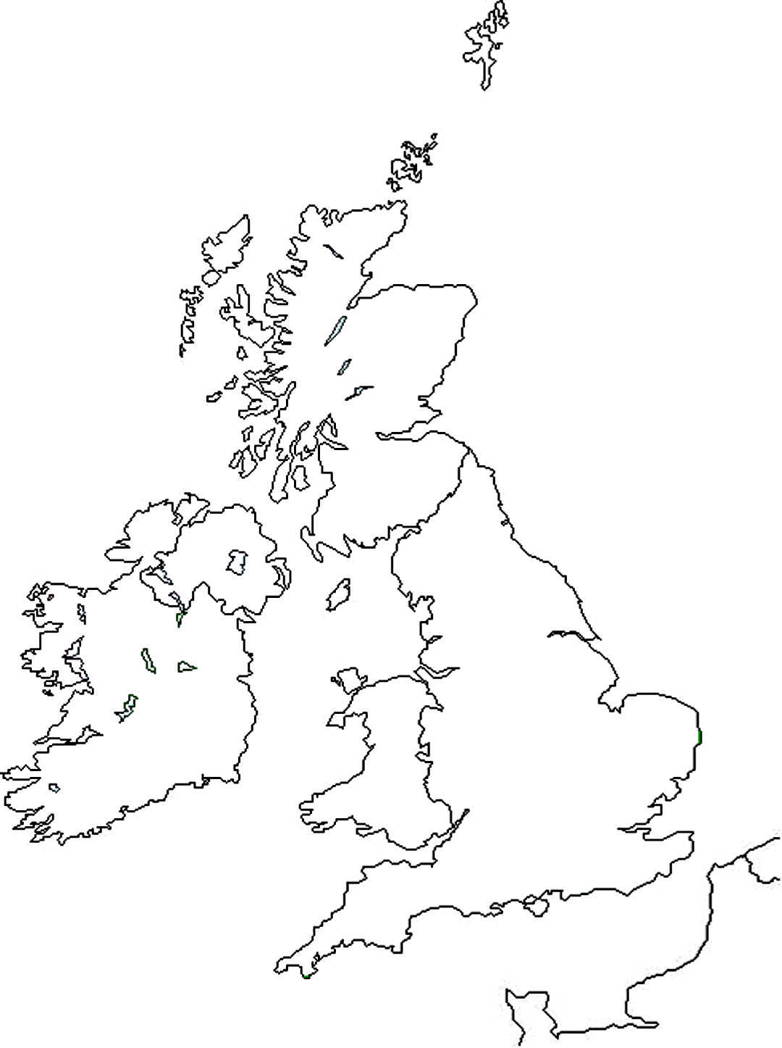
Edwards Second Reign
Regional Magnates

Slide 7
Better Government and Financial Management.
See booklets on law and order and financial management.

Slide 8
Foreign Involvement
1461 – Henry, Margaret and Edward flee to Scotland
1464 – French and Scottish support for the Lancastrians at Hedgeley Moor and Hexham
1465 – Edward ruins Warwick’s plans for a French alliance by revealing he has married Elizabeth Woodville. Edward allies with Burgundy instead.
1469 – 1471 – The Readeption; French and Burgundian Involvement.
1475 – Edward Invades France, Treaty of Piquany signed.
1480 – Richard Duke of Gloucester invades Scotland with Edwards Blessing.
1485 – The French, and to a lesser extent the Scots, back Henry Tudor at Bosworth.

Slide 9
Questions:
1: To what extent was Edward IV’s marriage to Elizabeth Woodville responsible for the readeption of Henry IV in 1470.
2: How far did foreign involvement influence the course and final outcome of the Wars of the Roses in the years 1469–85? (also next section as well)
3: How far did Edward IV restore the authority of the monarchy in the years 1461–83?
4: To what extent was effective royal government re-established in England in the years 1471–83?
5: Why was Edward able to overcome the challenges he faced in 1469-71 yet Richard III was not in 1485?

