Slide 1
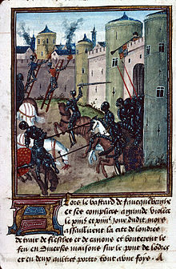
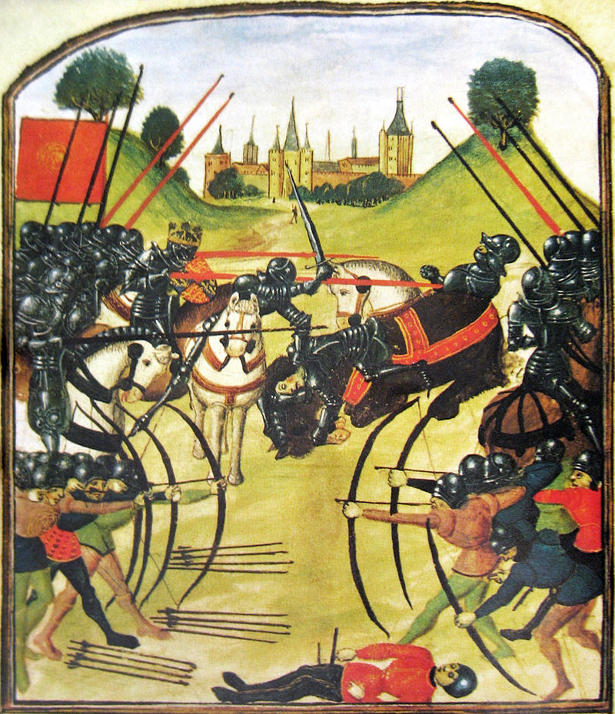
Wars of the Roses

Slide 2
What do I need to know: 1445 - 1461?
1445 – 1450; What caused the breakdown in law and order: Poor government, loss of French lands, Henry’s failings, Government Debt and Henry’s favourites = Cades Rebellion
1450 – 1455; York’s actions in the build-up to the wars: Return to England, Dartford, Henry’s breakdown, birth of Edward of Lancaster, Somerset in the tower, Neville Percy Feud, Build up to St Albans
1455 – 1461; War and downfall of the Lancastrians: Margaret's actions (parliament of Devils etc), key battles (Northampton, Wakefield, Towton, York’s actions (act of accord etc)
‘Source questions tend to revolve around:
Causes, extent or results of poor government.
Weakness of the King
York’s role in the events
Margaret's role in the events
Example: Using these three sources in their historical context, how far do they support the view that Henry VI was the main cause of the growing unrest in the years 1445 - 1450. (20 marks)

Slide 3
The 10 mark question
Use your knowledge of the opposition to the king to assess how useful source C is as evidence of growing discontent in England [10]
Not an essay
You need to use a combination of your own knowledge and an understanding of the provenance of the source to answer the question
Think about what the source says on the surface about the topic which is useful
Think about what the source implies about the topic which is useful
Consider the provenance of the source, issues such as who wrote it? When and why was it written? Does the tone or language suggest that it might be exaggerated? Does this information make the source more or less useful?
NOTE – the examiner can select any of the three sources as the focus of the question so read it carefully!

Slide 4
The 20 mark question
Using these three sources in their historical context, how far do they support the view that Henry VI was the main cause of the growing unrest in the years 1445 - 1450.[20]
Must use all three sources
You need to use a combination of your own knowledge and an understanding of the provenance of the sources and of their historical context to answer the question
Provenance: Why might the author have a particular view about the issue in the question?
Historical context: Explain how the events at the time the source was written may have influenced he author’s view
Stay focused on the specific issue in the question – when discussing provenance and context this is only to explain why the source has a particular view on the issue in the question

Slide 5
The 20 mark question
Using these three sources in their historical context, how far do they support the view that Henry VI was the main cause of the growing unrest in the years 1445 – 1450 [20]
Provenance of the sources
Context of the sources
Own knowledge
Focus on the question

Slide 6
How to analyse the provenance of sources
PURPOSE – why has the source been written and what is it trying to achieve?
AUTHOR – who wrote the source and what do you know about their role/views? Does this change your understanding of the content of the source?
NATURE – what kind of source is it? You will get no credit for simply stating this but it could help to explain why a source has a particular view
DATE – When was it written and what was happening at that time?
AUDIENCE – Who was the source written for and does this explain what it does or doesn’t say?
TONE – What is the tone of the author and does this make the content of the source more or less useful

Slide 7
What do I need to know: 1461 - 1471
How did Edward establish himself as King?
How well did Edward govern (domestic and foreign)?
What was the impact of Edwards marriage to Elizabeth Woodville?
Why did he lose the throne in 1470 and how did he then retake it in 1471?
What role did Warwick play in all these factors?
Old Spec questions
Assess the reasons for Edward IV losing the throne in 1470? (OCR textbook)
The most important reason for Edward IV losing the throne in 1470 was the actions of the Earl of Warwick’ how far to you agree (OCR textbook)
How successful was Edward IV in restoring royal authority by the year 1470 (OCR old spec)
The most important reason for Edward IV’s failure to establish royal authority in the period 1461– 1470 was the power of the Earl of Warwick.’ How far do you agree? (OCR new spec)

Slide 8
What do I need to know: 1471 - 1485
Old Spec questions
How successful was Edward IV’s managing of royal finances (OCR old spec)
How successful was Edward IV in restoring order (OCR old spec)
Edward IV was more successful in his second reign than his first’ how far do you agree with this view? (OCR old spec)
How successful were the domestic policies of Edward IV’s second reign of 1471 – 1483? (OCR textbook)
Richard III’s reign was so short because he was ineffective as King, how far do you agree?
Richard III was an able ruler, how far do you agree?
Richard III was an able but unlucky king, how far do you agree with this view?
Assess why Richard was able to secure the throne in 1483?
How well did Edward govern (domestic, law and order, financial and foreign)?
How did Richard take the throne?
How well did he rule?
Why did he lose the throne in 1485?

Slide 9
What do I need to know: 1485 – 1509 Henry VII Domestic policies
Henry’s first steps: Marriage, peace with France and Scotland, backdating reign.
Dealing with the rebellions; Lovell, Simnel, Warbeck, Yorkshire and Cornwall, De la Pole.
Dealing with the Nobility
Dealing with Finance.
Old Spec questions:
How effective was Henry VII in dealing with the Yorkist challenges to his Throne? (2009)
How effectively did Henry VII deal with England’s domestic problems (2010 Also Nobility and Finance topic)
How serious a threat to Henry’s rule was the Yorkist challenge? (2010 June)
How successfully did Henry VII deal with the problem of the Yorkists (Jan 2012)
How successfully did Henry deal with the domestic problems he faced?
How dangerous were Yorkist plots to Henry VII (Jan 2013)

Slide 10
What do I need to know: 1485 – 1509 Henry VII Foreign policy.
How Henry secured the kingdom through foreign policy, see attached.
How Henry developed the prestige of the Tudor Dynasty through his foreign policies.
How Henry used foreign policy through his financial policies
The methods Henry used to deal with the threat of Warbeck.
Old Spec questions
To what extent was Henry VII’s foreign policy a success?
“Marriage agreements were the most successful part of Henry VII’s foreign policy” How far do you agree with this statement?
How successful was Henry VII in achieving his foreign policy aims?
“The avoidance of war was the most important aim of Henry VII’s foreign policy.” How far do you agree with this statement?
“Henry VII’s foreign policy achieved little” How far do you agree with this statement?
“The need to secure his throne his throne dominated the foreign policy of Henry VII.” How far do you agree with this statement?

Slide 11
Revision session 1, causes of instability in England 1445 – 1455 Stage 1 1445 – 1450 Stage 2 1450 - 1455
Aims:
Identify the issues which were causing political instability in England.
Evaluate the significance of these.

Slide 12
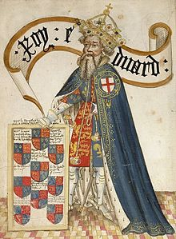
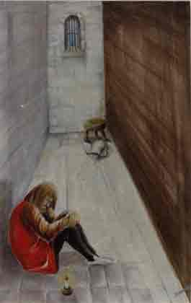
The legacy of the Lancastrian usurpation of the throne
Edward III had too many sons leaving too many with a claim to the throne
Did Henry IV’s usurpation of the throne create long term problems for the stability of the monarchy? Discuss in pairs evidence for and against.

Slide 13
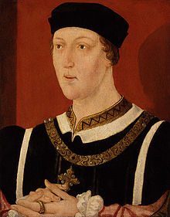
The fact that Henry VI had taken the throne as a child
Henry V’s death left Henry VI on the throne aged only 9 months old. This could well have been a problem.
However his uncles ruled well, Bedford maintained the French lands up until his death in 1435 and Gloucester’s council was unchallenged in England during Henry’s childhood.
You could argue this was the most successful part of Henry’s reign.

Slide 14
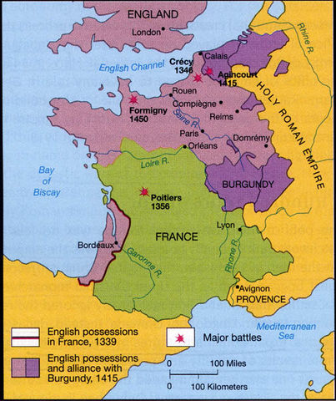
Events in France
In 1435 Burgundy swapped sides putting pressure on the English
By the 1440s commanders were beginning to go unpaid and crown lands were having to be sold to support the war. (York ended up being owed huge sums by the crown.)
York was appointed Lieutenant in France (commander) but was overlooked and failed campaigns were led by Somerset which caused resentment.
By 1444 the English were ready for peace. Marriage was agreed between Henry and Margaret of Anjou. In return Maine and Anjou were handed back to the French (causing more English resentment.
England broke the truce in 1449 and the French captured Normandy in 1450.

Slide 15
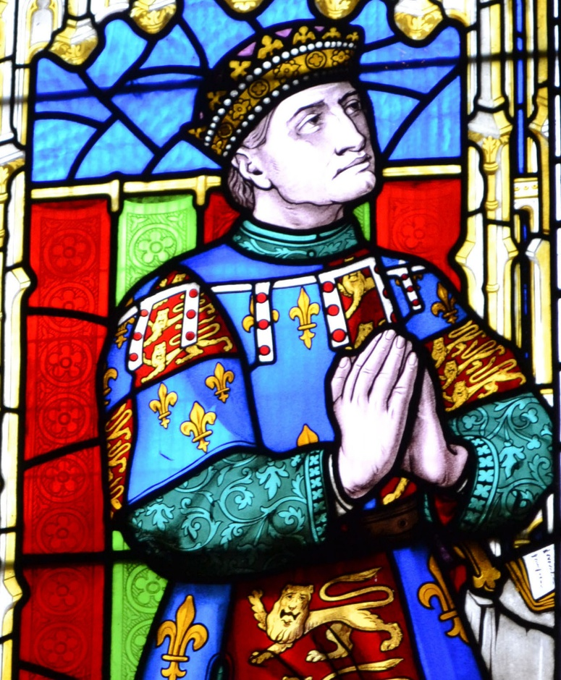
The alienation of Richard Duke of York
York was replaced as Commander in France in 1445 and sent to Ireland (He refused to go until 1447)
Therefore he could only watch as the English lost Normandy in 1450
Also Somerset's expenditure in France was repaid but York’s was not.

Slide 16
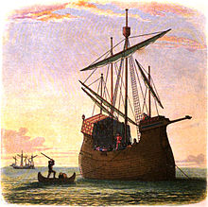
Henrys Favourites
Henry favoured Suffolk and Somerset over York.
Suffolk was promoted to Duke a position usually only reserved for the royal family
Henry rewarded these men with money and more importantly land which reduced the income of the Crown

Slide 17
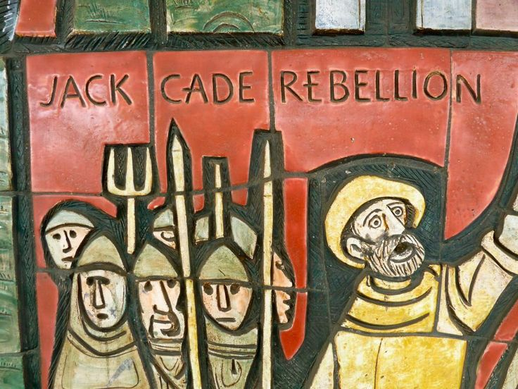
Result: Cades Rebellion
Look at the source in the workbook on Cades rebellion. What reasons does this give for the rebellion. Using own knowledge and provenance assess how useful this is as evidence for the causes.

Slide 18
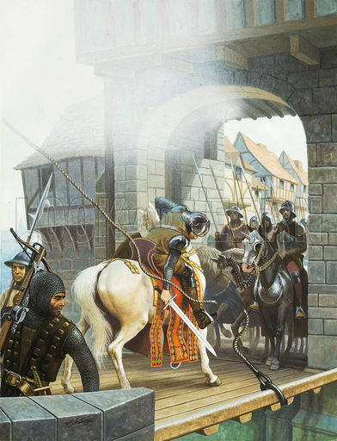
1450 – 55 causes of St Albans
After Cades rebellion. York had returned from Ireland, supposedly to help restore order to the kingdom but he had not been asked to do so by the king.
He probably was trying to clear his name after Cades rebels had used it.
It is also possible he wanted to be repaid the debts he was owed by the crown.
He also seems to have wanted to claim his position on the kings council over Somerset.

Slide 19
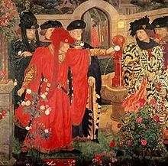
York’s first attempted Coup
York was unsuccessful in gathering support but returned to his castle at Ludlow rather than Ireland.
He turned down the opportunity to join the king’s council in 1451 and in 1452 raised armed support and marched on London
York was confronted by the king’s men at Dartford. The kings army included Buckingham, Salisbury and Warwick so York backed down.

Slide 20
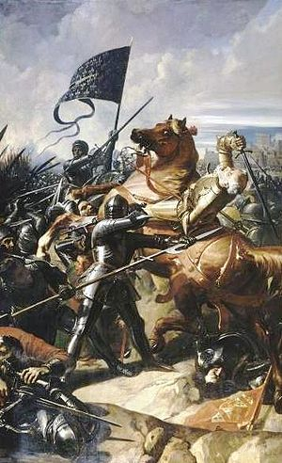
Loss of Gascony
On 17th July 1453 the English suffered a catastrophic defeat at the Battle of Castillon losing the province of Gascony.
Henry promptly had a mental breakdown losing all ability to interact with the world around him

Slide 21
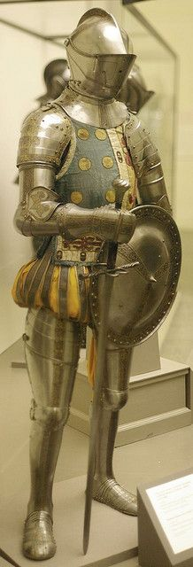
Instability in the regions
At the same time law and order had been breaking down in the provinces.
The feud over land in the North between the Neville and Percy family had been escalating for some time and had now escalated to open fighting.
Henry and his council did nothing to stop this so the Nevilles turned to York. This gave York more military support.

Slide 22
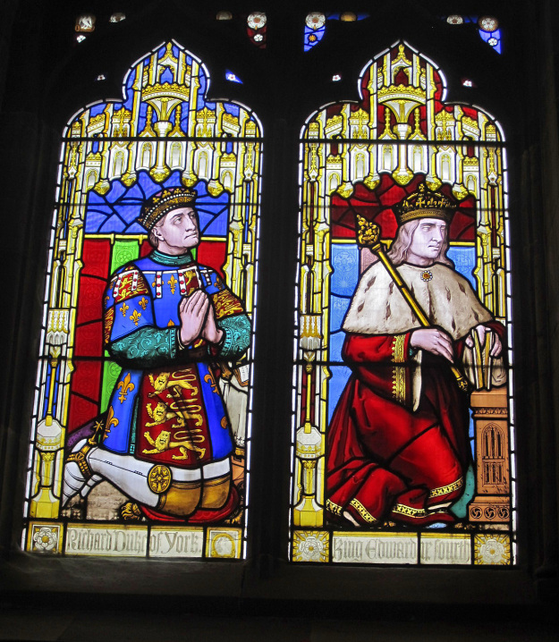
Henry has a mental breakdown and York assumes power
Henry’s breakdown in 1453 meant they now needed someone to act in his name.
York was appointed the protector of the kingdom. Henry’s illness had finally given York the status he craved.

Slide 23
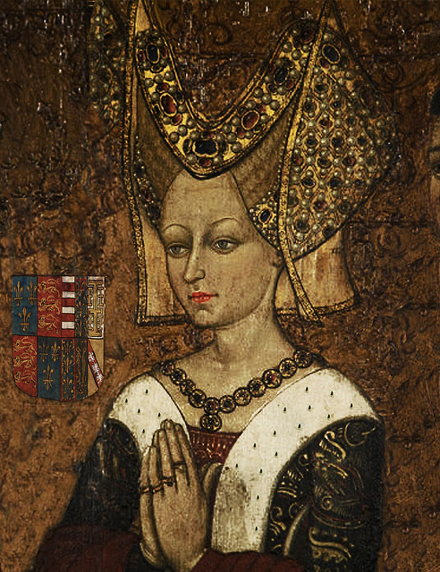
York Somerset Feud
On 13th October 1453, Edward of Lancaster was born. As York was no longer Heir he felt his position threatened and promptly sent Somerset to the tower.
Margaret of Anjou attempted to take power on the basis that she was the queen but the nobility supported York. However this is a sign of the later feud to come.

Slide 24
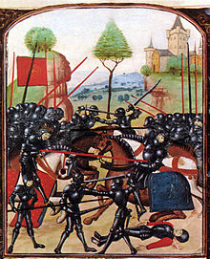
Henry recovers and Somerset is released
Henry recovered his senses at Christmas 1454 and by 1455 York was no longer protector. In February 1455 Somerset was released from the tower.
Why was the situation now so dangerous for both York and Somerset?

Slide 25
Battle of St Albans
York and the Nevilles now feared they were going to be attained so assembled their forces.
They met Henry, Somerset and the Percy forces at St Albans
It was the first Yorkist victory, Somerset and the Earl of Northumberland (Percy) were killed.

Slide 26
Rank the factors causing the wars of the roses into long and short term
The legacy of the Lancastrian usurpation
The loss of France
Henry’s financial problems
Henry’s mental illness
Margaret of Anjou
Richard Duke of York’s ambition
The Duke of Somerset
The Neville – Percy feud
Overmighty subjects

Slide 27
Battles of the Wars of the Roses 1455 - 1561
St Albans to Towton

Slide 28
Initial confrontation
York marched south in spring 1455.
His main objectives were the removal of Somerset and the court party and his own restoration to the Council.
En route to London, York linked up with his allies – the Neville family and their retainers.
By the time they reached St Albans, the force numbered around 5,000 armed men.

Slide 29
St Albans
York initially sought to 'parley' with the King.
The King was also keen to have a peaceful resolution, as he was heavily outnumbered, however when he heard York's demands he became angry and refused.
York returned to his men and prepared for battle.
So, on the morning of May 22nd 1455, a violent clash ensued in St Albans
The Duke of Somerset, the Earl of Northumberland, Lord Clifford, plus about 50 other notable Lancastrians, were killed
Fighting had turned rivalry into a: blood feud.

Slide 30
Results of St. Albans
Henry soon had another breakdown restoring York to the protectorate.
York appointed Warwick captain of Calais
Margaret set up a separate Lancastrian court in the midlands

Slide 31
Loveday and other attempts!
Disorder in the capital and the north of England (where fighting between the Nevilles and Percys had resumed)
The king and queen remained in Coventry because London merchants so angry with the interruption to trade.
York's ally, Warwick was growing in popularity in London as the champion of the merchants.
There was an attempt to reconcile the two sides and on 25 March (loveday) initiated a service in St. Pauls where Lancastrian and Yorkist nobles following him, hand in hand!!!

Slide 32
Blore Heath
In early 1459, both sides were actively recruiting (despite the “Loveday”)
Queen Margaret toured the Lancastrian heartlands of the north Midlands raising support.

Slide 33
Ludford Bridge
A disaster for the Yorkists.
To their dismay they found that much of the Calais garrison defected to the king. they brought not only many men over to the king, but much information on York’s army and plans.
York was outnumbered three to one and so he, his two sons, Warwick and Salisbury fled to Calais and Ireland. Their army disbanded and the Lancastrians plundered Ludlow.

Slide 34
Parliament of Devils
Parliament was convened in Coventry.
York was announced as a traitor – losing all his lands in an Act of Attainder. He now had to fight or lose everything.

Slide 35
BATTLE OF NORTHAMPTON
Edward, Earl of March and Warwick, defeated the Royal army at Northampton on 10th July 1460.

Slide 36
Repercussions of Northampton
After their victory, Edward, Earl of March (the Duke of York’s oldest son) and the Earl of Warwick found Henry VI abandoned by his troops and although they knelt before him here they were actually taking him prisoner.
With the king in their power set off for London.

Slide 37
Act of Accord.
The battle was an important victory for the Yorkists. Shortly afterwards the Duke of York returned to England and, in October, was bestowed the right of succession by Henry VI in the so called Act of Accord .
Queen Margaret refused to accept an agreement that disinherited her son and thus the Civil War inevitably continued.

Slide 38
Battle of Wakefield
Margaret had vengeance on Richard, Duke of York and he is killed in a skirmish outside his castle in battle along with one of his sons.
York’s head was cut off and displayed on the Micklegate in York

Slide 39
Margaret's Army rampage
Margaret marched south with her Army but lost control of them on route.
The subsequent destruction on towns they passed alienated people from the Yorkist cause

Slide 40
2Nd St Albans
Warwick was defeated by Margaret's Army and fled. Margaret had also regained control of Henry who had been brought to the battle by Warwick
However Margaret was unable to take advantage of the situation as the Londoners bared her from the city forcing her to return to the North

Slide 41
Edward now rode into the capital and proclaimed himself king.
He now set of with a huge range of support to engage the Lancastrians in battle

Slide 42
Battle of Towton
The battle of Towton was a rout – the Lancastrians were smashed by Edward’s army. Henry Margaret and their son Prince Edward flee to Scotland.

Slide 43
Edward IV
What characteristics did Edward have which were promising for a Medieval king?

Slide 44
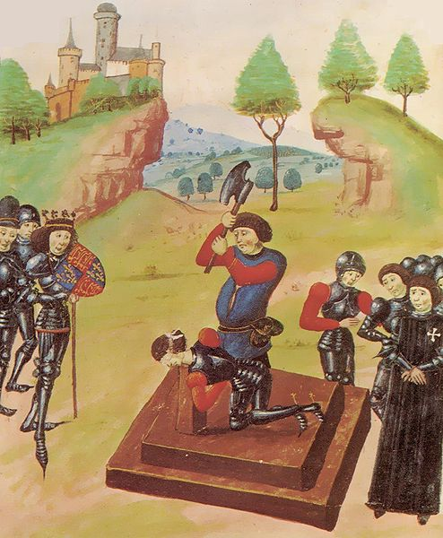
1st Steps Securing the Kingdon
Henry, Margaret and Prince Edward of Lancaster were still a threat and had taken shelter in Scotland. Their main support in England came from Sir Ralph Percy in the North.
Edward fought two battles in 1464 to try to gain control of the whole Kingdom; Hedgeley Moor where Percy was killed, and Hexham where Somerset was captured and executed. Margaret and Edward fled to France and Henry VI was captured and put in the tower the following year (1465).

Slide 45
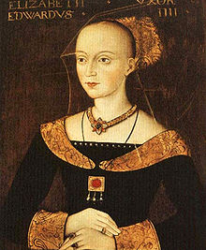
Marriage to Elizabeth Woodville in 1464
Edward married for love but why was this marriage an unwise move by Edward?

Slide 46
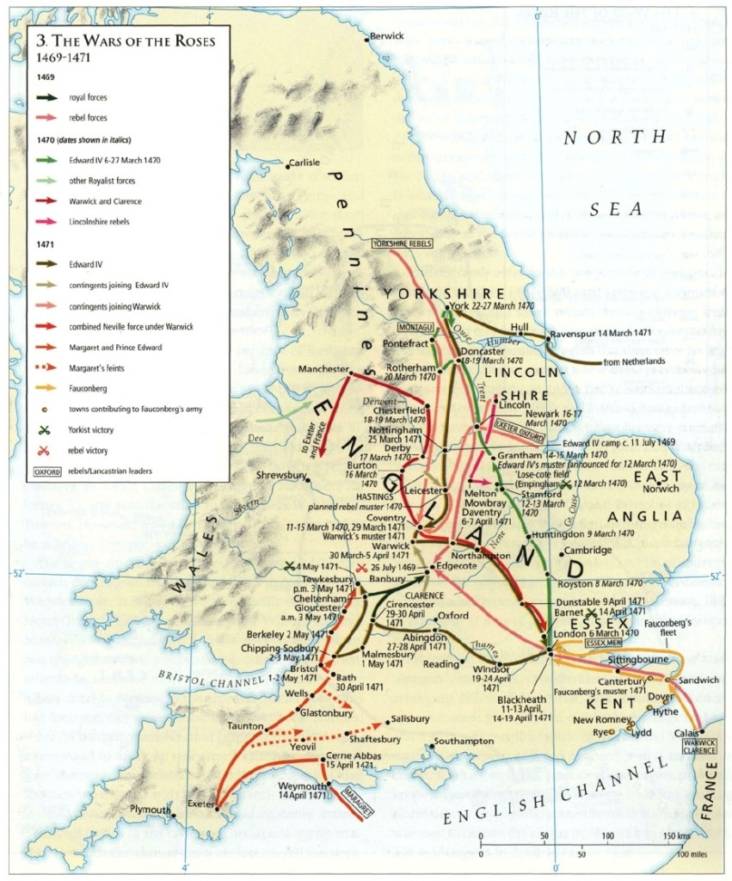
The Readeption of Henry VI
Human Timeline Exercise to Recap.

Slide 47
Causes of the Readeption
Edwards Marriage to Elizabeth Woodville alienated Warwick- Why?
Warwick was over mighty and unreasonable? – Give evidence
Foreign Involvement? Louis XI of France helped put Warwick and Margaret together. Why did he do this?

