Slide 1
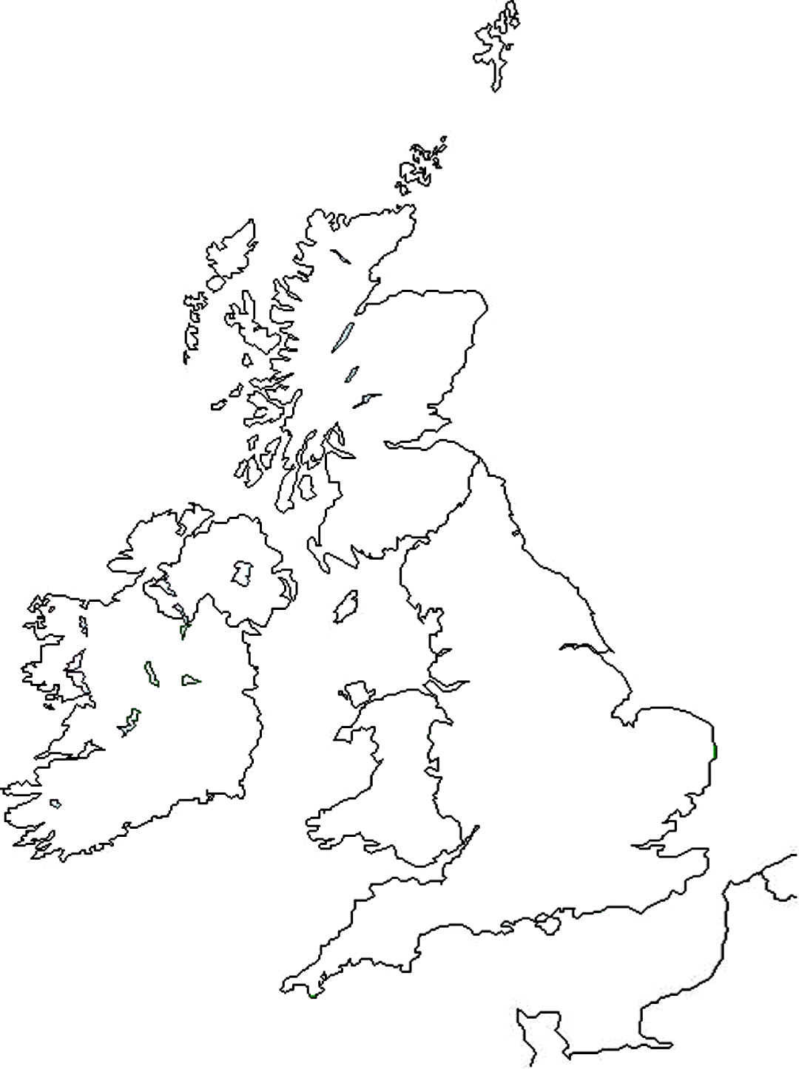
Edwards Second Reign
Regional Magnates

Slide 2
Better Government and Financial Management.
See booklets on law and order and financial management.

Slide 3
Foreign Involvement
1461 – Henry, Margaret and Edward flee to Scotland
1464 – French and Scottish support for the Lancastrians at Hedgeley Moor and Hexham
1465 – Edward ruins Warwick’s plans for a French alliance by revealing he has married Elizabeth Woodville. Edward allies with Burgundy instead.
1469 – 1471 – The Readeption; French and Burgundian Involvement.
1475 – Edward Invades France, Treaty of Piquany signed.
1480 – Richard Duke of Gloucester invades Scotland with Edwards Blessing.
1485 – The French, and to a lesser extent the Scots, back Henry Tudor at Bosworth.

Slide 4
Foreign Policy
When Edward became king in 1461 what would his immediate priorities for foreign policy have been? Discuss in pairs for 2 minutes.
Which countries should he have been particularly interested in?

Slide 5
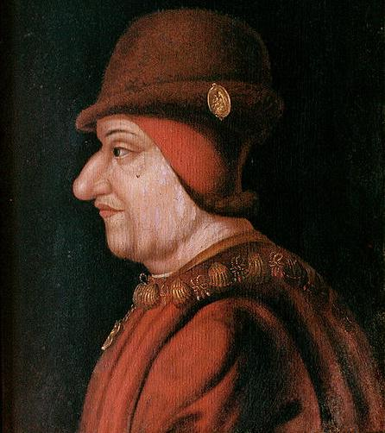
The Problems France and Scotland
Scotland and France were generally aligned in their dislike of England
In the early 1460s the Scots half-heartedly supported Henry and Margaret. They supported Margarets attempted invasion of 1463 but fled alongside her army when confronted by the Earl of Warwick’s forces.
By the end of 1463 Louis and the Scots had abandoned action against England

Slide 6
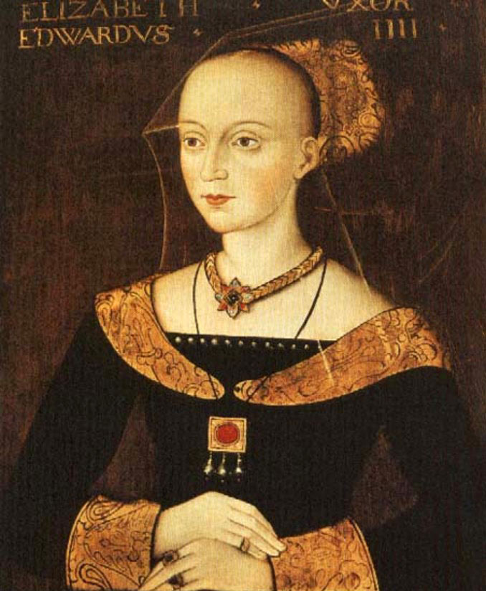
Foreign alliances
Warwick was negotiating a French match for Edward by 1464 but this was dashed by his marriage to Elizabeth Woodville.
As Edwards security on the throne grew so too did the willingness of others to make treaties with him. Treaties were made with Castile, Aragon, Denmark, Naples and the Holy Roman Empire.
Mark these on your map. How does this link to French hostility.

Slide 7
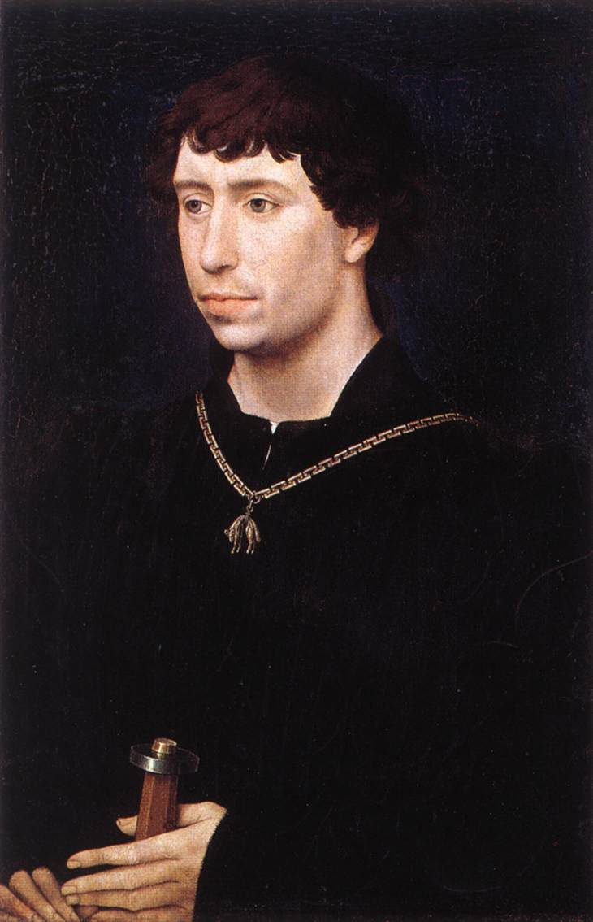
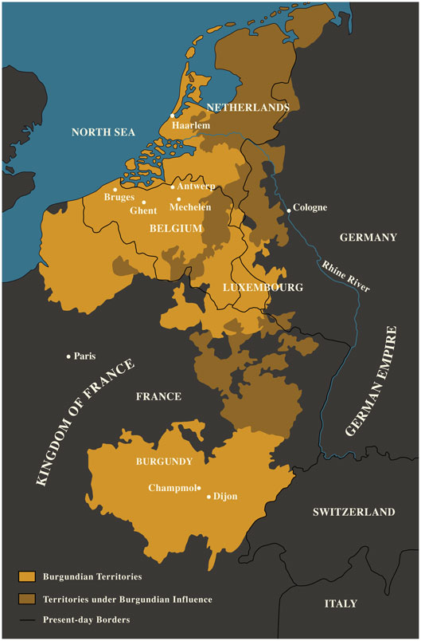
From 1466 – 67 Both France and Burgundy were trying to ally with England against each other.
Warwick favoured France but Edward chose Burgundy due to the trade links and traditional alliance with the country. The following year Edwards sister Margaret married the Duke of Burgundy Charles the Bold.
The counter side to this was French anger. They supported an attack by Jasper Tudor in West Wales. This was dealt with by Edward’s supporters
Far more dangerously though Louis then brought Margaret and Warwick together and played a role in the readeption.

Slide 8
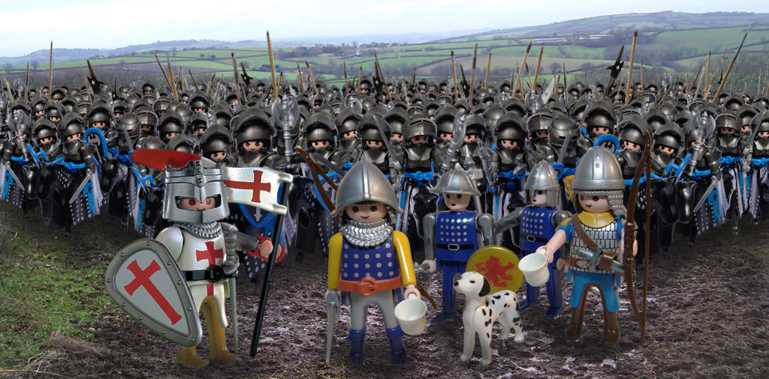
1471 – 1483 Foreign Policy in Edward’s Second Reign
In his second reign Edward was more aggressively anti-French.
Read pages 111 and 113
In pairs write a speech from either the point of view of Edward or Louis saying why the Treaty of Picquigny has been a success for your side.

Slide 9
Burgundy after 1475
In 1477 Charles the Bold of Burgundy died.
This left a vulnerable situation in Burgundy which Louis took advantage of. In 1482 the two countries signed the Treaty of Arras and Louis stopped paying the Pension to Edward as he no longer feared an Anglo-Burgundian move against him.

Slide 10
Scotland
In 1480 the Scots had started to raid England again stirred up by Louis.
The Duke of Gloucester retaliated for this and attacked Scotland in 1482. He captured the James III and Edinburgh but eventually had to withdraw due to a lack of support.
Nevertheless he recaptured Berwick upon Tweed from the Scots on his way back south.

Slide 11
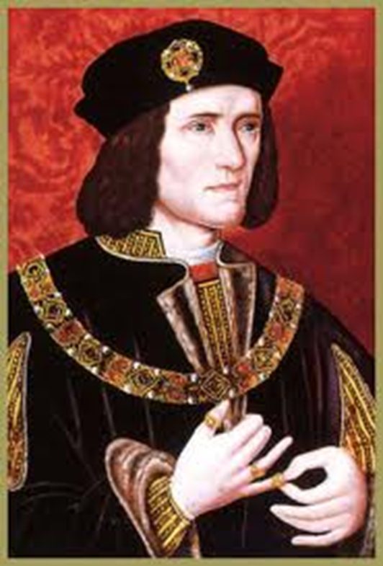
Reasons Why Richard III lost the throne (or reasons why Henry Tudor won)

Slide 12
Past questions (edexcel)
It was the weaknesses of Edward IV’s reign rather than the personal ambitions of Richard III which led to the usurpation of the crown in 1483.”How far do you agree with his statement in explaining the events of 1483?
Why was Richard III’s reign so short lived? (June 2011)
Was Richard responsible for his own insecurity? (Jan 2009)
How far was the unpopularity of Richard III responsible for the success of Henry Tudor’s challenge in 1485? (June 2009)
How accurate is it to say that Henry Tudor was able to seize the crown primarily because of Richard III’s inability to secure the support of the great nobles of England?
How far do you agree Richard was responsible for his own downfall (last year)
Why was Edward able to overcome the challenges to his reign in 1471 yet Richard unable to do so in 1485 (2013)

Slide 13
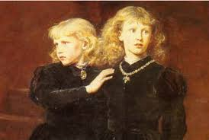
1. Richard lll’s claim to the throne was never generally accepted.
Edward V was only 12 years old in 1483 and it was easy for Richard to keep him and his brother in the Tower of London and to seize the throne. Richard claimed that they were illegitimate because their father had been precontracted to marry Eleanor Butler and so was not free to marry their mother Elizabeth Woodville. If this argument were accepted it would mean that Richard himself was the rightful heir of Edward lV. Most people did not believe this story.

Slide 14
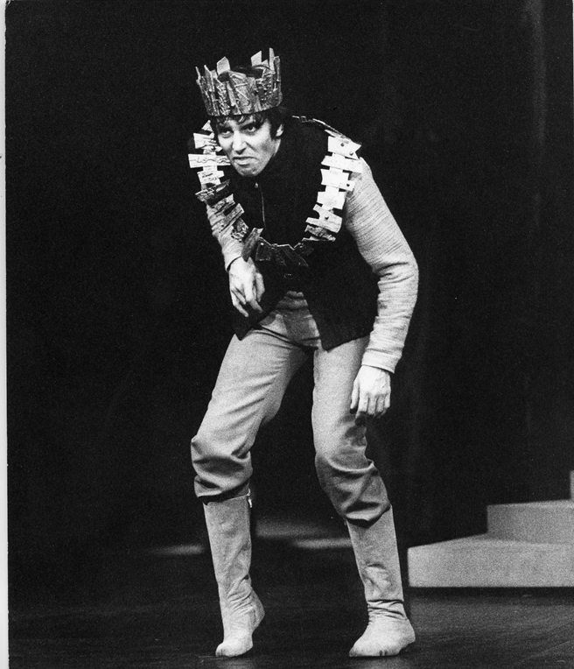
2. Richard lll had an evil reputation.
He executed his own former supporters and relatives of Edward V. Lord Hastings, Earl Rivers, Sir Thomas Grey and the Duke of Buckingham all died without a trial.
He was considered by many to be a usurper and in addition he was suspected of murdering his two young nephews.

Slide 15
Richard lll was unpopular in the South.
He spent most of his life, up to 1483, in the North. Most of his supporters were therefore from the midlands and the North and the southerners’ resentment of this was shown by the fact that rebellion broke out in every county south of London in the autumn of 1483. Richard retaliated by giving land and power to his northern supporters in the South. This made him even more unpopular.
As far as we know no southern nobles fought for Richard at Bosworth.

Slide 16
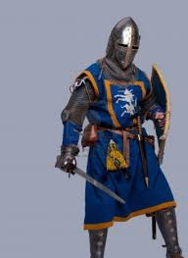
Richard lll was not supported by the nobility.
Richard is supposed to have been very popular in the North yet the two most powerful northern families, The Stanleys and the Percies failed to support him at Bosworth.
At a decisive point in the battle Sir William Stanley intervened on Henry Tudor’s side.
Buckingham’s rebellion.

Slide 17
Richard lll’s strategic errors on the battlefield.
What were these?

Slide 18
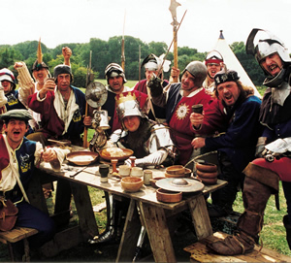
Legacy of the Wars of the Roses.
After 30 years of civil conflict fewer than half of the English nobility and gentry were prepared to commit themselves to either side. Respect and loyalty to the monarch had declined since the 1450s. The crown was weak and could not command the loyalty of the nobility. There had been frequent changes of monarch in recent years.

Slide 19

Henry Tudor had French support.
Charles Vlll of France gave Henry the money and the army he needed to invade England in 1485. Henry attracted little English support before Bosworth as most nobles refused to commit themselves until they knew who had won so his army was mainly French.

Slide 20

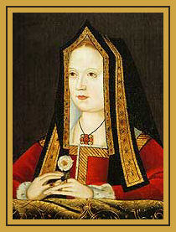
Richards actions taking the throne had split the Yorkists
Henry VII had promised to marry Elizabeth of York, the daughter of Edward lV, once he was king. Other Yorkists joined him.

Slide 21
Henry VII

Slide 22
Henry’s Aims
1: Secure the kingdom and end the wars of the roses
2: Secure his dynasty by: Financial security, controlling the nobility and by establishing his dynasty as a legitimate power in England.

Slide 23
Why was there unrest in the early years of Henry VII’s reign?
• Henry’s claim to the throne was weak. It came from his mother’s side – Margaret Beaufort who was a descendant of Edward III
• Henry took the crown by force at the Battle of Bosworth in 1485
• Yorkists would not accept Henry VII’s claim to the throne believing that Richard III had been usurped
• Henry was largely unknown in England before 1485 but his reputation was damaged by 14 years in exile in France along with French support in taking the English throne

Slide 24
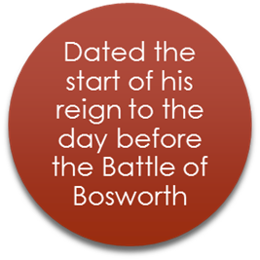
How did Henry Consolidate power
Foreign policy
Henry arranged his coronation for before the first meeting of Parliament
January 1486 Henry Married Elizabeth of YorkControl over the nobility
Control over the regions
Royal finances

Slide 25
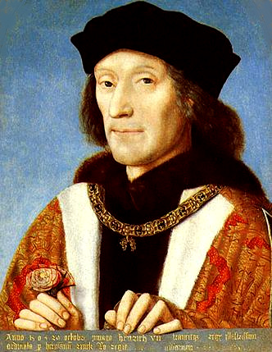
Henry and the nobility
A wise king would recognise the importance of keeping control of the nobility
Henry used a number of methods to do this.

Slide 26
What does this table show you about the different approaches of Henry VII and Edward IV to the nobility
 | Number of peers |  | Number of major peers
 | Start of reign | End of reign | Start of reign | End of reign
Edward IV | 42 | 46 | 7 | 12
Henry VII | 50 | 35 | 16 | 10

Slide 27
Size of the nobility
Henry deliberately refrained from making too many new nobles for three reasons:
A limited noble class was easier to control
He so rarely elevated anyone to the peerage that it was regarded as a distinctive honour when it did happen.
Nobles needed estates and Henry did not want these to come from crown lands.

Slide 28
Where as Edward IV created nine new Earls Henry VII created only 3
One was his stepfather Thomas, Lord Stanley, who became Earl of Derby

Slide 29
Henry Also Used the following to control the nobility
Punishments:
Acts of Attainder – Taking land
Bonds and Recognisances – A fine which put you in debt to the king
Wardship – Placing the estates of minors under royal control
Tower
Death
Rewards:
Titles
Land
Act of the Garter
Patronage
Kings council
Great council

Slide 30


Court of the Star
Chamber
King Henry VII
Parliament
Exchequer
Secretary
Great Councils
Councils chosen by Henry
Nobles and local government

Slide 31
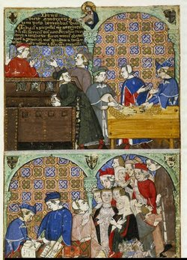
Henry VII Financial policy.
1485 - 1509

Slide 32
Why was money so important to the king?
Impoverished exile.
Value of financial stability
Soldiers and supporters

Slide 33
Henry’s reputation
exploited existing revenues
determined and systematic

Slide 34
Constraints on the King
Live off their own
Taxes

Slide 35
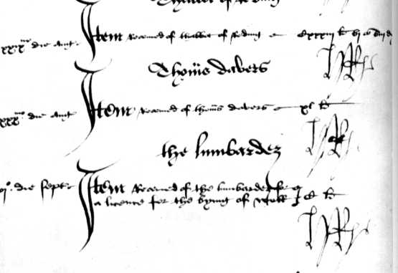
Financial Administration
Exchequer
King’s Chamber
Henry has initialled each entrance into the Book of receipts

Slide 36
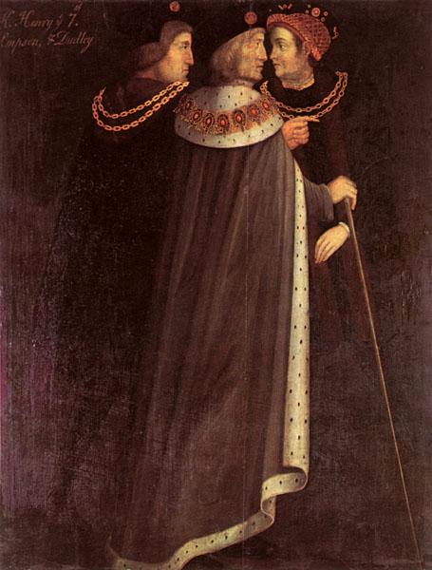
Personnel
Who were Henry’s financial officers?
professionals.
Sir Reginald Bray, Empson and Dudley
Moreton and his fork

Slide 37
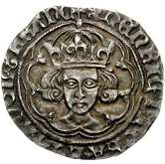
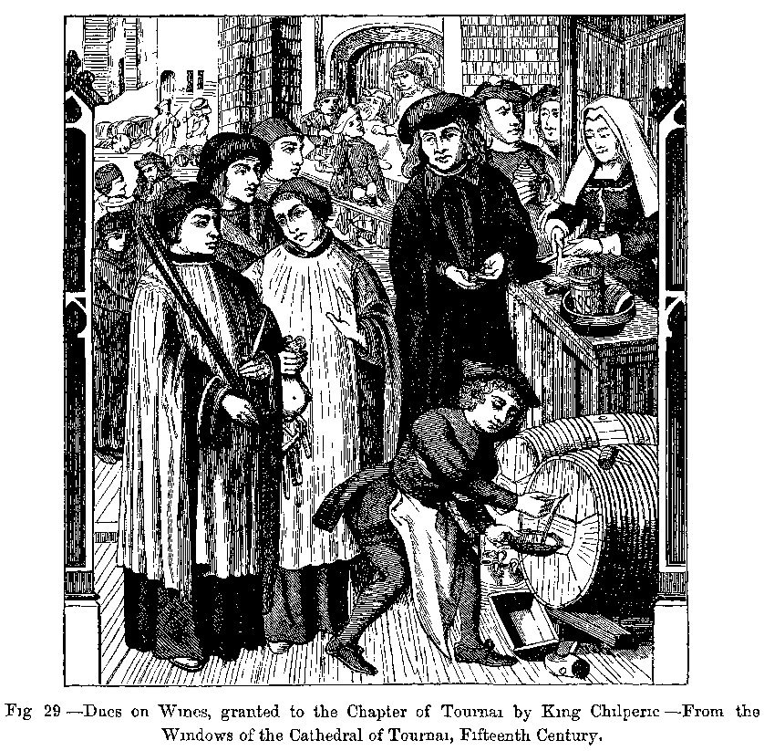
Ordinary Revenue
Crown lands – Henry increased Revenue from these with better management
Customs duties – Trade agreements
Feudal dues – Wardship - Buckingham
Profits of Justice

Slide 38

Extraordinary Revenue
Parliamentary grants
Loans and benevolences
Clerical taxes
Feudal obligations
French pension
Bonds: written agreements in which people promised to pay a sum of money fi they failed to carry out their promise – Willoby de Brooke.
Recognisances: acknowledgement of a debt or obligation that already existed, money would be paid if the obligation were not met

Slide 39
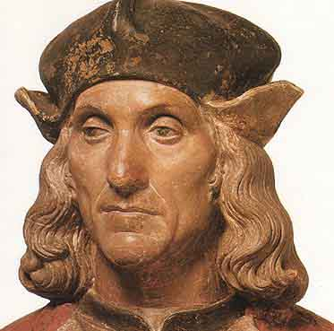
Henry VII’s foreign policy
Henry had 3 main aims at the start of his reign.
To maintain peace in England.
To avoid war.
To gain allies.

Slide 40
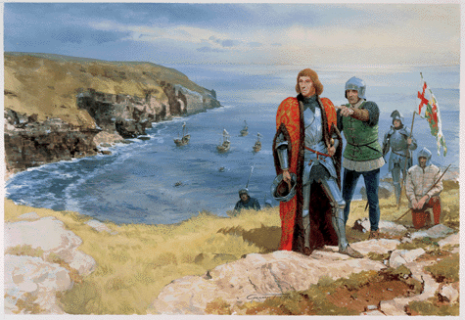
Henry’s motives
The reason he pursued a largely non-interventionist policy was because he had little choice. War was expensive and dangerous, peace was cheaper and gave him a chance to consolidate his power in England.
As a usurper Henry was very vulnerable and many of Europe's rulers did not expect him to last long.

Slide 41
1485 – 1488: First Steps
France: while England’s traditional enemy, France had ties with the Lancastrians and had helped Henry gain the throne. Henry negotiated a one year truce which was then extended for a further 3 years
Scotland: In July 1486 Henry succeeded in persuading James III to sign a three year truce. This truce survived James III assassination in 1488.
Brittany : A long term treaty was signed in 1486 which was more of a commercial relationship.

Slide 42
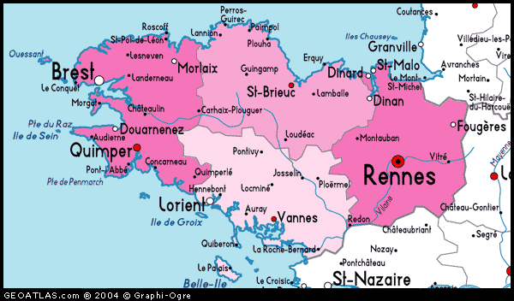
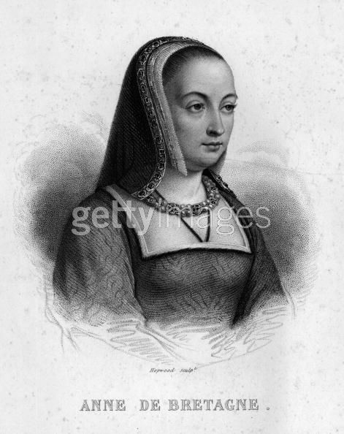
Brittany 1489 - 1492
In 1488 Duke Francis of Brittany had died and left the 12 year old Anne as his heir.
The French King Charles VIII claimed custody of Anne.
Why do you think Henry would not have wanted the French to have control of Brittany?
Henry with the support of Ferdinand of Spain and Maximilian, the Holy Roman emperor, sent 6000 men to support Brittany. Unfortunately this was too little too late and when the Spanish troops withdrew so did Henry. Anne married Charles in 1491 spelling the end of Brittany's independence.

Slide 43
France and the treaty of Etaples 1492
Henrys intervention in Brittany had angered the French and in retaliation they supported Warbeck’s claim to the throne. Henry had to respond to this.
Henry did not want war and could not afford it but he had to convince the French he was serious. He landed in Calais with an army of 26000 men hoping the French would back down. He timed this landing for November which some historians see as a signal to Charles that he was willing to negotiate.

Slide 44
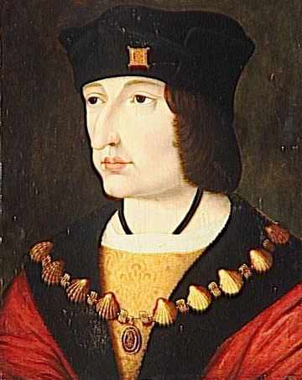
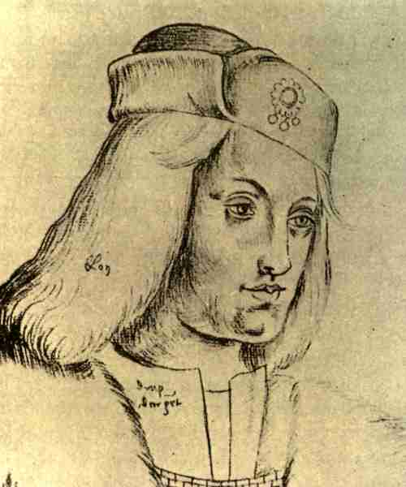
His bluff worked and Charles backed down. Henry managed to negotiate the following:
The French would give no further aid to English rebels, particularly Warbeck.
They would pay the cost of Getting Henry’s army back to England.
They would pay the arrears of the money owed to Edward IV at the treaty of Picqugny back in 1475.

Slide 45
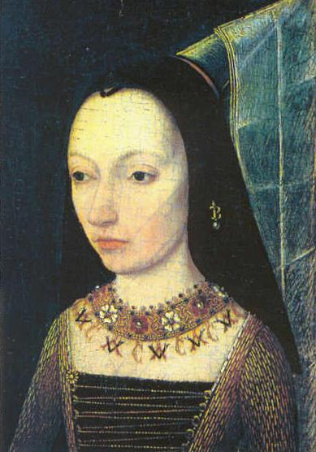
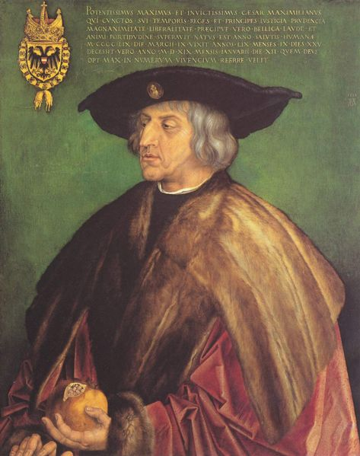
Burgundy
Traditionally England’s Ally Burgundy had close ties with the house of York and with London merchants.
Margaret of Burgundy (Edward IV and Richard III sister) saw Henry as a usurper and was determined to destroy him. 1486 they harboured Lovell and 1487 Lincoln.
Traditional historians see Margaret of Burgundy’s hatred of Henry as main reason for this but Burgundian interests were also at stake as they were worried about Henry’s connection to France.
It is worth noting that Henry’s relationship with Burgundy improved in the later years of his reign.

Slide 46
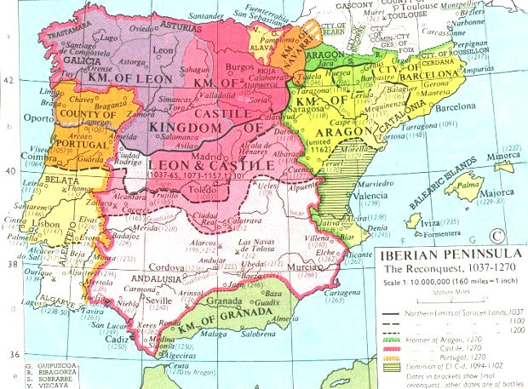
Spain

Slide 47
Spain
Henry spotted a useful ally in Ferdinand
The Treaty of Medina Del Campo was signed in 1489 this agreed:
1 Spain would not support pretenders to the English throne
2 They would act together against France in Brittany
3 Improved trade
4 Henry’s eldest son Arthur would marry Ferdinand & Isabella’s oldest daughter Catherine when they were old enough.

Slide 48
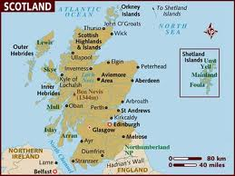
Scotland
Traditionally rivals – however neither Henry VII nor James III wanted trouble, so a three year truce was initially agreed
In 1488 James III was assassinated and replaced by the 15 year old James IV. James and his advisors were hostile to England

Slide 49

Scotland
James IV initially supports Warbeck
In 1496 James IV launched a massive border raid into England with Warbeck, but it achieved nothing as there was no support
By Autumn of 1497 James IV was willing to make peace and they made the Truce of Ayton
This was followed by the ‘Treaty of Perpetual Peace’ in 1502

Slide 50
Scotland
These treaties were a great achievement for Henry – there had been no significant treaty with Scotland since 1328
Henry married his daughter Margaret to James IV in 1503
However Scottish friendship and alliance with France remained – which was always seen as a potential threat to England

Slide 51
Scotland
Why was Scotland seen as a threat by Henry?
Why was 1496 such a difficult year for Henry?
What was the significance of the Truce of Ayton? Consider Henry VII’s foreign policy aims.
What was the significance of the marriage alliance between James IV and Margaret? (Again consider Henry’s foreign policy aims).

Slide 52
DESCRIPTION OF HENRY VII’S FOREIGN POLICY | EVIDENCE FOR | EVIDENCE AGAINST
Cautious/wary | Didn’t wage many wars (no long term ones) Tried to avoid provoking other countries as much as possible – didn’t claim the throne of France when he took the English throne Spent time and money trying to get hold of Warbeck. | When he sends an army of 26,000 men to France, to try to force them into a position when they will negotiate
Defensive | Trade embargo rather than invasion with Burgundy Marriages and peace treaties as a whole showed his defensive mind set | Invades France to force a positive position in negotiations
Pragmatic Practical/sensible | Doesn’t retaliate with war to the Scottish border raid Marriage of Margaret to James IV | Treaty of Windsor and alienating Ferdinand in the final years
Realistic | Didn’t try to regain the French land that had been lost. Treaty Etaples – accepts that he is going to lose Brittany, but sees the pension as at least he’s getting something out of it. | He believed he could make peace with everyone and not have them turn on him – actually by the end of his life most of his foreign policy ends up at least partially failing. England ends up isolated.
Forward thinking/ Strategically sound | Sending volunteers to Brittany – to try to stop it from going to France Treaties and marriages were thinking long term | Alienated Ferdinand in the final years and was excluded from international relations at Cambrai in 1508
Unambitious | Accepts the loss of Burgundy Never remarries after loss of Elizabeth | Tries to ransom France for a pension Alliance with Spain – very ambitious
Opportunistic | Treaty of Windsor – when bad weather makes Philip of Burgundy land, he negotiates a treaty with him. James IV being unmarried, marries Margaret | Could have intervened a lot more than he did, e.g. in Italy, or France or Brittanny
INSERT YOUR OWN DESCRIPTION HERE! Secure | Constantly trying to make peace with everyone | Nearly collapsed at the end of his reign.

