Slide 1
3.8.1 Alteration in the sequence of bases in DNA can alter the structure of proteins

Slide 2
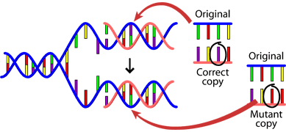
Mutations – what causes them?
Errors during DNA replication:
Happen spontaneously
Natural, unavoidable
Random process
Cells have proofreading mechanisms to correct these errors but occasional errors go uncorrected.
The mutation rate varies from species to species, but is around 2 mutations per 100,000 genes per generation.

Slide 3
Mutations – what causes them?
Chemicals called Mutagens:
Examples include nitrogen dioxide and benzopyrene (in cigarette smoke).
Can directly alter DNA base sequence, or interfere with transcription of certain genes.
Benzopyrene interacts with a gene called TP53 – a tumour suppressor gene – in a way which leads to cancer.
Radiation is another mutagenic agent:
High energy ionising radiation can damage DNA (e.g. alpha and beta particles)
Gamma rays, x-rays and UV waves can damage DNA as well

Slide 4
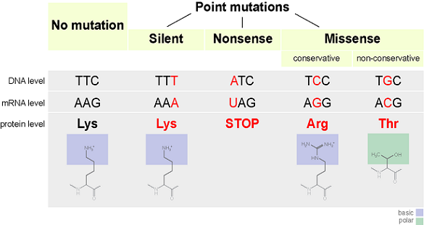

Slide 6
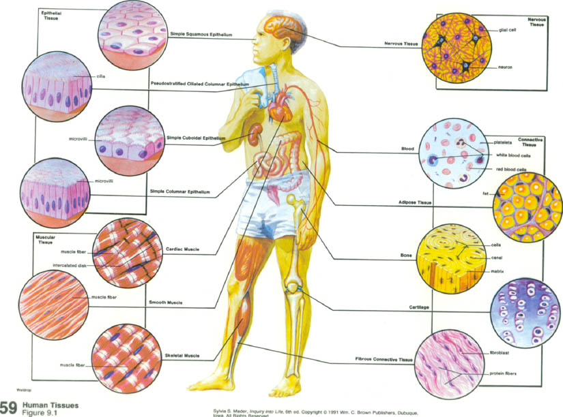
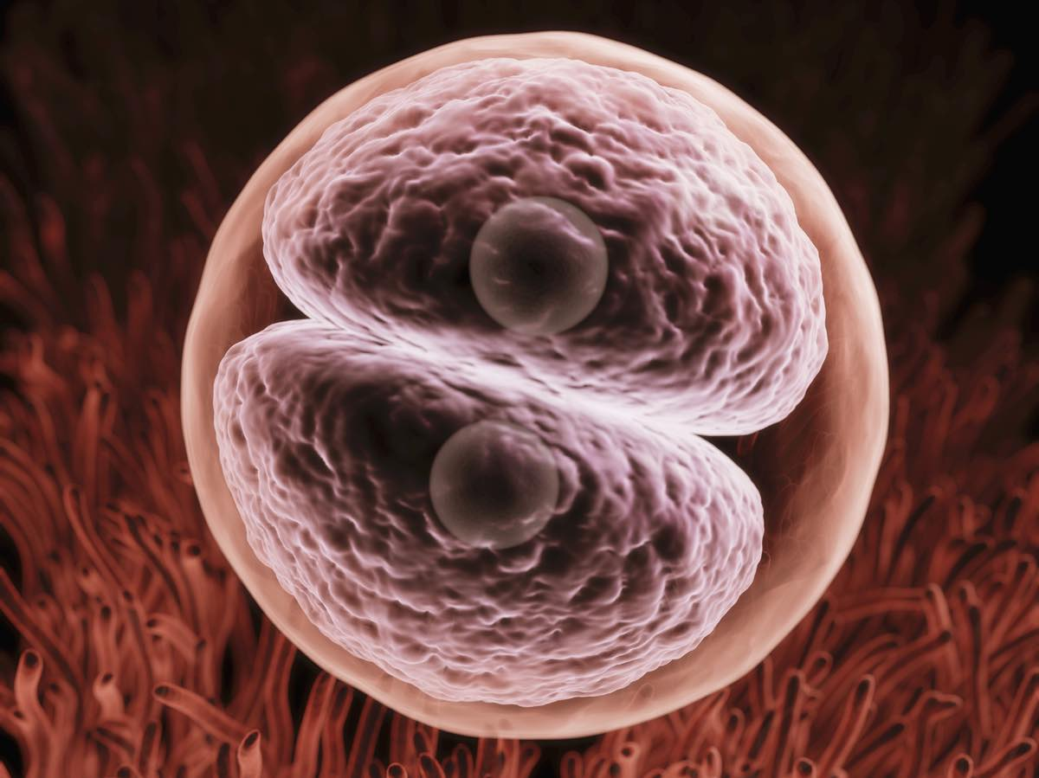
All cells in the human body are derived from one – the zygote
The fertilised egg has the ability to develop into any cell type within the body

Slide 7
Yet body cells do not all have the ability to turn into other cell types.
This is due to cell differentiation.
Cells express different genes controlling their development into particular cell types.
In extreme cases of differentiation, cells will even lose their genetic material once fully specialised (red blood cells in animals, xylem in plants).

Slide 8
All cells contain the same genetic material, but not all genes are expressed in all cells.
There are some genes that all cells express. These contain the instructions for essential processes, e.g:
  Enzymes involved in respiration
  Enzymes involved in membrane/organelle synthesis
  tRNA production
There are other genes that are only used in specialised cells e.g:
insulin, only expressed in beta cells of the pancreas
salivary amylase, only expressed in the salivary glands
The control of expression of these genes is essential if the growing embryo is to develop successfully

Slide 9
Differentiation
In unicellular and simple multicellular organisms each cell is capable of performing all functions.
Not so in more complex organisms.
All cells are derived by mitosis and so contain the same instructions, yet they develop differently and differentiate, i.e. they become specialised for particular functions.
Once differentiated they lose:
  ability to divide.
  totipotency i.e. ability to do everything.
Structure of specialised cells suits their function.

Slide 10
… Differentiation
During the process of differentiation cellular features are changed:
  size
  shape
  metabolism
In mammals differentiation is generally not reversible. However, it can be reversed in plants.
Cells that can differentiate are called:
  stem cells in animals.
  meristematic cells in plants.

Slide 11
What is a stem cell?
stem cell
SELF-RENEWAL
(copying)
DIFFERENTIATION
(specializing)
specialized cell
e.g. muscle cell, nerve cell
stem cell
Stem cells are different from other cells of the body because stem cells can both:
Self-renew: Make copies of themselves
AND
2) Differentiate: Make other types of cells – specialized cells of the body.
Notes:
What is a stem cell?
Note: The next slide provides an alternative version of this diagram that some younger audiences may find easier to understand. It aims to avoid the misconception that a stem cell always makes one copy of itself and one specialized cell when it divides (see below). The concept of a stem cell is very well explained in the short film, “A Stem Cell Story” at www.eurostemcell.org/films
What the diagram shows
Stem cells are different from other cells of the body because stem cells can both:
Self-renew: Make copies of themselves
AND
2) Differentiate: Make other types of cells – specialized cells of the body.
‘Specialized’ or ‘differentiated’ cells play particular roles in the body, e.g. blood cells, nerve cells, muscle cells. Specialized cells cannot divide to make copies of themselves. This makes stem cells very important. The body needs stem cells to replace specialized cells that die, are damaged or get used up.
Cell division - possible questions
1) 16+ year old students may remember learning about 2 kinds of cell division – mitosis and meiosis. They may have learnt that mitosis happens in wound healing or to replace short-lived cells, but probably won’t have discussed stem cells in this context. You might therefore need to explain that most specialized cells cannot undergo mitosis. There are a few exceptions (e.g. liver cells or T-cells) but in general specialized cells can no longer divide. Skin cells, red blood cells or gut lining cells cannot undergo mitosis. Stem cells do divide by mitosis and this makes them very important for replacing lost or damaged specialized cells.
2) Should mitosis be discussed, you may wish to note the following: In mitosis, the DNA in the daughter cells is identical to the DNA in the dividing cell. This is true for dividing stem cells, both in self-renewal and in differentiation. In differentiation, the daughter cells are more specialized than the original stem cell. So, the daughter cells behave differently even though they have the same DNA as the stem cell. This is because there are lots of other molecules inside and around the cells that can change the way the cells behave.
3) Scientists think that when human stem cells divide they probably make EITHER two stem cells, OR two more specialized cells. In fruit flies, stem cells can divide to make one stem cell and one more specialized cell in a single division.

Slide 12
Why self-renew AND differentiate?
1 stem cell
1 stem cell
4 specialized cells
Self renewal - maintains the stem cell pool
Differentiation - replaces dead or damaged
cells throughout your life
Notes:
Why self-renew AND differentiate?
1) Self renewal is needed because if the stem cells didn’t copy themselves, you would quickly run out. It is important for the body to maintain a pool of stem cells to use throughout your life.
2) Differentiation is important because specialized cells are used up, damaged or die all the time during your life. Specialized cells cannot divide and make copies of themselves, but they need to be replaced for your body to carry on working. For example, your body needs 100,000 million new blood cells every day. Of course, differentiation is also important for making all the different kinds of cell in the body during development of an embryo from a single fertilized egg.
Possible questions or misconceptions
1) School students may have learnt simply that ‘cells undergo mitosis to make copies of themselves to heal wounds or replace blood cells’. You may need to explain that specialized cells like skin, red blood or gut cells cannot undergo mitosis, which is why you need stem cells. There are a few exceptions (e.g. liver cells or T-cells) but in general specialized cells can no longer divide. For adult audiences, this could be expanded to cover the idea that there are intermediate cells (progenitors) between stem cells and specialized cells that divide to allow a large number of new cells to be made (see slide 26 on renewing tissues)
2) Scientists think that stem cells in the human body don’t generally divide to produce one stem cell and one specialized cell at the same time. They probably divide to make EITHER two stem cells, OR two more specialized cells. In fruit flies, stem cells can divide to make one stem cell and one more specialized cell.

Slide 13
Stem cell jargon
Potency A measure of how many types of specialized cell a stem cell can make
Totipotent Can make all the specialized cells in the body, and the cells in the extra-embryonic membranes (chorion, amnion, placenta). Embryonic cells within the first couple of divisions are totipotent
Pluripotent Can make all types of specialized cells in the body Embryonic stem cells are pluripotent
Multipotent Can make multiple types of specialized cells, but not all types
Tissue stem cells are multipotent
Unipotent Can differentiate along only one lineage, and can produce only 1 type of cell
Notes:
Stem cell jargon
Scientists use the words pluripotent and multipotent to help them describe stem cells. ALL stem cells can both self-renew and differentiate, BUT some stem cells can make more kinds of specialized cells than others. The terms on the slide are the key ones to remember. There are also stem cells that are:
TOTIPOTENT: can differentiate into all types of specialized cells in the body PLUS cells that are needed during development of the embryo only: placenta, yolk sac, umbilical cord.
UNIPOTENT: can only differentiate into one type of specialized cell. For example, spermatogonial stem cells (found in the testicles) are unipotent because they can only form sperm cells.
A useful place to look up other words and phrases to do with stem cells is the EuroStemCell online glossary: www.eurostemcell.org/glossary

Slide 14
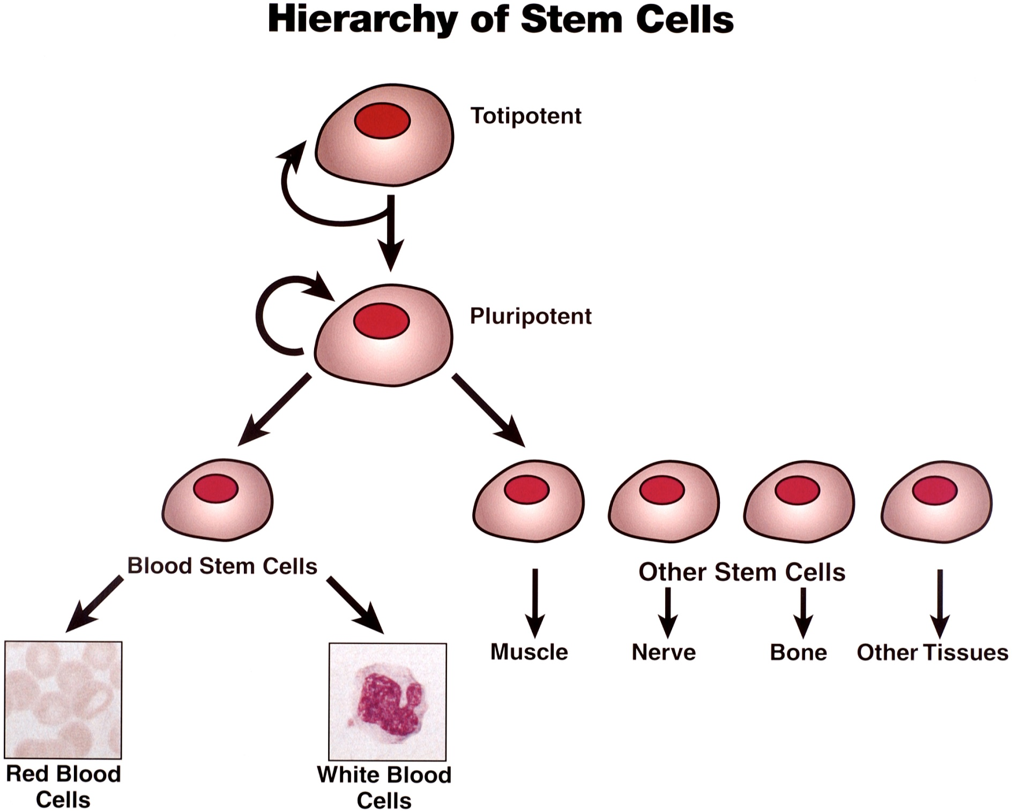

Slide 15










Multipotent stem cells example:
Haematopoietic stem cells (HSCs)
NK cell
T cell
B cell
dendritic cell
megakaryocyte
platelets
HSC
erythrocytes
macrophage
bone marrow
neutrophil
eosinophil
basophil
committed progenitors
specialized cells
Notes:
Tissue stem cells: Haematopoietic stem cells (HSCs)
HSCs = blood stem cells
HSCs are isolated from the bone marrow. They give rise to committed progenitors, which then give rise to all specialized blood cell types.

Slide 16
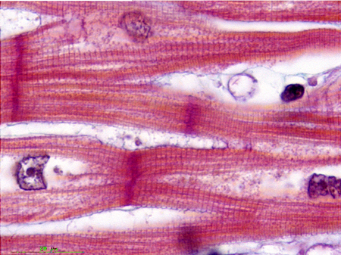
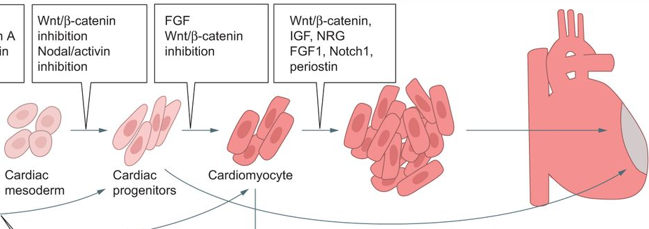
Unipotent Stem Cells
Cardiomyocytes – form cardiac muscle
Have their own precursor stem cells

Slide 17
Sources of Stem Cells
Embryonic Stem Cells
Come from the embryo early in development. Pluripotent
Umbilical Cord Stem Cells
Derived from umbilical cord blood, similar to adult stem cells. Multipotent
Placental Stem Cells
Found in the placenta. Multipotent
Adult Stem Cells
Despite the name, are found in the body tissues from the foetal stage of development into and throughout adulthood. Multipotent

Slide 18

Embryonic stem (ES) cells:
What they can do
differentiation
embryonic stem cells
PLURIPOTENT
all possible types of specialized cells
Notes:
Embryonic stem cells: What they can do
Embryonic stem cells are exciting because they can make all the different types of cell in the body – scientists say these cells are pluripotent.

Slide 19
Embryonic stem (ES) cells:
Challenges
skin
grow under conditions A
grow under conditions B
neurons
embryonic stem cells
grow under conditions C
The big challenge for scientists is to learn how to control these fascinating cells. If we could force embryonic stem cells to make whatever kind of cell we want, then we would have a powerful tool for developing treatments for disease. For example, perhaps we could grow new insulin-producing cells to transplant into a patient with diabetes.
blood
grow under conditions D
?
liver
Notes:
Embryonic stem cells: Challenges
Scientists around the world are trying to understand how and why embryonic stem cells produce skin, blood, nerve or any other particular kind of specialized cell. What controls the process so that the stem cells make the right amount of each cell type, at the right time?
The big challenge for scientists is to learn how to control these fascinating cells. If we could force embryonic stem cells to make whatever kind of cell we want, then we would have a powerful tool for developing treatments for disease. For example, perhaps we could grow new insulin-producing cells to transplant into a patient with diabetes. But there is a great deal to learn before such therapies can be developed. Scientists also want to use stem cells to:
Understand how diseases develop (disease modelling)
Test drugs in the laboratory

Slide 20


Induced pluripotent stem cells (iPS cells)
‘genetic reprogramming’
adult cell
induced pluripotent stem (iPS) cell
behaves like an embryonic stem cell
differentiation
culture iPS cells in the lab
Advantage: no need for embryos!
all possible types of
specialized cells
Notes:
Induced pluripotent stem cells (iPS cells)
Note: This slide contains a lot of information and may be too complex for some audiences unless there is plenty of time for explanations and discussions.
What are iPS cells?
In 2006, scientists discovered that it is possible to make a new kind of stem cell in the laboratory. They found that they could transform adult skin cells from a mouse into cells that behave just like embryonic stem cells. In 2007, researchers did this with human cells too. The new stem cells that are made in the lab are called induced pluripotent stem cells. Just like embryonic stem cells, they can make all the different types of cell in the body – so we say they are pluripotent.
Making induced pluripotent stem (iPS) cells is a bit like turning back time. Scientists add particular genes to adult cells to make them behave like embryonic stem cells. Genes give cells instructions about how to behave. So, this process is a bit like changing the instructions in a computer programme to make the computer do a new task. Scientists call the process they use to make iPS cells ‘genetic reprogramming’.
Why are they exciting?
Researchers hope that one day they might be able to use iPS cells to help treat diseases like Parkinson’s or Alzheimer’s. They hope to:
Take adult cells like skin cells from a patient
Make iPS cells
Use those iPS cells to grow the specialized cells the patient needs to recover from the disease, e.g. certain brain cells. These cells would be made from the patient’s own skin cells so the body would not reject them.
There is a long way to go before scientists can do this, but iPS cells are an exciting discovery.

Slide 21
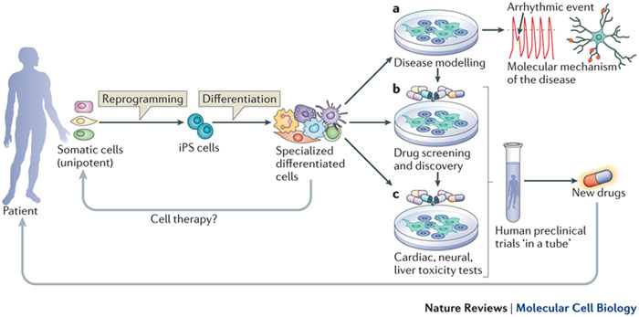
Proteins called transcription factors are added that “switch on” the long dormant genes necessary for a cell to be pluripotent
Given the right chemical stimulus a cell can be encouraged to specialise into a completely different type of cell.

Slide 23
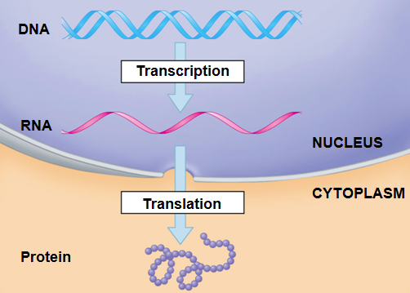
Regulation of transcription and translation
3.8.2.2

Slide 24
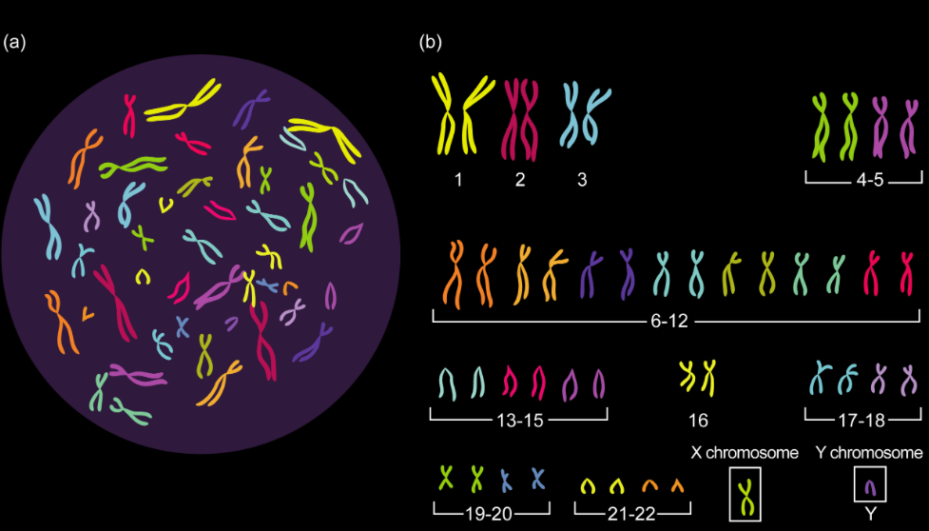
Regulation of transcription and translation
Are all genes in all cells always carrying out protein synthesis?

Slide 25
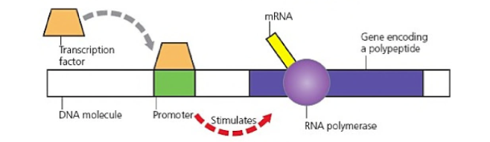
What are transcription factors?
They are proteins which move in from the cytoplasm and bind to DNA at specific sites called PROMOTERS, which are found near the start of a target gene ( about 100 base pairs upstream)

Slide 26
Regulation of transcription and translation
Transcription factors enable RNA Polymerase to attach to the start of the gene and BEGIN TRANSCRIPTION:

Slide 27
Regulation of transcription and translation
Some transcription factors are ACTIVATORS – they help RNA polymerase bind and activate transcription.
Others are called REPRESSORS and decrease the rate of transcription because they slow or prevent RNA polymerase from binding

Slide 28
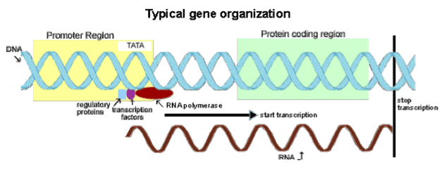

Slide 29
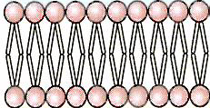
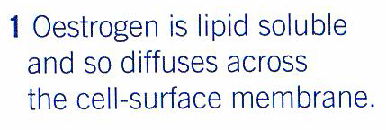
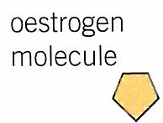
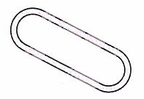
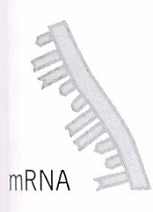
Outside environment
Cytoplasm
Nucleus
Transcriptional factor

Slide 30
How can this be possible?
Epigenetics involves heritable changes in gene function, without changes to the base sequence of DNA. These changes are caused by changes in the environment that inhibit transcription by:
  increased methylation of the DNA
  decreased acetylation of associated histones.

Slide 31
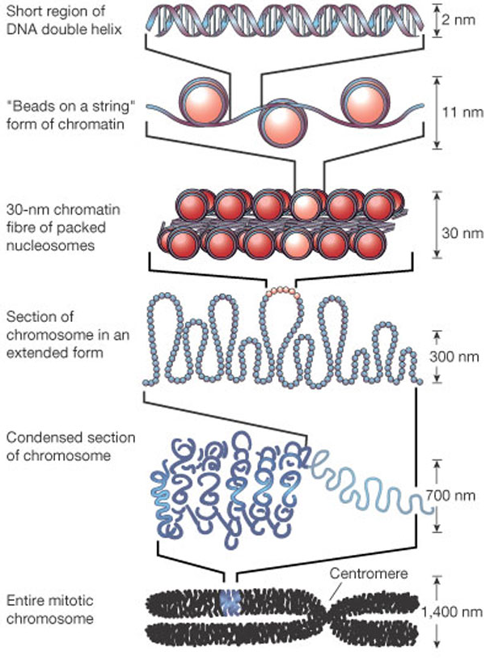
Image taken from Felsenfeld and Groudine (2003) Controlling the double helix
Nature 421, 448-453
Notes:
In order for the roughly 2m of DNA to be contained in the nucleus of each cell, it must be compacted and packaged so that it becomes small enough.
Initially, DNA is wrapped 1.7 times around a 8 core histone proteins (a H3-H4 tetramer and two H2A-H2B dimers) to create a nucleosome; arrays of nucleosomes are known as chromatin. It is the tails are histone proteins that are relatively free in this structure and become chemically tagged with marks that affect gene expression profiles.
Following this, the nucleosome chromatin fibre is further compacted to create a 30nm wide fibre which becomes more condensed at each level of packaging before forming a 1400nm wide mitotic chromosome.

Slide 32
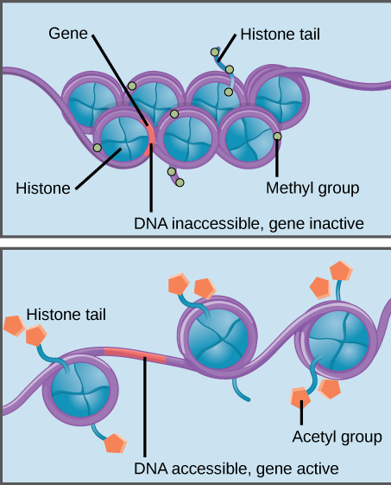
Inactive genes can be wrapped tightly and become inaccessible – ensuring they are not read – (epigenetic silencing)
Active genes are ‘looser’ and are more easily read and transcribed

Slide 33
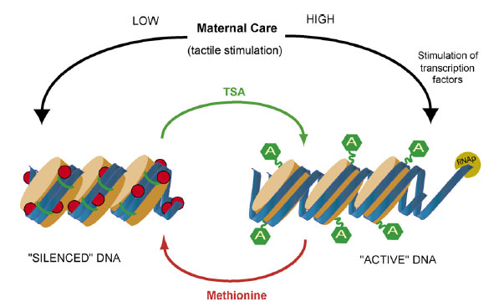
Epigenome - flexible
Chemical tags (methyl & acetyl) respond to environmental changes e.g. add on to or leave the DNA

Slide 34
The DNA histone complex
A weak association with histone = loosely packed DNA
DNA is accessible by transcription factors – mRNA can be made
Strong association with histone = tightly packed
Not accessible by transcription factors – no mRNA made

Slide 35
Decreased acetlyation
Acetylation = acetyl group is transferred to a molecule
Group donating is acetylcoenzyme A
Increases the positive charges on histones and therefore increases their attraction to the negative phosphate groups.
Association between histone and DNA is stronger and therefore no transcription
i.e. gene is switched off

Slide 36
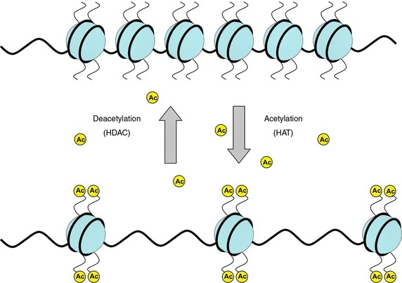

Slide 37
Increased methylation
Methylation = addition of methyl group to DNA molecules
It is added to cytosine bases
Normally is inhibitory (prevents transcription)
1) prevents binding of transcription factors
2) attracting proteins that condense the DNA – histone complex. Therefore is inaccessible to transcription factors.

Slide 38
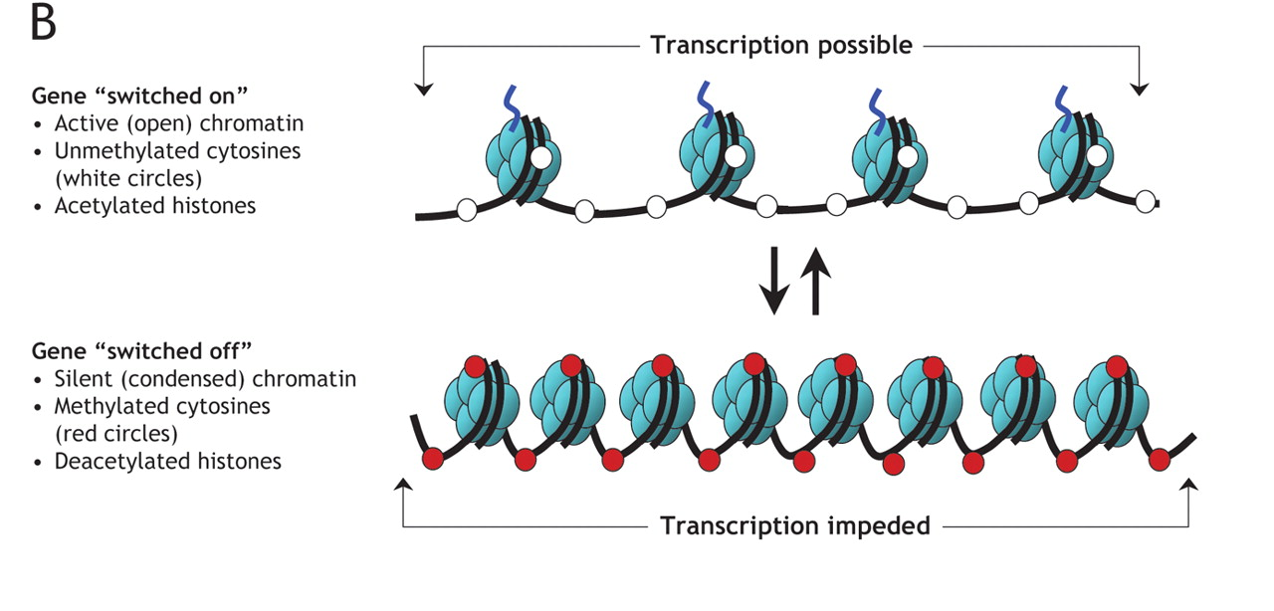

Slide 39
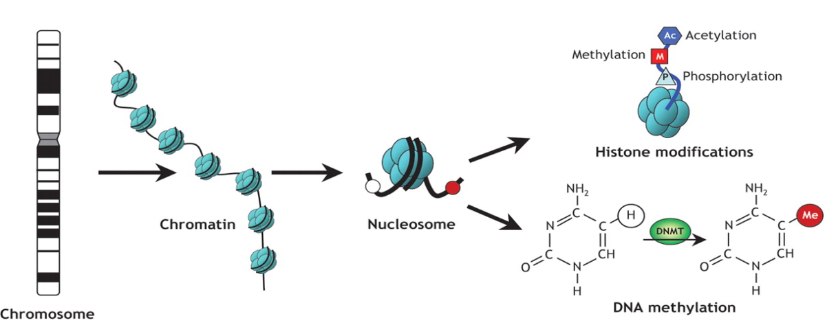
Add acetyl: turn genes on
A
Remove acetyl: turn genes off
Turn genes off
Notes:
The addition of the epigenetic tags directly alters the interaction between negative DNA (due to the sugar-phosphate background) and the basic (positively charged) histone proteins.
By altering the pattern of modifications, the overall structure of chromatin is changed meaning that areas that were previously condensed become decondensed and vice-versa meaning that genes can change between active and inactive states.
There are two main types of epigenetic modification: histone modification and DNA methylation.
DNA methylation is catalysed by enzymes known as DNA methyltransferases on position 5 (C5) of cytosine residues in the DNA sequence to form 5-methyl cytosine. This acts as a binding site for other enzymes which then modify histones.
Histone modification is performed by multiple enzyme families. Histone acetylation is performed by histone acetyltransferases (HATs) which add an acetyl group to lysine residues in the histone tail. This masks the positive charge of the residue, loosening the interaction between DNA and histones allowing gene activation.
This reaction is reversed through the action of histone deacetylases (HDACs) which remove the acetyl group, causing an increase in the attraction between DNA and histones and chromatin condensation, preventing gene activation.
Methylation of histones can occur on lysine or arginine residues and can occur in three ways: mono- (one), di- (two) or tri- (three) methylation events. This mark doesn’t alter the charge of residues and tends to be associated with gene inactivation, although in some cases it can be associated with gene activation.
Finally, phosphorylation can be performed by an enzyme family known as kinases which causes the addition of a phosphate group from ATP to be added to histone tails. Since phosphate is a negatively charged ion, this neutralises the positive charge of histones, reducing the interaction between DNA and the proteins, allowing gene activation.

Slide 40
Table – inaccessible gene
Histones | Decreased acetylation
DNA | Increased methylation
DNA-histone complex | More condensed
Chromatin type | Heterochromatin
Transcription factors | No access
Genes | Inactive

Slide 41
Table – accessible gene
Histones | Increased acetylation
DNA | Decreased methylation
DNA-histone complex | Less condensed (loosely packed)
Chromatin type | Euchromatin
Transcription factors | Access
Genes | Active

Slide 42
Epigenetics and disease
Epigenetics provides the missing link on how the environment can change the cell without causing mutation to cause disease
Studies have shown that modifications can be passed down from generation to generation and can be associated with causing or predisposing disease in offspring
Notes:
Historically, it was through that disease was caused through direct mutation of the genome. However, there are very few diseases that have been shown to be associated with mutation meaning that the vast majority of diseases must be caused by other alterations.
Environmental conditions can cause disease through changing the epigenome of individual cell types or the individual itself which would later cause disease. This means that epigenetics explains how the environment can change a cell without causing mutations to the genome to induce disease.
Recent evidence suggests that epigenetic modifications can be passed down from generation to generation i.e. from parent to child to grandchild, in a process known as transgenerational inheritance. This has direct implications on health because it means disease could be caused in a person due to what their grandparents were exposed to, even if they weren’t directly exposed to it themselves.

Slide 43
Cancer
Incorrect activation of a normally inactive gene linked with cancer e.g. tumour suppressor gene / oncogenes
Patients with colorectal cancer had less DNA methylation that normal = higher than normal gene activity (oncogenes turned on/overexpressed)

Slide 44
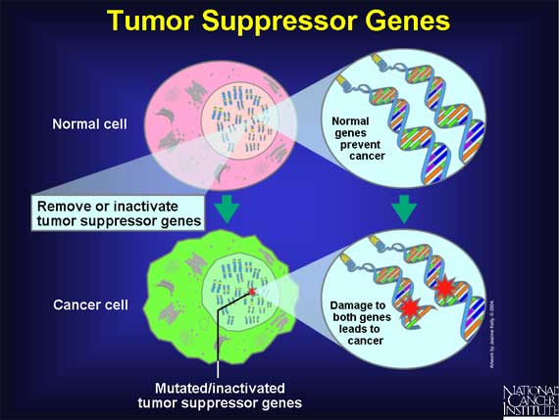
What controls cell division normally?
  Genes normally control cell division and division is halted by tumour suppressor genes when sufficient cells have been produced for growth and repair (like the brakes on a car).
  Another type of gene, a proto-oncogene, stimulates cell division (like the accelerator on a car)

Slide 45
Cancer can also be caused by excessive methylation of tumour suppressor genes
DNA in promoter regions for protective tumour suppressor genes have no methylation normally, so can be accessed by transcription factors and transcribed
In some cancers they can become highly methylated causing tumour suppressor genes to be “switched off”
This is seen in patients who develop cancer

Slide 46
A-LEVEL BIOLOGY
3.8.2.2 RNA interference (RNAi)
As a result of RNA interference, mRNA molecules produced by transcription of a gene can no longer be translated.
Even though the gene is ‘switched on’, the protein it encodes is not produced.
•The gene is effectively ‘silenced’.
Version 1.0

Slide 47
An outline of polypeptide synthesis
Transcription in the nucleus
  The base sequence of a gene is copied to pre-mRNA
  The pre-mRNA is ‘edited’ to remove the introns
Translation in the cytoplasm
  The base sequence of mRNA is used by ribosomes to assemble the amino acid sequence of a polypeptide
  The amino acids are carried to the ribosomes by tRNA
Version 1.0

Slide 48
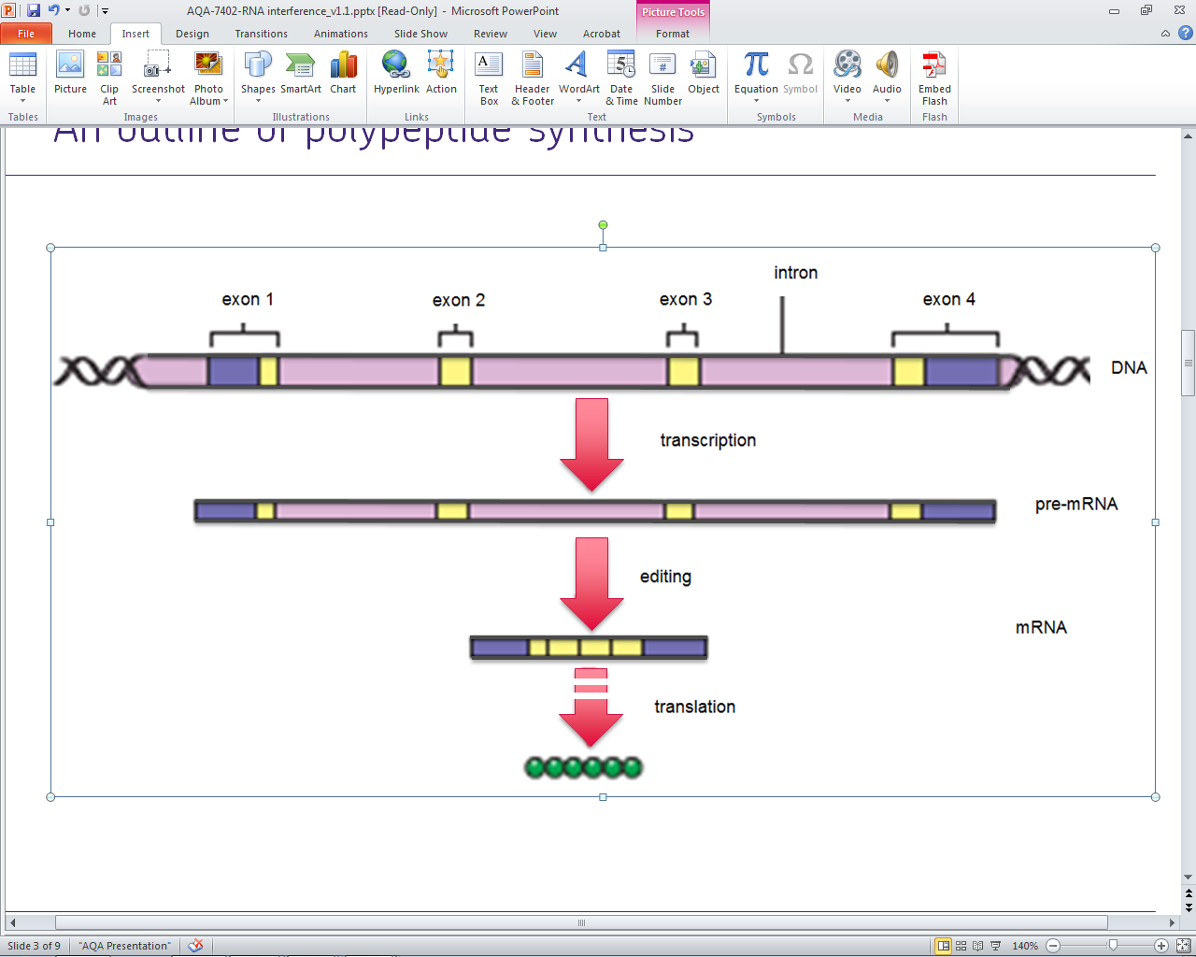
An outline of polypeptide synthesis
Version 1.0

Slide 49
RNA interference (RNAi)
Prokaryotes and eukaryotes have evolved mechanisms that either:
  destroy mRNA
  prevent ribosomes translating mRNA
These processes are called RNA interference (RNAi) and enable a cell to prevent the expression of a gene (‘silence’ the gene)
RNAi prevents the translation of mRNA.
Prokaryotes and eukaryotes (including humans) have these mechanisms.
It might interest students to learn that scientists believe the selective advantage of these mechanisms might have been that it gave cells a defence against infection by viruses.
Version 1.0

Slide 50
RNA-induced silencing complex (RISC)
Short regulatory RNA molecules are transcribed from a cell’s DNA
There are two types of this RNA
  microRNA (miRNA)
  small interfering RNA (siRNA)
A single-strand of miRNA or siRNA can bind to a protein in the cytoplasm to form a complex, called an RNA-induced silencing complex (RISC)
Small nuclear RNAs (snRNAs) operate within nuclei, where they are tightly bound to proteins to form small nuclear ribonucleoproteins, or snRNPs (often pronounced ‘snurps’), that control the splicing of pre-mRNA.
MicroRNAs (miRNAs) are formed as hair-pin bends of RNA but processed into single-strands about 22 to 26 nucleotides long. These single strands become incorporated into a protein-based RISC.
Small interfering RNAs (siRNAs) are formed as double-stranded molecules about 21 to 25 base pairs long. One of their strands becomes incorporated into a protein-based RISC.
When the single-stranded miRNA or siRNA within a RISC binds to a molecule of mRNA that contains a sequence of bases complementary to its own, the mRNA is either hydrolysed or its translation is stopped.
Students might be interested to know that the first discovery of a miRNA molecule was in 1993 but research into their role began only in 2000. This part of the specification is very much up-to-date.
Version 1.0

Slide 51
RISC binds to mRNA
The short miRNA or siRNA strand within a RISC binds to a target mRNA molecule
  The target is any mRNA molecule that happens to contain a base sequence that is complementary to its own
  Hydrogen bonds between the base pairs A-U and C-G hold the two RNA sequences together
Version 1.0

Slide 52
Once mRNA is bound to a RISC
Either
the mRNA is hydrolysed by an enzyme - RNA hydrolase
Or
ribosomes are prevented from attaching to the mRNA
Either way, the mRNA cannot be translated
Version 1.0

Slide 53
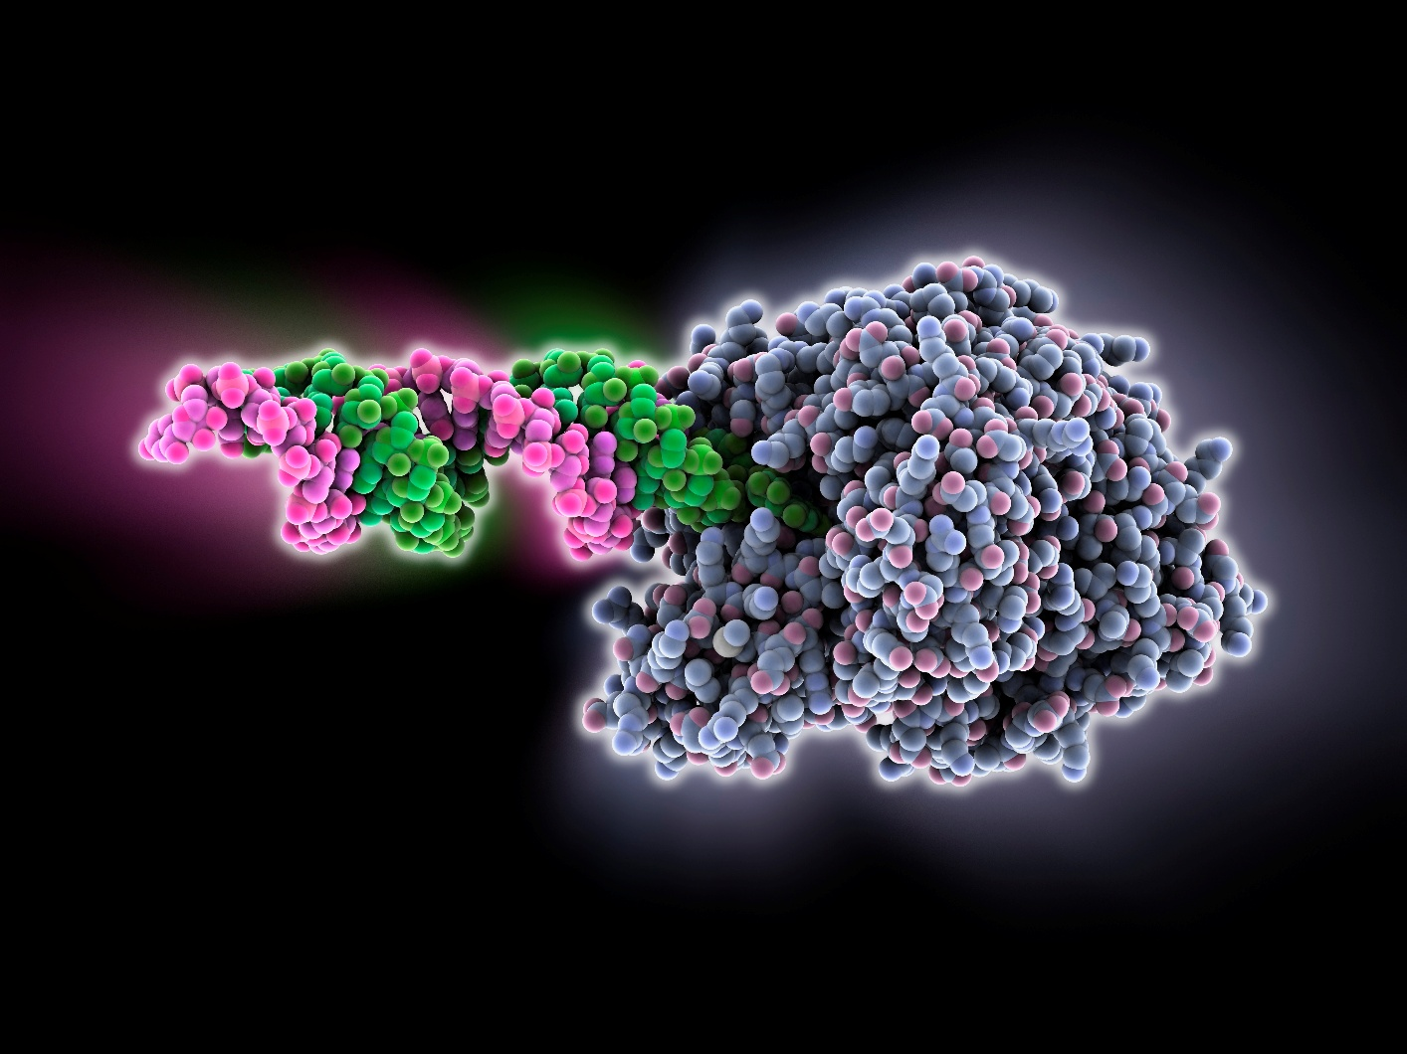
Model of a RISC - The RISC comprises an argonaute protein (grey) bound to a small interfering RNA (siRNA) molecule (pink and green).

Slide 54
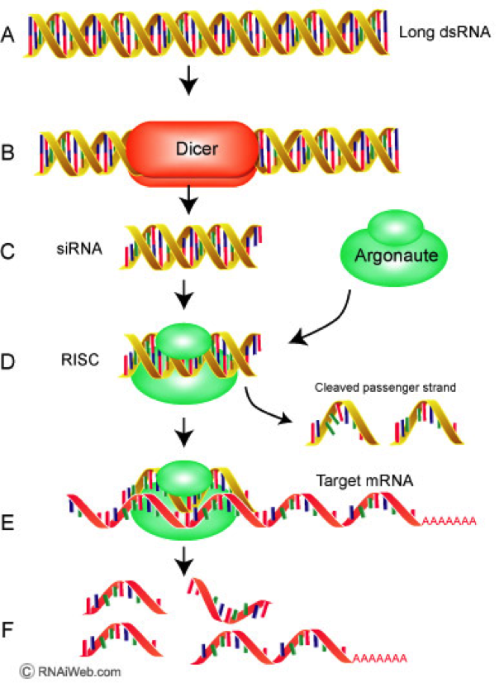
RNAi
A) Short strands of siRNA (short interfering) can be produced by a cell or introduced experimentally
B-D) These are cut into even shorter sequences, and dissociate into single strands.
E) The unpaired siRNA fragment binds to its complimentary sequence on a messenger RNA.
F) This blocks the progress of a ribosome, preventing translation. It can also attract other enzymes that will destroy the mRNA, cutting it into fragments.

Slide 55
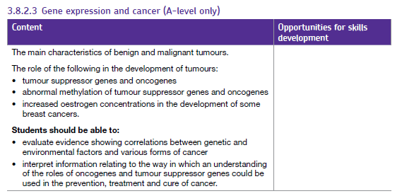

Slide 56
What are malignant tumours? – cancer
Cells divide by mitosis
Tumour cells growth abnormal / continuous / uncontrolled / rapid
Tumour cells spread / invade other tissues / form secondary tumours / metastasis
Via blood / lymph system

Slide 57
What are benign tumours?
Cells are not cancerous
Tumour cells growth is slower than malignant tumours
Tumour DO NOT invade other tissues / form secondary tumours / metastasis
Most of the time they are harmless
Can sometimes cause blockages
Could put pressure on organs / damage organs

Slide 58
Cell division and cancer
Cell division is tightly controlled by genes, there are two types involved in this:
  Tumour suppressor genes – that repress the cell cycle and promote apoptosis ( self destruction )
  Proto-Oncogenes - that promote the cell cycle and stimulate cell division
  These genes ensure that cells divide at a fairly constant rate, and those cells that are worn out or dead are replaced. If a mutation occurs in these genes it can lead to cancer.

Slide 59
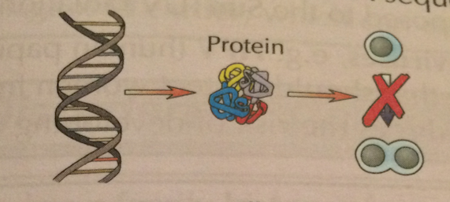
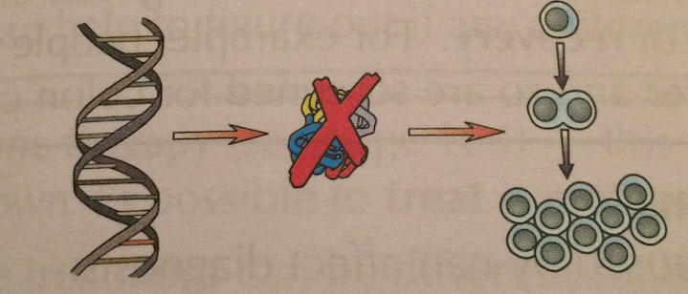
Tumour Suppressor Genes
When functioning normally these inhibit and slow down cell division by producing proteins that stop cells dividing or cause them to self destruct ( apoptosis)
If a mutation occurs a tumour can develop.

Slide 60
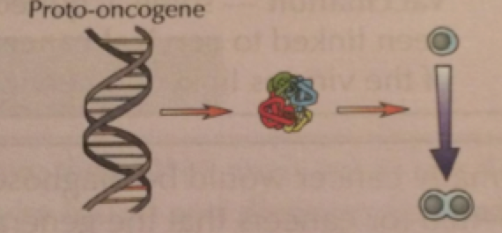
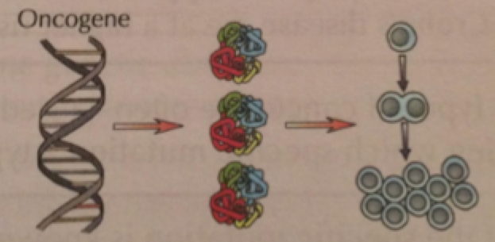
Proto oncogenes
When functioning normally proto oncogenes stimulate cell division by producing proteins that make the cell divide.
If a mutation occurs in a proto oncogene, the gene can become overactive and stimulate the cells to divide uncontrollably. This mutated proto oncogene is called an ONCOGENE and can lead to CANCER

Slide 61
Abnormal methylation of Tumour Suppressor Genes and proto oncogenes
When a CH₃ ( methyl) group is joined onto a something we say that METHYLATION has occurred.
Methylation of DNA is a way of regulating gene expression by controlling whether TRANSCRIPTION or TRANSLATION occurs.
If too much or too little METHYLATION occurs there can be problems.
HYPER = Too much HYPO = Low
No transcription
Protein not made
Increase in cell division
Hypomethylation of P O
Hyper methylation of TSG
Many proteins made

Slide 62
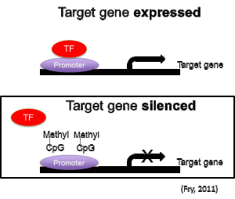
Abnormal methylation of other genes
METHYLATION can occur on other genes.
Methylation of DNA will regulate gene expression by controlling whether TRANSCRIPTION or TRANSLATION occurs.
If too much METHYLATION occurs on a part of the DNA where RNA polymerase would bind to attach RNA nucleotides together then this would mean NO mRNA and no TRANSCRIPTION and TRANSLATION of this gene.

Slide 63
Q1. Explain how the methylation of tumour suppressor genes can lead to cancer.(3)
1. Methylation prevents transcription of gene
2. Protein not produced that prevents cell division / causes cell death / apoptosis
3. No control of mitosis.

Slide 64
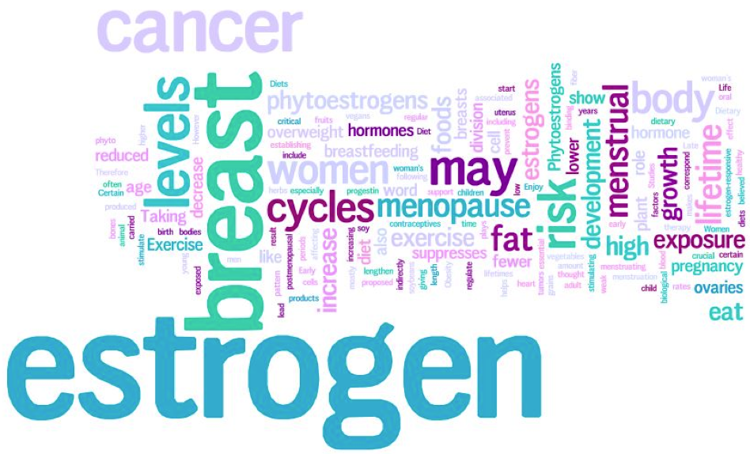
Oestogen and breast cancer
Some women are exposed to more oestogen than others due to earlier periods, earlier menopause or taking HRT. It is thought that this may increase the risk of breast cancer. Theories why include:
Oestrogen can stimulate cell division in breast cells. More cell division =- more chance of mutations
If mutation = cancer then increased oestogen = increased division of cancer cells = tumour forms quicker
We saw how oestrogen can activate genes by acting as a transcription factor. If the gene that is activated is a proto-oncogene then cells can divide uncontrollably.

Slide 65
http://www.macmillan.org.uk/
Breast cancer cells often have receptors (proteins) that hormones or other proteins can attach to and stimulate the cancer to grow. A pathologist does tests on the cancer to find out if receptors are present and what type they are. The results help you and your doctor to decide on the most effective treatment for you.
Hormone receptors
Breast cancers with receptors for the hormone oestrogen are called oestrogen-receptor positive or ER positive breast cancer. About 70% of breast cancers are ER positive. They respond well to treatment with hormonal therapies.
Protein receptors
Some breast cancers have high numbers of receptors for the protein HER2 (human epidermal growth factor 2). They are called HER2 positive breast cancers. About 1 in 7 women (15%) with early breast cancer have HER2 positive cancer. A drug called trastuzumab (Herceptin®) is an effective treatment for this type of breast cancer.

