Slide 1
Photosynthesis
Photosynthesis is a chemical reaction carried out by photoautotrophs which harnesses light energy to convert inorganic compounds into organic compounds

Slide 2
The light-dependent reaction in such detail as to show that:
chlorophyll absorbs light, leading to photoionisation of chlorophyll
some of the energy from electrons released during photoionisation is conserved in the production of ATP and reduced NADP
the production of ATP involves electron transfer associated with the transfer of electrons down the electron transfer chain and passage of protons across chloroplast membranes and is catalysed by ATP synthase embedded in these membranes (chemiosomotic theory)
photolysis of water produces protons, electrons and oxygen.
The light-independent reaction uses reduced NADP from the light dependent reaction to form a simple sugar. The hydrolysis of ATP, also from the light-dependent reaction, provides the additional energy for this reaction.
The light-independent reaction in such detail as to show that:
carbon dioxide reacts with ribulose bisphosphate (RuBP) to form two molecules of glycerate 3-phosphate (GP). This reaction is catalysed by the enzyme rubisco
ATP and reduced NADP from the light-dependent reaction are used to reduce GP to triose phosphate
some of the triose phosphate is used to regenerate RuBP in the Calvin cycle
some of the triose phosphate is converted to useful organic substances.

Slide 3
Students should be able to:
identify environmental factors that limit the rate of photosynthesis
evaluate data relating to common agricultural practices used to overcome the effect of these limiting factors.
Students could devise and carry out experiments to investigate the effect of named environmental variables on the rate of photosynthesis using aquatic plants, algae or immobilised algal beads.
Required practical 7: Use of chromatography to investigate the pigments isolated from leaves of different plants, eg, leaves from shade-tolerant and shade-intolerant plants or leaves of different colours.
Required practical 8: Investigation into the effect of a named factor
on the rate of dehydrogenase activity in extracts of chloroplasts.

Slide 5
Light energy is absorbed by photosynthetic pigments
In flowering types there are two main types of primary pigments located in the grana (thylakoids):
Chlorophylls (A and B are the most common): absorb light mainly in the red and blue violet regions of the electromagnetic spectrum
Carotenoids: absorb light from the blue violet region of the spectrum. Two main types of carotenoids; carotenes and xanthophylls. These act as accessory pigments, absorbing wavelengths of light not absorbed by the Chlorophyll and then passing the energy to chlorophyll A molecules.

Slide 6
Engelmann’s experiment

Slide 7
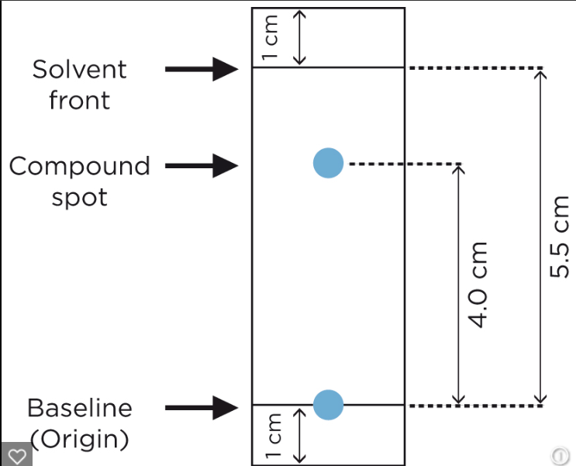
Chromatography
Origin
Concentrated spot
Run
Leading edge of pigment
Solvent front
Rf value
RF values can be used to identify pigments Unknown pigments. Required practical 7

Slide 8
Absorption and Action spectra
The graphs are related having corresponding peaks and troughs, because the rate of photosynthesis depends on the effectiveness of the different pigments in absorbing light.
Additional pigments increase the range of wavelengths that can be absorbed and therefore improve the rate of photosynthesis.

Slide 9
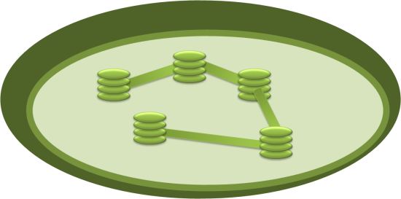
Structure and function of a chloroplast
Stroma contains enzymes for light-independent reactions
Granum is a stack of thylakoids. Stacking thylakoids maximises surface area for light capture
Outer membrane
Ribosomes for protein synthesis
Thylakoids contain chlorophyll and other pigments that can absorb light at a variety of wavelengths
Inner membrane helps regulate entry and exit of substances
Starch grains store excess carbohydrates made in photosynthesis. How would you test for starch?

Slide 10
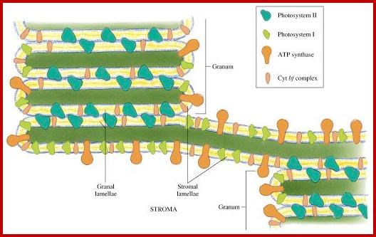
Chloroplast
.

Slide 11
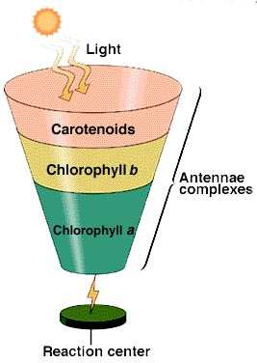
How are the pigments positioned?
The chlorophylls and accessory pigments are grouped in clusters of several hundred molecules. Each group is called an antenna complex.

Slide 12
Antenna complex

Slide 13
Chloroplast
PS2 uses energy of a shorter wavelength 680 nm
While PS1 uses energy of longer wavelength 700 nm
PS2 and PS1 are involved in non-cyclic photophosphorylation
Only PS1 is involved in cyclic photophosphorylation.

Slide 14
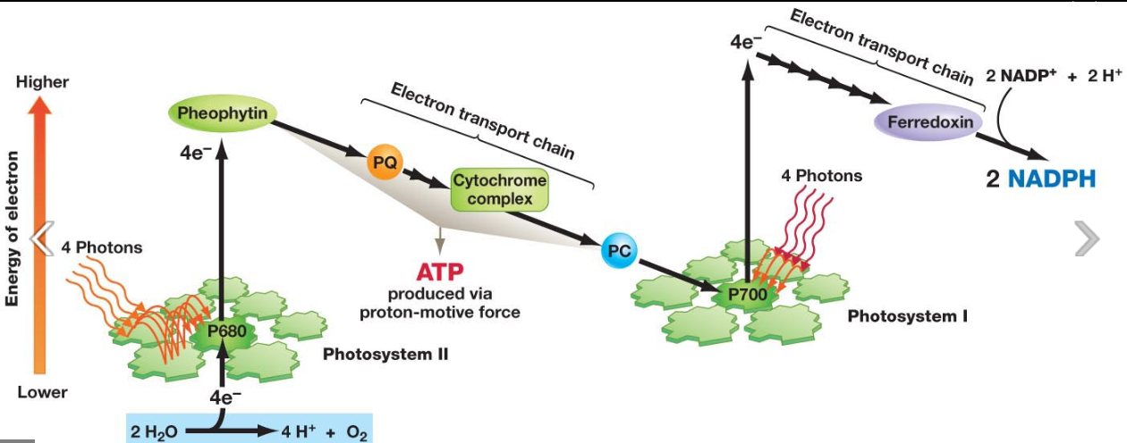

Slide 15
Electron donor and final electron acceptor
The electron donor in photosynthesis is chlorophyll a of photosystem I or II
Electrons from the photolysis of water replace the electrons emitted from PS II.
The final electron acceptor is NADP
Chemiosmosis occurs in thylakoids during photophosphorylation (comparable to that of oxidative phosphorylation).

Slide 16
Chemiosmosis and the thylakoid

Slide 17
Lollipop experiment

Slide 18
Autoradiographic analysis of organic compounds

Slide 19
Two way chromatography

Slide 20
Calvin cycle

Slide 21
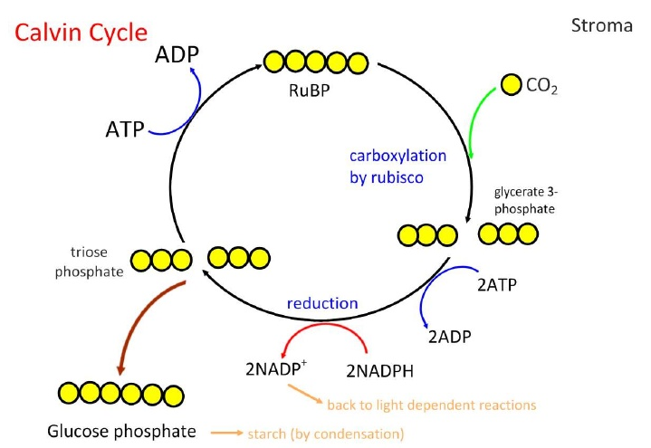
carbon dioxide reacts with ribulose bisphosphate (RuBP) to form two molecules of glycerate 3-phosphate (GP). This reaction is catalysed by the enzyme rubisco
ATP and reduced NADP from the light-dependent reaction are used to proved the energy for and reduce GP to triose phosphate
some of the triose phosphate is used to regenerate RuBP in the Calvin cycle

Slide 22
How does a plant get protein, lipids as well as other carbohydrates?
Plants take up nitrates from the soil, the nitrogen is then used in the synthesis of amino acids, then proteins by condensation.
Lipids are made of Carbon, hydrogen and oxygen only, the same three elements as carbohydrates but in different proportions. The plant can form its own lipids for waxy cuticles etc.
Glucose formed from TP can be condensed to form starch and the isomer Beta glucose will form cellulose, fructose (another hexose) and sucrose (a disaccharide) can be formed.

Slide 23
Nitrogen source
Absorbed through root hair cells by active transport as nitrates
Transported as nitrate in xylem and amino acids in phloem
Deficiency leads to reduced growth of all organs and chlorosis (yellowing of leaves)
Needed for protein synthesis
Phosphate
Absorbed through roots
Needed for phospholipid bilayers
Needed with a nitrogen source to form nucleic acids, ATP

Slide 24
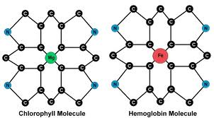
Magnesium
Forms part of the Chlorophyll molecule
Found within the hydrophylic head (the hydrophobic tail is a long hydrocarbon molecule that anchors the chlorophyll within the thylakoid membrane)
The head is used for absorbing and transducing the light energy into chemical energy.
Used for activation of ATPase

Slide 25
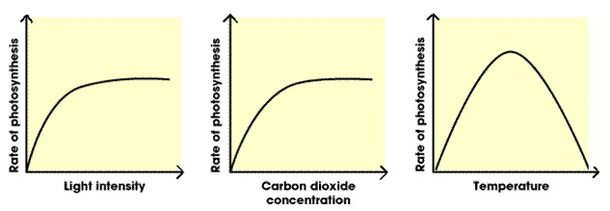
Limiting factors of photosynthesis

Slide 26
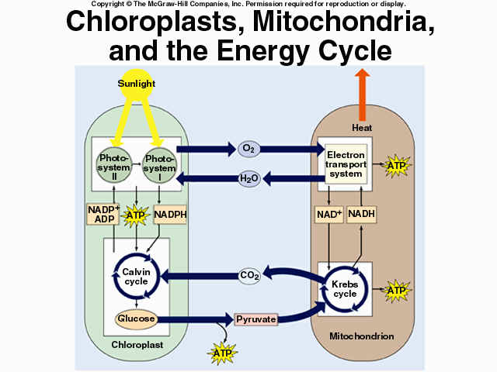

Slide 27
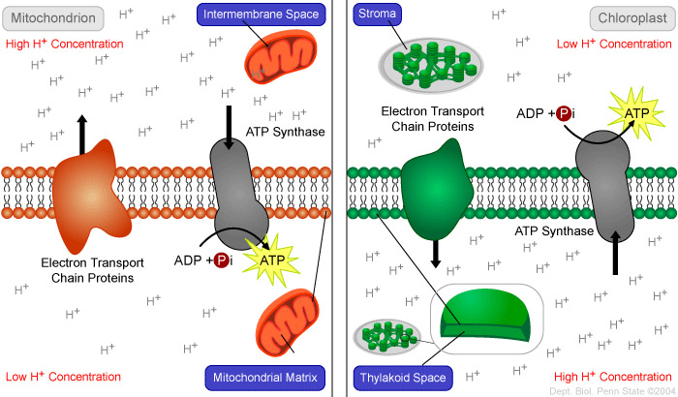
Electron Transport and ATP synthesis in Mitochondria and Chloroplasts
compared
Consolidation exercise: Visit Johnsons explorations: oxidative respiration and photosynthesis virtual labs – Mcgraw Hill

Slide 28
Complete the table
 | Oxidative phosphorylation | Cyclic photo phosphorylation | Non Cyclic Photo phosphorylation
Requires light
Requires oxygen
Number of proton pumps
Source of electrons
Final electron acceptor
Produces oxygen

Slide 29
Complete the table
 | Oxidative phosphorylation | Cyclic photo phosphorylation | Non Cyclic Photo phosphorylation
Requires light | No | Yes | Yes
Requires oxygen | Yes | No | No
Number of proton pumps | 3 | 1 | 1
Source of electrons | Reduced NAD/FAD | PS1 | PS11/water
Final electron acceptor | oxygen | PS1 | NADP/reduced NADP
Produces oxygen | No | No | Yes

Slide 30
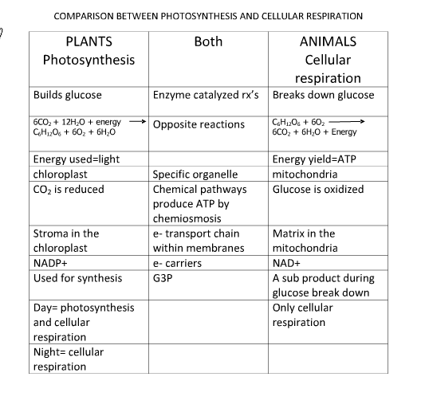

Slide 31
Required practical 8
Investigation into the effect of a named factor on the rate of dehydrogenase activity in extracts of chloroplasts
The effect of ammonium hydroxide on the time taken for chloroplasts to decolourise DCPIP
In this investigation you will use a chloroplast suspension and a blue dye called DCPIP to monitor the rate of dehydrogenase activity. DCPIP goes from blue to colourless when it accepts electrons released by the chlorophyll.

