Slide 1
3.7.2 Populations and Evolution
BFY 370, 380 – 381.
T and T (3rd ed.) 179 – 181, 196 - 198

Slide 2
The theory of evolution underpins modern Biology.
All new species arise from an existing species.
This results in different species sharing a common ancestry, as represented in phylogenetic classification.
Common ancestry can explain the similarities between all living organisms, such as common chemistry (eg all proteins made from the same 20 or so amino acids), physiological pathways (eg anaerobic respiration), cell structure, DNA as the genetic material and a ‘universal’ genetic code.

Slide 3
The individuals of a species share the same genes but (usually) different combinations of alleles of these genes. An individual inherits alleles from their parent or parents.

Slide 4
A species exists as one or more populations.
There is variation in the phenotypes of organisms in a population, due to genetic and environmental factors.
Two forces affect genetic variation in populations: genetic drift and natural selection.
Genetic drift can cause changes in allele frequency in small populations.
Natural selection occurs when alleles that enhance the fitness of the individuals that carry them rise in frequency.
A change in the allele frequency of a population is evolution.

Slide 5
Species exist as one or more populations.
A population as a group of organisms of the same species occupying a particular space at a particular time that can potentially interbreed.

Slide 6
Species exist as one or more populations.
A population as a group of organisms of the same species occupying a particular space at a particular time that can potentially interbreed.

Slide 7
Population Genetics
Selection can change the frequency of alleles in a population.

Slide 8
What is meant by a Gene Pool?
The total number of alleles in a population at any one time
Allele frequency is the number of times an allele occurs within a gene pool
If an environment remains stable the gene pool remains stable
If the environment changes the advantageous phenotypes will be selected for (or vice versa) and the gene pool will change

Slide 9
Population genetics
Study of the relative proportions of various genotypes present in a population from which can be calculated the relative proportions of alleles in a population – the allele frequency

Slide 10
Hardy-Weinberg Equation
The Hardy–Weinberg principle provides a mathematical model, which predicts that allele frequencies will not change from generation to generation if:
No mutations
Random mating
A large population
An isolated population
No immigration or emigration

Slide 11
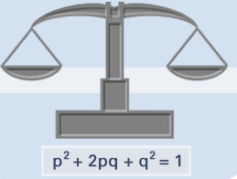
Hardy-Weinberg Equation
Shows that in the absence of selection, the proportion of two alleles (p and q) of a gene will remain constant in a population, regardless of whether they are dominant or recessive.

Slide 12
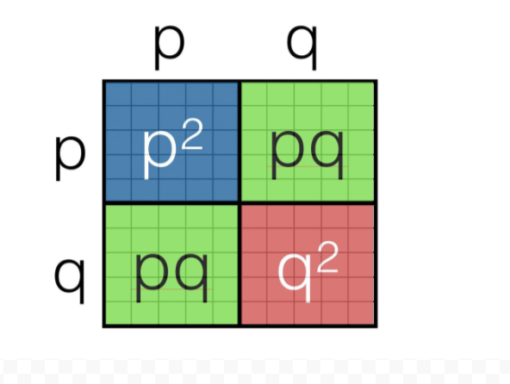

Slide 14
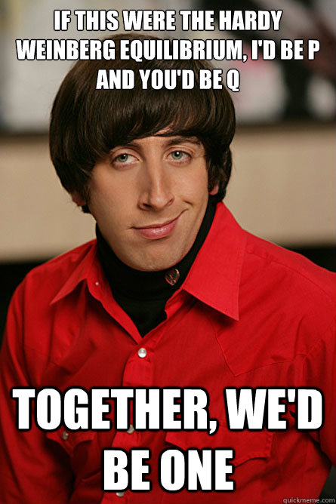

Slide 15
Spec
Individuals within a population of a species may show a wide range
of variation in phenotype.
This is due to genetic and environmental factors. The primary source of genetic variation is mutation.
Meiosis and the random fertilisation of gametes during sexual reproduction produce further genetic variation.
Predation, disease and competition for the means of survival result in differential survival and reproduction, ie natural selection.
Those organisms with phenotypes providing selective advantages are likely to produce more offspring and pass on their favourable alleles to the next generation.
The effect of this differential reproductive success on the allele frequencies within a gene pool.

Slide 16
Spec
The effects of stabilising, directional and disruptive selection.
Evolution as a change in the allele frequencies in a population.
Reproductive separation of two populations can result in the accumulation of difference in their gene pools.
New species arise when these genetic differences lead to an inability of members of the populations to interbreed and produce fertile offspring.
In this way, new species arise from existing species.
Allopatric and sympatric speciation.
The importance of genetic drift in causing changes in allele frequency in small populations.

Slide 17
Students should be able to:
explain why individuals within a population of a species may show a wide range of variation in phenotype
explain why genetic drift is important only in small populations
explain how natural selection and isolation may result in change in the allele and phenotype frequency and lead to the formation of a new species
explain how evolutionary change over a long period of time has resulted in a great diversity of species.

Slide 18
Vocabulary
Variation = the differences that occur between organisms.
Heritable variation= variation controlled by genes.
Non heritable variation = variation controlled by the environment.

Slide 19
Individuals within a population of a species may show a wide range of variation in phenotype.
This is due to genetic and environmental factors.
The primary source of genetic variation is mutation.
Meiosis and the random fertilisation of gametes during sexual reproduction produce further genetic variation.

Slide 20
Variation due to genetic factors
Within a population, all members have the same genes. Genetic differences occur as members of the population have different alleles of these genes.
Mutations
Meiosis
Random fertilisation of gametes
Mutation creates new alleles while meiosis and random fusion of gametes re-shuffle alleles

Slide 21
Causes of genetic variation
Crossing over in prophase I
Independent assortment in metaphase I of meiosis
Random mating
Random fusion of gametes

Slide 22
Mutations
This type of variation is acted upon by selection pressures (supply of food, climate, predation, camoflage etc)
Only the fittest individuals will survive to breed
This is the way that Evolution via Natural Selection operates
The environment exerts a selection pressure which determines the spread of an allele within a gene pool

Slide 23
Evolutionary significance of variation
Variations due to the effect of the environment have little evolutionary significance as they are not passed from one generation to the next.
Much more important to evolution is inherited variation that results from genetic changes.
Although these processes may establish a new combination of alleles in one generation it is mutations that generate long-lasting variation of a novel kind.
However the occurrence of a useful mutation is a very rare event.

Slide 24
Overproduction of offspring
All organisms have the reproductive potential to increase their populations, but they rarely do so.
Environmental factors control the population size
Organisms must compete for limited resources

Slide 25
Competition
Intraspecific competition is where members of the same species vie for the same resource in an ecosystem (e.g. food, light, nutrients, space, mates).
Interspecific competition is where individuals of different species vie for the same resource in an ecosystem.
Where food, space, NOT mates, are limited
Predator – prey relationships

Slide 26
Selection pressures
These are environmental forces that alter the frequency of alleles in a population.
They increase the chances of some alleles being passed on to the next generation and decrease the chances of others being inherited.

Slide 27
Selection Pressures
Selective Agents:
Supply of food
Nesting sites
Climate
Competition
Disease
Human influence

Slide 28
The effect of selection pressures on the frequency of alleles in a population is called natural selection which drives evolution.

Slide 29
The principles of natural selection in the evolution of populations.
Random mutation can result in new alleles of a gene.
Many mutations are harmful but, in certain environments, the new allele of a gene might benefit its possessor, leading to increased reproductive success.
The advantageous allele is inherited by members of the next generation.
As a result, over many generations, the new allele increases in frequency in the population.

Slide 30
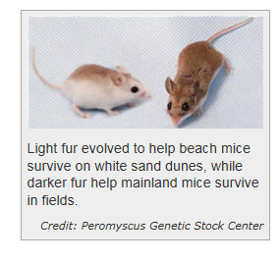
Change in allele frequency in the population
The frequency of the beneficial allele will INCREASE in the population.
The frequency of the disadvantageous allele will DECREASE.
The genotype and phenotype frequencies will change.

Slide 31
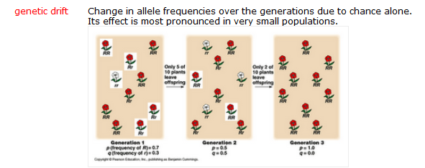
Genetic Drift
Much more likely to be observed in a small population

Slide 32
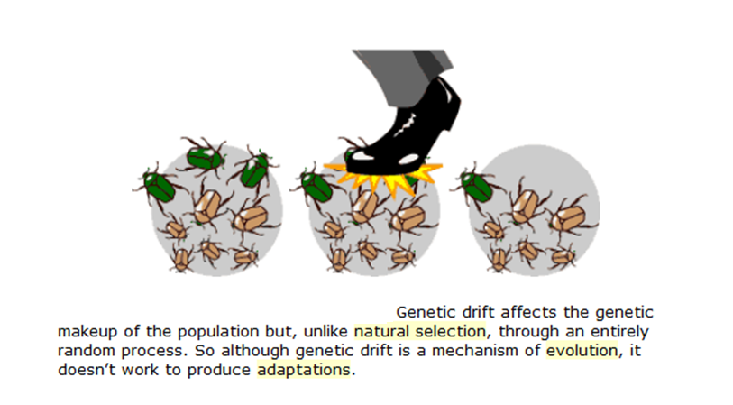

Slide 33
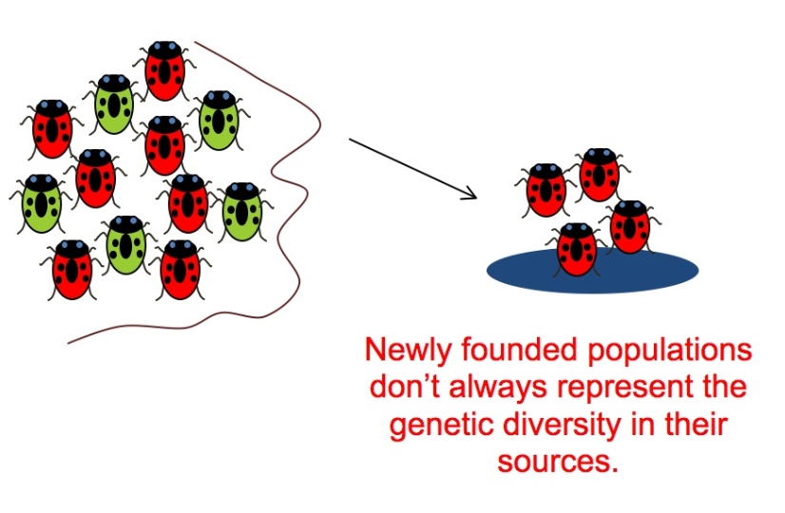
The founder effect
An important example of genetic drift is when a few individuals become isolated from the rest of the species and start a new population, for example, when a few individuals colonise an isolated island or some new habitat.

Slide 34
Founder effect and genetic drift
Founder members of the new population are a small sample of the population from which they originated. By chance they may have a very different gene frequency.
While the founder population remains small it may undergo genetic drift and become even more different from the large parental population. This process is called the founder effect. The effect undoubtedly contributed to the evolutionary divergence of Darwin’s finches after strays from the South American mainland reached the remote Galapagos Islands.

Slide 35
Founder effect and genetic drift
Disasters such as earthquakes, floods, and fires may reduce the size of a population drastically. The result is that the genetic makeup of the surviving population is unlikely to be representative of the makeup of the original population.
By chance certain alleles will be over represented among survivors, other alleles will be underrepresented, and some alleles will be eliminated completely.
Because alleles for at least some loci are likely to be lost from the gene pool, the overall genetic variability in the
population is usually reduced.

Slide 36
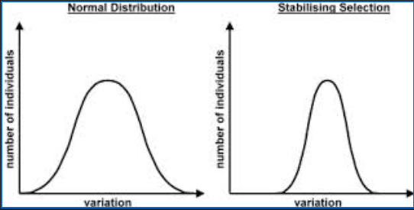
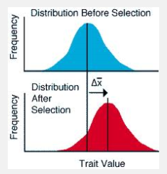
Types of Natural Selection
Stabilising Selection
Stable environment so extreme phenotypes eliminated
Directional Selection
Environment changes so extreme phenotype favoured

Slide 37
Types of Natural Selection
Stabilising Selection
Stable environment so extreme phenotypes eliminated
Directional Selection
Environment changes so extreme phenotype favoured

Slide 38
Disruptive Selection
This is opposite to stabilising selection
It favours extreme phenotypes at the expense of intermediates
Least common but most important for evolution
Occurs when env factor takes two or more distinct forms

Slide 39
Example 1 - temperature
If there was a wide range of temperatures throughout the year – continuous variation in fur length (graph A)
If summer temperatures is static (15oC) and winter (5oC) individuals with 2 distinct fur lengths predominate either active in the summer or winter. (graph B)
After many generations 2 distinct sub-populations are formed (graph C)

Slide 40
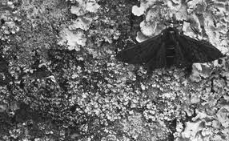
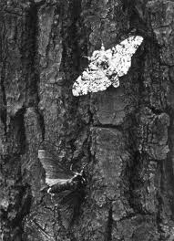
Industrial melanism in the peppered moth (example of Polymorphism)
Some species of organisms have two or more distinct forms. These different forms are genetically distinct but exist within the same interbreeding population.
This is called polymorphism
The peppered moth is an example of this
Dark form due to a single gene mutation resulting in the production of more melanin
The moth flies at night and rests on the bark of trees during the day.
Before the industrial revolution there were many light and very few dark moths.
1950s onwards dark moths became prevalent in areas with heavy pollution.
Why?

Slide 41
Isolation and speciation.
Separation of populations by geographical, behavioural, morphological seasonal and other isolation mechanisms.
Hybrid sterility.

Slide 42
If a population becomes isolated from other populations of the same species, there will be no gene flow between the isolated population and the others.
This may lead to the accumulation of genetic differences in the isolated population, compared with the other populations.
These differences may ultimately lead to organisms in the isolated population becoming unable to breed and produce fertile offspring with organisms from the other populations.
This reproductive isolation means that a new species has evolved.

Slide 43
Speciation
Speciation is the evolutionary process leading to the formation of a new species.
Populations first need to be isolated from each other so that gene pools can diverge and DEMES form (breeding sub units).
The isolated populations develop different characteristics & eventually will no longer be able to breed with each other.

Slide 44
How does a new species arise?
Evolution is the mechanism by which speciation occurs and involves changes to the genotype & phenotype.
These changes enable the organism to better exploit the environment.
Candidates should appreciate the concept of evolution and that species existing today have arisen from pre-existing ones

Slide 45
Speciation
Two types;
Geographical isolation (allopatric).
2. Reproductive isolation (sympatric)

Slide 46
Stages in Allopatric Speciation
A large interbreeding population of one species exists- sharing the same gene pool.
A barrier separates the population into 2 isolated sub-populations
Random mutations in each sub-population give rise to new variation within each group (but not shared by both groups)
Different selection pressures act on each sub-population depending on local conditions like:
Climate
Predators
Disease.

Slide 47
Natural selection affects each sub-group in a different way, by favouring the alleles that allow the individuals to better exploit their environment.
Over a very very long time the two gene pools to become so altered that the groups become genetically distinct & isolated.
If the original barrier is removed, the two sub-populations are no longer able to interbreed (since their chromosomes are no longer able to form homologous pairs).
There are now 2 separate distinct species.
Speciation has occurred!

Slide 48
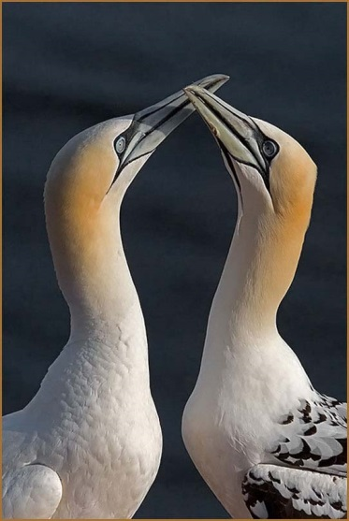
Stages in Speciation
Reproductive/ behavioural isolation
leads to sympatric speciation
Behavioural isolation – animals with elaborate courtship behaviours where members of a sub-species fail to attract the necessary response
Mechanical isolation – incompatible genitalia
Gametic isolation – failure of pollen grains to germinate on stigma or sperm fail to survive in oviduct
Hybrid inviability – embryo development may not occur – polyploidy (chromosomes don’t match

Slide 49
Reproductive isolation - examples
Hybrid
sterility
Odd number of chromosomes in hybrid means they
are unable to successfully produce gametes
Embryo and subsequent development produces
weak individuals that are unable to reproduce
Hybrid
inviability
gametic
Gametes released in the same place but chemical incompatibility
means fertilisation is impossible between different species
behavioural
Different mating calls
not recognised by different species
mechanical
Flower landing platforms are different size in different
species so are pollinated in different ways .
The genitalia of two groups of animals may become incompatible

Slide 50
Temporal – Breeding seasons do not coincide and so they do not interbreed.
Ecological – Populations inhabit different habitats within the same area and so individuals rarely meet
Geographical – populations are isolated by physical barriers such as oceans, rivers, mountain ranges

Slide 51
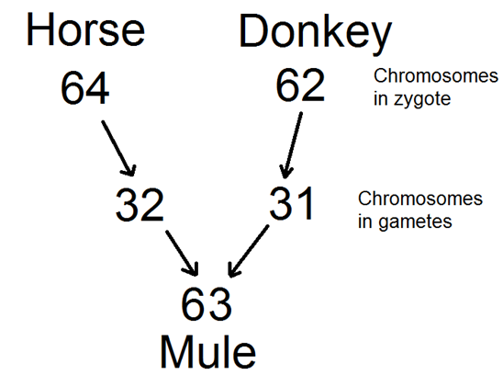
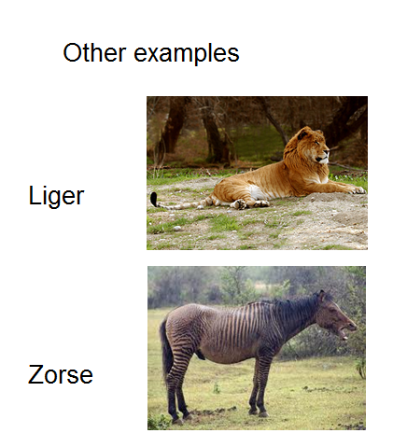
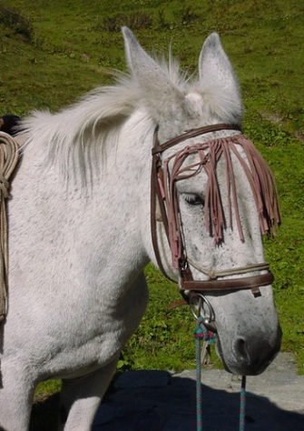
Hybrid Sterility

Slide 52
Explanation of hybrid sterility – failure to undergo synapsis and form bivalents
When two species try to breed, there will be two sets of different homologous chromosomes.
When the gamete nuclei fuse the homologues will not have partners and so pairing at prophase 1 will not take place.

