Slide 1
3.8.3 Using genome projects
Sequencing projects have read the genomes of a wide range of organisms, including humans.
Determining the genome of simpler organisms allows the sequences of the proteins that derive from the genetic code (the proteome) of the organism to be determined.
This may have many applications, including the identification of potential antigens for use in vaccine production.
In more complex organisms, the presence of non-coding DNA and of regulatory genes means that knowledge of the genome cannot easily be translated into the proteome.
Sequencing methods are continuously updated and have become automated.

Slide 2
Information from sequencing different organisms may provide information to help cure disease, or allow us to use genes that provide specific adaptations in some organisms such as withstanding extreme or toxic environments, cleaning up pollutants or manufacturing biofuels.

Slide 3
Bioinformatics
The sequencing of the human genome would not have been possible without the use of bioinformatics.
What is bioinformatics?
Bioinformatics is the branch of biology that is concerned with the acquisition, storage, and analysis of the information found in nucleic acid and protein sequence data. Computers and bioinformatics software are the tools of the trade.

Slide 4
Sequencing genomes
Whole-genome shotgun sequencing involves cutting DNA into many small, easily sequenced sections and using computer algorithms to align overlapping segments to assemble the entire genome

Slide 5
Medical advances as a result of the human genome project
Single nucleotide polymorphisms (SNPs) have been found in the human genome.
SNPs are single base variations in the genome (caused by a point mutation).
They can be associated be disease and other disorders.
Medical screening allows identification of potential medical problems and allows for early intervention to treat them
https://www.youtube.com/watch?v=tJjXpiWKMyA

Slide 6
The proteome
All the proteins produced by a given type of cell (cellular proteome) at a given time, under specified conditions.
All the proteins produced by the genome (complete proteome)

Slide 7
Determining the proteome of simple organisms
Relatively easy
Prokaryotes have one, circular piece of DNA not associated with histones
No non-coding portions of DNA

Slide 8
Applications
Identification of the proteins on pathogens that act as antigens to develop vaccines
Classification of bacteria
Understanding metabolism of bacteria

Slide 9
Determining the genome and proteome of complex organisms
More difficult to do as many non-coding genes and regulatory genes
In humans only 1.5% of genes may code for proteins

Slide 10
3.8.4.2 Differences in DNA between individuals of the same species can be exploited for identification and diagnosis of heritable conditions
The use of labelled DNA probes and DNA hybridisation to locate specific alleles of genes.
The use of labelled DNA probes that can be used to screen patients for heritable conditions, drug responses or health risks.
The use of this information in genetic counselling and personalised medicine.
Students should be able to evaluate information relating to screening individuals for genetically determined conditions and drug responses.

Slide 11
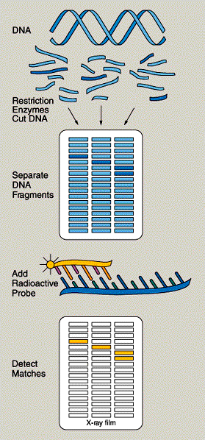
Radioactively labelled probes – nucleotide sequence with the isotope 32P. The probe can be identified using x-ray film that is exposed to radioactivity

Slide 12
DNA Probes
Base sequences complementary to the allele of the gene we want to find
The double stranded DNA to be tested has its strands separated by heating the DNA.
The separated strands are cooled and mixed with the probe
If the probe is complementary to a section of the DNA strand it will bind. This is DNA hybridisation
The site where the probe binds can be identified by the radioactivity or fluorescent label

Slide 14
Locating specific alleles of genes
The sequence of nucleotides on the mutated gene is determined by DNA sequencing (Genetic libraries store DNA sequences responsible for many common genetic diseases)
Fragment of DNA with complementary bases to mutant allele of gene produced
DNA probe is formed by fluorescently labelling DNA fragment
PCR techniques used to produce multiple copies of DNA probe

Slide 15
Locating specific alleles of genes
Double stranded DNA denatured by heating
Probe added to single stranded DNA fragments from person being screened and strands cooled
If donor has mutated sequence the DNA probe will bind to the complementary sequence on the donor DNA
DNA washed to remove unattached probes

Slide 16
Locating specific alleles of genes
The presence of bound DNA probe is detected by shining light on the fragments causing the probe to fluoresce which can be seen using a special microscope

Slide 17
It is possible to fix hundreds of probes in an array on a glass slide
This means when donor DNA is added to the slide many different genetic disorders can be tested simultaneously

Slide 18
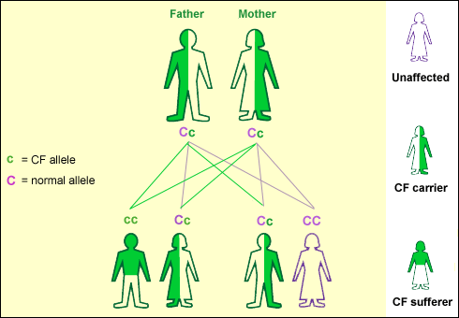
Uses of genetic testing
Carrier screening which identifies unaffected parents who carry a recessive allele (heterozygous e.g. Cc) for an inherited disease, that requires homozygous recessive genotype (cc) to be expressed e.g. cystic fibrosis

Slide 19
Uses of genetic testing
pre-implantation genetic diagnosis
pre-natal diagnostic testing
newborn baby screening
pre-symptomatic testing for predicting adult-onset disorders such as Huntington's disease
pre-symptomatic testing for estimating the risk of developing adult-onset cancers eg mutations in tumour suppressor genes
Confirmation that an individual has a suspected disease
forensic/identity testing

Slide 20
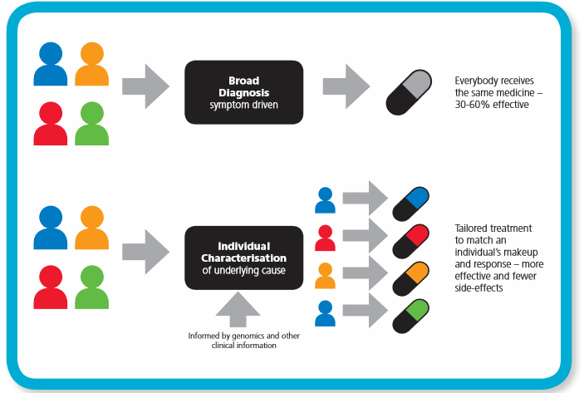
Personalised medicine
Genetic screening allows doctors to provide advice and health care based on an individuals genotype

Slide 21
Advantages and Limitations of gene testing
Advantages | Limitations
Gene testing can help to clarify a diagnosis and direct a physician toward appropriate treatments. | There is a possibility for laboratory errors. E.g. sample misidentification, contamination of the chemicals used for testing, or other factors.
Identify people at high risk for conditions that may be Preventable so they can change their lifestyle (give up smoking, lose weight, eat healthily, avoid mutagens) and have regular checkups | The tests give only a probability for developing the disorder and some people will never develop the disease. Scientists believe that other mutations or environmental factors may be needed to cause the disease to develop.
Tests can help families avoid having children with devastating diseases | Some believe that if prenatal tests are carried out, finding defective alleles will lead to an increase in the number of abortions

Slide 22
Ethical issues of genomic knowledge
It is now possible to carry out automated screening to identify mutated genes in a sample of DNA
This presents serious issues:
Who owns the genetic information?
Who has access to the genetic information?
Insurers may discriminate against those with genes for say Alzheimer’s
Knowledge of genome could lead to social stigmatization.
Can parents test their children for adult-onset diseases?
Couples will need to decide if they want a child with a genetic defect
Could be used to choose or modify characteristics of a child
http://www.amazon.com/Gattaca/dp/B000I8G5B2

Slide 23
Genetic Screening & Counseling
Genetic counselling is the process of:
evaluating family history and medical records
Explaining the probability of passing on specific alleles
Explaining the emotional, psychological, medical, social and economics consequences of genetic diseases to help with family planning
ordering genetic tests
evaluating the results of this investigation
Patients screened at regular intervals
Advice on lifestyle changes
helping parents understand and reach decisions about what to do next

Slide 24
Recombinant DNA
3.8.4 Gene technologies allow the study and alteration of gene function allowing a better understanding of organism function and the design of new industrial and medical processes

Slide 25
3.8.4.1 Recombinant DNA technology
Recombinant DNA technology involves the transfer of fragments of DNA from one organism, or species, to another.
Since the genetic code is universal, as are transcription and translation mechanisms, the transferred DNA can be translated within cells of the recipient (transgenic) organism.
Fragments of DNA can be produced by several methods, including:
• conversion of mRNA to complementary DNA (cDNA), using reverse transcriptase
• using restriction enzymes to cut a fragment containing the desired gene from DNA
• creating the gene in a ‘gene machine’. Fragments of DNA can be amplified by in vitro and in vivo techniques.

Slide 26
3.8.4.1 Recombinant DNA technology
The principles of the polymerase chain reaction (PCR) as an in vitro method to amplify DNA fragments. The culture of transformed host cells as an in vivo method to amplify DNA fragments.
• The addition of promoter and terminator regions to the fragments of DNA.
• The use of restriction endonucleases and ligases to insert fragments of DNA into vectors. Transformation of host cells using these vectors.
• The use of marker genes to detect genetically modified (GM) cells or organisms.
(Students will not be required to recall specific marker genes in a written paper.)

Slide 27
3.8.4.1 Recombinant DNA technology
Students should be able to:
• interpret information relating to the use of recombinant DNA technology
• evaluate the ethical, financial and social issues associated with the use and ownership of recombinant DNA technology in agriculture, in industry and in medicine
• balance the humanitarian aspects of recombinant DNA technology with the opposition from environmentalists and antiglobalisation activists
• relate recombinant DNA technology to gene therapy.

Slide 28
Genetic engineering
Manipulation, alteration and insertion of genes
Uses
Transfer genes into bacteria so they can make useful products e.g. Insulin
Transfers genes into plants and animals enabling them to acquire new characteristics e.g disease resistance
Gene therapy

Slide 29
Genetic Engineering
Manipulation, alteration and insertion of genes
Uses
Transfer genes into bacteria so they can make useful products e.g. Insulin
Transfers genes into plants and animals enabling them to acquire new characteristics e.g disease resistance
Gene therapy

Slide 30
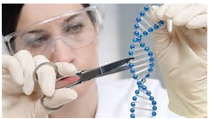
Genetic engineering – Four stagesDNA Technology
Formation of DNA fragments including gene for replication
Splicing of the DNA fragment into the vector
Introduction of the vector into the bacterium
Selecting of newly transformed organism for cultivation

Slide 31
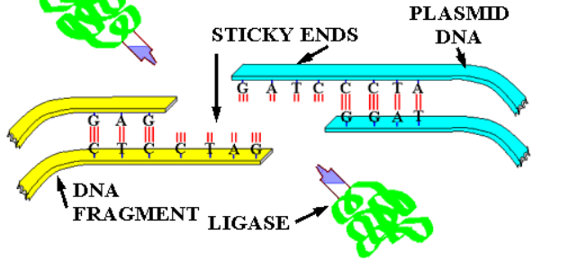
Recombinant DNA Technology key terms
Donor DNA – a gene that is isolated for insertion.
Plasmids – circular loops of DNA found in bacteria. The plasmid is known as a vector.
Restriction endonuclease – enzymes which cut DNA molecules between specific base sequences.
DNA ligases – enzymes which join together portions of DNA.

Slide 32
Sticky ends – the two ends of the ‘foreign’ DNA segment. They have a short row of unpaired bases that match the complementary bases at the two ends of the opened-up plasmid.
Recombinant DNA – DNA which results from the combination of fragments from two different organisms.
Reverse transcriptases – enzymes used to synthesize DNA from mRNA in specific cells.
Clone – a population of genetically identical cells or organisms.

Slide 33
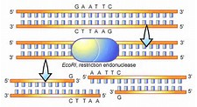
Genetic engineering
Isolating the gene from donor DNA molecule
Gene located using gene probe
Restriction endonuclease used to cut DNA into small pieces allowing gene to be isolated
Restriction endonuclease cuts DNA between specific base sequences (recognised by the enzyme)
Most Restriction endonucleases split two strands in a staggered sequence. This forms sticky ends.

Slide 34
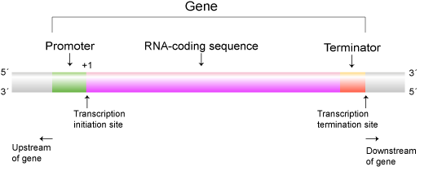
Preparing the DNA fragment for insertion
A length of DNA is also added at the end of the gene
This is the terminator sequence which releases RNA polymerase and ends transcription.

Slide 35
Inserting the gene into vector
Plasmids are removed from bacteria by treating the bacteria and dissolving the cell wall and separating the plasmid from the cell debris.
The same restriction endonuclease (as used to cut your desired gene from the DNA) is used to cut open the plasmid (vector).
The enzyme creates sticky ends complementary to the sticky ends created in the ‘cut out’ gene
When the vector and the donor DNA are mixed together the donor DNA is spliced into the vector DNA. The complementary bases on the donor and vector DNA at the sticky ends pair up.
DNA Ligases joins the donor and vector DNA together.
Recombinant DNA has been created

Slide 36
Insertion into plasmids
What combinations of plasmid will form?

Slide 37
Introduction of DNA into host cells – Transformation https://www.dnalc.org/resources/animations/transformation1.html
The plasmids must be reintroduced into the host cell e.g. bacteria
This process is called transformation.
The bacteria, plasmids and calcium ions are mixed together.
By altering the temperature (and including calcium ions ion the mixture) the bacterial membranes become permeable and the plasmid can pass through the cell-surface membrane into the cytoplasm.

Slide 38
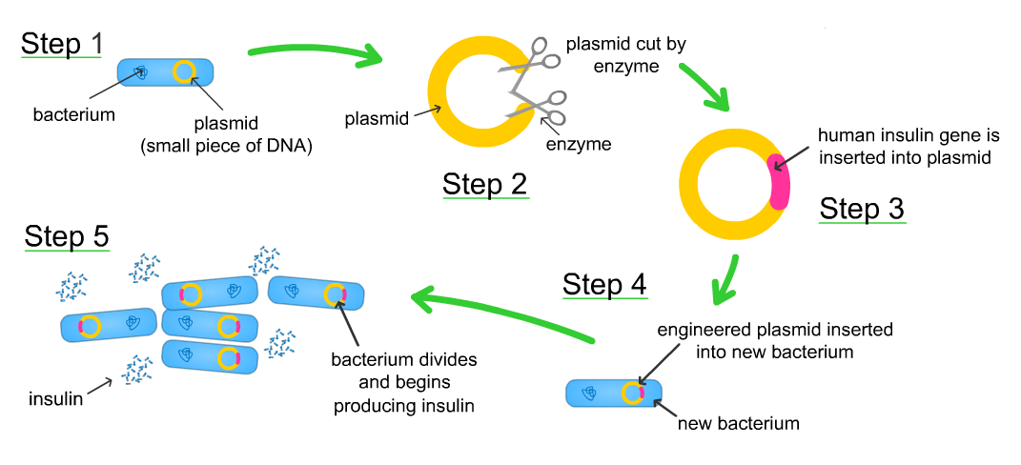
Insertion of gene into a Vector

Slide 39
Marker Genes
Antibiotic resistance gene are included in the recombinant DNA forming the plasmids.
When bacteria and plasmids mixed together only some bacteria take up plasmid. If bacteria grown on agar with antibiotic only those bacteria containing the plasmid will grow.
These bacteria are then able to replicate and replicate the recombinant DNA.
This is cloning and results in production of multiple copies of the recombinant gene.

Slide 40
Fluorescent markers
A more recent marker gene
Jellyfish have a gene which codes for a green fluorescent protein (GFP)
The gene to be cloned is inserted in the middle of the GFP gene
Any bacteria which takes up the plasmid with the gene in will not produce GFP and will not fluoresce
Cells which have not taken up the gene will fluoresce
No need for replica plating just select the colonies which do not fluoresce.

Slide 41
Cloning (stage 5) the bacteria
Following successful identification of the bacteria containing the plasmid AND the DNA fragment, the bacteria are cloned in suitable containers with suitable conditions. (fermenter)
As the bacteria are cloned, so is the plasmid containing the DNA fragment.
This type of gene cloning is in vivo (cloned within a living organism).

Slide 42
Doing it in reverse
Only 2 copies of DNA in each cell
Cell may contain large numbers of mRNA molecules transcribed from desired gene
Functional mRNA found in cytoplasm
Extract mRNA
Use the enzyme reverse transcriptase to make a DNA copy from the mRNA
This single strand cDNA is replicated to a double strand by the addition of DNA Polymerase and free nucleotides
This DNA can then be inserted into a plasmid

Slide 43
Reverse Transcriptase
DNA polymerase
Reverse Transcriptase makes DNA from an RNA template – it does the opposite of transcription.
The cDNA only contains Exons

Slide 44
Using reverse transcriptase to make the human gene for insulin production
B-cells from Islets of Langerhans in the Human pancreas.
Extract mature mRNA coding for Insulin.
A single stranded complementary copy of DNA (cDNA) is
formed using reverse transcriptase on the mRNA template.
Single stranded cDNA is used to form double stranded
DNA using DNA polymerase
This forms a double stranded copy of the Human Insulin
gene.

Slide 45
The ‘gene machine’
It is now possible to manufacture genes in a laboratory.
The amino acid sequence of a desired protein is determined
The mRNA sequence can then be worked out by looking up the mRNA codons and the DNA triplets are worked out
This sequence is fed into a computer
The sequence is checked for biosafety and biosecurity to ensure it meets international standards

Slide 46
The ‘gene machine’
The computer designs a series of small, overlapping strands of nucleotides, called oligonucleotides, which can be assembled into the desired gene
In an automated process, each of the oligonucleotides is assembled by adding one nucleotide at a time in the required sequence
The oligonucleotides are joined together to make a gene containing only exons
The gene is replicated using PCR (polymerase chain reaction)

Slide 47
The ‘gene machine’
The complementary strand is synthesised using PCR to make a double stranded gene. This is then multiplied
Using sticky ends the gene can be inserted into a bacterial plasmid.
The genes are checked using standard sequencing techniques and those with errors are rejected
These artificial genes can be produced in a short period of time and only contain exons so can be transcribed and translated by prokaryotic cells

Slide 48
Manufacture and advantages
The genetically modified bacteria are cultured in a fermenter.
Large scale production of protein coded for by the donor gene
Protein extracted and purified
Human proteins can be used instead of animal

Slide 49
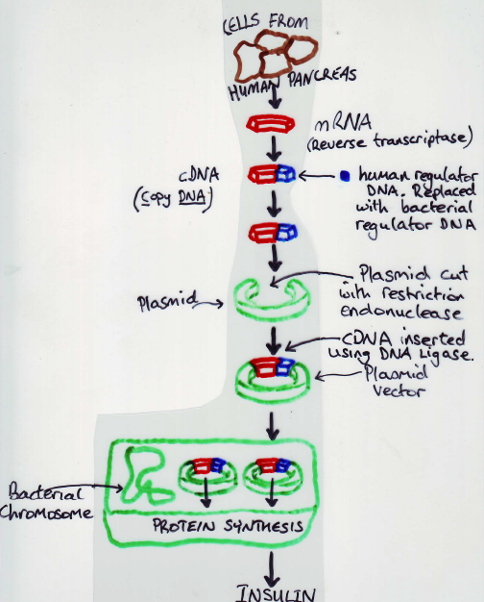
Producing human insulin

Slide 50
Hazards
bacteria readily exchange genetic material.
deliberate use of antibiotic resistant genes in E. coli which lives in the human gut means that these genes could be accidentally transferred to human pathogens
The possibility of transfer of DNA with linked pathogenic genes, for example, oncogenes thus increasing cancer risks

Slide 51
PCR – polymerase chain reaction
Objectives –
Describe how PCR is used to amplify a section of DNA
Describe the role of PCR in genetic fingerprinting in solving a crime or paternity

Slide 52
PCR
At a crime scene a small sample of DNA may be found, perhaps a single strand of hair or a small spot of blood.
In order to carry out numerous laboratory tests larger samples are required.
Using the PCR technique copies of specific fragments of DNA may be made.
PCR rapidly produces many billions of molecules from a single DNA molecule.
This enables tests to be carried out accurately and more rapidly regardless of the age of the sample.

Slide 53
PCR
The stages in the process are as follows:
The original DNA (target DNA) is denatured by heating to 95⁰C and it separates into two single strands.
The solution is cooled to 55⁰C triggering the primers to join to the complementary base sequences on each of the single strands of DNA. This in turn triggers DNA replication.
The solution is heated to 70⁰C and DNA polymerase (which is not denatured at this temperature) catalyses the synthesis of a complementary strand for each of the single strands of DNA, producing two identical double strands of DNA.
Steps 1-3 are repeated many times, doubling the quantity of DNA produced each time.

Slide 55
Privacy issues
Scientists are confronted with vast quantities of data, a large proportion of which is genetic fingerprinting information.
This information is used for phylogenetic studies, forensic science, paternity studies etc.
This raises concerns regarding the storage of this information as well as who has access to the data. Will insurance companies use the data to determine life and health insurance premiums?
On the wider issue of biodiversity of human beings, efforts are being made to store genetic material from the many races and tribes of the world before isolated tribes are intermixed and lost.
This is scientifically useful, but careful ethical standards need to be maintained in order that genetic privacy is maintained and that no misuse of the information occurs in the future.

Slide 56
Advantages of in vitro gene cloning | Advantages of in vivo gene cloning
Rapid – within hours 100 billion copies of a gene can be made. Useful when very minute quantities of DNA available eg at a crime scene | Useful if want to introduce a gene into another species via a plasmid (eg into a human for gene therapy)
No live cells needed. No complex culturing techniques | No risk of contamination. As gene cut with restriction endonuclease will have same sticky ends as plasmid. Contaminant DNA will not be taken up by plasmid. Contamination DNA could also be amplified when using PCR
 | Very accurate – PCR can make mistakes when copying DNA. Mistakes and mutations very rare in vivo
 | Cuts out specific gene, PCR amplifies whole DNA sample
 | Produces transformed bacteria which can be used to produce large quantites of gene products eg insulin

Slide 57
Evaluation of DNA Technology
Microorganisms can be modified to produce a wide range of substances
Eg – antibiotics, hormones (insulin), enzymes
http://www.prospecbio.com/Recombinant_Proteins/
Microorganisms can be used to control pollution eg Oil and harmful gases
https://www.dti.dk/specialists/using-microorganisms-for-pollution-control-in-soil-and-groundwater/33725

Slide 58
Pharming
Genetically modified plants can be transformed to produce a specific substance in a particular organ of the plant. These organs can then be harvested and the desired substance extracted. If a drug is involved this is called plant pharming.
Produce plants that could manufacture antibodies or antigens
http://learn.genetics.utah.edu/content/science/pharming/

Slide 59
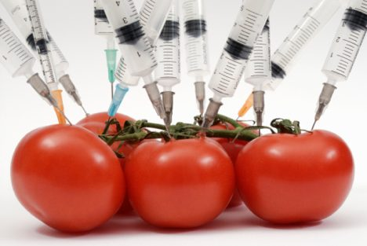
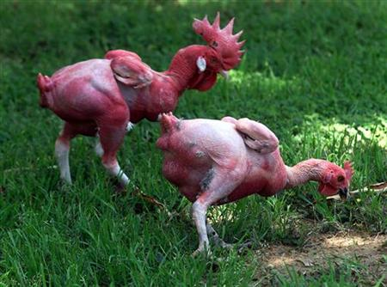
GMO’s - genetically modified organisms http://www.bbc.co.uk/education/guides/z9mg87h/revision/2

Slide 60
Genetic engineering – GM crops and livestock
Genetic engineering/transgenics/Genetic Modification (GM) involves the artificial transfer of genes between different species.
Bacteria are readily introduced into plants.
Certain species naturally attack damaged plants and cause the plant cells to multiply and form a tumour.
The bacteria do this by inserting genes from their own plasmids into one of the plant’s chromosomes.
The plasmid gene links with the DNA of the plant but stimulates the growth of a tumour.
Scientists can replace the tumour-forming genes in the bacterial plasmids with useful genes.

Slide 61
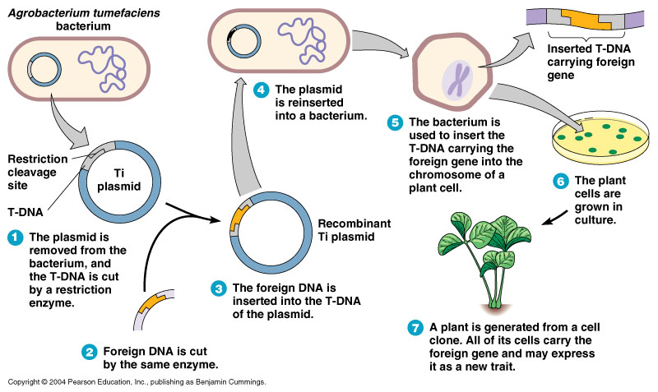
Genetically modified plants

Slide 62
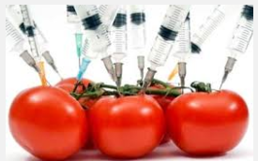
Tomatoes
Flavr Savr
Insertion of gene with complementary base sequence to gene of enzyme that breaks down pectin in cell walls causing tomatoes to ripen.
A double strand of mRNA produced which prevents the production of this enzyme.
Gives Flavr Savr tomatoes a longer half life and better flavour

Slide 63
Genetic engineering –Advantages of GM crops
Solving food shortages in various parts of the world; perhaps also enabling crops to be grown in drought areas.
• Producing improved food with improved flavour and better keeping qualities.
Golden rice – includes gene for vitamin A production. Vitamin A deficiency leads to blindness
• Reducing the harmful effects of modern farming by:
Introducing nitrogen-fixing genes into crops such as rice and wheat, reducing the use of artificial fertilizers.
Introducing genes that confer resistance to insects, weeds and diseases.

Slide 64
Genetically modified animals
Can be used to produce expensive drugs, antibiotics, hormones and enzymes relatively cheaply

Slide 65
Risks of genetically modified organisms
Risks
Impossible to predict the ecological impacts of releasing genetically engineered organisms into the environment
A recombinant gene may pass from the organism it was placed in, to a completely different one
Manipulation to DNA will affect the metabolic pathways within that cell. Could these metabolic malfunctions cause cancer or create a new form of disease
Genetically modified bacteria often have antibiotic resistance marker genes which could be spread to harmful bacteria
What if an engineered gene mutated?
What are the long term consequences of introducing new gene combinations?
What are the financial consequences developing plants and animals to grow in new regions?

Slide 66
Gene Therapy
There are many diseases that are caused by faulty alleles of genes
The aim of gene therapy is to treat a genetic disease by replacing defective genes in the patient’s body with copies of a new DNA sequence.
Advances in gene technology and the success of the Human Genome Project in mapping the human chromosomes has enabled scientists to identify precisely many more genes responsible for genetic disease.

Slide 67
Cause of genetic diseases
A mutation of a gene that causes a recessive allele is often the cause (but not always – Huntington’s is caused by a dominant allele).
Defective genes could be replaced to cure certain genetic disorders such as cystic fibrosis and severe combined immunodeficiency (SCID)

Slide 68
Two possible methods of replacing defective genes;
Somatic cell therapy – the therapeutic genes are transferred into the somatic (body) cells, of a patient. Any modifications and effects will be restricted to the individual patient only, and will not be inherited by the patient's e.g. use of liposomes to treat cystic fibrosis.
Germ line therapy – sperm or eggs, are modified by the introduction of functional genes, which are integrated into their genomes. This would allow the therapy to be heritable and passed on to later generations. This is largely prohibited for ethical reasons.

Slide 69
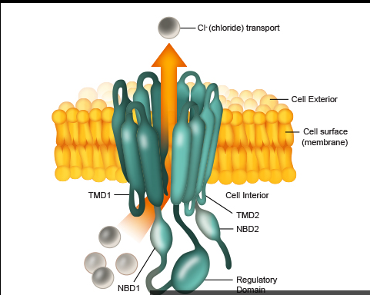
CFTR
A mutation in the cystic fibrosis transmembrane regulatory protein.
This protein transports chloride ions out of cells into mucus.
Sodium ions follow leading to reduction in water potential of mucus. Water then leaves epithelial cells by osmosis.
The mutation leads to a protein lacking one amino acid so transmembrane protein cannot perform this function.
Mucus becomes less watery

Slide 70
The gene therapy technique works as follows:
The genes are inserted into liposomes (minute spheres of lipid molecules capable of carrying DNA).
This involves wrapping the gene in lipid molecules that can pass through the membranes of lung epithelial cells.
An aerosol inhaler is used to add the non-defective gene to the epithelial cells of the lung.
The liposomes fuse with the phospholipid bilayer of the cell membrane and the DNA enters the cells. These cells start to express the inserted gene by making the protein CFTR.

Slide 71
Gene delivery using a liposome

Slide 72
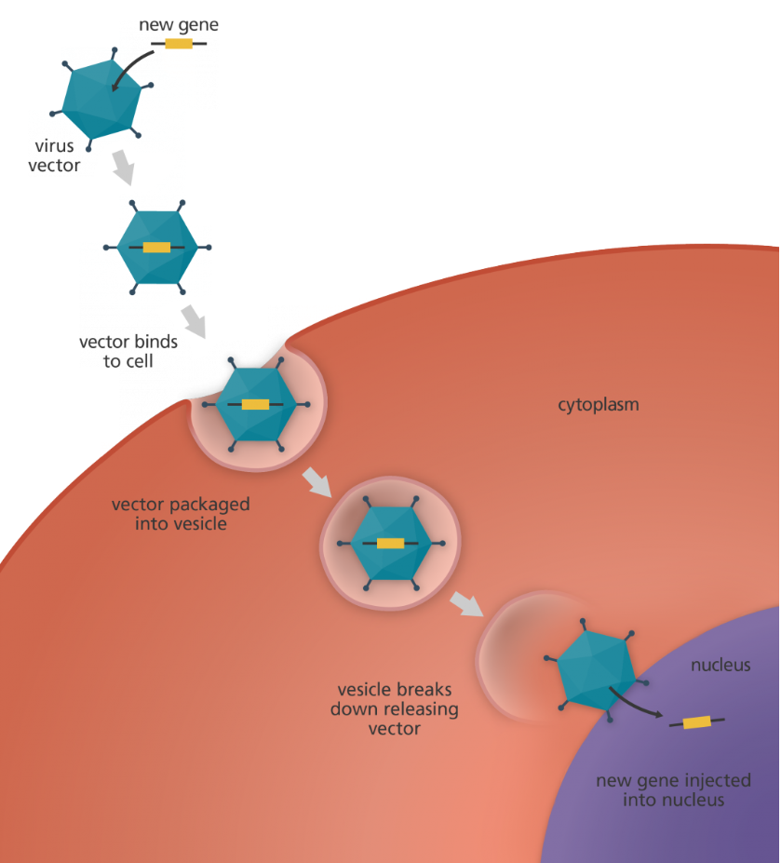
Gene delivery with a viral vector

Slide 73
Treatment of severe combined immunodeficiency (SCID) using gene therapy
SCID is a rare inherited disease. People with this disorder are unable to mount a cell-mediated response. They cannot produce antibodies. The disorder arises when individuals inherit a defect in the gene that codes for the enzyme adenosine deaminase (ADA). This enzyme destroys toxins that would otherwise kill white blood cells. These sufferers need bone marrow transplants and/or injections of ADA.

Slide 74
Gene therapy for SCID
Normal ADA gene isolated from human tissue
ADA gene inserted into a retrovirus
Retrovirus grown in host cells to increase their number
Retrovirus mixed with the patient’s T cells into which they inject a copy of the normal ADA gene
The T cells are reintroduced into the patient’s blood
This lasts for 6-12 months
Long term treatment could be achieved by introducing the normal gene into bone marrow stem cells

Slide 75
Risks
While it might be acceptable to introduce new genes to cure diseases is it acceptable to introduce new genes for intelligence, cosmetic improvements or different facial features?
What if this technology gets into the wrong hands?
Should money be better spent on tackling poverty and hunger?

Slide 76
3.8.4.3 Genetic fingerprinting
A person’s DNA is known as their genetic fingerprint
Unique to individuals
Used for forensic evidence and paternity cases
All cells contain same DNA so can use blood, hair, skin cells or semen.

Slide 77
Candidates should..
Understand the original genetic fingerprinting technique using restriction enzymes,
separation of different sized fragments by electrophoresis,
and radioactive DNA probes which produce banded patterns effectively unique to an individual which can be compared to reference samples.
Appreciate that there are concerns about the storage of genetic data and its access

Slide 78
Genetic Fingerprinting
About 90% of the DNA of the human chromosome has no known function.
Individuals acquire different sequences of this non-functional DNA.
They vary in length but consist of sequences of bases, 20-40 bases long, often repeated many times.
These unique lengths of non-coding DNA, Called variable number tandem repeats (VNTRs) are passed on to the offspring.
It is the number of times that these lengths of non-coding DNA are repeated that is used to show the differences between individuals.
Mutations within these regions not selected for or against as don’t code for polypeptide (will not affect phenotype)

Slide 79
2. Electrophoresis
Gel electrophoresis is a method of separating DNA fragments according to size.
The gel is made from agarose (similar to agar) which contains pores in its matrix.
The DNA is extracted from the sample and cut into small fragments using restriction endonucleases.
The DNA fragments are separated by a technique known as electrophoresis.
The fragments of DNA are placed at one end of a trough containing gel and exposed to an electric current.
Since the fragments are negatively charged they move towards the positive terminal. The smaller the fragment the faster it moves and the DNA becomes separated into bands according to the size of the fragments DNA samples are loaded and a voltage is applied across the gel.

Slide 80
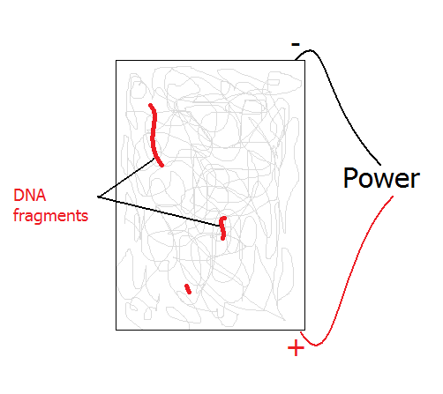
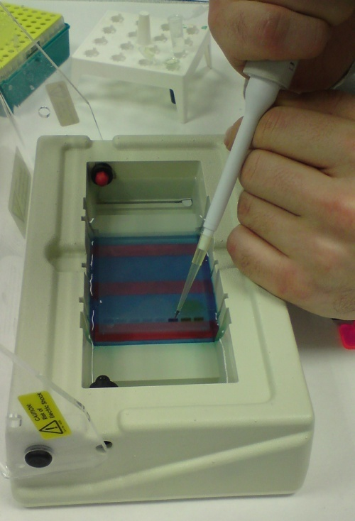
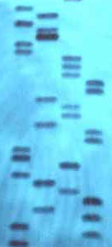
Final product

Slide 81
Method of DNA fingerprinting
The trough is covered with a nylon membrane and the fragments are transferred to the membrane by a process called Southern blotting.
Radioactive DNA probes (now largely replaced by non-radioactive or chemi-luminescent probes) are used to attach to specific parts of the fragments and any unbound fragments are washed off.
The nylon membrane with DNA fragments attached is placed under X-ray film and the radioactive probes expose the film.
This autoradiograph reveals a pattern of light and dark bands (the dark band indicates where a radioactive probe is present) which are unique to individuals and is called a genetic fingerprint.

Slide 82
Interpreting the results
DNA fingerprints from two different samples are examined visually. If they match the patterns of bands of each fingerprint is passed through a scanning machine which calculates the length of the DNA fragments
Different sized bands travel different distances through the electrophoresis gel
The odds are calculated of someone having an identical fingerprint
The greater the match between the bands the higher the chance the DNA has come from the same person

Slide 83
Uses of DNA fingerprinting
Genetic relationships and variability
Can be used in paternity tests. As we inherit half our DAN from each parent each band on a DNA fingerprint should have a corresponding band in one of the parents’ DNA fingerprint
Genetic variability within a population can be assessed as members of a population with similar genetic fingerprints have little genetic variation

Slide 84
Uses of DNA fingerprinting
2. Forensic science
Any DNA left at the scene of a crime can be collected and a DNA fingerprint created and compared with suspects.
This may only suggest a person was present at the crime scene

Slide 85
Uses of DNA fingerprinting
3. Medical diagnosis
Eg. Huntington’s disease can be detected.
It is caused by a genetic disorder on chromosome 4.
AGC is repeated over and over
People with less than 30 repeats are unlikely to get the disease
People with more than 38 repeats almost certain to get disease

Slide 86
Uses of DNA fingerprinting
4. Plant and animal breeding
Genetic variability within a population can be assessed as members of a population with similar genetic fingerprints have little genetic variation – used to prevent inbreeding (especially in zoos)
Used in selective breeding to identify desirable alleles

