Slide 1
Respiration
Respiration produces ATP.
Glycolysis is the first stage of anaerobic and aerobic respiration. It occurs in the cytoplasm and is an anaerobic process.
Glycolysis involves the following stages:
phosphorylation of glucose to glucose phosphate, using ATP
production of triose phosphate
oxidation of triose phosphate to pyruvate with a net gain of ATP and reduced NAD.

Slide 2
If respiration is only anaerobic, pyruvate can be converted to ethanol or lactate using reduced NAD. The oxidised NAD produced in this way can be used in further glycolysis.
If respiration is aerobic, pyruvate from glycolysis enters the mitochondrial matrix by active transport.
Aerobic respiration in such detail as to show that:
pyruvate is oxidised to acetate, producing reduced NAD in the
process
acetate combines with coenzyme A in the link reaction to produce acetylcoenzyme A
acetylcoenzyme A reacts with a four-carbon molecule, releasing coenzyme A and producing a six-carbon molecule that enters the Krebs cycle
in a series of oxidation-reduction reactions, the Krebs cycle generates reduced coenzymes and ATP by substrate-level phosphorylation, and carbon dioxide is lost
synthesis of ATP by oxidative phosphorylation is associated with the transfer of electrons down the electron transfer chain and passage of protons across inner mitochondrial membranes and is catalysed by ATP synthase embedded in these membranes (chemiosomotic theory)

Slide 3
other respiratory substrates include the breakdown products of lipids and amino acids, which enter the Krebs cycle.
Students could use a redox indicator to investigate dehydrogenase activity.
Required practical 9: Investigation into the effect of a named variable on the rate of respiration of cultures of single-celled organisms.

Slide 4
Respiration
You must know Aerobic respiration and Anaerobic respiration. There are two different types of anaerobic respiration: in fungi eg yeast and plants eg rice, and in animals. The end products of anaerobic respiration in plants/fungi and animals are different.

Slide 5
Aerobic respiration
There are four stages:
Glycolysis
Link reaction
Krebs cycle
Oxidative phosphorylation / electron transport chain.
Where do these take place and what are the reactants and products of each stage?

Slide 6
Stages of respiration
Glycolysis – in the cytoplasm, starts with glucose and ATP ends with pyruvate and ATP and reduced NAD.
Link reaction – in the matrix of the mitochondria, starts with pyruvate (3C) and ends with Acetate (2C) , produces carbon dioxide and reduced NAD,
Krebs cycle – in the matrix of the mitochondria, starts with acetyl coA and oxaloacetate ends with oxaloacetate and carbon dioxide and reduced NAD, and reduced FAD.
Electron transport chain on the cristae of the mitochondria, starts with reduced NAD and reduced FAD needs oxygen to complete and ends with ATP, and water

Slide 7
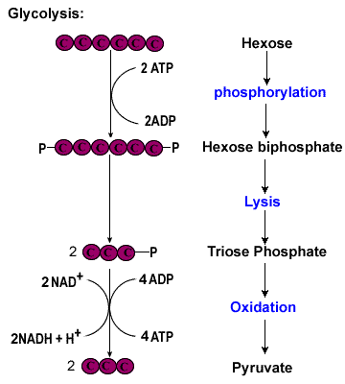
Glycolysis (in the cytoplasm)
glycolysis song
Glucose (hexose)
= the main respiratory substrate, a store of chemical energy
http://highered.mheducation.com/sites/0072507470/student_view0/chapter25/animation__how_glycolysis_works.html

Slide 8
Glycolysis
1.Glucose: (6C): contains a lot of stored chemical potential energy but is not very reactive.
2. Addition of 2 phosphate groups from the hydrolysis of 2 ATP: phosphorylation of glucose to glucose phosphate. This lowers the activation energy of glucose making it more reactive.
3.The to glucose phosphate molecule now undergoes lysis (splitting) and 2 molecules of triose phosphate (3C) are formed (also known as G3P – glyceraldehyde 3 phosphate)

Slide 9
4: Triose Phosphate (3C) is oxidised to pyruvate (3C)
Hydrogen atoms (oxidation, specifically dehydrogenation) are removed from Triose phosphate. The hydrogen atoms are transferred to a carrier molecule, a coenzyme called NAD (nicotinamide adenine dinucleotide) which becomes reduced.

Slide 10
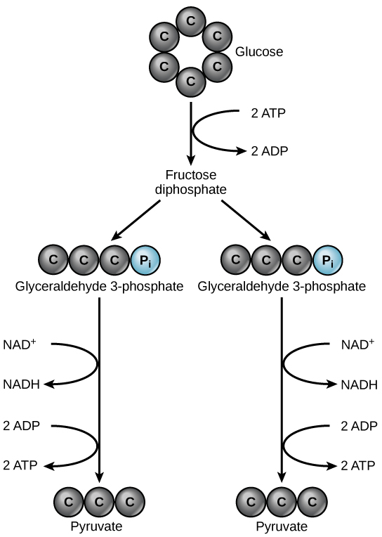
5: The Oxidation (dehydrogenation) of triose phosphate yields enough energy to transfer the phosphate groups from some intermediate compounds, to ADP to produce ATP directly. This is called substrate level phosphorylation. 4 ATP molecules are produced. The hydrogen formed is used to reduce NAD to NADH.
6: Pyruvate (the ion of pyruvic acid with 3 carbon atoms) is the end product of glycolysis

Slide 11
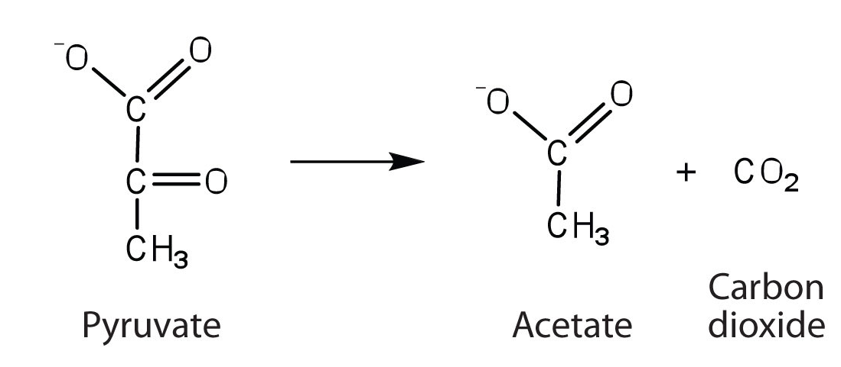
Link Reaction
Pyruvate is oxidised to acetate, producing reduced NAD in the process
+ reduced NAD
acetate combines with coenzyme A in the link reaction to produce acetylcoenzyme A
Acetate + Coenzyme A acetylcoenzyme A
acetylcoenzyme A reacts with a four-carbon molecule, releasing coenzyme A and producing a six-carbon molecule that enters the Krebs cycle

Slide 12
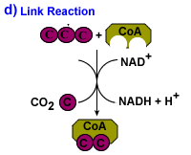
Pyruvate is not very reactive so it is made more reactive by combining with a molecule called coenzyme A (made from vitamin B3)
Hydrogen atoms are removed from pyruvate – so the link reaction is an oxidation (dehydrogenation) reaction.
Reduced NAD is produced as it accepts the hydrogen. CO₂ is lost in the link reaction as well (decarboxylation). A 2C molecule is formed called acetate.
The 2 C acetate combines with coenzyme A to form called acetyl coenzyme A.
The acetyl fragment then goes to the Krebs cycle and the coA is recycled.

Slide 13
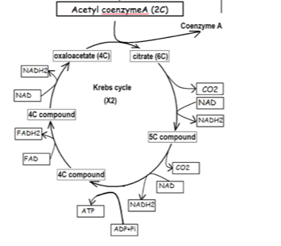
Chemists: http://www.austincc.edu/emeyerth/krebs1.htm
The Krebs Cycle Read BFY 288
Focus on the number of carbon atoms in the compounds don’t be distracted by any names. The names could appear in exam questions in place of the number of carbon atoms but you are not expected to know them.

Slide 14
DENA DENA…… A FA NA
DENA: Decarboxylation and production of reduced NAD
DENA: Decarboxylation and production of reduced NAD
A: Production of ATP
FA... : Production of reduced FAD (The space means a gap)
NA: Production of reduced NAD

Slide 15
The Krebs Cycle: DENA DENA A FA... NA
Acetyl Coenzyme A (2C)
NAD
2C
Coenzyme A
NA
Reduced
NAD
Oxaloacetate (4C)
Citrate (6C)
(6C)
(4C)
NAD
(4C)
CO₂
DENA
FAD
Reduced
NAD
FA
Reduced
FAD
CO₂
(5C)
(4C)
DENA
NAD
A
ADP + Pi
(4C)
Reduced
NAD
ATP

Slide 16
Dehydrogenation and decarboxylation
What is the difference between these processes?
Where do they occur?

Slide 17
Dehydrogenation and decarboxylation
Dehydrogenation is the removal of hydrogen atoms (NOT gas!) to a coenzyme (FAD or NAD – these are derived from vitamins. This occurs in the cytoplasm and in the matrix of the mitochondria.
Decarboxylation is the removal of carbon as carbon dioxide. This occurs in the matrix of the mitochondria.

Slide 18
Summary of Krebs (2 Turns of the cycle)
Key role: To provide Hydrogen that can be delivered to the electron transport chain to liberate more ATP

Slide 19
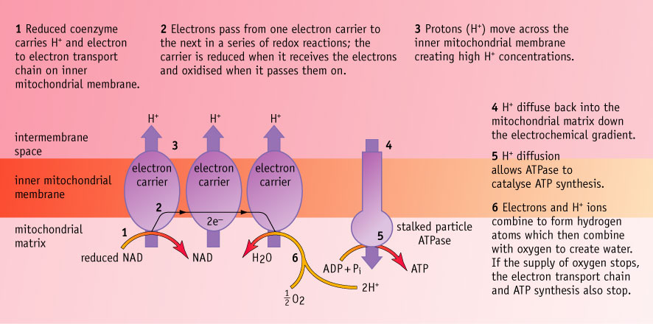
How ATP is generated by the electron transport system
The protons are pumped across the inner membrane
ATP synthase

Slide 20
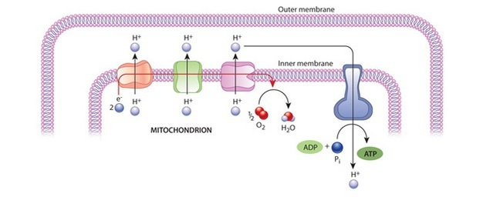
Synthesis of ATP by oxidative phosphorylation is associated with the transfer of electrons down the electron transfer chain and passage of protons across inner mitochondrial membranes and is catalysed by ATP synthase embedded in these membranes (chemiosomotic theory)

Slide 21
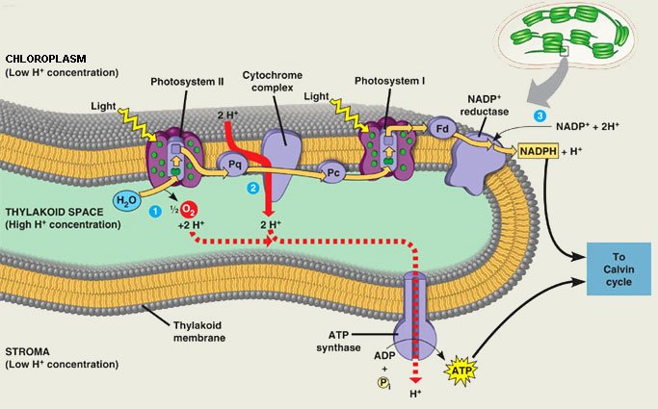

Slide 22
Energy budget
You must make sure you know that 1 reduced NAD yields 3 ATP and 1 reduced FAD yields 2 ATP via the electron transport chain where oxidative phosphorylation occurs.
Then you must know how many reduced NAD are formed in each stage of respiration. Don’t forget to notice if the molecule that starts the stage is 6C or 3C.
Sometimes you have to multiply by 2.

Slide 23
Energy budget continued
Glycolysis yields 2 reduced NAD
Link yields 1 reduced NAD for 1 pyruvate but remember there are 2 pyruvate ions produced from one glucose
Krebs cycle yields 3 reduced NAD and 1 reduced FAD for each acetyl coA that enter. Remember that there are 2 acetyl coA molecule that enters for each glucose molecule.

Slide 24
Therefore:
Glycolysis starts with an investment of 2 ATP (so -2, effectively)
Glycolysis yields 2 reduced NAD, therefore 2 x 3 = 6 ATP
Glycolysis yields 4 ATP by substate level phosphorylation.
Link reaction X2 as there are 2 pyruvate ions yields 1 reduced NAD, therefore 2 x 3 = 6 ATP
Krebs cycle yields 1 ATP per Acetyl coA by Substrate level phosphorylation, 2 cycles = 2 ATP
Krebs cycle yield 3 reduced NAD per acetyl coA, therefore 2 x 3 x 3 =18 ATP
Krebs cycle yield 1 reduced FAD per acetyl coA therefore 2 x 1 x 2 = 4 ATP
4 + 6 + 6 + 2 + 18 + 4 -2 = net gain of 38

Slide 25
 | ATP in | ATP out | NAD | FAD
Glycolysis | 2 | 4 | 2 | 0
Link | 0 | 0 | 2 | 0
Krebs | 0 | 2 | 6 | 2
Total | 2
No ATP | -2 | 6 | 30 | 4
 | 6+30+4-3
Net Gain | 38

Slide 26
ANAEROBIC RESPIRATION
Definition: A form of incomplete intracellular breakdown of glucose or other organic compounds in the absence of oxygen that releases energy.

Slide 27
Anaerobic respiration – yeast and fungi
Fungi and yeast carry out anaerobic respiration using pyruvate and producing ethanol and carbon dioxide and 1 carbon dioxide. There will be 2 pyruvate from 1 glucose so double the products. Reduced NAD will be oxidised so it can be used in glycolysis again.

Slide 28
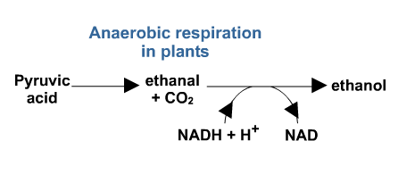
Ethanal
What chemical reaction occurs to convert ethanal to ethanol?

Slide 29
Anaerobic respiration in animals
Reduced Oxidised

Slide 30
Other molecules can be used as energy sources because they can feed into glycolysis and the Krebs cycle
Glycogen/starch
glucose
Other sugars
Via TP
Proteins → amino acids
pyruvate
Necessary during starvation
Glycerol
←
acetyl CoA
fatty acids ← Lipids
First choice when glucose is depleted
Krebs cycle
ATP
Notes:
Proteins → amino acids

Slide 31
A-level Biology required practical No. 9
Investigation into the effect of a named variable on the rate of respiration of cultures of
An investigation of the effect of temperature on respiration in yeast
Yeast is a single-celled fungus. It can respire aerobically and anaerobically. During aerobic respiration, the transport of electrons is linked to the synthesis of ATP. In this investigation these electrons will be accepted by a substance called methylene blue. When methylene blue accepts electrons, it changes from blue to colourless.

