Slide 1
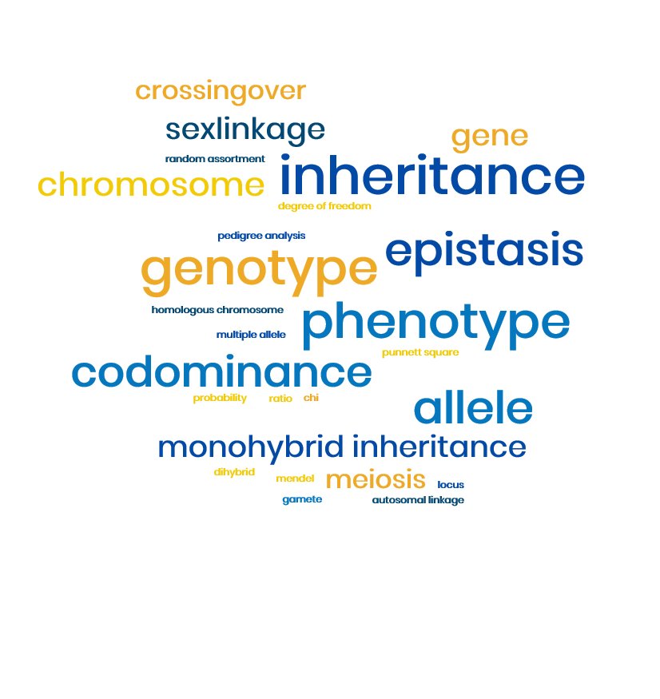
3.7.1 Inheritance

Slide 2
Specification 3.7.1 Inheritance
The genotype is the genetic constitution of an organism.
The phenotype is the expression of this genetic constitution and its interaction with the environment.
There may be many alleles of a single gene.
Alleles may be dominant, recessive or codominant.
In a diploid organism, the alleles at a specific locus may be either homozygous or heterozygous.
The use of fully labelled genetic diagrams to interpret, or predict, the results of:
monohybrid and dihybrid crosses involving dominant, recessive and codominant alleles
crosses involving sex-linkage, autosomal linkage, multiple alleles and epistasis.
Use of the chi-squared (X2) test to compare the goodness of fit of observed phenotypic ratios with expected ratios.

Slide 3
Candidates should know these terms
Genetics – The study of inheritance, controlled by genes.
Genome – The total genetic make up of an organism.
Gene - A section of DNA on a chromosome coding for a particular polypeptide. They can separate and combine, they can mutate.
Locus – The position of a particular gene on a chromosome.
Allele – Different forms of the same gene.
Homologous chromosome – a pair of chromosomes, one maternal and one paternal, that have the same gene loci
Dominant allele – The allele that is always expressed in the phenotype e.g. T for tall
Recessive allele – The allele that is only expressed in the phenotype when present as a pair of recessive alleles (homozygous recessive) e.g. t for short
Phenotype – The appearance of the organism
Genotype – The genetic make up of the organism

Slide 4
Candidates should know these terms
Homozygote - Two alleles of a pair are the same e.g. TT or tt
Heterozygote – Two alleles of a pair are different e.g. Tt
Monohybrid inheritance – Involves the inheritance of a single characteristic (2 alleles involving a single gene)
Dihybrid inheritance – Involves the inheritance of two separate genes.
Codominance – Where the heterozygous individual has a phenotype intermediate between the two homozygous parents.
Linkage – Refers to two or more genes that are found on the same chromosome. Linked genes are inherited together.
Autosome – A chromosome that is not a sex chromosome.
Sex linkage – A characteristic is sex linked if the gene that controls it is on one of the sex chromosomes
F1 – The first generation of offspring from parents that are homozygous

Slide 5
Inheritance – Links to useful sites
https://learn.genetics.utah.edu/content/basics/
  This has videos and information on the entire inheritance topic (and more)
interactive tutorial for help with monohybrid & dihybrid and sex-linked crosses
  series of multiple choice questions with tutorials attached to each question if you are unsure of the answer
https://www.youtube.com/watch?v=NWqgZUnJdAY
  Bozeman Mendelian Genetics
https://www.youtube.com/watch?v=KaxSDryqB6M
  Bozeman video that describes genetics at the chromosome level.
https://www.youtube.com/watch?v=rIe7mPXkYhs
  Bozeman – non mendelian genetics

Slide 6
If you can’t open any of the links for videos do the following:
Open estream from GOL home page
Log in using your college login and password
Click the categories tab at the top of the page
Click biology
Write inheritance in the search box
All the inheritance videos will be there

Slide 7
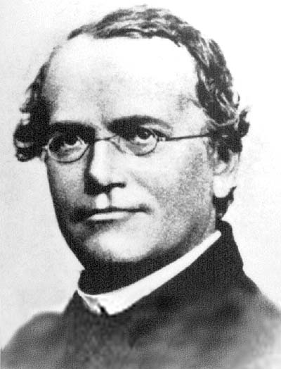
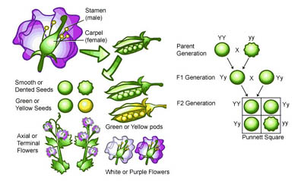
Monohybrid Inheritance
Involves the inheritance of a single characteristic
The inheritance of one gene (two alleles) from a homologous pair of chromosomes is called monohybrid inheritance.
Based on Mendel’s first law of inheritance
(the following slides give information on Mendel’s experiments but are not needed to be learnt for your specification)
https://www.youtube.com/watch?v=MWkFxWXHTnw
Watch this video for more information on Mendel’s pea plant experiments

Slide 8
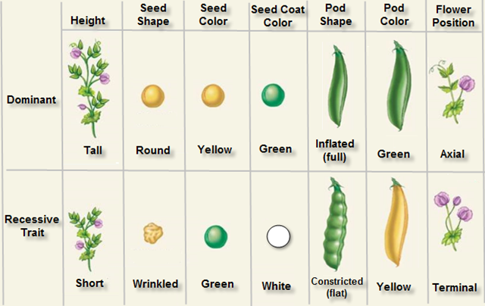
Mendel’s peas and crosses
Peas showed a variety of contrasting traits (controlled by single genes that behave independently)
Shape of pea flower protects it from foreign pollen (self pollinator)
Pea plants grow quickly and don’t require much space.

Slide 9
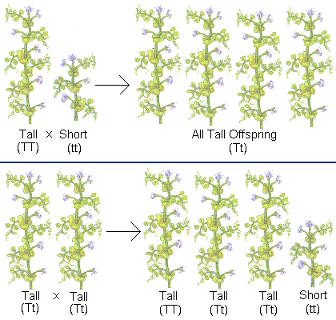
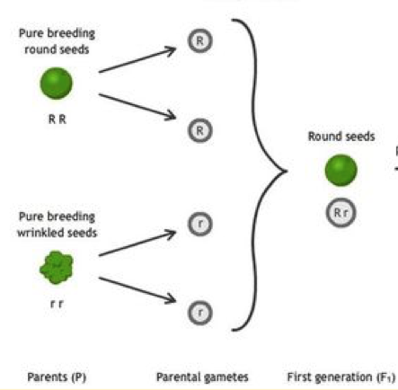
Mendel studied two generations at a time
Mendel followed the inheritance of 7 pea traits. For round and wrinkled seeds, dominant traits (round pea) appeared in the first-generation hybrids (F1), whereas recessive traits (wrinkled peas) were masked.

Slide 10
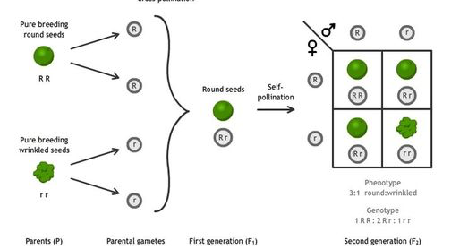
Mendel studied two generations at a time
However, recessive traits reappeared in the second generation (F2).

Slide 11
Mendel’s Conclusions
A characteristic can disappear for a generation and then reappear again, looking exactly the same. So a characteristic can be present but hidden.
The outward appearance (phenotype) is not necessarily the same as the inherited factors (genotype)
One form of characteristic can mask another (dominant and recessive)
As a result of the early experiments Mendel formulated his first law of inheritance
'The characteristics of an organism are determined by factors (alleles) which occur in pairs. Only one of a pair of factors (alleles) can be present in a single gamete‘

Slide 12
Setting out genetic crosses
Always read the information you are given very carefully
Write the phenotypes of the parents.
Write the genotypes of the parents. Choose suitable symbols for alleles. upper case letter be dominant and the lower case letter recessive.
Write the possible gametes that can be formed. Draw circles around the gametes
Draw a Punnett square showing the possible combinations of gametes
Write the genotypes of the offspring/F1.
Write the phenotypes of the offspring/F1
Write the expected ratio of the phenotype
Parental phenotype: Tall x Short
Parental genotype: TT tt
Gametes: T t
Punnett square:
F1 genotype: all Tt
F1 phenotype: Tall
F1 ratio: 100% tall
 | t
T | Tt

Slide 13
Genetic diagram using parents from F1 of previous cross
Parental phenotype: Tall x Tall
Parental genotype: Tt Tt
Gametes: T t T t
Punnett square:
F1 genotype: Tt , Tt, tt
F1 phenotype: Tall : short
F1 ratio: 3 : 1
How did the short plant reappear?
This 3:1 ratio is the monohybrid ratio obtained when both parents are heterozygous for one characteristic.
 | T | t
T | TT | Tt
t | Tt | tt
Task: Watch the video
Inheritance problems 1 - Godalming College eStream - Powered by Planet eStream
Then complete your cross for the problem in your student booklet

Slide 14
Probability and Genetic Crosses
Genetic crosses allow us to determine the probability of producing a particular phenotype in the offspring. This probability can be written as a ratio or percentage. Ratios give us a measure of the relative size of groups expressed as a proportion. E.g. if there are 60 dogs and 30 cats then there is a ratio of 60:30 which is simplified to 2:1. For comparisons, ratios are simplified so the smallest value is 1.
In reality, crosses rarely end up with this exact ratio as it is completely random which gametes will fuse at fertilisation. The larger the sample size (number of crosses) the closer to the theoretical ratio the results will be.

Slide 15
Test Crosses
You can see an individual’s phenotype but not its genotype.
If you have an individual that is showing the dominant trait, how do you know if it is heterozygous or homozygous?
A testcross can be used to determine if a particular dominant characteristic observed in an organism is determined by one or two dominant alleles i.e. in the example below; FF or Ff

Slide 16
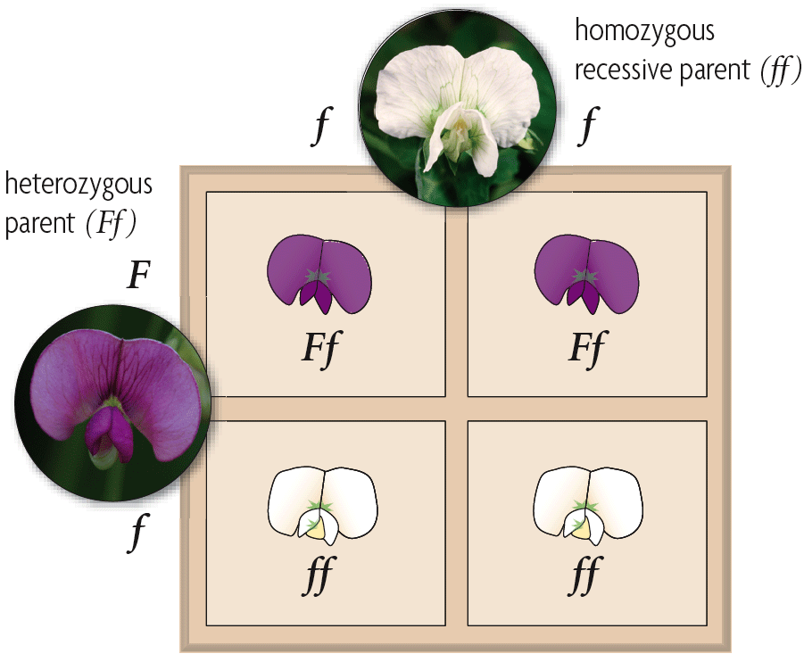
Test Crosses
The backcross consists of crossing the unknown plant with a known ‘recessive’ genotype. If the resulting offspring are
a mixture of forms then
the unknown parent was heterozygous.
Task:
Watch the video (up to 3 min 20 sec)
Inheritance problems 2 - Godalming College eStream - Powered by Planet eStream
Then complete your cross for the problem in your student booklet.
Complete the knowledge test questions on Pg. 9 of the student booklet

Slide 17
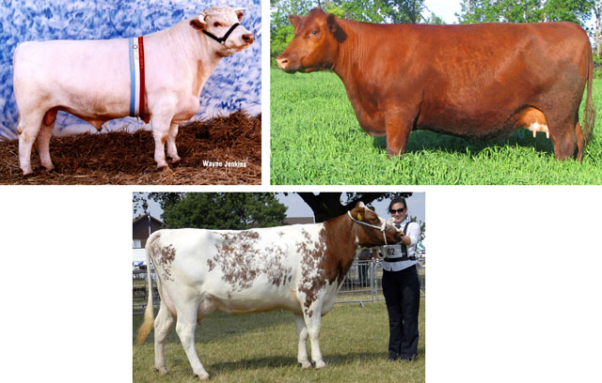
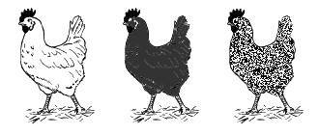
Co-dominance
Not all characteristics are controlled by a single gene which behaves independently as observed by Mendel
In co-dominance both alleles are expressed in the phenotype equally.

Slide 18
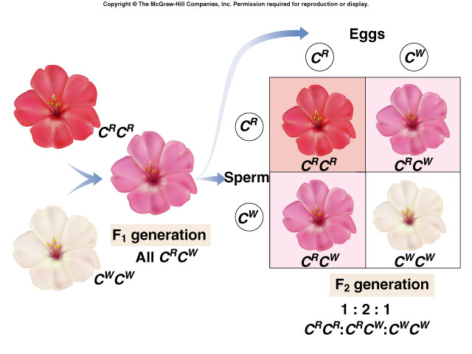
Co-dominance symbols
Use a capital letter for the characteristic
The capital letters for alleles are placed superscript on the characteristic letter
E.g. Colour of petals in carnations – red, white, pink (co-dominant colour)
Let C = colour
Let C^{R}= red allele
Let C^{W}= white allele
Pink flower has a genotype C^{R}C^{W}
Task:
Watch the video (from 3 min 20 secs) and follow the notes below
Inheritance problems 2 - Godalming College eStream - Powered by Planet eStream
Complete the cross for blood grouping in the student booklet

Slide 19
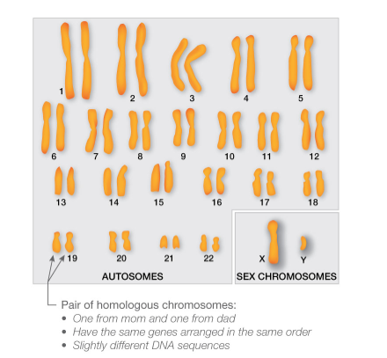
Inheritance of Sex
One pair of the homologous pairs of chromosomes are the sex chromosomes which carry the genes coding for male and female sexual characteristics. The non sex chromosomes are called autosomes.
Humans have 23 homologous chromosomes, the first 22 are autosomes the 23rd pair are the sex chromosomes:
X = female sexual characteristics
Y = male sexual characteristics
Females are XX (homogametic) and produce eggs/ova that always have X chromosome present.
Males are XY (heterogametic) i.e. sperm produced can either have an X or Y chromosome:

Slide 20
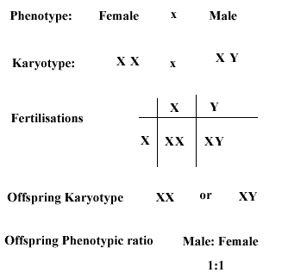
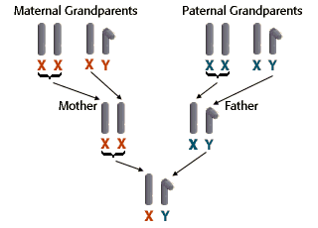
The Y chromosome can only be passed from Father to Son.

Slide 21
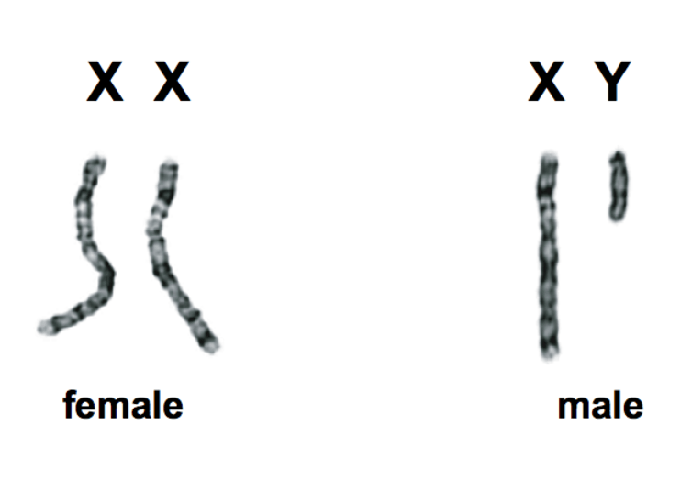
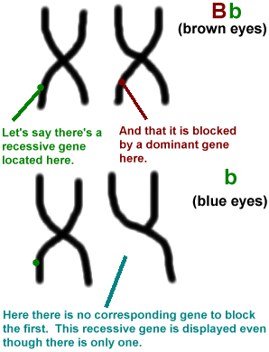
Sex Linked Inheritance
Some alleles are carried on the sex chromosomes and are said to be sex linked
The y chromosome is much smaller than the x chromosome and carries very few genes
Often the allele for a gene is carried on the X chromosome but not on the Y (as Y is smaller).
In this situation, any recessive genes carried on the X chromosome will express themselves in the phenotype because the genes are unpaired i.e. on X not on Y, and so there is no dominant gene present.
http://scitechconnect.elsevier.com/sex-genes-y-chromosome-future-of-men/

Slide 22
Haemophilia
Caused by a recessive allele on the X chromosome.
The gene that codes for factor 8, an important protein in blood clotting, is a sex linked gene on the x chromosome.
The inability to clot leads to slow and persistent bleeding
Occurs almost exclusively in males
Women can carry the allele but their second chromosome will block it out with a healthy gene. It is very rare to inherit two defective genes together because the recessive allele is rare.

Slide 23
Symbols used in sex-linked crosses
Sex linked disorder genetic diagrams use the allele letter superscript on the X chromosomes. Y chromosomes do not have an allele so have no letter.
  H is the dominant allele that code for factor 8 in haemophilia
  h is the recessive allele that does not code for factor 8 in haemophilia
The following genotypes are possible in inheritance of haemophilia
  X^{H} X^{H} – healthy female
  X^{H} X^{h} – carrier female
  X^{h}X^{h} – affected female
  X^{H} Y – healthy male
  X^{h} Y – affected male

Slide 24
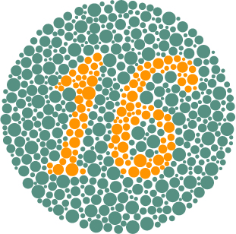
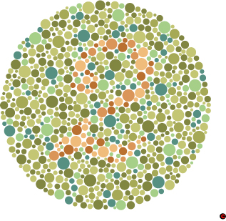
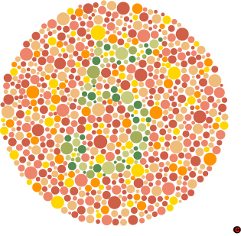
Task:
Watch the video and follow the notes in your student booklet
Inheritance problem 3 - Godalming College eStream - Powered by Planet eStream
Pause the video and complete your cross for the colour blindness question in your student booklet.

Slide 25
Dihybrid inheritance
This involves the inheritance of two separate genes (2 pairs of alleles) at the same time but independent of each other.
There are a greater number of gamete types produced when 2 genes are considered.
The genes are carried on separate chromosomes and are sorted independently of each other at meiosis leading to 4 possible types of gamete.

Slide 26
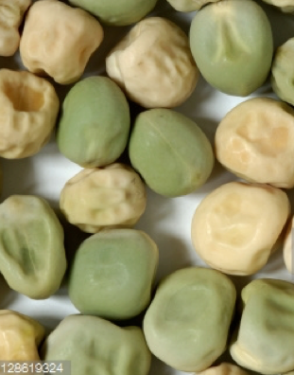
Mendel’s Peas (again)
Mendel had observed that the seeds of his pea plants varied in several ways – among them, whether the peas were round or wrinkled and whether they were green or yellow.
He did monohybrid crosses on both characteristics, and found that round shape was dominant to wrinkled and that yellow colour was dominant to green.

Slide 27
Seed colour and seed shape are 2 genes carried on different chromosomes. There are four possible combinations of the two characteristics. Peas can be:
1) round and yellow
2) round and green
3) wrinkled and yellow
4) wrinkled and green
Yellow is dominant over green
Round shape is dominant over wrinkled.
  Y – yellow allele, y – green allele
  R – round allele, r – wrinkled allele
Starting with individuals that were homozygous, either for both dominant characteristics or both recessive characteristics he set off breeding again…

Slide 28
X
Parent phenotype
Round, yellow
Wrinkled, green
RRYY
rryy
Parent genotype
Gametes
all RY
all ry
F1
all RrYy
All of the F1 generation would be heterozygous for both characteristics, meaning that they would all be round and yellow. As with monohybrid crosses, he then crossed two of the F1 generation together…

Slide 29
F1 parent phenotype: Round, yellow x Round, yellow
F1 parent genotype: RrYy x RrYy
Gametes: RY Ry rY ry RY Ry rY ry
Punnett square:
F2 genotype: in the Punnett square
F2 phenotype: Round yellow : round green : wrinkled yellow : wrinkled green
F2 ratio: 9 : 3 : 3 : 1
 | RY | Ry | rY | ry
RY | RRYY | RRYy | RrYY | RrYy
Ry | RRYy | RRyy | RrYy | Rryy
rY | RrYY | RrYy | rrYY | rrYy
ry | RrYy | Rryy | rrYy | rryy
This is the typical ratio expected in a dihybrid cross when the parents are heterozygous for two traits/characteristics.

Slide 30
Mendel's second law of inheritance
This law applies to dihybrid inheritance and states that;
'Each member of an allelic pair may combine randomly with either of another pair’
It is also known as the law of independent segregation and essentially says the alleles of two (or more) different genes get sorted into gametes independently of one another. In other words, the allele a gamete receives for one gene does not influence the allele received for another gene.
Task:
Watch the and follow the notes in your student booklet
Inheritance problems 4 - Godalming College eStream - Powered by Planet eStream
Then complete your cross for the guinea pig question in the booklet.

Slide 31
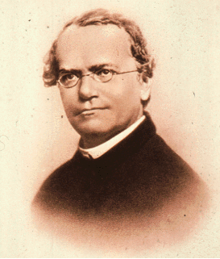
Probability and genetics
Mendel was the first to recognise that the principles of probability could be used to predict the outcome of genetic crosses.
Punnett squares are used to predict outcomes from breeding experiments.
What is actually observed may not agree precisely with the prediction
Results are due to chance
https://www.youtube.com/watch?v=y4Ne9DXk_Jc watch for rules of multiplication and addition

Slide 32

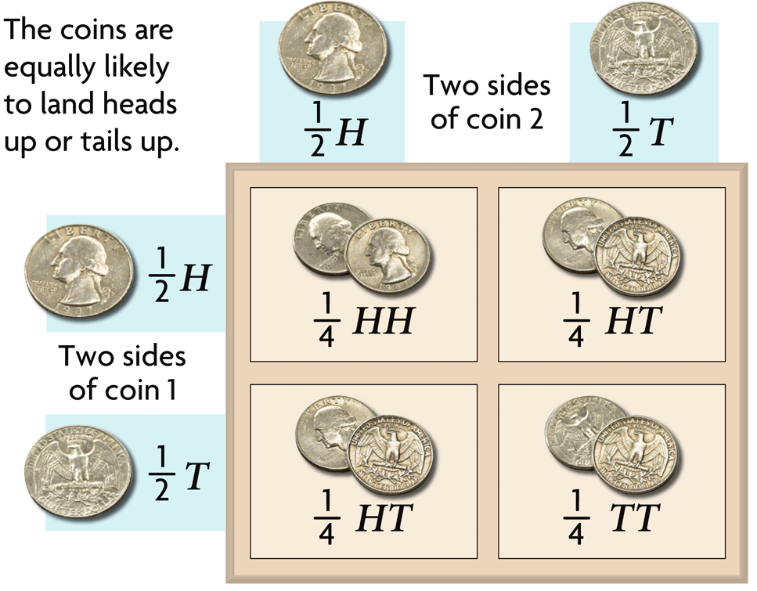
Heredity patterns can be calculated with probability.
Probability is the likelihood that something will happen.
Probability predicts an average number of occurrences, not an exact number of occurrences.
Probability applies to random events such as meiosis and fertilization.

Slide 33
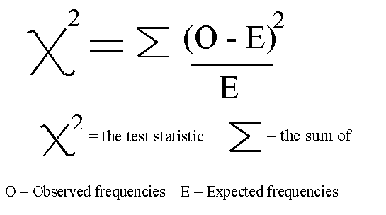
The Chi-squared (goodness of fit) test
It enables us to find the probability of the difference between the observed and expected numbers being due to chance and hence whether there is a significant difference and whether the genetic ratios are supported.
We can know if some other factor is responsible for the differences in results.
Chi – squared test formula

Slide 34
How to do a Chi-squared test
Write a null hypothesis which is a hypothesis of “no difference”
  E.g. There is no difference between the numbers observed in the experiment and those expected (according to the ratio) from the theory.
Calculate the expected numbers (see next slide)

Slide 35
Phenotype | round and yellow | round and green | wrinkled and yellow | wrinkled and green
Observed seed phenotype number(O) | 315 | 108 | 101 | 32
Phenotype Ratio (from genetic cross) | 9 | 3 | 3 | 1
Expected number (E) | 312.75 | 104.25 | 104.25 | 34.75
If a cross is carried out and the above numbers of phenotypes are observed to find the expected numbers according to the ratio you must:
Add up all the parts of the ratio = 9 + 3 + 3 + 1
= 16
Add up all the numbers of individuals whose phenotype was observed
= 315 + 108 + 101 + 32
= 556
Find the proportion of each phenotype expected from the ratio, i.e. find 9/16 of 556, 3/16 of 556 and 3/16 of 556 and 1/16 of 556

Slide 36
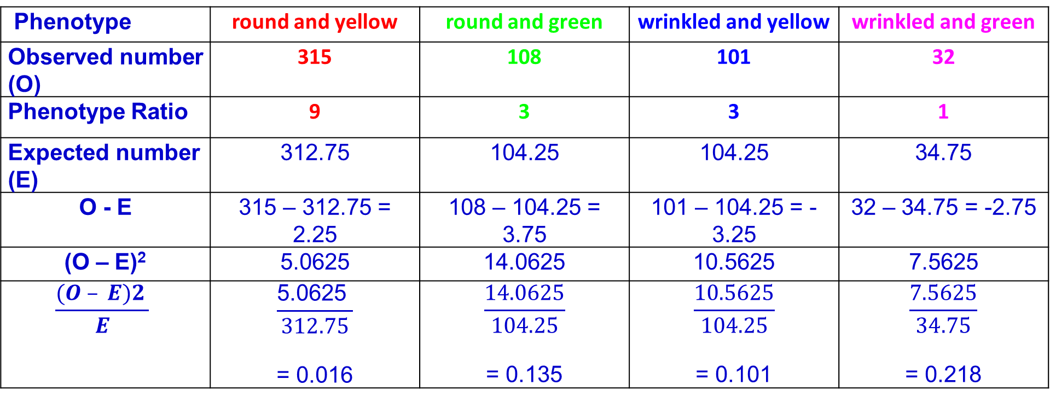
Phenotype | round and yellow | round and green | wrinkled and yellow | wrinkled and green
Observed number (O) | 315 | 108 | 101 | 32
Phenotype Ratio | 9 | 3 | 3 | 1
Expected number (E) | 312.75 | 104.25 | 104.25 | 34.75
O - E | 315 – 312.75 = 2.25 | 108 – 104.25 = 3.75 | 101 – 104.25 = -3.25 | 32 – 34.75 = -2.75
(O – E)² | 5.0625 | 14.0625 | 10.5625 | 7.5625
$$\frac{(O – E)2 }{E}$$ | $$\frac{\text{5.0625 }}{312.75}$$ = 0.016 | $$\frac{14.0625}{104.25}$$ = 0.135 | $$\frac{10.5625}{104.25}$$ = 0.101 | $$\frac{7.5625}{34.75}$$ = 0.218
Then find the difference between observed and expected numbers
Now square the difference (deviation) between observed and expected numbers.
This will remove any negative sign.
Divide (O – E)² by E (for the particular phenotype)

Slide 37
Calculating chi-squared value
Need to add up all your values for (O – E)2/E
0.016 + 0.135 + 0.101 + 0.218 = 0.47
Χ² = 0.47

Slide 38
What does the calculated chi-squared value tell us?
Do we have a significant difference between the observed and expected numbers of each phenotype?
It is deemed that if the probability (P) is 5% or lower (P<5%),e.g. 2%/1%, the difference between the observed and expected results is said to be significant i.e. the difference between the observed results and expected results is not due to chance alone and some other factor is influencing the results

Slide 39
Using a probability table
You must know the degrees of freedom. (The number of different phenotypes in this case).
We have 4 phenotypes, so we must find n-1 for degrees of freedom so 4 -1 = 3
Now we must use the third row of the probability table and find the critical value at P=0.05.
If the calculated chi-squared value is equal or larger than the critical value then the null hypothesis is rejected. The difference between the observed and expected results is significant.
If the calculated chi-squared value is smaller than the critical value then you accept the null hypothesis. The difference between the observed ad expected results is not significant and is due to chance.

Slide 40
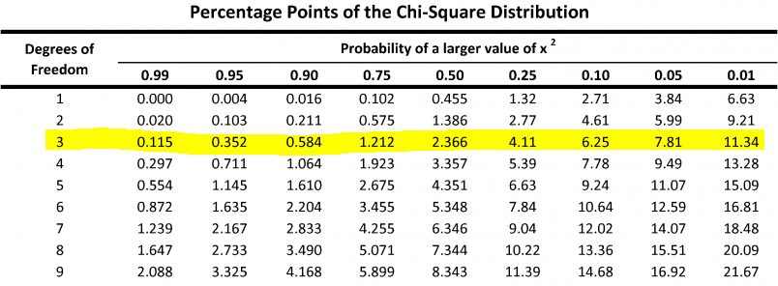
Using a probability table
  Find the critical value from the table at P=0.05
  Critical value at p=0.05 is 7.81
  The chi-squared value = 0.47 which is smaller than the critical value = 7.81 so the null hypothesis is accepted. Therefore, in this case the difference from the 9:3:3:1 ratio is not significant and is due to chance alone

Slide 41
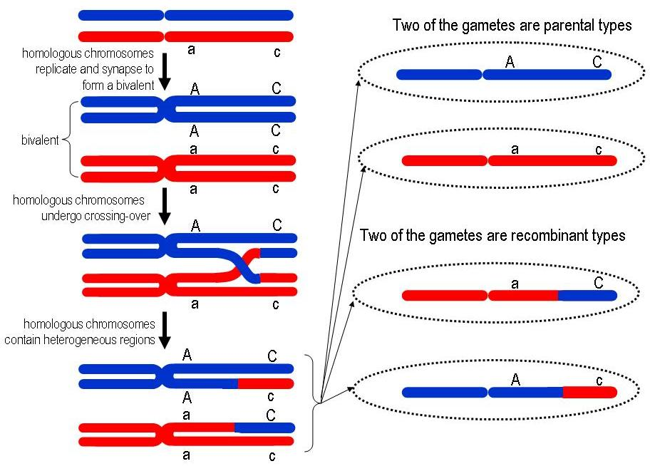
Autosomal linked genes
Linkage occurs when 2 different genes occur on the same chromosome.
Therefore, genes on the same chromosome will tend to be inherited together because they move together during meiosis and appear in the same gamete.
Task:
Watch the video and ensure you follow your notes in your student booklet
Inheritance problems 5 - Godalming College eStream - Powered by Planet eStream
Pause the video and answer the question 1a and b in the booklet.

Slide 42
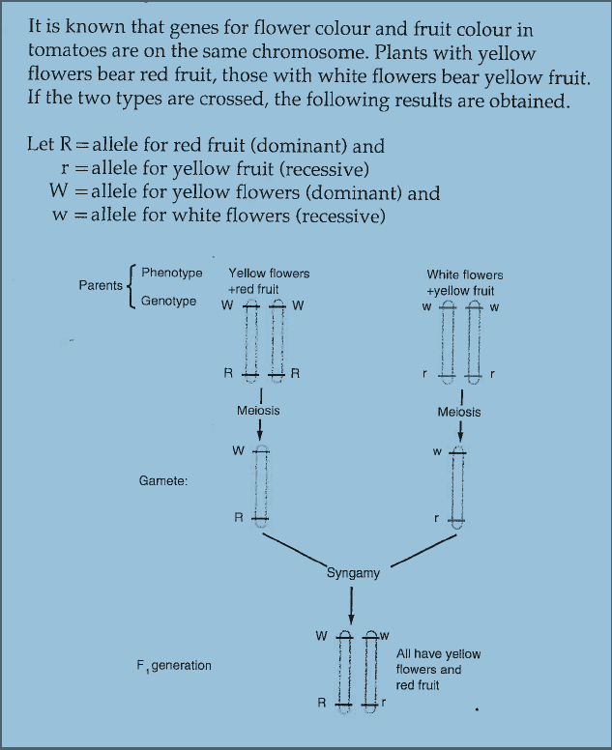
Autosomal Linkage
This shows an example of 2 genes on the same chromosome in tomato plants

Slide 43
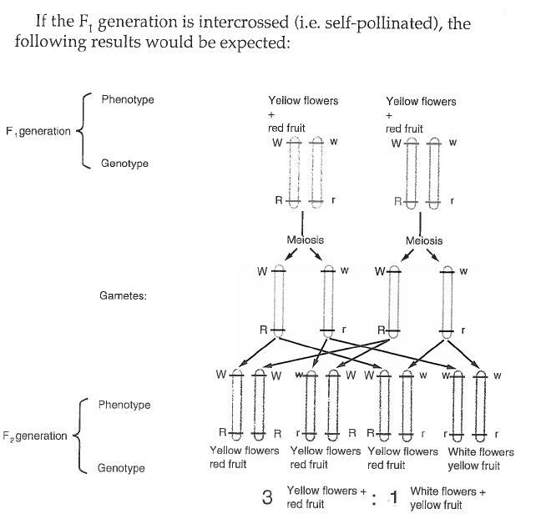

Slide 44
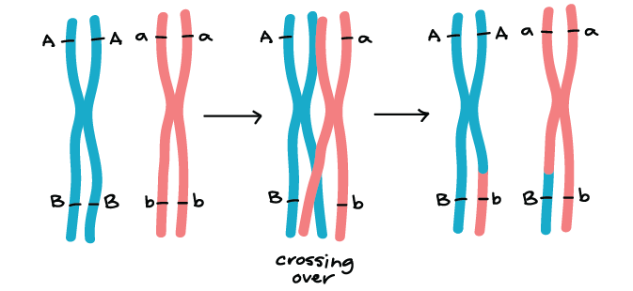
Unusual recombinants
Sometimes unexpected phenotypes are produced from autosomal linked genes when they are crossed.
Recombination of DNA occurs when alleles are exchanged as part of crossing over in meiosis. Crossing over can put new alleles together in combination on the same chromosome, causing them to go into the same gamete.

Slide 45
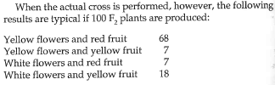
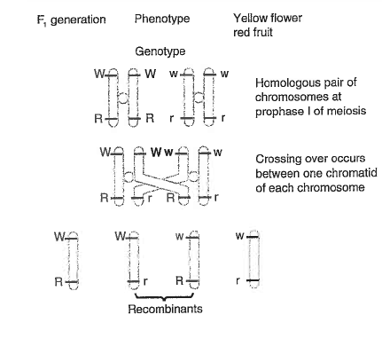
These are the expected phenotypes
These are the unusual recombinants
Crossing over can explain the unexpected results.
Crossing over does not always occur.
So the proportion of gametes with recombinants is not as high as those without and this explains why the yellow flowers and red fruit and white flowers and yellow fruit occur in greater numbers.
The further apart the 2 genes on a chromosome are, there more chance there is of crossing over taking place and the genes being separated.

Slide 46
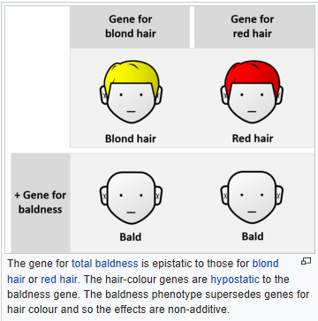
Epistasis
In epistasis the phenotypic expression of a gene at one locus alters that of a gene at a second locus. It is another example where Mendelian expected ratios do not occur.
Epistasis is the interaction of different gene loci so that the allele of one gene masks or suppresses the expressions of the alleles of other genes.
Task:
Watch the video
Inheritance problems 6 - Godalming College eStream - Powered by Planet eStream
Fill in the answers in your student booklet and ensure you understand the notes.

Slide 47
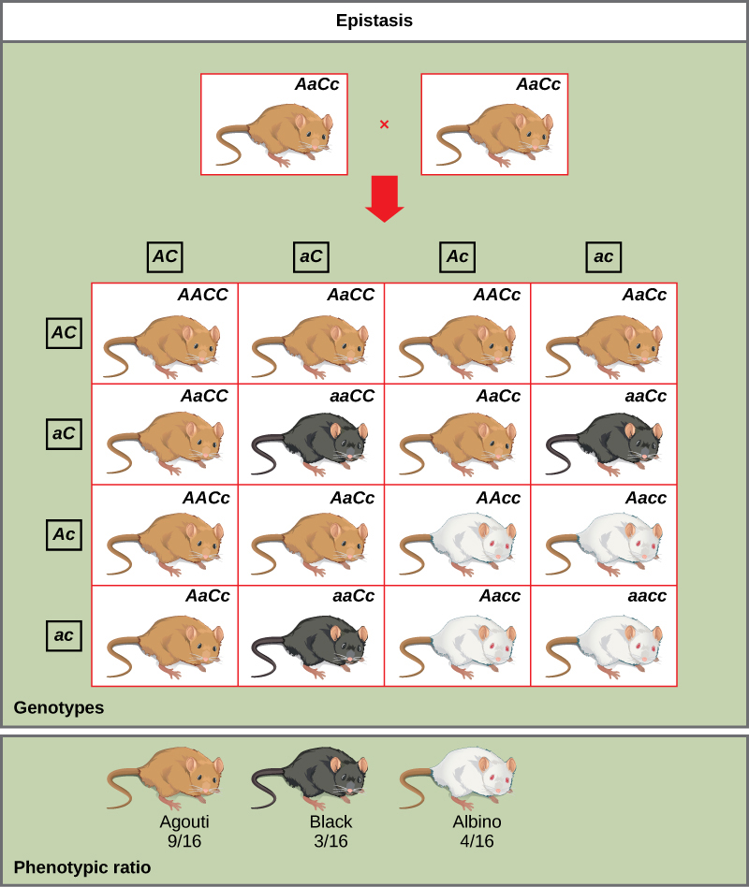
Epistasis in Mice
Wild-type coat color, agouti (AA) is dominant to solid-colored fur (aa).
Another gene C, when present as the recessive homozygote (cc), negates any expression of pigment from the A gene and results in an albino mouse
Genotypes AAcc, Aacc, and aacc all produce the same albino phenotype.
A cross between heterozygotes for both genes (AaCc x AaCc) would generate offspring with a phenotypic ratio of 9 agouti:3 black:4 albino (different ratio to a normal dihybrid cross of 9:3:3:1)
In this case, the C gene is epistatic to the A gene.

Slide 48
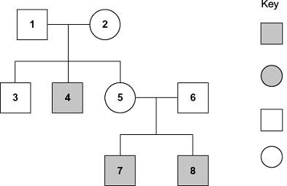
Pedigree analysis
Pedigree analyses are used to trace the inheritance of traits through generations so is a form of family tree.
Each row represents a generation
Squares represent males
Circles represent females
Line between individuals in a generation indicate parents
Shading represents individuals showing the trait

Slide 49
Pedigree analysis questions
Questions involving pedigree analysis often want you to identify the genotypes of individuals and give evidence that the traits are recessive or dominant. Or give evidence that the trait is sex-linked or not.
When answering questions always:
  Write the genotypes of individuals using the information you have been given.
  Remember that each individual acquired one allele from each parent
  Use a Punnett square if you need to help work out genotypes
  Use the number of individuals given in the chart in your answers.
Task:
Watch the video
Inheritance questions using pedigree analysis - Godalming College eStream - Powered by Planet eStream
Fill in the answers in your student booklet and ensure you understand the notes.

Slide 50
Tips on answering pedigree analysis questions
1. If a question asks; “What evidence is there that the disorder is recessive?”
Look for an affected child with normal parents
Answer: Both sets of parents are normal, and yet their children are affected. If the allele for disorder were dominant, then at least one of the parents would be affected.
2. If a question asks; “What evidence is there that this is not sex linked?”
Look for an affected/recessive female with a normal father
Answer: For female to be affected she must receive an allele for disorder from both parents. Father is unaffected, therefore not sex linked
Do not say: “Female is affected”

Slide 51
The following slides are information on basic genetic terminology and meiosis

Slide 52
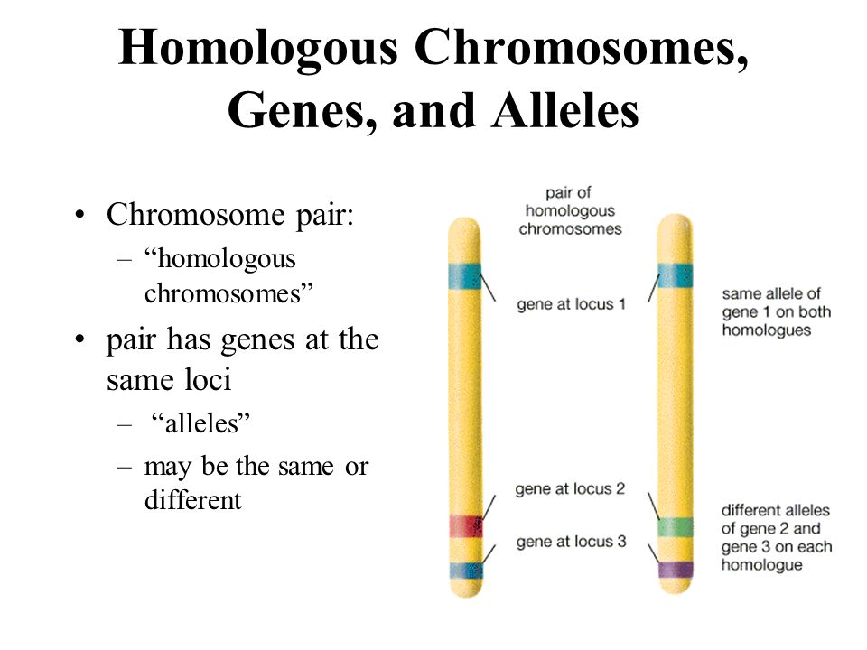
Genetic terms

Slide 53
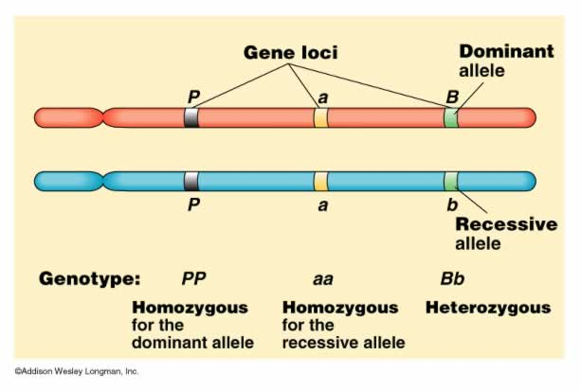
Genetic terms

Slide 54
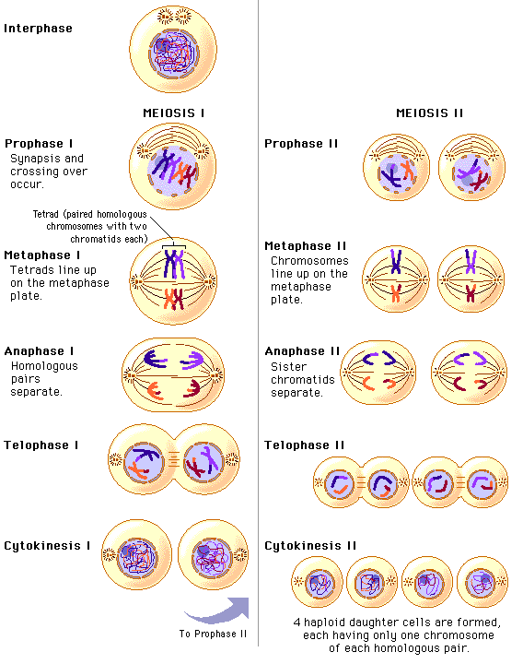

Slide 55
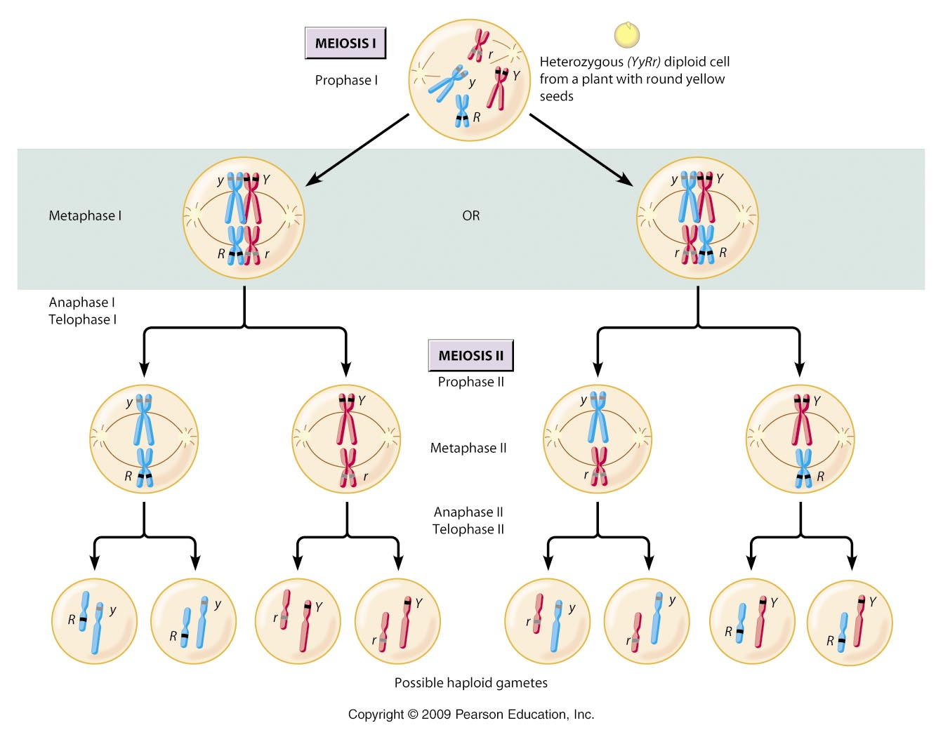

Slide 56
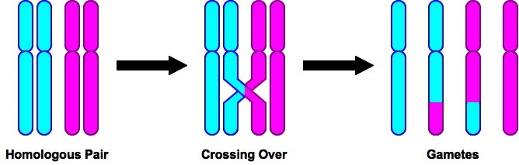
Crossing over – prophase 1 leads to variation

Slide 57
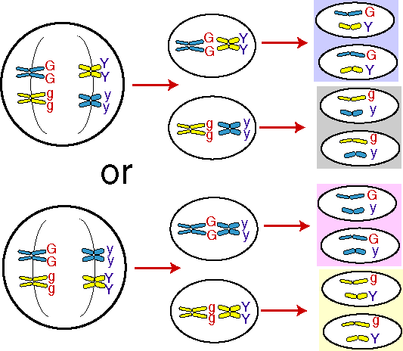
Random Assortment
Random assortment of homologous pairs of chromosomes at Metaphase 1 gives new combinations of chromosomes

Slide 58
Random fusion of gametes at fertilisation
Random fertilisation in which any possible gamete from the male can randomly fertilise any other possible gamete from the female.
The ovum has 8 million (2²³) possible chromosome combinations, so does the sperm cell. 8 million x 8 million = 64 trillion possible diploid combinations in each and every zygote.
Therefore meiosis and random fusion of gametes gives rise to tremendous variety
Genetic terminology sort

Slide 59
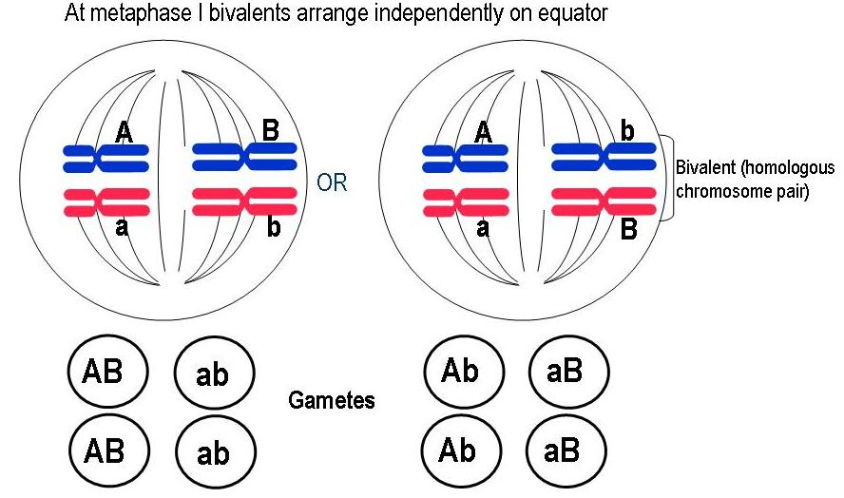
At metaphase alleles are randomly arranged on the equator and will be distributed randomly into gametes

