Slide 1
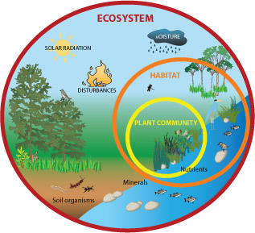
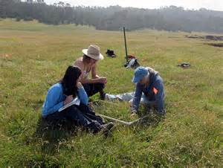
Ecology Investigation Analysis and Introduction to Statistics
Objectives:
To understand the need for using statistics to analysis your data obtained from the belt transect and make valid conclusions.
Use statistical tests to form a conclusions
To know when to use spearman rank correlation and how to interpret results from this test

Slide 2
Ecological Investigations
Aim
  To complete the analysis and conclusion of the abiotic factor and species distribution investigation

Slide 3
Aim: To investigatehow the distribution of plants is affected by light intensity
The end goal
Aim
Null Hypothesis
Results/stats/graphs
Conclusion – detailed description of what you found out and including scientific knowledge to explain results (including details of population ecology, adaptations to different environmental conditions and details of succession)
Evaluation – critical discussion on the validity and reliability of your investigation with suggestions on improvements and further investigations.

Slide 4
Why use statistics?
Statistics is a mathematical process that enable conclusions to be made.
Statistics is a process that we can apply to biological investigations where numerical raw data is collected and comprises the following steps:
  Organise the data (table)
  Illustrate the data using an appropriate diagram (bar chart, scatter graph etc.)
  Analyse the data using the correct statistical method so that a conclusion can be made.

Slide 5
What kind of statistic to use?
Depending on the investigation being done, you would use different kinds of statistic.
1. Descriptive statistics - measuring ‘spread’
Use descriptive statistics to measure the ‘spread’ of data and to describe data. E.g. if you were investigating the number of visitors to a beach in August, you might draw a graph to see how the number of visitors varied each day, work out the average number of visitors each day (using mean, mode or median), work out the range of visitor numbers each day.
Descriptive statistics also involve using:
  Range
  ± 2 Standard Deviations from the mean
  ± 1.96 Standard Errors of the mean

Slide 6
2. Inferential statistics - using what we know to make inferences about what we don’t know.
Use inferential statistics which are techniques that allow us to use what we know to make inferences (i.e. judgements) about what we don’t know.
E.g. if we asked 200 people who they were going to vote for, on the day before the local election, we could try to predict which party would win the election. We need to choose a statistical test to use:
  Chi squared
  Spearman’s rank correlation coefficient
  Student’s t-test
Inferential statistics test a theory (hypothesis). You must have a null hypothesis in order to carry out a statistical test. The statistical test with either support of reject the null hypothesis.

Slide 7
Making a null hypothesis.
A hypothesis is an explanation you can test.
It’s human nature to look for patterns e.g. to argue that there is a link between x and y. Science can actually never prove anything with absolute certainty.
Researchers assume that no link exists and explore how likely it is that they would still see the same result because of chance or other unknown factors.
A hypothesis is the explanation you think is behind an observation. To show a scientific hypothesis to be true, you actually need to show that the null hypothesis – a ‘non-event’ where the effect is not seen – is false.
E.g. you might think that bumblebees prefer one colour flower over another.
Null hypothesis (H₀) is ‘There is no difference in the number of visits to each colour of flower’, and the alternative hypothesis (H₁) is ‘There is a difference in the number of visits to each colour of flower’.

Slide 8
Null Hypotheses for the Salt Marsh and Sand Dune Investigations
Write a null hypothesis for these 2 hypotheses.
Investigation 1: Chickens fed maize supplemented by lipid produce more male offspring than those fed maize alone.
Null hypothesis: There is no difference between the number of male and female offspring of chickens fed maize supplemented by lipid and those fed maize alone.
Investigation 2: There is a lower abundance of fine-leaved grasses in areas where there is less light
Null hypothesis: There is no correlation between the distribution of fine-leaved grasses found in shadier conditions

Slide 9
Spearman Rank Correlation
An example of a statistical test that is concerned with the relationship between variables is Spearman’s rank correlation. It assess the degree of association between different measurements from the same sample. That is, if you are looking for a positive or negative correlation between two variables.
Positive correlation No correlation Negative correlation
When the points on a graph clearly fit onto a line of best fit it is easy to determine whether a correlation exists. However, as the points become further placed from each other it is hard to make an accurate judgement. This is where statistics is used; to clarify how confident we are that a correlation exists.

Slide 10
Spearman rank correlation explained
Video on calculating spearman rank
https://www.youtube.com/watch?v=1tvHisfVB6U
Video on critical values
https://www.youtube.com/watch?v=wryq7-0Aqi8&feature=youtu.be

Slide 11
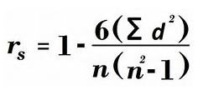
Spearman’s Rank correlation Coefficient
It uses the formula
Where ‘d’ is the ‘difference in rank between data pairs’
And ‘n’ is the total number of data pairs

Slide 12
Spearman’s Rank correlation Coefficient
The null hypothesis states that there is no correlation either negative or positive between the two variables.
Use your data to rank the two variables you are investigating.
Eg
Number of pesticide applications | Index of diversity
0 | 4.89
1 | 4.19
2 | 3.80
3 | 3.12
4 | 3.26
5 | 2.36
6 | 1.92

Slide 13
Then work out the difference in rank between the two variables.
Number of pesticide applications | Rank | Index of diversity | Rank
0 | 7 | 4.89 | 1
1 | 6 | 4.19 | 2
2 | 5 | 3.80 | 3
3 | 4 | 3.12 | 5
4 | 3 | 3.26 | 4
5 | 2 | 2.36 | 6
6 | 1 | 1.92 | 7
Number of pesticide applications | Rank | Index of diversity | Rank | Difference between ranks (d) | d²
0 | 7 | 4.89 | 1 | 6 | 36
1 | 6 | 4.19 | 2 | 4 | 16
2 | 5 | 3.80 | 3 | 2 | 4
3 | 4 | 3.12 | 5 | 1 | 1
4 | 3 | 3.26 | 4 | 1 | 1
5 | 2 | 2.36 | 6 | 4 | 16
6 | 1 | 1.92 | 7 | 6 | 36

Slide 14
Now put this into the formula
r_{s} = -0.964
As this is a negative value this suggests a negative correlation. Now use the critical value table to assess if this is statistically significant

Slide 15
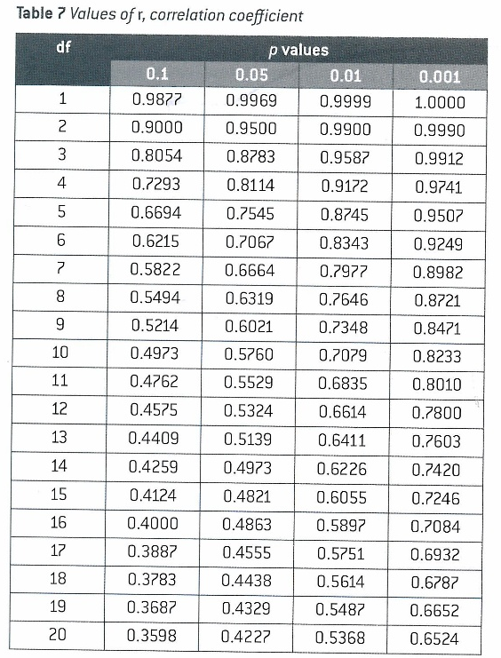
Critical values
Need to look at a table with critical values to accept of reject your null hypothesis.

Slide 16
Statistical Analysis of the light and grass investigation
Calculate your critical value using the spearman rank correlation
Reject or accept your null hypothesis and analyse your results
Remember when you describe your results;
If the calculated value of Spearman’s rank correlation coefficient, r_{s} is larger than the critical value .
Then there is less than 5% probability that the correlation between the 2 factors/variables investigated is due to chance.
You reject our null hypothesis.

