Slide 1
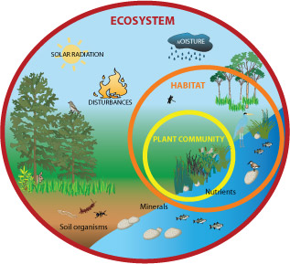
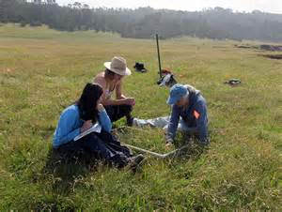
Investigating Populations
Objectives:
To describe the techniques of random sampling using quadrats and systemic sampling using transects and explain when are the appropriate use of these techniques
To describe measures of abundance and explain how to ensure that estimates are reliable
To explain how random sampling avoids bias

Slide 2
Data from investigations
When designing an investigation, data collected must be relied upon to be able to draw valid conclusions.
The table on the next slide outlines the various qualities that a good investigation must have taken into account.
Most environmental investigations will need to measure both biotic and abiotic factors.
All investigations must have an appropriate risk management.

Slide 3
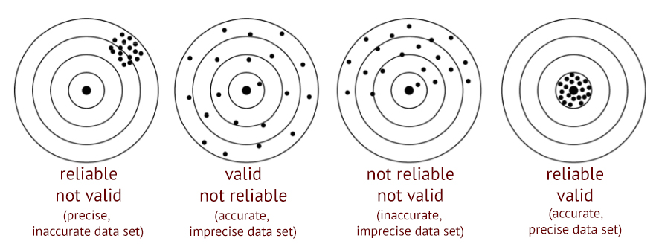
Quality | Explanation
Accuracy | A measure of how close to the true/real value the recorded data is
Bias | Deviation from results either due to systematic errors or flaws in study design leading to flawed data or data collection
Precision | Intervals between possible recorded results. E.g. measuring in milligrams rather than grams
Representative data | Data that accurately reflects the complete data set
Reliable data | Provides consistent results that are repeatable. Reliability can be achieved with repeat measurements
Anomalous results | A result that differs from other results in a data set. Repetition of the study will identify anomalous results
Validity | If accurate, precise and reliable data is collected then it is valid and conclusions can be based on results.
Dart board analogy to explain reliable, precise, accurate and valid results

Slide 4
Investigating populations – why?
WHY?
Ecologists need to know population sizes (i.e. counting numbers of individuals from samples) to:
Study the dynamics of a population
Look at the distribution of the members of a population to see if they are influenced by a biotic or an abiotic factors
Compare differences between communities and species
Impact assessments (measuring effects of disturbance from changes in ecosystems)
Restoration ecology (restoring ecological systems that have been damaged)
Set harvest limits on commercial and game species (e.g. fish, deer, etc.)
Controlling pest populations
DIFFICULTIES
It can be difficult or simply not possible to count all of the individuals in the target area.
SOLUTIONS
Need to estimate population size using some form of sampling technique.
There are numerous types of sampling techniques. Some are designed for specific types of organisms (e.g. non-mobile vs. mobile animals).
Quadrats – used for non-mobile/sessile organisms (plants and inverterbates)
Mark-release-recapture – used for motile animals (covered in another lesson)

Slide 5
Sampling
The object is to collect as many randomly selected samples as possible (so as to increase the proportion of the total population sampled).
The accuracy of an estimate increases with the number of samples taken. This is because the number of individuals found in any given sample will vary from the number found in other samples. By collecting numerous samples, the effect of these variations can be averaged out.
The purpose for collecting the samples randomly is to avoid biasing the data. Data can become biased when individuals of some species are sampled more frequently, or less frequently, than expected at random. Such biases can cause the population size to be either over estimated or under estimated, and can lead to erroneous estimates of population size.

Slide 6
What you need to know
Sampling techniques - random vs systematic
Quadrats - frame vs point
Measuring abundance – frequency vs percentage cover

Slide 7
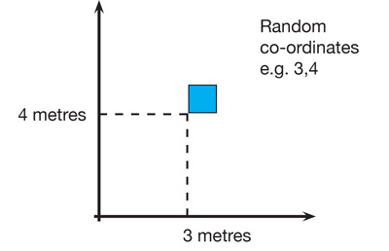
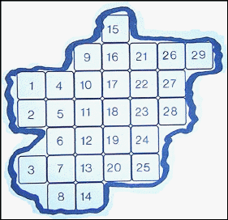
Random Sampling
The principal assumptions of this technique are that samples taken are representative of the population as a whole.
Method
Lay out 2 long tapes at right angles in the study area
Obtain a series of coordinates by using randomly generated numbers taken from a table or computer
Place a quadrat at the intersection of each pair of coordinates and the number of individuals of the target species is then counted in each of the chosen quadrats.
Different ‘axes’ made with tapes may be done in different areas to collect more samples
If the sample area is an irregular shape then numbers can be allocated and then chosen at random with a random number generator
Random sampling with a frame quadrat video
http://www.bing.com/videos/search?q=using+quadrats&&view=detail&mid=45D8E03FDC5EF69EC1E545D8E03FDC5EF69EC1E5&FORM=VRDGAR

Slide 8
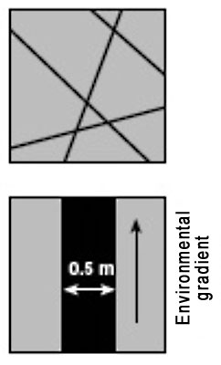
Systematic sampling
To investigate changes in habitats (where there is an environmental gradient) or along lines of succession (sand dunes, rocky shores) systemic sampling is more appropriate.
Transects are used:
Line transect - records all of the species which actually touch the rope or tape stretched across the habitat. A lot of organisms could be missed out = less representative.
Belt transect – a frame quadrat is laid down along a straight line and species recorded in the transect
Interrupted belt transect - records all those species present in a number of quadrats places at fixed points along a line stretched across the habitat.
Line Transects
Belt Transects
Line transect video
http://www.bing.com/videos/search?q=using+quadrats&&view=detail&mid=48C6E5A75A89FB9823BB48C6E5A75A89FB9823BB&FORM=VRDGAR

Slide 9
Using quadrats
The quadrat method is used primarily in studies of plant populations, or where animals are immobile.
Size of quadrat – depends on size of plants/animals and their distribution.
Larger species = larger quadrats
Species not evenly distributed = larger number of smaller quadrats
Number of sample quadrats taken
More sample quadrat = more reliable results
Greater number of species present = more quadrats samples needed
Position of quadrat
To produce statistically significant data random sampling used

Slide 10
Quadrats
Standardising
Use quadrats of the same size (depending on what you are sampling)
Typical sizes include:
Lichens: 10cm x 10cm
Ground flora: 0.5m x 0.5m
Trees in a woodland: 100m x 100m
Bird survey: 10km x 10km
Limitations
Often subjective judgement when estimating percentage cover
Quadrat frames may flatten or move plants

Slide 11
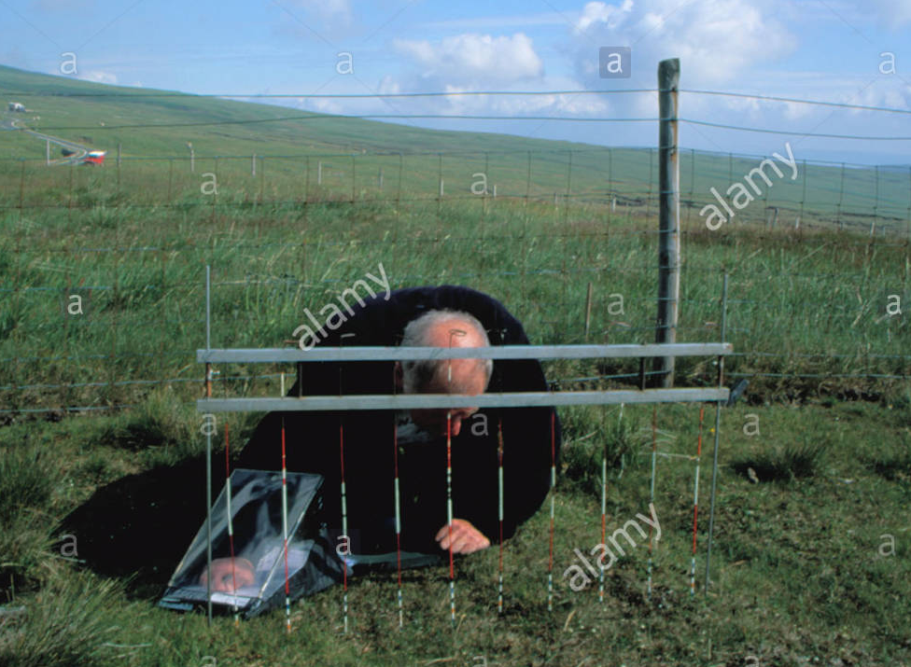
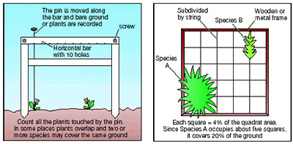
Point Quadrats
This quadrat is made of a horizontal bar with 10 holes that a long pin can be dropped through.
Each species the pin touches is recorded (hit).
Useful when plants are living in a mixed community and it is hard to identify distinct individuals.
Used to estimate percentage cover where there is short vegetation (becomes difficult with long vegetation).
It is less subjective than using frame quadrat so gives more reliable results but you may miss rare or small plants as you are sampling a very small proportion of the population.
To calculate percentage cover = number of hits x 100
total number of pins

Slide 12
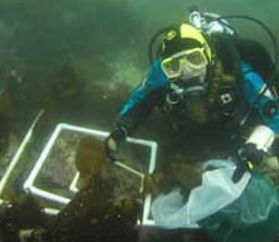
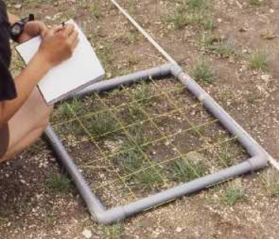
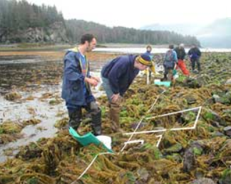
Frame Quadrats
Square of different sizes used to look at plant communities and small slow moving invertebrates.
Can be used to look at abundance of species or simply species diversity
It is assumed that the contents of a quadrat is representative of the whole sampling area
Placed in different locations and abundance of each species recorded.
Random sampling with a frame quadrat video
http://www.bing.com/videos/search?q=using+quadrats&&view=detail&mid=45D8E03FDC5EF69EC1E545D8E03FDC5EF69EC1E5&FORM=VRDGAR

Slide 13
Measuring Abundance
Abundance = the number of individuals of a species in a given area.
Using quadrats for sessile organisms, abundance can be measured in different ways.
Density*
Frequency
Percentage cover
Biomass*
*Your specification does not state the need for knowing density or biomass but it is useful to know these as they come up in other parts of the environment topic

Slide 14
Density
Density = the mean number of individual per unit area.
Achieved by counting numbers of organisms within a quadrat
Advantage: objective measure
Disadvantage: time consuming if the size or number of sampling units is large

Slide 15
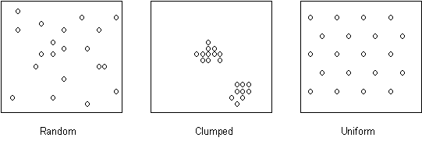
Frequency
Frequency = likelihood of a particular species occurring in a quadrat.
If a species is present in 15 out of 30 quadrats then the frequency of its occurrence is 50%.
Advantage: good method to use for species are hard to count e.g grass
quick assessment of general distribution
Disadvantage: no information about density and detail distribution of a species
no measure of actual numbers of species
This diagram shows how species may be distributed in different ways

Slide 16
Percentage Cover
Percentage cover = estimate of the area within a quadrat that a particular species covers
Advantages: avoid needing to count individuals so is faster
useful for identifying species where its hard to see individuals e.g. mosses, lichens and sponges
Disadvantages: it can be difficult to do with overlapping organisms (plants)

Slide 17
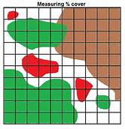
Calculating Percentage Cover Using a Frame Quadrat
To record percentage cover of species in a quadrat, look down on the quadrat from above and estimate the percentage cover occupied by each species (e.g. species A - D left).
Species often overlap and there may be several different vertical layers. Percentage cover may therefore add up to well over 100% for an individual quadrat.
The estimation can be improved by dividing the quadrat into a grid of 100 squares each representing 1% cover. If the plant takes up a more than half od a square that will represent 1% cover.
This is only practical if the vegetation in the area to be sampled is very short, otherwise the string/wire will impede the laying down of the quadrat over the vegetation.

Slide 18
Biomass
Biomass = measure of the dry weight of plants and animals in a certain area
Advantage: Biomass can reflect the amount of energy stored in the vegetation, which can indicate the potential productivity at the site.
Disadvantage: Need to harvest organisms which is disruptive
Time consuming

