Slide 1
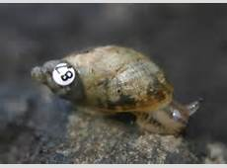
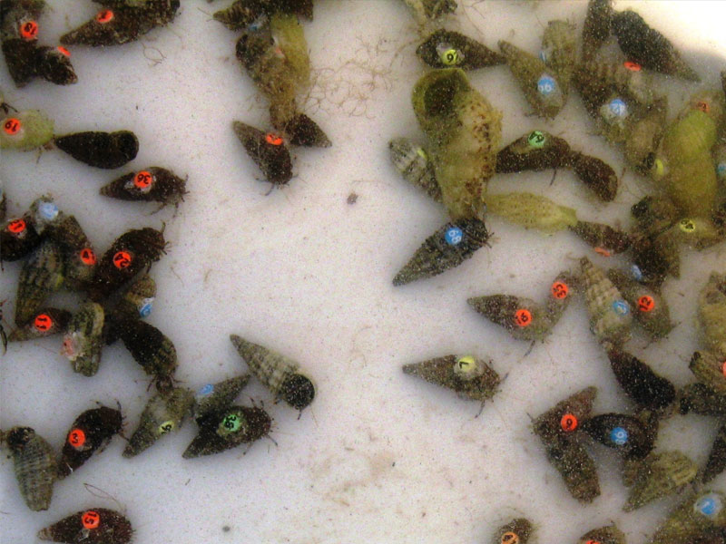
Mark-release-recapture and Lincoln Index
Objectives:
To understand when and how to use the mark-release-recapture method to measure abundance of a species and the limitation of this method
To calculate population sizes using the Lincoln index and explain the assumptions that are made when using this index
To explain when a student t-test would be used for statistical analysis.

Slide 2
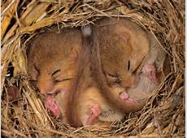
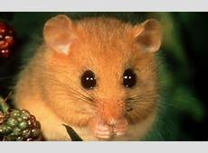
How would we find the population size of dormice?

Slide 3
Estimating Trout Population Size
Work through the Lincoln index sheet

Slide 4
Mark-release-recapture
The problem with counting animals is getting a good estimate of the total number in the area; they move quickly, they cover larger area and they try to remain hidden. So the capture, release, recapture method is used
Capture a sample of animals (the sampling method will depend on the animal). The larger the sample the better the estimate works.
Count all the animals in this sample (S1) and mark (using one of methods below) then so that they can be recognised later. Release all the animals where they were caught and give them time to mix with the rest of the population (typically one day).
Capture a second sample of animals using the same trapping technique.
Count the total animals in the second sample (S2), and the number of marked (i.e. recaptured) animals in the second sample (R).
Calculate the population estimate using the Lincoln Index

Slide 5

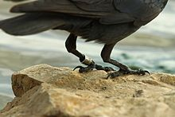

Marking techniques
Invertebrates - a spot of paint
Birds - leg-rings
Mammals - a shaved patch of hair
Fish - small metal disks.
Larger animals - collecting a small blood sample and making a DNA fingerprint.
Marking should:
not be harmful to animals
prevents reintegration to the population
will not wash off
will not makes animals more susceptible to predators.

Slide 6

Lincoln Index
N = population
n₁ = total number first caught and marked
n₂= total number caught in second sample
m = number of marked individuals in second sample
Assumptions
Proportion of marked to unmarked individuals in the second sample is the same as the proportion in the population as a whole
Marked individuals released from the first sample distribute themselves evenly amongst the remainder of the population (and have time to do this)
The population has a definite boundary – no immigration/emigration
Few deaths and births
Method of marking is non-toxic and does not make individuals more conspicuous and susceptible to predation
The mark id not lost/rubbed off during the investigation

Slide 7
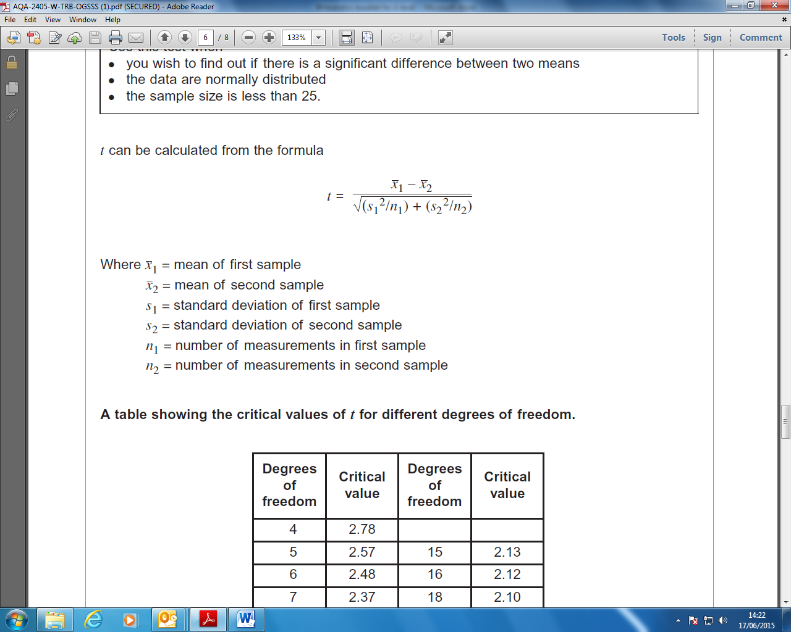
Student t-test
Use this test when you are looking for the difference between two means, and you want to know if the difference is ‘significant’ or not.
Null hypothesis
“there is no significant difference between the two different means”

Slide 8
Worked example

Slide 9

t = $\frac{487.5 – 257.5}{√(189.6 +122.9)}$
t = $\frac{230}{√312.5}$
t = $\frac{230}{√17.7}$
t = 12.99

Slide 10
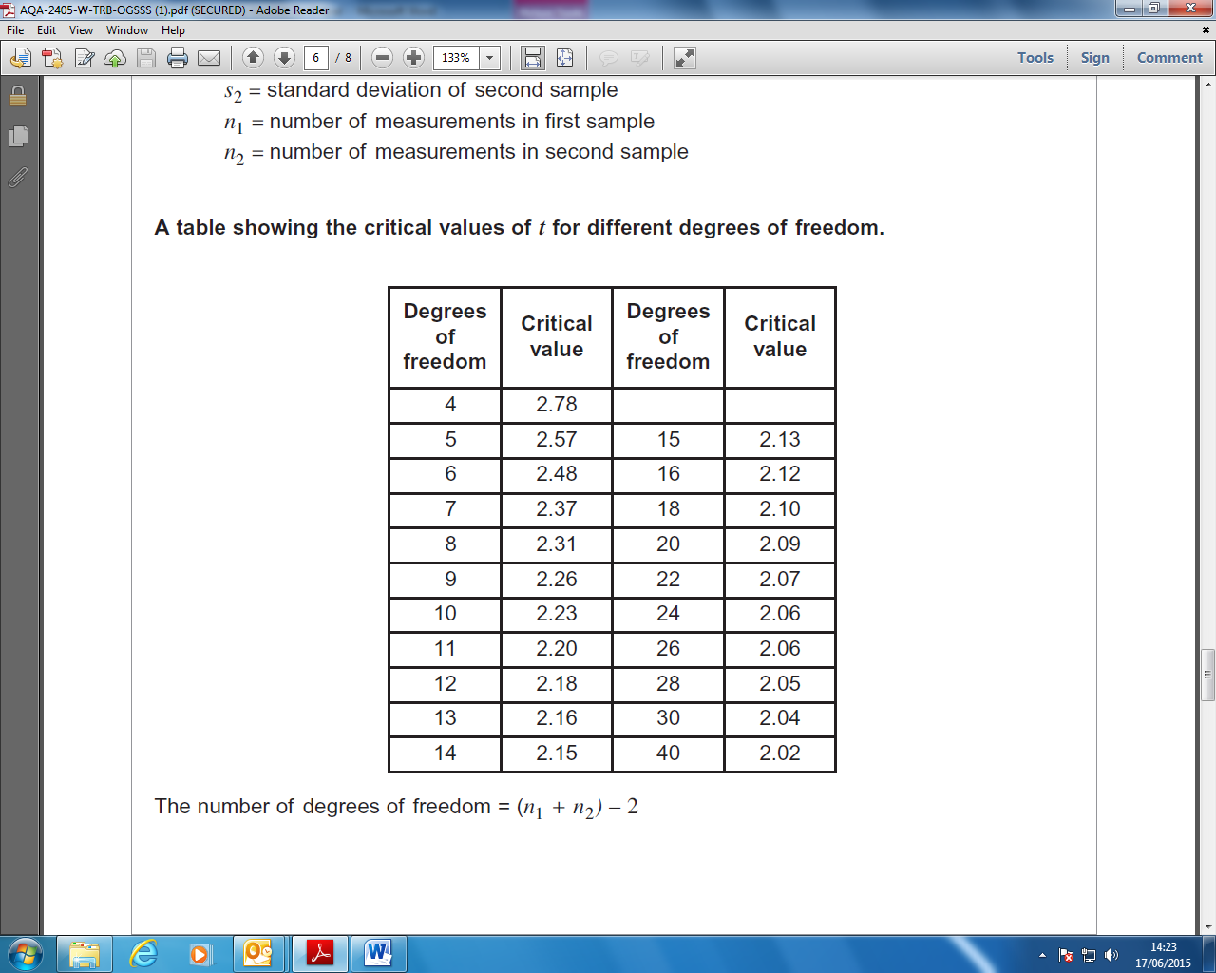
The ‘critical value’ & the ‘degrees of freedom’
Before we can interpret our results we need to work out the ‘critical value’. You will remember from Chi-squared that this represents the borderline between accepting or rejecting our null hypothesis. We get the critical value from the data sheet, but this depends on the number of ‘degrees of freedom’. Hopefully you will remember all about 'degrees of freedom' from Chi-squared. The calculation is slightly different simply because it allows for two sets of data.
There were 4 flasks for each of the bacteria (n=4 for both bacteria)
Hence:
The number of degrees of freedom = (4 + 4) – 2
The number of degrees of freedom = 6
So we can see from the table of critical values of t, that 6 degrees of freedom = 2.48
Our value of t = 12.99 This is much higher than the critical value.

Slide 12
Using the t-test for trout populations
Interpreting results
If the calculated value of t is greater than the critical value for t, there is more than a 5% probability that the differences in mean between the 2 lakes are not due to chance.
Therefore the null hypothesis can be rejected

