Slide 1
Interactionism and labelling theory
Paper 3 – Crime and Deviance

Slide 2
Revision
What can you remember about interactionism?

Slide 3
The Problems of Postivism
Interactionist theories of crime and deviance are fundamentally critical of positivistic theories [e.g., Structural Functionalism] for the following reasons:

Slide 4
Positivists seem to rely on common-sense definitions of deviance – for interactionists deviance is “subjectively problematic”
Positivist research is usually based on flawed data (official crime statistics)
Positivists adopt “a view from above” – interactionist sociologists tend to stick up for the underdog e.g. inappropriately labelled working class youths
Positivistic approaches focus on the causes of deviance e.g. anomie / social deprivation, rather than the social reactions to rule breaking e.g. labelling, self fulfilling prophecies

Slide 5
In general:
Interactionist perspectives tend to concentrate on relatively small-scale levels of social interaction (between individuals, small social groups)
They are interested in how crime is social constructed.
For this reason, they are sometimes referred-to as a "micro level of sociological analysis".

Slide 6
Basic ideas- recap:
They focus on the way in which individuals ("social actors") act (How they make conscious choices about their behaviour based upon the way they interpret situations) - rather than simply react to social stimulation.
The way in which different social actors interpret the behaviour of others is significant as a means of understanding the way in which the world is socially constructed.
The social context within which people interact is significant for both their interpretation of the behaviour of others and the way they themselves choose to behave at any given time.

Slide 7
How do Interactionist sociologists study deviance?
Critical of positivistic methodology.
Aims to identify and interpret the social context of people's behaviour = Labelling theory.
Bilton - "We need to ask why is it that behaviour in some contexts and engaged in by some people comes to be defined and processed as "criminal", while other behaviour and actors experienced no such labelling?".

Slide 8
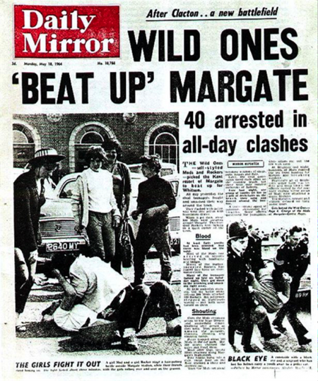
Example of research you already know
Stan Cohen, ‘Folk Devils and Moral Panics’
Cohen explored the effects of labelling, leading to deviancy amplification.
Explored how exaggeration led to deviancy amplification and a self-fulfilling prophecy

Slide 9
What problems can you already identify with labelling theory
Taking into account the approach interactionist and labelling theorists take to understanding crime and deviance, what issues can you see with their approach?

Slide 10
How do Interactionist sociologists study deviance?
Go online.
Find the most up to date crime statistics for the UK you can.
Consider what detail these statistics give you.
Do you think interactionists would consider these statistics valuable for researching Crime & Deviance?

Slide 11
Social construction of crime statistics
Interactionists see crime statistics as socially constructed.
At each stage of the criminal justice system, agents of social control make decisions about whether to proceed to the next stage. The outcome depends on the label they attach to the individual.
Statistics only tell us about the activities of police and prosecutors, rather than the amount of crime and who commits it.
This leads to the ‘dark figure’ of crime

Slide 12
Labelling theory:
The main basis of labelling theories of crime and deviance is the idea that, in order to understand these social phenomena, we have, as sociologists, to take account not simply of what people do or do not do (behaviour) but also, more importantly, the social context of that behaviour.
In this respect, we are dealing with such questions as:
  How behaviour is interpreted (and by whom)
  Why it is interpreted in particular ways at different times.

Slide 13

Howard Becker: labelling

Slide 14
Labelling theory- Becker
Moral crusade
Response
Result
Moral entrepreneurs seek to outlaw certain behaviour
Public response can be to accept or reject the ‘crusade’
Labelled group can respond in a number of ways. They can reject or accept the label (self fulfilling prophecy)
If the group is successfully labelled, then their behaviour and sense of identity changes
Moral crusade
+
Moral panic
Sensitization
Are the public already concerned?
Labelled group
Sense of stigmatization. Change behaviour to avert punishment/stigma. Possible amplification of deviance
Power
Has the labelled group enough power to reject deviant label?
Power
Have the crusaders access to power?
Taken from Moore et al, Sociology for A2 OCR, (2010) Harper Collins
Wider society
Apply the label as ‘master status’
Cultural values
Does the ‘crusade’ fit with existing beliefs?

Slide 15

Becker’s Theory in 4 steps:
STEP 1: SOCIAL REACTION
Deviance is measured by the SOCIAL REACTION to the act of deviance committed. The behaviour and act of the criminal is constant, but the reaction – and the sanction/reward given – is always dependent on the people in a position of power who ‘set the line’ for deviance.

Slide 16
STEP 2: THE OUTSIDER (How to embark upon your criminal career)
Becker believed that everyone thought or fantasised in a deviant way and this might lead to PRIMARY DEVIANCE.
What was important, however, was that someone in a position of authority caught the deviant and LABELLED them as such.

Slide 17
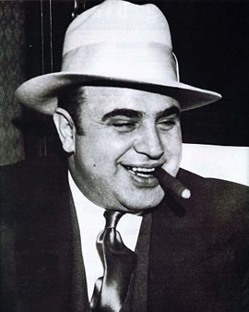
STEP 3: SECONDARY DEVIANCE (learning to embrace your inner deviant)
Once the deviant accepts their label as ‘deviant’ and conforms (which sometimes becomes their MASTER STATUS ) they become what Becker terms an OUTSIDER.
SECONDARY DEVIANCE is the key step taken on a career of crime and it marks the deviant out from mainstream society.
From this point, they are denied a ‘normal life’ and resort to illegal means to make a living.

Slide 18
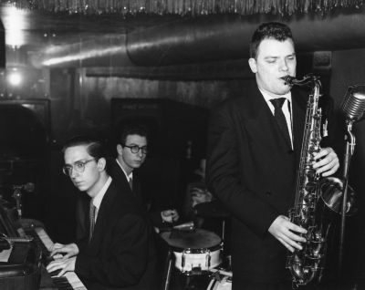
STEP 4: A DEVIANT SUBCULTURE (sharing is caring)
The final step of an accomplished criminal career is the movement of a deviant into a deviant subculture. The organisation can provide moral support and justification to their deviant behaviour. Becker used participant observation on dance musicians in Chicago to prove this point – the subculture led to a change in attitudes and behaviour in order to conform.

Slide 19
Lemert
Effects of Labelling: Primary and Secondary Deviance

Slide 20
Primary Deviation
This consists of deviant acts “in the raw” - before they are so labelled.
This is simply “norm-violating behaviour”.
There may be any number of causes of primary deviation and it is a fruitless exercise to inquire into them.

Slide 21
Secondary Deviation
This is deviance recognised and labelled by others.
Lemert believed secondary deviance occurred when people used deviant behaviour and deviant roles as a defence mechanism

Slide 22
Jock young

Slide 23
Young – Secondary Deviance: Example drug taking
Studied hippy marijuana users in Notting Hill in the 1970s. Initially drugs were peripheral to the hippie’s lifestyle.
Labelled by the police led to the hippies seeing themselves as outsiders. Took on a master status. Retreated into closed groups.
This encouraged further deviance. Wearing longer hair and more ’way out’ clothing. Drug use became a central activity, attracting further attention from the police.

Slide 24
Young
The deviant career is completed when individuals join an organised deviant group. In doing so, they confirm and accept their deviant identity. They are surrounded by others in a similar situation who provide them with support and understanding. Leads to a self fulfilling prophecy
Labelling approaches have a close relationship with the work of Stan Cohen’s ‘folk devils and moral panics’, whereby the involvement of the media and police can lead to deviancy amplification and the spiral of this into further deviance.
This work illustrates the idea that it is not the act itself, but the hostile reaction to it, that creates serious deviance. Social control processes that are supposed to produce law-abiding behaviour might do the opposite.

Slide 25
Exam practice
Outline two ways in which crime and deviance are socially constructed [4 marks]
Outline three consequences of labelling [6 marks]
Outline and explain two criticisms of labelling theory [10 marks]

Slide 26
Aaron Circourel
Negotiation of justice
Phenomenological approach

Slide 27
Cicourel: negotiation of justice
Police officers’ decisions to arrest are influenced by their stereotypes about offenders.
Officers’ typifications led them to concentrate on certain ‘types’.
This resulted in law enforcement that showed class bias- working class people most closely fit the typificiations.
This led to more focus on policing these areas, which in turn to more arrests confirming the stereotype.

Slide 28
Cicourel
In his view justice is not fixed but negotiable, for example if a middle class youth was arrested they would be less likely to be charged.
Can you think of any recent examples in the media that would help support this argument?
Notes:
e.g. Brock Turner 6month sentence for sexual assault https://www.independent.co.uk/news/world/americas/brock-turner-swimmer-olympic-hopeful-sexual-assault-stanford-university-woman-unconscious-a8090006.html

Slide 29
Cooley
The Looking-Glass Self

Slide 30

The Importance of Self Concept
Cooley describes how our self-concept is a REFLECTION of others’ reactions and assumptions
How we see ourselves is at least partly constructed by others

Slide 31
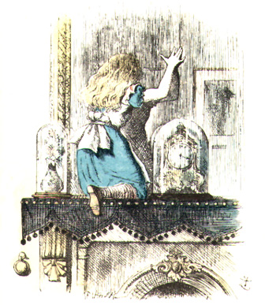
Through the Looking Glass
Consider how others may have changed your opinion of yourself by reference to your appearance, e.g., “You don’t look well” when you were feeling OK, or “I like what you’ve done with your hair” when you’ve done nothing to it!
We are often at the mercy of others’ opinions.

Slide 32
Goffman
Interactionism in Practice

Slide 33
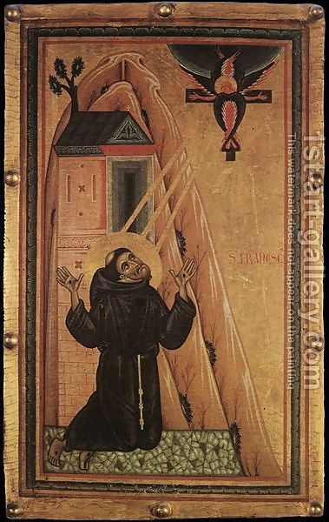
Stigma
Goffmann was concerned with the importance of interpersonal relationships at the micro level in Sociology
One key concept of Goffmann’s was that of stigma – as he referred to it the problem of “the management of spoiled identity”
Individuals may have to live with social disapproval – this links to Becker’s concept of Master Status, and has been taken up by Stan Cohen and others applied to whole groups in society.

Slide 34
The Total Institution
In his work on asylums Goffmann showed how everyday practices would reinforce negative labels rather than cure patients.
Mortification – would make patients adopt negative self-concepts
Institutionalisation would arise from the disculturation experienced as people lose touch with the outside world.

Slide 35
evaluation

Slide 36
What problems are there with the interactionist view of deviance?
Generally? Use p.461 of Browne
From a functionalist view?
From a strain theory view?
From a marxist view?
What is good about these approaches?

Slide 37
30 mark exam question
Item: Rather than look for the initial cause of the deviant act, as functionalists do, labelling theorists ask how any why some groups and acts come to be labelled as criminal or deviant while others do not. Coming from an interactionist perspective, they argue that what we mean by crime or deviance is the outcome of the same processes of social interaction- between police officer and suspect, for example- as any other social behaviour. Therefore to understand crime and deviance, we must grasp the meanings involved in the interaction.
Applying material from the item and your knowledge, evaluate the contribution of labelling theory to our understanding of crime and deviance [30 marks]

