Slide 1


Unit 2 Composition
The NEW AS/A Level
2016-17

Slide 2
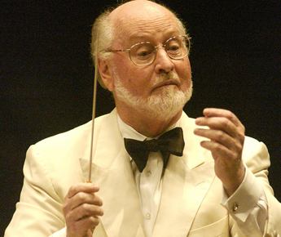

MY EXPECTATIONS
All work is completed on time meeting deadlines set.
Work is of high quality demonstrating mastery of skills and pride in the product – Composition is tough and for many of you is a NEW skill
Students have an open mind to all music, styles, artists and genres.
Students support and respect each other.
Attend every class – don’t flake out.
No phones – no one out there is more important than 100% focus on me (during lesson time) and the course.
No time wasting – that includes wasting my time!
Bring a Pen and Don’t be late to every class! That drives me crazy!
Do all this and you will be a Star.
John Williams would never forget a pen or be ill.
YOU could be this star!

Slide 3
Aims
During today’s lesson I will be introduced to composition. I will go on to study building Cadences, looking at typical harmony and voicings and using Sibelius.
I will be able to:
Understand the demands of the compositions brief.
Identify aurally and visually different Plagal and Perfect cadences
Set up a Sibelius project and Compose my own Cadence using ‘Pirate’ instruments
Extra Challenge: to prepare extended cadences
Literacy Aim: to be able confidently articulate aurally the design of Plagal and Perfect cadences
Keywords: Plagal, Perfect, Interrupted, Imperfect, Cadence, Extended, Harmony

Slide 4

Introduction to the Course
Unit 2 is all about Composition - You will be composing two pieces of music to reflect the following briefs:
Composition 1 - Brief 3 – Music For Film
Compose music for a trailer promoting a PG-rated film about pirates.
The music must depict at least three contrasted scenes and/or action sequences.
It must be minimum 2.5 minutes long.
Composition 2 - Free Composition
Exploiting Your Instrument
Compose a piece for your own instrument with accompaniment.
It must exploit the technical and musical idiomatic features of your instrument.
Your piece must have at least one Cantabile Section.
It must be minimum 2 minutes long.

Slide 5
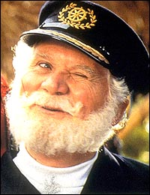
Course Overview
Autumn 1 – Compositional Techniques/Start Pirate Composition
Autumn 2 – Complete Pirate Composition
Spring 1 – Start Instrument Composition
Spring 2 – Complete both Compositions
By Easter BOTH compositions are fully completed, printed and in some cases recorded!
Pro active high achieving students would consider getting started on their 2nd composition earlier rather than later….

Slide 6

Banned Phrases
The following phrases are banned:
Sibelius hates me
Composition is so difficult
It sounds bad
Everyone else’s sounds so much better than me
I hate computers
There is a fine to be imposed immediately for anyone who breaks this rule!

Slide 7
Relative Listening List ‘Pirates’ – Homework 1
Opposite is a full list of relative listening tunes that I have compiled.
Make a playlist of these tunes and listen like crazy!
Either using 3 of these or some of your own suggestions you are to complete a written musical analysis of the pieces.
Include: instrumentation, tonality, harmony – including specific progressions, notate the lead melody, structure, rhythm and metre
Include any additional information you feel is relevant. Work can be set out as paragraphs or in a table or mind map.
MUST BE THOROUGH – Substandard work is NEVER tolerated.
‘Drink Me Up Hearties’ – Hans Zimmer
‘The Secret of Monkey Island – Introduction/Main Theme’ – Michael Land
‘Hook – Flight to Neverland’ – John Williams
‘Master and Commander – The Far Side of the World’ – Iva Davies
‘La Musica Notturna Delle Strade Di Madrid’ No.6, Op. 30’ - Luigi Boccherini
‘Barrett’s Privateers’ – Stan Rogers
‘The Mariner’s Revenge’ – The Decemberists
‘Shiver My Timbers – The Muppets Treasure Island’ – Hans Zimmer
‘Yo Ho A Pirate’s Life for Me’ – George Bruns
‘The Sailor’s Hornpipe’ – Traditional
‘Over the Hills and Far Away’ - Thomas D'Urfey
‘I am a pirate king – Pirates of Penzance’ – Gilbert and Sullivan
‘Weird Beard’ – The Mad Caddies

Slide 8
Harmony Writing
Mark Scheme
Level 1 | Limited control of harmony detrimental to the music
Level 2 | Harmony is functional but uninteresting
Level 3 | Harmony is functional but uninteresting. The same chord set is used throughout.
Level 4 | Appropriately chosen harmonies with some variety of chord sets.
Level 5 | Imaginative harmony appropriate to the style.

Slide 9
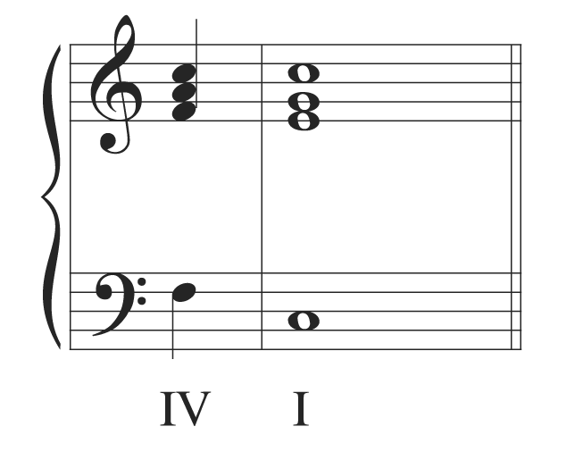
What Cadence is this?

Slide 10
PLAGAL

Slide 11
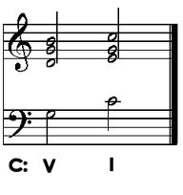
What Cadence is this?

Slide 12
PERFECT

Slide 13
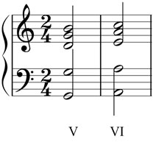
What Cadence is this?

Slide 14
INTERRUPTED

Slide 15
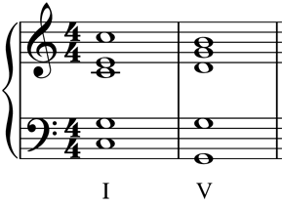
What Cadence is this?

Slide 16
IMPERFECT

Slide 17
What do we mean by Cadence?
Plagal Cadence: IV > I
In this case going F > C
Perfect Cadence: V > I
In this case going G > C
Can you hear the difference?

Slide 18
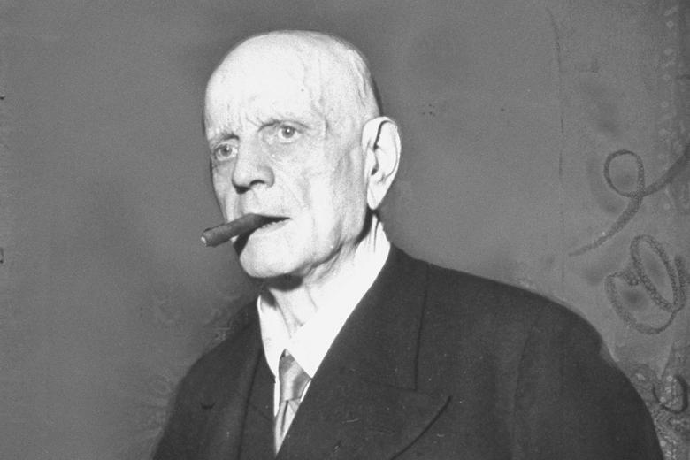
Introduction to Sibelius
You must:
Set up a new project with title (Unit 2 Composition) and composer name (James Ingham)
Set up a new project
Add instruments for a Pirate jig……
Pick your tonal centre/key signature (I’d suggest C, D, F or G)
Map out 8 Bars
Draw in your chord I in the final bar
Prepare your final chord with either a Plagal or Perfect cadence
Save your work as “Unit 2 – Pirate Composition”
Extra Challenge: try using inverted chords!

Slide 19
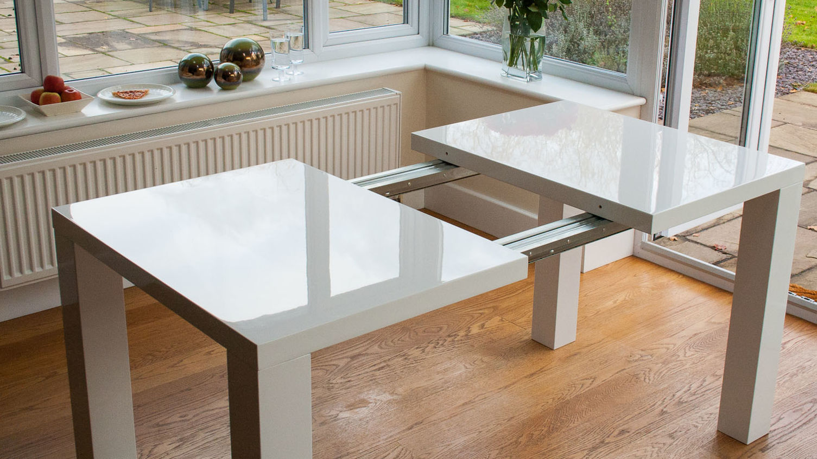
Extra Challenge: Extended Cadence
An extended cadence is where you prepare your penultimate chord with another chord.
Experiment with:
ii > V > I
IV > V > I
bVII > IV > I
iidim7 > V7 > im7

Slide 20
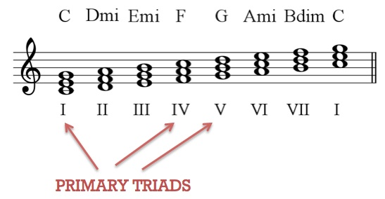
Sibelius Task 2 – Build a Chord Progression
You must develop your Sibelius Chart with the following:
Chord Progression for your Verse and/or Chorus
It must start from your Root Chord
Start by using Primary Chords
Enhance with Secondary Chords
Extra Challenge – add the following:
7th Chords
Different Chords in the 1st/2nd time bars

Slide 21

Plenary – Cadences
What chords make up:
Plagal Cadences in D, F and G
For example in C: F > C
Perfect Cadences in D, F and G
For example in C: G > C

Slide 22
Relative Listening List ‘Pirates’ – Homework 1
Opposite is a full list of relative listening tunes that I have compiled.
Make a playlist of these tunes and listen like crazy!
Either using 3 of these or some of your own suggestions you are to complete a written musical analysis of the pieces.
Include: instrumentation, tonality, harmony – including specific progressions, notate the lead melody, structure, rhythm and metre
Include any additional information you feel is relevant. Work can be set out as paragraphs or in a table or mind map.
MUST BE THOROUGH – Substandard work is NEVER tolerated.
‘Drink Me Up Hearties’ – Hans Zimmer
‘The Secret of Monkey Island – Introduction/Main Theme’ – Michael Land
‘Hook – Flight to Neverland’ – John Williams
‘Master and Commander – The Far Side of the World’ – Iva Davies
‘La Musica Notturna Delle Strade Di Madrid’ No.6, Op. 30’ - Luigi Boccherini
‘Barrett’s Privateers’ – Stan Rogers
‘The Mariner’s Revenge’ – The Decemberists
‘Shiver My Timbers – The Muppets Treasure Island’ – Hans Zimmer
‘Yo Ho A Pirate’s Life for Me’ – George Bruns
‘The Sailor’s Hornpipe’ – Traditional
‘Over the Hills and Far Away’ - Thomas D'Urfey
‘I am a pirate king – Pirates of Penzance’ – Gilbert and Sullivan
‘Weird Beard’ – The Mad Caddies

Slide 23

Don’t forget….
Tea Party tomorrow
In 818
1-2
There will be some food but not enough to qualify as a full lunch.

Slide 24
Unit 2 Composition
The NEW AS/A Level
2016-17

Slide 25
Starter – Think Pair Share Square
What did you listen to and how could this help inspire your compositions? Share with your partner first then share with the group.
Identify:
Composer, title and date composed
Key instrumentation and ensembles
Tonality
Textures
Harmonic Features
Melodic Features
Rhythmic Features

Slide 26
Objectives
In today’s lesson we will develop our lead melody and Noah’s Main Theme
We will:
Analyse the harmony of the Back to the Future theme lead melody and accompanying chords
To develop a lead melodic theme that includes the use of primary and secondary chords as well as either lead brass instrumentation or Unison Strings.
To build a developing progression to create sense of excitement in music
Extra Challenge: to identify and explain melodic and harmonic features in the Back to the Future Main Theme by Alan Silvestri
Literacy Aim: to articulate aurally and through written work, key musical terminology when appraising ‘Back to the Future Main Theme’.

Slide 27
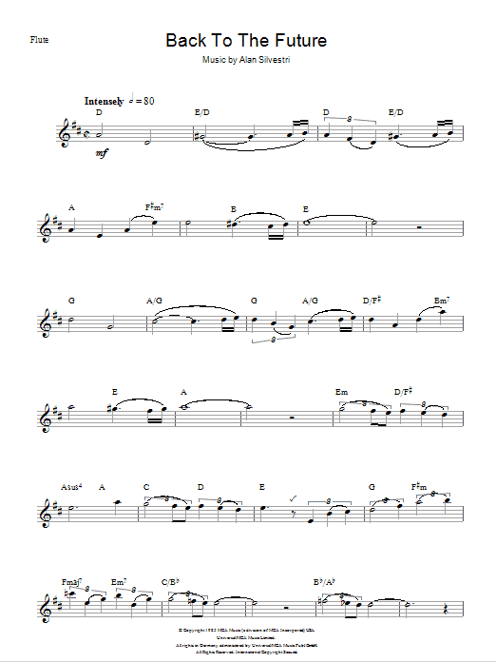
Task 1:
Back to the Future by Alan Silvestri
Steps (in pairs or solo):
Analyse the chord progression – roman numerals
Analyse the notes of melody in relation to the chord
How long are phrases and how are they structured?
Extra Challenge – how has modulation been used to develop a sense of excitement?

Slide 28
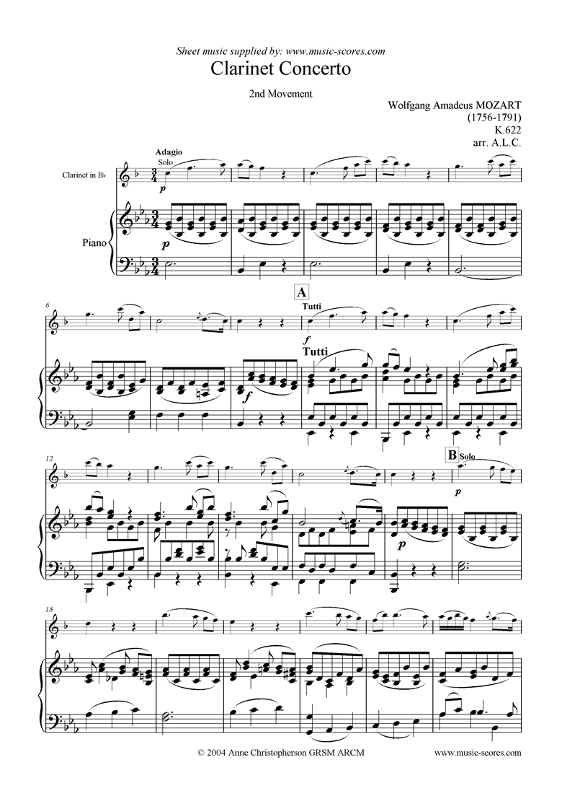
Phrasing – 2 bar, 2 bar, 4 bar
Mozart’s Adagio from the Clarinet Concerto

Slide 29
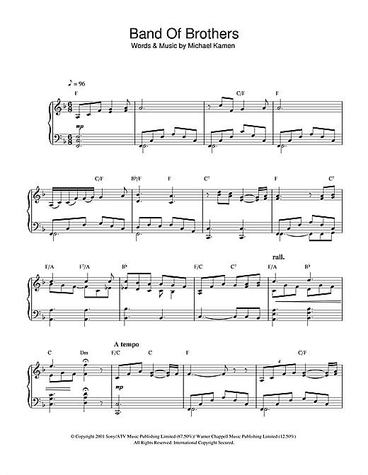
Phrasing – 2 bar, 2 bar, 4 bar
Michael Kaman’s Opening Title Seuqence from ‘Band of Brothers’

Slide 30
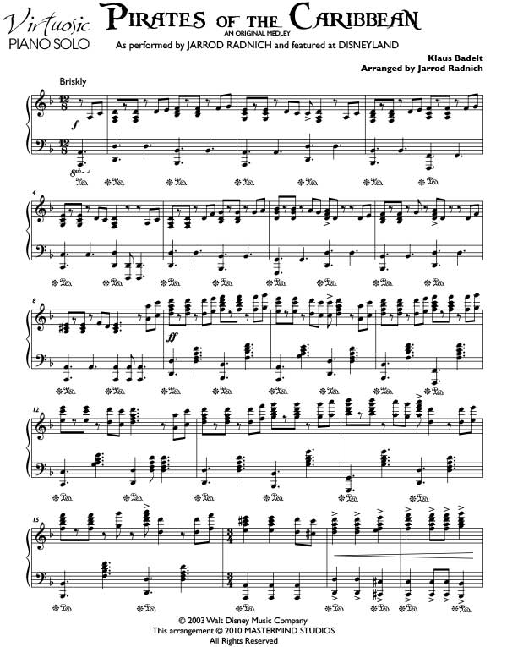
Pirate of the Caribbean – Main Theme
Hans Zimmer

Slide 31
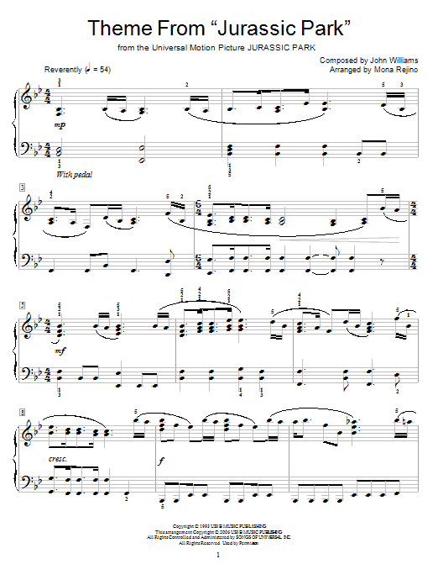
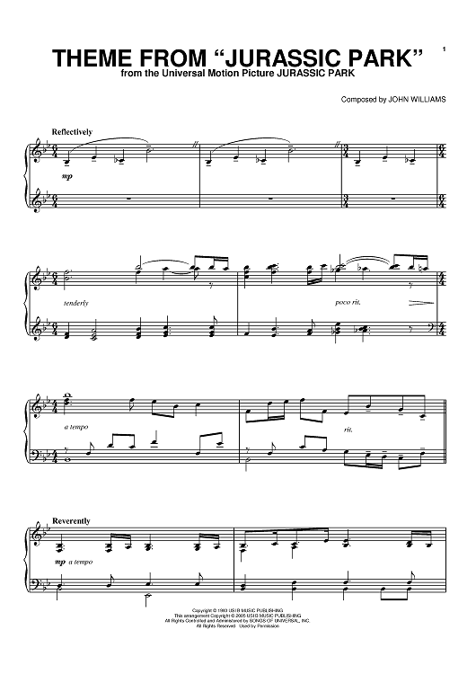
John Williams’ ‘Jurassic Park’

Slide 32
Task – Writing a Short Melody
3 Rules:
Must use chord notes on beats 1 and 3
Must be in neat 2 or 4 bar phrases
Should have flow in shape – no big leaps
Start by on keyboards, holding down a chord and improvising using the notes of the scale.
Keep the chords simple initially and write on your instrument FIRST! Sibelius to notate ideas!
Extra Challenges:
Link/extend phrases to perform over 2 chords
Notate your melody on manuscript paper

Slide 33
Task 3 – Develop Main Theme
Develop your main theme using some/all of the following devices:
Chromatic Melody – implying the rich harmony
Modulation – move your main theme to primary chord (sub-dom/dom)
Structure – “A1 A2 B(release)”
Imitation – altering instrumentation and harmony
Introduction – chromaticism/atonal – building the tension/release

Slide 34
Homework and Monday Cover Lesson
Task 1 – Composition Task – complete your melody and chords from today. MUST:
Be 16 bars long and completed on Sibelius – compose on your instrument though!
Minimum 1 melody instrument and 1 chordal accompaniment
Melodies based 2/2/4 then again 2/2/4
Chords explore Primary and Secondary chords
Minor key is preferably
6/8 or 12/8 preferable
Task 2 – Research 7th chords – how do you construct Dominant 7th, Major 7th, Minor 7th, Half Dimished and Diminished chords in different keys!
Task 3 - Research the following terms: Sequence, Imitation, Antiphony, Contrapuntal, Diatonic, Chromatic
Define the terms and find musical examples of where they can be heard/seen.
All due next lesson!

Slide 35
Unit 2 Composition
The NEW AS/A Level
2016-17

Slide 36
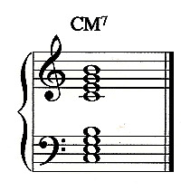
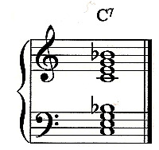
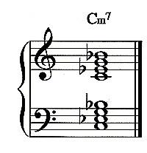
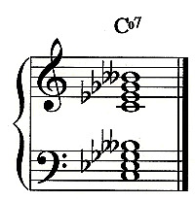
Starter - Constructing 7th Chords
Major 7 - 1 > 3 > 5 > 7
Dominant 7 - 1 > 3 > 5 > b7
Minor 7 - 1 > b3 > 5 > b7
Diminished 7 - 1 > b3 > b5 > bb7

Slide 37
Objectives
In today’s lesson we will learn how to construct chord progressions, extended chords and modulations
We will:
Analyse 7th chord construction
Analyse how to create fluid chord progressions
Look at using Pivot Chord Modulation
Extra Challenge: to identify and explain melodic and harmonic features in the Back to the Future Main Theme by Alan Silvestri
Literacy Aim: to articulate aurally and through written work, key musical terminology when appraising ‘Back to the Future Main Theme’.

Slide 38
Building Chord Progressions
With your partner, follow the process to design a chord progression of your choice in a minor key!

Slide 39
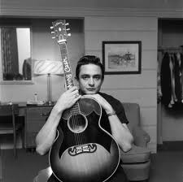
Task 1 – Why Modulate?
Listen to these examples of modulations
How have they modulated?
To what key have they moved to?
To what effect?
Johnny Cash - Walk the Line
http://www.youtube.com/watch?v=jmHNfWRw-qg
Dusty Springfield – Son of a Preacher Man
http://www.youtube.com/watch?v=DjydOI4MEIw
Michael Jackson – Man in the Mirror
http://www.youtube.com/watch?v=P5vz6iwV38U
Michael Jackson – Will you Be There?
http://www.youtube.com/watch?v=d-8KIIWrR6Y
Under the Sea
http://www.youtube.com/watch?v=NPQVrjnC1jo

Slide 40
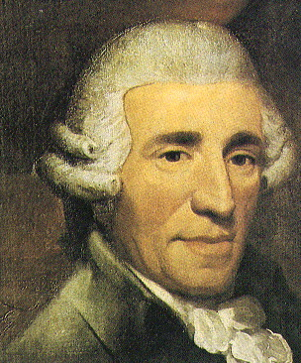
Task 2 – Pivot Chord Modulation
Look at the two examples of Pivot Chord Modulation
How have Haydn and Fats Waller used it to change the key of their music?
Fats Waller – Aint Misbehavin’
http://www.youtube.com/watch?v=97Wwhe9Hx_w

Slide 41
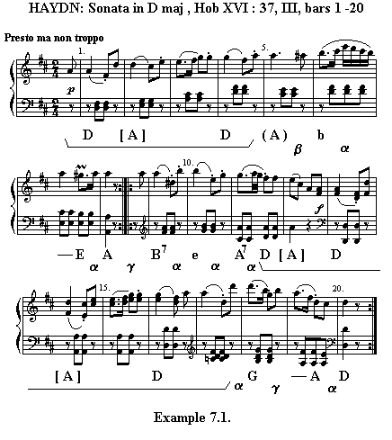
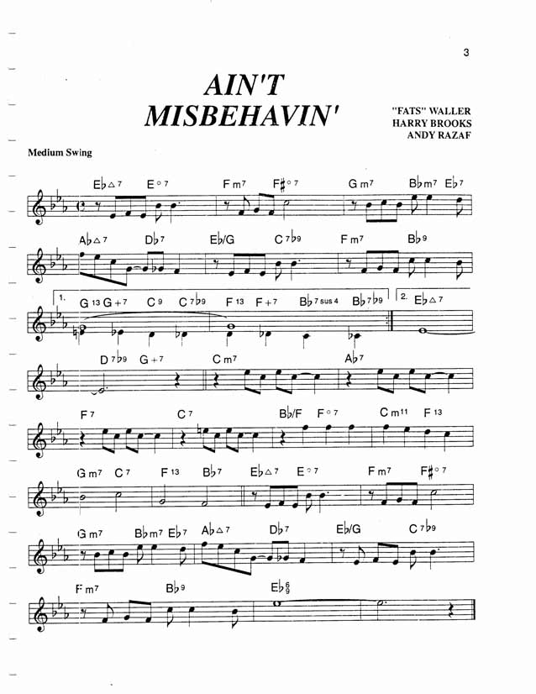

Slide 42
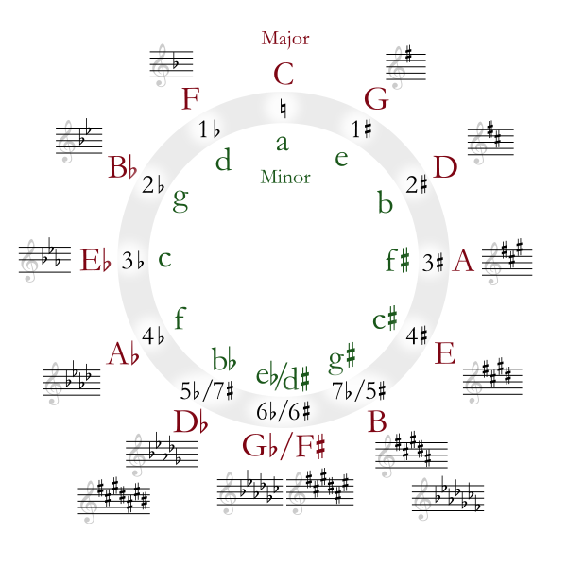
Circle of 5ths (or 4ths…..)

Slide 43
Composition Task – Compose a Chord Progression that Modulates at the end!
You decide, either modulate to the Dominant of Sub Dominant
Remember:
If moving to the Dominant “+1#” or “-1b”
If moving to the Sub-Dominant “-1#” or “+1b”

Slide 44
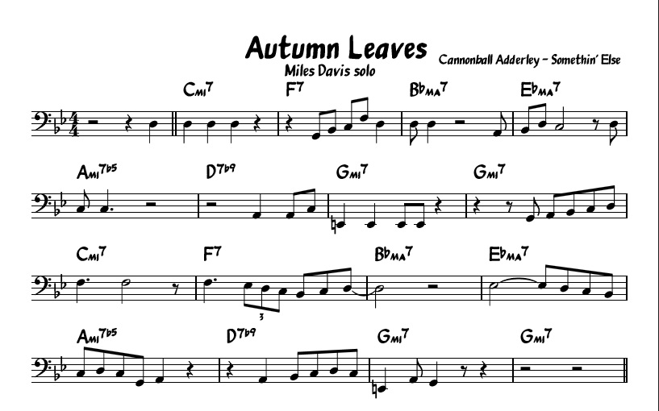
Composing with Cycle of 4ths

Slide 45

Homework
Task 1 – Composition Task – complete your chords and modulation from today. MUST:
Be 8 bars long
Must modulate to a new key at the end – add a key signature
Task 2 – You need to plan your composition and start to plan to compose your themes for your different sections:
Overall structure of piece – story board ideas
Keys and time signatures
Instrumentation
Chords
Melodic ideas – start composing your themes
Influential pieces
These are going to be your main ideas to put into your composition.
WORK MUST BE WRITTEN/TYPED AND ACCOMPANIED WITH NOTATIONS, CHORD PROGRESSIONS AND SUITABLE IMAGES.
All due next lesson!

Slide 46
Unit 2 Composition
The NEW AS/A Level
2016-17

Slide 47
Starter – Share your ideas!
Storyboard your composition. You are going to have a minimum of three sections.
Consider and include:
Sections – how many, lengths
Story – what is behind each section
Instruments
Tonality – of all sections
Harmony – ideas of chord progressions/chords
Melody – ideas of melodies or lead instrumentation
Rhythm and Metre – Time Signature and Tempo
Include listening examples of pieces you want to use to inspire you

Slide 48
Objectives
In today’s lesson we are going to start the composition.
We will:
Set up projects adding instruments
Set up structure and sections with labels
Add keys and time signatures
Compose our first melody and chord progression
Extra Challenge: to nail that almighty first melody!
Literacy Aim: to articulate aurally and through written work, key musical terminology when appraising our own compositions.

Slide 49
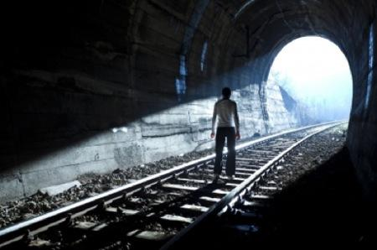
Darkness into Light– The finished article!
Both of these achieved 75%+
Follow the score!
Follow the melodic development!
Examine the part writing!
Enjoy the moment!
Yours is going to sound this good!

Slide 50
Task – Start Your Composition
Today you are starting your composition – COMPLETE draft DUE 15th December – must be 2.5 minutes long minimum.
First minute/main theme due HALF TERM!!!!! –2 WEEKS!!!!
Starting Points:
Set up a new project saved ‘Unit 2 – Pirates’
Title, composer, add instruments, set key
Structure:
Using your plan mark in all sections, bar lines, key shifts
Label Sections with sub-titles – chess pieces names
Compose:
Start by focussing on your initial chords and main melody – start with MAIN THEME
Homework:
All homeworks between now and the Thu 15th of December are to compose.
You must use lesson time, free periods and home time to compose
Key Points:
Remember the mantra ‘NO PASSAGE SUB-STANDARD’
I will work with you in lesson time but YOU MUST book tutorials with me at least once before half term and 3 times after!!!!!

Slide 51
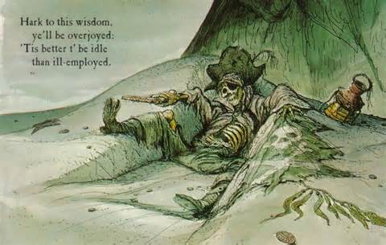
Unsure getting started….?
Set up the project with all labels etc…
Compose a chord progression using the process…
Copy your ideas you have created already into a new project…
Draw up a composition timetable….
Book a tutorial….
Watch Hook or Pirates of the Caribbean……?

Slide 52
Unit 2 Composition
The NEW AS/A Level
2016-17

Slide 53
Objectives
In today’s lesson we are going to work on the composition.
We will:
Set up projects adding instruments
Set up structure and sections with labels
Add keys and time signatures
Compose our first melody and chord progression
Extra Challenge: to nail that almighty first melody!
Literacy Aim: to articulate aurally and through written work, key musical terminology when appraising our own compositions.

Slide 54
Unsure getting started….?
Set up the project with all labels etc…
Compose a chord progression using the process…
Copy your ideas you have created already into a new project…
Draw up a composition timetable….
Book a tutorial….
Watch Hook or Pirates of the Carribean……?

Slide 55
Unit 2 Composition
The NEW AS/A Level
2016-17

Slide 56
Plan today….
Work on compositions
Email James your compositions
Half Term Homework……

Slide 57

Half Term Homework…
Work on composing/compositions:
Remaining sections
New themes
Filling in blanks
New ideas
Relative listening
Start thinking about the ‘Exploiting Instrument Composition’……..
Only 6 weeks after half term to complete ‘Pirates’
BY NO MEANS DOES THIS MEAN YOU “DON’T HAVE ANY HOMEWORK”

Slide 58

Next half term overview:
Lesson 1 – AS MT Recording Day – NO JAMES
Lesson 2 – L6th Safe Drive – All day – NO LESSON
Lesson 3 – Regular Lesson + My Birthday
Lesson 4 – Regular Lesson + Parents Evening
Lesson 5 – Regular Lesson
Lesson 6 – Regular Lesson
Lesson 7 – HAND IN DEADLINE/XMAS PARTY
End of Term

Slide 59

Today’s Aims
Work on compositions
Finishing off – deadline next lesson!!
Completing scores and making them look perfect-o

