Slide 1
NO et MOI
Essai 1
Autumn Benchmark
« Lou et No s’entendent si bien parce que leurs vies sont similaires. » Dans quelle mesure êtes-vous d’accord avec ce jugement ?

Slide 2
AQA mark scheme
Content (20 marks)
Top marks: Excellent critical and analytical response to the question with knowledge of the film or text consistently accurate and detailed. Opinions, views and conclusions are consistently supported by relevant & appropriate evidence. Essay demonstrates excellent evaluation of the issues, themes & cultural and social contexts of the text or film.
Quality of language (20 marks)
Top marks: The language is mainly accurate with only occasional minor errors. Consistent secure grasp of grammar and able to manipulate complex structures accurately. Wide range of vocabulary appropriate to task and context.

Slide 3
Content
Excellent critical and analytical response to the question with knowledge of the film or text consistently accurate and detailed.
Opinions, views and conclusions are consistently supported by relevant & appropriate evidence.
Essay demonstrates excellent evaluation of the issues, themes & cultural and social contexts of the text or film.

Slide 4
Structure:
INTRODUCTION: Identify the topic without rewriting the essay title. You ned to show your understanding of the question and work. Single paragraph which respond CONCISELY to the essay question.
Body of the essay:
In several interconnected paragraphs you should give evidence to support a number of main points.
Each point will carefully pick up and develop a point.
Each paragraph should start with a sentence stating what each paragraph is about.
Make sure you follow a clear logic all to lead to the conclusion.

Slide 5
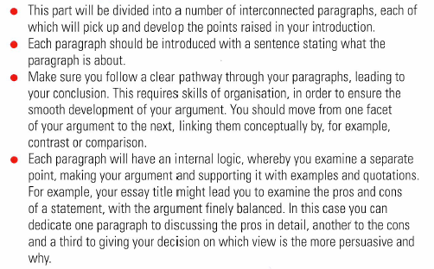
Body of the essay

Slide 6
Content
Excellent critical and analytical response to the question with knowledge of the film or text consistently accurate and detailed.
Opinions, views and conclusions are consistently supported by relevant & appropriate evidence.
Essay demonstrates excellent evaluation of the issues, themes & cultural and social contexts of the text or film.

Slide 7
Conclusion

Slide 8
« Lou et No s’entendent si bien parce que leurs vies sont similaires. » Dans quelle mesure êtes-vous d’accord avec ce jugement ?
Leurs vies sont-elles similaires?
Quelles sont leurs différences?
Sont-elles essentielles? Dans quelle mesure le sont-elles ou pas?

Slide 9
Non, leurs vies ne sont pas similaires:
Lou lives in a comfortable home with her parents;
/ No is on the street and has nobody close to her.
Lou is well-fed and cared for even though her domestic life is far from ideal;
/ No never knows where her next meal will be coming from.
Lou benefits from an education; she has a purpose in life afforded by her studies;
/No is receiving no education and has few prospects.
Lou is loved by her parents;
/No is estranged from her family.
Lou finds comfort in reading and studying;
/No is an alcoholic.

Slide 10
Pourtant leurs vies comportent des similarités:
Both are in a sense marginalised
No literally so as a homeless person forced to beg and live on the street;
Lou because of her hyper-intelligence is something of a misfit; she has been to a special school for gifted pupils.
Both live in a sort of silence or isolation
No because of her status as a beggar
Lou because of her mother’s mental illness as a result of losing a child.

Slide 11
Résultat:
Thus an empathy and understanding develops between the two girls, forming a strong bond.
  This part is essential. You will not score high if you don’t draw conclusions and evaluate the question fully.
    Do their differences matter and to what extend?
    Can they understand each other, get on and to what extend?

Slide 12
Corrections de vos erreurs

