Slide 1
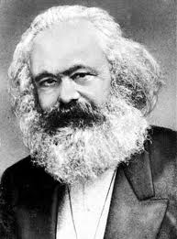
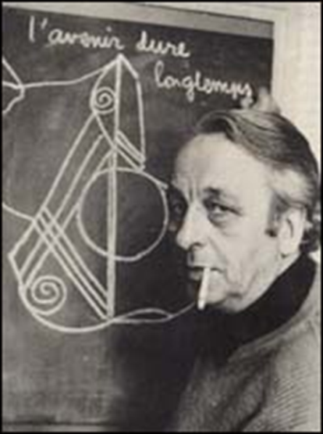

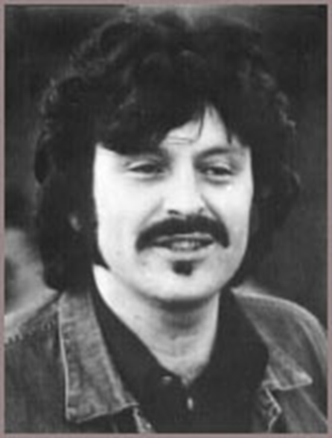
Marxism and education

Slide 2
Objectives
To review the Marxist account of education and its problems
To relate Marxist accounts of education to the wider concerns of Marxist theory
To assess the usefulness of Marxist theory

Slide 3
Family
Society/Capitalism
WHAT I KNOW ABOUT MARXISM
On whose side are the Marxists?
Education?

Slide 4
Re-cap of main ideas of Marxism
Starts from the idea that the economic system largely shapes the rest of society.
Marxists argue there are two main classes in society- the ruling class and the working class.
Capitalists- those who own private industry- form the ruling class. They have power over the working class who work for them.
According to Marx the ruling class exploit the working class.

Slide 5
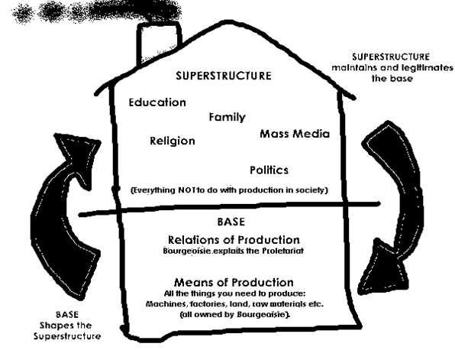
Re-cap of main ideas of Marxism

Slide 6
Re-cap of main ideas of Marxism
According to Marx the ruling class ‘rule also as thinkers, as producers of ideas’.
What do you think he meant by this?
How could we apply this idea to how education works?
Page 13- what do you think Marxists would see as the main role of education?

Slide 7
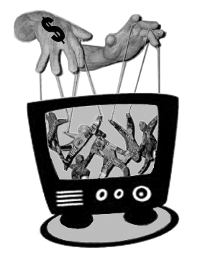
Marxism and Education
Ideological Control
Students learn to accept the authority of others as natural
They learn their place for work and life
This is an efficient means of SOCIAL CONTROL through IDEOLOGY

Slide 8
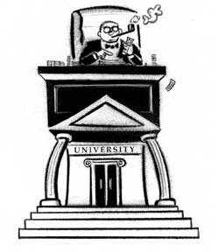
Marxism and Education
Support for Capitalism and the Ruling Class
Students learn necessary skills for work “on the cheap”
Workers learn place in the workplace hierarchy – passively obeying orders
Ruling Class benefits – it creates more PROFIT

Slide 9
Marxism and Education
Cultural Reproduction
Meritocracy seems to be there but untrue
Meritocracy is a useful myth - the system seems fair and this placates the workers
Dice remain loaded against lower classes
The education system LEGITIMATES INEQUALITY to the benefit of the capitalist class

Slide 10
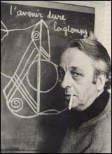
Education and Ideology
Louis Althusser
Key figure in the revival of Marxist sociology in the 1960s
Regarded the education system as an ideological state apparatus
Basis for Bowles and Gintis’ work

Slide 11
Education and Ideology
Louis Althusser
Schools act as an ideological state apparatus in 2 ways:
Schools transmit an ideology which states that capitalism is just and reasonable.
Schools prepare pupils for their roles in the workforce by training people to accept authority.
Ideology in capitalist society is fundamental for social control.
Complete the activities on p.14

Slide 12

Correspondence Theory
Samuel Bowles and Herbert Gintis
American Marxist economists
Writing on an AMERICAN Junior High School (1976)
Claim there is a close correspondence between the social relationships in the school and those in the workplace.
Notes:
D1 start 21/11 & A1 start 21/11

Slide 13
Correspondence Theory
The Hidden Curriculum
Schools teach a formal curriculum intentionally
They also attempt to foster a school ethos, rules, etc.
BUT
A Hidden Curriculum also operates in a similar way to the world of work- there is a hierarchy of authority and particular norms and values which should be followed.

Slide 14
The Correspondence Theory
Schools mirror the nature of the working world
Acceptance of Hierarchy (obeying those in authority)
Subservience (conformity , following instructions without challenging them)
Fragmentation (knowledge is separated)
Extrinsic Rewards (e.g. commendations, exam results)
Schools allocate people to their later roles by sorting and sifting people based on their ability to conform to the education system.
Notes:
D2 group Thurs

Slide 15
The Correspondence Theory
Social Inequality
Bowles and Gintis argue meritocracy is a myth, what do you think they mean by this?- Write your answer on p.16

Slide 16
The Correspondence Theory
Social Inequality
The myth of meritocracy allows students to believe that if they work hard they have an equal chance of succeeding. However, Bowles and Gintis argue success in education and occupation is not based on ability but on social background.
From examples we have already looked at, what evidence could we use to support this argument?

Slide 17

Correspondence Theory
Education Serves Capitalism
Over education – creating a surplus of skills
Legitimation of inequality
Illusion of equality of opportunity
– making the unfair seem fair
Schools are myth making machines

Slide 18
Activity
Imagine completing a day in the life of one job. (It may be a part-time job you have or an imaginary one) and note down how this corresponds to school/ college life.
Fill in the grid on p.16

Slide 19

Paul Willis
Neo-Marxist
Attempted to take a different approach to the study of the education system from a Marxist point of view.
Whilst he substantially agreed with the basic outlook of the Marxist approach, as outlined above, he also tried to combine a Marxist approach with an understanding of the culture of the school, using ethnographic research to look at the process of schooling
http://estream.godalming.ac.uk/view2.aspx?id=11138~5b~ssonmxL8R6

Slide 20
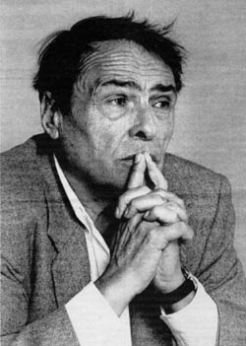
Pierre Bourdieu
Bourdieu focused on the relationship between education and privilege
Education, rather than challenging privilege helps to reinforce it e.g.?
Meritocracy is difficult to justify given the differing levels of capital individuals hold.
His principal focus was on the relationship between
  Economic capital- wealth and ownership
  Social capital- who you know, and
  Cultural capital- what you know
  On p.19 add more detail to these descriptions using (p.23-24 Webb):

Slide 21
Bourdieu and THREE types of Capital
Capital is usually seen as wealth that is invested to secure a living
However, Bourdieu identifies THREE types of capital in the class pyramid
  Economic Capital - command over economic resources (cash, assets). These are invested to make more wealth.
  Cultural Capital - forms of knowledge, skills, education, and advantages that give a person a higher status in society.
  Parents provide their children with cultural capital by transmitting the attitudes and knowledge needed to succeed in the current educational system.
  Social Capital - resources based on group membership, relationships, networks of influence and support.
  For example the “Old Boy Network” through public schools and Oxbridge.
How are each of these “invested”?

Slide 22

Cultural Capital not in action
You should have worked harder.
We’ll help you find a job
Just not very good at Maths, are you?.
I’ve failed my maths exam
The teachers know what they’re doing, why don’t you?
We’re all a bit dim in our family, aren’t we? Never mind.

Slide 23
Cultural Capital in action
We’ll hire a private tutor
We’ll buy you a revision guide
We’ll write and ask to change groups so you get the best teacher.
I’ve failed my maths exam
We’ll complain to the headmaster – he’s a personal friend
Let’s go through every question together – I was good at maths.

Slide 24
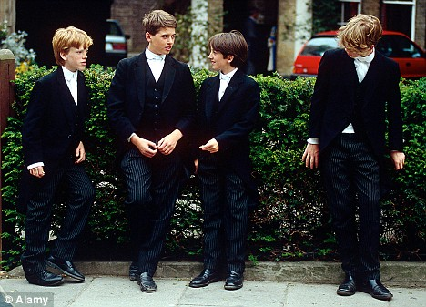


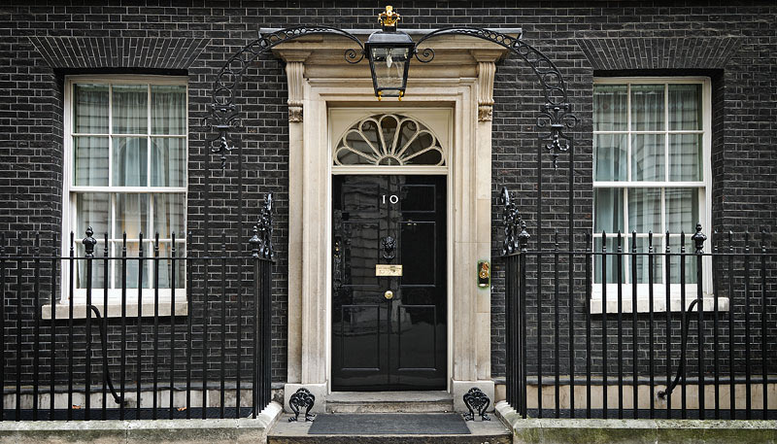
Economic Capital invested in School Fees, etc
Cultural Capital developed through schooling and education generally
Social Capital found in “Old Boy” networks
From Eton to Government

Slide 25
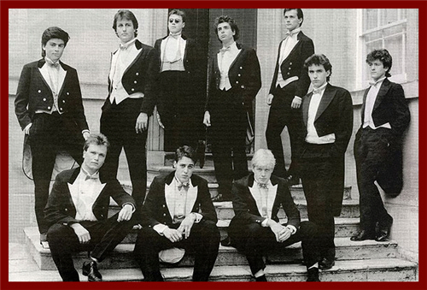
Economic Capital + Social Capital + Cultural Capital =
Dave & Boris at University [the boys who brought you Brexit]

Slide 26

Glenn Rikowski
Rikowski has focused on recent developments in Education both nationally and internationally
Concerned with
  The business takeover of schools and
  The globalisation of education
Notes:
D2 B1 Thurs

Slide 27
Who is he?
Glenn Rikowski is a contemporary British Marxist
He adopts a Marxist framework to review recent developments in the educational system such as marketization in response to postmodernist theory.

Slide 28
What are his main arguments about how education system has now changed?
Modern day education has moved away from learning and has evolved into a means of profit.
This has been achieved by:
- the privatisation of schools’ functions for example school dinners will be made by a private company which will run for less than the contract price resulting in profit.
- Schools themselves will operate as commercial enterprises; selling education as a product e.g. making profit out of school uniforms
- There are greater links between schools and businesses, for example academies are sponsored by businesses
Notes:
D1 to finish Monday

Slide 29
What he thinks of Willis
Rikowski thought that Willis’s observation of working class children rebelling against the education system within the classroom was a redundant act.
This did not alter their situation as they would still remain working class once leaving education.
To this extent he returns to traditional Marxism rather than neo-Marxism – ideas here are less important than economic forces
On p.20 write a summary of how Rikowski views the impact of marketization on education.

Slide 30
Evaluation
Using the textbook and your own knowledge come up with 4 detailed evaluation points for the Marxist view of education. Complete p.20

Slide 31
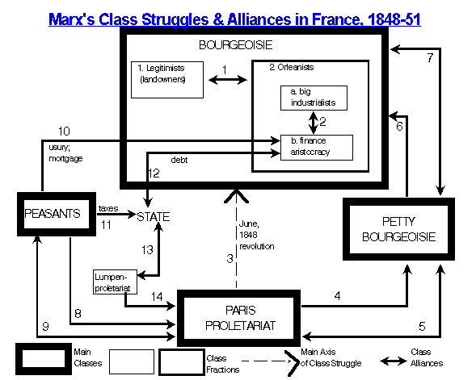
Some Problems with Marxist Theory
Reductionist – is social order only a product of the economic system?
Neglects degree of agreement and consensus in society?
Single cause to all social change?

Slide 32
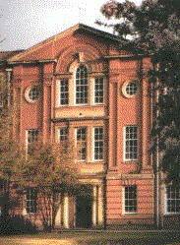
Problems for Marxists and the Education System
Does the education system merely prepare us for work or for more?
What alternative can we offer to the existing system?

Slide 33

Uses of Marxism
A coherent alternative to consensus approaches
A critical view of the everyday world looking beyond official views
A focus on the material conditions of schooling

Slide 34
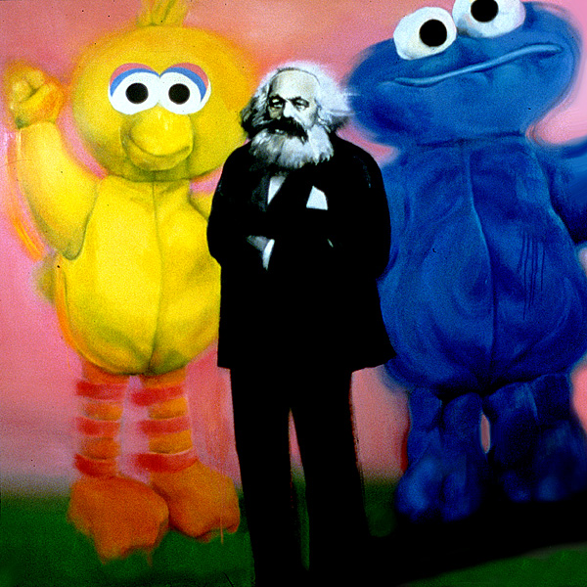
Impact of Marxism
Some influence on other theories regarding the importance of social class
Critique of meritocracy
Key concepts: hidden curriculum,
Encouraged other conflict/critical approaches, e.g., feminism
Little direct impact on education policy

Slide 35
Illich vs the Marxists
BOTH see the school as a means of ideological control and as an institution which crushes the individuality out of the young
BOTH see it as an institution which supports a system of inequality
BUT they disagree as to how to change the situation
ILLICH SAYS: Abolish the school and allow individuals to create a better world
DESCHOOLING = REVOLUTION
MARXISTS SAY:
Before you can change the school you must first change society through
SOCIALIST REVOLUTION

Slide 36
Further Work
Describe in Marxist terms how and why the system of mass schooling developed at the end of the 19th century in Britain.
Some necessary terms:
Function
Cultural reproduction
Capitalism
Hierarchy/Control
Ideological State Apparatus
Hidden Curriculum
Over-education

