Slide 1
Policy Initiatives: Social Democracy, the New Right and responses to Functionalism

Slide 2
Whilst British Governments have largely agreed with the Functionalist agenda on education, i.e., that it should be an agency of social integration, should prepare individuals for the workforce, and should sort and sift in a meritocratic way as an agency of role allocation, it has been clear that this has not been a complete success.

Slide 3
Functionalism
Social Democracy
Neo-Liberalism
Assumptions:
Assumptions:
That society needs to reinforce value consensus by its financial support
That meritocracy relies on an equal start for all – equal opportunities
That this can only be achieved through an active “Welfare State”
That society benefits from an investment in its Human Capital
That an over active state undermines people’s values and creates dependency culture
That meritocracy relies individual choices and efforts, not state action
That the “Welfare State” is too expensive and undermines individual responsibility
That individuals and their families are the best judges of what is right for them, not the government
The “Democratic Left”
The “Democratic Right”

Slide 4
Functionalism
Social Democracy
Neo-Liberalism
Some policies:
Some policies:
A National Health Service
The public ownership of key industries, e.g., railways to ensure the national interest
Regulated prices for energy providers Stop them getting too high
Democratic accountability to elected bodies
Available housing provided by the state for those unable to afford their own
Privatised health care
De-nationalisation of industries, e.g., railways – to make them more efficient
Increased competition between energy providers market forces will make them more efficient
Wider share ownership – everyone controls companies
Less social housing, more private landlords – it’s not the state’s business!
The “Democratic Left”
The “Democratic Right”

Slide 5


Functionalism
Social Democracy
Neo-Liberalism
The “Democratic Left”
The “Democratic Right”

Slide 6
Consequently different governments have attempted to address the issue of fairness in the education system in very different ways. The debate since the 1944 Education Act may be seen to be between two broad traditions which cut across the main political parties:
The Social Democratic and
The New Right
Video available on the foundations of New Right thought on estream: http://estream.godalming.ac.uk/view2.aspx?id=1591~4q~qLPcevUK

Slide 7
Bear in mind that these approaches are based upon political views of education policy.
They are not sociological perspectives.
They provide a critical response to Functionalism and an attempt to apply it in the “real world” of education

Slide 8
Activity
Email to dak@godalming.ac.uk
Each group will be given an area to research - make a one slide PPT:
Social Democratic
Areas to look at:
What are their main arguments?
Who are the key thinkers?
What problems do they see with the education system – what solutions do they offer?
Evaluation of the approach
Use p.167-170 Sociology In Focus, pages 60-61 of the OCR textbook (A2) and your workbook
New Right
Areas to look at
What are their main arguments?
Who are the key thinkers?
What problems do they see with the education system- what solutions do they offer?
Evaluation of the approach
Use p.167-170 Sociology in Focus, pages 69-70 of the Webb book your workbook and, for recent policies, pages 77-84 of Webb

Slide 9
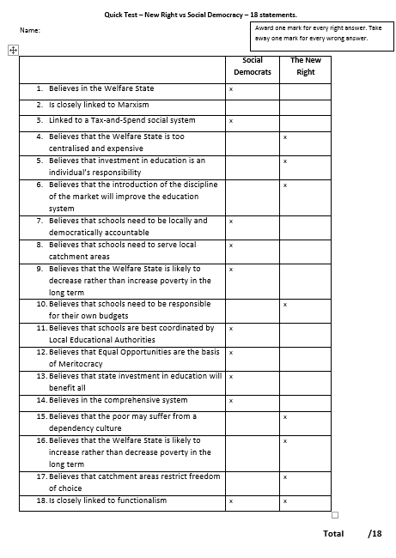

Slide 10
Shifting educational policy
This is a list of eight changes in educational policy over many years
Try to identify
Specific initiatives connected with these ideas
How this might be regarded by a New Right or Social Democratic theorist – changing for the better?
Complete a four slide PowerPoint to explain this.
Focus on England and Wales / UK where possible
Raising the School Leaving Age (ROSLA)
Students meeting cost of their own education
Business Investment in State Education (PPI, etc)
Marketization and competition between educational providers
Selective Education
Compensatory Education
Financial support for learners
Positive Discrimination / Affirmative Action
Notes:
C1

Slide 11
Task
Raising the School Leaving Age (ROSLA)
Students meeting cost of their own education
Business Investment in State Education (PPI, etc)
Marketization and competition between educational providers
Selective Education
Compensatory Education
Financial support for learners
Positive Discrimination / Affirmative Action
SLIDES:
Title with names
Define the Policy
Give examples of the Policy
What would the New Right make of this Policy?
What would Social Democratic theorists make of this Policy?
Email to dak@godalming.ac.uk

