Slide 1
B1 Education Policies
B1 Group

Slide 2
Social Democratic Policies

Slide 3
Financial Support for Learners
Policy:
EMA (Education Maintenance Allowance)
Started in 2007 but no longer available in England since 2010
Still available in the rest of the UK
Bursary 16 to 19 replaced EMA in England
This is a Social Democratic policy as it attempts to help the vulnerable and offer equality of opportunity.
Criticisms:
Marxist- creates surplus of skills as more people are staying in education so more people are available for higher skilled jobs.
New Right- People become dependent on funding instead of individualism
Feminist- Tricks females into believing they will be successful instead of being oppressed
Social Democratic- Need resources to know of funding.

Slide 4
Compensatory Education
Examples of policy:
-Educational priority -Sure Start funding and care for 0-4 year olds
-Action zones -E2L
New Right or Social Democratic? Social Democratic
Criticisms:
Feminism – Sure start disadvantages single parent mothers as it had to be closed down.

Slide 5
ROSLA
By callum Marshall and Elliot COPPOLA

Slide 6
ROSLA
1944- Post world war leaving age raised to 15
1971- school leaving age raised to 16
Education made compulsory up to 17 by 2013 and to 18 2014
This policy more supports the social democrats as they believe that making everyone have a higher education will decrease unemployment and further the education of young people
The New Right would disagree that this is a good policy as they believe only the most capable should further there education ( this is meritocracy) . They believe those that are not as academically inclined should have a chance to go out and work rather than waste time in education.

Slide 7
New Right Policies

Slide 8
Sociology
Students meeting cost of their own education

Slide 9
Examples of polices:

Slide 10
Social Democracy
Mixed Economy without capitalism.
Accountable to local communities. (LAs)
Social justice.
Equality of opportunity.
Help the vulnerable.
Meritocracy.

Slide 11
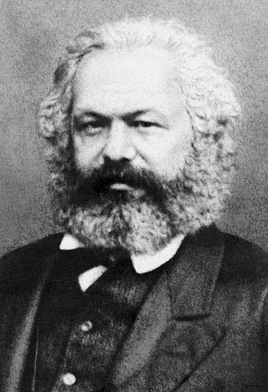
Marxist
Business Takeovers.
Preparing a workforce to benefit capitalists.
‘fit’ – system + capitalism.
Profit.
Ideological state apparatus.
Ideological control “capitalism good”.

Slide 12
Feminist
Patriarchal System
Gender Stereotype – Constraining both men and women.
Gender Regime
Feminised Curriculum
‘Jock’ culture

Slide 13
Grammar Schools

Slide 14
What are grammar schools?
Grammar schools are commonly the same sex schools
They are usually found in areas where the 11+ exams still exists.
Grammars schools are harder to be accepted into compared to normal state schools
Being grammar schools is more about status rather then how the school works and what subjects are taught.

