Slide 1
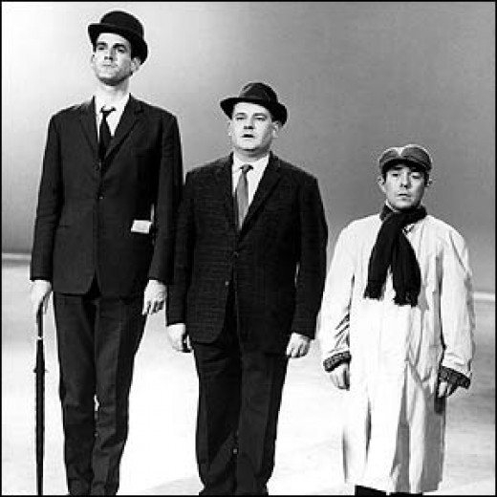
Why are there class based differences in education?

Slide 2
Objectives
To know the patterns and trends of class based differences in educational achievement
To be able to provide examples of EXTERNAL and INTERNAL reasons why such patterns occur
To be able to evaluate and analyse the above reasons and explain how they interact

Slide 3
What is class?
A form of social stratification, placing people into a hierarchy based on their occupational status
Class is said to be socially constructed – why?
Complete the diagram on p2 of your booklets – how can you identify a persons class background?

Slide 4
Ways to measure class
NS-SEC – current official way that class is measured, considers diverse range of occupation and the way in which people are paid (i.e salaried or not)
Marxism – what do they say about class?
Bourdieu – types of capital – which ones do you know?

Slide 5
Which class are you?
Take the test…..
http://www.bbc.co.uk/news/magazine-22000973
What does this tell us about the way in which class has changed?
What are the different features of the different classes in this survey?

Slide 6
Why does class matter?
Why does class matter?
When students from lower working class backgrounds have been compared to middle class children of the same ability, it has been found that;
They are more likely to start school unable to read
They will do less well in SATS
They are less likely to get places in the best state schools
They are more likely to be placed in lower streams and sets
They get poorer exam results – 75% of children from upper middle class backgrounds get 5 or more A*-C grades at GCSE compared to less than 33% from working class backgrounds
They are more likely to leave school at the minimum age of 16 (but they have to stay in some form of education and training until they are 18) with no qualifications. Around 50% of working class children stay in post 16 full time education, compared to 90% of middle class children
They are less likely to go to University – in 2008, 70% of children who went to University were from middle class backgrounds, 5% of children were from unskilled backgrounds.

Slide 7
Explaining class and underachievement
What reasons can you give that explains the previous list?
Separate your reasons into;
Those that occur at home and those that occur at school

Slide 8
External and Internal reasons
Reasons for class differences can be explained in the following ways:
EXTERNAL - Factors that occur OUTSIDE the school. These are….
Material explanations- social and economic reasons
Cultural explanations- values, attitudes and lifestyles
INTERNAL - Factors that occur INSIDE the school. These are….
The way in which the school process works – how students are labelled and stereotypes, setting and streaming, language used and the hidden curriculum

Slide 9
Recap
Briefly explain one way that class is measured in contemporary society (2)
Outline and explain three types of ‘capital’ according to Bourdieu (6)
Outline and explain three ways that class and underachievement can be explained, using internal and/or external factors (6)

Slide 10
External (out of school) factors
Material deprivation
Cultural deprivation
Cultural capital

Slide 11
Material Deprivation - poverty
Sociologists of poverty have identified the cycle of deprivation or cycle of disadvantage ‑ this suggests that the "hard core" in society who are in poverty remain largely the same from one generation to another, i.e., deprived children in their turn become parents of deprived children.
Material deprivation is closely linked to the problem of educational failure, partly as cause and partly as effect.
How can poverty be linked to educational underachivement?

Slide 12
The Life Cycle
 | Stage in lifecycle | Typical Circumstances | Poverty status
[a] | Childhood | Low family income and children to rear | In Poverty
[b] | Working youngster | Earns more than is paid to parents for keep | Not in Poverty
[c] | Young married | Children to support | In Poverty
[d] | Middle age | Children earning or have left home | Not in Poverty
[e] | Old age | Income falls, living on a pension | In Poverty

Slide 13
The cost of schooling
Using the list in the booklet and your own experiences, add up the cost of your own schooling per year

Slide 14
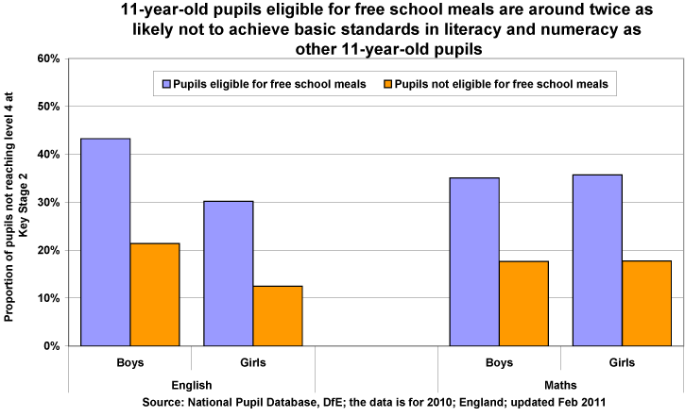
Free school meals and achievement

Slide 15
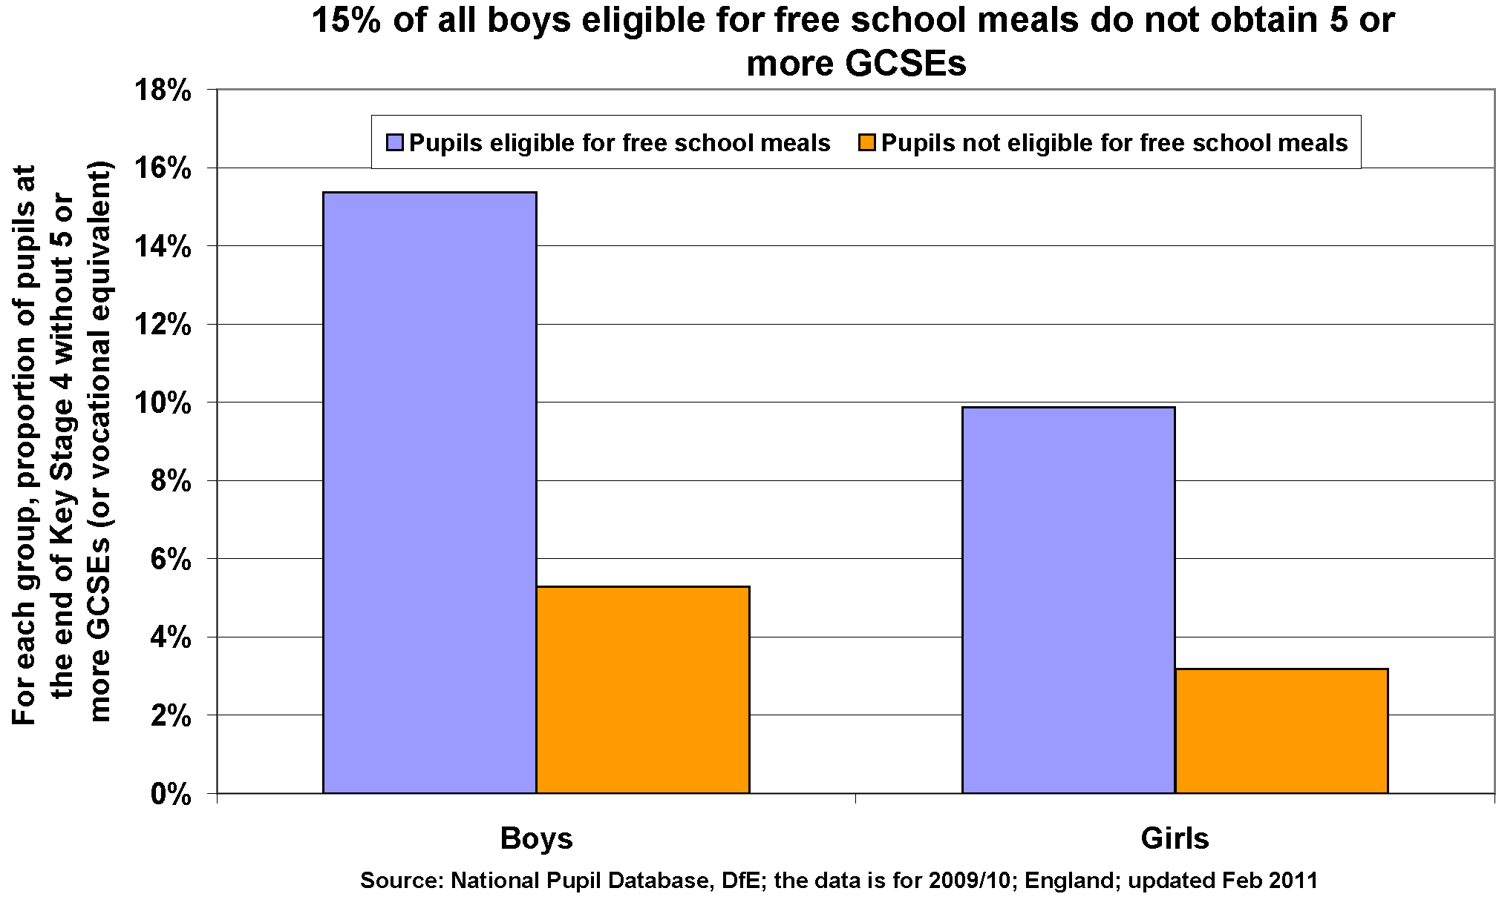

Slide 16
What causes the link between free school meals and underachievement?
Waldfogel and Washbrook (2013) – children from lower income backgrounds are more likely to live in damp and crowded accommodation and a home that is unclean and unsafe. This makes study at home difficult. This may also mean poorer diet and higher levels of illness.
Cooper and Stewart (2013) – being poor may affect a childs cognitive and social-behavioural abilities.

Slide 17
Reasons continued….
Less likely to have access to good preschool facilities
Cannot afford educational toys, books, tutoring and other resources
Working class more likely to have part time jobs
Poor facilities and limited resources at state schools in disadvantage areas
Parents unable to financially support children in post 16 and higher education
Complete page (5) in booklet

Slide 18
Cultural deprivation
Cultural deprivation” is a kind of cultural “poverty” (as opposed to real, material poverty) and tends to view any culture which is not that of the teacher (white, middle class, etc.) as bad or inferior.
Assumes there is something ‘lacking’ in working class culture that causes underachievement
Working classes have a different value system
Evaluation: can you be deprived of a culture?

Slide 19
Douglas (1964) The Home and the School
Working class parents are to blame. They do not attend parents evenings and do not value school work, spending insufficient time helping with home work and reading with children.
Evaluation – how could we criticise this study?

Slide 20
Sugarman – different values
Middle class | Working class
Deferred gratification | Immediate gratification
Individualism | Collectivism
Future orientated | Present time orientated
Optimistic about the future and their chances of success | Fatalistic

Slide 21
Bernstein - Language
Elaborate code- used mainly by middle class people. Involves a far greater range of words and the ability to communicate and understand. This sort of language tends to be used in a more formal context.
Restricted code- Bernstein argues all people use the restricted code but lower-working class people tend to use this language predominately, and are constrained to its use. This is the more informal language used between friends and family. It tends to include slang and everyday language.

Slide 22
Bourdieu – Cultural Capital
Cultural capital – high status knowledge that is valued by the school
Middle classes possess more of this
Read the list in the article and consider whether you have cultural capital?!
In what ways might some of the examples help with achievement at school?!

Slide 23
Evaluations
Keddie (1973) states that cultural deprivation is a myth and argues it is a form of victim blaming. Argues that working classes are culturally different and not deprived – does this link with Bourdieus ideas?
Mortimore and Whitty (1997) state that material deprivation has a greater effect on achievement than cultural ones. Robinson says that addressing child poverty is the most important thing that can be done to solve the issue – how would a Marxist respond to this?
Sullivan (2001) argued that cultural capital only explains part of the picture. She states that greater resources and aspirations of the middle classes are the most significant factor.

Slide 24
Complete the summary table at the end of the section in your booklets (p15-16)

Slide 25
Recap
Explain what is meant by;
Material deprivation (2)
Cultural deprivation (2)
Outline and explain 3 pieces of evidence to support the ideas of cultural deprivation (6)

Slide 26
Internal (In school) factors
Labelling
Self fulfilling prophecy
Setting and streaming
Subcultures
Identities and school

Slide 27
Interactionism
Takes a micro/top down approach to society
Emphasises the importance of ideas
Looks at small scale human interactions
Considers how people internalise what they see around them to build up their own identity
Small scale studies, looking at micro-interactions

Slide 28
Labelling
Self Fulfilling Prophecy

Slide 29
How does labelling affect achievement?
Becker (1971) was an Interactionist Sociologists who looked at labelling in 60 Chicago high schools. He stated that teachers judged a pupil based on how closely they fitted their idea of the ideal pupil
Becker stated that middle class children were closest to the ideal and working classes, furthest from it. However, some teachers have different ideas of what makes an ‘ideal pupil’.
Complete (18-19) in booklets

Slide 30
Self fulfilling prophecy
Rosenthal and Jacobsons study can be used to illustrate this
What did they study?
What conclusion did they come to?

Slide 31
Setting and streaming
Setting and Streaming: separating students into different ability subject groups (setting) or for all subject groups (streaming).
Gilborn and Youdell;
A-C Economy
Educational Triage
How are setting and streaming, the A-C economy and Educational Triage, examples of labelling?

Slide 32
Subcultures
Groups that share some norms and values with society, and have some of their own
What subcultures were there in your school? Complete p (22) in booklet
Lacey (1970) stated that streaming leads to either pro school or anti school subculture formation.
Features of pro school subculture:
Features of anti school subculture:

Slide 33
Recap
Explain what is meant by ‘labelling’ (2)
Outline and explain three internal factors that explain class and underachievement (6)

Slide 34
Identities
Habitus
Symbolic capital
Nike identities
Look at the youtube clips(p24) and define habitus in your own words

Slide 35
Habitus
Bourdieu argues that each social class possess their own cultural frame work or set of ideas, which he calls Habitus. This cultural framework contains ideas about what counts as good and bad taste, good books, newspapers, TV programmes etc. The habitus is learned through socialisation in the family.
How does this link to cultural capital?

Slide 36
Symbolic capital
This is what is gained from achieving in school as a result of possessing the habitus of the school. Middle class students are those who possess the habitus school and as a result are recognised and valued by the school and the symbolic capital they gain, reinforces the status of the middle classes as superior, and the working classes ‘inferior’. Bourdieu argues that by defining working class culture as inferior, inequality is reproduced, which keeps the working classes ‘in their place’. He calls this ‘Symbolic violence’.

Slide 37
Nike Identities
The way in which the working classes seek to gain status in society using heavily branded clothing. Appearance and style was a way of earning symbolic capital and constructing a meaningful class identity.
How might each of the three previous concepts affect educational achievement?

Slide 38
Evaluations
Complete p (26-27) in your booklets
Complete the summary table

Slide 39
The relationship between Internal and External Factors
Complete the activity on p(29)
Habitus – identities are formed outside the school but when expressed within the school may cause conflict
Languages used at home can cause teacher labelling
Stereotypical views of working class pupils home life can also cause teachers to label
Poverty can lead to truancy and subcultural formation, which is linked to underachievement
Wider national policies and trends may affect internal school processes. For example, league tables and the A-C economy.

