Slide 1
Gender and DEA
2016/2017

Slide 2
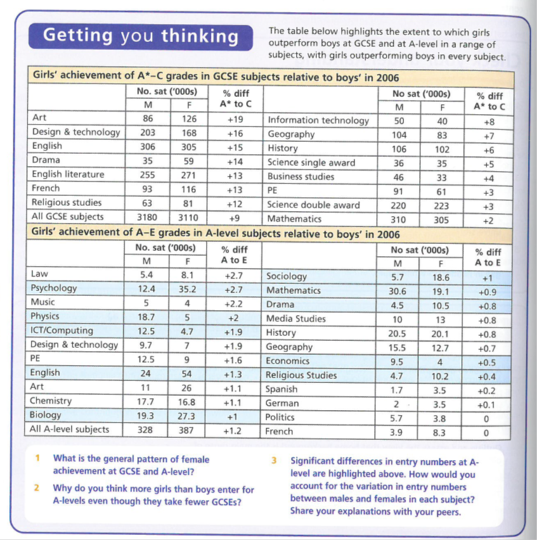
Gender and DEA: Data

Slide 3
Girls and Boys achievement in Education
STUDENT WORK
A1 group
March 2017

Slide 4
The impact of the women’s movement | Webb 52 Browne 69
The Family | Webb 52
Changes in women’s employment | Webb 52 Browne 69-70
Girls’ ambition | Webb 52 Browne 70
Maturity | Browne 69 & 70
Globalisation and declining traditional male employment | Webb 57 Browne 71 SIF 184
Male Identity Crisis | SIF 43 & 184
Hegemonic Masculinity | Webb 72 SIF 41
Over estimation of ability | Browne 70 & 71
Labelling and the Self-fulfilling prophecy | Webb 54
Equal Opportunities Policies | Webb 53-54 Browne 69
Positive role models in school | Webb 53 & 54
Challenging gender stereotypes | Webb 55
Marketization | Webb 55
Labelling and the Self-Fulfilling Prophecy | Webb 58 Browne 70
Anti-school subcultures | Webb 58 Browne 71
Feminised curriculum | Webb 57 & 58
Lack of male role models | Webb57-58

Slide 5
EXTERNAL FACTORS: Girls’ relative achievement

Slide 6
The impact of women's movement
Abi Sheppard
Although feminists argue that full equality has not been achieved, since the 1960’s the women's movement and feminism have achieved success in improving their rights. Also, self esteem and expectations in women have now been raised.
Many women now look beyond being only a housewife or mother as their only role in life as people are becoming aware of the problem of patriarchy and gender stereotyping/ sex discrimination.
these changes encouraged by feminism have also affected girls self image and their ambition In relation to family and careers.
This could be the reason for improvements in their educational system success.

Slide 7
The Family
Euan Cooper

Slide 8
Changes in Family
There have been major changes in the family since the 1970s. These include: an increase in the divorce rate, an increase in cohabitation and a decrease in the number of first marriages. An increase in the number of lone parent families, Smaller families.
These changes are affecting girls’ attitudes towards education in a number of ways. For example, increased numbers of female-headed lone parent families may mean more women need to take on bread winner role.

Slide 9
Changes in the Position of Women in Employment
Jem

Slide 10
Women’s Movement and Feminism
Women have achieved considerable success in improving the rights and raising the expectations and self-esteem of women. Since the Feminist movement in the 1960’s, women have challenged the traditional stereotype of women’s roles as housewives and mothers and more people have become aware of the problems of patriarchy, gender role stereotyping and sex discrimination. This means that women have more opportunities in the workplace and look behind their main role as a housewife.
Campaigns such as Women into Science and Engineering have aimed to inspire girls to attract them into studying and following careers into subjects like science, technology, engineering and mathematics. Due to this, teachers are now more sensitive about avoiding gender stereotyping in the classroom which may of affected previous girls in school.

Slide 11
Ambitions and more opportunities for women
There has been a decline in recent years in the number of what were traditionally regarded as ‘men’s jobs’, particularly in semi- and unskilled manual work, while there are growing employment opportunities for women in the service sector. As a result of this girls have become more ambitious and they are less likely to see having a home and family as their main role in life.
Sociologist McRobbie (2008) argues that changes in the job market have meant more young women now expect to gain a degree qualifications as a requirement for an interesting and rewarding career. This have formed an aspiration which in ways has replaced marriage and motherhood.

Slide 12
Girls Ambitions
Maddie Kilpatrick

Slide 13
The view that changes in the family and employment are producing changes in girls ambitions, Sue Sharpe's interviews with girls in the 1970ss and 1990s show a major shit in the way girls see their future.
In 1974 the girls had low aspirations and they believed that educational success wasn’t feminine, and that having ambitions was unattractive. Their priorities were love, marriage, husbands, children, jobs and careers in that order.
By the 1900s girls ambitions had changed and their order of priorities. They were more for careers and being able to support themselves. Sue Sharpe shows that girls are now able to see their future as an independent women, rather than being dependant on their husband and his income.
O’Connor’s study in 2006 of 14 – 17 year olds found that marriage and having children weren’t a major part of their life plans.
Beck and Beck 2001 link this to the trend towards individualisation in modern society where independence is valued much more than in the past.
In order to achieve independence and self sufficiency girls need good education.
There are a higher proportion of females that stay on in sixth form and post 18 education which shows that Girls have bigger ambitions. However many girls are still underachieving, and there is a difference between the achievement in middle class and working class girls.

Slide 14
Maturity
Girls allegedly mature earlier – By the age of 16, girls are estimated to be more matured than boys by up to 2 years. This means girls are more likely to take responsibility and take exams and work more seriously and recognize the importance of their academic achievement in helping them gain the career they want in later life. As boys are less mature, they tend to be more irresponsible and overestimate their ability, causing them to not work as hard as they could be. This links with girls increasing ambition, as they are more mature and consider their future.
Frances

Slide 15
EXTERNAL FACTORS: Boys’ relative underachievement

Slide 16
Globalisation and declining traditional male employment
Is the interconnectedness of societies across the world, with the spread of the same culture consumer goods and economic interests across the globe
The decline in heavy industries is partly a result of globalisation which has lead to much of the manufacturing industry to relocate to another country (china etc) so they can take advantage of cheap labour
Mac an Ghaill (1994) believe the decline in traditional male working class jobs accounts for the underperformance of boys in school. This is because they lack motivation and ambition as their job prospects are limited so there is no point in trying
Boys therefore have lower expectations and lower self esteem and give up on trying to get qualifications
Lotte

Slide 17
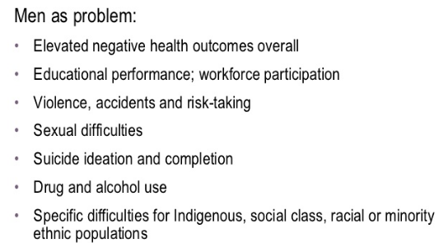
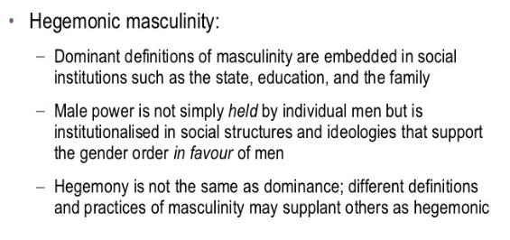
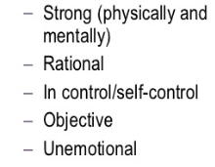
Charlie

Slide 18
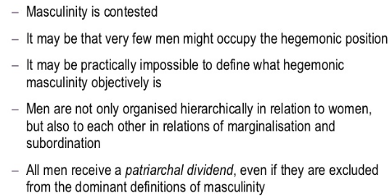
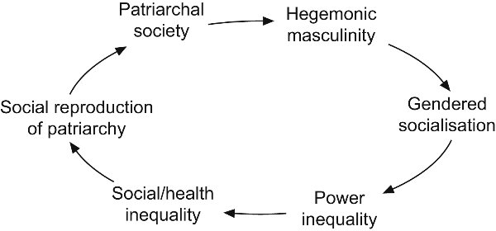
Hegemonic masculinity is a defined by sociologist R.W. Connell as the dominant social position of men, and the lesser social position of women.

Slide 19
Over estimation of ability
Abby Wilkinson

Slide 20
Some research has shown that the typical 14 year old girl concentrates for about three to four times as long as her fellow male students.
Francis suggests the development of feminine identity in school settings involves cooperative and conciliatory attitudes of teachers, other pupils and authority in general. This femininity is linked to a supportive attitude to schoolwork, reinforced and enhanced by a consequently more pro-school peer group.
Girls mature earlier: by the age of 16 girls are estimated to be more mature than boys by up to two years. Girls are more likely to view exams in a far more responsible way, and recognise their seriousness and importance of the academic and career choices that lie ahead of them.
Reasons why boys underachieve:
Lower expectations: evidence staff aren’t as strict with boys as girls. More likely to extend deadlines for them and be more tolerant of disruptive behaviour. These lower expectations could create a self-fulfilling prophecy contributing to boys’ lower achievement, as they perform less well than they otherwise might.
Boys are more disruptive: the male peer group often devalues school work and boys may achieve peer-group status by aggressive and dominating disruptive classroom behaviour. Boys are over three times more likely than girls to be excluded from schools, either permanently or for fixed terms; the most common reason for these exclusions is persistent disruptive behaviour, with exclusion usually coming at the end of a series of incidents.

Slide 21
Masculinity and the anti-learning subculture: Forde et. Al (2006) suggest peer-group pressure encourages boys to maintain dominant masculine identity, partly developed through resistance to school and therefore largely incompatible with academic success.
Epstein (1998) found that working-class boys, appear to gain ‘street cred’ by not working, and some develop an anti-education subculture, where schoolwork is seen as ‘girly’ and ‘unmacho’ where it is seen as not ‘cool’ to work hard.

Slide 22
INTERNAL FACTORS: Girls’ relative achievement

Slide 23
Labelling and self-fulfilling prophecy
Interactionist emphasises the idea of teacher labelling and say that this can have a significant effect on the way in which a student views themselves and their abilities thus causing them either succeed or fail at school.
Boys
Girls
In schools evidence has shown that some staff are not as strict with boys than they are with girls, as a result teachers are more likely to extend deadlines for work, therefore lower expectations of boys, to be more tolerant of the disruptive behaviour often found within classrooms. Theses lower expectations could create a self-fulling prophecy that’s contributing to boys lower achievement. For example Becky Francis (2000) she found that gendered based classrooms are tended to be dominated by boys, since they tend to monopolize space in the classroom and playground.
In classroom girls tend to draw less attention to themselves and are less disruptive in classrooms. In schools girl are seen as quieter than boys and teachers tend to treat boys and girls differently. This suggest that the expectations for girls are much higher than boys. Teachers expect girls to be better at language and creative subjects which creates a caring and sensitive label
Lucy Fazzone

Slide 24
Equal opportunities policies Tilda Horton-Insch
Since feminism there has been a greater emphasis on schools, equal opportunities meaning that that policy makers are more aware of gender issues.
These policies include monitoring teachers (such as Ofsted)and encouraging ‘girl-friendliness’ in male dominated subjects.
Campaigns such as WISE (women into science and engineering) have aimed to inspire girls to follow careers in subjects like science, technology, engineering and mathematics (STEM).
Other policies consist of GIST (Girls into science and technology) with many female scientist visiting schools acting as role models.
The introduction of the national curriculum in 1988 meant that girls and boys studied the same subjects, with Jo Boaler 1998 saying that barriers have been removed and schooling has become more meritocratic - girls who work harder will achieving more then boys.

Slide 25
Positive role models in schools
EMILY BOWDEN

Slide 26
Female role models in schools
There has been an increase in the amount of female leaders in schools. An example of this is the rise in female heads and teachers. Women in senior roles act as good role models for female students as it shows that women can achieve as much as or more than men. Important women in schools give girls non traditional goals to aim towards and help women and girls feel empowered in and out of school. The fact that female teachers would have had to undertake intense and lengthy education and training can also encourage girls to work hard in school to achieve what their role models have. Role models in schools pay an important role in explaining gender differences as seeing women and men as equal in a school environment integrates the idea of equal opportunities into the child's head. Although much of this is done at home, its does happen in school including in other ways such as teacher attention and challenging stereotypes.

Slide 27
Challenging Gender Stereotypes
Hannah
Some sociologists argue that the removal of stereotypes from textbooks, reading schemes and other learning materials in recent years has removed a barrier of girls achievement.
Research in the 1970s and 80s found that reading schemes portrayed women mainly as housewives and mothers, that physics books showed them as frightened by science, and that math's`` books depicted boys as more inventive.
Gaby Weiner in 1995 argued that since the 1980s teachers have and like to challenge stereotypes. Sexist images and stereotype roles have been removed from learning materials and education. This therefore may have lead to girls achieving higher as they have more opportunities.

Slide 28
Marketization
Marketization: the policy of introducing market forces of supply and demand into areas run by the state, such as education and national health service. The 1988 Education Reform Act began the marketization of education by encouraging competition between schools and choice for parents.
Marketization policies have created a more competitive climate in which schools see girls as desirable recruits because they achieve better exam results.
David Jackson (1988) notes the introduction of league tables has improved opportunities for girls: high achieving girls are attractive to schools, whereas low achieving boys are not which creates a self fulfilling prophecy – because girls are more likely to be recruited by good schools, they are more likely to do well.
Roger Slee (1998) argues that boys are less attractive to schools because they are more likely to suffer from behavioural difficulties and 4 times more likely to be excluded resulting in boys being seen as ‘liability’ students – obstacles to the school improving its league table scores.
This encourages:
Cream-skimming: Good schools can be more selective, choose their own customers and recruit high achieving, mainly middle class pupils. As a result, these pupils gain an advantage.
Silt-shifting: Good schools can avoid taking less able pupils who are more likely to get poor results and damage the schools league table position.
Aysha

Slide 29
INTERNAL FACTORS: Boys’ relative underachievement

Slide 30
As above …
Labelling and self-fulfilling prophecy
Interactionist emphasises the idea of teacher labelling and say that this can have a significant effect on the way in which a student views themselves and their abilities thus causing them either succeed or fail at school.
Boys
Girls
In schools evidence has shown that some staff are not as strict with boys than they are with girls, as a result teachers are more likely to extend deadlines for work, therefore lower expectations of boys, to be more tolerant of the disruptive behaviour often found within classrooms. Theses lower expectations could create a self-fulling prophecy that’s contributing to boys lower achievement. For example Becky Francis (2000) she found that gendered based classrooms are tended to be dominated by boys, since they tend to monopolize space in the classroom and playground.
In classroom girls tend to draw less attention to themselves and are less disruptive in classrooms. In schools girl are seen as quieter than boys and teachers tend to treat boys and girls differently. This suggest that the expectations for girls are much higher than boys. Teachers expect girls to be better at language and creative subjects which creates a caring and sensitive label
Lucy Fazzone

Slide 31
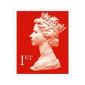
Anti school subcultures
Alex
To be “Anti school” is to go against the norms and values of the school system. (often associated with “laddish” culture)
Students will often reject the system by refusing to listen to teachers, not doing homework and being disruptive within lessons.
Can be a self fulfilling prophecy as it is often students who are put in lower sets and believe they cannot achieve high results who behave in this way.
Boys are more likely to reject the school system in this way because it is a sign of masculinity and if they do appear to always be good students they are more likely to receive verbal abuse from their peers. (Epstein et al 1998)
Could be due to a lack of role models for boys as there are fewer male than female teachers.

Slide 32
Why are boys underachieving? Internal Factors
Will
Tony Sewell claims our education system has become ‘feminised’. Schools no longer nurture masculine qualities such as competitiveness and leadership.
They focus on qualities more closely associated with girls instead. (Methodical working, attentiveness in class.
He argues that some coursework needs to be replaced with final exams and a greater emphasis must be placed on outdoor activity/adventure in the curriculum.
As girls’ educational achievement has overtaken boys’, teachers have begun labelling female students as more likely to succeed, thus creating a self-fulfilling prophecy.
Girls are generally more willing to conform to the rules of the school than boys + disproportionate number of female teachers alienates them further from the school culture.
Research suggests that boys find it harder to conform to ‘hardworking’ school culture, due to their juxtaposed ‘laddish’ subculture.
Boys face social attack for deviating from their ‘laddish’ anti-work subculture and trying to work hard. They face negative labelling and bullying if they try to conform to school culture.

Slide 33
Lack of male role models
Lucy R

Slide 34
The lack of male role models both at home and at school is believed to be a cause of boys underachievement. For example, large amounts of boys are being brought up in the 1.5 million female-headed lone parent families in the UK.
Although, only 14% of primary school teachers are male. According to Yougov (2007), 39% of 8-11 year old boys have no lessons whatsoever with a male teacher. Yet most boys surveyed said the presence of a male teacher made them behave better and 42% said it made them work harder.
Some commentators argue that this has become as a result of the culture of the primary school. It has become feminised caused by being staffed by female teachers, who are unable to control the boys behaviour. In this view, male teachers are better able to impose the strict discipline boys need in order to concentrate. If this view is correct, it would suggest primary schools need more male teachers.

Slide 35
However, research suggests that the absence of male teachers may not be a major factor in boys underachievement. For example, Becky Francis (2006) found that two thirds of 7-8 year olds believed the gender of the teacher did not matter.
Barbara Read (2008) is also critical of the claims that the culture o of primary schools is becoming feminised and that only male teachers can exert the firm discipline that boys need to achieve.
To test this, Read studied the type of language teachers use to express criticism. She identified two types of discourse:
A disciplinarian language: the teachers authority is made explicit and visible, for example, shouting
A liberal language: the teachers authority is implicit and invisible. This child-centred discourse involves ‘pseudo-adultification’

Slide 36
So overall…

Slide 37
FEMINIST ANALYSIS blends the structuralist and Interactionist
Concerned with the ways schooling may systematically disadvantage girls and reinforce the nature of patriarchy.
PAST | PRESENT
Concerned with the underperformance of girls in the educational system The ways in which this may have been reinforced by school structures and interaction. | The remaining patriarchal systems that exist in education. Interactions in the classroom and how they create DEA. Some Feminists maybe interested in looking at why boys are now failing. (Liberal feminism)
[What may have influenced this change in focus?]

Slide 38
Recent Trends in Gender from the late 1980s to the present day.
GCSE was introduced in 1988 and from then onwards the female- male gender difference in educational achievement at GCSE level widened
By the late 1980s females were more likely than males to gain two or more A Level passes and during the course of the 1990s they also became more likely to gain 3 or more A level passes.
Females became more likely than males to gain A grades in almost all A Level subjects BUT gender differences in exam performance at A level are smaller than at GCSE.
Females are more likely than males to enrol on Undergraduate and Post Graduate courses.
Males are still marginally more likely than females to gain First Class degrees but females are significantly more likely than males to gain Upper Second degrees.
There are still some significant gender differences in subject choice at Advanced level and Degree level and these differences could potentially restrict women’s future employment prospects.

Slide 39
Problems with this picture
It is important to consider the relative sizes of gender, social class and ethnic differences in educational achievement and the interconnected effects of gender, ethnicity and social class on educational achievement. This is called INTERSECTIONALITY.
Gender differences are far smaller than social class differences in educational achievement. Students of both sexes who are eligible for free school meals are far less likely than students of both sexes ineligible to be successful at all levels of the education system.
Some ethnic differences in educational achievement are also greater than gender differences in educational achievement.
NOTE: All of these are potential evaluation points to include in a relevant essay!

Slide 40
Summary: Explaining the differences
In order to analyse the relative educational improvement from the 1980s onwards we must distinguish between:
factors accelerating the rate of female improvement
factors restricting the rate of male improvement.
and then look at the possible division between schools as a factor in this or wider socio-economic issues
BUT REMEMBER:
Females’ and males’ educational achievements have both improved over time - the rate of female improvement has been faster and this widened the female-male achievement gap
Gender, social class and ethnicity are interconnected. Girls are more successful than boys in all ethnic groups but middle class boys are still more educationally successful than working class girls in all ethnic groups.

Slide 41
CONTINUING PROBLEMS FOR GIRLS? 2 examples
IN EMPLOYMENT
The so-called “glass ceiling” still exists in employment – as women’s careers can stall because of
family pressures / maternity leave
Stereotyping by employers
“Old Boy” Networks
etc
(Post?) feminist approaches – THE “GENDER REGIME”
Valerie Hey/ Martin Mac an Ghaill – Heteronormativity
Heterosexuality is a learned characteristic for most if not all, and hegemonic male sexuality dominates
Other sexualities and genders are relatively stigmatised, marginalised or punished through the hidden curriculum of the school, or the actions of other pupils in reinforcing group norms.
So girls still learn subordination and schools still reinforce patriarchal attitudes

Slide 42
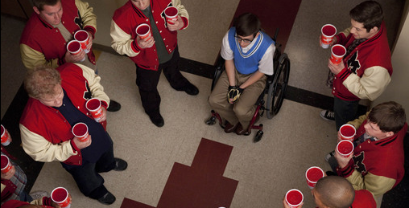
Heteronormativity represented in US TV shows/ Films:
The hierarchy of gender/sexuality
Heterosexual male
Heterosexual female
Homosexual female
Homosexual male
Gender Regime
“Jock Culture”

Slide 43
CASE STUDY: Archer et al
You will need to review the booklet on page 7 and use the textbook pages 56-57 and article. This follows the main headings only

Slide 44
Archer et al Key headings
Symbolic Capital
Hyperheterosexual feminine identities
Boyfriends
Being "loud"
Working Class Girls' dilemma
'Successful' working class girls

Slide 45
Symbolic Capital
Symbolic Capital = status, recognition, sense of worth from others
This is gained by "performing" working class feminine identities
Contrast to educational capital lost in conflict with schools
strategies to create valued sense of self include:
hyper-hetrosexuallity
having a boyfriend
being "loud"
etc.

Slide 46
Hyperheterosexual feminine identities
Bid for status amongst peers to create a desirable/glamorous identity
Uses branding, etc - identity through consumption
Takes time / effort / money
Leads to conflict with schools
rules on jewellery / makeup / clothing etc
Seen as a distraction from education
THEREFORE school "othered" girls (Symbolic Violence)
Working class girls deemed “unworthy” / “incapable” by school and teachers

Slide 47
Boyfriends
Increased symbolic capital with peers
BUT
obstructs schoolwork
lowered aspirations
“Settling down” becomes the only ambition/aspiration

Slide 48
Being "loud"
Alternative option to be outspoken / assertive
BUT
This leads to conflict with school
Questioning teachers' authority
Behaviour interpreted as aggressive

Slide 49
Working Class Girls' dilemma
EITHER
gain symbolic capital from peers and
maintain hyperheterosexual identity
OR
gain educational capital from school through conformity but
This rejects working class identity
MAYBE ALSO
Try to be "good underneath"
coping mechanism to deal with rejection by school
establish self-worth in face of rejection

Slide 50
“Successful” working class girls remain “home centred”
Even successful girls wish to remain in parental home because
They want to succeed educationally to help their family (Evans)
Its an economic necessity
debt averse and may struggle to meet costs (limited resources)
They positively choose home (Archer)
Habitus – they prefer local to distant
BUT taking the home option limits
Their university choices
The market value of available degrees

Slide 51
Planning/Evaluating?
Gender & Education

Slide 52
Q. Why do girls do better than boys in the education system?
INTERNAL
EXTERNAL
Key factors within schools with studies/evidence
Key factors from outside schools with studies/evidence
Identify 3/4 key factors and supporting evidence you would use
Identify 3/4 key factors and supporting evidence you would use
NB
Do these factors effectively explain the change from 1988 onward?
Are these factors measurable/quantifiable?
Do they focus on girls’ relative success or boys’ relative failure?
Can we assume that girls really “do better” in an unqualified way?

