Slide 1
Gender and DEA
2016/2017

Slide 2
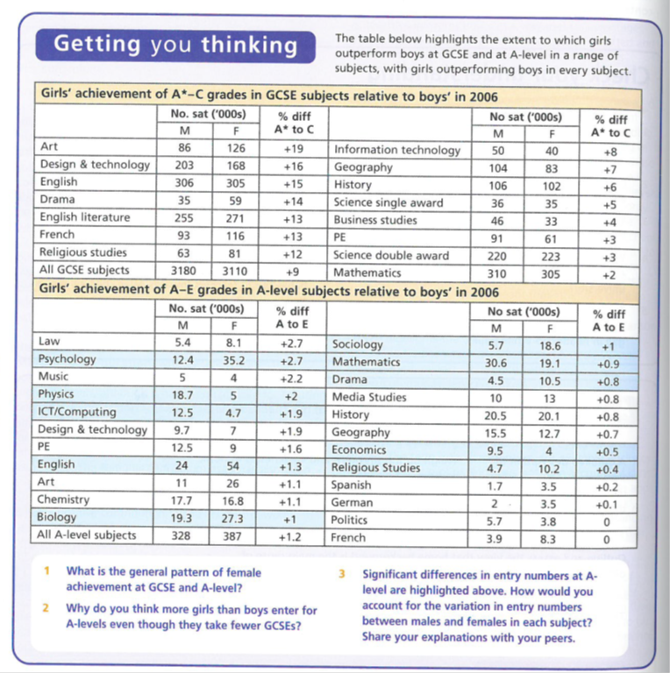
Gender and DEA: Data

Slide 3
Girls and Boys achievement in Education
STUDENT WORK
D2 group
March 2017

Slide 4
The impact of the women’s movement | Webb 52 Browne 69
The Family | Webb 52
Changes in women’s employment | Webb 52 Browne 69-70
Girls’ ambition | Webb 52 Browne 70
Maturity | Browne 69 & 70
Globalisation and declining traditional male employment | Webb 57 Browne 71 SIF 184
Male Identity Crisis | SIF 43 & 184
Hegemonic Masculinity | Webb 72 SIF 41
Over estimation of ability | Browne 70 & 71
Labelling and the Self-fulfilling prophecy | Webb 54
Equal Opportunities Policies | Webb 53-54 Browne 69
Positive role models in school | Webb 53 & 57
Challenging gender stereotypes | Webb 55
Marketization | Webb 55
Labelling and the Self-Fulfilling Prophecy | Webb 58 Browne 70
Anti-school subcultures | Webb 58 Browne 71
Feminised curriculum | Webb 57 & 58
Lack of male role models | Webb57-58

Slide 5
EXTERNAL FACTORS: Girls’ relative achievement

Slide 6
The impact of women's movement and feminism
Feminism is a social movement that strives for equal rights, since the 1960’s, the feminist movement has changed the traditional stereotype of a women's role as solely of a mother and housewife in a traditional nuclear family and inferior to men outside the home, in work and in the law
Feminist argue we have not yet achieved equality between the sexes, but the feminist movement has had a huge impact in improving women’s rights and opportunity's through changes in the law. Feminism has improved women's self esteem and expectations.
Angela McRobbie’s (1994) – study of girls magazines - in the 1970’s they emphasised the importance of getting married and not being ‘left on the shelf’, whereas nowadays they contain images of assertive and independent women
The change which came from feminism affects girls self image and ambitions with regard to the family and careers, which can improve their educational achievement
Florrie

Slide 7
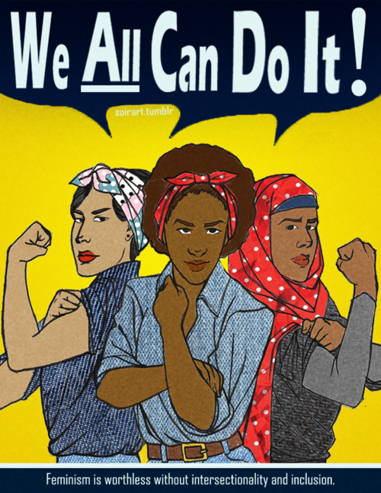
Mitsos and Browne 1998 – why females do better than males
The women's movement and feminism have achieved considerable success in improving the rights and raising the expectations and self esteem of women.
They have challenged the traditional stereotype of women's role as housewives and mothers , and more people have become aware of the problem of patriarchy, gender role stereotype and sex discrimination
This means women now look beyond being a housewife/mother as their main role in life
By Florrie

Slide 8
Changes in the Family
There have been major changes in the family since the 1970s:
An increase in the divorce rate
An increase in cohabitation and a decrease in the number of first marriages.
An increase in the number of lone parent families
Smaller families
To achieve this independence women need well paid jobs and therefore good qualifications. Likewise increases in the divorce rate may suggest to girls that it is unwise to rely on a husband to be their provider. Again, this may encourage girls to look to themselves and their own qualifications to make a living
These changes are affecting girls’ attitudes towards education in a number of ways. For example increase number of female headed lone-parent families may mean more women need to take on the breadwinner role.
Rory

Slide 9
Changes in the Position of women in employment.
Equal Pay Act 1970 – made it illegal to pay women less than men for work of equal value.
Sex Discrimination Act 1975 – Outlaws any discrimination at work.
Since 1975, the pay gap between men and women has decreased from being 30% to 15%. Apart from this there has been a rise in the amount of women in employment in 1971 the statistic was at 53% and in 2013 it was 67%. This can be caused by the growth of the of the private sector as well as the flexibility of working hours now each has allowed women to have more opportunities.
The ‘Glass ceiling’ which had previously limited women from what they wanted to accomplish. Some women are now breaking through the invisible barrier which blocking women from reaching high level professional and managerial jobs with the sectors of the working world.
As a result of this it has enabled girls to see their futures as something more than just being housewives. Since greater opportunities are now being offered to them along side better pay. Successful women act as role models for young girls to provide incentive to gain qualifications.
Angelica

Slide 10
GIRLS’ AMBITION
Beck and Beck-Gernsheim (2001)
Link this to the trend towards individualism in modern society
independence is valued much more strongly now than in the past.
A career has become part of a women’s life project because it promises recognition and economic self-sufficiently.
Sue Sharpe (1994)
Interviews with girls In the 1970s and the 1990s show a major shift in the ways that girls see their future.
In 1974, the girls had low aspirations; they believed educational success was unfeminine and that appearing to be ambitious would be viewed as unattractive. The girls gave their ambitions as ‘love, marriage, husbands, children, jobs and careers, more or less in that order.
By the 1990s, girls ambitions had changed and they had a different order of priorities – careers and being able to support themselves. Sharpe found that girls were now more likely to see their future as an independent women with a career rather than as dependent on their husbands and his income.
O’Conner’s (2006)
Study of 14-17 year olds found that marriage and children were not a major part of their life plans.
Carol Fuller (2011)
Educational success was a central aspect of their identity
In order to achieve independence and self-sufficiency, many girls now recognise that they need a good education
Nicole Amy Taylor

Slide 11
Maturity
Girls priorities in 1994 were ‘job, career and being able to support themselves’.
Francis (2000) found out from her research that many girls were very ambitious, aiming for higher professional occupations like doctors and solicitors rather than traditional female occupations.
Evidence that girls work harder and are better motivated compared to boys. They put more effort into their work and spend more time on their homework.
By the age of 16 girls are seen to be more mature than boys in some cases, up to 2 years. Due to this, girls are more likely to view exams more seriously and are far more responsible towards their career and academic choices.
Girls are better organised, while boys are more disruptive in the classroom than girls.
Boys spend less time in the classroom learning due to either being sent out or being sent home.
Jazmine

Slide 12
EXTERNAL FACTORS: Boys’ relative underachievement

Slide 13
Globalisation
Sociology
Luke

Slide 14
What is Globalisation?
Globalisation is the process by which the world is becoming increasingly interconnected as a result of massively increased trade and cultural exchange. Globalisation has increased the production of goods and services. The biggest companies are no longer national firms but multinational corporations with subsidiaries in many countries.
Globalisation has been taking place for hundreds of years, but has speeded up enormously over the last half-century.

Slide 15
What has globalisation resulted in?
increased international trade
a company operating in more than one country
greater dependence on the global economy
freer movement of capital, goods, and services
recognition of companies such as McDonalds as well as Starbucks

Slide 16
Reasons for globalisation
Improvements in transportation - larger cargo ships mean that the cost of transporting goods between countries has decreased. Economies of scale mean the cost per item can reduce when operating on a larger scale. Transport improvements also mean that goods and people can travel more quickly.
Freedom of trade - organisations like the World Trade Organisation (WTO) promote free trade between countries, which help to remove barriers between countries.
Improvements of communications - the internet and mobile technology has allowed greater communication between people in different countries.
Labour availability and skills - countries such as India have lower labour costs (about a third of that of the UK) and also high skill levels. Labour intensive industries such as clothing can take advantage of cheaper labour costs and reduced legal restriction.

Slide 17
Positive impacts of globalisation
Inward investment helps countries by providing new jobs and skills for local people.
brings wealth and foreign currency to local economies when they buy local resources, products and services. The extra money created by this investment can be spent on education, health and infrastructure.
The sharing of ideas, experiences and lifestyles of people and cultures. People can experience foods and other products not previously available in their countries.
Globalisation increases awareness of events in far-away parts of the world. For example, the UK was quickly made aware of the 2004 tsunami tidal wave and sent help rapidly in response.
Globalisation may help to make people more aware of global issues such as deforestation and global warming - and alert them to the need for sustainable development.

Slide 18
Negative impacts of globalisation
Globalisation operates mostly in the interests of the richest countries, which continue to dominate world trade at the expense of developing countries. The role of LEDCs in the world market is mostly to provide the North and West with cheap labour and raw materials.
There are no guarantees that the wealth from inward investment will benefit the local community. Often, profits are sent back to the MEDC where the TNC is based. Transnational companies, with their massive economies of scale, may drive local companies out of business. If it becomes cheaper to operate in another country, the TNC might close down the factory and make local people redundant.
An absence of strictly enforced international laws means that TNCs may operate in LEDCs in a way that would not be allowed in an MEDC. They may pollute the environment, run risks with safety or impose poor working conditions and low wages on local workers.
Globalisation is viewed by many as a threat to the world's cultural diversity. It is feared it might drown out local economies, traditions and languages and simply re-cast the whole world in the mould of the capitalist North and West. An example of this is that a Hollywood film is far more likely to be successful worldwide than one made in India or China, which also have thriving film industries.

Slide 19
Globalisation and the decline of traditional men's job
Since the 1980s, there has been a significant decline in heavy industries such as iron and steel, shipbuilding, mining and engineering. This has been partly the result of the globalisation of the economy, which has led to much manufacturing industry relocating to developing countries such as China to take advantage of cheap labour.
Traditionally, these sectors of the economy mainly employed men. Mitsos and Brownie claim that this decline in male employment opportunities has led to an ‘ identify crisis for men ‘. Many boys now believe that they have little prospect of getting a proper job. This undermines their motivation and self esteem and so they give up trying to get qualifications

Slide 20
Male Identity Crisis
Libby
New jobs in the service sector tend to be desk jobs in offices and call centres or jobs involving care for others which requires sensitivity and interpersonal skills, which do not sit happily with traditional working class masculine identities. And now even ‘macho’ jobs in the service sector (e.g. police, fire service) require high levels of sensitivity. This causes a male identity crisis because they are unsure on what jobs they want to take part in because they want to uphold their masculine identity like they feel they should.
Because of a collapse in the ‘macho’ jobs which fitted traditional working class masculine identities it has left these men who would normally do these jobs uncertain of their identities and threatened and confused, according to Jackson (1998)
Gender roles can now overlap with men and women adopting similar attitudes and lifestyles. It is more accepted now for women to do ‘male’ jobs and the other way round, which can cause a male identity crisis because they are unsure of the split between what they should and shouldn’t do as a masculine person

Slide 21
Hegemonic Masculinity Gabriel
Hegemonic control is about how there is a form of dominance in patriarchy, which convinces the rest of society that whatever the patriarchy say is the truth and they should not be questioned.
This relates to the start of GCSEs and women starting to become more involved in studies. Men were made to do more logical subjects, and women more into creative subjects.
Men may still tend to be influenced by Hegemonic Masculinity to be dominant and to follow what defines a “real man”. Those who don’t tend to follow this are seen as being odd, or even abnormal.

Slide 22
Over estimation of ability
Megan

Slide 23
Over estimation of ability
Stanworth (1983) and Licht and Dweck (1987 found that girls lacked confidence in and underestimated their own ability, and felt that they were undervalued in the classroom.
Renold and Allens (2006) research suggests that this is still true today. They found from their research from looking at different primary schools and looking at the high achieving girls were torn between being seen as academically bright and also being attractive to boys.
The problem with this is that by being attractive to boys it has resulted in the girls academic achievements falling.

Slide 24
Barber (1996) showed that more boys than girls think that they are able or very able, and fewer boys than girls think that they are below average.
The GCSE results show that boys think that they are bright and capable to achieve good results, but they don’t want to revise for their exams, so they don’t end up doing as well.

Slide 25
Why are girls outperforming boys? Labelling and the self-fulfilling prophecy
CAM HEATHER
Girls are more cooperative and attentive in class
When working in groups they take turns instead of interrupting which is usually seen in boy’s behaviour
They take more care in their work and presentation
Therefore, teachers respond more positively to girls, than boys
Who they see as more potentially disruptive
This can lead to a self-fulfilling prophecy;
Successful interactions with the teachers; teachers believe they will do well
Promotes the girl’s self esteem and they want to do better
Therefore raises their achievement levels and they do better.
Key studies
Jane and Peter French (1993):
Analysed classroom interactions and found boys had more attention due to more reprimands
Becky Francis (2001):
While boys got more attention, they were disciplined more harshly and felt picked on by teachers
Swann (1998):
Also found gender differenced in communication styles- boys dominated whole-class discussion whereas girls are more quiet and prefer pair and group work.

Slide 26
INTERNAL FACTORS: Girls’ relative achievement

Slide 27
Equal opportunity Policies- Tabitha Sowa
Feminist ideas have had a major impact on the education system. Policymakers are now much more aware of gender issues and teachers are more sensitive to the need to avoid stereotyping. The belief that boys and girls are entitled to the same opportunities is now part of mainstream thinking and it influences educational policies.
There are programmes such as GIST (Girls into science and technology) and WISE (women into science and engineering) encourage girls to pursue careers in these non-traditional areas.
Ofsted enforced the national curriculum introduced in 1988 removed one source of gender inequality by making girls and boys study mostly the same subjects, which was often not the case previously. Jo Boaler (1998) sees the impact of equal opportunities as a key reason for the changes in girls’ achievement. Many of the barriers have been removed and schooling has become more meritocratic (based on equal opportunities)- so that girls, who generally work harder than boys, achieve more.

Slide 28
WHY ARE GIRLS OUTPERFORMING BOYS?
POSITIVE ROLE MODELS IN SCHOOL
Hannah Fisher☺
Within primary school(especially), there is a very strong female dominance in the teaching sector, this is because women usually have a maternal nature/nurture behaviour, additionally, children more often respond better to women as they see them as a kind of mother figure. Also, girls will respond to this better than boys and therefore, do better at their education, because they see the teachers(female) as a role model; being successful at work, and friendly.
86% of primary school teachers are female.
Liberal Feminists celebrate the progress made so far in improving achievement. They believe that further progress will be made by the continuing development of equal opportunities policies, encouraging positive role models and overcoming sexist attitudes and stereotypes.
According to Statistical First Release - Gov.uk;
Female teachers account for 74% of all teachers. Although there is a more pronounced difference by phase. For example, 85% of primary school teachers are female compared with 62% of secondary school teachers.
In 2014, 80% of the full-time equivalent number of employees working in schools were female. There has been a very small increase compared with 2013 when 79.7% were female.
79% of school support staff and 91% of teaching assistants are female.

Slide 29
Challenging gender stereotypes
Alicia

Slide 30
Removal of gender stereotypes
The removal of gender stereotypes from textbooks, reading schemes and other learning materials, has removed a barrier to girls’ achievement in recent years. This has been argued by some sociologists.
Research in the 1970s and 80s found that reading schemes portrayed women as mainly housewives and mothers, taking on a more emotional, caring role. Physics books showed women as frightened by science and maths books depicted boys as more inventive.
Gaby Weiner (1995) argues that since the 1980s, teachers have challenged such stereotypes. Also, sexist images have been removed from learning materials which may have helped to raise girls’ achievement by presenting them with more positive images of what women can do.

Slide 31
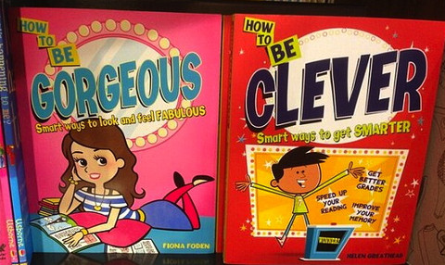
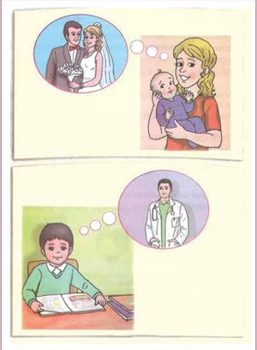

Slide 32
The result
It is important to ensure that children’s aspirations are not limited by traditional ideas about what girls and boys can do, which is why there was such a need to remove all gender stereotypes in learning materials.
This will help young people and adults to have respectful relationships and improving behaviour in our classrooms. Indeed, a significant body of research already exists to support this argument. This can be achieved at an early age through the removal of gender stereotypes in educational resources. This will help people in later life to achieve whatever they want to do.

Slide 33
Marketization
Rosie
Marketization policies create competition in which schools see girls and desirable recruits as they receive better exam results.
David Jackson (1998) notes intro of exam league tables has improved opportunities for girls, high achieving girls are attractive to schools, low achieving boys are not. Creates self-fufilling prophecy- as girls are more likely to be recruited by schools as they more likely to do well.
Roger Slee (1998) argues boys are less attracted to schools because they are more likely to suffer from behavioural difficulties and are four times more likely to be excluded.
As a result boys may be seen as ‘liability students’ – obstacles to the school improving its league table boards.
They give the school a ‘rough, tough’ image that deters high-achieving girls from applying.

Slide 34
INTERNAL FACTORS: Boys’ relative underachievement

Slide 35
Labelling and Self Fulfilling Prophecy:
Why boys are underachieving:
There is some evidence that staff aren’t as strict with boys as they are with girls.
They are more likely to extend deadlines for work, have lower expectations and to be more tolerant of the disruptive behaviour often found more commonly from boys in the classroom and to accept more poorly presented work.
These lower expectations could create a self-fulfilling prophecy contributing to boys’ lower achievement, as they perform less well than they otherwise might.
Kane (2006) developed Willis’s ideas that working class boys actively participating in creating their identities and in doing so come into conflict with the school. Kane study of 4 schools in Scotland where heavy industry had all but finished, working class boys were excluded for general persistent disobedience (they were negatively labelled). Kane also argued that some of the boys sought well paid jobs, but because of a lack of knowledge about university and the financial burdens involved, none of them had considered it. They were actively responding to their situation in different ways. The higher rates of exclusion for boys are closely linked to the impact of class, as middle class boys are less likely to be excluded.
Kane’s study shows that the negative labelling of working class boys creates a self fulfilling prophecy, therefore instead of being pushed by their teachers they continue to slack and get behind in class work. This slacking has cause them to underachieve and instead of improving they just get worse.
Caitlin

Slide 36
Anti-school subcultures
Lottie
Some sociologists argue that the growth of ‘laddish’ subcultures has contributed to boys’ underachievement. Debbie Epstein (1998) examined the way masculinity is constructed within school. She found that working class boys are likely to be harassed, labelled as sissies and subjected to homophobic verbal abuse if they appear to be ‘swats.’
This supports Francis’ (2001) finding that boys were more concerned than girls about being labelled by peers as swots, because this is more of a threat to their masculinity than it is to girls’ femininity.
She notes that: ‘ the demand on boys within their peer group, but also sometimes from teachers, is to appear to do little or no work, to be heavily competitive at sports and heterosex, to be rough, tough and dangerous to know.’

Slide 37
The Feminised Curriculum
Tony Sewell - Schools do not nurture masculine traits such as competitiveness and leadership instead focus on qualities associated with girls such as methodical working.
Sewell sees coursework as a major cause of gender differences in achievement
In 1974 Glenys Lobban found evidence of gender bias towards boys in a very wide range of educational reading Lesley Best confirmed these findings in the 1990s. But more “politically correct” materials have been an important result of this sort of research. This may not privilege boys’ experience as they might expect. (DAK pushed this one in…)
Mitch

Slide 38
LACK OF MALE ROLE MODELS
Val Vadcard // 2D // 09/03/2017

Slide 39
ACHIEVEMENTS
BOYS AND LITERACY
There was a study in 2007 made by the DCSF which showed that the gender gap has come as a result of boy’s poorer literacy and language skills. One reason which is said to be the responsible of this is the fact that children see their mothers as the one who reads the most, therefore, they label it as a “feminine” activity and feel discourage to read in fear of losing masculinity.
Similarly, as boys see reading as a feminine activity, they often go to sports- maybe because they want to or they are encouraged by their parents to do so. Playing sports do not improve boys language and communication skills, however, all boys around them as well as their teachers are likely to be male who create an example for them.
Boys are often not encouraged by their fathers to read or so any activity which could improve their language. It is likely that they see these kind of activities as “feminine” as well, moreover, these ideas are passed down.
DECLINE ON TRADITIONAL MALE JOBS
Mitsos and Browne claim that the recent decline in male employment opportunities has led to an “identity crisis for men”. Many boys now don’t see any chance of them getting a “proper job”. They lose motivation and give up on trying to get qualifications.
FEMINSATION OF EDUCATION
Tony Sewell argues that boys are falling behind in education because education it has become “feminised”. There isn’t a figure in school which represents “masculinity” with traits such as competiveness and leadership.
SHORTAGE OF MALE PRIMARY SCHOOL TEACHERS
The lack of male role models both at home and at school is said to be the cause of boys’ underachievement.
Only 14% of primary school teachers are male and according to Yougov (2007) 39% of year 8-11 years old boys have no lessons whatsoever with a male teacher.

Slide 40
So overall…

Slide 41
FEMINIST ANALYSIS blends the structuralist and Interactionist
Concerned with the ways schooling may systematically disadvantage girls and reinforce the nature of patriarchy.
PAST | PRESENT
Concerned with the underperformance of girls in the educational system The ways in which this may have been reinforced by school structures and interaction. | The remaining patriarchal systems that exist in education. Interactions in the classroom and how they create DEA. Some Feminists maybe interested in looking at why boys are now failing. (Liberal feminism)
[What may have influenced this change in focus?]

Slide 42
Recent Trends in Gender from the late 1980s to the present day.
GCSE was introduced in 1988 and from then onwards the female- male gender difference in educational achievement at GCSE level widened
By the late 1980s females were more likely than males to gain two or more A Level passes and during the course of the 1990s they also became more likely to gain 3 or more A level passes.
Females became more likely than males to gain A grades in almost all A Level subjects BUT gender differences in exam performance at A level are smaller than at GCSE.
Females are more likely than males to enrol on Undergraduate and Post Graduate courses.
Males are still marginally more likely than females to gain First Class degrees but females are significantly more likely than males to gain Upper Second degrees.
There are still some significant gender differences in subject choice at Advanced level and Degree level and these differences could potentially restrict women’s future employment prospects.

Slide 43
Problems with this picture
It is important to consider the relative sizes of gender, social class and ethnic differences in educational achievement and the interconnected effects of gender, ethnicity and social class on educational achievement. This is called INTERSECTIONALITY.
Gender differences are far smaller than social class differences in educational achievement. Students of both sexes who are eligible for free school meals are far less likely than students of both sexes ineligible to be successful at all levels of the education system.
Some ethnic differences in educational achievement are also greater than gender differences in educational achievement.
NOTE: All of these are potential evaluation points to include in a relevant essay!

Slide 44
Summary: Explaining the differences
In order to analyse the relative educational improvement from the 1980s onwards we must distinguish between:
factors accelerating the rate of female improvement
factors restricting the rate of male improvement.
and then look at the possible division between schools as a factor in this or wider socio-economic issues
BUT REMEMBER:
Females’ and males’ educational achievements have both improved over time - the rate of female improvement has been faster and this widened the female-male achievement gap
Gender, social class and ethnicity are interconnected. Girls are more successful than boys in all ethnic groups but middle class boys are still more educationally successful than working class girls in all ethnic groups.

Slide 45
CONTINUING PROBLEMS FOR GIRLS? 2 examples
IN EMPLOYMENT
The so-called “glass ceiling” still exists in employment – as women’s careers can stall because of
family pressures / maternity leave
Stereotyping by employers
“Old Boy” Networks
etc
(Post?) feminist approaches – THE “GENDER REGIME”
Valerie Hey/ Martin Mac an Ghaill – Heteronormativity
Heterosexuality is a learned characteristic for most if not all, and hegemonic male sexuality dominates
Other sexualities and genders are relatively stigmatised, marginalised or punished through the hidden curriculum of the school, or the actions of other pupils in reinforcing group norms.
So girls still learn subordination and schools still reinforce patriarchal attitudes

Slide 46
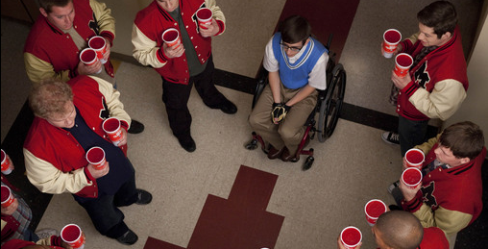
Heteronormativity represented in US TV shows/ Films:
The hierarchy of gender/sexuality
Heterosexual male
Heterosexual female
Homosexual female
Homosexual male
Gender Regime
“Jock Culture”

Slide 47
CASE STUDY: Archer et al
You will need to review the booklet on page 7 and use the textbook pages 56-57. This follows the main headings only

Slide 48
Archer et al Key headings
Symbolic Capital
Hyperheterosexual feminine identities
Boyfriends
Being "loud"
Working Class Girls' dilemma
'Successful' working class girls

Slide 49
Symbolic Capital
Symbolic Capital = status, recognition, sense of worth from others
This is gained by "performing" working class feminine identities
Contrast to educational capital lost in conflict with schools
strategies to create valued sense of self include:
hyper-hetrosexuallity
having a boyfriend
being "loud"
etc.

Slide 50
Hyperheterosexual feminine identities
Bid for status amongst peers to create a desirable/glamorous identity
Uses branding, etc - identity through consumption
Takes time / effort / money
Leads to conflict with schools
rules on jewellery / makeup / clothing etc
Seen as a distraction from education
THEREFORE school "othered" girls (Symbolic Violence)
Working class girls deemed “unworthy” / “incapable” by school and teachers

Slide 51
Boyfriends
Increased symbolic capital with peers
BUT
obstructs schoolwork
lowered aspirations
“Settling down” becomes the only ambition/aspiration

Slide 52
Being "loud"
Alternative option to be outspoken / assertive
BUT
This leads to conflict with school
Questioning teachers' authority
Behaviour interpreted as aggressive

Slide 53
Working Class Girls' dilemma
EITHER
gain symbolic capital from peers and
maintain hyperheterosexual identity
OR
gain educational capital from school through conformity but
This rejects working class identity
MAYBE ALSO
Try to be "good underneath"
coping mechanism to deal with rejection by school
establish self-worth in face of rejection

Slide 54
“Successful” working class girls remain “home centred”
Even successful girls wish to remain in parental home because
They want to succeed educationally to help their family (Evans)
Its an economic necessity
debt averse and may struggle to meet costs (limited resources)
They positively choose home (Archer)
Habitus – they prefer local to distant
BUT taking the home option limits
Their university choices
The market value of available degrees

Slide 55
Planning/Evaluating?
Gender & Education

Slide 56
Q. Why do girls do better than boys in the education system?
INTERNAL
EXTERNAL
Key factors within schools with studies/evidence
Key factors from outside schools with studies/evidence
Identify 3/4 key factors and supporting evidence you would use
Identify 3/4 key factors and supporting evidence you would use
NB
Do these factors effectively explain the change from 1988 onward?
Are these factors measurable/quantifiable?
Do they focus on girls’ relative success or boys’ relative failure?
Can we assume that girls really “do better” in an unqualified way?

