Slide 1
Quick recap of definitions for families and households. Definition of the Family
A family is a group of people who are related by kinship ties: relations of blood, marriage or adoption.

Slide 2
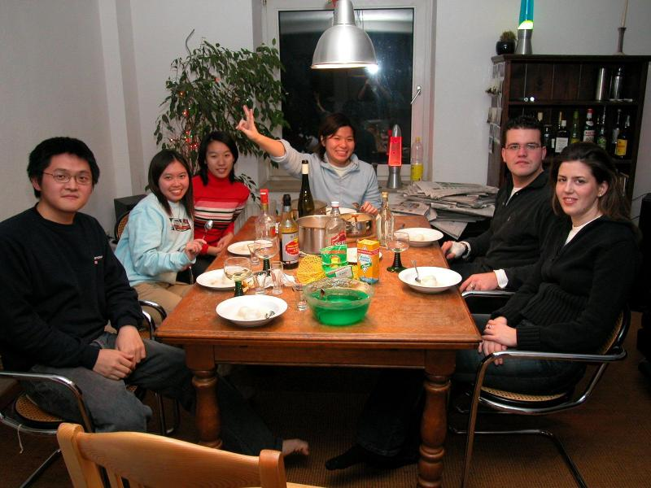
Definition of a household
A household means one person or a group of people who live at the same address and share living arrangements.

Slide 3
Different forms of marriage
Monogamy | One husband and one wife. | Found in Europe, USA and most Christian cultures.
Serial Monogamy | A series of monogamous marriages | Found especially in Europe and the USA, where there are high rates of divorce and remarriage
Arranged marriage | Marriages arranged by parents to match their children with partners of a similar background and status. | Found in the Indian subcontinent and Muslim, Sikh and Hindu minority ethnic groups in Britain.
Civil partnership | A legal recognition of the relationships of same-sex couples. Give equal treatment to same-sex partners. In 2014 gay and lesbian couples are now able to marry on the same basis | England, Scotland, Wales, Northern Ireland (Same-sex marriage is still not possible in Northern Ireland)

Slide 4
Different forms of marriage
Polygamy | Marriage to more than one partner at any one time | (N.B – includes polygyny and polyandry.)
Polygyny | One husband and two or more wives. | Found in Islamic countries like Egypt or Saudi Arabia
Polyandry | One wife and two or more husbands | Found in Tibet, among the Todas of Southern India. Also The Nayar (South West India)

Slide 5
Different forms of household
Nuclear Family | Two generations: parents and children living in the same household.
Extended Family | All kin including the and beyond the nuclear family.
Classic Extended Family | An extended family sharing the same household or live very close by
Patriarchal Family | Authority held by males
Matriarchal Family | Authority held by females
Symmetrical Family | Authority and tasks shared between male and female partners

Slide 6
Different forms of household
Reconstituted or step-family | One or both partners previously married, with children of previous marriages.
Lone-parent Family | Lone parent with dependant children, most commonly after divorce or separation (though may also arise as a result of death of a partner or unwillingness to marry or cohabit)
Beanpole Family | Form of extended family with intergenerational relationships as the norm. (e.g. childcare)
Gay and Lesbian Family | Same-sex couple living together with children.
Single-person household | An individual living at home

