Slide 1
Childhood

Slide 2
Learning Objectives
To outline the western notion of childhood and evaluate its global influence
To explain what is meant by childhood as a social construct
To examine cross-cultural and historical differences in childhood

Slide 3
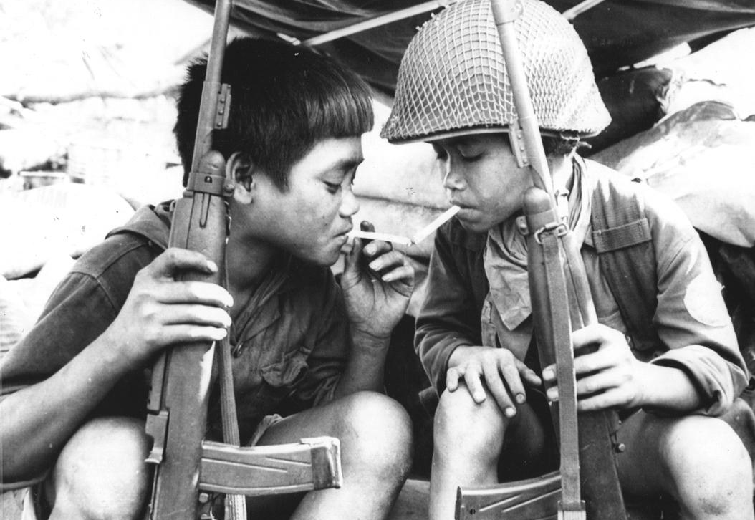
1.What stereotype of childhood does the picture challenge?
2. List five words you associate with childhood in the UK

Slide 4
Modern western notion of childhood
An innocent and special time of life - a ‘golden age’.
Different from adulthood – physically and psychologically immature
Jane Pilcher (1995) – childhood is distinctly separate from adulthood, it is its own clear life stage where children occupy a different social status form adults.
The separate status is seen in laws, clothes, products and services (e.g. books, play areas).
Vulnerable and in need of protection from the dangers of the adult world.
Childhood is lived in a sphere of family and education – away from the real world and paid work.

Slide 5
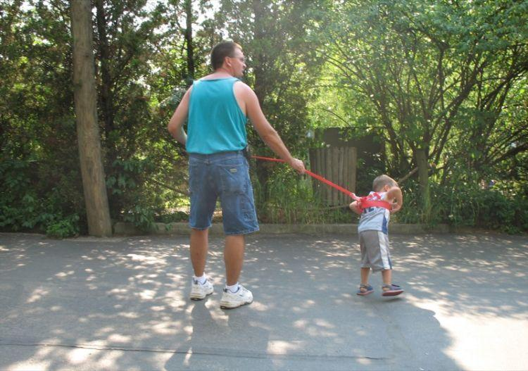
What image of childhood does this picture communicate?

Slide 6
Childhood as a social construct
Question: What is meant by the phrase ‘childhood is a social construct’
Wagg (1992) - “Childhood is (…) what members of particular societies, at particular times and a particular place, say it is. There is no single universal childhood, experienced by all. So childhood isn’t ‘natural’, and should be distinguished from mere biological immaturity’
Evidence to support the view that childhood is a social construct can be found in 1) historical differences 2.) cross-cultural differences 3.) differences in the same society

Slide 7
Historical differences
Ariès (1962) – between the 10th and 13th century childhood didn’t exist. Children were not seen to have a different nature or needs from adults
Ariès looks at art from that period, noticing how children were depicted as smaller – not as having any different characteristics.
Shorter (1975) – parental attitude was different. High death rates encouraged indifference and neglect toward infants.
Ariès – elements of the modern notion of childhood started to emerge from the 13th century onwards:
Schools started to specialize in education of the young.
Growing distinction between children's and adults clothing.
18th century – handbooks on childbearing were available
19th century – factory acts banned the employment of children in mines/factories. Complete p.6-7

Slide 8
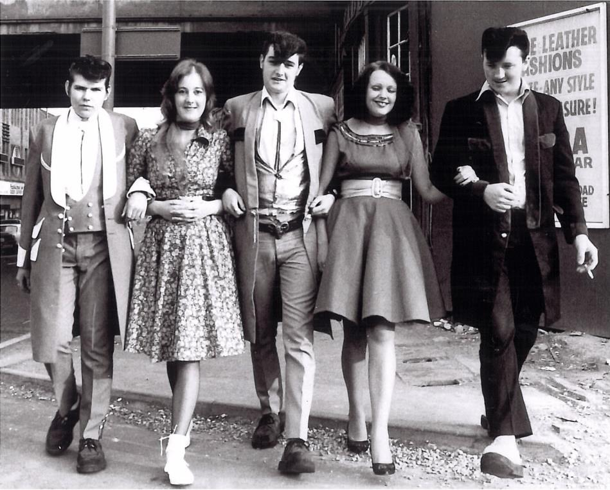
Teddy boys in the 1950s

Slide 9
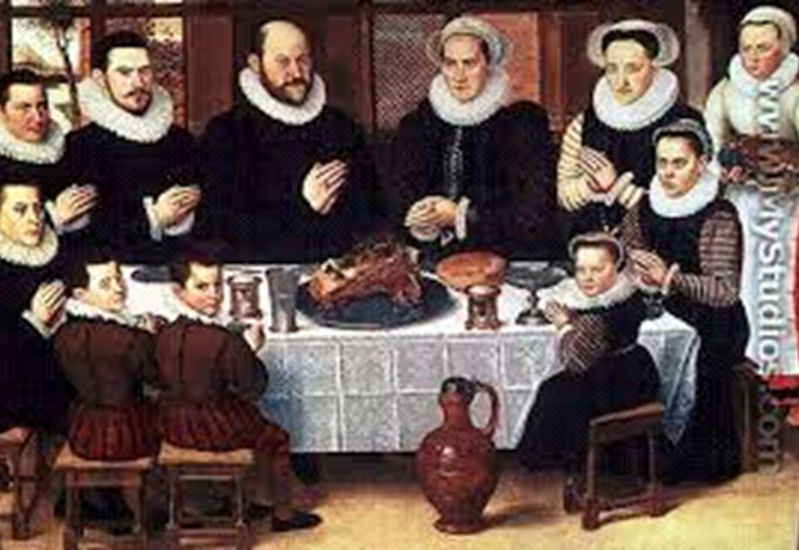
Phillipe Aries (1962)
Question: What criticisms have been made of Aries work?
Pollock (1983) – limited and unrepresentative sources
Pollock (1983) – during the Middle Ages society had a different notion of childhood than today
Wilson (1980) – Aries’ work is present-centred and applies today’s views to the past

Slide 10
Cross-cultural differences (p. 8-9 in booklet)
Benedict (1934) – children from non-industrial societies are different from western children in three ways:
1.) Responsibility - Punch (2001) found that once children in Bolivia reach 5, they are expected to take work responsibilities in the home and community. Holmes (1974) noticed that in Samoan society, ‘too young’ is no reason to prohibit an activity
2.) Obedience to authority – Firth (1970) observed that among the Tikopia, doing what you are told by an adult is regarded as a concession to be granted by the child
3.) Sexual behaviour – Malinowski (1957) observed that among the Trobriand Islanders, adults took an attitude of ‘tolerance and amused interest’ towards children's sexual activities.
Notes:
How does this differ from the West?

Slide 11
Activity: Go to http://www.life-hack.co.uk/2014/04/16-children-and-their-bedrooms-from.html?m=1 What conclusions can you draw about cross-cultural differences in childhood?

Slide 12
The globalisation of western childhood?
Some sociologists have argued that western notions of childhood are being globalised
For example, campaigns against child labour in developing countries reflect Western views of what childhood ought to be.
Question: Do you agree that Western ideas of childhood have become globalised (p.9 in booklet)?

Slide 13
Is our culture child centred?
Using the Browne textbook complete p.10
What problems can you identify with the argument that we have become more child centred?

Slide 14
Has the position of children improved or worsened?
Improved: legal protection
The Children Acts 1989/2004
What other legislation has had an impact on the role of children today?
Which age? Do some research and complete the table on p.12
Worsened: unhappiness and child abuse

Slide 15
Worsened: Unhappy children
Womack (2011) reports that Britain’s children are some of the unhappiest in the West.
Family breakdown is a key cause of this leading to poor physical and mental health, poor relationships with parents and friends, failure at school and more likely to engage in risky behaviour.
Child poverty: 3.7 million children officially classed as living in poverty 2012-13.
Margo- British children spend more time with peers than parents and other adults. Many children are concerned their parents are not there for them when they need them.
3000 offences evert year are comitted by children under the age of 10.
75,000 school age children a year (approx.) enter the criminal justice system for various offences.

Slide 16
Worsened: Child abuse
2013, statistics from the Department of Education showed there were 43,100 children and young people under the age of 18 who were subject to a Child Protection Plan in England because of various forms of abuse: 41% neglect, 31% emotional abuse, 12% physical abuse, 5% sexual abuse, 11% more than one category.
ChildLine has helped over 3.5million children since it opened in 1986.
Sibling abuse: Womack found from a longitudinal study of families that 31% of young people reported they were hit, kicked or pushed by a sibling ‘a lot’ or ‘quite a lot’. Around a third were frequently bullied by a sibling. Bowes et al (2014) found children who had been bullied by a sibling were twice as likely by the age of 18 to have depression, self harm or suffer anxiety.

Slide 17
Two views of modern childhood: Stainton-Rogers
WELFARE | CONTROL
Children are vulnerable and need protection e.g. | Children need boundaries for their behaviour and anti-social tendencies e.g.

Slide 18
Has childhood disappeared?
Nick Lee vs Neil Postman

