Slide 1
FAMILY TRENDS SUMMARY A GROUP

Slide 2
The average size of the family in the UK declining along with the birth rate and fertility rate. One reason is the fact that raising children in modern society is becoming increasingly expensive with costs of childcare and transport to schools etc. Furthermore there is more access to contraception and abortion which means that there are less children being born unintentionally. Sharpe identifies the idea of how women's expectations are changing as previously in the 1970s women were leaving school and immediately thinking about getting married and having children. However since the 1990s women are more focused on pursuing careers and work is a priority, once they feel they are more stable in the workplace they are then considering settling down and having a family. A decline in infant mortality rate is also impacting a decline in birth rate as previously children were unlikely to make it through the early years into adulthood so parents were having more children in the hope that one would live longer where as now children are almost guaranteed to make it to adulthood.
Fertility Rate – Number of live births per 1000 women aged between 15 and 44
1900 – 28.7
2014 – 12.2
Life Expectancy – measure of how long someone should live on average based on year of birth, current age and other demographics including sex.
1900 – Males 50
Females 57
2013 – Males 90.7
Females 94
Impact on Family : Families are having children later as they know they are living longer so don’t need to rush into anything.
Elderly people are more dependant on younger people and older people like grandparents are caring for children more while parents pursue careers – Beanpole family.
Giddens identifies the idea of confluent love and how people are more cautious in ensuring they have found the right partner before settling down to have a family.
Grundy and Henretta identify the rise of the ‘sandwich generation’ where middle aged women are looking after both their elderly parents as well as their children as they are now having them later.
Why are families having children later in life? Why is there a reduction in family size?
Birth Rate – number of live births per 1000 people of population
1964 – 2.95 Children
2001 – 1.63 Children
2014 – 1.83 Children

Slide 3
Reasons for the decline in the birth rate:
The percentage of families who have one dependent child has increased from 42% in 1996 to 47% in 2012. Meanwhile, the percentage of families with three or more children has decreased from 19% to 14%. This represents a decline in birth rate and a shift toward smaller family sizes.
Contraception. In 1961, the pill started being used widely. This, coupled with the increased use of condoms, partly due to increased secularisation. (Secularisation refers to the historical process in which religion loses social and cultural significance). Alan Crowe
Childcare costs. Childcare costs are ever increasing and now it costs £231, 843 on average to raise a child to the age of 21. Children have become an economic liability rather than an asset, as children are no longer allowed to work.
Women developing careers over having families. A change in women’s position in society and social attitudes toward women has resulted in women being able to devote more time to their careers. The average age women have children is now 30. This is also due to an increased life expectancy, which reduces the perceived need to have children before their biological clock ‘ticks over’. Sue Sharpe – 1978-1994 study found that women’s priorities had changed to developing a career and being able to look after themselves. Found that young girls attitudes had become more ambitious, confident and assertive.
Families are more child centred. This results in a shift from quantity to quality. Parents would rather have fewer children and invest more attention and resources into them. Aries
Having a baby is no longer the biggest part of every woman’s life. Social attitudes shifting toward women developing a career and focusing on other things in life rather than having a baby. Girl’s aspirations showed significant change especially in the 1970’s and 80’s, toward developing their own career rather than simply having a child, which was a main aspiration in the 60’s.
Access to abortion. In 1967, abortion was legalised in the UK. Since then, attitudes toward abortion have improved significantly, resulting in more abortions.
Decline in infant mortality rate
Children being more likely to survive also influences birth rates – lower birth rates because people aren’t having children for ‘insurance’.
Introduction of NHS in 1948 – means better healthcare is provided across the board. Development in medical sciences and medical advancements made childbirth safer. (eg. Hygiene)
Impacts:
More child centred families.
Less children leading to an aging population.
Children seen as something that are worth being invested in. As opposed to before when it was feared that babies may die, resulting in a distant parenting attitude. Today, a more committed and involved parenting attitude is adopted.

Slide 4
Reasons for the rise in number of households:
More elderly people living on their own. – Increased dependency ratio. In 2015 there were 3.2 people of working age for every pensioner in the UK.
Increased proportion of single parent households (values moving toward acceptability of lone parent households + rise in divorce)
Population growth. Since 1964 the population of the UK has increased by more than 10 million.
Strength of welfare state has improved. This means more housing provided for families.
1 in 10 adults – Living Apart Together (LATs) (Important long term relationship but not cohabiting or married) Accounts for roughly half of those considered ‘single’. Duncan and Philips (2013).
Longer life expectancy – more people living longer means households are in existence for longer.
Number of people cohabiting has increased significantly between 1960s (2% of couples lived together) and 2002 (80%). Allan and Crow (2001) Found that marriage is increasingly viewed as not a binding contract, but rather as a relationship in which individuals seek personal fulfilment – couples likely to divorce if they don’t find it.
Immigration – About 70% of the population increase from 2001 to 2011 was foreign-born.
Divorce rates – Higher divorce rates means that there are more lone parents households and singles living alone after divorcing. 26 thousand divorces in 1960, increased to 155 thousand in 2000.
Greater individualism and emphasis on personal choice. More young people choosing to move out and live on their own and more cohabitation.
Impacts:
Less housing is available – higher house prices.
Strain on NHS and welfare state in general.
Growth in beanpole families
Social care costs higher – increased strain on NHS.

Slide 5
Summaries of changes to the family
By Hannah, Maddie and Abby

Slide 6
Why has there been an increase in divorce rates?
Nowadays it has been discovered that 50% of marriages will end in divorce.
Women have been granted 65% of divorces which reflects than women are more unhappy in marriages then men and that they may still be being treated unfairly in some marriages.
Another factor that divorce rate has increased is because before 1969, if a divorce was wanted the couple needed to show that adultery, desertion or a form of harm had occurred. However, the divorce reform act in 1969 lets couples could file for divorce if they had fallen out of love and no longer got along well.
In 1950 it was estimated that there were 30,870 divorces whereas in 2012 there was around 118,140.
Functionalists argue that divorce has risen due to couples having high expectations of their marriage and to expect more from it then they actually do.
Alan and Crow say it is easier and nowadays more acceptable to get a divorce, more couples will get a divorce if they have problems rather than trying to fight for their marriage and go to council ling etc.
Giddens additionally identifies the idea o confluent love and how people are more cautious in ensuring the correct partner before settling down and finding a partner. In addition, he argues people want to find the ‘right’ love so if they don’t find it in a marriage, they are happy to divorce one another to find it.

Slide 7
Same-sex couples have risen by 8% in 2014 compared to 2013.
In 2013, 13,000 same-sex couples bringing up children.
Same-sex couples in UK have had right to adopt children since 2002, following Adoption and Children Act 2002.
People have become more accepting to same-sex couples as well as them bringing up children.
LGBT community has become larger and more supportive.
Same-sex partners with children
Sociological studies: Stacey and Biblarz argued that children with same-sex parents are more likely to depart from traditional roles.
‘children born to and raised by homosexuals tend to play, dress and behave differently than children reared by heterosexual households.’ – USC study on gay parenting.
Weeks stresses there is a large degree of choice occurring in same-sex families – ‘chosen families’, negotiated commitment.
Technology: advances in science allows same-sex couples to have greater opportunities to have children, such as IVF.

Slide 8
Increase of one person households
A suggested reason for the increase in OPH is the increase of divorce rate.
The number of OPH almost doubled between 1981 and 2001 from 393,000 to 721,000.
The greatest increase in proportion of OPH was found amongst women ages 25-34 and men ages 35-44, explanations for the increase amongst women between these ages are that more women are opting for a career prior to settling down and having children whilst men between these ages may be due to divorce.
By 2005 the number of OPH has doubled since 1971 from 3 million – 7 million.
The governments projections for numbers and types of household confirm that there will continue to be a large increase in the number of people living alone.
29% of UK households are OPH.
Of the 7.7 million people living alone in 2013, 46% were men and 54% were women.
Women have become more socially and economically self reliant so are more able to establish a OPH.
The increasing numbers of OPH increase the demand for housing, transportation, natural resources and energy.
OPH tend to be more vulnerable, and are potentially more costly to society than those with a partner.
OPH are more precarious with lower median household incomes and face more difficulties with dealing with unemployment, injury, illness, disability, social isolation and loneliness.
1 in 5 women fall into poverty as a result of divorce.
It is seen as acceptable for younger people to live on their own than it is for middle aged people.
Another issue of the increase of OPH is the death of a partner which leaves the other person on their own.

Slide 9
Lone Parent Families now make up 22% of all families with children. One child in four lives in Lone parent families. Over 9% of these families are headed by lone mothers. Until early 1990’s divorced women were the biggest group of lone mothers. From early 1990’s, never married women became the biggest group of lone mothers. A child living with a lone parent is twice as likely to be living in poverty.
Number of lone parent families has risen due to the increase in divorce and separation. The increase in the number of never married women having children. This is linked to the change in values of marriage when children are born outside of wedlock.
Lone Parent Families
Death of one parent used to be the common cause of lone parent families but this is no longer the case. They tend to be female headed for a number of reasons:
Belief women are more nurturing than husbands.
Divorce courts usually give custody to the mothers.
Men may be less willing to give up work to care for the children.
Single by choice, women may not wish to cohabit or marry or they may wish to limit the fathers involvement with the child. Jean Renvoize (1985) found that professional women are able to support their children without the fathers involvement.

Slide 10
Definition of living apart together couples: couples who are in a significant relationship but not married or cohabiting, some sociologists suggest that LAT’S may reflect a trend towards less formalized relationships
Simon Duncan and Miranda Phillips for the British Social Attitudes survey (2013) found that about 1 in 10 adults are LAT’s. this is about half of the people officially classified as single. It has been suggested that this may reflect a trend towards less formalized relationships and families of choice. They conclude that although being a LAT is no longer seen as abnormal, it probably does not amount to a rejection of more traditional relationships
LAT’S
Reasons for LAT’S
Some don’t live together because its too early to cohabit or because of previous relationships
- 20% of LAT’s see their relationship as their ‘ideal relationship’
Couples always used to live together when married or cohabiting. LAT’S were rare or non existent.

Slide 11
Thomas Hylland Eriksen (2007) globalisation has created more diverse migration patterns with back and forth movement of people through networks rather than a permanent settlement in another country. Modern technology makes it possible to sustain global ties without having to travel.
The movement of people from place to place internal (within a given society) or transnational (crossing nation frontiers)
Immigration refers to the movement into a society.
Emigration refers to the movement out.
Net migration is the difference between the numbers of immigrants and the numbers of emigrants, and is expressed as a net increase or a net decrease due to migration.
Migration
(1939-1945) the largest immigrant group was irish mainly for economic reasons followed eastern and central European jews. During 1950s black immigrants from the carribean began to arrive from the uk. Followed during the 1960s and 1970s by south Asian immigrants from india, Pakistan, bangledesh and sri lanka. One consequence is more ethnically diverse society. By 2011 ethnic minority groups ecounted for 14% of the population
Population size is influenced by net migration since 1900’s birth rate has declined producing smaller family size, due to lower infant mortality and changes in the position of women and children. The death rate decline and life expectancy increased largely due to social changes. Effects of an ageing population include a greater cost of health care. Migration affects age structure and fertility rates, because of push and pull factors.
However a series of immigration and nationality acts from 1962-1990 placed severe restrictions on non white immigration.

Slide 12
CHANGES TO EXTENDED FAMILIES
An example of a change in extended families is the rise in the beanpole family which was an idea developed by Brannen where the family is long a thin (3+ generations with fewer siblings). This may due to the survival rate of children growing so less of a need to have multiple children.
A reason for a change in extended families is the normalisation of divorce leading to fewer intergenerational ties. This results in a breakdown of contact between the family.
Failing fertility rates mean people are more likely to have less siblings leading to longer skinnier families.
In 1996, 21% of peo0ple lived as part of an extended family.
Due to geographical mobility, extended families are harder to move than nuclear families so there’s been an increase in nuclear families and a decline in extended families.
An increase in wealth means less of a need for the security of an extended family.
Smaller families rely on each other more. Parsons argues that this increases bonds between family members making the nuclear family stronger than the extended family.
Grandparents can take on a caring role for children allowing parents to work.

Slide 13
Decline in the number of marriages
One issue that causes decline in marriages is people believe in “marrying for the sake of marriage”. The divorce rate has increased a lot since 1980, therefore this puts a negative impact on couple who want to marry. Couple may feel its not necessary to get married due to aspects in society, for example having children out of wedlock is no longer seen as unacceptable and is seen more as a norm.
There are too many gender roles in marriages. Still women are expected to do most of parenting aspects, cooking, cleaning, laundry and grocery shopping. Although in contrast to this, thanks to the feminist movement, women are now reluctant to give up their careers to become housewives. In both men and women there is a need for freedom to enjoy own hobbies, interest and social engagements, which may be restricted in a marriage. This relates to Becks theory of individualism.
Wedding are extremely expensive, since the recession, on average a wedding that includes over 200 guests, a wedding venue and all the extras could cost up to £70,000. Also many marriages are less religious, on average 77,490 marriages involve a religious ceremony, this is half as many compared to 1991.
Singlehood parenting is also more common in todays society. In 1901, 1 out of 20 households were alone, however in 2008 1 out of 5 between the ages of 25-44 were single households.

Slide 14
The pattern of child bearing has changed in Britain over the last 100 years, the reason for this are families are getting smaller as the number of births are dropping due to woman having fewer children. Some women may delay having children until they are older or are choosing to remain childless.
The growing proportion of births outside of marriage nearly half of all births (47% in 2013) in England and wales are now outside marriage.
This suggest that parents are cohabiting and children are being born into a stable couple relationship even if the partners are not legally married.
Caribbean families: Berthoud (2001) sees family life in the Caribbean community as based on modern individualism, this emphasizes individual choice, independents and commitment based on the quality of relationships rather than custom, duty or a marriage certificate. The Caribbean group who came to the UK more than 60 years ago- growth has been less than 5%, which is down to the excess to births over deaths, rather than immigration.
In Multicultural families there is an increasing number of partnerships between people from different ethnic groups, Beck Gernsheim (2002) studies show that there can be conflict between the ethnic groups, but she found that multicultural marriages help break down social barriers.
Women choosing not to have children
Ethnic differences between families and reason for this
There's a changing role of women in society, who give more priority to their jobs and careers; Sue Sharpe conducted an interview in 1976 with girls prioritizing love and marriage. However, these beliefs rapidly change by 1996 with women becoming more confident, ambitious and committed to gender equality.
Out of the established groups, only the Indians have substantially grown through immigration; accounting for 2/3 of their growth as a majority of students.
The Irish group, with a relatively elderly population, have reduced by 18% over the decade, both from an excess of birth over death.
Most Asian households are based on the nuclear model, although they tend to encourage the extended family form.
African Caribbean single parent hood is very high 48% were headed by lone parents i.e. woman
Potential parents way up the costs of having children and future life opportunities lost e.g. careers and leisure against the benefits of children.
Also has a greater social acceptability of the desire for having a child free lifestyle, reflecting Beck Gernsheim (2002),
she refers to the growing of individualisation of contemporary life.
Couples may decide to delay having children or not at all because of the rising costs of raising a family. Hirsch 2014 estimated each child cost £154,000 up to 18.
South Asian families: Ballard (1982) found extended family relationships are now more common in minority ethnic groups, originating in self south Asia- from Pakistan, Bangladesh and India. Pakistani and Bangladeshi groups have grown each by about 50% during 2011, mostly because more people have been born over the amount of deaths.
By Lucy x2

Slide 15
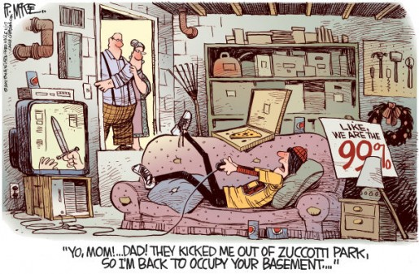
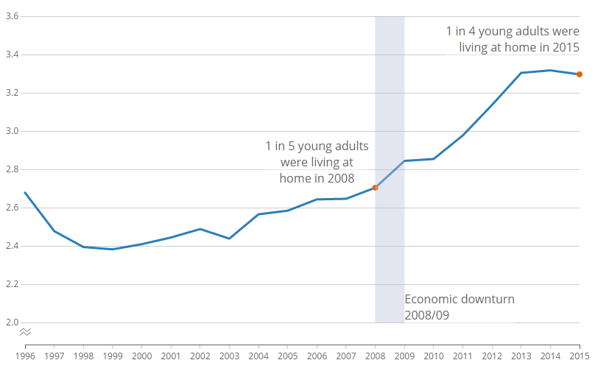
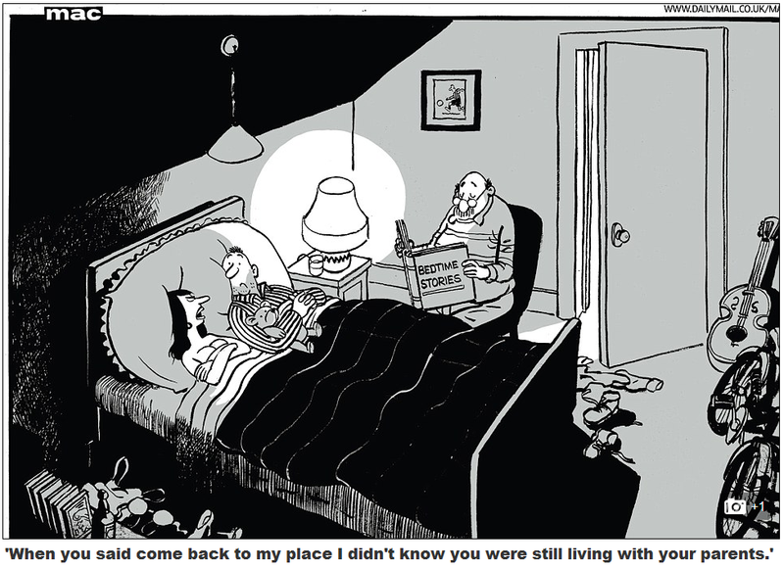
Increase of young adults living with their parents.
Young adults (aged 20 to 34) in the UK are more likely to be sharing a home with their parents than any time since 1996.
Increasing numbers of young adults are also choosing to stay in education for longer. the number of young adults aged 18 to 24 in full-time education was 1.9 million, an increase of 791,000 since 1996.
Reasons for increase:
Increase in housing price.
University becoming more expensive.
In a 2013 poll of parents of 18-29-year-olds, about ¾ said their relationship with their adult child was mostly positive, and only two percent said it was mostly negative. – more people have good relationships with their parents, therefore more likely to live together.
No longer HAVE to get a job.
Men aged 20 to 34 were more likely to be living with their parents than women. that is almost 1 in 3 compared to one in five women.

Slide 16
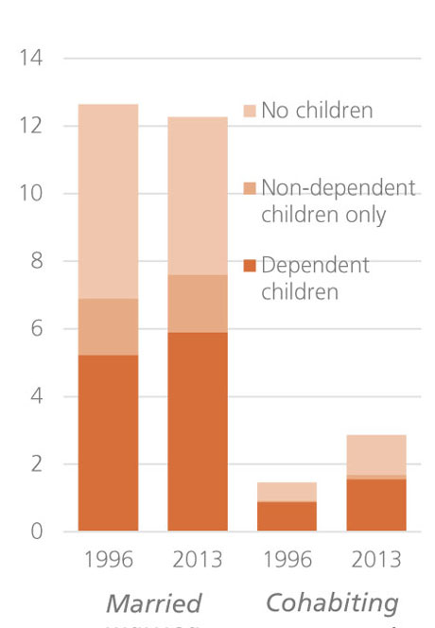
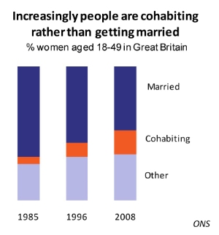
Increase in number of couples cohabiting
However:
Cohabiting couples do not have the same rights as married couples so if there is a breakdown in the relationship, then one partner stands to lose more than the other
Reasons for higher cohabitation rates
Average price of a wedding in the UK is £20,000
Religion is less important nowadays so there is less pressure to have a “traditional marriage”
Statistics:
In 2005, 24% of couples were cohabiting and unmarried
Number of cohabiting couples has doubled since 1986
In 1979 in the UK less than 3% of women were cohabiting but in 2005, 12% of women were cohabiting.
Giddens writes: ‘Unlike romantic love, confluent love is not necessarily monogamous, in the sense of sexual exclusiveness. What holds the pure relationship together is the acceptance on the part of each partner, ‘until further notice’, that each gains sufficient benefit from the relation to make its continuance worthwhile. Sexual exclusiveness here has a role in the relationship to the degree to which the partners mutually deem it desirable or essential’ from Giddens (1992).
Chandler (1993) argued that cohabitation is increasingly becoming as a long term alternative to marriage. This is reflected in the increasing proportions of children out of marriage ­ partners no longer feel as much pressure to marry to legitimize a pregnancy.
In Canada, only about 12 percent of cohabitations are expected to last ten years. By comparison, 90 percent of first marriages are expected to last this long (Wu 2000).

