Slide 1
FAMILY TRENDS SUMMARY B GROUP

Slide 2
Legal acts
Divorce Reform Act (1969/71)
There needed to be proof that one partner was the ‘guilty party’ and had committed one of three ‘matrimonial offences’:
Cruelty
Adultery
Desertion
The act removed the need to prove a guilty party and made irretrievable breakdowns the grounds for divorce.
Key Statistics
Around a third of marriages now involve a remarriage for one or both partners, mainly reflecting the increase in the divorce rate. A lot more divorced men remarry than divorced women, reflecting women's greater dissatisfaction or disillusionment with marriage. This is perhaps not surprising, given the way women often have to balance the triple and competing demands of paid employment, domestic labour and childcare, and emotional management of the family. The same factors that have increased divorce and separation ,and that have generated more lone parenthood, have also meant there is an increasing trend towards serial monogamy, as individuals divorce and then form new married or cohabiting monogamous relationships with a series of different partners.
Increase of reconstituted/step families
Changes in Values
Marriage these days is more about love instead of status.
The primary reason given for modern marriage is ‘love’. Giddens argues people seek confluent love (fulfilment).
The idea of ‘permanence’ is not regarded as a central idea.
Some functionalists such as Talcott Parsons have argued that the increase in the divprce rate may actually be due to the increased importance place upon marriage.

Slide 3
Beanpole Families – ‘long and thin’:
Beanpole families are occurring for 2 main reasons:
Increased life expectancy – more grandparents and great grandparents (Brannen).
Smaller family sizes – people have fewer siblings.
Heath (2004) – young people are more likely to stay living at home rather then ‘settling down’ into a married or cohabiting couple therefore increasing the likelihood of an extended family of residence.
Colin Bell (1968)
Amongst the middle class, more financial help was given from the father to the son.
Within the working class, families had more frequent contact as they lived closer together (local extended family) and more domestic help was given from mothers to daughters.
Changes to extended families
Statistics
90% of people had given or received financial help and about half had cared for a sick relative. (Finch & Mason)
The number of homes containing 3 generations of a family will treble in the next 20 years.
The extended family has declined but not disappeared. Mary Chamberlain (1999) suggested that this is because the extended family perform important functions.
The improvement and advancement of technology means that families are able to keep closer together even if not physically. These are called dispersed extended families

Slide 4
Family trend: Increase of marriages that are remarriages
Remarriages rose by one third between 1971 and 1972
Following 1969 divorce reform act in England and wales making it easier to get a divorce from a partner.
2005 - remarriages for one or both parties accounted for 40 per cent of all marriages
2012 – one third of all marriages were remarriages for one or both partners.
Leads to serial monogamy – a pattern of marriage…divorce…remarriage
Main reason for increase in remarriages is due to rise in divorces which rose dramatically towards the end of the 20th century. Reached its height in 1993 with 180,000 divorces. (all those people who divorced then meet new people and now want to remarry. There are also trends in rise of divorce after legal changes.
Another reason for the increase In remarriages could be due to secularisation- religion has much less influence and so its now more socially excepted to get a divorce and re marry
This links to Giddens argument of choice and the pure relationship. People are now less scared of divorce and so are more willing to keep remarrying until they find a partner that they want to stay with

Slide 5
Living Apart Together (LATS)
Simon Duncan and Miranda Phillips found that about 1 in 10 adults are living apart together. This may reflect a trend towards less formalised relationships.
Duncan and Phillips found that both choice and constraint play a part in whether couples live together. For example, some said they could not afford to. However a minority actively chose to live apart.
Public attitudes towards LATS are favourable. A majority believe that a couple don’t need to live together to have a strong relationship, while 20% see LATS as their ideal relationship ( more than the number who prefer cohabitation )

Slide 6
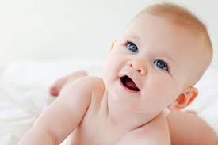
Why women are choosing not to have children
Fertility rate
1964 = 2.95
2001 = 1.63
2014 = 1.83
More women are in paid employment so they may not want to leave their job top have a child.
More access to abortion and contraception, giving women more control over their fertility
Society is now more open to a variety of possibilities in life apart from the traditional family. Many would choose their careers over a family.
Children are an economic liability and can cause financial pressure. Parents are now less willing to have large families
The family is now more child centred, there is more focus on the children we have instead of having more children
There are lower child mortality rates
29% of couples are childless
Judith Stacey (1998) argues that greater freedom and choice has benefitted women. It has enabled them to free themselves from patriarchal oppression and shape their family arrangements to meet their needs, e.g. not having children.
Sue Sharpe (1947) she argued that girls had low aspirations and they believed that educational success was seen as unattractive. Their main priorities were love, marriage, husbands and children. This totally flipped in the 1990’s where women's careers took priority in order to provide for themselves economically and financially.

Slide 7
Mirza (1997) argues that the higher rate of lone-parent families among blacks is not the result of disorganisation, but rather reflects the high value that black women place on independence.
Tracey Reynolds (2010) argues that the statistics are misleading, in that many apparently ‘lone’ parents are in fact in stable supportive but non-cohabiting relationships.
Under slavery, when couples were sold separately, children stayed with the mother. It is argued that this established a pattern of family life that persists today.
Equality Act 2010 – (which includes gender and equality acts: Equal Pay Act 1970 and Sex Discrimination Act 1975).
Hybrid identities: Hall (1992) – ethnic identities have become increasingly harder to identify with a merging or hybridisation of identity occurring. This makes it more difficult to identify specific ethnic identities.
Roger Ballard (1982) found that extended family ties provided an important source of support among Asian migrants during the 1950s and 1960s.
Legal acts/ issues
Sociological Studies
Family Trend: Ethnic differences between families and reasons for this
Changes in family types in ethnic families, e.g. from extended families to nuclear families due to immigrants assimilating into western cultures.
It is argued that male unemployment and poverty have meant that male unemployment and poverty have meant that black men are less able to provide for their family, resulting in higher rates of desertion or marital breakdown.
Changes in Values
Changes in social issues
Key Statistics
Acceptability of mixed ethnicity families has changed.
Immigration into Britain since the 1950s has helped to create greater ethnic diversity.
In this early period of migration (1950s and 1960s), houses were often shared by extended families. Later, although most Asian households were now nuclear, relatives often lived nearby. There was frequent visiting, and kinship networks continued to be a source of support. Today, Sikhs, Muslims and Hindus are still more likely than other ethnic or religious groups to live in extended family units.
Of the 14% belonging to an ethnic minority, the main groups were Asian and Asian British (7.5%), Black and Black British (3.3%), and Mixed (2.2%).
Analysis of the zoil census shows that 86% of the UK population were white.

Slide 8
Lone Parent Families
Single Parent families are not just a recent occurrence. Even hundreds of years ago you would commonly find that a large amount of people would find themselves with only one parent. Especially in eras such as the medieval one where mortality was very high and mothers would often die during birth.
However now single parent households are at a all time high due to the higher acceptance of divorce. It has become very easy now for couples to end in divorce we have seen an astonishing rise over the last 50 years in single parent households due to this.
We can see this escalation from studies like the United States Consensus taken in 1980 revealing to us that 19.5% of all households were single parent. This was largely due to mortality however divorce was becoming a common occurrence but was still quite frowned upon.
However since then there has been a tremendous spike in single parent households. For example in 2009 the single parent household jumped to 29%. Also in a separate study in 2010 it was found that 40.7% of births were to un married women. We can see this incredible escalation probably due to larger acceptance of divorce and sex out of wedlock in the past 10 years
Although they are more common they are certainly not the norm which may have an effect on the child's schooling in 2009 it was revealed in the Early Childhood longitudinal study that children from two parent households did significantly better than children from lone parent households in maths and grammar tests.

Slide 9
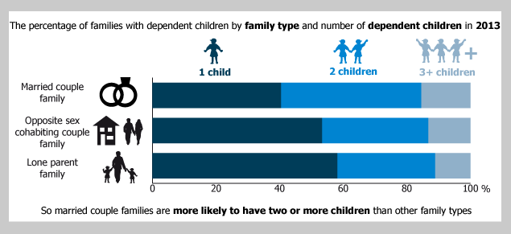
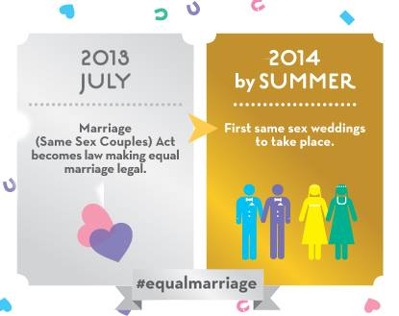
Family Trend: Increase of same sex partners with children
There is evidence of increased social acceptance of same-sex relationships in recent years. Male homosexual acts were decriminalised in 1967 for consenting adults over 21, more recently the age of consent has been equalised with heterosexuals. Opinion polls show more tolerance of homosexuality.
Stonewall (2012) The Campaign for same sex rights estimates that about 5% to 7% of the adult population today have same-sex relationships.
Social policy now treats all couples more equally for example, since 2002, cohabiting couples have had the same right to adopt as married couples.
Civil Partnership act 2004 – Introduced by new labour, gave gay couples rights and responsibilities equal to marriage. Rights to inheritance, access to children, pension benefits etc. Similar process of ending the relationship to divorce.
Marriage (Same Sex Couples) 2013 – Legalised Same-Sex marriage in England and Wales.
There are an estimated 69,000 same-sex cohabiting couples in the UK.
The number of opposite sex cohabiting couple families has increased significantly, from 2.2 million in 2003 to 2.9 million in 2013. The number of dependent children living in opposite sex cohabiting couple families rose from 1.4 million to 1.9 million over the same period.

Slide 10
Legal acts/issues:
Children Act of 1989- More intervention and protection of children- police, doctor, teacher, therapist combine information- if more children are taking away from danger, more will survive.
Family Tax Allowance- In 1990’s after recession benefit for first child was increased but for children after was frozen- can’t afford to have and look after more children.
Equality Act 2010- Women can’t be discriminated against in wages and job availability- if women are working not as focused on having children. Mothers can invest more into children’s health.
NHS Act 1948- Everyone has free access to healthcare- reduce disease
Factory and workshops Act 1878- Employment under 10 banned.
Abortion Act 1967- Abortion legal up to 24 weeks, legal to abort at any time if life of mother and/or baby at risk.
Changes in values:
More child-centred society- Increase in child specialists in 20th Century (paediatrics and child psychologists) = more understanding of children’s mental and physical health - more children survive.
More economically aware- With being more child-centred it is acknowledged that by having less children parents can invest more money and further the opportunities of the child/children- lowers birth rate.
“Seen not heard”- In the 20th century parents would rather there children be kept quiet and hidden away and left to explore whereas now they are more protected for risk of ‘stranger danger’ - more chance of survival.
Sociological studies:
Sue Sharpe- (longitudinal study) interviewed girl to see what there aspirations were: In 1974- low ambitions and prioritised love, marriage, and having children; In 1994- careers and self-dependency was the priority.
Sarah Harper- Women being more educated see other opportunities except motherhood- have no kids or wait and can’t have as many. Infant mortality decreases- no need for child ‘replacement’.
Aries- Society is more child-centred- less children means more focus to allow social mobility. Children are an economic issue as they can’t work.
Brannen- There is an increase in beanpole families- not extending with aunts, uncles, cousins as couples have less children.
Decrease in birth rate and infant mortality rate.
Key statistics:
The family size has declined from 3.1 people in 1961 to 2.4 in 2006.
In 2005 the average age of a mother having their first child was 27.3, in 1971 it was 24.
In 1962 the birth rate was 2.86 in 2012 it was 1.9.
The infant mortiality rate in 2014 was the lowest ever recorded in England at 3.6. In 1964 it was 19.7.
95% of children are vaccinated.
8.46 milion women worked full-time in late 2015.
1 in 5 women stay childess due to choosing career.
Changes in social issues:
Discrimination- In law since 1970 equal pay act socially the view of what equality is has changed- housewife/baby-maker to part-time to full-time paid worker. If women not considered just a baby-maker it makes it less a part of life to have children
Health- Since NHS begun providing free healthcare more children are being treated for diseases and illnesses that otherwise could have killed them. The NHS also offers immunisation for diseases for babies, toddlers, children, and teenagers- they receive booster jabs as well to increase chance of survival. Not only does it reduce infant mortality but also birth rate as don’t need child ‘replacement’. With lower birth rate comes less strain on NHS meaning children get seen too soo er and therefore more likely to survive.
Education- With more people being educated at school and on TV about how to improve health and where to get help- infant mortality will decline. Resources are available to show the cost of having children- decreases birth rate.
Technology:
Contraception- The combined “monthly” pill is over 99% effective and contains artificial oestrogen and progesterone hormones. The male condom is over 98% effective. Both of these forms of contraception are commonly used to prevent pregnancy thus decreasing the birth rate.
Abortion- In England, Scotland, and Wales the Abortion Act 1967 made abortion legal up to 24 weeks if approved by two doctors. If at any point in pregnancy the mother’s life is at serious risk then abortion is legal. If the baby’s quality of life due to deformation/ illness after leaving womb is considered serious abortion is legal at any point in pregnancy- this reduces infant mortality and the birth rate.

Slide 11
Technology
There are more ways to contact extended family who may live far apart or near such as;
Facetime
Social media
Telephone
This therefore leads to families becoming smaller and live further apart.
Contraception has also developed, and the introduction of the pill in 1960s allowed women to have more choice and control over having children, which lead to women being able to have children later and decreased family sizes, due to less accidental pregnancies. Also, the access to abortion in 1967 (Abortion Act 1967) allowed women to have more control over their fertility.
Sociological
Women are having children later;
Between 1971-2012, the average ages at birth of their first child rose four years to 28.1 years.
Sue Sharpe (1994) interviews girls in the 1970s and 1990s and shows a major shift in the way girls see their future. In 1974, girls had low aspirations; they believed educational success was unfeminine. They gave their priorities as ‘love , marriage ,husbands, children, jobs and careers’ in that order.
However by the 1990s, girls’ ambitions had changed and their top priority were careers and being able to support themselves.
Social Issues
Lots of couples delay having children or have no children at all due to the rising costs of raising a family.
Hirsch (2014) estimated it costs roughly £154,000 to have a child at 18.
Having children later in life and the reduction in family size
Legal
As society has developed, there are laws that have developed, surrounding equal rights for men and women.
The Equality Act 2010 legally protects people from discrimination in the workplace and in wider society.
1920 The Sex Discrimination Removal Act allows women access to the legal profession and accountancy.
Therefore, more women have the option to choose careers and work over or before having children, explaining the rise in having children later in life.
Change in values
There is now a greater social acceptability of and desire for a childfree lifestyle, reflecting Beck-Gernsheim (2002) which refers to as the graving individualisation of contemporary life, in which people now have and want more space for personal action and choice.

Slide 12
The beanpole family
Beanpole families structures are extended, they are long and thin. Beanpole families means there is more intergenerational contact between its generations. This relates to the increase in life expectancy and decrease in death rates.
The sandwich generations
Grundy and Henrietta (2006) use the concept of the sandwich generations to refer to women aged between their needy parents and their own children. Research shows a growing number of women who will be in this position of helping in both directions
Death rates
Death rate is the number of deaths per thousand of the population per year. Death rate has decreased over the years of for a number of reasons.
Statistics
Older ages are more likely to run into health issues and need important healthcare provided by the NHS.
Support for people to remain living independently in their own homes has been severely affected by cuts to care services. Spending on home care services has reduced by almost a fifth.
local authorities were spending a total of £8.26 billion in real terms on older people’s care services.
Reasons for decrease in death rate and increase in life expectancy
Decline in dangerous occupations for example mining.
Smoking and good diet
Improved public health measures
Medical improvements
Natural resistance on infectious diseases
Improved nutrition
Fall in death rates/ increased in life expectancy
The ageing population
The aging population means the average age of the population Is increasing, with a greater proportion of the population over retirement age and smaller proportion of young people. In 2015 there was 3.2 people for every pensioner by 2033 this is expected to have fallen to 2.3. More older people are likely to require care and financial support.
How the ageing population may effect family life and trends
Elderly pensioners are likely in this society to depend on their children to fiancially support them and care for them. However this effects family trends as it makes it harder for families to have more children as they have the burden of having to financially support their parents as well as children. Some elderly pensioners move in with their children and their families to make it easer for them to care for them it also means they don’t have to pay the fees for a care home. This effects trends in the family household as well.

Slide 13
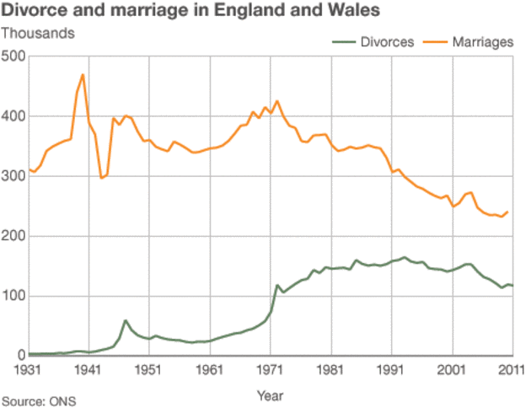
Divorce is now more common, that is begins to ‘normalise’ it and reduces the stigma attached to it. So instead of it being seen as shameful, today it is more likely to be regarded as a misfortune.
In 2014, 33.9% of people were not or had never been married, an increase of 3% in 10 years.
Marriage rates are at their lowest since the 1920s
Divorce was very difficult for women to obtain in the 19th century Britain for women, where as now laws have gradually made it easier for them to file for divorce.
Decline in the number of marriages.
The introduction of legal aid, for divorce cases in 1949, lowered the cost of divorcing.
About 1 in 8 people are living together as couples, but were not married, 28% of men and 22% of women live alone and have never married.
Those who marry young, have kids before marriage, or those whose partners have been married before, are most likely to end in divorce.
Divorce rates have risen with every change in the law.
The number of married people rose, 700,000 in the last 3 years but an increase in the overall UK population means the percentage dropped.
Over half the population (51.2%) were married, a fall from (53.8%) 10 years ago.

Slide 14
Higher proportion of men live alone, this is because of more men never getting married which was 58%.
Legal acts/issues
In 1969 there was the divorce act which meant that couples were able to get divorced. This meant that when they did the mother usually stayed in the house with children whist the dad lived alone in another place.
By 2005 the number of one person households had doubled since 1971 from 3 million to 7 million.
An increase in one person households
Ageing population-For those aged 65 to 74, and 75 and over, the pattern is reversed; at these ages the majority of people living alone were female (62% and 73% respectively). since medication and research has been done into healthy living this has meant people live until they're older. In most cases the man dies before the women, meaning that the wife is left widowed living in a house alone.
The largest change is in the 45 to 64 age group, where the number of people living alone increased by 27% between 2004 and 2014, a statistically significant change. This is partly due to the increasing population aged 45 to 64 in the UK over this period, as the 1960s baby boom generation have been reaching this age group
the number living alone in the 25 to 44 age group fell by 15% between 2004 and 2014. Previous research has shown that the proportion of those aged 20 to 34 living with their parents has increased over the past decade. Affordability of moving out of the parental home has been cited as a possible factor in this increase.

Slide 15
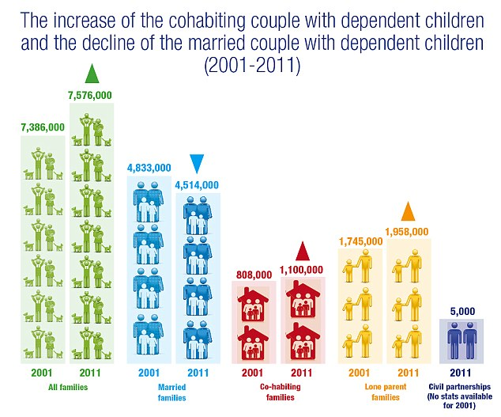
Increase in the number of couples cohabiting
Cohabitation arose in the 1970s.
It has become the norm to cohabit before getting married.
In 2005, 14% of non-married people in the UK were cohabiting.
This is a 100% arise in cohabitation rates recorded in 1986.
In 20014, 15% of all families with dependent children consisted of cohabiting couples, who were neither married nor in a civil partnership.
Evidence suggests that women in cohabiting relationships carry out less housework than those in married relationships.
While the number of marriages has been falling, the number of couples cohabiting has continued to increase.
Legislation in this area has not moved with the times and this means couples who live together have very few rights in law in the event of relationship breakdown. The only way for couples to protect themselves and their assets in the event of a split is to prepare a cohabitation agreement or property ownership document with advice from legal specialists from the outset.
The Office for National Statistics (ONS) data suggests the number of people who cohabit has doubled to 2.9 million since 1996.
Anthony Giddens’s concept of structuration holds that ‘structure’ and ‘action’ are necessarily related to each other: societies have ‘structure’ insofar as people behave in regular ways, and ‘action’ is only possible because each individual possesses socially structured knowledge.
Cohabitation is more common due to the fact people can make choices before having to get married.

Slide 16
The increase of young adults living with their parents
And the statistics behind it.

Slide 17
What does the U.K government say about this issue?
Recently the U.K government have said that they wish to increase the accessibility of affordable housing prices for young adults, while other political parties have also raised this issue – including the opposition, to help ensure that the situation will be recognised.
The LGA whom represent councils across England and Wales have urged the government to kickstart housebuilding, especially ones which are affordable with rent and ownership.
LGA housing spokesman Martin Tett said "Our figures show just how wide the generational home ownership gap is in this country” A shortage of houses is a top concern for people as homes are too often unavailable, unaffordable and not appropriate for the different needs in our communities.

Slide 18
Statistics
Around ¼ of young adults were typically living with their parents in 2015, however there are now 33 million 20-34 year olds still living with their parents which is a 618,000 leap since 1996.
The ONS research have discovered that young men are more likely to live at home with their parents, roughly 1/3 men were in this category whereas the comparison with women was 1/5.
In 1996 55% of 25-29 year olds owned a property, and so did 68% of 30-34 year olds.

Slide 19
Why could this be?
This could be an issue because of the cost of housing prices and monthly rents which are almost impossible to achieve on a regular standard income, unless sharing an apartment with friends or partners, however that defeats the point of independence.

Slide 20
The Rising Divorce Rate
By Gene Enriquez

Slide 21
Divorce rate between 1961 to 2005
The divorce rate has risen from 27,000 in 1961 to 167,000 by 2005.
We are now the highest divorce rates in European Union.

Slide 22
Reasons For Divorce Rate
Change in Law
Change in the role of women
Change of expectation of marriage
Declining influence of Religion
Divorce has become more socially acceptable
Demographic change

Slide 23
The change in Law
Removal of legal and financial barriers: Prior to 1857, divorce could only be obtained by Act of Parliament. The grounds for divorce were based on matrimonial offences; this remained the basis for divorce until 1971. In 1971, The Divorce Reform Act of 1969 replaced blame with irretrievable breakdown. The 1985 Matrimonial and Family Proceedings Act reduced the time limit on divorce from a minimum of three years of marriage to one. However, legislation cannot be seen as a cause of higher divorce rates, it has simply made divorce easier to obtain if couples want it.

Slide 24
The change in the role of women
Better rights under divorce law, increased job opportunities and the provision of state financial support can all be seen as contributing to enhancing the bargaining position of women in conjugal relationships. Women have, in the past 100 years, achieved many new rights in terms of property, the vote, employment and education, and the rise in divorce may reflect this shift in the position of women within society and make them less willing to accept an unsatisfactory marriage.

Slide 25
The change of expectation of marriage
Some researchers place the cause of increased divorce on higher expectations (Fletcher, 1966). And given the rates of remarriage it is not the institution of marriage, or the ideology picturing lifelong happiness that is rejected, but an insufficient partner. Dennie (1984) regards western style marriages based on romantic love as fragile because they are only held together by emotional ties.

Slide 26
Declining influence of Religion
Less than 50% of marriages now involve a religious ceremony, and even those that do might not be based on a religious institution for religious reasons. The idea of a lifelong marriage blessed by God is clearly less significant now than previously.

Slide 27
Divorce has become more socially acceptable
There is now considerably less social stigma and blame attached to divorce. Wilson (1966) argues that this reduction in stigma is a result of secularisation, the decreasing influence of religion in contemporary society.

Slide 28
Demographic change
Anderson (l983) has pointed out that lifelong marriage in the past often lasted a relatively short time. Marriage was often late and life expectancy was short. The highest risk groups for divorce are; teenage brides, couples who had children early, couples with 4 or more children, local authority tenants, and couples with relatively low income (Kiernan, 1989). The underlying focus is clearly the financial condition of the marriage (Gibson 1994). Clearly, part of the explanation for higher divorce rates among those married as teenagers has to be other contributory factors. A study by Ineichen (l977) of 179 marriages in Bristol suggested that teenage marriages were often linked to other factors associated with a higher risk of divorce such as manual employment, poor housing, and sharing accommodation with relatives.

