Slide 1
FAMILY TRENDS SUMMARY D1 GROUP

Slide 2
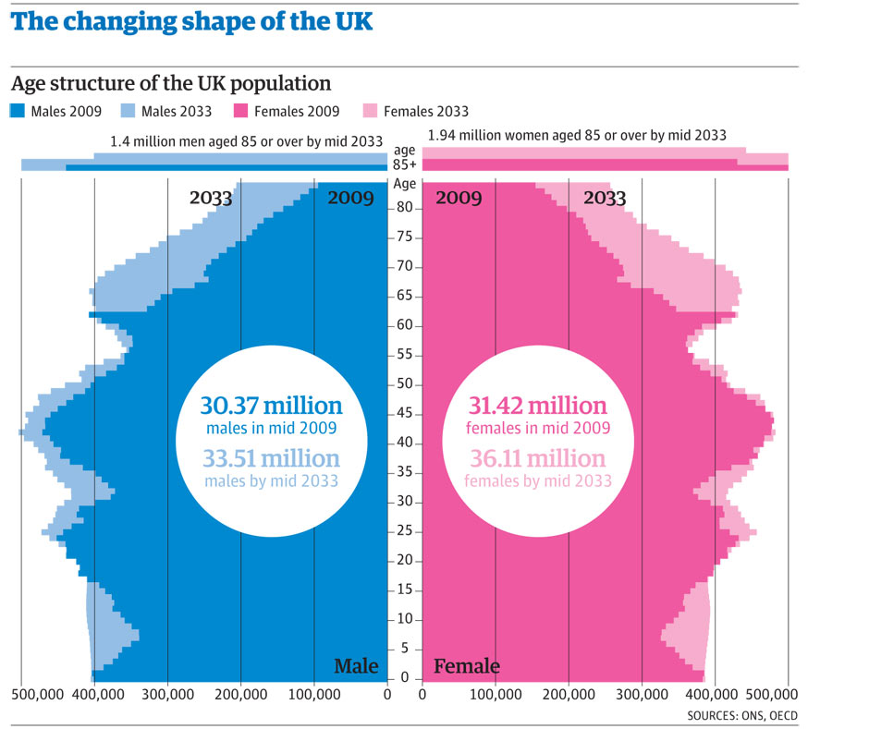
Legal acts/issues: The Matrimonial Causes Act 1973 specifies that the marriage may be found to have irretrievably broken down if one of the following is established: Adultery, unreasonable behaviour, desertion (two years), separation, agreed divorce (two years), separation, contested divorce (five years). The Matrimonial Causes Act 1937 made divorce easier to access, particularly for women, who until then could not get a divorce merely on grounds of adultery.
Changes in values: Reconstituted/step families are more common and widely accepted within society. Divorce is now more often viewed as a step towards happiness and out of a failed marriage.
Sociological studies: Giddens – the family now has greater freedom via choice. Previously families were more likely to stay together and not separate, yet now due to a shift in the basis of marriage and external forces such as laws changing individuals are free to choose what they want to do. Connectedness thesis (Smart) – we are fundamentally social beings whose choices are made within a ‘web of connectedness’. This means we live within a network of existing relationships and interwoven personal histories. This thesis has no mention of these relationships being permanent therefore accepts and allows changes in the family such as divorce.
Changes in social issues: The changing role of women – around ¾ of divorces are requested by women Suggests that women are more unhappy with their marriage than men. Rising expectations of marriage - Functionalists say divorce rates have increased because of couples expecting more from their marriage, women in particular. This leads, for some, to discontent and the feeling that they want more, leading to divorce. Growing secularization – has led to marriages becoming less sacred and important. Divorces are more widely accepted. Social attitudes – there is more stigma surrounding divorce. Growth of the privatized nuclear family - The increase in privatization of families has led to much less support and advice for a couple having issues. Being more private means the couple will be less worried about the social implications of getting a divorce. Reduced functions of the family - Some functionalist writers argue that the family has lost its functions, this mean that there is less need to be married. Increased life expectancy – As people are living longer there is more time for something to “go wrong” in a marriage. Also people are going to have higher demands of a marriage as it will last longer if there isn’t a separation before death.
Changes to the family: Increase of reconstituted/Step families. The impact of an ageing population.
Possible solutions:
1 Raise the age of retirement 2 Sustain or increase levels of migration to help fill labour /skills gaps 3 Encourage the working, taxpaying population to save more through pension schemes 4. Encourage people to remain active, engage in regular exercise and refrain from behaviours that could have a detrimental effect on their health
Issues of an ageing population: Increased spending will be required on public services. In addition there will be large expenditures on health care via tablets and medication. The elderly may be living in poverty, eg low state pension. One person households take up housing space which could be used by a family. Struggling to balance the dependency ratio of the economically active and their dependents (children and the elderly)
Key statistics: More than one in 12 people in the UK will be aged over 80 by 2039. The UK's population is set to rise by 4.4m in the next decade, and by 10m in 25 years. By 2039, the number of people aged 75 and over is projected to rise by to 9.9 million. In 2014, the UK's old age dependency ratio stood at 310.4, meaning that there were 310 people of pensionable age for every 1,000 people of working age in the UK.
In 2019, there will be 290 people of pensionable age per 1,000 people of working age - but this number will increase to 370 in 2039.

Slide 3
Increase of marriages that are remarriages
There were more remarriages in 2012 with 1/3 of all marriages remarriages for one or both partners, for many people this is leading to serial monogamy which is a pattern of marriage – divorce – remarriage
In the past people were expected to marry for life however the 1937 divorce act meant that the law changes to allow divorce on the ground of drunkenness, insanity and desertion. The 1969 divorce reform act was passed allowing couples to divorce after being separation for two years or five years if only one person wants the divorce
The negotiated family is more equal than the patriarchal family but is less stable. This is because individuals are free to leave if their needs are not met leading to more remarriages.
Giddens is a postmodernist and believes that relationships are more fragile as individuals are unwilling to remain with a partner if it fails to deliver personal fulfilment, this is confluent love and shows individuals seek ‘pure love’
Functionalists believe that divorce is the result of peoples higher expectations of marriage today and the high rate of remarriage shows people commitment to the ideas of marriage and that they split up to form happier families
A lot more divorced man remarry than divorced women, reflecting women's greater dissatisfaction or disillusionment with marriage. This is because women have to meet the triple demands of paid employment, domestic labour, childcare and emotional management of the family

Slide 4
Dependency ratio:
Immigrants are more likely to be of working age and this helps to lower the dependency ratio. In addition, many return to their country of origin to retire. However because they are younger many immigrants have more children, therefore raising the ratio. Finally, the longer a group is settled in the country, the close their fertility rate comes the national average, reducing ratio.
Immigration:
During the 1950’s, black immigrants from the Caribbean began to arrive in the UK. This led to a more ethnically diverse society and greater diversity of family patterns.
Age Structure:
Immigration lowers the average ago of the population both directly and indirectly:
Directly- immigrants are generally younger. For example in 2011 the average age of UK passport holders was 41, whereas that non UK passport holders living in Britain was 31.
Indirectly- being younger, immigrants are more fertile and thus produce more babies.
Impact on population structure:
Increase in immigration and emigration. The population size is currently growing.
Natural increase, with births exceeding deaths. However births to UK born mothers remain low. Births to non-UK born mothers are higher and account for about 25% of all births.
Impact of migration on types of families and the UK population structure.
Chambers (2012) suggests that globalization has meant there are more global family networks, as migrants in the UK try top maintain relationships and send money to their families in other countries.
Migrants from Eastern Europe tend to have larger families- contributed to new ‘baby boom’ in the 2000’s. Beck and Beck-Gernsheim (2014) talk of the growth of ‘world families’, and ‘distant love’, in which love and other forms of relationships are constructed between people living in different countries and continents.
Chambers also points to globalization leading to a growing trade in surrogate motherhood, mail-order brides – what Chambers calls the ‘purchase of intimacy’- and the purchase of family personal care, such as home helps and nannies from poorer countries across the world for those who can afford it.

Slide 5
Family trend: decline in the number of marriages
Sociological studies:
Allan and Crow 2011- ‘Love, personal commitment and satisfaction are now seen as the cornerstone of marriage. The absence of those feelings is itself satisfaction for ending the relationship”
Cashmore 1985- some working class mothers with less earning power choose to live on welfare benefits without a partner, often because they experienced abuse.
Ideological changes in values:
Cohabitation as the norm- idea of living together without being married is no longer regarded as ‘living in the sin’ but as the norm. 1950- 2% of married partners had combined prior to marriage, today it is most couples.
Attitudes towards single parent families- there is less social stigma towards lone parenthood. Historically women who were married that became pregnant would be socially shunned and dep ding on their age may have had to give the baby up for adoption.
Legal acts/issues:
Divorce Reform Act 1969/71- before this act there needed to be prove that one partner was the guilty party and had committed one of the matrimonial offence…Cruelty and adultery. The act removed this and made a breakdown grounds for divorce.
Family Law Act 1996- this act relieved the amount of time you had to be married to fill a divorce form, three years down to one.
Key statistics:
Decline in family size- in 2015, more than 50% of all men and women in the UK were married.
Increase in divorce- the proportion of children living in single long parent families tripled to 24% between 1972 and 2006.
Cohabitation- the number of people cohabiting has doubled between 1996 and 2002. in the 1960s around 2% of couples lived together before marriage, by the 2000s this has changed to 80%.

Slide 6
Increase in the number of couples cohabitating.
Key statistics:
Cohabitation- the number of people cohabiting has doubled between 1996 and 2002. in the 1960s around 2% of couples lived together before marriage, by the 2000s this has changed to 80%.
Cohabitation arose in the 1970s.
This is a 100% rise in cohabitation rates recorded in 1986.
Couples who lived together before marriage tend to divorce early in their marriage.
Ideological changes in values:
Cohabitation as the norm- idea of living together without being married is no longer regarded as ‘living in the sin’ but as the norm. 1950- 2% of married partners had combined prior to marriage, today it is most couples.
Secularisation- the decline in religious values has led to less stigma around cohabitation as it is no longer seen as ‘sinful’ to live together out of wedlock.

Slide 7
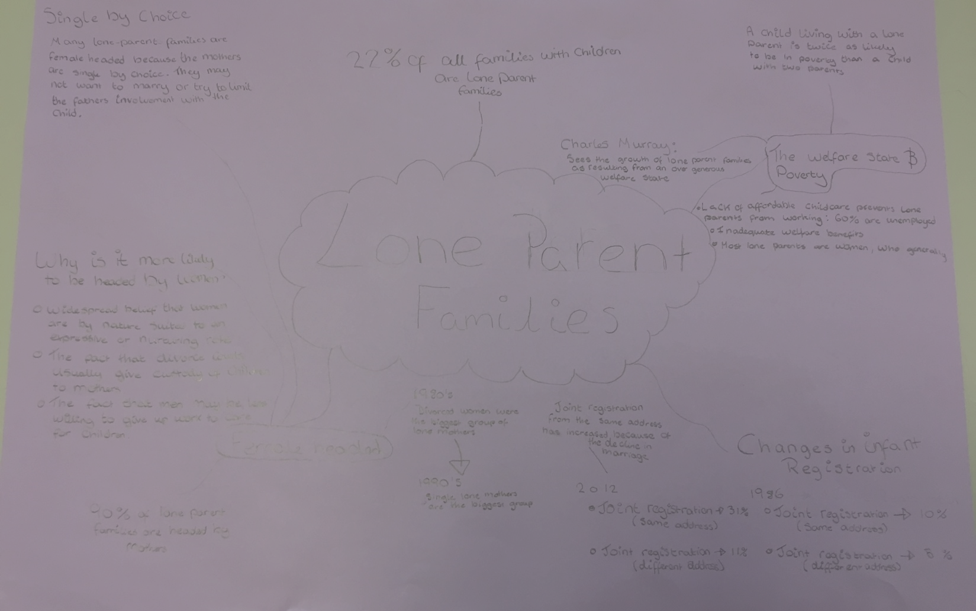

Slide 8
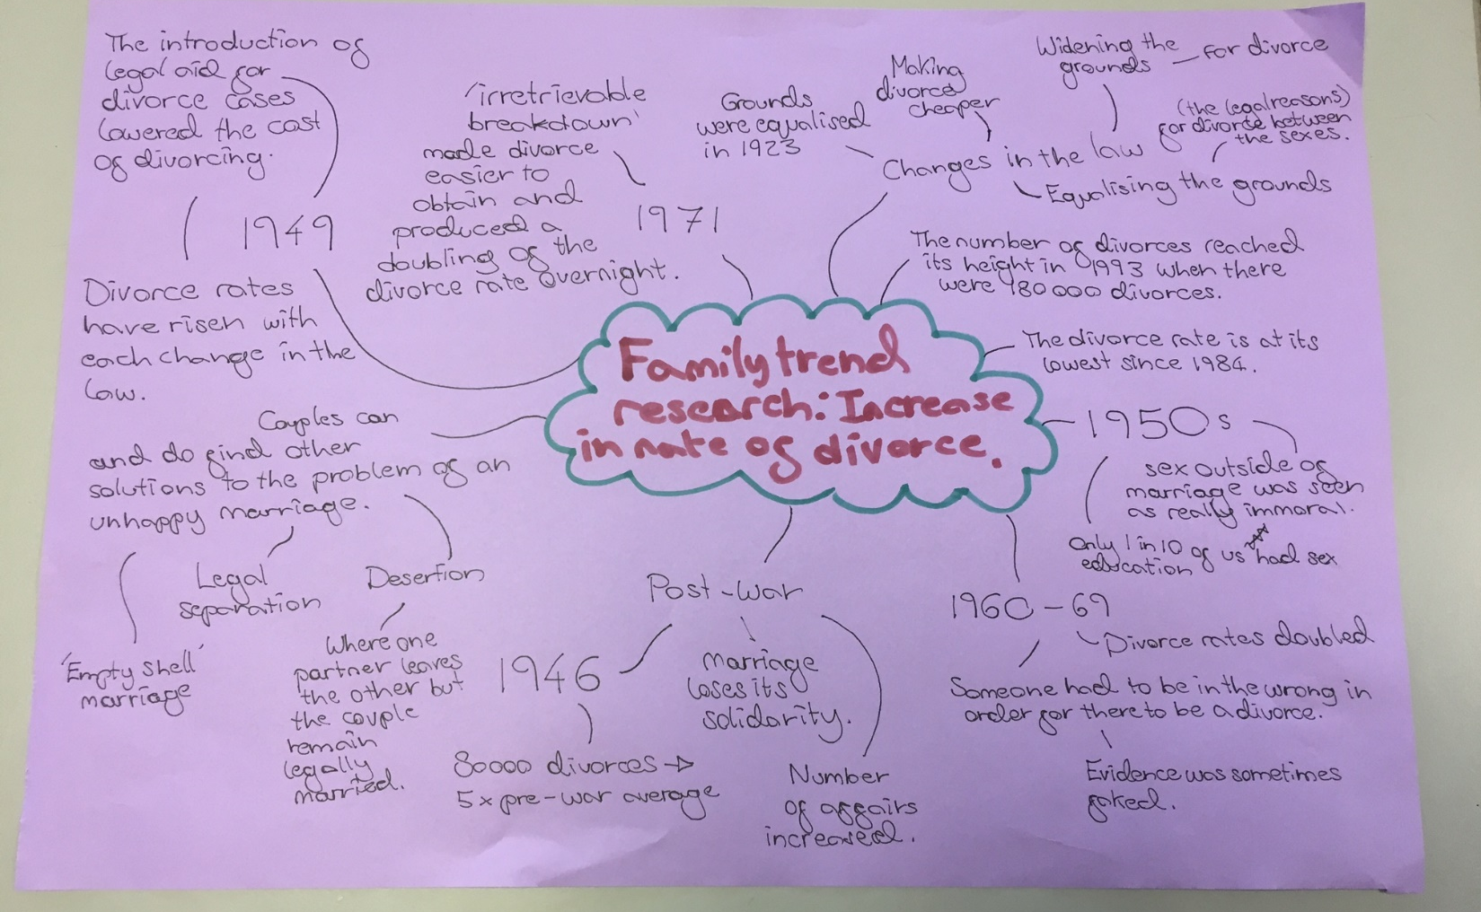

Slide 9
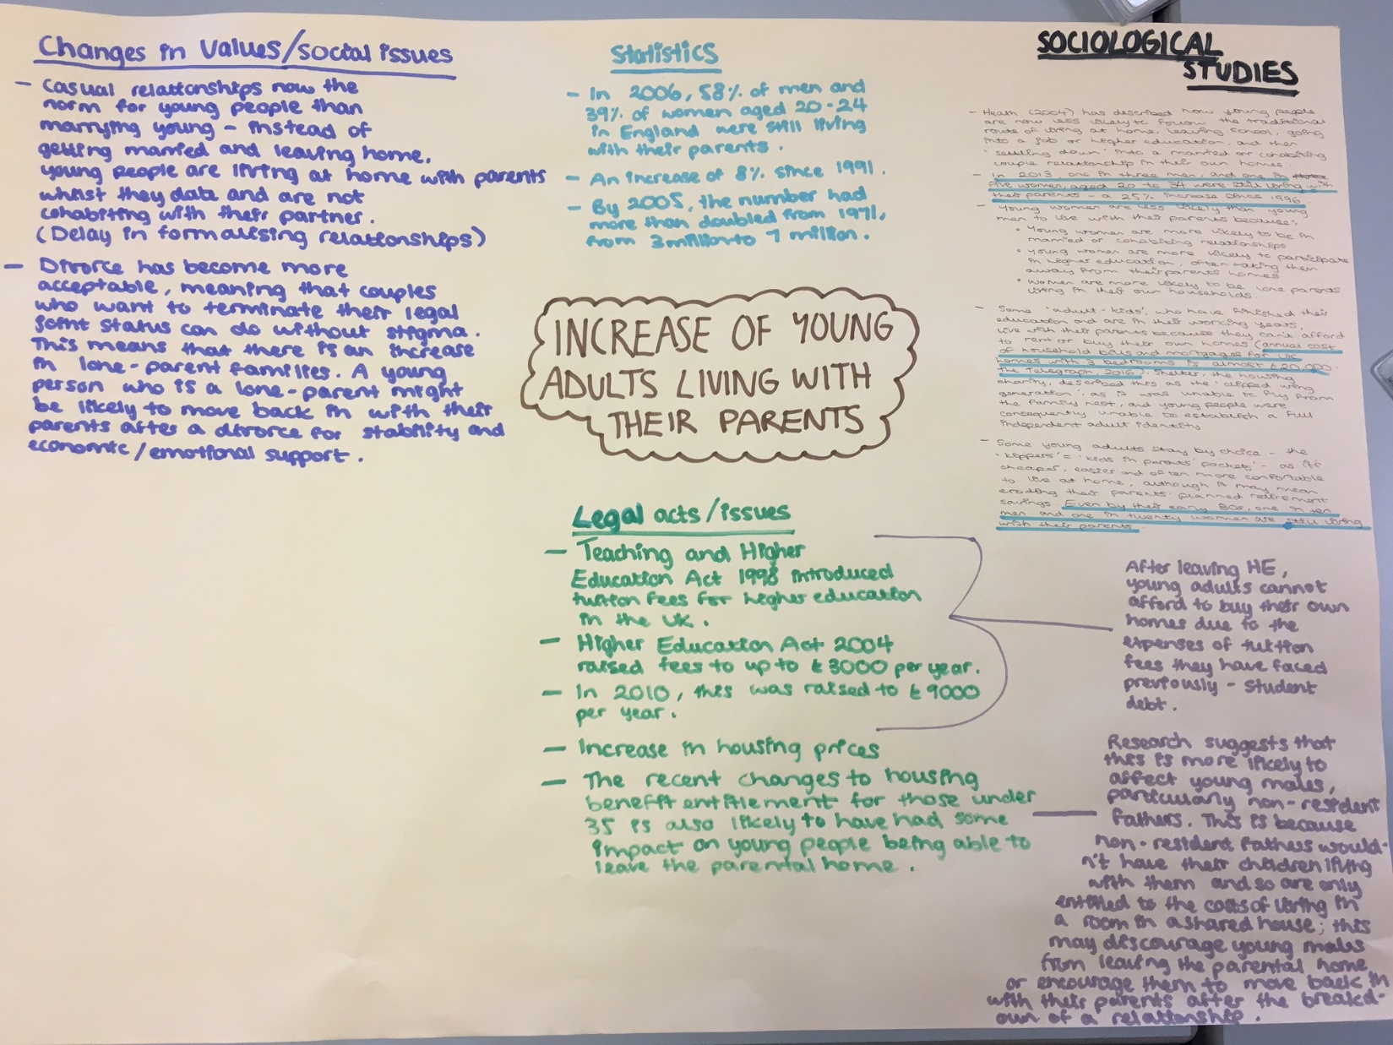

Slide 10
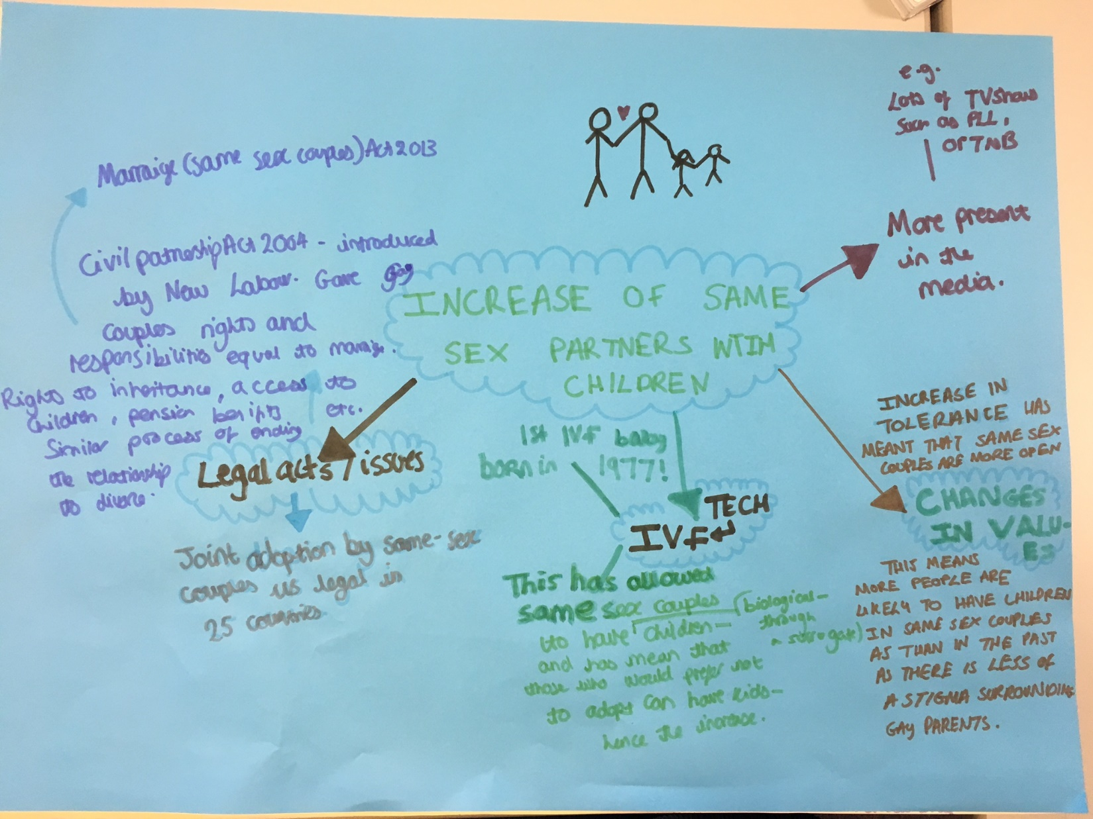

Slide 11
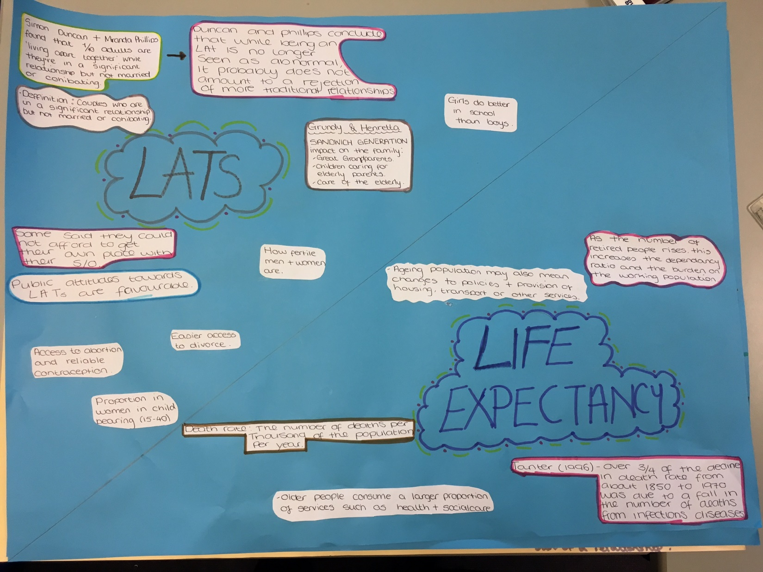

Slide 12
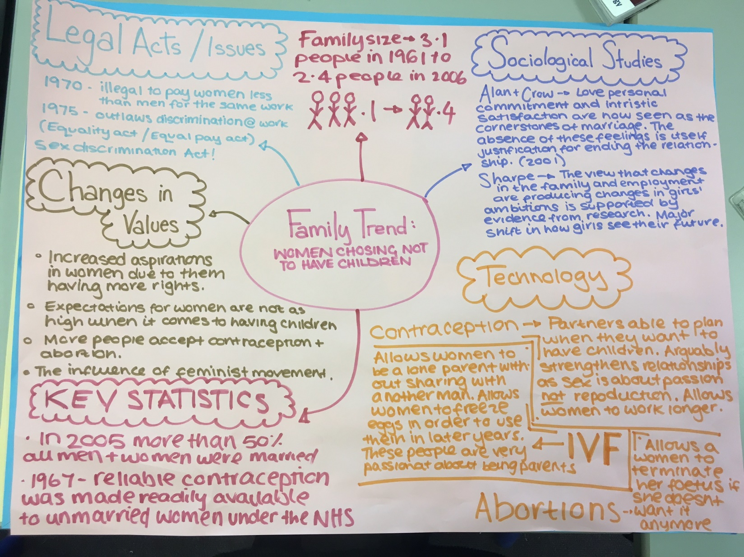

Slide 13
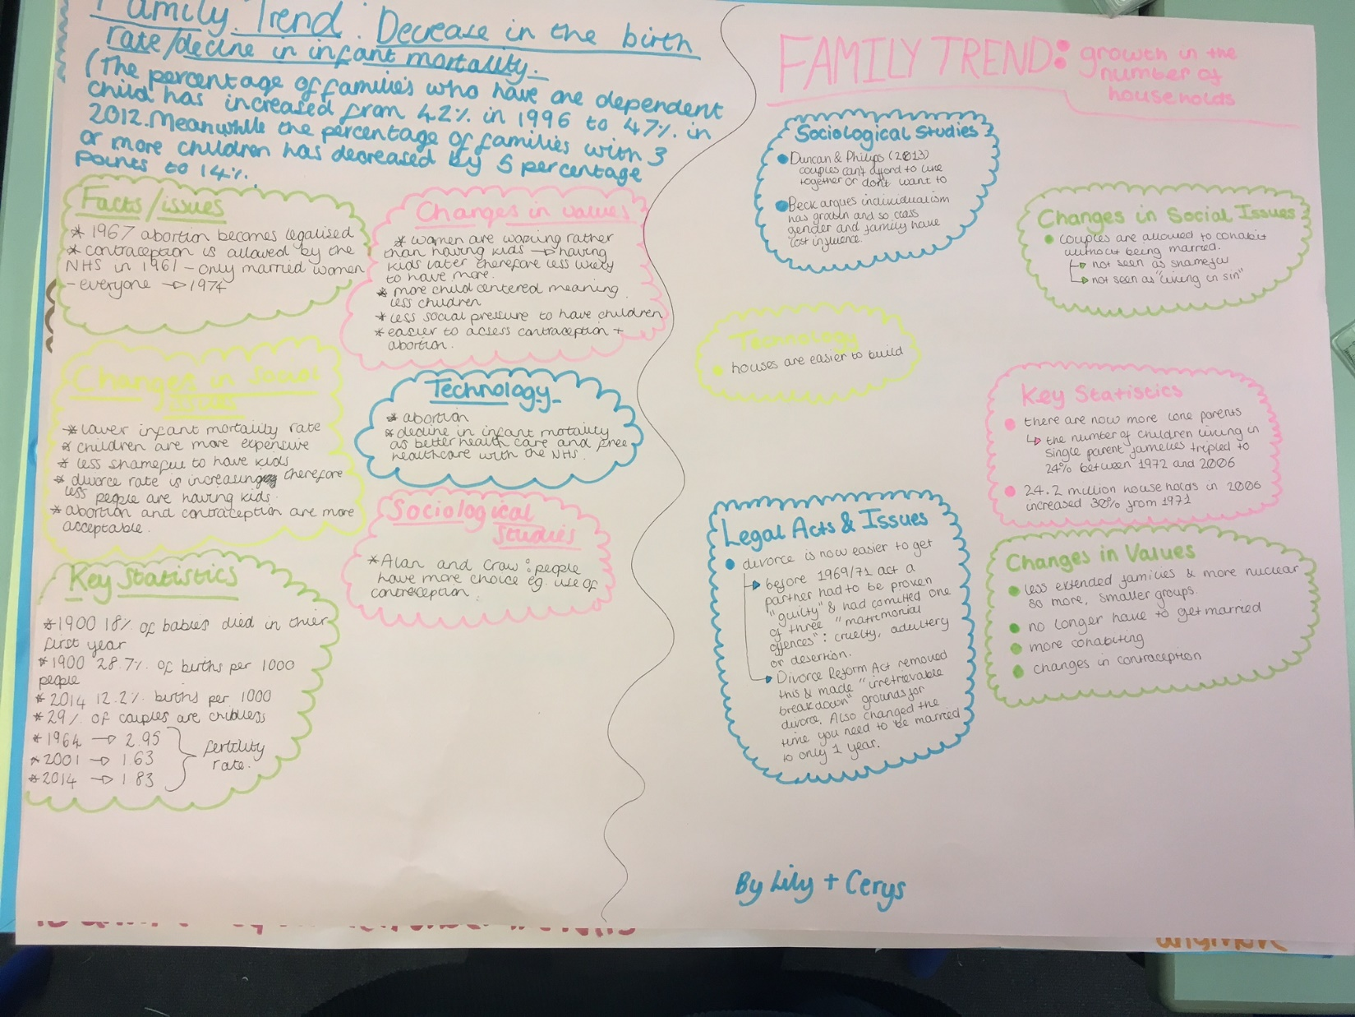

Slide 14
Changes in social issues:
Increased separation and divorce has created more one person households, especially men under 65.
Decline in number of people marrying, and the trend of people marrying later.
Changes in values:
Many people are remaining single. The number of adults who are single has risen by half since 1971.
CHANGES TO THE FAMILY: AN INCREASE OF ONE PERSON HOUSEHOLDS
Key statistics:
In 2013, almost 3 in 10 households 7.7millon people contained only 1 person
40% of all one person households are over 65.
By 2033, over 30% of the adult population will be single (un-partnered and never-married)
Sociological studies:
Duncan and Phillips
1 in 10 adults are ‘living apart together’ or ‘LATs’ that is, in a significant relationship, but not married or cohabiting.

