Slide 1
FAMILY TRENDS SUMMARY D2 GROUP

Slide 2
Widening the grounds for divorce
The matrimonial family proceedings act (1984)- removed the length of time that a couple have to be married before filing for a divorce from 3 years to 1 year.
2012- a third of all marriages were remarriages
Divorce rate at it’s lowest since 1984
Equalising the grounds for divorce between the sexes
1993- divorce rate reached its height of 180,000
Constant increase in divorce since the 1960s
Making divorce cheaper
Number of divorces doubled between 1961 and 1969, doubled again by 1972
Divorce reform act (1969/71)- removed the need to prove a guilty party and made “irretrievable breakdown” the grounds for divorce.
Key Statistics
Legal acts
Child maintenance service (2012)- absent parents to pay maintenance for children they do not live with. This is beneficial for divorced parents who can't agree on a “family based arrangement” making the financial side of divorce in families easier
Changes in values
Changing the norms of love, marriage an divorce
Increase in divorce rate
The idea of “permanence” is no longer regarded as a central idea
Changes in social issues
The government is taking account of demographic changes within the family helps these families such as lone parent families receiving benefits.
Less social stigma attached to divorce
Sociological studies
Changing attitudes towards single parent families makes it more socially acceptable for parents to divorce.
Parsons (and other functionalists) have argued that the increase in divorce may be due to the increased importance placed on marriage.
Secularisation- influence of religious ideas about “till death do us part” has weakened.
Beck and Beck’s study showed increased individualism and emphasis on personal fulfilment. If someone is unhappy in a marriage they are able to leave.
Giddens- primary reason given for modern marriage is love, people divorce when they are no longer in love

Slide 3
Cashmore- lone parenting- working class mothers with less earning power chose to live on welfare benefits without a partner
Divorce reformat- more couples getting a divorce lead to more households
Rise in the number of people living alone 3 in 10 households consist of only 1 person
Mitza- higher rate of single parent families among black families
In 2006 there were 24.2 million households, and increase of 30% since 1971.
Duncan and Phillips- 1 in 10 adults are living apart together in relationships (LATS)
Allan and Crow- a decline in marriage due to a change in expectation of marriage
Legal acts
Key studies
Key statistics
Growth in the number of households
Beck and Giddens on individualisation
The proportion of children living in single parent families tripled to 24% between 1972 and 2006.
Ideological changes
Social changes
Decline in death rate- aging population due to people living longer
Cohabitation is the norm- idea of living together without being married
Changing attitudes towards single parent families
Changing the norms of love, marriage and divorce leads to more divorces as well as younger people moving from family home to get married.
Increase in immigration
Increase of population size due to natural change with net migration

Slide 4
Increase of same sex partners with children
Social Changes:
Giddens argues that marriage is based on confluent love rather than status.
It’s socially acceptable to be in a same-sex couple and have children.
Alan and Crow argue that our lives are now characterised by choice which makes family more diverse- if gay couples want to have children because its more acceptable in society.
Weeks et al (1999) argues that all increased social acceptance may explain a trend towards same-sex cohabitation and stable relationships that resemble those found among heterosexuals. He says gays as creating families based on ‘friendship and kindship’ which he calls the ‘chosen family’ where they have the same stability and security as heterosexual families.
Legal Changes:
Civil Partnership Act 2004- gave gay couples rights and responsibilities equal to marriage. Rights to inheritance, access to children, pension benefits etc. and a process of ending the relationship similar to divorce.
Equality Act 2010- brought together key anti-discrimination in the workplace on grounds of gender, religion, sexual orientation and age.
Marriage (same-sex couples) Act 2013- allows same-sex couples to marry on the same basis as opposite sex couples.
Statistics:
The most common family type in 2015 was the married/civil partnership couple family with or without dependent children at 12.5 million- the Office for National Statistics.
It is estimated that in the UK in 2013 there were around 20,000 dependent children living in same-sex couple families - Common Law Marriage and Cohabitation report, p.5.
As of 8 December 2016, there had been 2,317 adoptions by LGBT people in Great Britain.

Slide 5
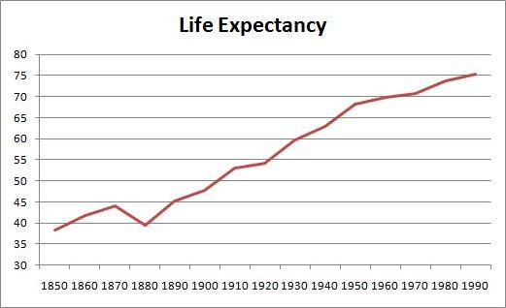
Fall in death rate/increase in life expectancy
Reasons for the decline in death rate:
Public heath measures- in 1948 the NHS was formed
Fall in number of deaths from disease
Improved nutrition – reduced the death rates by half
medical improvements – antibiotics and immunisation
People smoke less and diet has improved
Decline in dangerous jobs such as mining
Smaller families reduce the rate of transmission in infection
This will eventually lead to an ageing population
In 2014 nearly ¼ of all deaths in England and Wales were from causes considered potentially avoidable through timely and effective heath care or public health interventions.
Will lead to demographic change changes in the population
Impact on family:
Children are more likely to have great grandparents because of increased life expectancy.
Grundy and Henretta – rise in the ‘sandwich generation’- as women are now dual carers and care for their children and their grandchildren.
Since 1900 most of the growth in the UK population has been due to the natural increase with more birth rates than death rates and greater life expectancy. The population of the UK rose from about 38.3 million n 1901 to around 64 million by the end of 2013
The number of UK deaths registered in 2014 was 507341. this is a fall of 1.1% compared with 2013 when there were 576458 deaths

Slide 6
INCREASE IN ONE PERSON HOUSEHOLDS
LEGAL ACTS/ISSUES
Divorce Reform Act 1969
Allowing couples to divorce after they had been separated for two years (or five years if only one of them wanted a divorce)
Marriage could be ended if it had irretrievably broken down
No longer had to prove fault
Increased divorce rates therefore increase in one person households
Equal Pay Act 1970
prohibits any less favourable treatment between men and women in terms of pay and conditions of employment
Women are able to financially support themselves, thus they are able to live alone (not dependent on males).
Pensions Act 2014
Improved pension scheme
Elderly people are less financially dependent on others therefore can live alone, and not with family as they may have done in the past.
CHANGES IN VALUES
The stigma attached to divorce has reduced
This has led to an increase in divorce as its becoming more normalised.
Being a ‘LAT’ (Living apart together) is now not considered abnormal, unlike in the past.
TECHNOLOGY
Medical care
NHS introduced in 1948, allowed everyone to have access to health care.
Advances include:
Introduction of antibiotics
Immunisation
Blood transfusion
Improved maternity services
Improved technology within the home
E.g. stair lifts, dishwashers, phones
Allows people like the elderly to live independently for longer
SOCIOLOGICAL STUDIES
Duncan and Philips (2013)
About one in 10 adults are living apart together (LAT)
20% of people see LATs as the “ideal relationship”(more than the number of people who prefer cohabitation
Sharpe (1984)
Interviews with girls in 1970s and 1990s show a major shift in the way girls see their future.
In 1974, the girls had low aspirations. Their priorities were love, marriage, husbands and children.
By the 1990s girls ambitions had changed with career and being able to support themselves being their top priorities.
This means that women are less likely to get married and are therefore more likely to live alone.
Donald Hirsch (2005)
Traditional age pyramid is disappearing and being replaced by more or less equal sized ‘block’ representing the different age groups.
By 2041 there will be as many 78 year olds as 5 year olds.
This shows that there is an ageing population, thus there will be more one pensioner households.
KEY STATISTICS
One person pensioner households now account for 12.5% or 1 in 8 households in the UK
By 2005 the number of 1 person households had doubled since 1971- from 3 million to 7 million
Women today are much more likely to be in paid work- the proportion of women working rose from 52% in 1971 to 67% in 2013

Slide 7
INCREASE OF RECONSTITUTED/STEP FAMILIES
LEGAL ACTS/ISSUES
1923- Grounds for divorce equalised for men and women
Divorce is more accessible therefore the divorce rates increase and new families can be formed due to remarriage
Divorce Reform Act 1969
Allowing couples to divorce after they had been separated for two years (or five years if only one of them wanted a divorce)
Marriage could be ended if it had irretrievably broken down
No longer had to prove fault
Increased divorce rates therefore increase in people remarrying and families merging.
CHANGES IN VALUES
The stigma attached to divorce has reduced
This has led to an increase in divorce as it becoming more normalised.
SOCIOLOGICAL STUDIES
Juliet Mitchell and Jack Goody (1997)
Note that an important change since the 1960s has been the rapid decline in the stigma attached to divorce.
Ulrich Beck (1992) and Anthony Giddens (1992)
In modern society traditional norms such as the duty to remain with the same partner for life lose their hold over individuals.
Jessie Bernard (1976)
Many women feel a growing dissatisfaction with patriarchal marriage, this creates a rising divorce rate.
KEY STATISTICS
In 2012 one third of all marriages were remarriages for one or both partners. For many people this is leading to serial monogamy- a pattern of marriage-divorce-remarriage
Step families account for over 10% of all families with dependent children in Britain.
In 85% of step families at least one child is from the women's previous relationship, while in 11% there is at least one child from the mans previous relationship, in 4% of step families there are children from both partners previous relationships.

Slide 8
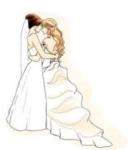
Changes in Values
More women want to work so remarry into a mire suited lifestyle and husband,
Marrying for love – can divorce if there is no love and can then remarry
Less social disapproval of divorces. Therefore people are more likely to seek legal ends to unhappy divorce.
Socialogical Studies
Postmodernists – Beck & Beck-Gernstein; rising divorce rates is due to the growing of individualism and all aspects of life are subject to more choice, negotiation and decision making.
Giddens – Confluent love and personal fulfilment have gained significance and people are less willing to stay unhappy within their relationships
Legal Acts/Issues
1969, divorce law reform act – idea that matrimonial offence was abolished so that made an irretrievable breakdown a sole ground to divorce.
A lot more men remarry than divorced women.
Family Trend:
Increase of Marriages that are Remarriage's
Key Statistics
More remarriages in 2012, 1/3 of all marriages were remarriages for one or both partners.
In 2012, the no. of divorces was highest in men and women aged 40-44, which means there is still mo9re time to be married after divorce.

Slide 9
Legal Acts/Issues
Increase in divorce and number of never married women having children is linked to decline in stigma attached to births outside marriage.
Changes in Values
People not wanting to marry
Lone parent families often limits fathers involvement.
Socialogical Studies
Jean Renvoize(1985) – working class women are able to support child without involvement from father.
Ellis Cashmore (1985) – working class mothers with less earning power choose to live on welfare benefits without a partner – experienced abuse.
Feminists – greater opportunities for women and encouraged an increase in number of never married mothers.
Charles Murray (1984) – over generous welfare state providing benefits for unmarried mothers and children.
- created a ‘perverse incentive’ – rewards irresponsible behaviour, eg. having children without being able to provide for them.
- Welfare state creates ‘dependency culture’ – assume state will support them and their children.
Family Trend:
Increase in Lone Parent Families
Statistics
Lone parents make up 22% of all families with children.
1 in 4 children live this way.
90% are headed by lone mothers.
Until 1990’s divorced women were the biggest group of lone mothers .
Child living with lone parents us twice as likely to be in poverty than a child with two parents.
Changes in Social Issues
More likely to be in poverty because; lack of affordable childcare, parents from working class – 60% are unemployed. Inadequate welfare benefits. Women in this family earn less than men more often than not.

Slide 10
Key Statistics
1950 – black immigrants from Caribbean.
1960 – South Asian from India, Pakistan, Bangladesh and East Africa.
1980 – non-whites = less than a ¼ of all immigrants.
Population size = net migration high eg. 260,000 more immigrants that migrants (47% non-EU, 38% EU citizens and 14% returning to UK).
Greater ethnic diversity led to changing family patterns in the UK.
Higher proportion of lone parent households were headed by black persons (at least ½).
Changes in Values
More pull factors for a certain country; better housing, education and safer.
UK is a multicultural society: may different cultures and families now living there.
More accepted top have mixed race families.
Sociological Studies
Mirza;
Caribbean Families brought higher rates of single parent households. 2012; over half of families with depended children headed by a black person were lone parent.
Ballard; South Asian Families have increased in extended families.
Family Trend:
Impact of Migration on Types of Families and the UK Population Structure

Slide 11
1969 – Divorce Law Reform Act (came into effect in 1971) this meade irretrievable breakdown of marriage the safe ground for divorce – established by proving unreasonable behaviour, adultery, desertion, separation. Divorce was available after 2 years of agreed separation or 5 if one partner did not agree
Changes in values:
Stories about affairs are more common in the media. The media shows lots of different types of families. Marriage isn’t seen as a necessity. People have more sexual partners than they used to.
Changes in values
Legal acts/ issues
Decline in the number of marriages
Sociological studies:
Alan and Crow (2001) Marriage is increasingly viewed not as a binding contract, but as a relationship in which individuals seek personal fulfilment, and this encourages couples to divorce if they do not find it. Mirza (1997) argues that the higher rate of lone parent families among blacks is not the result of disorganization, but it reflects the high value that black women place on independence.
Family Law Act encourages couples to seek meditation but allows divorce after a period of reflection
Sociological issues
Changes in social issues
Key statistics
Half of adults are married, compared with 90% of 60 year olds, but divorce rates are also highest among older couples. In 2014 about 1in 8 people were living together as a couple but were not married. In 2015, 50.6% of the population was married compared with 54.8% in 2002
The publics response to changing material norms and family forms reflects a mix of acceptance and unease.
Seven- in –ten say the trend toward more single women having children is bad for society, and 61% say that a child needs both mother and father to grow up happily.

Slide 12
Changes in values
Legal acts and issues
Sociological studies
Impact on the decrease in birth rate
Sociological studies:
Interviews with girls in the 1970’s and 1990’s show a major shift in the way girls see their future. 1974 girls- low aspirations believed educational success was unfeminine. Gave their priorities to love marriage, husbands, children, jobs and career. 1990’s girls- ambitions changed and they had a different order of priorities- careers and being able to support themselves.
Key statistics
There were 698,512 live births in England and wales in 2013, a decrease of 4.2% from 729,647 in 2012
In 2013 the stillbirth rate fell to 4.7 per thousand total births, from 4.9 in 2012
In 2013, the total fertility rate decreased to 1.85 children per women from 1.94 in 2012
Over a quart(26.2%) of live births were mother born outside the UK; a small increase compared with 25.9% in 2012

Slide 13
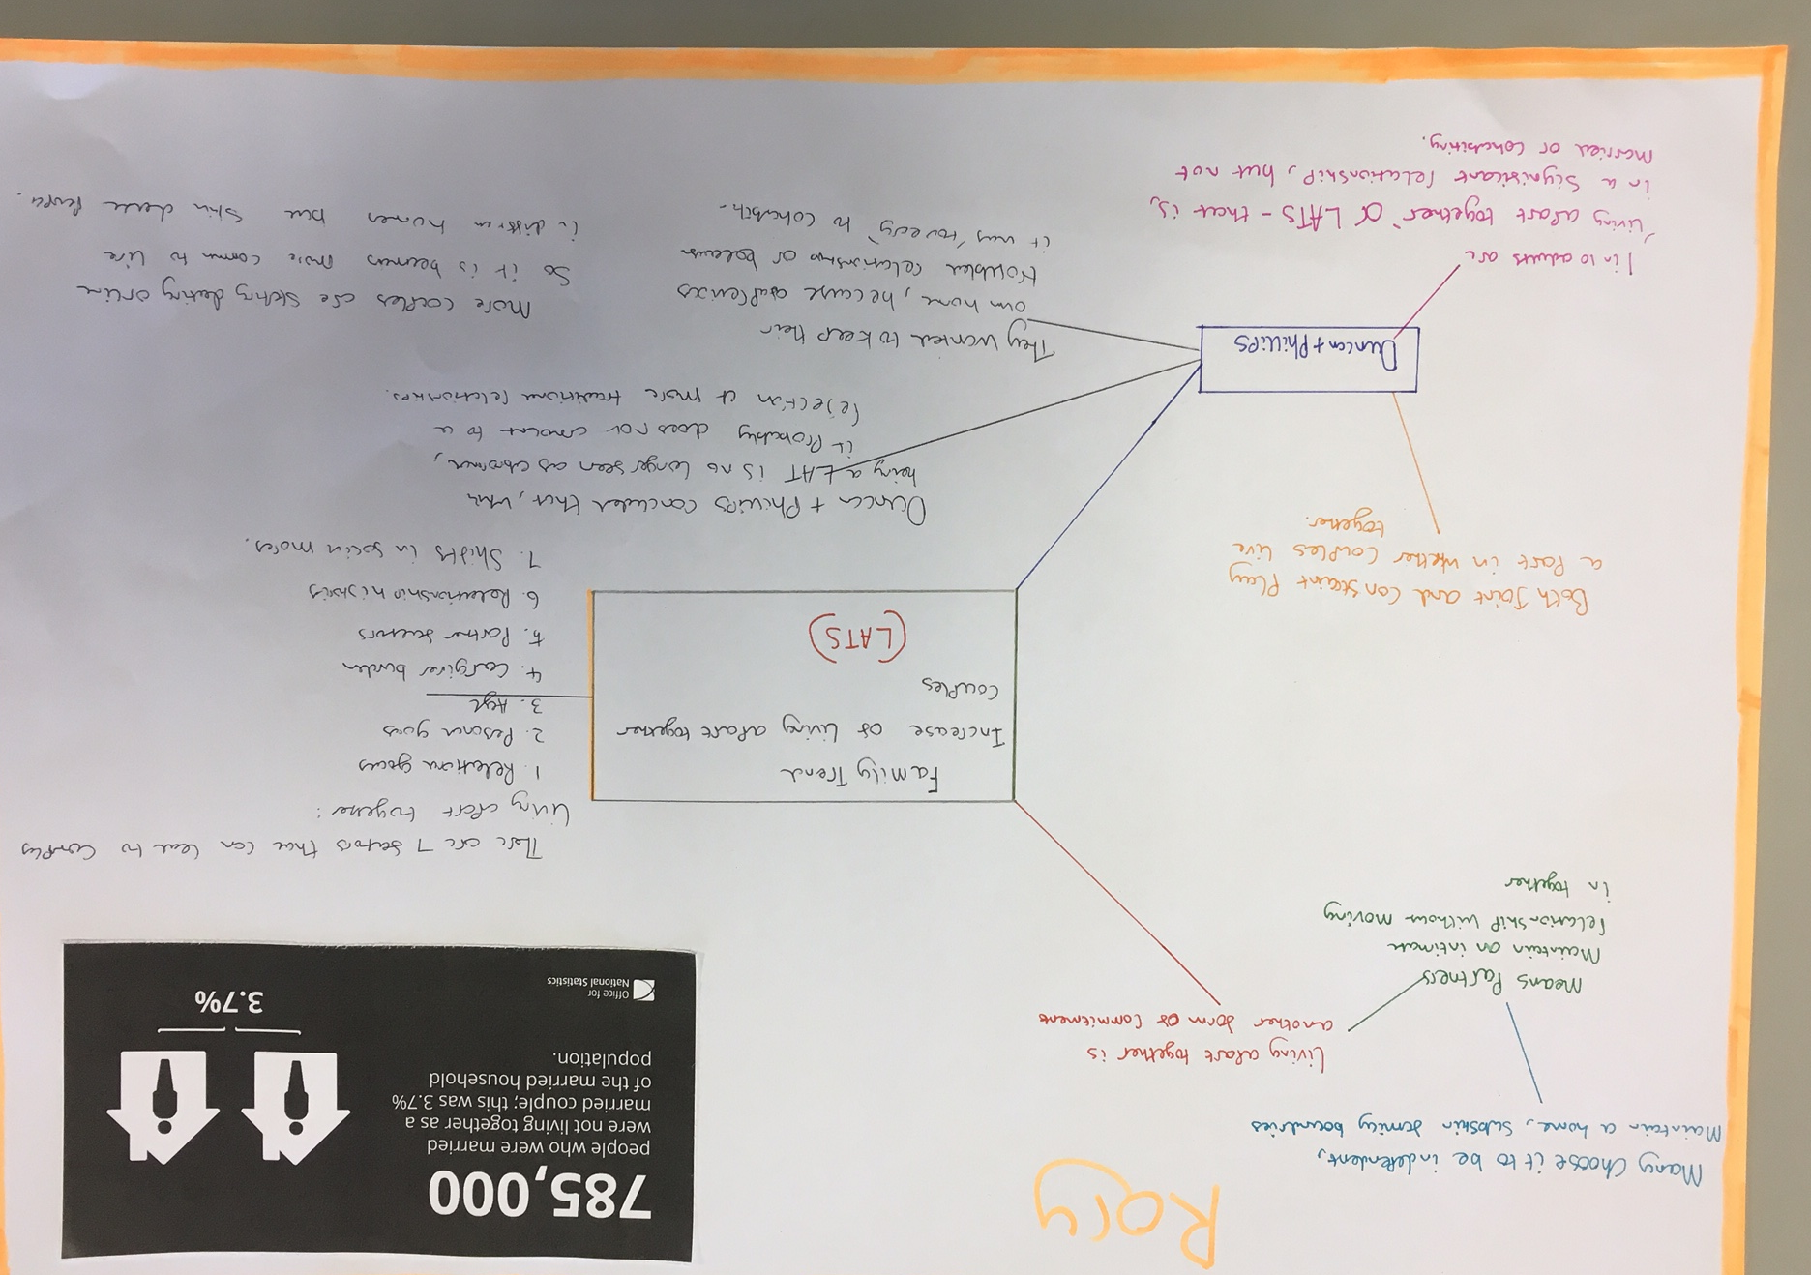

Slide 14
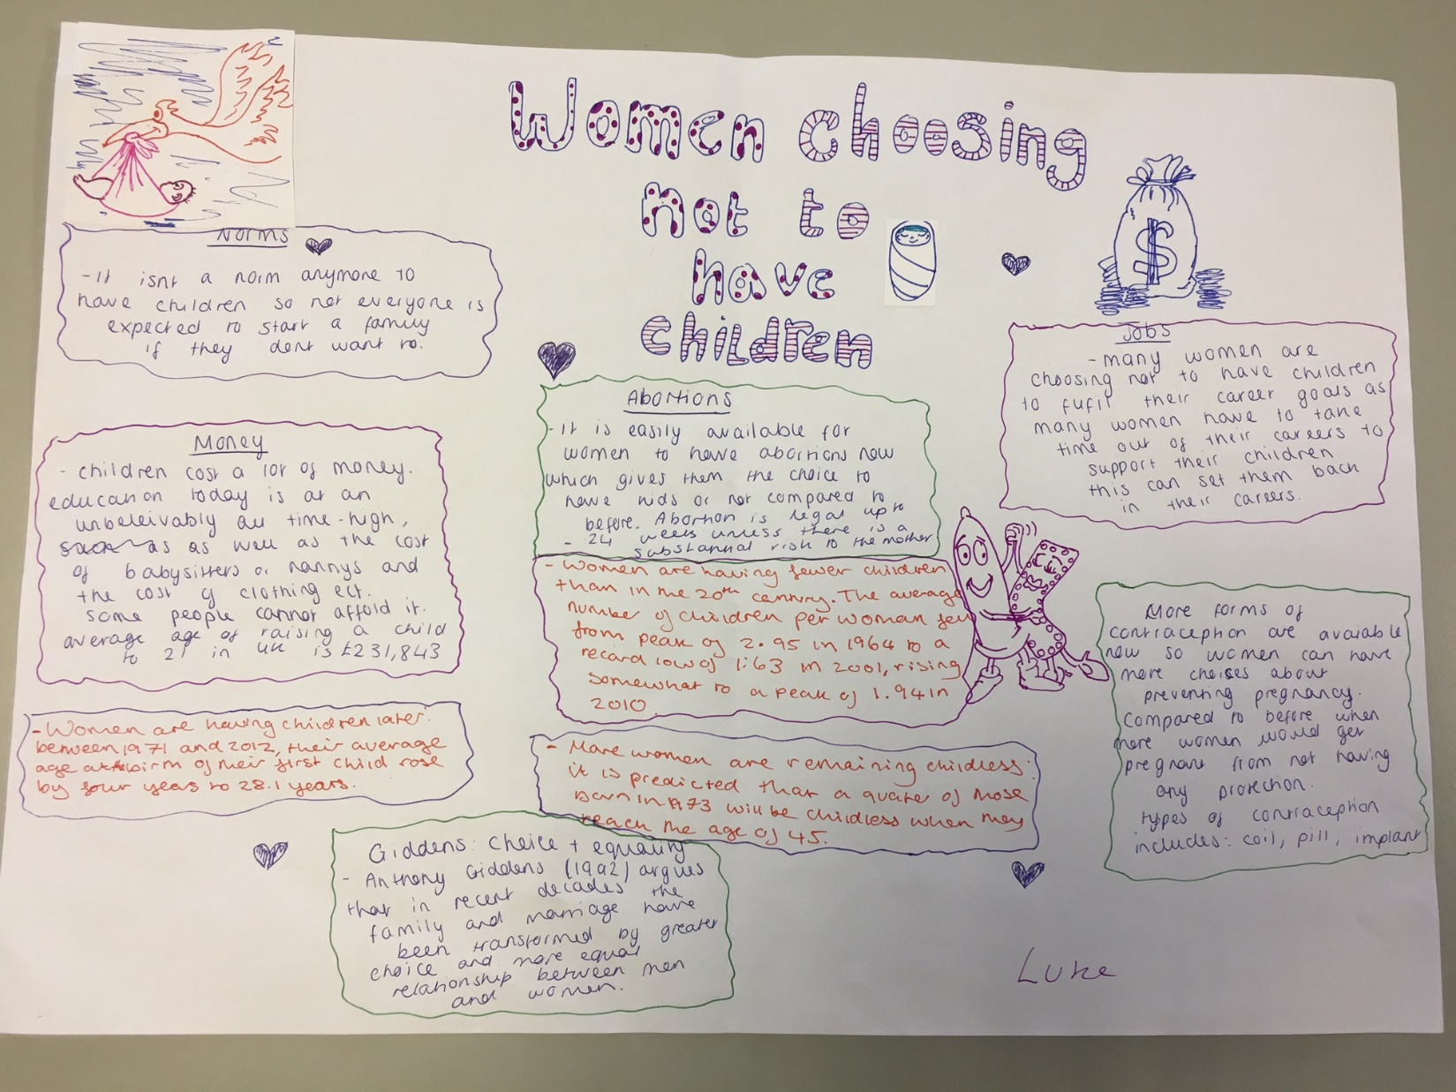

Slide 15
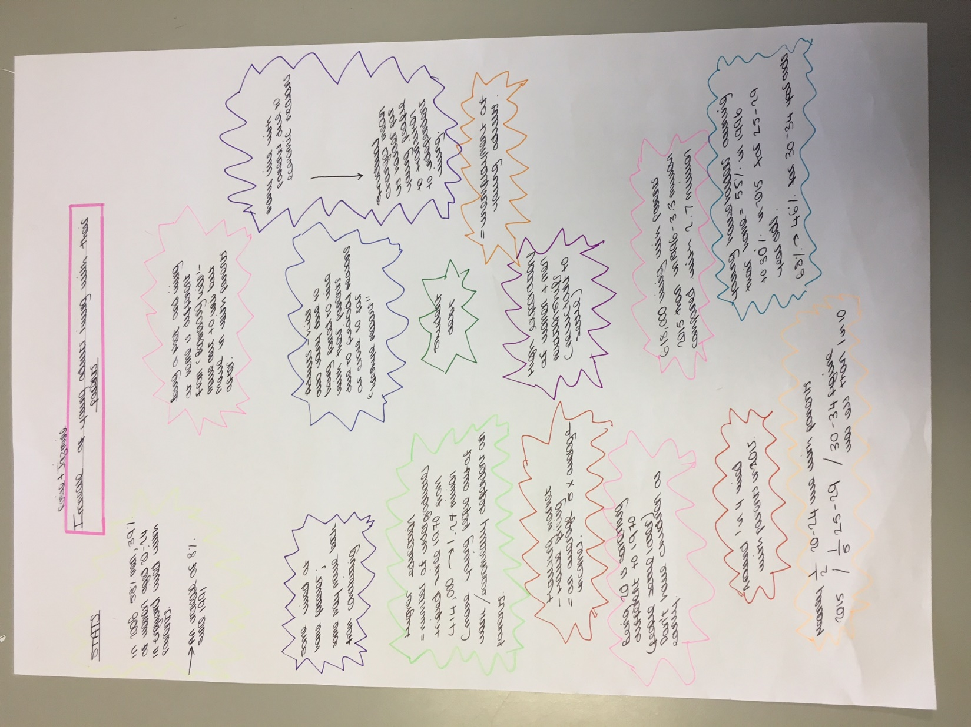

Slide 17
