Slide 1
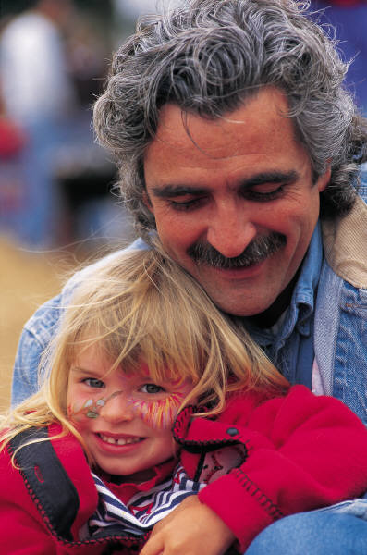
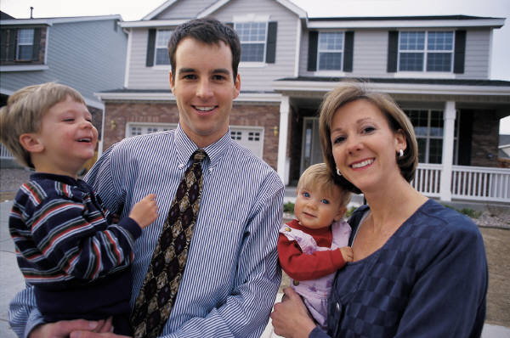
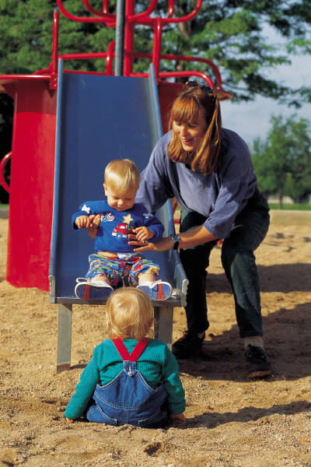
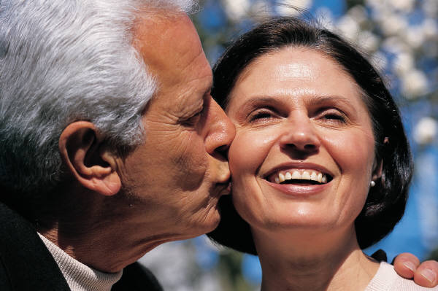
Family Diversity
HHR / DAK

Slide 2
What do we mean by the term diversity? p.3
DIVERSITY

Slide 3
Activity p.4
Draw a picture of the dominant stereotypical family in the UK.
What problems can you see with this stereotypical image of the family?
Who would agree with this image?
Who would be opposed to or challenge this image?

Slide 4
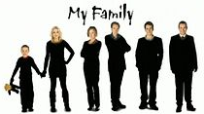
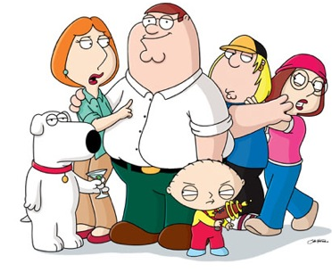
Key Question: Is the nuclear family still dominant?
This is the key issue when discussing diversity.
Is the nuclear family dominant or are British families a bit more complicated than this?

Slide 5

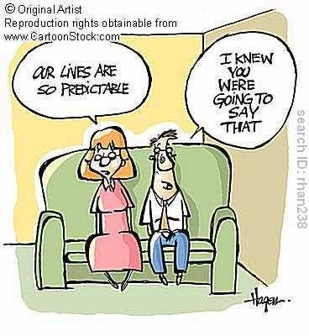
Functionalism and Family Diversity
Modernist perspective Modern society is fixed and predictable. One type of family is the best.
Parsons the functional fit is the nuclear family as provides 2 main functions
Primary socialisation
Adult stabilisation

Slide 6
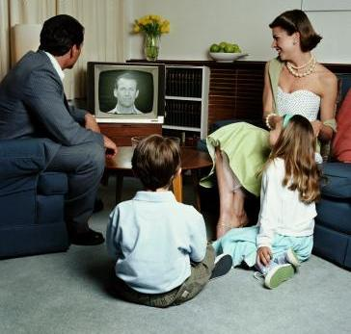
Functionalism
Parsons believes we can generalise about the family type we will find in society – Nuclear with a clear division of labour.
Other types could be seen as deviant or unproductive as they are less able to perform the functions required of the family.

Slide 7
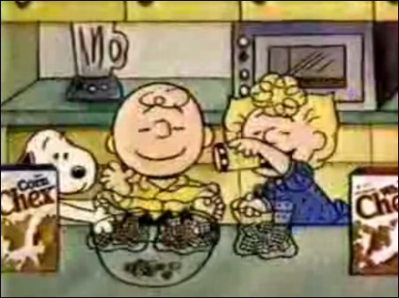
Traditional ideas of the nuclear family
The nuclear family is presented as ‘normal’- Edmund Leach regarded the nuclear family as the ‘cereal packet’ image of an ideal family in the 1960s of a heterosexual couple and two children who were close in age.
Leach regarded the modern nuclear family as broadly dysfunctional when compared to more extended family networks – as an emotional hothouse it becomes “the source of all our discontents”
Like other functionalists though, he assumes this family structure is dominant in our society

Slide 8
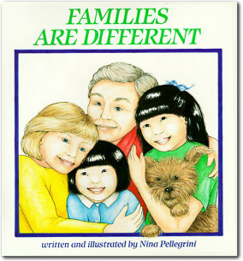
The Neo-conventional Family
Chester (1985) accepts recent diversity, but does not see this as significant or negative.
1 important change is move from:
Traditional Neo-conventional
Nuclear family Family

Slide 9
The Neo-conventional Family
Dual earner family (symmetrical family)
Nuclear family remains an ideal.
Most people will be part of a nuclear family at some point.
Most people still:
marry
have children
stay together till death
jointly register births
live in a household with a married couple.
The New Right Exagerrate

Slide 10


The New Right
Conservative and anti-feminist approach. Firmly opposed to family diversity.
Only one correct family type.
The nuclear family is ‘natural’ and based on fundamental biological differences between men and women.
Decline in nuclear family is the cause of many social problems.
Bensons (2006) study shows that cohabitating couples (20%) are more likely to separate after having a child than married couples (6%).
Amato (2006) children in nuclear family are less likely to experience poverty, education failure crime and health problems.

Slide 11
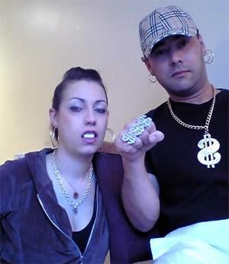
New Right & Conservatives
Huge welfare benefits are seen as really bad as they create PERVERSE INCENTIVES and encourage a dependency culture.

Slide 12
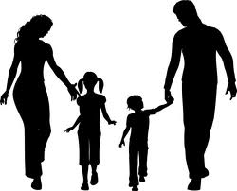
Dominance of the nuclear family?
This dominance only relates to the structure, it ignores
Class
Sexuality
The lifecycle of the family- change over time e.g. divorce
Ethnicity
Differences in conjugal roles
Statistics indicate that the structure of 2 parents and children is still dominant in contemporary Britain. In 2006 76% of children were living in this structure of family.
Where the family is living
Religion
Can you think of anything else?

Slide 13
Key Study: Rapoport and Rapoport
Robert and Rhona Rapoport are postmodernists- offering contemporary reasons for social phenomena.
Argue that although families might look like nuclear families from the outside they may be very differently set up on the inside. They also argue there are many other types of family, which traditional theorists tend to ignore.

Slide 14
Rapoport and Rapoport (1984) identified five elements of family diversity:
Organisational: different structures and how roles are divided in the household.
Cultural: the nature of the family and relationships can vary considerably between different ethnic and cultural groups
Class/Economic: differences may be based on class, such as sharing of domestic roles and decisions, employing a nanny. Differences in socializing children.

Slide 15
Life Course: The nature of the family can change over the life-course of an individual. For example, living in a nuclear family is more likely for those in their thirties than those in their sixties
Cohort: individuals born at the same time may have similar experiences because of wider social and historical events, such as economic depression, war, expansion of education

Slide 16
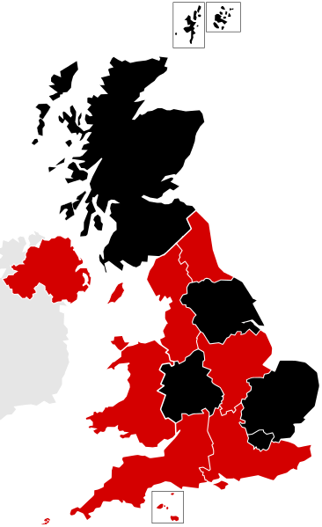
Eversley and Bonnerjea (1982) – Diversity and Location
David Eversley and Lucy Bonnerjea add in the additional factor of regional diversity
They suggest that local influences produce different life experiences, and so, diversity.
They identify FIVE areas of Britain which offer different types of family organization- affluent, rural, geriatric, inner cities, old industrial

Slide 17
Eversley and Bonnerjea (1982) – Diversity and Location
Many coastal regions attract elderly couples ‘geriatric wards’, e.g.,
Inner city areas have greater concentrations of lone parents and ethnic minority families in the poorer areas, e.g.,
Traditional rural areas have more reliance on extended family, e.g.,
Affluent Suburbs tend to attract young families ‘family builders’, e.g.,
Old industrial areas may have the kind of extended family networks identified by Young and Willmott in their original study, e.g.,

Slide 18
Extended families
There is also the idea that although families may look nuclear they may in fact be part of a more complex extended structure.
Unlike Parsons, other functionalist sociologists such as Sussman (1965), have argued that the thesis of family units being isolated must be rejected. In particular, he showed that aid and assistance, particularly financial, still flows from parents to children and argued that extended family networks occur widely in industrial societies.
The findings of Willmott and Young, etc support this

Slide 19
Peter Willmott (1988)
Conducted a study of families in a North London suburb and identified FOUR main types of extended families:
Extended family of residence – where members of the family live in the same household
Local extended family – where 2 or 3 nuclear families live separately, but in close proximity and see each other often
Dispersed extended family: nuclear families who see each other reasonably frequently but live further apart and do not see each other as regularly
Attenuated extended family: similar to the dispersed extended family but the contact is even less frequent

Slide 20
Conclusion
Diversity is not just about the structure- the extent to which the family looks like the nuclear family- it is also about how similar families are on the inside- at the interpersonal level. For example
  differences in male/female roles
  ideas about socialising children
  the role of religious ideas
  etc.
  What matters in interpreting this is the emphasis placed on different features.

Slide 21



Explanations for changes in the family

Slide 22
LIST
Legal (changes in law and government policy)
Ideological (changes in ideas about what is right or desirable)
Social (includes sociological theory and studies)
Technological

Slide 23
LEGAL

Slide 24
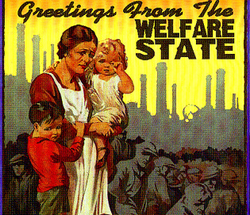
Legal Factors – Expansion of the Welfare State System
Since the 2nd world war there has been a rapid expansion of the welfare state system – this has included improved healthcare and the development of the ‘safety net’of the benefits system including housing child and income support benefits

Slide 25

Legal Factors – Divorce Reform Act (1969/71)
Before this act there needed to be proof that one partner was the ‘guilty party’ and had committed one of 3 ‘matrimonial offences’:
  Cruelty
  Adultery
  Desertion
The act removed the need to prove a guilty party and made ‘irretrievable breakdown’ the grounds for divorce

Slide 26

Legal Factors – The Matrimonial Family Proceedings Act (1984)
This act reduced the length of time that a couple needed to be married before filing for divorce down from 3 years to 1 year

Slide 27
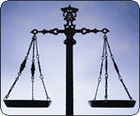
Legal Factors – Equality Act 2010
This Act brought together key anti-discrimination policy to protect people against discrimination in the workplace based on grounds of gender, religion, sexual orientation and age.
It Includes the:
The Sex Discrimination Act 1975 and Equal Pay Act 1970

Slide 28
Children Act 2004
The Act aims to make living in the UK, as a child, as safe as possible by protecting their welfare and rights.
The act allows the state to intervene in a family should the welfare of a child be called into question.

Slide 29
Child Maintenance Service (2012)
Requires absent parents to pay maintenance for children they do not live with.
This service is used when parents cannot agree on a ‘family-based arrangement’
This maintenance is calculated using a set formula.

Slide 30
Civil Partnership Act (2004)
Gave legal recognition to the relationships of same-sex couples who enter a civil partnership, involving similar arrangements to a legal marriage.
Allows same-sex couples to marry on the same basis as opposite- sex couples.
Marriage (Same Sex Couples) Act 2013

Slide 31
IDEOLOGICAL

Slide 32

Ideological Factors – Materialism / Individualism
Many social commentators point to the following changes in values:
Increased individualism and an emphasis on personal fulfilment (Beck and Beck)
Increased materialism and a pursuit of wealth
A greater emphasis on careerism

Slide 33

Ideological Factors – Cohabitation as the Norm
The idea of living together without being married is no longer widely regarded as ‘living in sin’ but as the norm
In the 1950’s only 2% of marriage partners had cohabited prior to marriage today it is estimated to be over 80%

Slide 34
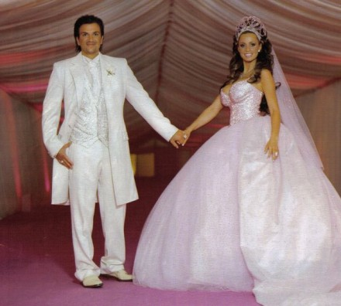
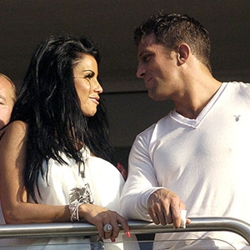
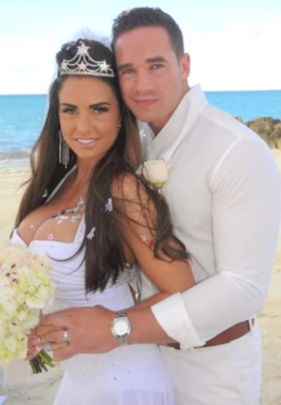
Ideological Factors – Changing Norms of Love, Marriage and Divorce
The primary reason given for modern marriage is ‘love’. Giddens argues people seek confluent love (fulfilment).
The idea of ‘permanence’ is not regarded as a central idea
There is less social stigma attached to divorce
Some Functionalists such as Talcott Parsons have argued that the increase in the divorce rate may actually be due to the increased importance placed upon marriage.

Slide 35
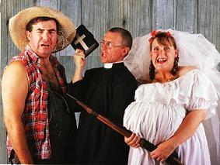
Changing attitudes towards single parent families
There is less social stigma toward lone parenthood.
Historically women who were unmarried that became pregnant would be socially shunned and depending on their age may have had to give the baby up for adoption.
Becoming pregnant without being married often led to many ‘shot gun’ weddings to avoid the social stigma. This did not always mean the couple were happy together.

Slide 36
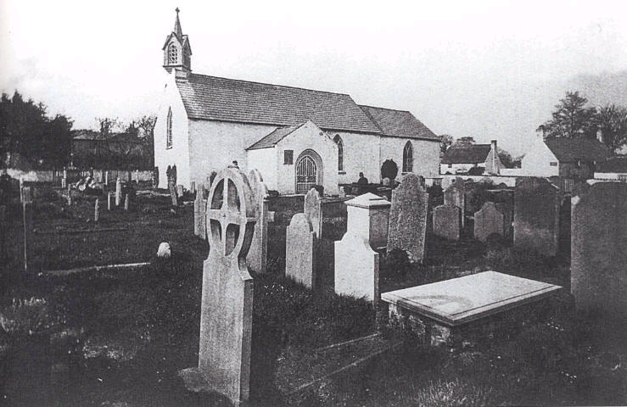
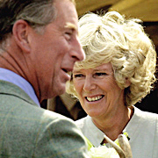
Ideological Factors - Secularisation
The decline in religious values, has led to:
The influence of religious ideas about ‘til death us do part’ weakened.
Fewer weddings in churches
Living together and not being married no longer viewed as ‘living in sin’

Slide 37

Ideological Factors – The influence of the Feminist Movement
The feminist movement has done much to empower women to be able to assertively make their own life choices.
Sue Sharpe demonstrated women’s aspirations have changed between the 1970s and 1990s, with more focus on careers rather than marriage.
Second wave feminism of the 1970s has had an important impact on many legal changes.

Slide 38
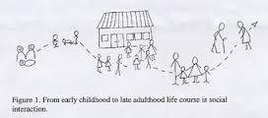
Changing life course of the family
A wide range of choices and options means there is far more uncertainty when it comes to making decisions about an individual’s life course.
Allan and Crow argue our lives are now characterised by choice, which makes families far more diverse.
The life course no longer occurs in one set pattern, but can vary massively between people.

Slide 39
SOCIAL

Slide 40
Social factors- Finance
Economic issues- costs of weddings (av £20,000), problems with getting mortgages.
Cost of childcare- A survey in 2004 by the Daycare Trust found that childcare costs were nearly a quarter of an average household income.
Bills going up due to cost of living rising

Slide 41
Social factors- demographics
Demographics are the statistical data about a population e.g. age, life expectancy, income, level of education, number of families etc.
Some examples of demographics linked to the family- there has been a decline in the size of the average family from 3.1 people in 1961 to 2.4 in 2006.
Why is it important for the government to take account of demographic change in relation to the family? P.15

Slide 42
Key terms
LIFE EXPECTANCY
BIRTH RATE
DEATH RATE
AGEING POPULATION
IMMIGRATION AND MIGRATION
DEPENDENCY RATIO
ASSIMILATION
MULTICULTURALISM

Slide 43
TECHNOLOGICAL

Slide 44
How have changes in technology impacted upon the family? p.22
INFLUENCE OF TECHNOLOGY

