Slide 1
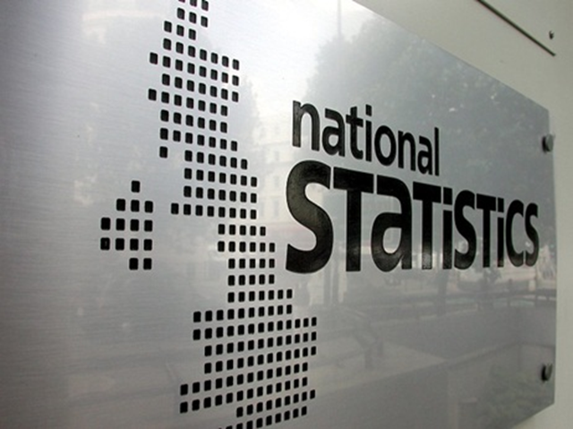
Official Statistics
Dave King
Sociology Department

Slide 2
Objectives
To review the relative importance of practical ethical and theoretical issues in using official statistics as a form of secondary data
To suggest examples and conclusions to assist essay writing

Slide 3
Statistics
Official
Who would use them?
Positivists
Because they are scientific?
Interpretivists
Because they lack meanings?
Realists
Because they are useful?
Definition
Numerical data?
Produced by government sources and agencies?

Slide 4
Why use Official Statistics?
A key source of data for sociologists interested in structuralist theory and especially comparative method
Often used as a starting point of research – establishing context or generating hypotheses

Slide 5
Types of official statistics
Statistics gathered by government agencies in the course of their work e.g., demographic statistics from the registration of births, marriages and deaths, crime statistics from the criminal justice system, school league tables, etc
Specific surveys – most obviously the 10 yearly national census, but also others such as the now defunct General Household Survey.
There are also a variety of statistics available from semi-official sources

Slide 6
Varieties of Gathered statistics
HARD – cannot be easily manipulated or changed, e.g., live births per 1000
SOFT – more easily manipulated, e.g., statistics on migration (do we include or exclude international student visas, citizens of the EU…?) or employment (are housewives unemployed? Are people below the age of 18? Do we simply measure those who claim benefit?)

Slide 7
Weblinks
Office for National Statistics - https:/www.ons.gov.uk/
Crime Survey of England and Wales - https://www.crimesurvey.co.uk/
Joseph Rowntree Foundation - https://www.jrf.org.uk/society
The Sutton Trust - http:/www.suttontrust.com/research

Slide 8
https://www.compare-school-performance.service.gov.uk/

Slide 9
Theoretical Issues: Positivism
Verification is difficult – the replication of any statistical survey is generally too costly and impracticable. We might doubt their representativeness on occasion, but cannot check this.
Reliability is problematic – the use of statistics and criteria for assessing them as accurate may change over time or between authorities

Slide 10
Theoretical Issues: Interpretivism / Phenomenology
Official statistics are clearly socially constructed, they rely not only on specific rules for their gathering but also on underlying cultural assumptions
This must affect their validity, i.e., do they measure what they seem to measure?

Slide 11
Practical Issues
Often Official Statistics are the only practicable source for certain studies
BUT
If statistics are not created then they are not available to anyone.
Governments may not be interested in collecting (and publishing) a number of statistics, for example -
There may be problems of collection – especially where the public are required to report honestly, for example -

Slide 12
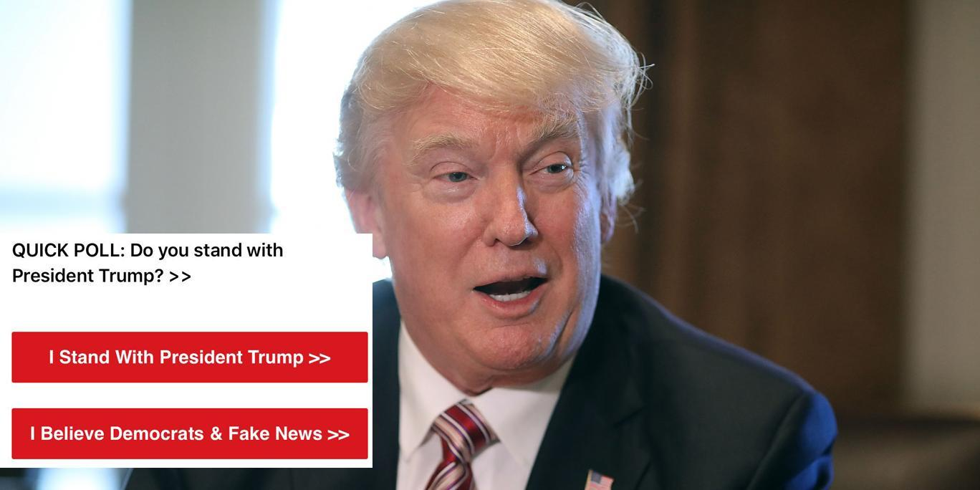
Would you trust this poll?

Slide 13
Ethical Issues
If secondary data is already in the public domain, Official Statistics present almost no ethical problems of data gathering for sociologists who use them “second-hand”
However, ethical issues may result in raw data being unavailable, e.g., the 100 year rule on the National Census. This then becomes a practical and theoretical concern, i.e.,

Slide 14
Crime Statistics and the Dark Figure
https://www.youtube.com/watch?v=jzdTiM5wS_c

Slide 15
Some Useful Case Studies
Emile Durkheim - Suicide
A study of suicide rates between countries
Used official suicide statistics to compare differing social contexts and their effect on the suicide rate urban vs. rural, protestant vs. Roman Catholic, etc.
Durkheim felt that this was a clear demonstration of the usefulness of (positivist) Sociology – looking at longer term trends rather than individual problems

Slide 16
Some Useful Case Studies
Max Atkinson’s Critique of Durkheim
For Atkinson, suicide rates as official statistics are constructed from the interpretation of individual coroners who have to:
Abide by differing rules for classification
Reconstruct the event using the often partial evidence available after a suspicious death
Rely upon their own beliefs about the nature of suicidal behaviour and “the sort of person” who will choose to commit the act
A comparison of suicide statistics simply tells us about differences in classification – these are not “HARD” enough as statistics

Slide 17
Conclusions
In any question on this you should emphasise:
That official statistics are socially constructed
That some are harder than others
That there remain problems of reliability and the researcher will be unable to verify procedures, methods and outcomes
That validity will be questionable
Practical advantages and disadvantages.
Whilst official statistics represent an easy and cheap source of data for the sociologist they present a range of practical issues in their construction..

Slide 18
 | Strengths | Weaknesses
Practical Access, time,/money, etc | A | B
Ethical Consent, safety, misrep[resentation etc | C | D
Theoretical Positivism Interpretivism Realism, Validity, reliabilioty representativerness, etc | E | F

Slide 19
Questions
Outline and explain two problems that sociologists face in the use of official statistics.
Or
Outline and explain two reasons for sociologists to use official statistics.

