Slide 1
Research skills course
Course Outline
Notes:
Use this section to write notes that remind you of what to say but that don’t appear on the slide

Slide 2
Why am I on this course?
Because it is an excellent short course which will equip you with many transferable skills.
Because you gain another qualification when you complete it.
Because we want you to pass this course to help you improve your writing in other subjects and after college.

Slide 3
What is this course about
Research – how to plan and research an area, how to assess the reliability of information, how to reference sources properly
You will have a short booklet to work through and you will need to write a short (1,000 – 1,500 word) essay (that’s two to three sides of A4)
You can even use an essay you have already written or are about to write.

Slide 4
Course Outline
Content
Understanding research
Research methods
Evaluating research sources
Using your sources
Referencing your work
Giving a bibliography for your work
Researching and writing your own essay
Handing in the completed booklet and essay
Giving a presentation/discussing your work with your teacher
You will have a teacher but you are also expected to work on this independently. You can use this PowerPoint on Godalming Online to help you complete this course outside lessons if you are absent.

Slide 5
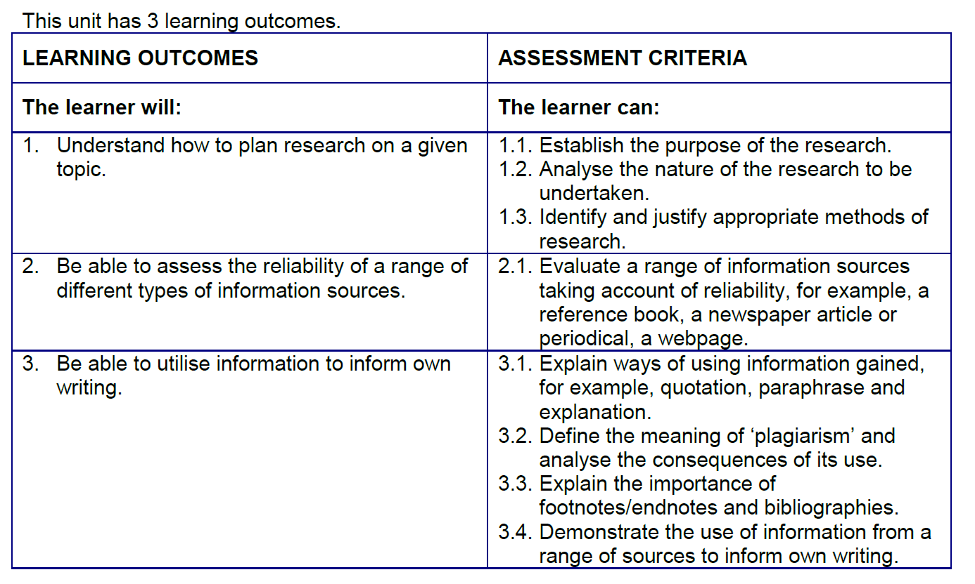
Course Content

Slide 6
What you need to do
At the end of the course you should:
Hand in your completed workbook
Hand in your assignment / essay (correctly referenced and with a bibliography)
Give a short presentation
You should be able to complete this in 11 weeks.

Slide 7
Research skills course
Work through the booklet
Notes:
Use this section to write notes that remind you of what to say but that don’t appear on the slide

Slide 8
What is research?
“the systematic investigation into and study of materials and sources in order to establish facts and reach new conclusions.”
Reference: Oxford dictionary online, accessed 31October 2017 via https://www.bing.com/search?q=research+definition&src=IE-TopResult&FORM=IETR02&conversationid=
Academic research – to advance a body of knowledge
Personal research – For your own interest and education

Slide 9
Thinking Toolbox
TIME REBELLION DOUBT REASON RULES ANGER COMPETITION STRUCTURE GUESSWORK PLAY FEAR SURROUNDINGS FREEDOM DEAD ENDS IGNORANCE UNCERTAINTY IMAGINATION DESTRUCTION DISAGREEMENT OPPOSITION CONVERSATION

Slide 10
Words detrimental to research?
TIME REBELLION DOUBT REASON RULES ANGER COMPETITION STRUCTURE GUESSWORK PLAY FEAR SURROUNDINGS FREEDOM DEAD ENDS IGNORANCE UNCERTAINTY IMAGINATION DESTRUCTION DISAGREEMENT OPPOSITION CONVERSATION

Slide 11
Types of Research
Here are some examples – you should think of others yourself and not just copy this list!
Lab Experiments
Field Experiments
Observations
Questionnaires
Interviews
Reports
Meta-Analysis

Slide 12
Experiments
E.g. Conducting clinical drug trials
Strengths | Weaknesses
Can have tight control of variables Cause and effect can be established Able to be replicated Can enable the use of complex equipment Often cheaper and less time consuming than other methods | If using people who are aware they are in an experiment they may behave differently Artificial environment Experimenter effects – e.g. the experimenter’s expectations can affect behaviour (bias)

Slide 13
Questionnaires and Interviews
e.g. Questioning war veterans
Strengths | Weaknesses
Detailed information can be obtained from a large number of people Can be easy to analyse if closed questions are used Allows attention to an individual’s point of view Unstructured questions may encourage openness | Unstructured questions can be difficult and time- consuming to analyse Possible interviewer effects People may not be truthful or recall information correctly

Slide 14
Primary + Secondary Research
primary research is something that you gather first hand... usually through interviews, covert/overt observation, questionnaires...
secondary research analyses information from other sources, for example government statistics, academic journals etc

Slide 15
Primary + Secondary Research
 | Strengths | Weaknesses
Primary | Researcher can focus on both qualitative and quantitative measures Addresses specific research issues High level of control | Can be expensive and time consuming to carry out Scope of research may be limited Other research may date it quickly Might get a low response rate
Secondary | Easy to access Cheap to acquire Helps to clarify own research May highlight difficulties in collecting primary research | Reliability and validity of source Not specific to researcher’s needs Information may be incomplete May be dated

Slide 16
Primary or Secondary?
QUESTIONNAIRE | P | NEWSPAPER | S
NGO STATISTICS | S | MARKET RESEARCH | P
JOURNALS | S | TEXT BOOK | S
EXPERIMENT | P | INTERVIEWS | P

Slide 17
Qualitative + Quantitative Research
Qualitative research gathers information that is not in numerical form. For example, diary accounts, open-ended questionnaires, unstructured interviews and unstructured observations. Qualitative data is typically descriptive data.
Quantitative research gathers data in numerical form which can be put into categories, or in rank order, or measured in units of measurement.

Slide 18
Qualitative + Quantitative Research
 | Strengths | Weaknesses
Qualitative | Issues can be examined in detail Questions are not restricted The direction of research can be revised as new information emerges Focus on human experience | Can be influenced by researcher’s bias Rigour is more difficult to maintain The type of data can make it difficult to analyse Researcher’s presence can affect responses
Quantitative | Easy to analyse the data and draw conclusions Less influenced by bias Easy to replicate Larger sample sizes can be used | Statistical reports can be difficult to interpret Ignores ‘human’ aspects that are difficult to capture in numbers

Slide 19
Qualitative or Quantitative?
FOCUS GROUP | Qualitative | MARKET | Both
STATISTICS | Quantitative | PARTICIPANT OBSERVATION | Quantitative
INTERVIEWS | Both | PERCENTAGES | Quantitative
EXPERIMENT RESULTS | Quantitative | SALES FIGURES | Quantitative

Slide 20
Fact, Opinion and Bias
FACT - a thing that is known or proved to be true
‘The moon is 384,400km away from the earth’
OPINION - a view or judgement formed about something, not necessarily based on fact or knowledge
‘We shouldn’t waste money sending men to the moon’
BIAS - inclination or prejudice for or against one person or group, especially in a way considered to be unfair.
‘The Chinese are trying to colonise the moon’

Slide 21
Reliability and Validity
Reliability = Dependability and consistency. If the findings are replicated consistently, then the outcome can be said to be reliable.
Validity = Is the research measuring what it says it is measuring?
E.g. Is using a tape measure around someone’s head to measure their IQ
(a) Reliable? (b) Valid?

Slide 22
Text one – Daily Mail
What is the piece of information about? (Does it actually fit your research aims)?
The text is about young people and would fit with research about how young people are represented
Who has written it? Does the author have any academic credentials?
The author is Matt Chorley the political editor of the Mail on line – the online version of the Daily Mail.
As the political editor the author has experience in the field however he is not an academic.
When was it published? Is it recent or outdated?
It was published on 1st October 2013 but that cannot be deduced from the evidence you have.
Where was it published? Is the source reputable?
It was published by the Mail on line – the online version of the Daily Mail. The Daily Mail is a mainstream newspaper but the Daily Mail is not an academic source.
It cites Boris Johnson’s and Jamie Oliver’s opinions but not facts.
It ignores all the British teenagers who aren’t lazy and are successful so it is giving a stereotypical view.
It ignores the fact that many immigrants are highly skilled.
It is a one-sided argument.
Why was it written? What was the writer’s intention?
It was written for the Daily Mail’s readership. The Daily Mail is renowned for right wing political views and hard line views on immigrants and the benefits system.
Therefore it is likely to be biased and spin stories to suit their readership.

Slide 23
Text two – The Guardian
What is the piece of information about? (Does it actually fit your research aims)?
The text is about young people and would fit with research about how young people are represented
Who has written it? Does the author have any academic credentials?
The author is not named but is a University student..
When was it published? Is it recent or outdated?
It was published on 19th June 2011. It is not therefore a recent article.
Where was it published? Is the source reputable?
It was published by The Guardian. The Guardian is a mainstream newspaper but is not an academic source.
It appeared in the ‘Comment’ section which invites opinion
It was written by a university student who may have an age bias.
It does use reliable data from Ipsos Mori, the Metropolitan Police and the National Foundation for Educational Research.
It is a one-sided argument.
Why was it written? What was the writer’s intention?
It was written to express an opinion. The Guardian is renowned for left wing political views.
Therefore likely to be biased to suit their readership.

Slide 24
Plagiarism
Definition
the practice of taking someone else's work or ideas and passing them off as one's own.
Consequences
can be serious
disqualification from awarding body so you don’t pass the qualification you are taking
Being discredited as a researcher.

Slide 25
Referencing via footnotes
In the text a superscript number appears where the cursor is positioned when you click on ‘Insert Footnote’
Smith points out that a division began in the latter half of the nineteenth century with the doctrine of ‘separate spheres’.¹
At the foot of the page the same number appears under a line. You can then use ‘Insert Citation or type in the full reference if required.
¹ Smith M. (1988), ‘Intimate strangers’ in Making a Life: a People’s History of Australia Since 1788, V. Burgman and J. Lee (eds), Penguin, Victoria, p. 155.

Slide 26
Reference formats
When you reference a source for the first time, you often have to provide full bibliographic information (information about the source). This includes:
author(s) initial(s) and surname(s)
name of the article, book or journal
editors (if applicable)
publisher name and location
year published

Slide 27
Reference format
Titles of publications should be italicised.
Use minimum capitalisation for publication titles.
Use minimal capitalisation for journal or book article titles.
Article titles should be enclosed between single quotation marks.
Use commas to separate each item of the citation and end with a full stop.

Slide 28
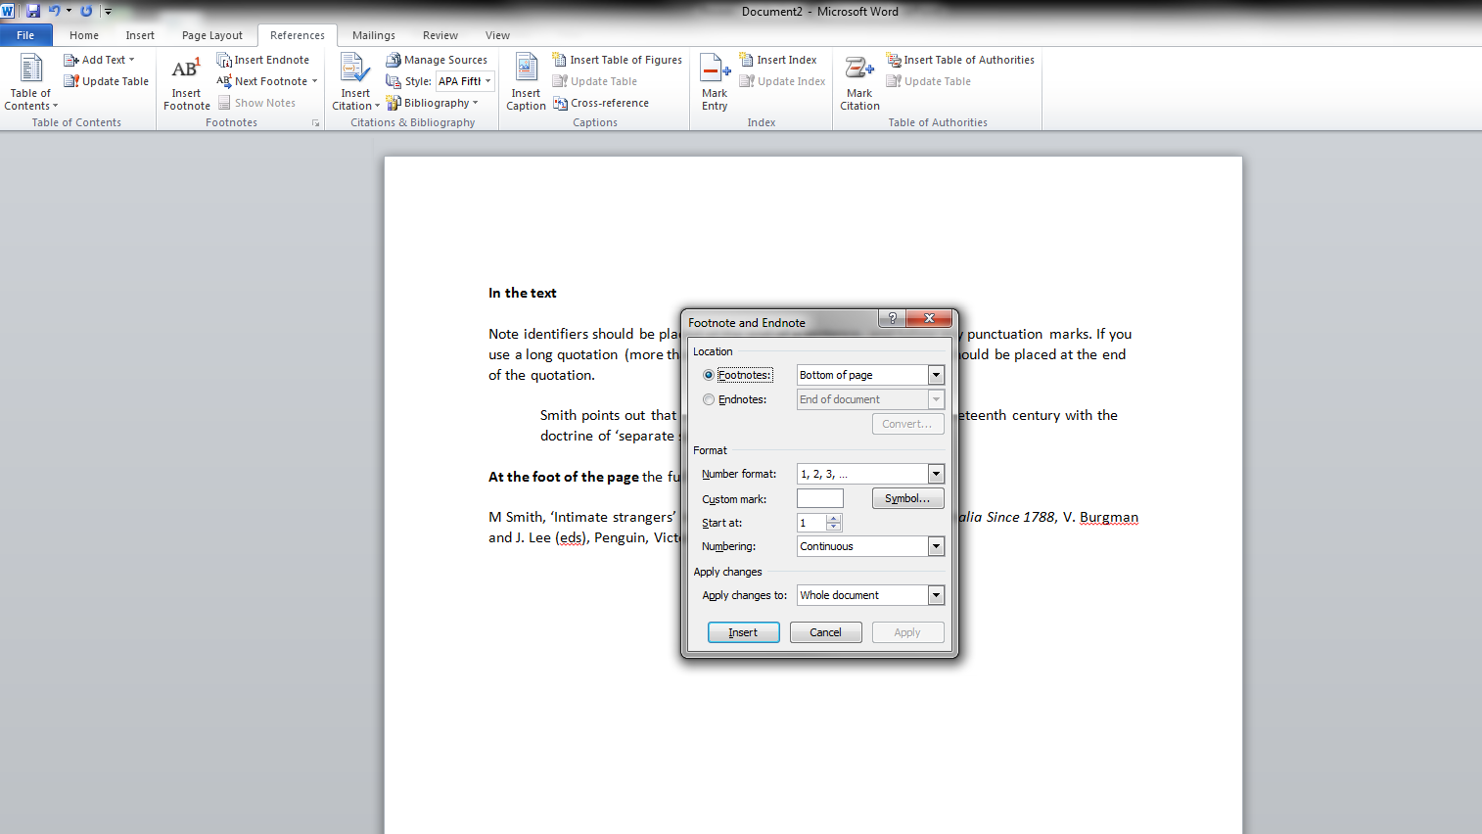

Slide 29
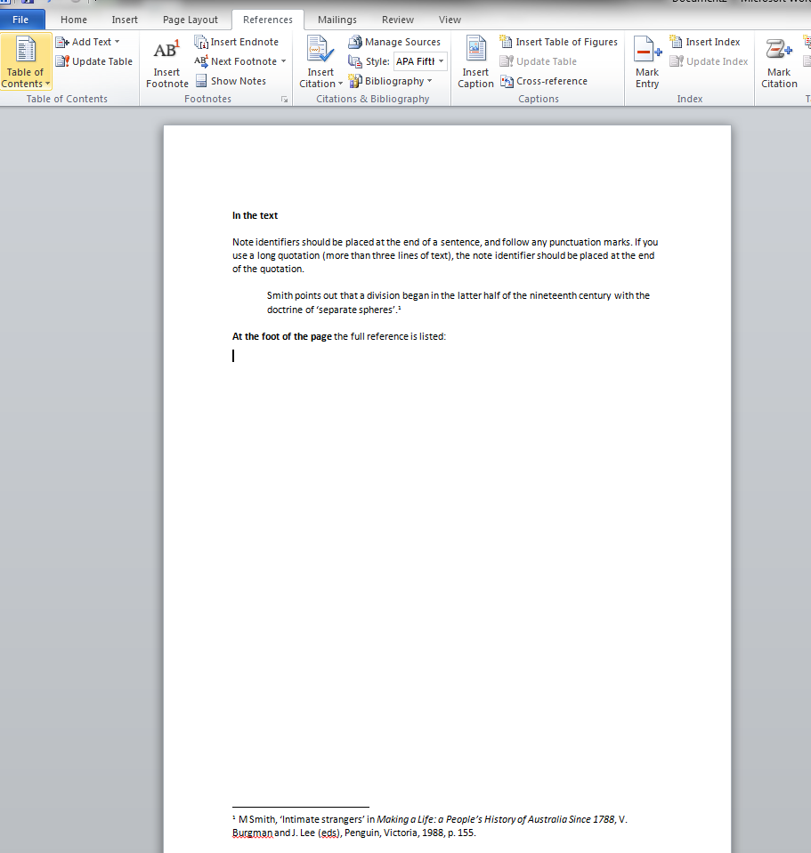

Slide 30
Paraphrasing
Below is a passage taken from Raymond S. Nickerson's "How We Know - and Sometimes Misjudge -What Others Know” Psychological Bulletin 125.6 (1999): p737.
“In order to communicate effectively with other people, one must have a reasonably accurate idea of what they do and do not know that is pertinent to the communication. Treating people as though they have knowledge that they do not have can result in miscommunication and perhaps embarrassment. On the other hand, a fundamental rule of conversation, at least according to a Gricean view, is that one generally does not convey to others information that one can assume they already have.”

Slide 31
Paraphrasing
Here is an example of what would be considered plagiarism of this passage:
For effective communication, it is necessary to have a fairly accurate idea of what our listeners know or do not know that is pertinent to the communication. If we assume that people know something they do not, then miscommunication and perhaps embarrassment may result (Nickerson, 1999).
The writer in this example has used too many of Nickerson's original words and phrases such as "effective communication," "accurate idea," "know or do not know," "pertinent," "miscommunication," and "embarrassment." Also note that the passage doesn't have an opening tag to indicate where use of the Nickerson's material begins. A citation at the end of a paragraph is not sufficient to indicate what is being credited to Nickerson.
How would you paraphrase this material?

Slide 32
Paraphrasing – Have a go:
“In order to communicate effectively with other people, one must have a reasonably accurate idea of what they do and do not know that is pertinent to the communication. Treating people as though they have knowledge that they do not have can result in miscommunication and perhaps embarrassment. On the other hand, a fundamental rule of conversation, at least according to a Gricean view, is that one generally does not convey to others information that one can assume they already have.”

Slide 33
Paraphrasing
Here is an example that would be considered acceptable summarizing of this passage:
Nickerson argues that clear communication hinges upon what an audience does and does not know. It is crucial to assume the audience has neither too much nor too little knowledge of the subject, or the communication may be inhibited by either confusion or offense (Nickerson, 1999, p. 737).
Notice that the writer both paraphrases Nickerson's ideas about effective communication and compresses them into two sentences. Like paraphrasing, summarizing passages is a tricky endeavour and takes lots of practice.

Slide 34
Your Assignment Task
Write an essay between 1,000 + 1,500 words on anything you are interested in – you can use previous work if you want to…
You need to have a title that allows you to argue for and against a point of view.
Identify the area to write about
‘The causes of Schizophrenia’
Decide on the exact title to be discussed
‘Is Schizophrenia caused by biological factors or by environmental factors?
Then think about how to structure what you write…..

Slide 35
Planning your project
Probably 6 paragraphs of 200 words each covering the following for this title.
What are the symptoms of schizophrenia?
What evidence is there that it is caused by biological factors?
What are the strengths / weaknesses of biological evidence
What evidence is there that it is caused by environmental factors?
What are the strengths / weaknesses of the environmental research?
Conclusion – caused by an interaction of both

Slide 36
Requirements
You must include information from three different sources of different mediums.
These must be referenced correctly.
You need to complete the commentary table on the type of source and the reliability and validity of this source in your booklet.
You must plan your time and reflect on your progress – use the reflective journal for this.

Slide 37
The Presentation
You should create a short presentation on PowerPoint
It should include:
The title of your project
How you answered it and what you have found out
How it has helped your research and study skills
An opportunity for the audience to ask questions

Slide 38
Remember to hand in
Your completed workbook
Your essay
A print-out of your presentation slides (4 or 6 to a page)

