Slide 1
GOLD
ARTS AWARD
Art | Dance | Drama | History of Art
Music | Music Technology | Performing Arts

Slide 2
Why should I take the Arts Award?
Extend your arts practice
Develop your skills within the arts sector
Research and review the work of other artists and creatives
Form a view about an issue in the arts world
Lead an arts project that results in a public showing
Create a portfolio that captures your progress and production as an artist

Slide 3
Overview
Unit 1: Personal Arts Development
Extend your knowledge and skills as artists, explore the professional arts world and form a view on an arts issue.
Arts practice
Extend your existing arts practice by gaining experience of a new area of the arts. Work with another practitioner to develop your skills and produce new work which integrates, or is influenced by, the new art form, genre or practice.
The wider arts sector
Get involved in the arts world through placements, volunteering, training, workshops and research.
Research and review
Experience and review high quality arts events, reflect on how it influences your work, and also find out about the artists and their career paths.
Forming a view
Make the case for an arts issue you care about, investigate the arguments around it from a range of perspectives. Present your findings to others and gather feedback.

Slide 4
Overview
Unit 2: Arts Project Leadership
Take charge of running an arts project, building your skills as an effective leader and deliver your project to a public audience. Your project needs to show you have taken independent responsibility for every aspect of the arts project, from planning stages to delivery, followed by evaluation.
Plan
Plan all aspects of the project including identifying the qualities of a leader and the personal leadership skills you want to develop. Identify the aims and outcomes of the project and organise the people and resources, considering how you will gather feedback on your progress.
Do
Deliver the project, manage its production and share it with the public. Demonstrate how you are working effectively with others and developing your leaderships skills. Plan and manage the public sharing of their project and gather feedback.
Review
Collect feedback from participants and audience, and evaluate both the project and how well you have developed your leadership skills. Consider your achievements and the things you would improve. Gather feedback on the project.

Slide 5
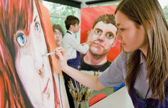
What sort of work will I be doing?
Lessons will be spent researching chosen art forms, developing your skills in a specific area and planning your arts project. As part of unit 1, you will have to attend an arts event and review it. You also need to interview arts professionals as research.
How will I be assessed?
You will create a portfolio of evidence for both units 1 and 2.
Evidence is likely to consist of written reports, logs and diaries,
photos, video footage and social media feeds.
What is the time commitment?
You will have one lesson a week. You will need to dedicate time outside of lessons to research, planning and creating your portfolio.

Slide 6
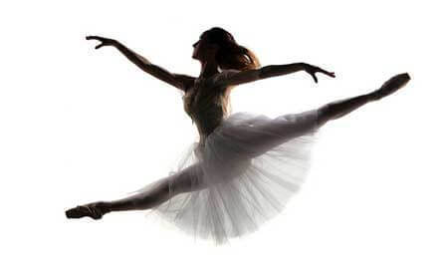
The Gold Arts Award is worth
16 UCAS
points
That’s the equivalent of a B grade at AS level
or Grade 7 Distinction in an instrument/singing exam.
Employers and universities know that Arts Award is a qualification that shows young people’s level of commitment and progress in the arts, and in developing new skills.
This qualification strongly supports applications to Art Colleges, Music Conservatoires
and Drama Schools, as well as universities.

Slide 7
What now?
Date | Lesson
Monday 12th June | Introduction to course Starting ‘Arts Issue’ work (Unit 1, Part D)
Monday 19th June | Confirming ‘Arts Issue’ choice with teacher Start research
Monday 26th June | Researching ‘Arts Issue’
Monday 3rd July | G2G day – no lesson Start writing up results of research
Monday 10th July | Submit first draft of Unit 1, Part D
As with EPQ, this work must be completed before the summer holidays in order to secure your place on the course for September.

